Slide 1
Python for Beginners (Part 2)
Ferdinand.Jamitzky@LRZ.de

Slide 2
Python command line interpreters (CLI) and integrated developer environments (IDE)

Slide 3
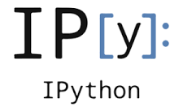
ipython
the python interactive command line interface was not very comfortable, so ipython was born. It evolved later on to a Web-Interface (jupyter). You can enter even shell commands.
$ ipython
Python 3.6.2 |Continuum Analytics, Inc.| (default, Jul 20 2017, 13:51:32)
Type 'copyright', 'credits' or 'license' for more information
IPython 6.1.0 -- An enhanced Interactive Python. Type '?' for help.
In [1]: pwd
Out[1]: '/home/hpc/pr28fa/a2815ah‘
In [2]: import os; os.getcwd()
Out[2]: '/home/hpc/pr28fa/a2815ah'

Slide 4
ipython
ipython is a hybrid between the python cli, a bash shell and macros. It recognizes shell commands (ls, pwd, cp, ..) and macros (magic commands) can be defined by %name or %%name.
In [2]: %timeit sum(range(1000))
20.8 µs ± 412 ns per loop (mean ± std. dev. of 7 runs, 10000 loops each)
In [13]: %%timeit
...: x=sum(range(100))
...: y=x+1
...:
1.52 µs ± 5.34 ns per loop (mean ± std. dev. of 7 runs, 1000000 loops each)

Slide 5
ipython
help information can be retrieved by ?command and more detailed information by ??command
In [17]: ?pprint
Docstring: Toggle pretty printing on/off.
File: ~/.conda/envs/py36/lib/python3.6/site-packages/IPython/core/magics/basic.py
In [16]: ??pprint
Source:
@line_magic
def pprint(self, parameter_s=''):
"""Toggle pretty printing on/off."""
ptformatter = self.shell.display_formatter.formatters['text/plain']
ptformatter.pprint = bool(1 - ptformatter.pprint)
print('Pretty printing has been turned',....

Slide 6

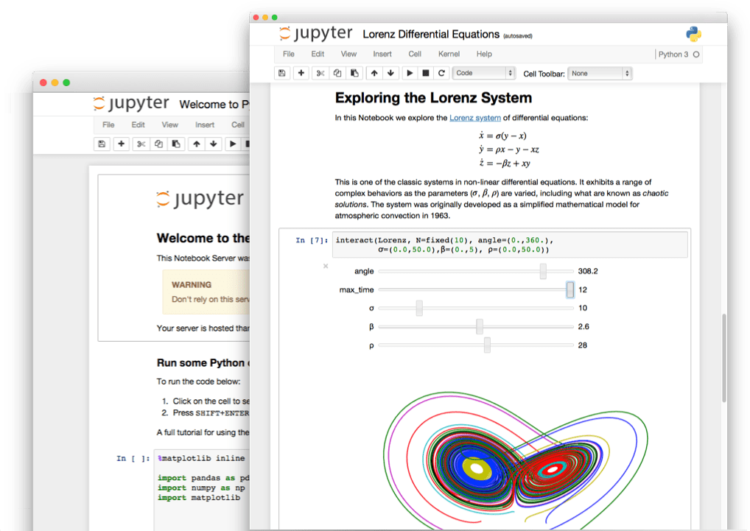
jupyter (Julia – Python – R)
finally ipython evolved into a web-service where you can run any code through a browser interface and even plot.

Slide 7
ipython exercise
Explain what the following commands return
>>> !ls
>>> files=!ls –al
>>> files.sort(5,num=True)
>>> files.grep(“a”,field=2)
>>> %cd
>>> %timeit

Slide 8
Computing and Plotting Libraries

Slide 9
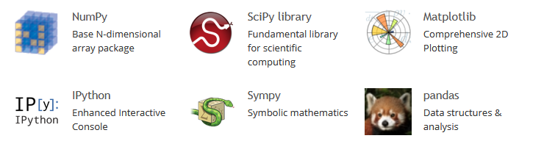
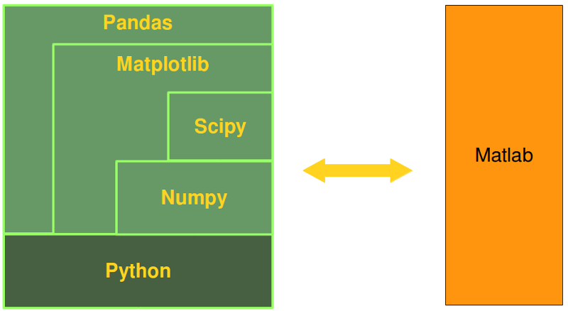
scipy

Slide 10
Numerical Computations

Slide 11
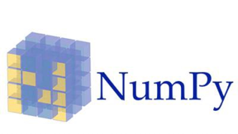
NumPy (numerical python)
a powerful N-dimensional array object
sophisticated (broadcasting) functions
tools for integrating C/C++ and Fortran code
useful linear algebra, Fourier transform, and random number capabilities
for comparison to other array languages (Numpy vs MATLAB, R, IDL) see:
http://mathesaurus.sourceforge.net/

Slide 12
NumPy in a nutshell
NumPy’s main object is the homogeneous multidimensional array. It is a table of elements (usually numbers), all of the same type, indexed by a tuple of positive integers. In NumPy dimensions are called axes.
>>> A = [ [ 1., 0., 0.], [ 0., 1., 2.] ]
>>> A.ndim
>>> A.shape
>>> A.size
>>> A.dtype
>>> A.itemsize

Slide 13
Array Creation
>>> import numpy as np
>>> a = np.array([2,3,4])
>>> a
array([2, 3, 4])
>>> a.dtype
dtype('int64')
>>> b = np.array([1.2, 3.5, 5.1])
>>> b.dtype
dtype('float64')

Slide 14
Array Creation
>>> np.zeros((3,4))
>>> np.ones((3,4), dtype=np.int16)
>>> np.empty((2,3))
>>> np.arange(10,30,5)
>>> np.arange(0,2,0.3)
>>> np.linspace(0,2,9)
>>> b = np.arange(12).reshape(4,3)

Slide 15
Basic Operations
Vector Operations on Arrays:
elementwise add, substract, multiply, divide, power
special functions: sin, cos, ...
elementwise comparison
Matrix Product A@B
in place operations A+=3
A.sum(), A.cumsum(), A.min(), A.max()

Slide 16
Universal Functions
these functions operate elementwise on an array, producing an array as output
all, any, apply_along_axis, argmax, argmin, argsort, average, bincount, ceil, clip, conj, corrcoef, cov, cross, cumprod, cumsum, diff, dot, floor, inner, inv, lexsort, max, maximum, mean, median, min, minimum, nonzero, outer, prod, re, round, sort, std, sum, trace, transpose, var, vdot, vectorize, where

Slide 17
Indexing, Slicing, Iterating
indexing and slicing like for python lists
>>> a[2:5]
>>> a[ : :-1]
>>> b[1:3, : ]
>>> b[-1]

Slide 18
Stacking Arrays
>>> np.vstack((a,b))
array([[ 8., 8.],
[ 0., 0.],
[ 1., 8.],
[ 0., 4.]])
>>> np.hstack((a,b))
array([[ 8., 8., 1., 8.],
[ 0., 0., 0., 4.]])

Slide 19
Copy and views
Simple assignments make no copy of array objects or of their data.
>>> a = np.arange(12)
>>> b = a # no new object is created
>>> b is a # a and b are two names for the same object
True
>>> d = a.copy() # a new array object with new data is created
>>> d is a
False

Slide 20
Random Numbers
Numpy has a plentitude of random number distributions
uniform:
>>> A = np.random.random(2,3))
>>> A = np.random.uniform(size=10)
others are:
beta, binomial, chisquare, dirichlet, exponential, F, gamma, geometric, gumbel, hypergeometric, laplace, logistic, lognormal, logseries, multinormal, normal, pareto, poisson, power, Rayleigh, Cauchy, standard_t, triangular, uniform, vonmises, wald, weibul, zipf

Slide 21

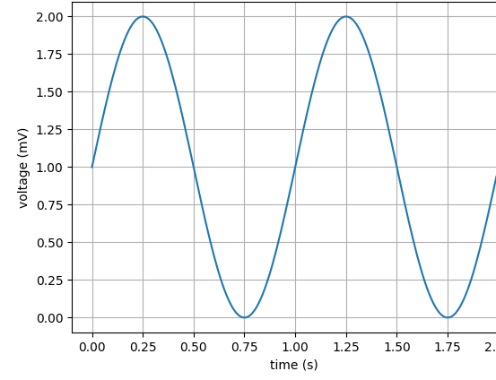
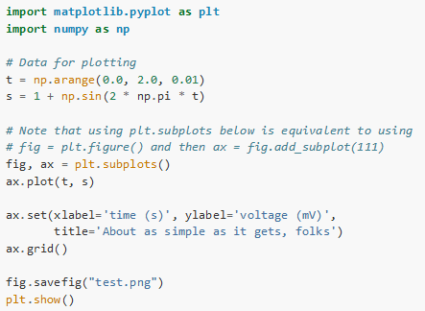
matplotlib

Slide 22
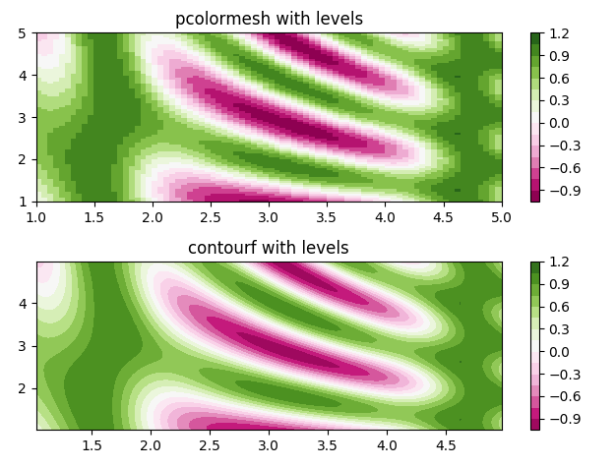
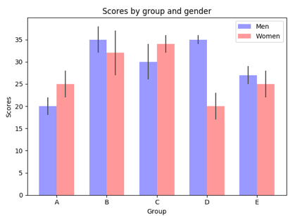
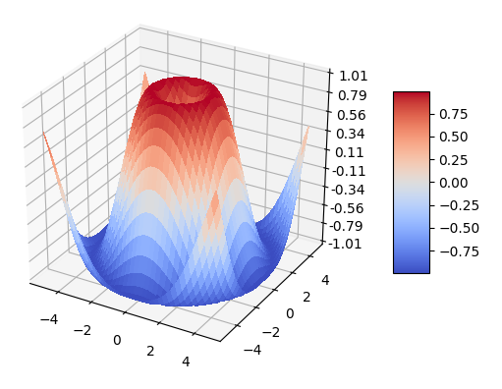
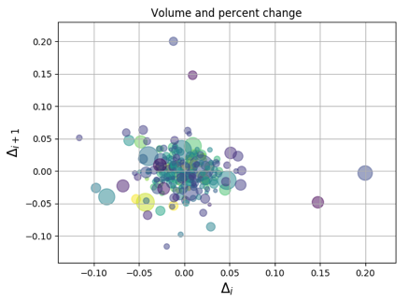
matplotlib

Slide 23

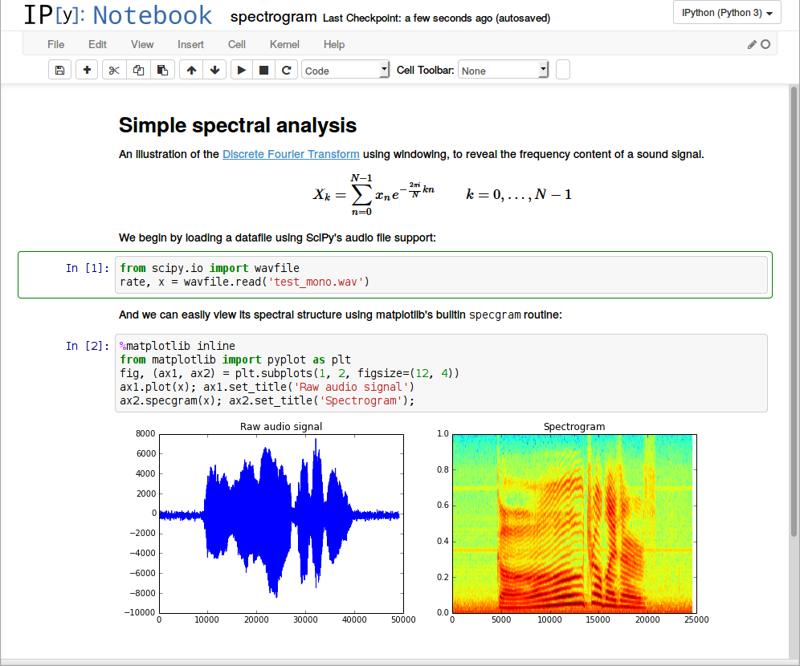
jupyter+scipy+matplotlib+latex

Slide 24
Data Analysis using Pandas

Slide 25
Pandas – Data Frames for python
DataFrame object for data manipulation with integrated indexing.
Tools for reading and writing data between in-memory data structures and different file formats.
Data alignment and integrated handling of missing data.
Reshaping and pivoting of data sets.
Label-based slicing, fancy indexing, and subsetting of large data sets.
Data structure column insertion and deletion.
Group by engine allowing split-apply-combine operations on data sets.
Data set merging and joining.
Hierarchical axis indexing to work with high-dimensional data in a lower-dimensional data structure.
Time series-functionality: Date range generation and frequency conversion, moving window statistics, moving window linear regressions, date shifting and lagging.

Slide 26
Pandas in a nutshell
The two primary data structures of pandas
Series (1-dimensional)
DataFrame (2-dimensional)
handle the vast majority of typical use cases in finance, statistics, social science, and many areas of engineering.
For R users:
DataFrame provides everything that R’s data.frame provides
pandas is built on top of NumPy and is intended to integrate well within a scientific computing environment with many other 3rd party libraries.

Slide 27
Dataframes and Series
DataFrame is a container for Series, and Series is a container for scalars.
import pandas as pd
df = pd.DataFrame(data=d)
for col in df.columns:
series = df[col]
# do something with series
s = pd.Series([1, 3, 5, np.nan, 6, 8])

Slide 28
pandas
Object Creation
Viewing Data
Selection
Missing Data
Operations
Merge
Grouping
Reshaping
Time Series
Categorials
Plotting
Data I/O

Slide 29
Object Creation
Creating a Series by passing a list of values, letting pandas create a default integer index:
s = pd.Series([1, 3, 5, np.nan, 6, 8])
Creating a DataFrame by passing a NumPy array, with a datetime index and labeled columns:
df = pd.DataFrame(np.random.randn(6, 4), index=dates, columns=list('ABCD'))

Slide 30
Viewing Data
df.head()
df.tail(3)
df.index
df.columns
df.to_numpy()
df.describe()

Slide 31
Selection
df['A']
df[0:3]
df.loc[:, ['A', 'B']]
df.iloc[3:5, 0:2]
df[df.A > 0]
df[df > 0]
df[df['E'].isin(['two', 'four'])]
df.loc[:, 'D'] = np.array([5] * len(df))
df[df > 0] = -df

Slide 32
Missing Data
df1 = df.reindex(index=dates[0:4], columns=list(df.columns) + ['E'])
df1.dropna(how='any')
df1.fillna(value=5)
pd.isna(df1)

Slide 33
Operations
df.mean()
df.mean(1)
df.apply(np.cumsum)
df.apply(lambda x: x.max() - x.min())
s.value_counts()
s.str.lower()

Slide 34
Merge
pieces = [df[:3], df[3:7], df[7:]]
pd.concat(pieces)
pd.merge(left, right, on='key')
df.append(s, ignore_index=True)

Slide 35
Grouping
By “group by” we are referring to a process involving one or more of the following steps:
Splitting the data into groups based on some criteria
Applying a function to each group independently
Combining the results into a data structure
>>> df.groupby('A').sum()
>>> df.groupby(['A', 'B']).sum()

Slide 36
Reshaping
Stack The stack() method “compresses” a level in the DataFrame’s columns.
Pivot Table
>>> pd.pivot_table(df, values='D', index=['A', 'B'], columns=['C'])

Slide 37
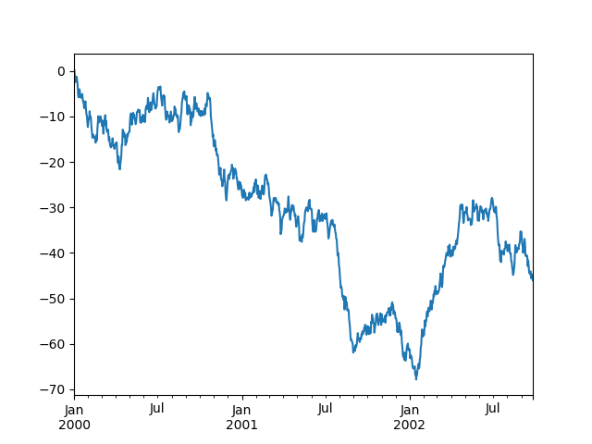
Plotting
>>> ts = pd.Series(np.random.randn(1000), index=pd.date_range('1/1/2000', periods=1000))
>>> ts = ts.cumsum()
>>> ts.plot()

Slide 38
Getting Data In/Out
CSV
>>> pd.read_csv('foo.csv')
>>> df.to_csv('foo.csv')
Excel
>>> pd.read_excel('foo.xlsx', 'Sheet1', index_col=None, na_values=['NA'])
>>> df.to_excel('foo.xlsx', sheet_name='Sheet1')
HDF5
>>> pd.read_hdf('foo.h5', 'df')
>>> df.to_hdf('foo.h5', 'df')

Slide 39
Machine Learning Packages

Slide 40
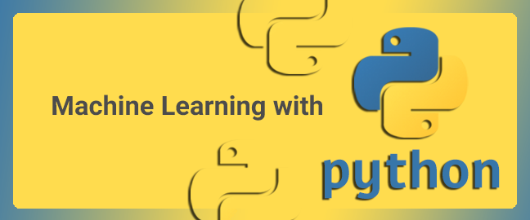
Python Packages
Theano (discontinued)
Tensorflow (Google)
Torch/PyTorch (Facebook)
MXnet (Apache, Amazon)
CNTK (Microsoft)
Keras (on top of TensoFlow, Tehano or CNTK)
Caffe / Caffe2 (Facebook, lightweight)
PaddlePaddle (Baidu for text mining in English and Chinese)
Scikit Learn (google summer of code)

Slide 41
theano
Theano:
numerical computation library for Python
computations are expressed using a Numpy-esque syntax
compiled to run efficiently
CPU or GPU architectures
Dead since 2017, but still in use
Developers now at goolge

Slide 42
tensorflow
open-source software library
dataflow programming across a range of tasks
symbolic math library
used for machine learning applications
neural networks
research and production at Google
very active
steep learning curve !

Slide 43
tensorflow
# load TensorFlow
>>> import tensorflow as tf
# Initialize two vectors
>>> x = tf.constant([1,2,3,4])
>>> y = tf.constant([5,6,7,8])
# Multiply – generate dataflow object
z= tf.multiply(x, y)
# Initialize Session and run
>>> with tf.Session() as sess:
. . . out = sess.run(z)
. . . print(out)
6

Slide 44
dataflow programming
# load TensorFlow
>>> import tensorflow as tf
# Initialize two vectors
>>> x = tf.constant([1,2,3,4])
>>> y = tf.constant([5,6,7,8])
# Multiply – generate dataflow object
z= tf.multiply(x, y)
# Initialize Session and run
>>> with tf.Session() as sess:
. . . out = sess.run(z)
. . . print(out)
6

Slide 45
Keras
Keras is a high-level neural networks API
Running on top of TensorFlow, CNTK, or Theano
Developed with a focus on enabling fast experimentation
Allows for easy and fast prototyping (through user friendliness, modularity, and extensibility)
Supports both convolutional networks and recurrent networks, as well as combinations of the two
Runs seamlessly on CPU and GPU

Slide 46
Keras Applications
# resnet50 pretrained application in keras
from keras.applications.resnet50 import ResNet50
from keras.preprocessing import image
from keras.applications.resnet50 import preprocess_input, decode_predictions
import numpy as np
model = ResNet50(weights='imagenet')
img_path = 'elephant.jpg‘
img = image.load_img(img_path, target_size=(224, 224))
x = image.img_to_array(img)
x = np.expand_dims(x, axis=0)
x = preprocess_input(x)
preds = model.predict(x)
# decode the results into a list of tuples (class, description, probability)
# (one such list for each sample in the batch)
print('Predicted:', decode_predictions(preds, top=3)[0])
# Predicted: [(u'n02504013', u'Indian_elephant', 0.82658225), (u'n01871265', u'tusker', 0.1122357), (u'n02504458', u'African_elephant', 0.061040461)]

