Slide 1

Master of Research on Teaching and Learning
Information about your start of the semester
Kristin Moyer, Tania Sultana,
Santiago Hurtado
München, October 15, 2021
Notes:
Hallo dear RTL students.
My name is Xin Xu. I am from RTL 2018 cohort. Today I will give information about your start of the new semester

Slide 2

Notes:
welcome to munich! a warm welcome to all students who managed to come here today and who are still abroad joining us through online.

Slide 3
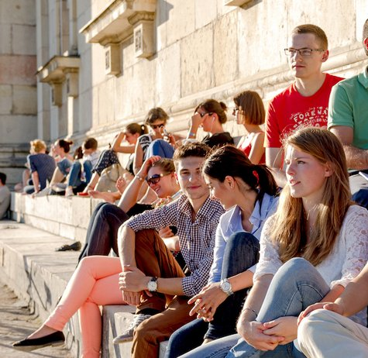
Welcome!
The new TUM School of Social Sciences and Technology
Previously TUM School of Education.
First faculty in Germany for teacher training and education research
Information about TUM: https://www.youtube.com/watch?v=iu6UboRqanI
Kristin Moyer, Tania Sultana, Santiago Hurtado | RTL Welcome Session | 10/2021
Notes:
on behalf of the team of the TUM School of Education and the other RTL students, i would like to welcome you. in the following i would like to give you some information that is important for the start of the semester. Some information you probably already got to know in the last weeks, like for example the basic functions of TUMonline, but in the video you can watch everything in peace and quiet and skip what you already know
The photo was taken in the last course in the classroom of RTL 2018. The building in which the faculty and the classrooms are located is close to munich's main train station and is easily accessible. when all of you are in munich and the corona crisis is over, or allows it again, then you will see each other here regularly.

Slide 4

Today we will talk about …
Important contact people
Program overview
  Modules and seminars
  Class expectations
Your instructors
First semester schedule
University facilities (Library, Mensa)
Online Systems
  TUMonline – course registration
  Moodle - course material
Information of Covid19 regulation
Life in Munich
Notes:
Today we will talk about six parts,
firstly, I will introduce important contact people;
secondly, we will have an overview of RTL master program;
thirdly, we will take a look your instructors in the first semester;
and also have am impression of the first semester schedule;
fifthly, we will introduce university facilities, such as Library and Mensa. Due to Corona crisis, the opening time is subject to change;
Lastly, we will learn to use online systems to register courses and manage course materials.

Slide 5
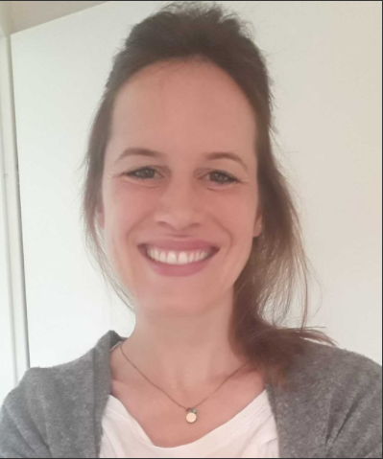
1. Important contact people
Aptitude Assessment
Questions regarding application and enrollment process
Lisa Wiesmaier
eignungsverfahren@edu.tum.de Tel.: +49 (89) 289 - 25127
Room: 121A
Notes:
If you have questions regarding application and enrollment process, you can contact Ms. Delia Hilmayr.
All employees of TUM are currently reachable by mail and telephone. The office hours for telephone contact can be found on the homepage.
If you want to meet TUM staff in person, please first contact them to arrange an appointment. But at the moment appointments on site are only possible in exceptions!!

Slide 6
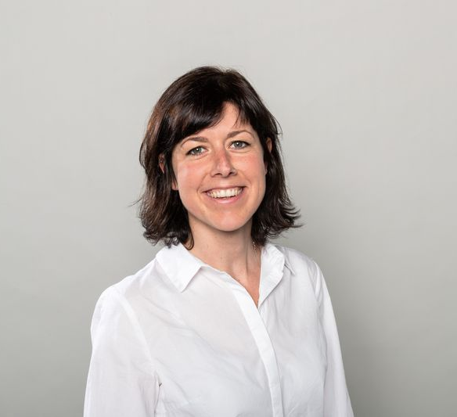
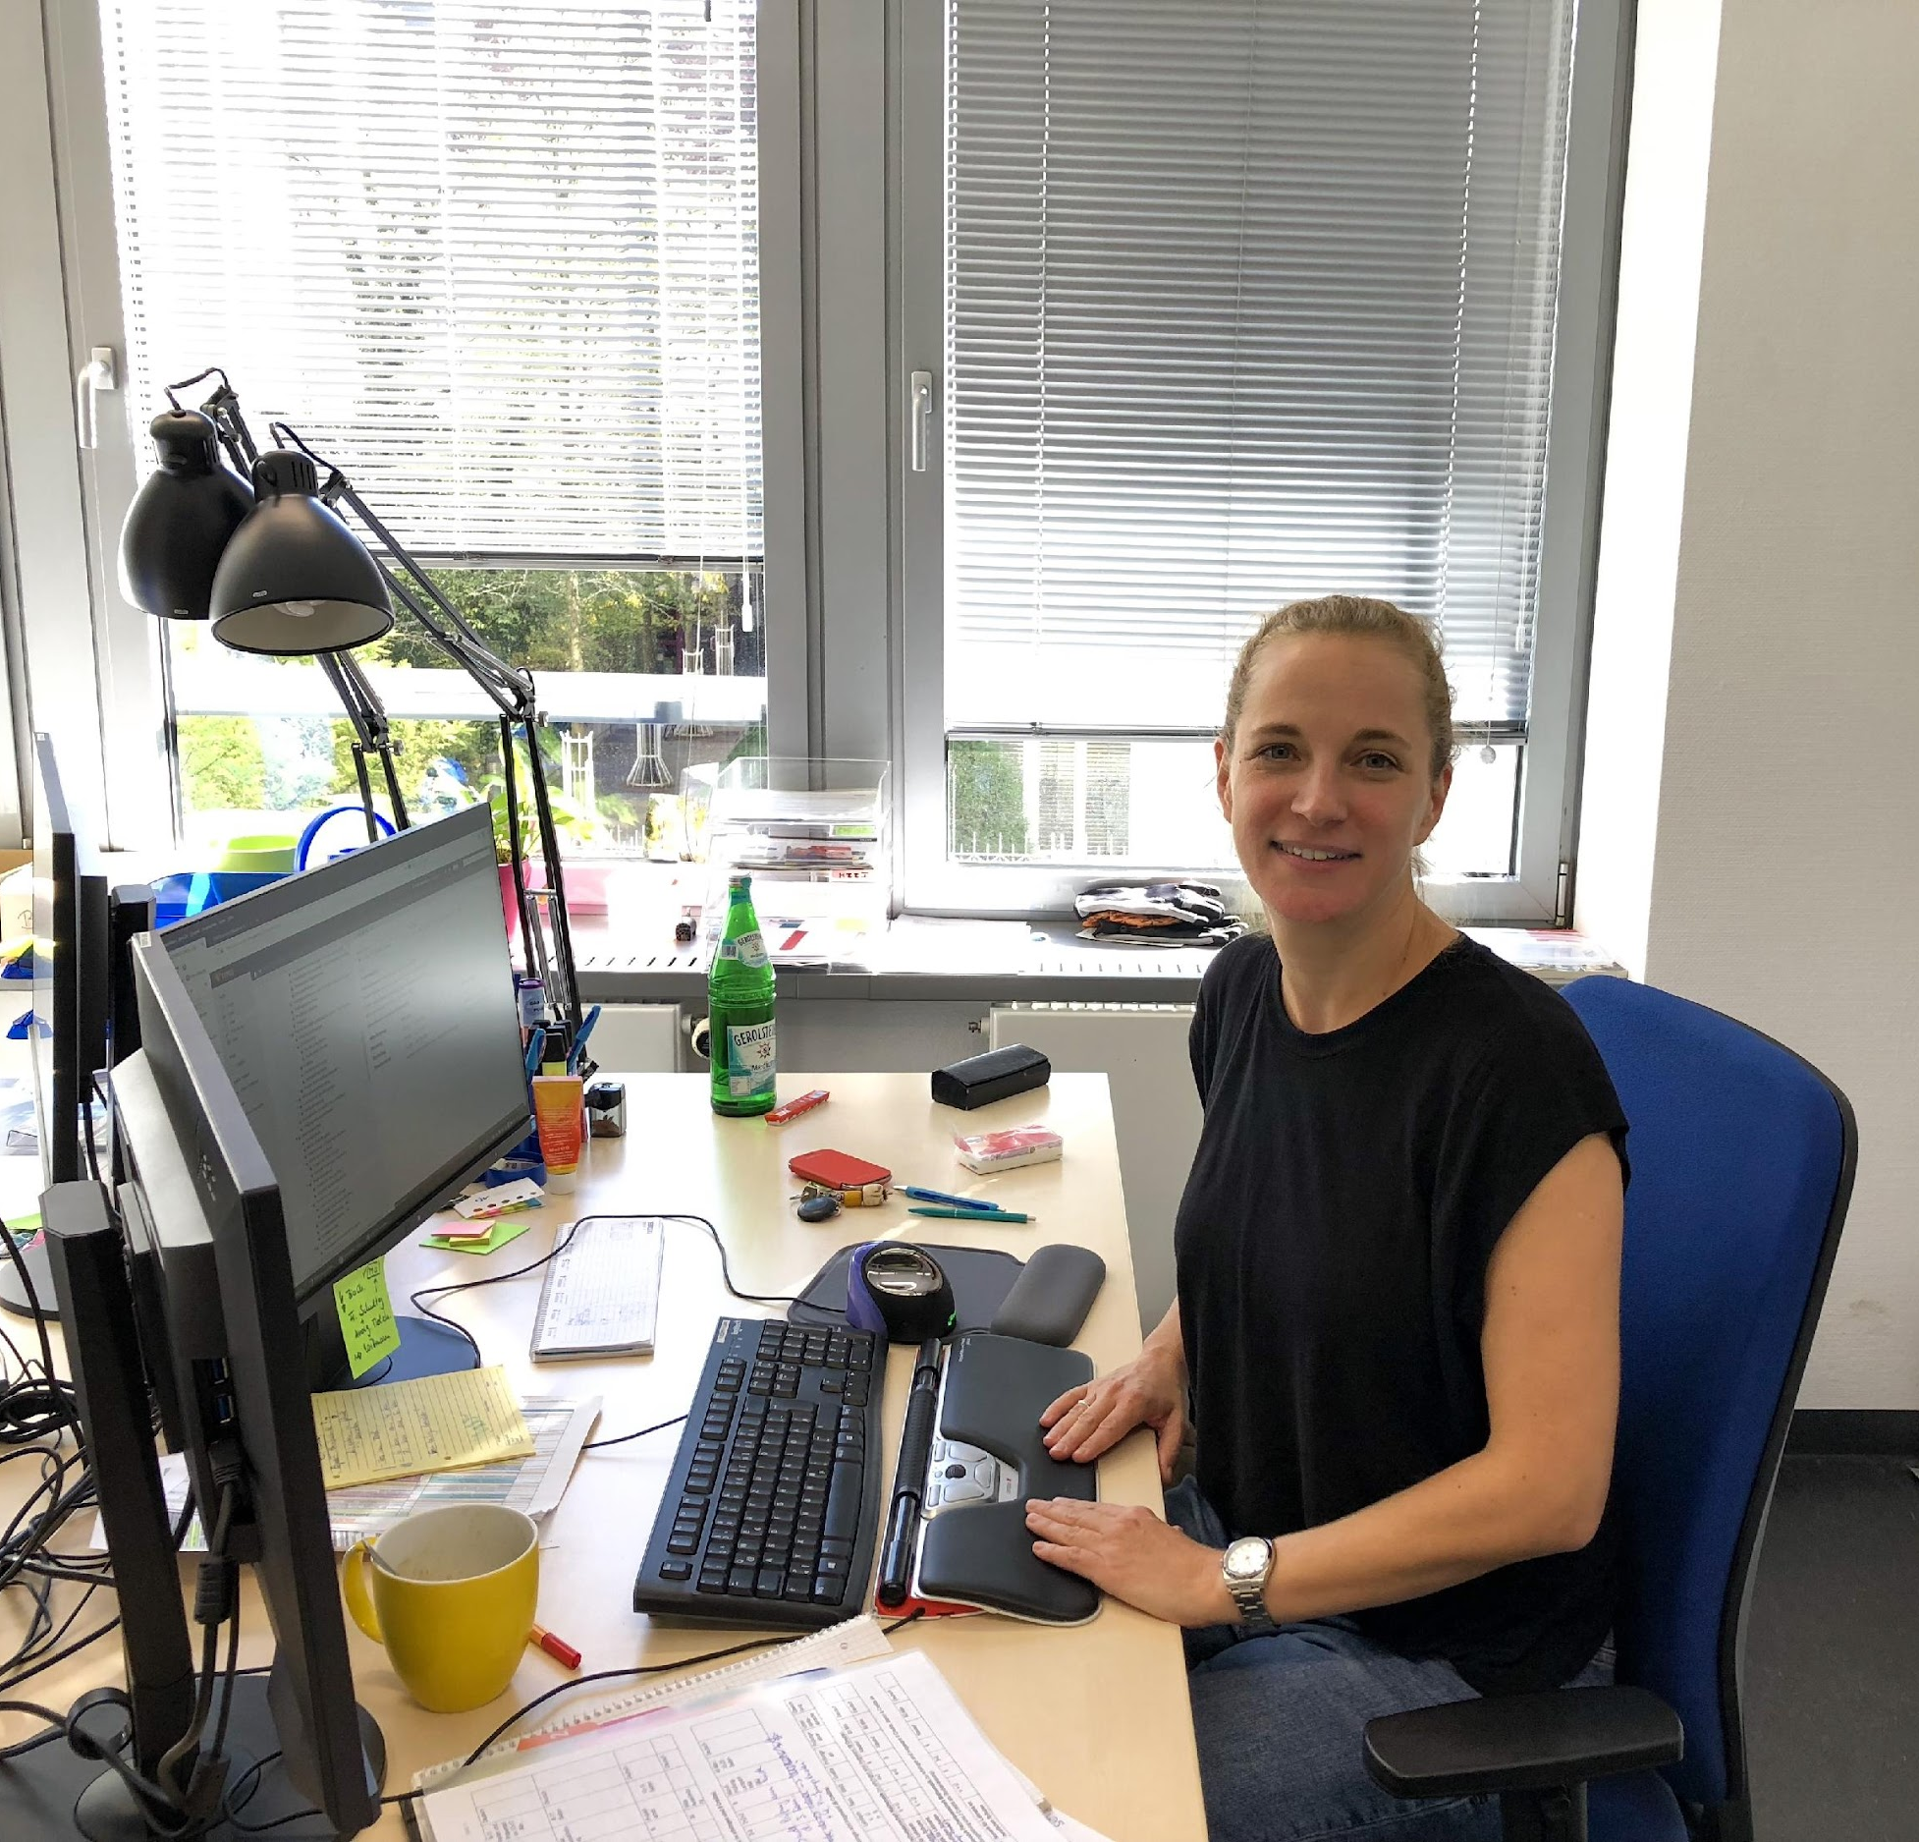
1. Important contact people
Student Advisors
All questions regarding the program contents and during the studies
Verena Euler
Julia Stahl
studienberatung@edu.tum.de
Tel.: +49 (89) 289 - 24333, +49 (89) 289 - 24239
Room: 123
Notes:
When you have questions during your studies and regarding the RTL contents, you can reach for Ms. Verena Euler. She is your main contact person. but she is gladly supported and represented by her colleague Mrs. Stahl.

Slide 7
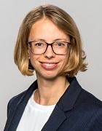
1. Important contact people
Examination Board
Issues with your study progress or with instructors
Lisa Wiesmaier
Secretary of the
examination board
lisa.wiesmaier@tum.de
Tel.: +49 (89) 289 - 25127
Room: 121A
Verena Euler
Deputy of the examination board
verena.euler@tum.de
Tel.: +49 (89) 289 - 24333
Room: 123
Prof. Dr. phil. Doris Holzberger
Head of the
examination board
doris.holzberger@tum.de
Tel.: +49 (89) 289 – 28278 Room: 216
Notes:
Prof. Dr. Tina Seidel is the head of RTL program.
If you need help from the Examination Board, please contact Ms. Verena Euler or Ms. Monika Ritscher.
Please contact for the following issues: Disadvantage compensation, Deficiencies in the examination procedure, Deadline extensions/hardship applications in case of e.g. problems during the course of the study, Late registrations for examinations, Problems with Master's Thesis (e.g. return of the topic, extension of processing time, recognition, processing outside of TUM)

Slide 8
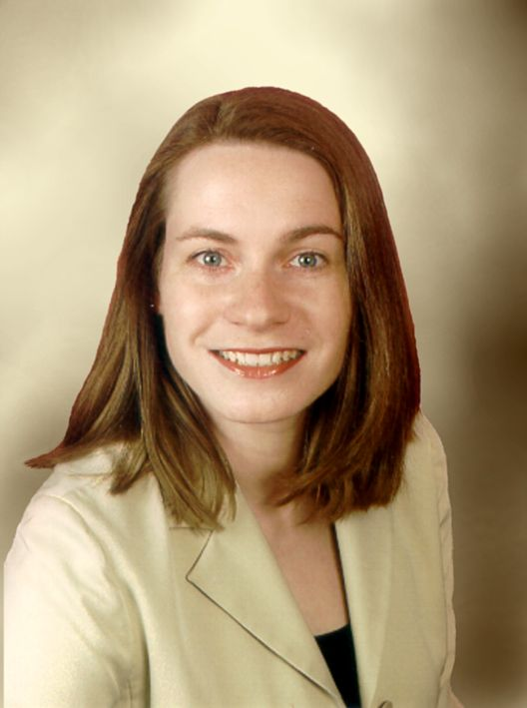
1. Important contact people
Study coordination
Questions regarding your schedule
Monika Hanser
    monika.hanser@tum.de
Tel.: +49 (89) 289 - 24281
Room: 121A
Notes:
When you have questions regarding RTL schedule or if you have special questions about application on TUMonline, you can contact Ms. Monika Hanser.

Slide 9
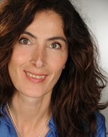
1. Important contact people Examination office
Examination registration and registration for the master’s thesis
Helen Wermuth
    prüfungsverwaltung@edu.tum.de
    Tel.: +49 (89) 289 - 24393
    Room:121
Notes:
We need to register for many exams and the master thesis, when you have problems with that, you can ask Ms. Helen Wermuth for help.

Slide 10
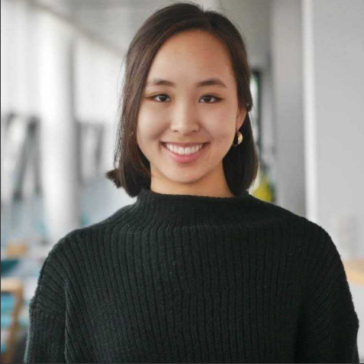
1. Important contact people
Student Representative
Shayla Giap
Student Representative at examination board
Questions regarding studies
(from October)
Notes:
Ms. Laura Pflieger is the new student representative. She is from RTL 2019 cohort. When you have questions concerning your study or living in Munich, Laura is willing to help.

Slide 11
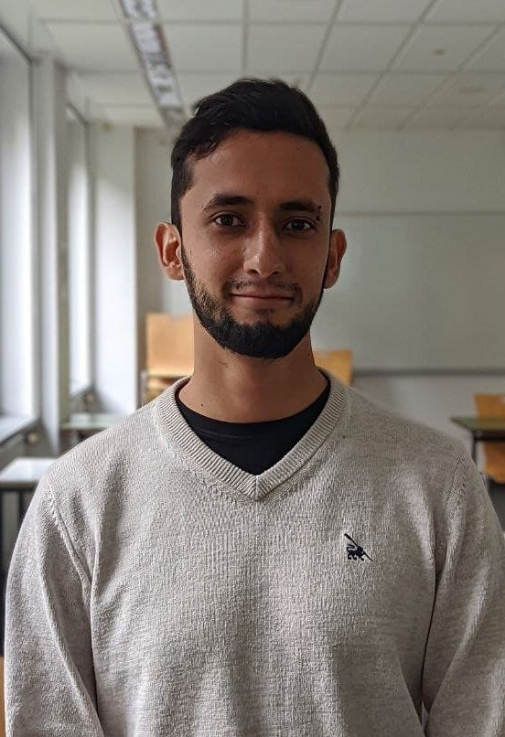
1. Important contact people
Student Assistant/Coordinator of RTL
Santiago Hurtado
Student Assistant of RTL
Organizing events, managing schedules
    s.hurtado@tum.de
    Tel.: +49 157 393 09803
Notes:
I am Xin Xu, from RTL 2018 cohort. I am responsible for organizing events and managing RTL schedules.

Slide 12
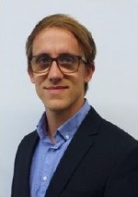
1. Important contact people
Internships
Christian Kosel
Internship information, reports, registration for credits
christian.kosel@tum.de
Tel.: +49 (89) 289 - 25183
Room: 426
Notes:
Mr. Christian Kosel is responsible for the internships. When you want more information of internship, you can contact him.

Slide 13
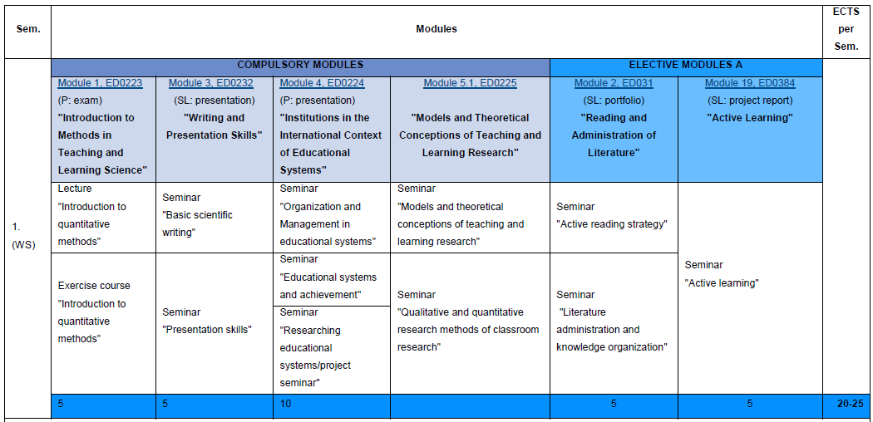
2. Program structure (I)
Notes:
This is the RTL study plan. Purple ones are compulsory modules, and orange ones are elective modules. In order to graduate, we need to fulfill 120 credits. The credits are given based on modules (not single courses). You may notice that some modules consist of two or more seminars, while some is just one single seminar. You should be careful, not to mix up seminars under different modules. Here in the green rows you can see the credits of each module.

Slide 14
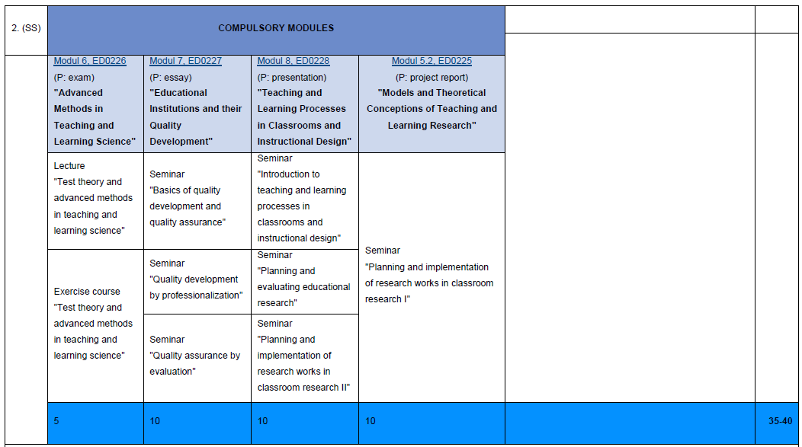
2. Program structure (II)
Notes:
The grey ones are the internships. 120 credits consist of 70 credits compulsory modules, 10 credits elective modules, 10 credits internship, and 30 credits master thesis.

Slide 15
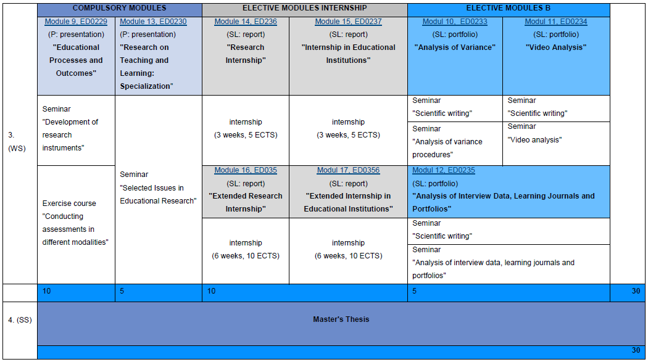
2. Program structure (III)

Slide 16
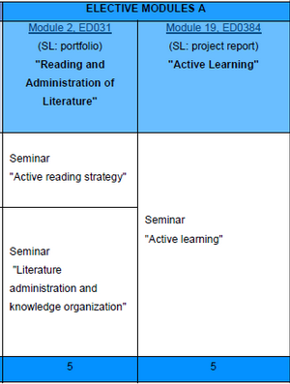
Elective Modules
10 Credits total
  5 ECTS Elective Module A
  5 ECTS Elective Module B
  Elective Module A Options:
  Active Learning – 5 ECTS
  Reading and Administration of Literature – 5 ECTS
  Doing Research with the R Software (Summer Semester) – 5 ECTS
  Digital Sustainability Transformation of, by and for the TUM – 3 ECTS
  Ethics and Responsibility: Current Areas of Application – 2 ECTS
  Entering Virtual Museum Worlds – 3 ECTS
  Diversity Kompetenz (In German Only) – 2 ECTS
  franziska.recknagel@tum.de

Slide 17
Study Progress Monitoring
In any case, students are required to meet the deadlines and thus comply
with the standard duration of study of four semesters.
It is possible to exceed the standard duration (4 sem.) up to max. 2 semester.
According to § 38 FPSO and § 10 APSO
a minimum of 30 Credits by the end of your third semester
a minimum of 60 Credits by the end of your fourth semester
a minimum of 90 Credits by the end of your fifth semester
120 Credits by the end of your sixth semester (Graduation)
Note: one of the fundamental module examinations must be successfully completed by the end of the second term.
Notes:
The standard duration of RTL master program is 4 semesters. In certain cases, you can have up to max 2 more semesters. You are highly suggested to monitor your study progress in TUMonline, I will mention it soon.

Slide 18
Please familiarize yourself with these regulations:
The APSO: General Academic and Examination Regulations applying to all study programs at the TUM
https://portal.mytum.de/archiv/kompendium_rechtsangelegenheiten/apso/aspo-3.pdf/file_view
The Examination and Academic Regulations (FPSO) and their Amending Statutes specify the regulations regarding admission, examinations and the course of studies.
      https://www.edu.tum.de/en/studium/fuer- studierende/studiengaenge/bildungswissenschaften/research-on-teaching-and-learning/academic-and-examination-regulations/
Notes:
Here are the links of the General Academic and Examination Regulations of TUM and the specific regulations of RTL.

Slide 19
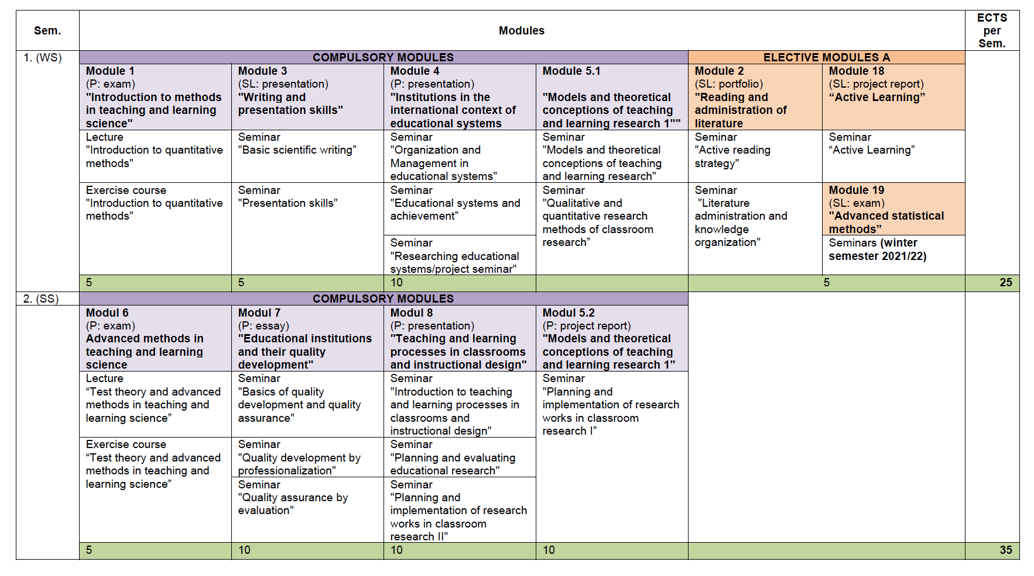
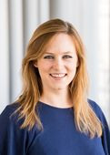
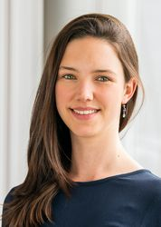
3. Your instructors
Notes:
You will meet your instructors of your first semester soon. I would like to introduce them to you here.
In M1, Prof. Doris Holzberger will give Lecture “Introduction to quantitative methods”, Ms. Kaley Lesperance and Ms. Lisa Ziernwald will instruct the exercise course.
”

Slide 20
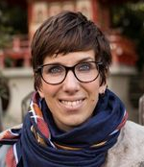
3. Your instructors
Insert photo
Prof. Dr. Keune
Notes:
In M3, Prof. Dr. Keune will instruct “Basic scientific writing” and Prof. Azzurra Ruggeri will teach you “Presentation skills".

Slide 21
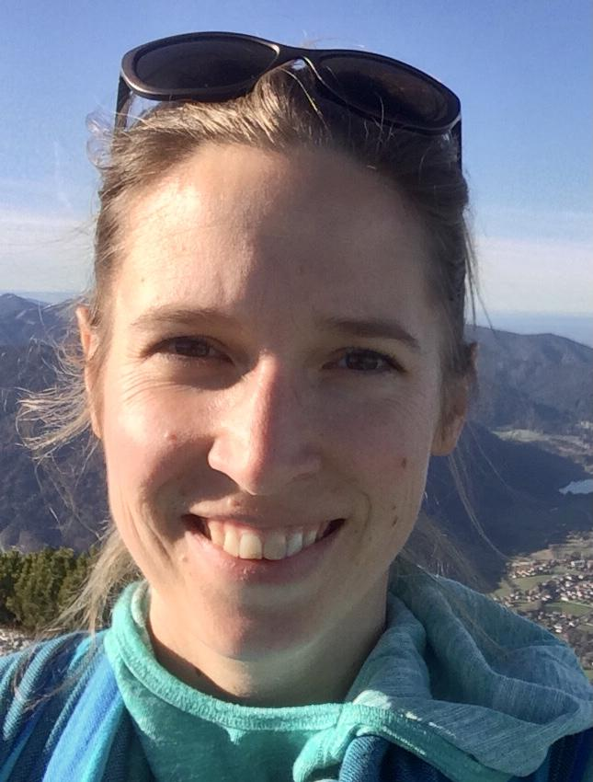
3. Your instructors
Notes:
In M4, Dr. Jessica Bodensteiner will instruct both “Organization and Management in Educational Systems” and “Educational Systems and Achievement”
–> Foto?

Slide 22
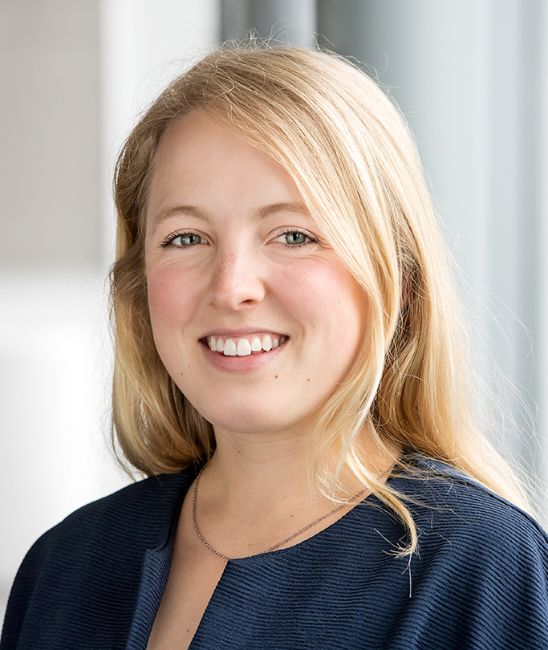
3. Your instructors
Notes:
In M5.1, Ms. Annika Diery will instruct “Models of Teaching and Learning Research” and “Qualitative and Quantitative Research Methods of Classroom Research”

Slide 23
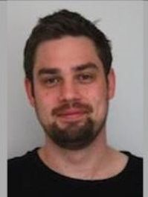
3. Your instructors
Notes:
You need to choose one selective module in the first semester, either M2 or M18. M2 consists of seminar “Active Reading Strategy”, it is given by Mr. Christian Hartmann and library courses.

Slide 24
3. Your instructors
Notes:
M18 consists of a single seminar, which is “Active learning”, offered by Prof. Azzurra Ruggeri.

Slide 25
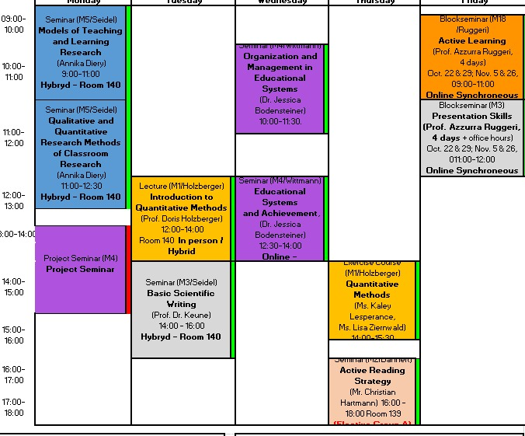
4. First semester schedule
Notes:
All seminars in your first semester are digital. In the schedule, we use colors to differentiate modules. For example, two blue seminars belong to M5. Two seminars on Friday are block seminars. You can see the summary in next slide.

Slide 26
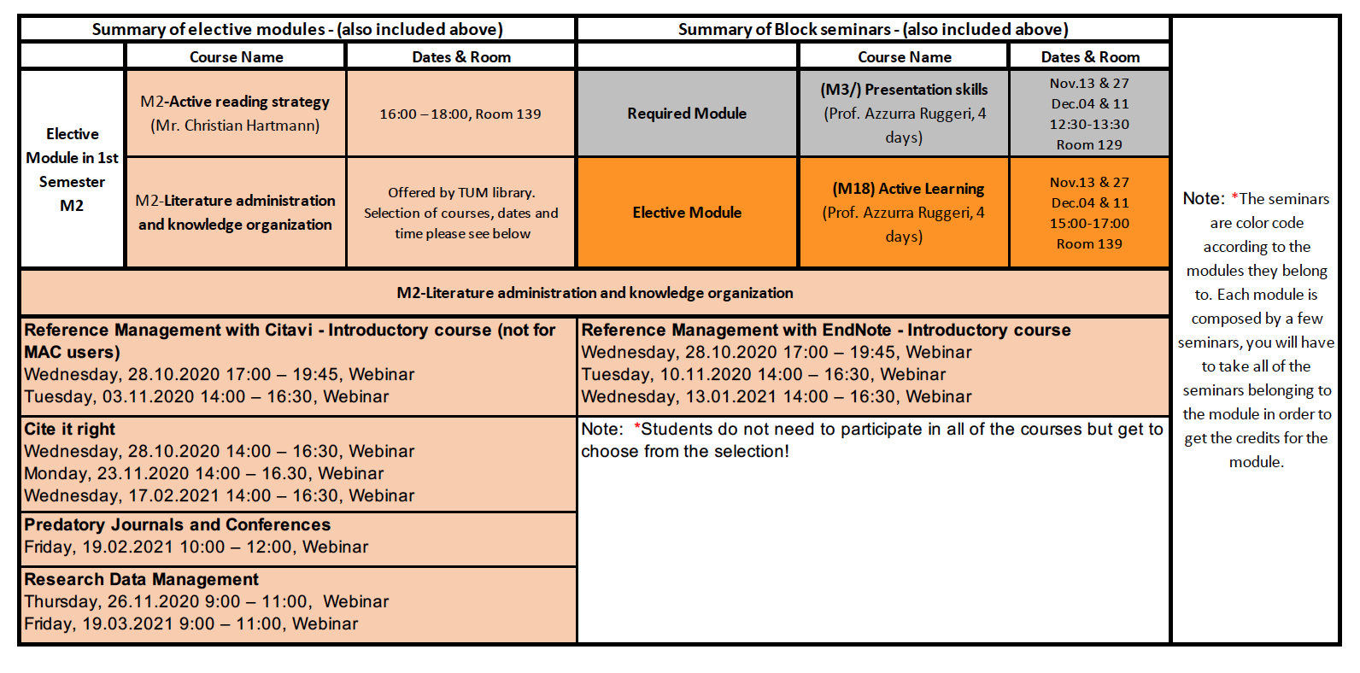
4. First semester schedule
Library courses: https://www.ub.tum.de/en/workshops
Notes:
The nude color all belong to M2. In order to pass M2, you need first finish seminar “Active reading” and also finish the library courses. Don’t freak out to see so many courses, you just need to choose some of them, not all! Now all library courses are online, webinar or e-course. I would recommend webinar.

Slide 27
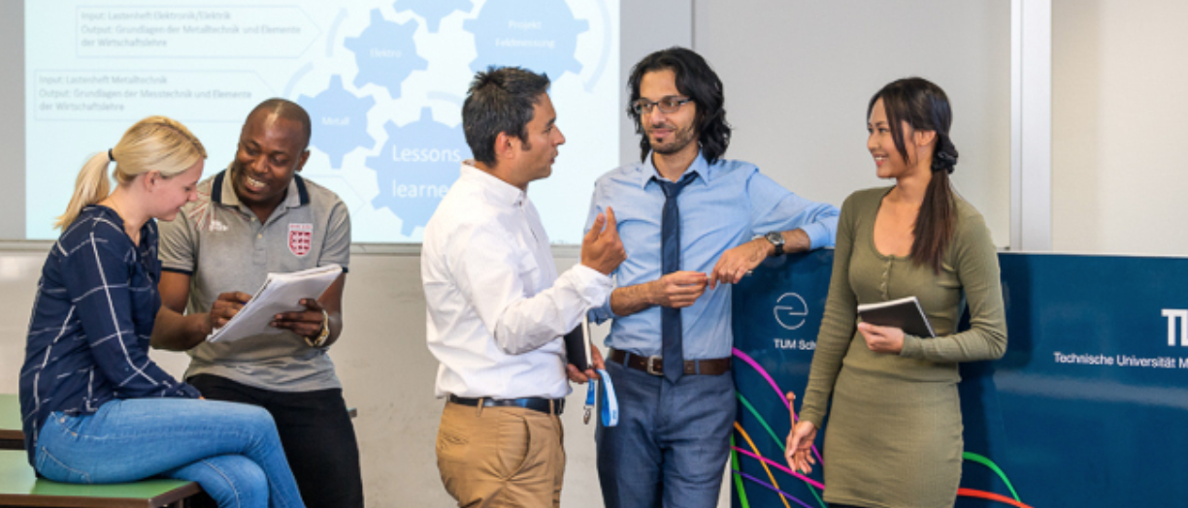
What we expect from YOU:
Carefully read through every course syllabus (course schedule, readings, exams, detailed course policy, etc.)
Active participation in discussions
Collaborative work
Attend courses (required + elective ones) and pass exams or complete
tasks to achieve ECTS

Slide 28
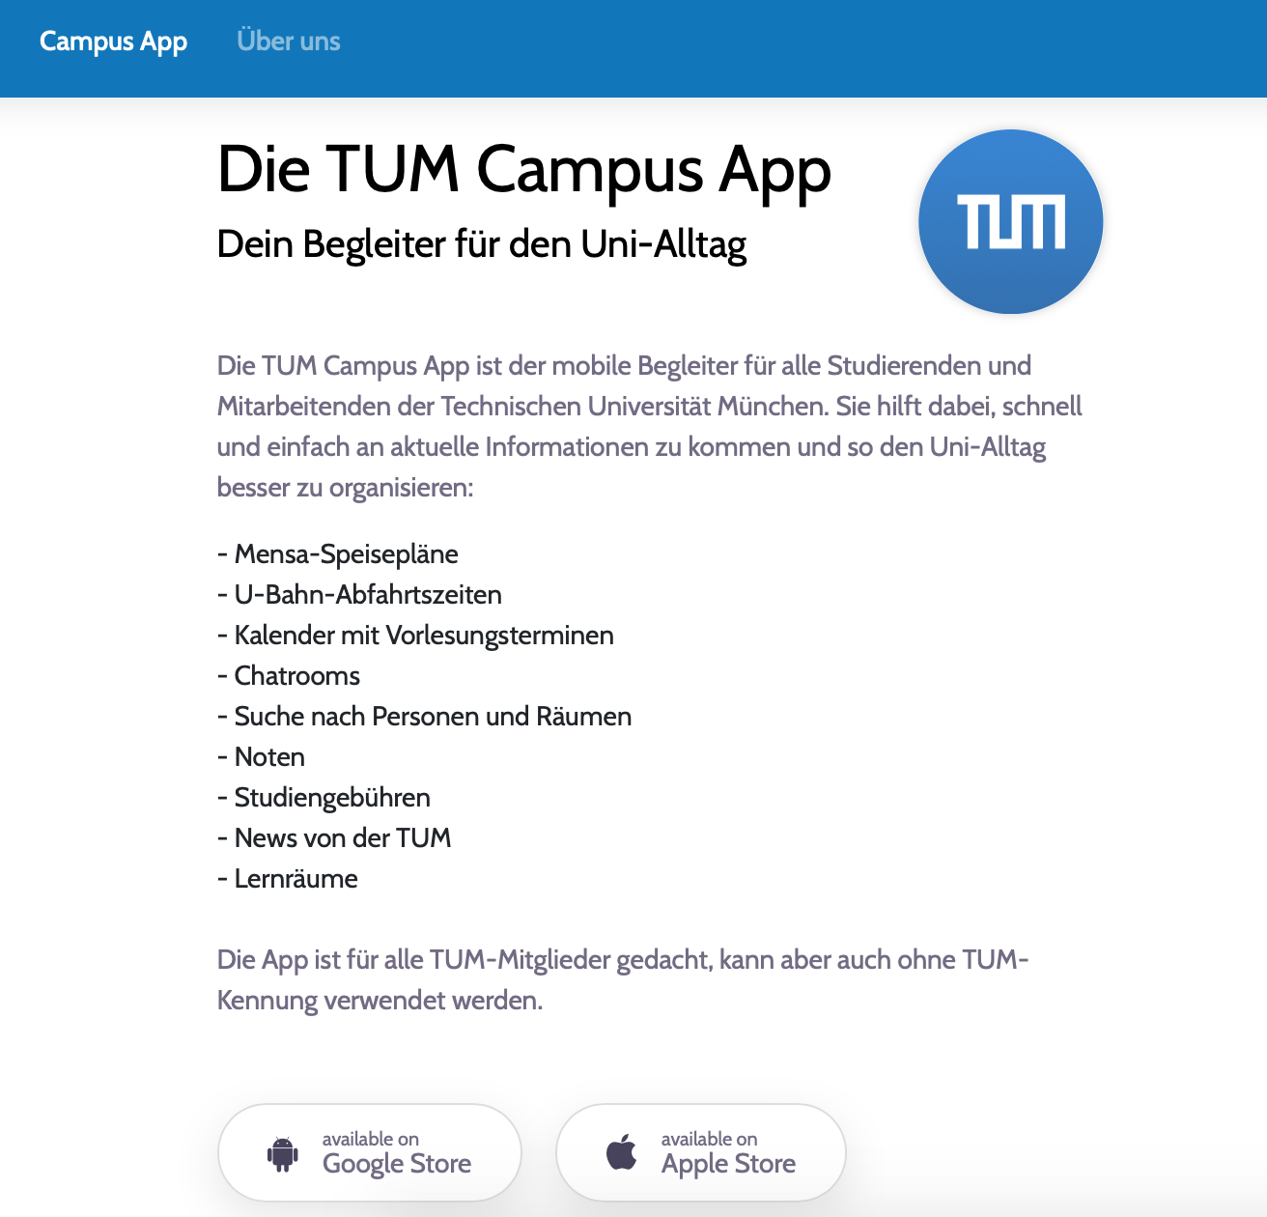
4. First semester schedule
Notes:
I recommand you to use TUM Campus App. You can download it either in Google store or Apple store. The App is connected to TUMonline. You can see your study calander here. Especially if there are changes of the seminars, you can easily see that in the App.

Slide 29
5. University facilities
TUM Library (Main Campus, Arcisstraße 21, about 15 min walk from here OR take the bus line 100, 11 min)
  You will have some introductory sessions there and of course you might need books!
  Very important: To rent books from the library you need your student card and you also need to sign up online
Mensa & cafeteria
  Arcisstrasse 17, next to main campus
  You can have lunch for a very good price and in the same building there is also a good cafeteria.
  Very important: To buy something in the Mensa you have to charge money on your student card.
Notes:
please always inform yourself online about the current status and which possibilities are available despite or because of corona.

Slide 30
6. Online Systems
EDU Website (https://www.edu.tum.de/en/home/)
    - Find important information about the study program
WIKI (https://wiki.tum.de/display/studiumedu/Master+Research+on+Teaching+and+Learning)
    - Find more information about the study program
TUMOnline (https://campus.tum.de/tumonline/webnav.ini)
    - Download of students‘ documents (enrollment certificate, transcript, …)
    - Calendar
    - Course & exam registration
Moodle (https://www.moodle.tum.de/)
    - Course Material (skripts, readings, …)
Library (http://www.ub.tum.de/en)
    Choose Branch “Library Main Campus

Slide 31
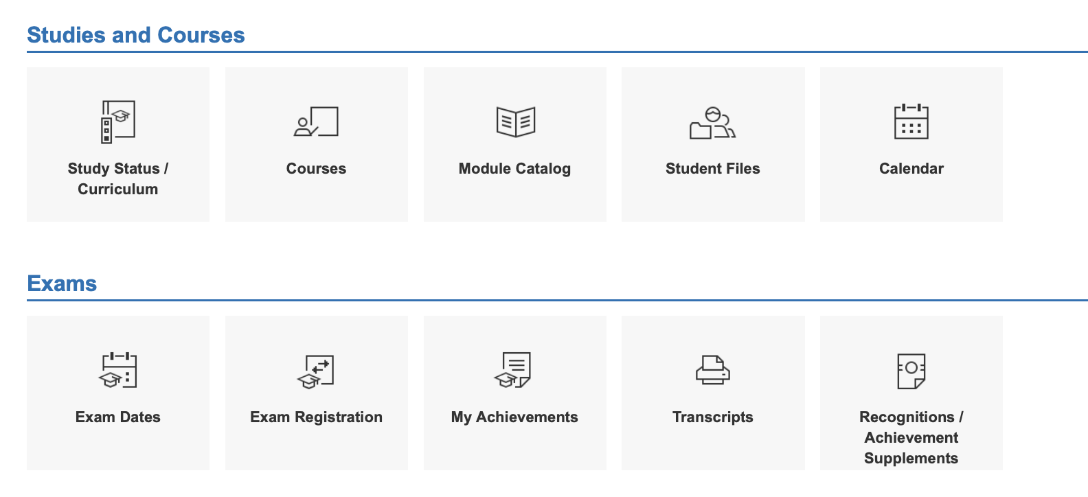
TUMOnline: Course Registration
https://campus.tum.de/
TUMonline: Introduction to Interface, Navigation, and Features:
https://www.youtube.com/watch?v=e-67iU_DH34
Notes:
The most useful online tool is TUMonline. TUMonline just changed to the new interface, here is the link of the general introduction video.
Mrs. Euler has already sent it to you and many of you have already registered for courses. Nevertheless i would like to give you some important information here. There are two ways of registration courses.
The first way is to click “Courses”

Slide 32
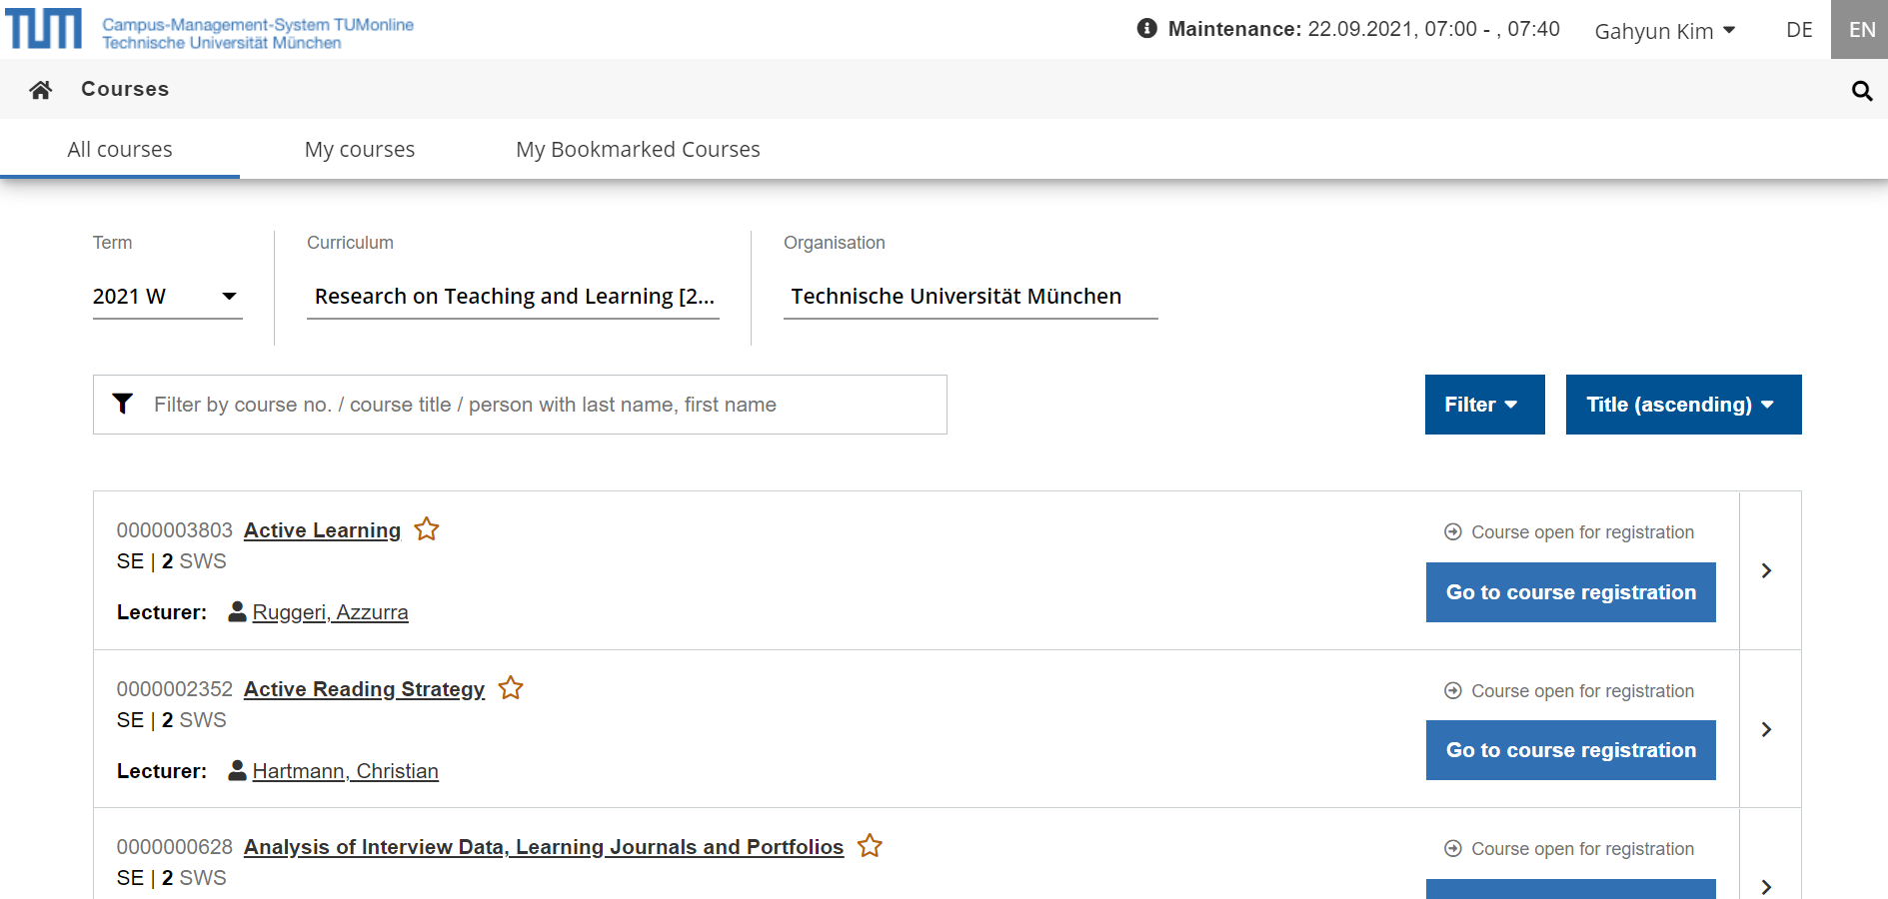
TUMOnline: Course Registration
Notes:
You will see on the top, the term, and choose your Curriculum “Research on Teaching and Learning”.
Then all courses of RTL will be shown on the page. Choose the ones of the first semester and register them!

Slide 33
TUMOnline: Course Registration
Notes:
I would prefer the second way. Let’s go back to the main page. Click “Study status”. Through this way you can better moniter your study progress.

Slide 34
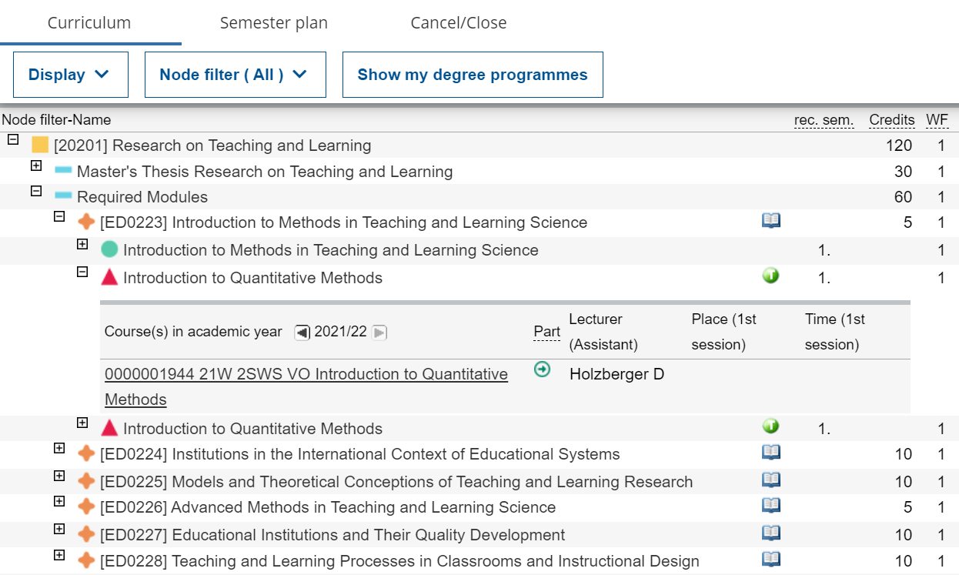
TUMOnline: Course Registration
Notes:
This page contains a lot of information.
Let’s read from left to right.
Click “Required Modules” to unfold all compulsory modules.
Each orange four points star means a module. For example ,we unfold the first one, the red triangles show the seminars, you can register them here.
You can see how many credits each module has, and whether you pass it or not (P), and how many credits you gain.

Slide 35
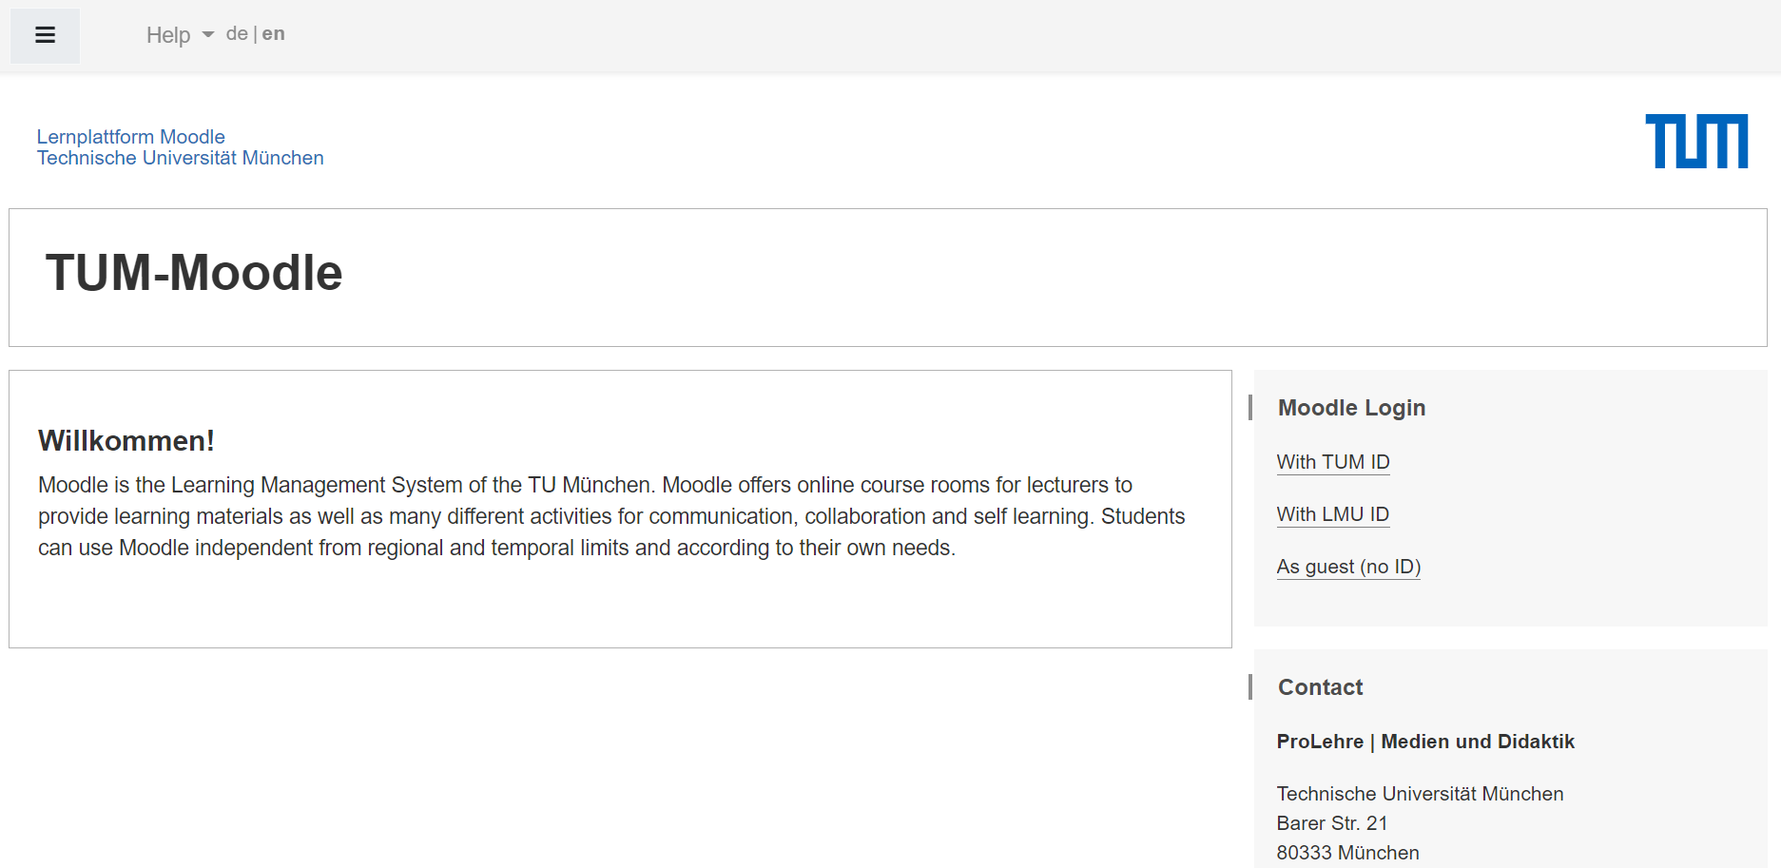
Moodle: Course Material
https://www.moodle.tum.de/
Notes:
The second useful tool is Moodle. All your learning materials will be uploaded on Moodle.

Slide 36
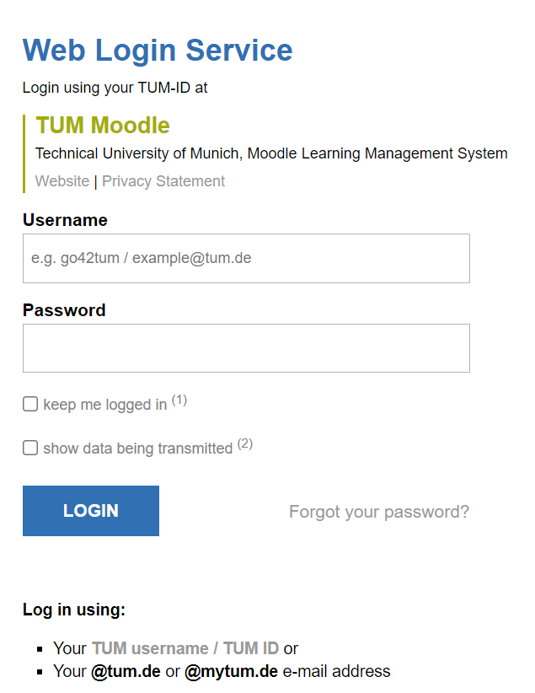
Moodle: Course Material
Notes:
Log in with your TUM ID

Slide 37
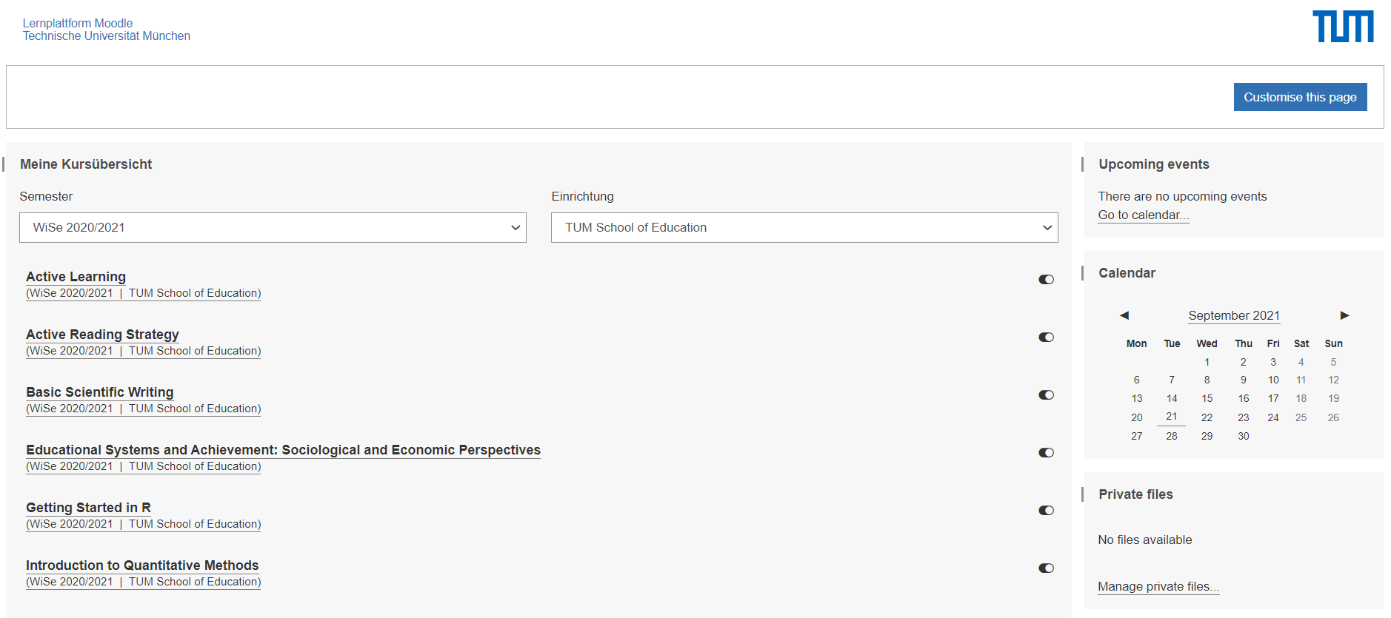
Moodle: Course Material
Notes:
Once you register the courses on TUMonline, you will find them on Moodle. Here you can watch videos, download syllabus, slides and upload your assignments.

Slide 38
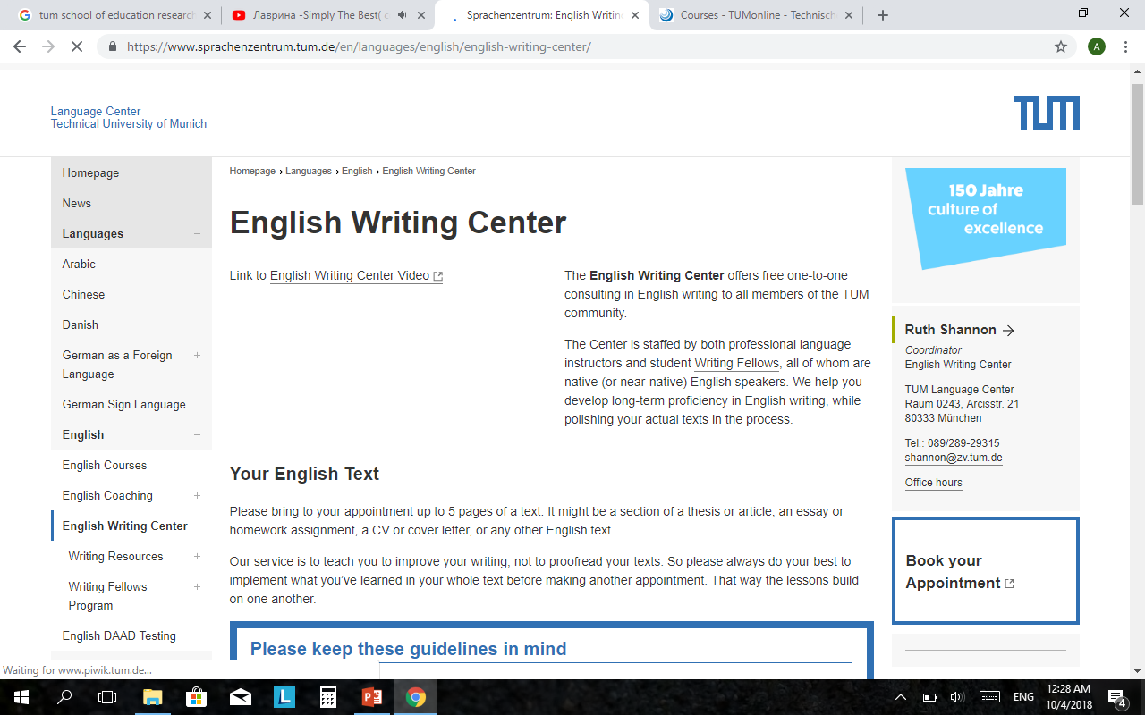
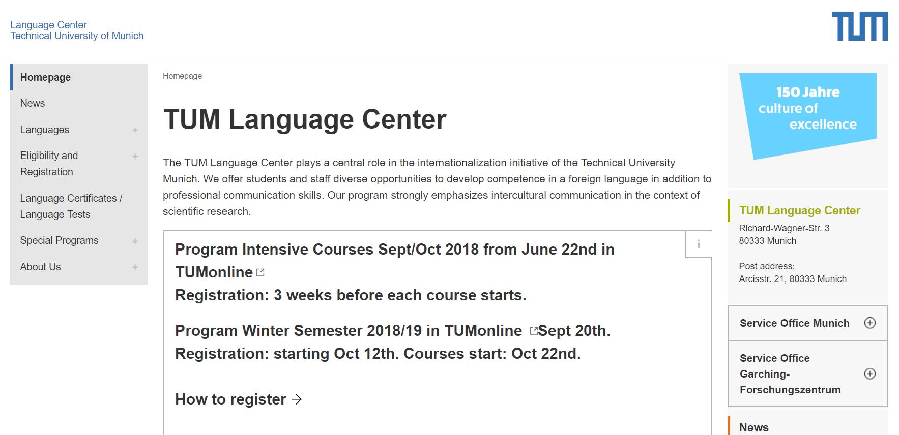
TUM Language Center
https://www.sprachenzentrum.tum.de/en/languages/english/english-writing-center/
https://www.sprachenzentrum.tum.de/en/languages/german-as-a-foreign-language/
Notes:
You can ask English writing center for help if you need to improve the writing skills (you may also find internship there if you are good at writing!).
TUM language center offers free language courses to us, both during the semester and semester break. But the courses are currently only available online
In order to meet RTL requirements, we need to prove to have basic German language skills. You can provide certificate of Goethe-Institut or similar institution, you may also pass a German Language course.

Slide 39
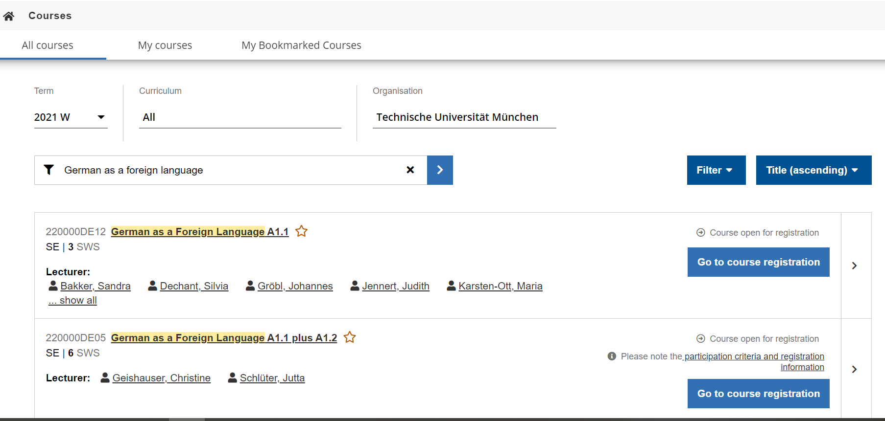
TUM Language Center how to register German course
Notes:
To get the place of German courses is like winning lottery.
First, we go to TUMonline to check which course are offered. If you want to attend German courses high than A1.1, you need to pass placement test. The test will suggest which level you are suitable. Then register the courses on TUMonline.
Let’s take A1.1 as an example.

Slide 40
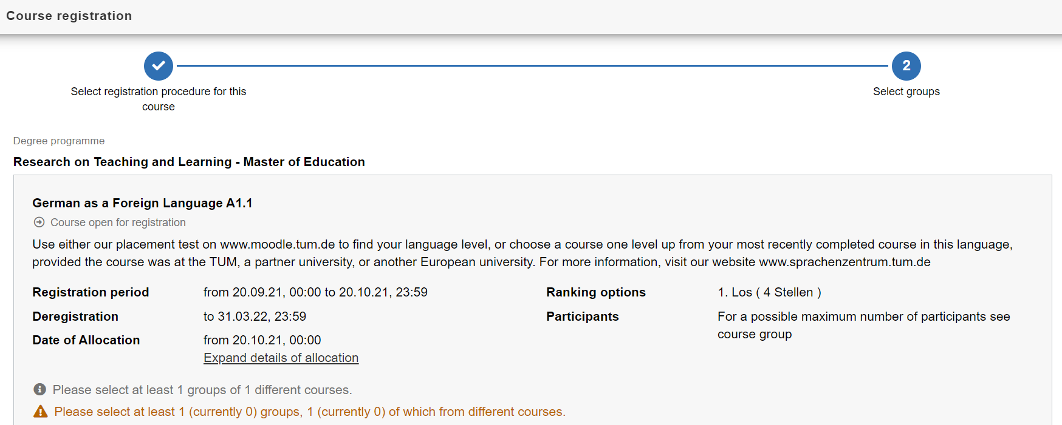
TUM Language Center how to register German course
Notes:
Be careful of the “registration period”, you have to register within this time.
To get a higher chance, register more courses.

Slide 41
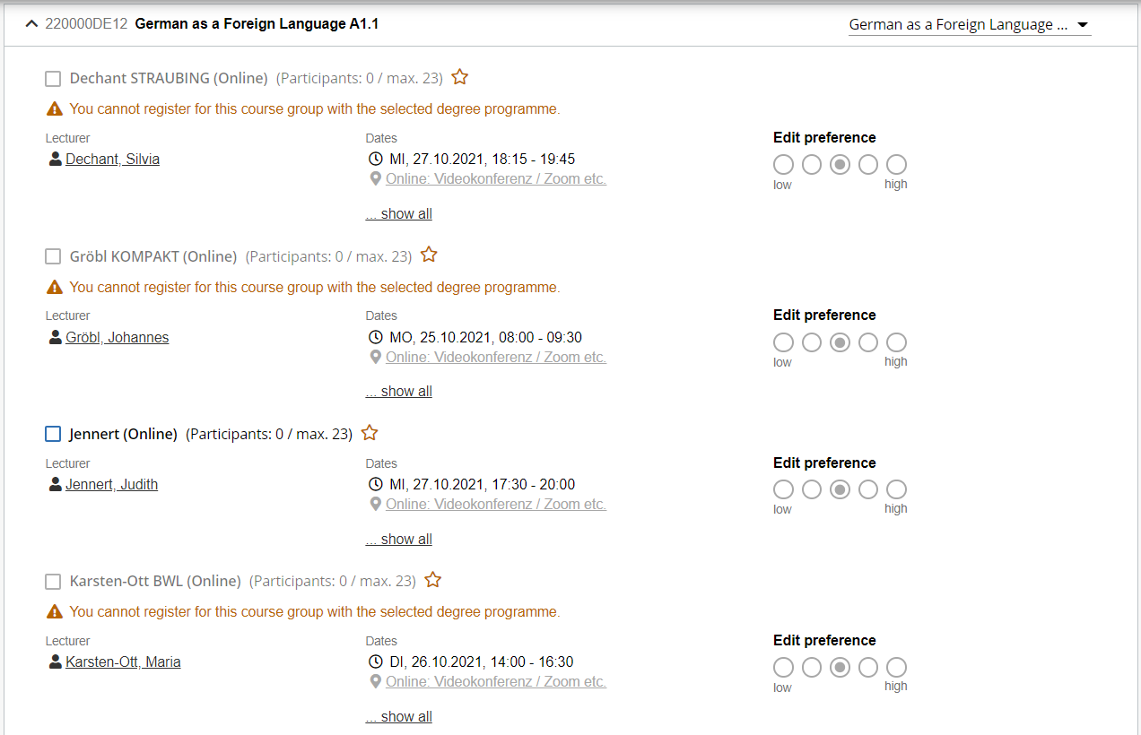
TUM Language Center how to register German course
Notes:
There are several A1.1 courses offered. You can choose your preference of each one.
Now the winter semester registration is closed. You can wait for the semester break course in March.
Usually the registration is one month before the courses start.

Slide 42
Critical information of Covid-19 regulations
3G rule
- Vaccinated: asymptomatic persons who are in possession of a vaccination certificate. Information on approved vaccinations from the Paul Ehrlich Institute
- Recovered: asymptomatic persons who are in possession of a certificate of recovery
- Negative test result: PCR test, PoC-PCR test (48 hours) / antigen test “rapid test” (24 hours) / a supervised antigen test “self-testing”
Rapid tests
- Quick-tests free of charge for students and employees
- in Munich city center (Arcisstraße 17) and Garching, as well as Weihenstephan
Notes:
Because of the ongoing corona crisis, the university is following some mandatory covid regulations. You may already know about 3g rules which is you have to be vaccinated, recovered or hold a negative test result. The rapid test is free of cost for the students and employees. Follow these websites to have rapid test appointment.

Slide 43
Critical information of Covid-19 regulations
Masks and hygiene
- Wearing a medical mask or an FFP2 mask is mandatory in all TUM buildings.
- If the Corona indicator reaches the yellow level, FFP2 masks are mandatory.
- The mask may be taken off at fixed sitting, standing or working places if a minimum distance of 1.5 meters from other persons is maintained
Contact tracing with QRONITON
- Check-in via the QR code in the lecture hall
Behavior in case of positive result
- not attend the face-to-face event
- make an appointment for PCR testing via the family doctor, the health office or the 116 117 (number of the Association of Statutory Health Insurance Physicians)
Notes:
Also, Wearing a medical mask or an FFP2 mask is mandatory in all TUM buildings, however, the covid situation is continuously changing. If the Corona indicator reaches the yellow level, FFP2 masks are mandatory. The mask may be taken off at fixed sitting, standing or working places if a minimum distance of 1.5 meters from other persons is maintained.
Contact data collection at TUM is done with the help of the contact tracing system. Please visit the weblink for more information.
If a person get a covid positive he may not attend the face-to-face event and take PCR test to proceed further procedure.

Slide 44
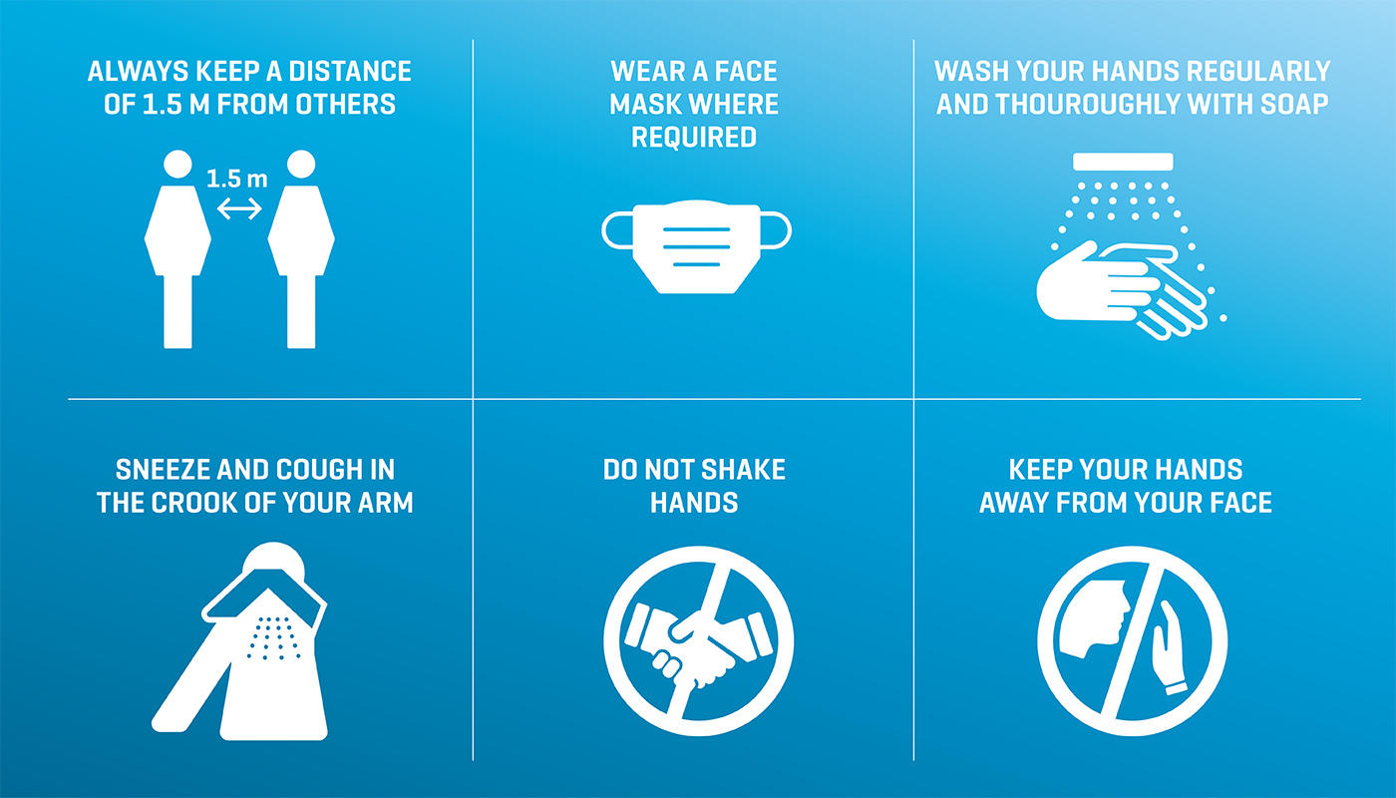
Protect yourself and others
Coronavirus: current information
https://www.tum.de/en/about-tum/news/coronavirus/
Corona-App:
https://www.bundesregierung.de/breg-de/themen/corona-warn-app/corona-warn-app-englisch
Notes:
In such a hard time, we hope you protect yourself and others, no matter you are in Munich or in your hometown. TUM will provide updated information online.
we would also recommend you to install the corona warn app on your cell phone. you will find the link above.

Slide 45
Mental Health
TUM4Mind https://www.tum.de/en/studies/support-and-advice/wellbeing/tum4mind/
Dealing with Psychological Pressure
Relaxation for Body and Soul
Personal Development and Self-Management
TUM General Student Advising
TUM Academic Coaching
TUM Office for Disabled and Chronically ill Students
Interactive Workshops at TUM on the topics of stress management, motivation and much more
Interactive Workshops and advice at TUM on learning, exam preparation and much more
Notes:
In such a hard time, we hope you protect yourself and others, no matter you are in Munich or in your hometown. TUM will provide updated information online, please do check if you want to go to the library and Mensa, or use other university facilities.
we would also recommend you to install the corona warn app on your cell phone. you will find the link above.

Slide 46
Mental Health
Buddy Program
Sharing experiences moving abroad
Managing expectations for the RTL Master
Someone you can reach out to in your new life here in Munich

Slide 47
Life in Munich
Getting Around
• Bus, Straßenbahn, U-Bahn, S-Bahn (https://www.mvg.de/)
🡪 Activate Semester Ticket!
🡪 Purchase the IsarCard Semester Ticket (201.60 EUR)
🡪 Avoid buying single tickets, buy a stripe ticket (pack of 10 rides)
🡪 All tickets need to be validated each time you ride
• Regional Trains
• Bikes and E-scooters
• Rent a bike for a month(s)
• Taxis

Slide 48
Life in Munich
Some TUM Activities
October
• Inner City Bike Tour - 13 km (17:00, 22.10)
• Van Gogh Alive - Multimedia Exhibition Visit (26.10)
• Plant a Seed - Urban Gardening Course (27.10)
November
• Cultural Language Café: open German conversation club ONLINE
(Thursdays starting 04.11)
• Munich Symphonic Ensemble (SEM) performs together with the
TUMChor choir (28.11)

Slide 49

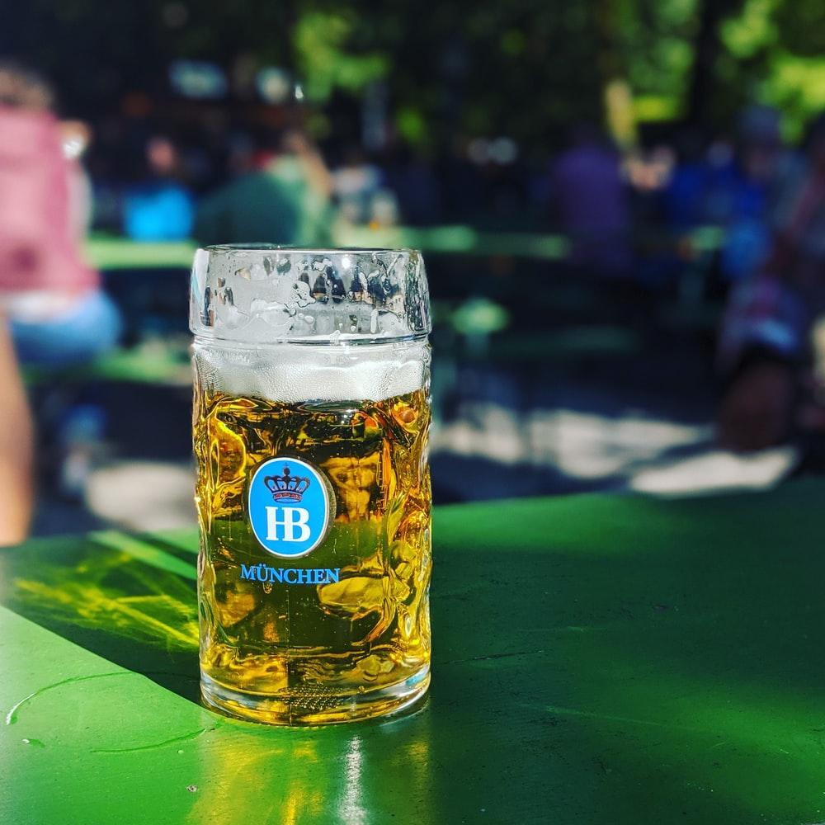

Life in Munich
Things to Do
• Museums (1 Euro on Sundays)
• Biergartens
• Parks (Englisher Garten, Olympia Park, West Park, and more!)
• Mapped out routes of bike tours to lakes outside of the city center

Slide 50
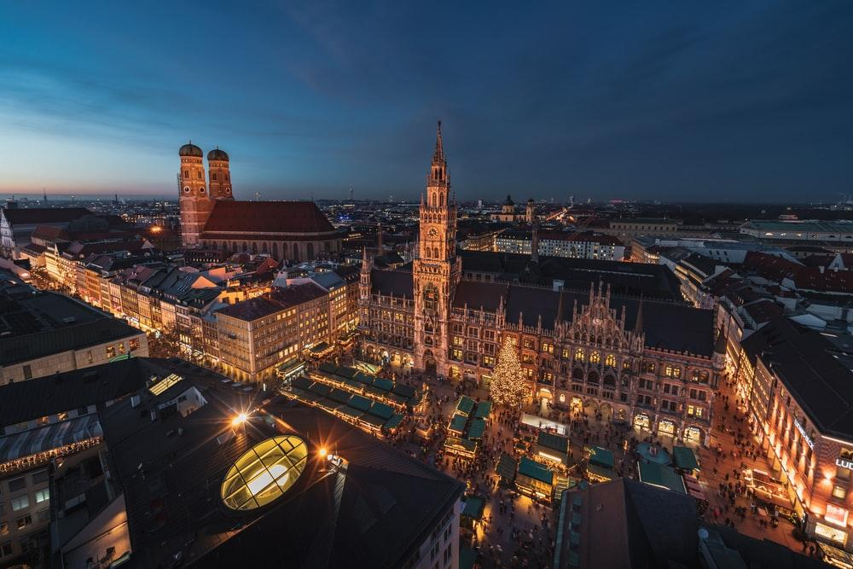
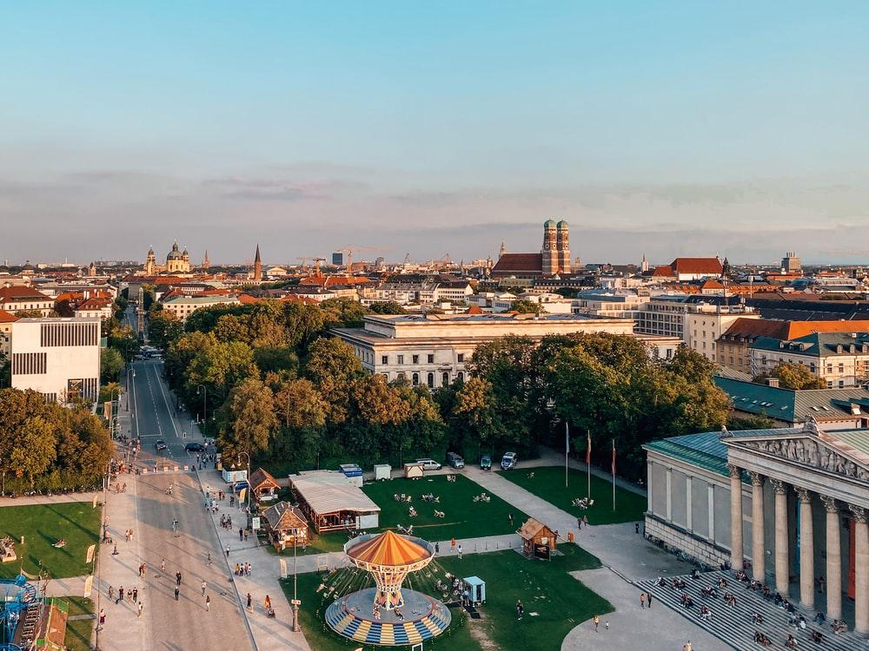
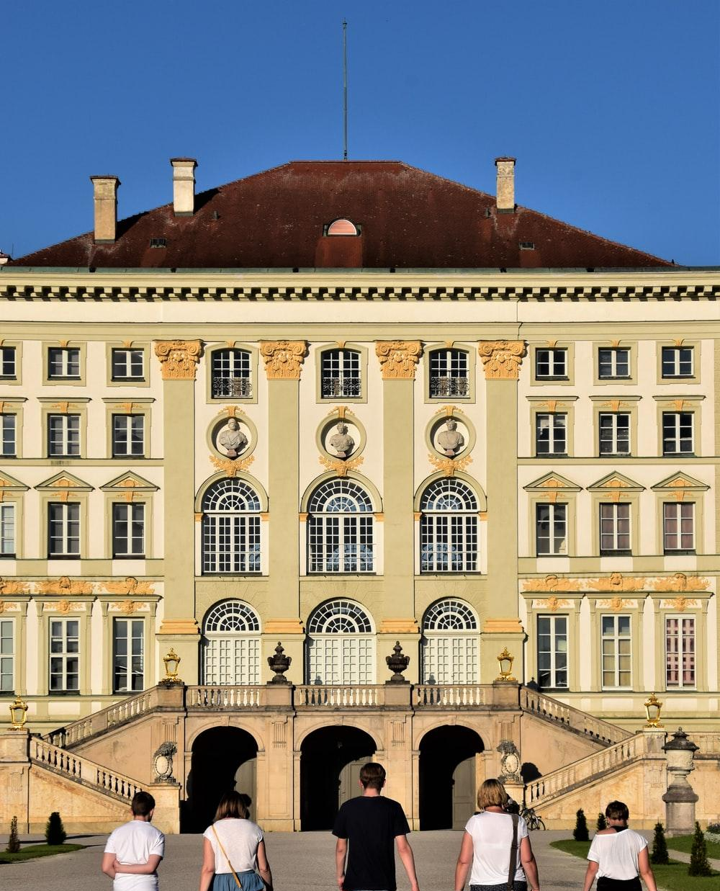

Life in Munich
Things to Do
• Flea markets
• Opera
• Nymphenburg Palace
• Festivals (Music, Christmas)

Slide 51
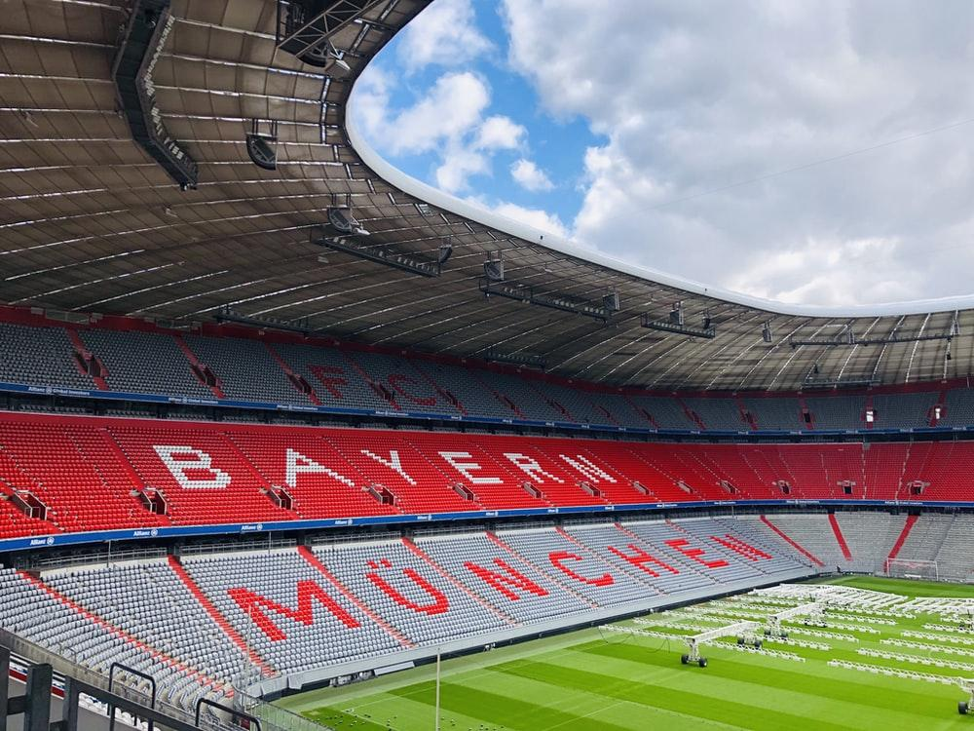


Life in Munich
Things to Do
• Football games
• Hikes in the mountains
• Day trips to neighboring cities (Neuschwanstein, Nuremberg, Rothenburg)
Check out: https://boredinmunich.com/ and https://www.muenchen.de/int/en/events.html for more ideas!

Slide 52
Life in Munich
Sports and Fitness
ZHS (Central University Sports)
€ 10 per semester
• Permits participation in courses like ball sports, climbing, fitness, water
sports, dancing, martial arts
• some courses are additional costs
Things to Note
• About 600 classes per semester
• Fitness studio, beach volleyball, swimming pool, tennis courts
• Online classes available
The Fit in the Park
• Fitness activities in the surrounding parks (Free, likely held in German)
• Runs until October 31st
• Yoga, Zumba, Qi Gong, Pilates, Workouts and more

Slide 53
Life in Munich
Tips!
• Each semester you will need to pay your tuition fee
• You can repeat exams if you fail them
• Each semester you will need to validate your student ID card
• Take advantage of student discounts and offers
• You must register for your own exams

Slide 54

HAVE A WONDERFUL START AT TUM!
Notes:
we wish you a good start, so that you can start your studies at TUM healthy and successful!

