Slide 1
Kickoff presentation master thesis
Tim Henkelmann
Munich, 20. Dezember 2018

Slide 2
General information
Name: Tim Henkelmann
Studies: Master of Informatics

Slide 3
General information
Name: Tim Henkelmann
Studies: Master of Informatics
Topic: Combining a drinking gadget with a board game to improve the quality of life of Alzheimer's patients.

Slide 4
General information
Name: Tim Henkelmann
Studies: Master of Informatics
Topic: Combining a drinking gadget with a board game to improve the quality of life of Alzheimer's patients.
Thesis supervisor: Prof. Gudrun Klinker
Advisor: Christian Eichhorn & David A. Plecher

Slide 5
General information
Name: Tim Henkelmann
Studies: Master of Informatics
Topic: Combining a drinking gadget with a board game to improve the quality of life of Alzheimer's patients.
Thesis supervisor: Prof. Gudrun Klinker
Advisor: Christian Eichhorn & David A. Plecher
Start: 15. November 2018
End: 15. May 2019

Slide 6
Alzheimer's disease

Slide 7
Alzheimer's disease
Widely spread:
In Germany 1,1 million people with Alzheimer‘s
Increase of 100 patients every day

Slide 8
Alzheimer's disease
Widely spread:
In Germany 1,1 million people with Alzheimer‘s
Increase of 100 patients every day
Symptoms:
Early-stage: short term memory loss, cognitive and motoric impairing

Slide 9
Alzheimer's disease
Widely spread:
In Germany 1,1 million people with Alzheimer‘s
Increase of 100 patients every day
Symptoms:
Early-stage: short term memory loss, cognitive and motoric impairing
Late-stage: early-stage symptoms get worse, withdrawal from family/society, loss of bodily functions

Slide 10
Alzheimer's disease
Resulting problems:

Slide 11
Alzheimer's disease
Resulting problems:
Mental and physical abilities decrease

Slide 12
Alzheimer's disease
Resulting problems:
Mental and physical abilities decrease
Loss of motivation / depression

Slide 13
Alzheimer's disease
Resulting problems:
Mental and physical abilities decrease
Loss of motivation / depression
Dehydration

Slide 14
Alzheimer's disease
Resulting problems:
Mental and physical abilities decrease
Loss of motivation / depression
Dehydration
No treatments known but:
Using cognitive and motoric abilities is supposed to slow down the progress

Slide 15

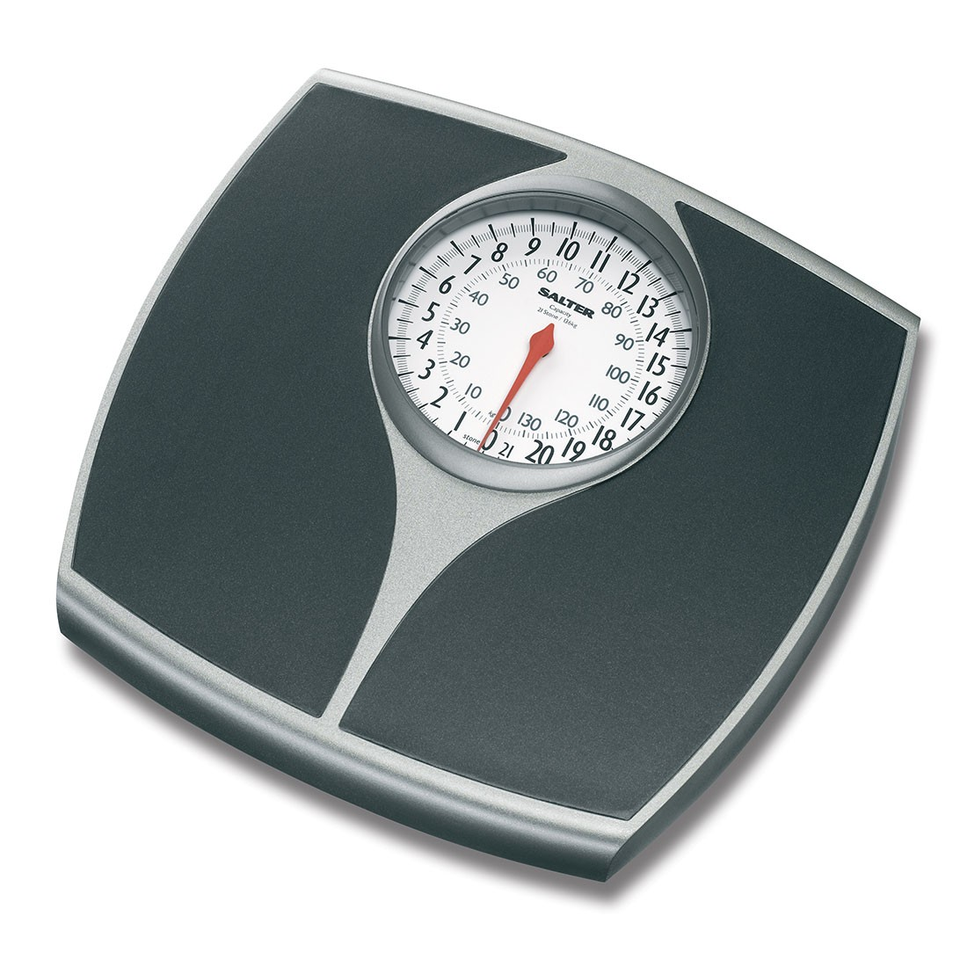
Previous research at the chair
Drinking gadget: Visualize the data
+

Slide 16
Previous research at the chair
Drinking gadget: Visualize the data
What’s missing?
Motivate the patients to drink more
Challenge them mentally and physically

Slide 17
Topic Master Thesis
Combining a drinking gadget with a
board game to improve
the quality of life of Alzheimer's patients.

Slide 18
Why a board game?
Known from the past

Slide 19
Why a board game?
Known from the past
Social get-together and fun

Slide 20
Why a board game?
Known from the past
Social get-together and fun
Sequential flow of the game

Slide 21
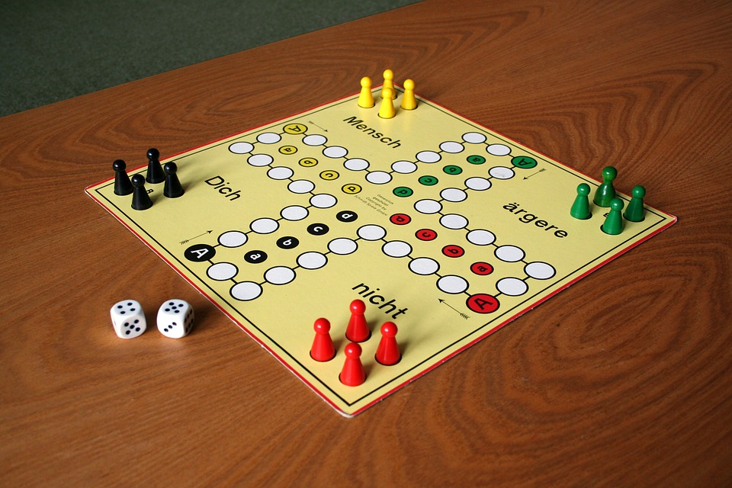
Why a board game?
Known from the past
Social get-together and fun
Sequential flow of the game
Ludo

Slide 22
Why on a Tablet?
Flow of the game can be controlled by the tablet

Slide 23
Why on a Tablet?
Flow of the game can be controlled by the tablet
Pieces are „fixed“ on the board

Slide 24
Why on a Tablet?
Flow of the game can be controlled by the tablet
Pieces are „fixed“ on the board
Adjustable difficulty:
  General: Size of the game board
  Per player: Rolling the dice, moving the pieces

Slide 25
Why on a Tablet?
Flow of the game can be controlled by the tablet
Pieces are „fixed“ on the board
Adjustable difficulty:
  General: Size of the game board
  Per player: Rolling the dice, moving the pieces
Drinking devices can be integrated

Slide 26

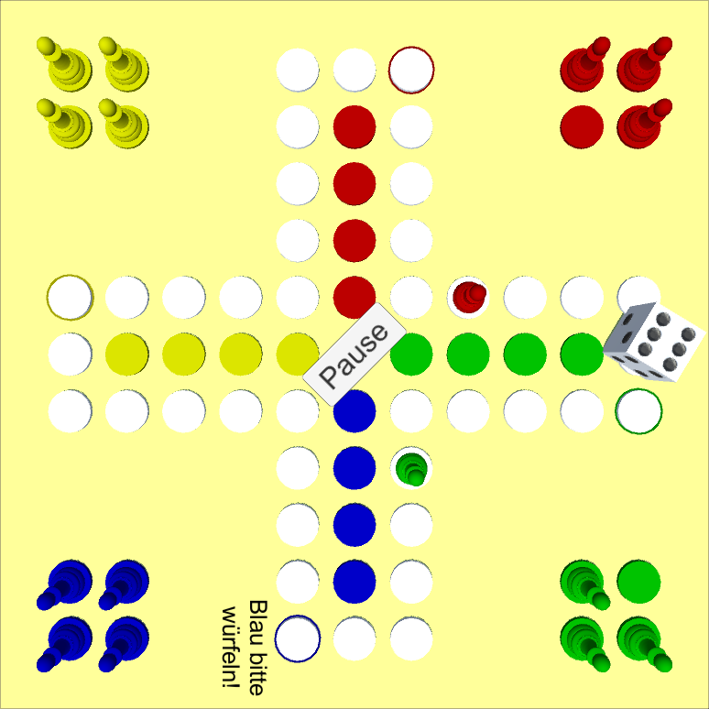

Slide 27



Slide 28


Slide 29

Drink!

Slide 30
Alzheimer‘s disease
Problems:
Mental and physical abilities decrease
Loss of motivation / depression
Dehydration

Slide 31
Alzheimer‘s disease
Problems:
Mental and physical abilities decrease
Loss of motivation / depression
Dehydration
Drinking gadgets + board game:
Challenge patients mentally and physically
Social interaction and playful atmosphere
Drinking is integrated in the game flow

Slide 32
Timeline
November
December
January
February
March
April
May
15.11.18
15.01.19
01.05.19
15.05.19
Preparation
Mainpart
Finish

Slide 33


Timeline
Kickoff presentation
Development 1. prototype
Literature research
November
December
January
February
March
April
May
15.11.18
15.01.19
01.05.19
15.05.19
Preparation
Mainpart
Finish

Slide 34
Timeline
Kickoff presentation
Evaluation & feedback integration
Writing the master thesis
Development 1. prototype
Literature research
November
December
January
February
March
April
May
15.11.18
15.01.19
01.05.19
15.05.19
Preparation
Mainpart
Finish

Slide 35
Timeline
Final presentation TBD
Proofread, bind etc.
Kickoff presentation
Evaluation & feedback integration
Writing the master thesis
Development 1. prototype
Literature research
November
December
January
February
March
April
May
15.11.18
15.01.19
01.05.19
15.05.19
Preparation
Mainpart
Finish

Slide 36
Thank you
for your attention!

