Slide 1
Combining a drinking gadget with a board game to improve the quality of life of Alzheimer's patients
Tim Henkelmann
23.05.2019
Final: Master Informatics
Supervisor(s): Christian Eichhorn, David A. Plecher

Slide 2
Motivation
Alzheimer‘s disease:
Irreversible, neurodegenerative illness
Notes:
Most common form of dementia, roughly 2/3
1,7 million people in germany, more than 50 million worldwide

Slide 3
Motivation
Alzheimer‘s disease:
Irreversible, neurodegenerative illness
Cause: unclear (genetics, …) [1]
Notes:
Different hypotheses exist: cholinergic, amyloid and tau

Slide 4
Motivation
Alzheimer‘s disease:
Irreversible, neurodegenerative illness
Cause: unclear (genetics, …)
Characteristics: nerve cell loss + plaque + neurofibrils [2]
Notes:
Loss of nerve cells, destroying up to 20% of the brain
Neurofibril bundles: formation of abnormally altered protein fragments, first described by Alois Alzheimer in 1907
Plaque: between nerve cells

Slide 5
Motivation
Alzheimer‘s disease:
Irreversible, neurodegenerative illness
Cause: unclear (genetics, …)
Characteristics: nerve cell loss + plaque + neurofibrils
Symptoms [3] :
  Memory impairment, perceptual and sensory problems
  Gradually worsen
  Late stage: almost no cognitive functions, completely bedridden

Slide 6
Motivation
Alzheimer‘s disease:
Irreversible, neurodegenerative illness
Cause: unclear (genetics, …)
Characteristics: nerve cell loss + plaque + neurofibrils
Symptoms:
  Memory impairment, perceptual and sensory problems
  Gradually worsen
  Late stage: almost no cognitive functions, completely bedridden
No medical cure
Notes:
Costs around 1 trillion, double in the next 12 years
Demographic change => less care-givers, more seniors

Slide 7
Problem Description: Issues
Symptoms
Decay of cognitive and physical functions

Slide 8
Problem Description: Issues
Symptoms
Decay of cognitive and physical functions
Dehydration

Slide 9
Problem Description: Issues
Symptoms
Decay of cognitive and physical functions
Dehydration
Isolation

Slide 10
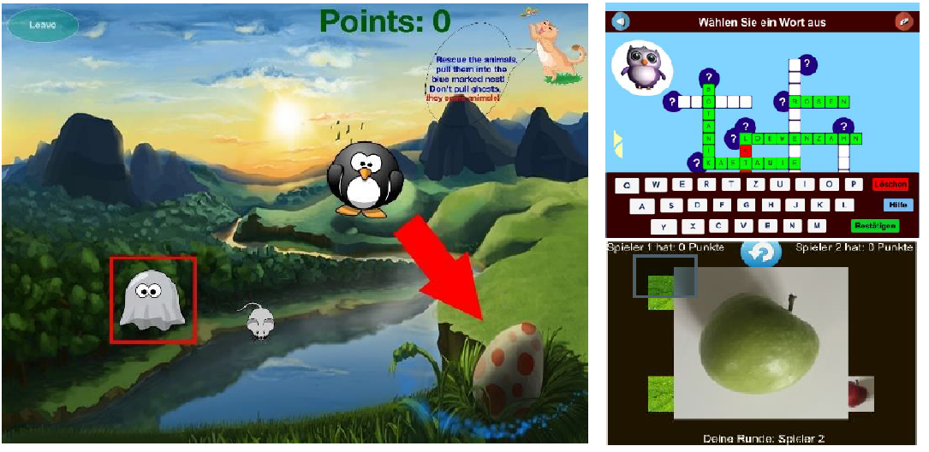
Existing Solutions
Games for AD patients:
Notes:
Cogntive stimulation BUT: mainly single player focused and only partial physical engagement

Slide 11
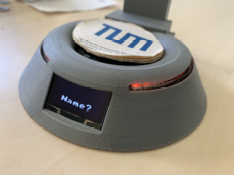
Existing Solutions
Drinking gadget:
Notes:
Hydration trackable but no motivation to actually improve hydration

Slide 12
Thesis Title
Games for AD patients + drinking gadget
Combining a drinking gadget
with a board game to improve the quality of life of Alzheimer's patients
Notes:
Hydration trackable but no motivation to actually improve hydration

Slide 13
Thesis Goals
Challenge cognitively
Challenge physically
Integrate socially
Improve hydration

Slide 14
Critical Research Issues
(Alzheimer‘s disease)
Notes:
Understand particularities about the disease, symptoms, communication

Slide 15
Critical Research Issues
(Alzheimer‘s disease)
Application development for seniors/AD patients
  Design
  Motivation
Notes:
Age related decline, Serious games, virtual agents,

Slide 16
Critical Research Issues
(Alzheimer‘s disease)
Application development for seniors/AD patients
  Design
  Motivation
Hybrid tabletop games and tangibles
Notes:
real-world game is extended with computing functionality to create an improved gaming experience

Slide 17
Critical Research Issues
(Alzheimer‘s disease)
Application development for seniors/AD patients
  Design
  Motivation
Hybrid tabletop games and tangibles
Evaluation (TAM, survey methods, …)
Notes:
TAM = Technology Acceptance Model => is new tech accepted?
Survey methods: guidelines by Fraunhofer Institute regarding product development for seniors

Slide 18
Approach
„Mensch Ärgere Dich Nicht!“
Deployed on a tablet
With a Bluetooth dice and physical pieces

Slide 19
Approach
„Mensch Ärgere Dich Nicht!“
  Known from the past
  Multiple users
  Simple, consecutive, extensible gameflow
Deployed on a tablet
With a Bluetooth dice and physical pieces
Notes:
known from the past since childhood
Multiple users;
simple, consecutive gameflow; extensible gameflow;

Slide 20
Approach
„Mensch Ärgere Dich Nicht!“
  Known from the past
  Multiple users
  Simple, consecutive, extensible gameflow
Deployed on a tablet
  Gameflow control
  Customization options
  Connect peripherals
With a Bluetooth dice and physical pieces
Notes:
gameflow control (reminder who‘s turn, what to do, …)
customization options: board size, color blindness, …, other peripherals

Slide 21
Approach
„Mensch Ärgere Dich Nicht!“
  Known from the past
  Multiple users
  Simple, consecutive, extensible gameflow
Deployed on a tablet
  Gameflow control
  Customization options
  Connect peripherals
With a Bluetooth dice and physical pieces
  Connect to known experiences
  Physical engagement
Notes:
Peripherals:
Physical engagement, closer to classic version, diversified: Combination of old and new is aimed to spark interest

Slide 22
Implementation
Notes:
Broken, had to be redeveloped, how to improve hydration now? „I will pick up on this point later.“

Slide 23
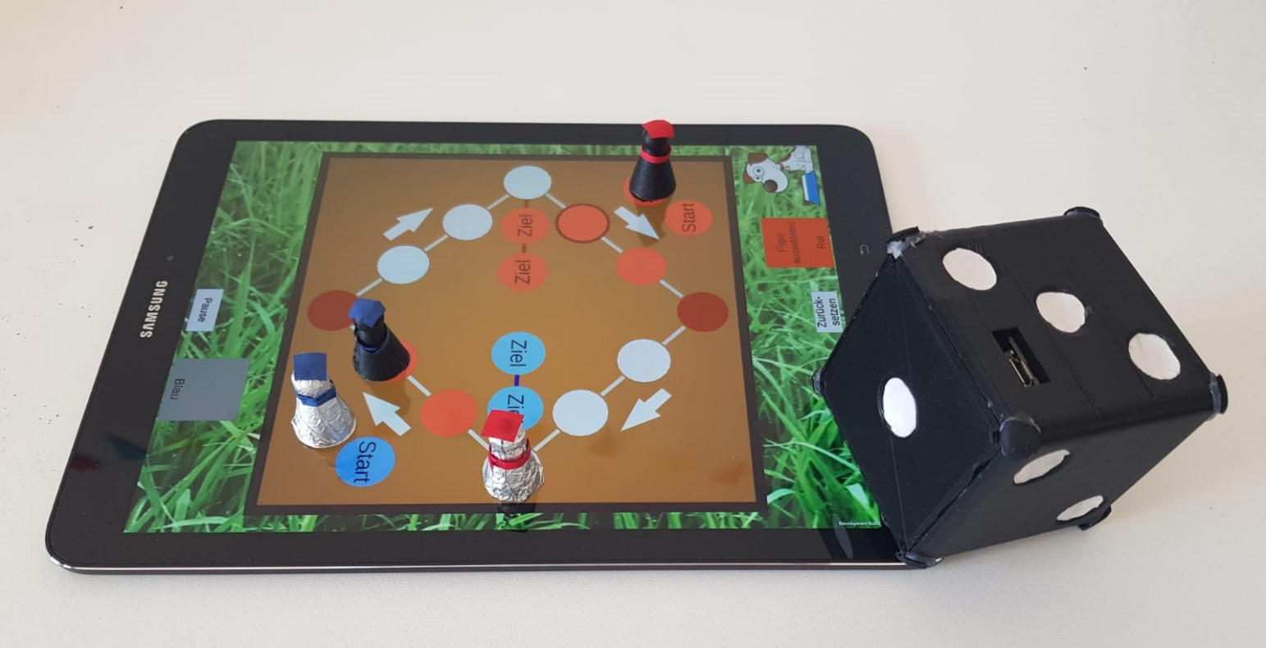
Implementation
Demo
Notes:
Background Music
Companion dog
Start and Play!
Describe field: Dice=>Bluetooth dice, pieces => physical pieces, helper panels, companion dog with bowl => Drinking reminder!, reset button, path marker
Different options: board size, players, physical pieces, color blindness, …
Personalize: name players, crop faces,

Slide 24
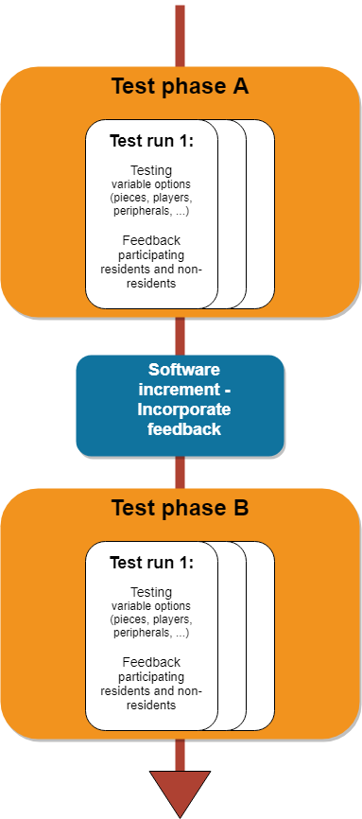
Evaluation
Notes:
2 Test phases with software increment inbetween
In testphase: multiple test runs and try to test as much as possible BUT go along with patients‘ mood

Slide 25
Evaluation
Location:
Tertianum Munich
Survey methods:
Questionnaire
Observation
Think Aloud

Slide 26
Evaluation
Location:
Tertianum Munich
16.04.2019
4 test runs
Survey methods:
Questionnaire
Observation
Think Aloud
Notes:
All test runs with 2 people except last test run with 3 people, all for 3 rounds
Insights: Intuitive but non-resident was needed,
BUT: Bluetooth dice results were transfered too early, residents had trouble to distinguish pieces, where to press + „mistakes“ were made (resident still touched tablet => trigger next players dice throw)

Slide 27
Evaluation
Location:
Tertianum Munich
16.04.2019
4 test runs
Survey methods:
Questionnaire
Observation
Think Aloud
Design, Path marker, Reset-button, physical pieces, …
Notes:
Design rework (marking start and end tiles, color selection, background image)
More room for error: reset-button, click on piece or endtile,
Improved state-detection algorithm: make use of accelerometer and tweak gyroscope-values
Create physical pieces: first tries with constant tracking (PUCs, …) but did not work => use conductive paint/tinfoil

Slide 28
Evaluation
Location:
Tertianum Munich
16.04.2019
4 test runs
Survey methods:
Questionnaire
Observation
Think Aloud
Design, Path marker, Reset-button, physical pieces, …
13.05.2019
1 test run
Notes:
Only 1 test run but:
continous game flow, barely any assistance needed
played as 2, 3 and 4 players
many small informal chats
Reset-button and color-rework useful!
Integration of more impaired residents
=> Very good testing, might be due to software improvement or good mood of patients

Slide 29
Discussion
Testing gave valuable insights
  Touchscreen usage was easy
  Connect to known experiences
  Physical engagement motivates
Notes:
Testing gave valuable insights even after extensive research
Connect to known experiences: Dice + Pieces => everyone knows what to do
Physical engagement motivates
Fun while playing!

Slide 30
Discussion
Testing gave valuable insights
  Touchscreen usage was easy
  Connect to known experiences
  Physical engagement motivates
Thesis aims:
  Challenge cognitively
  Challenge physically
  Integrate socially
  Improve hydration

Slide 31
Discussion
Testing gave valuable insights
  Touchscreen usage was easy
  Connect to known experiences
  Physical engagement motivates
Thesis aims:
  Challenge cognitively
  Challenge physically
  Integrate socially
  Improve hydration
Promising results, more (long term) testing necessary

Slide 32
Suggested Future Work
Long term testing
  Include researchers from medicine, psychology, etc.

Slide 33
Suggested Future Work
Long term testing
  Include researchers from medicine, psychology, etc.
  Check for changes regarding:
    Cognitive + physical constitution
    Hydration
    Social interaction
    Progress of Alzheimer‘s disease

Slide 34
Suggested Future Work
Long term testing
Further application development:
  drinking gadgets
  larger tablet
  incentives for malnutrition
  …

Slide 35
Suggested Future Work
Long term testing
Further application development
Different user group
  Seniors (useful features already included)
  Reduce computer anxiety
  Improve computer self efficacy

Slide 36
Conclusion
Very interesting!
Great support by supervisor
Great collaboration with Tertianum

Slide 37
List of References
C. Reitz and R. Mayeux. “Alzheimer disease: epidemiology, diagnostic criteria, riskfactors and biomarkers”. In: Biochemical pharmacology 88.4 (2014), pp. 640–651
Deutsche Alzheimer Gesellschaft e.V. Die neurobiologischen Grundlagen der Alzheimer-Krankheit. 1999. URL: https://www.deutschealzheimer.de/fileadmin/alz/pdf/factsheets/FactSheet02_01.pdf (visited on 21.05.2019).
H. Förstl and A. Kurz. “Clinical features of Alzheimer ’s disease”. In: European Archivesof Psychiatry and Clinical Neuroscience 249.6 (Dec. 1999), pp. 288–290.
Statischtisches Bundesamt (Destatis). 13. koordinierte Bevölkerungsvorausberechnung für Deutschland. 2015. URL: https://service.destatis.de/bevoelkerungspyramide/ (visited on 20.05.2019)
Alzheimer's Disease International. World Alzheimer Report 2018. 2018. URL: https://www.alz.co.uk/research/WorldAlzheimerReport2018.pdf (visited on 20.05.2019)

Slide 38
Thank you
for your attention!

Slide 39
Questions?

Slide 41

Backup Demo

Slide 42
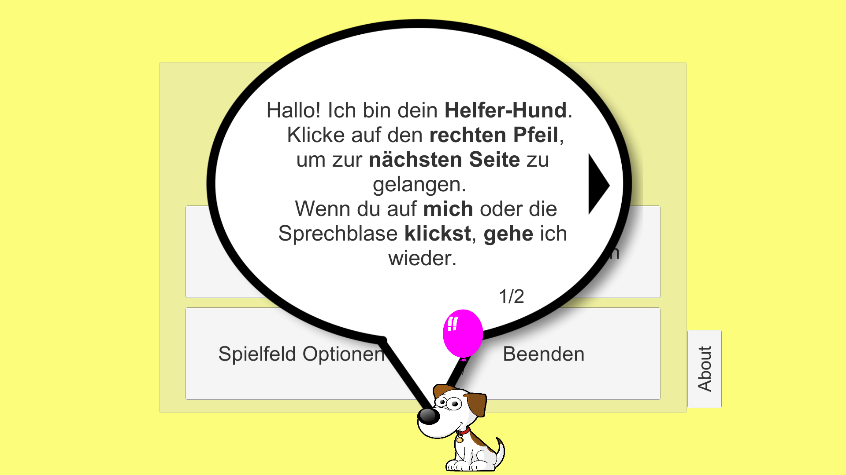
Backup Demo

Slide 43
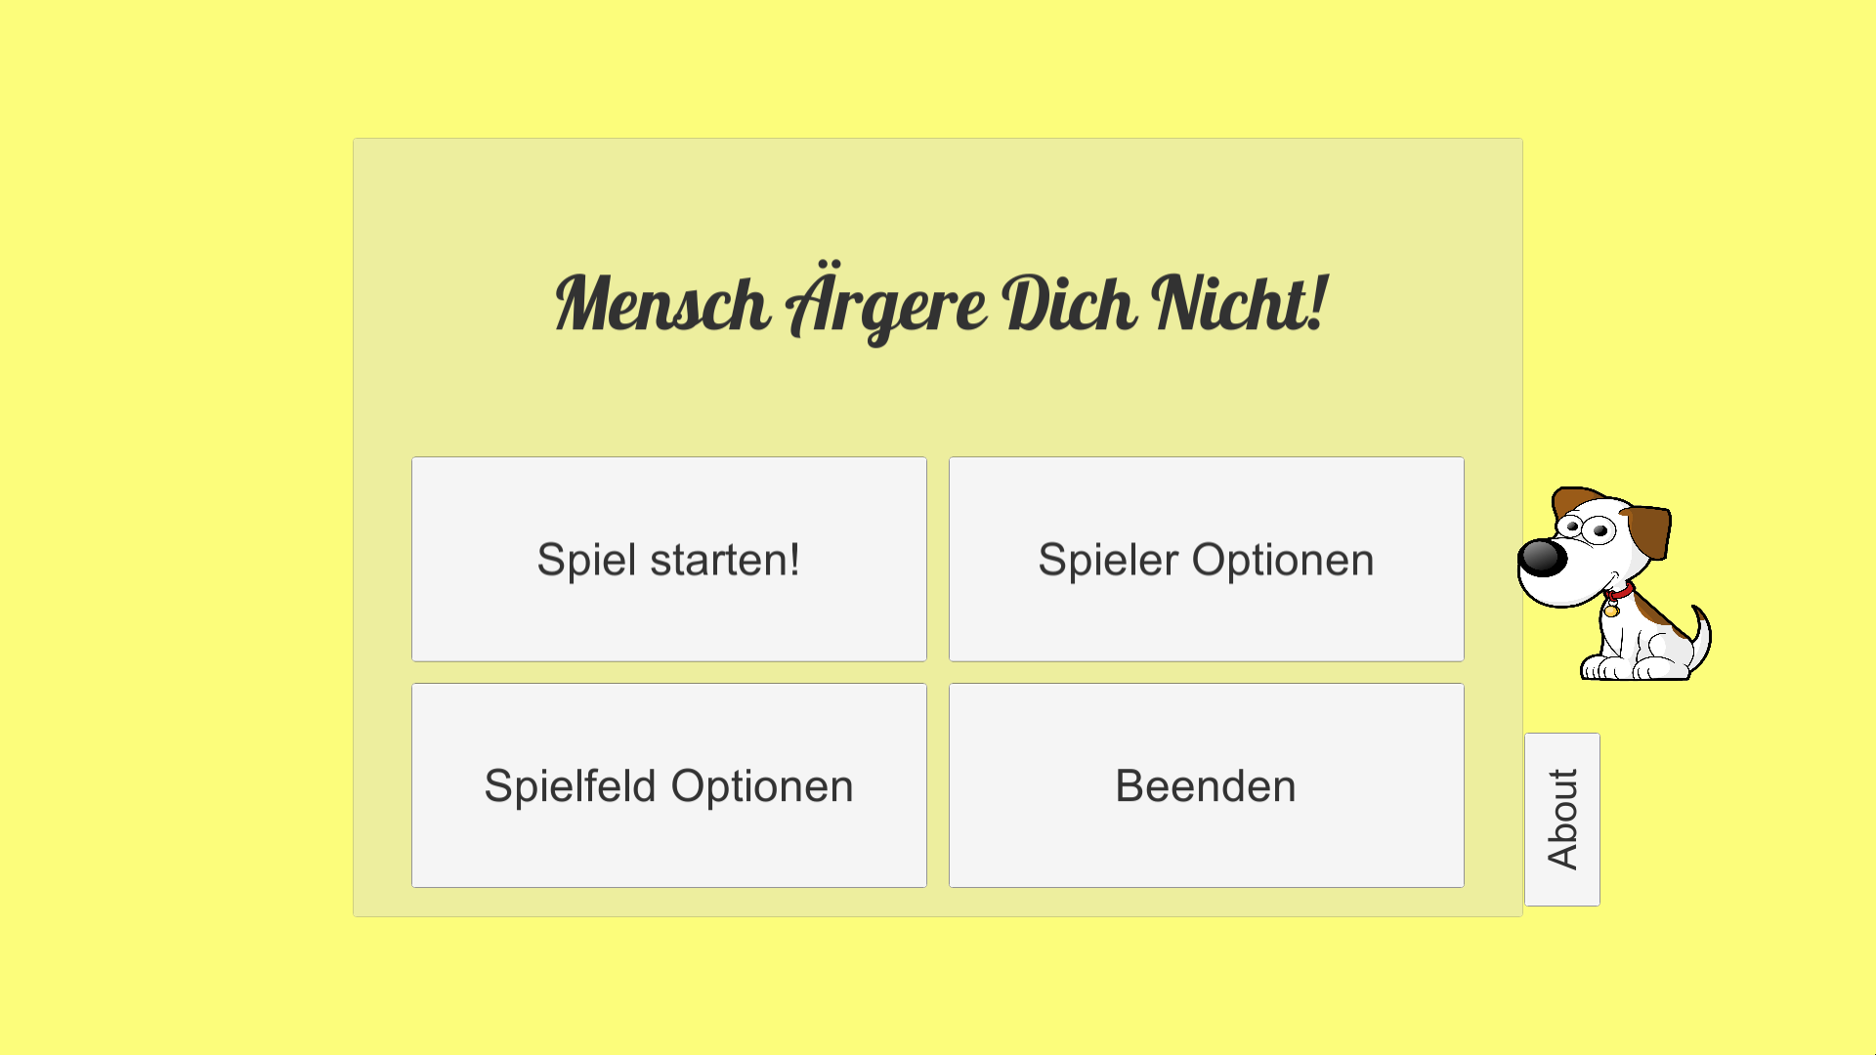
Backup Demo

Slide 44
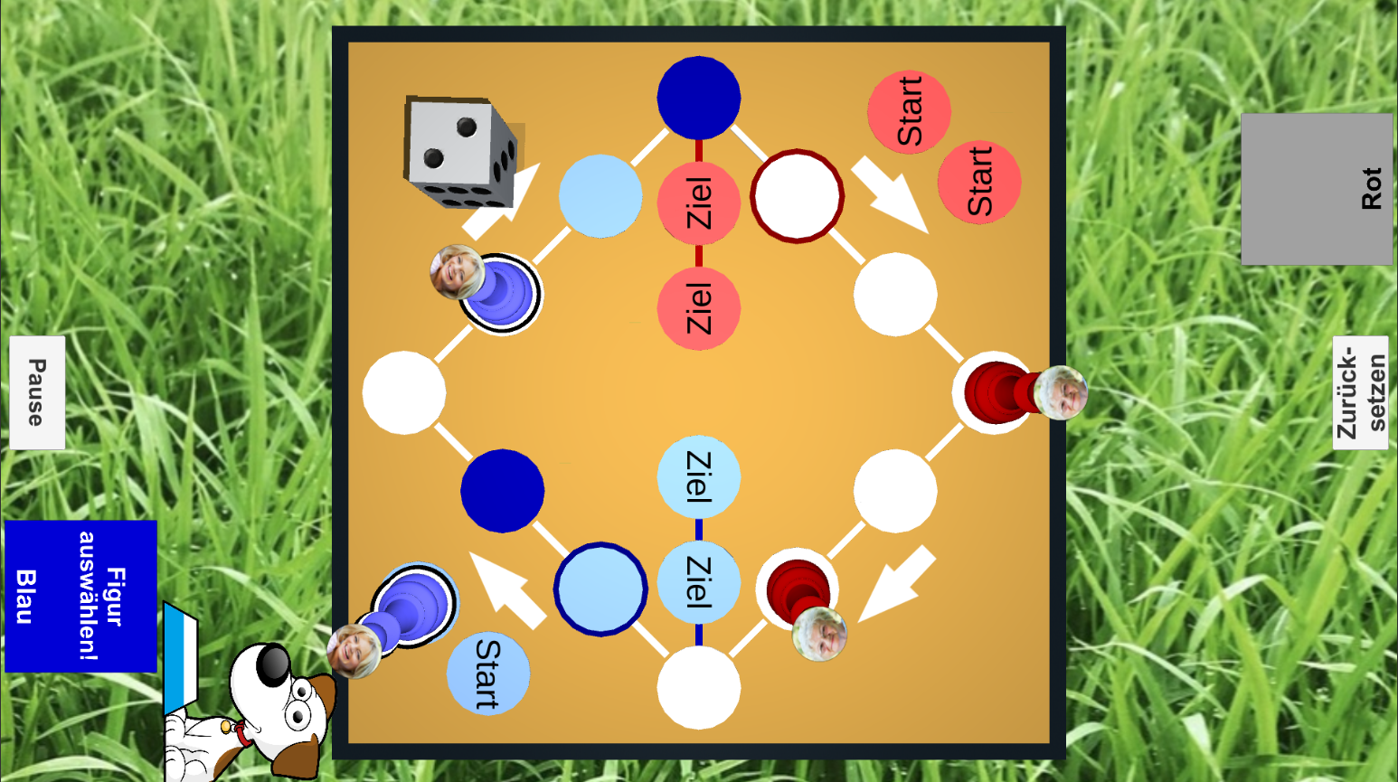
Backup Demo

Slide 45
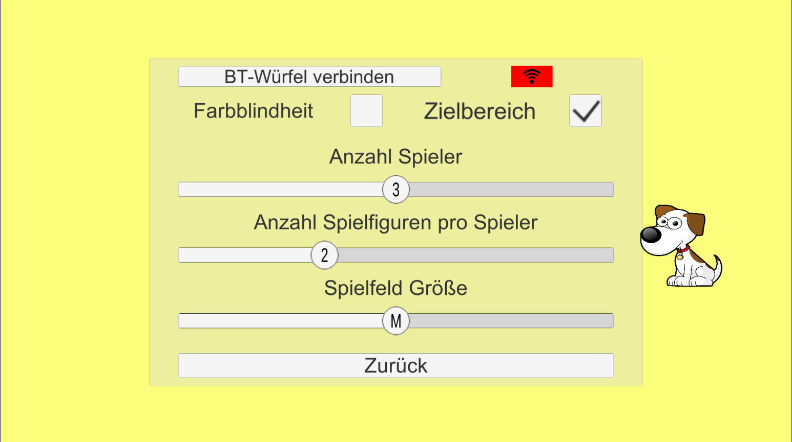
Backup Demo

Slide 46
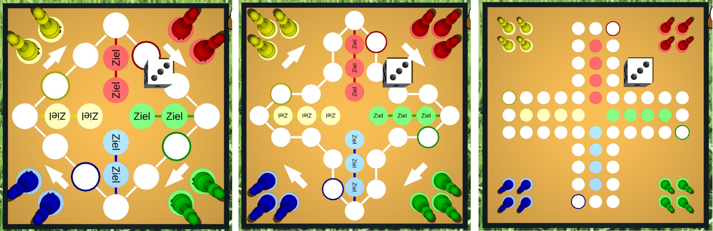
Backup Demo

Slide 47
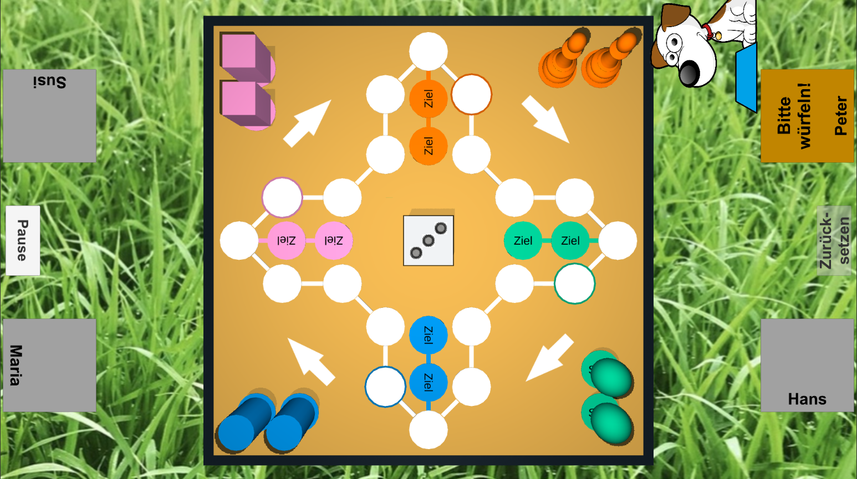
Backup Demo

Slide 48
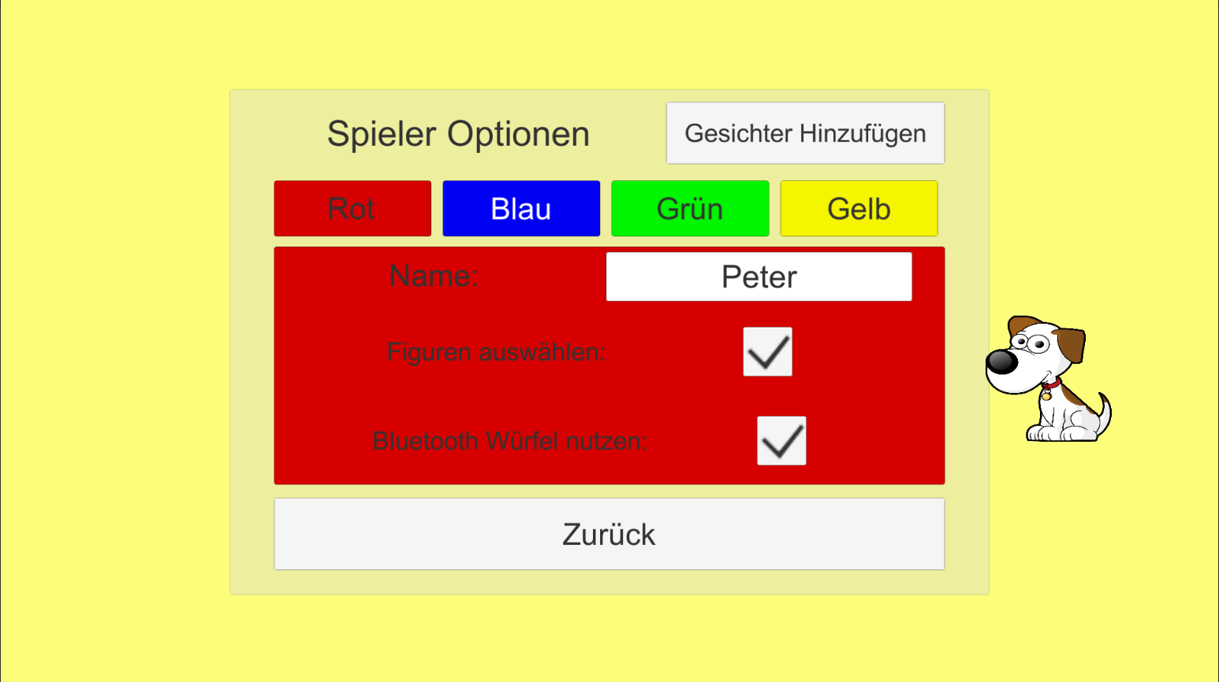
Backup Demo

Slide 49
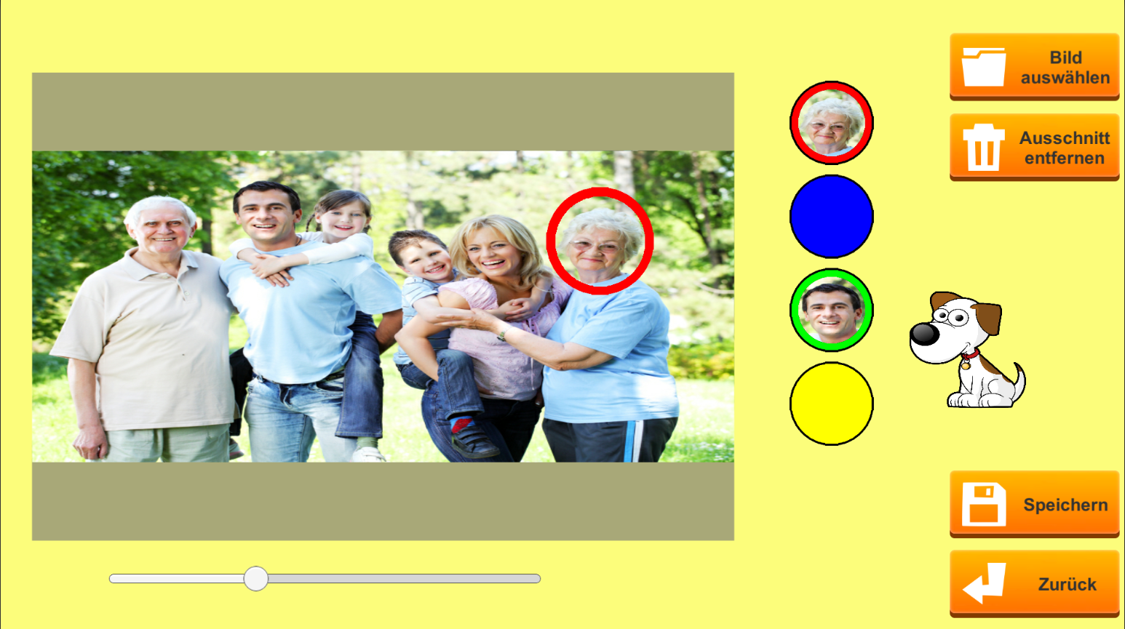
Backup Demo

Slide 50
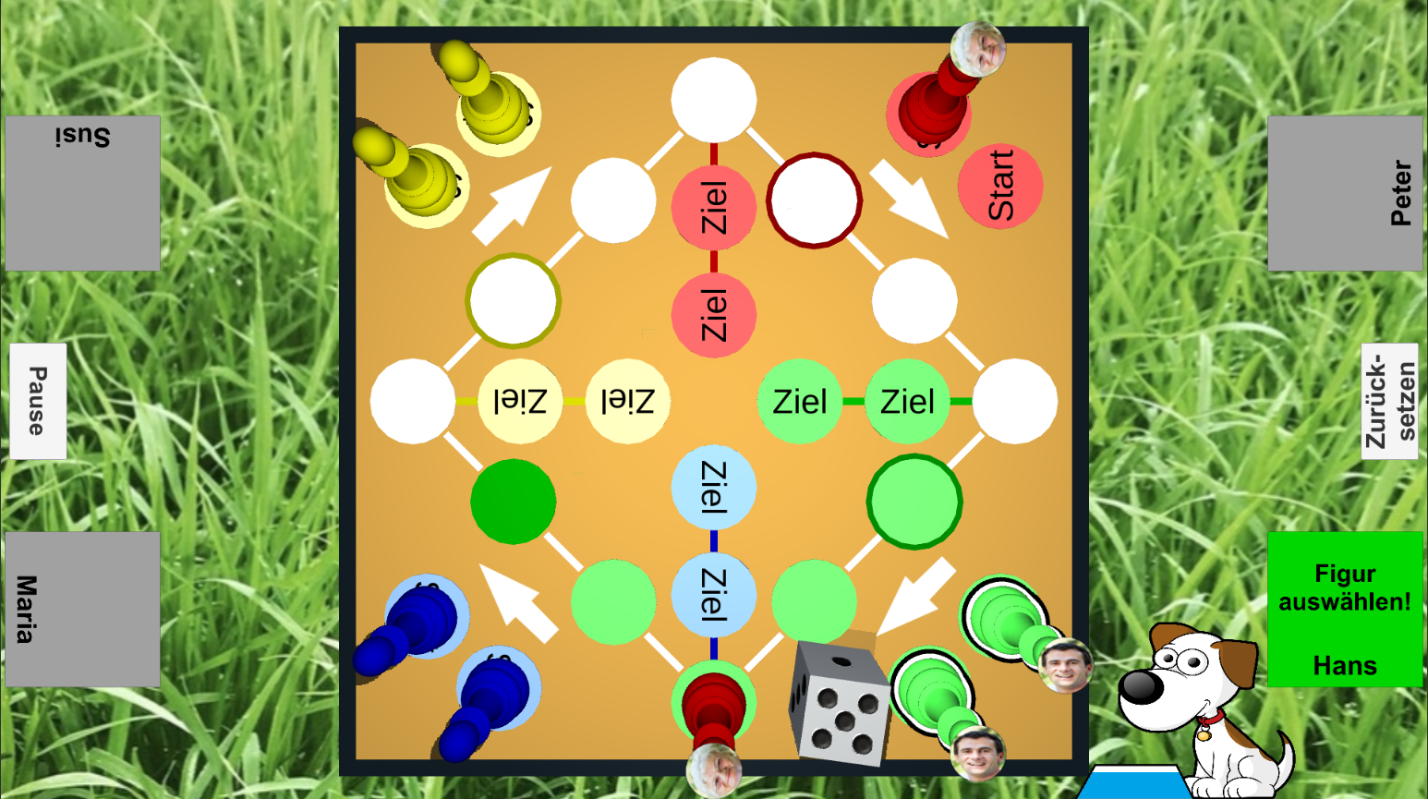
Backup Demo
Notes:
Reset button; Helper panels; Path marker;

Slide 51
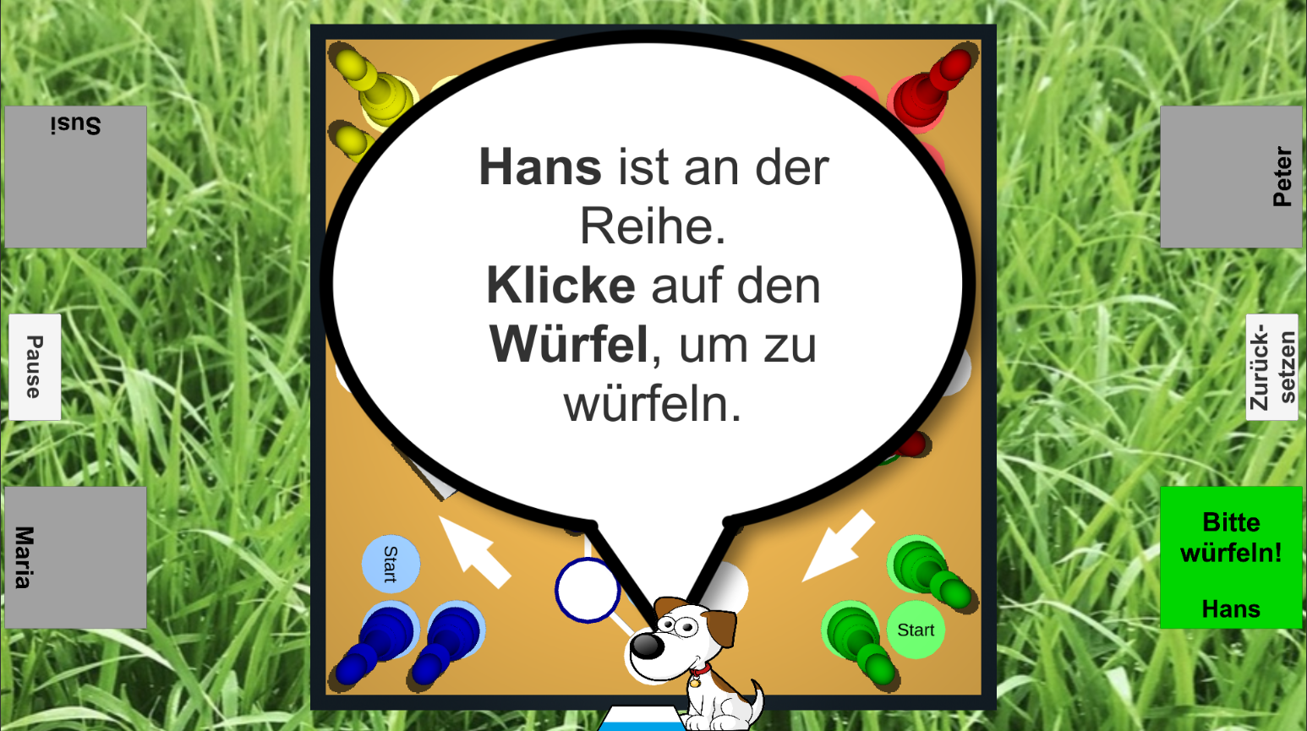
Backup Demo

