Slide 1
Conceptioning and prototyping of a mixed realities dungeon crawler
Dennis Assmann
17.01.2019
Final: Bachelor Informatic: Games Engineering
Supervisor: Frieder Pankratz

Slide 2
Introduction / Motivation
A step to a full immersion game
Blending reality and virtual world together
Enjoy making games
There is no game like this

Slide 3
Problem Description: Issues
Movement
Hardware
Threat detection
Controls

Slide 4
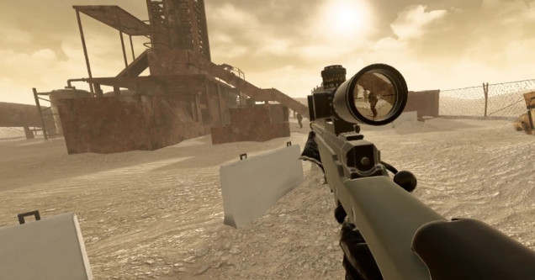
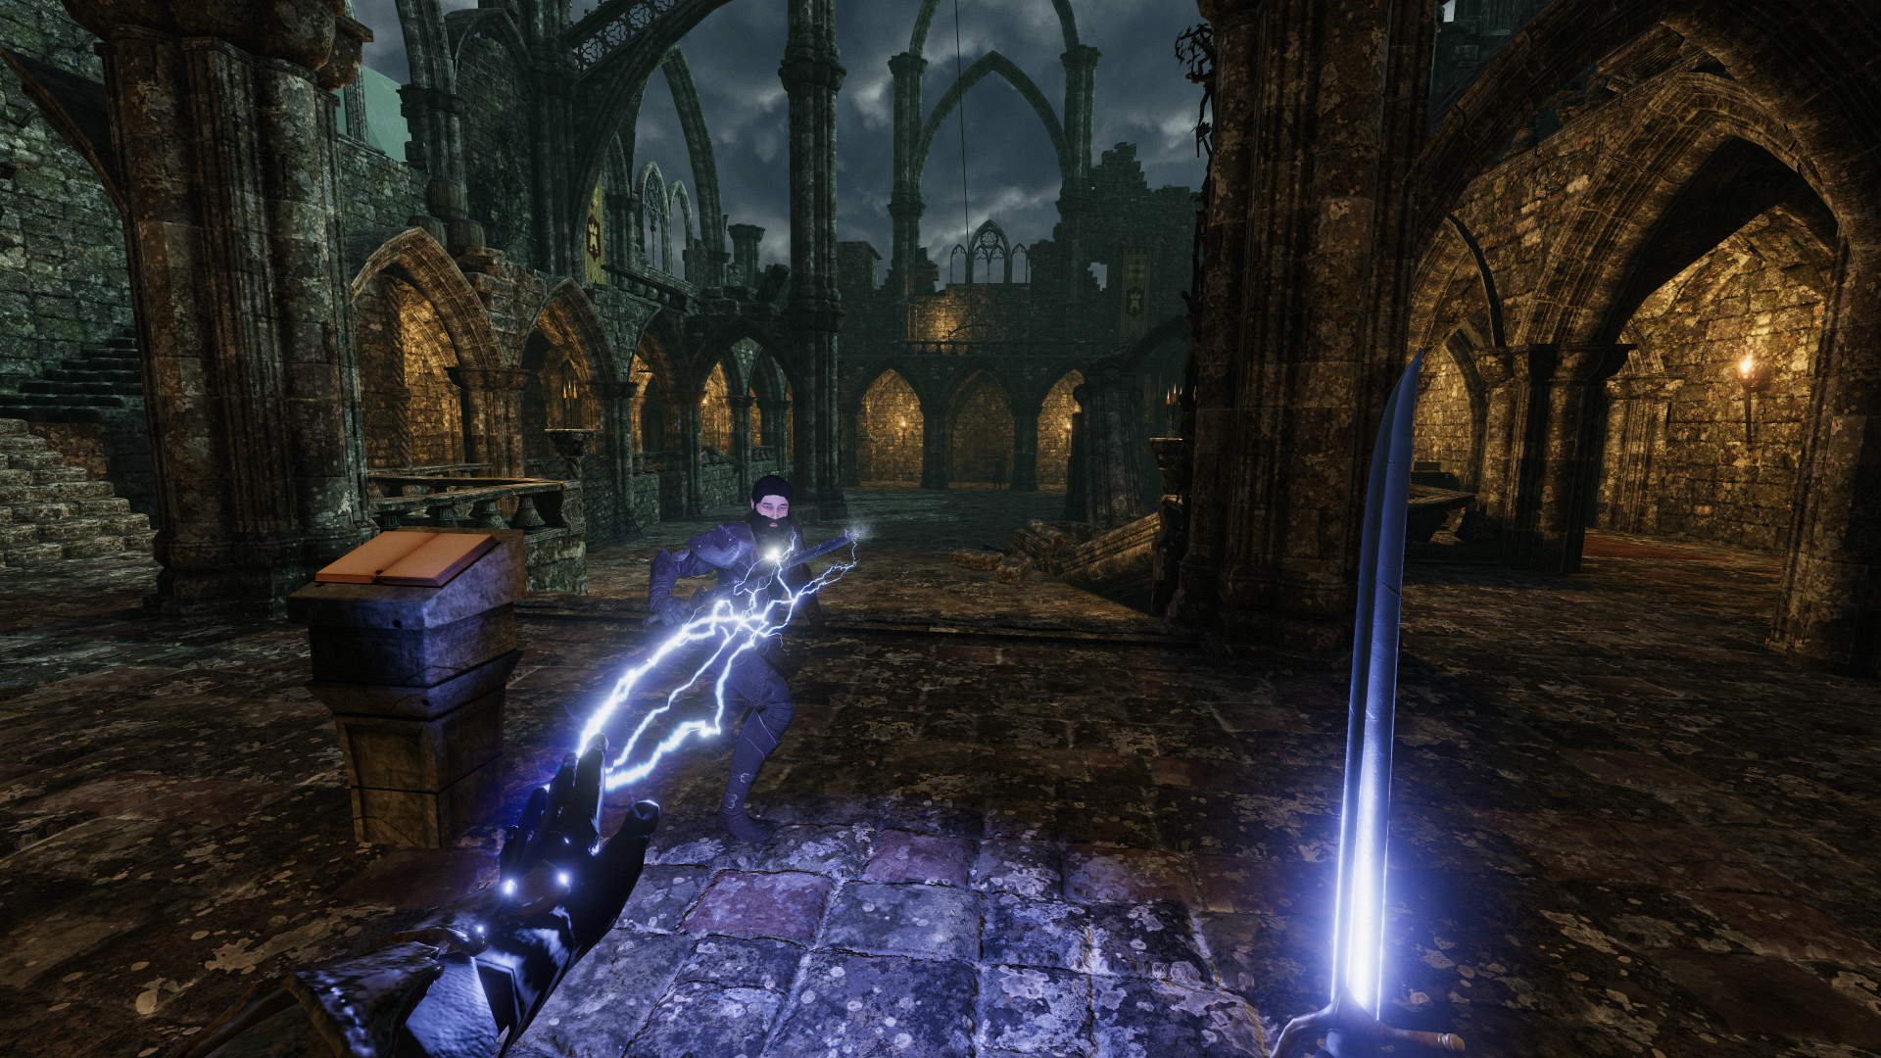
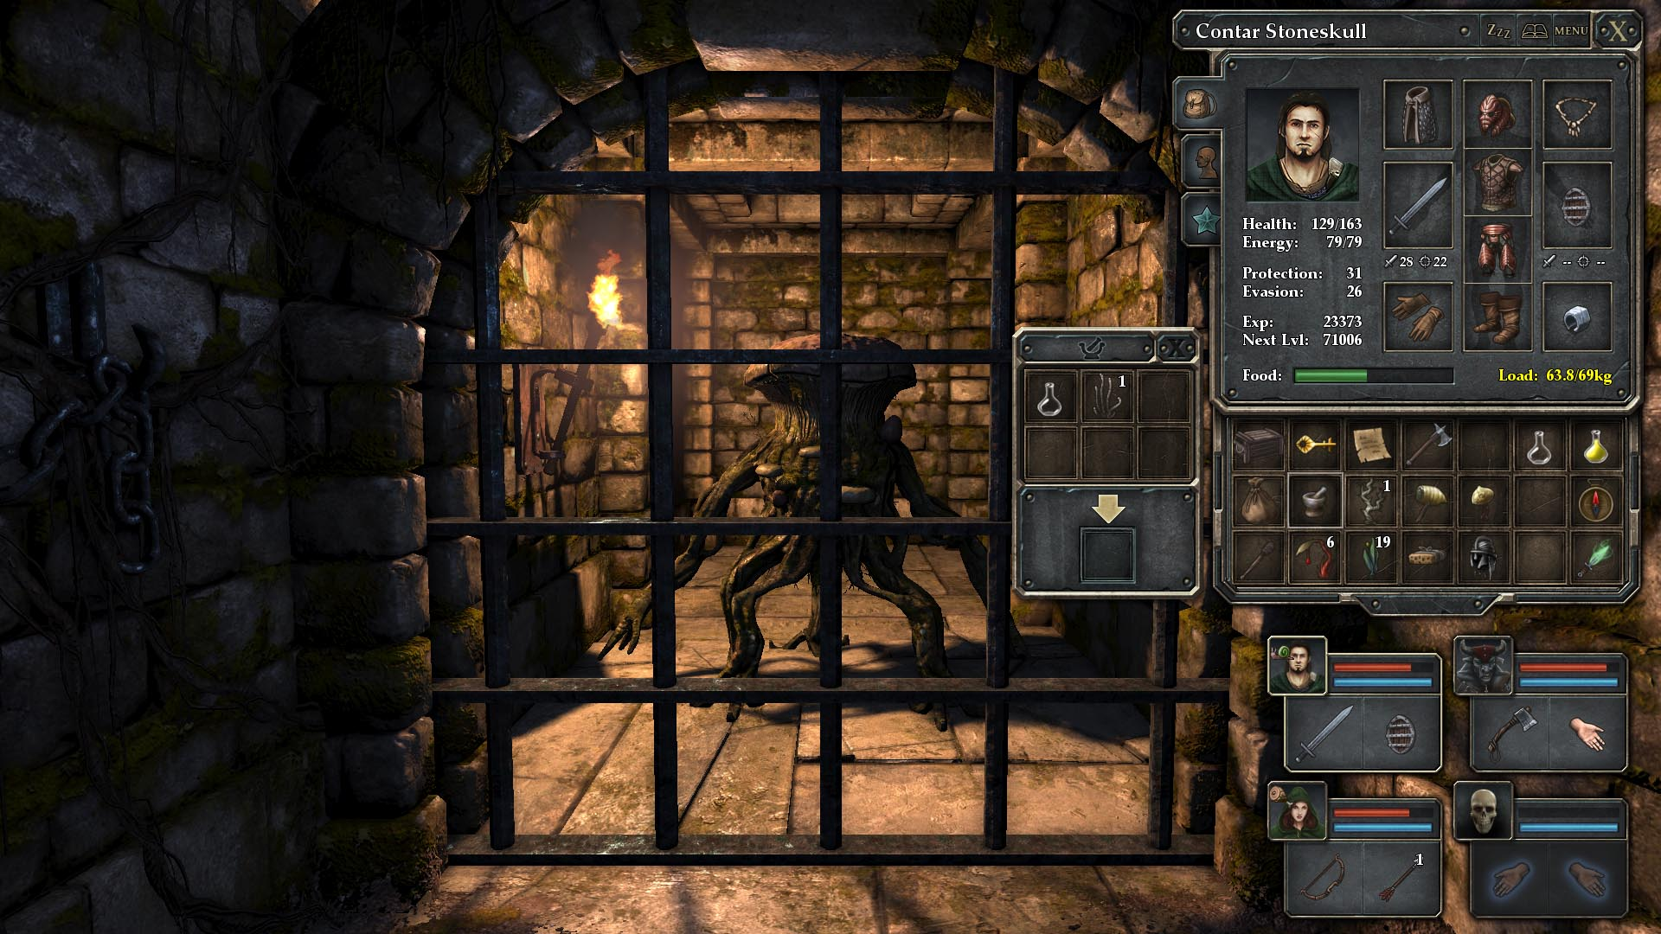
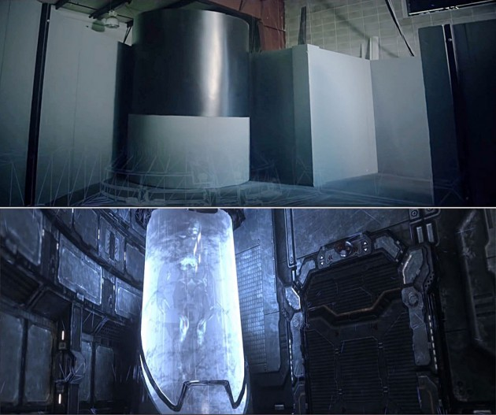
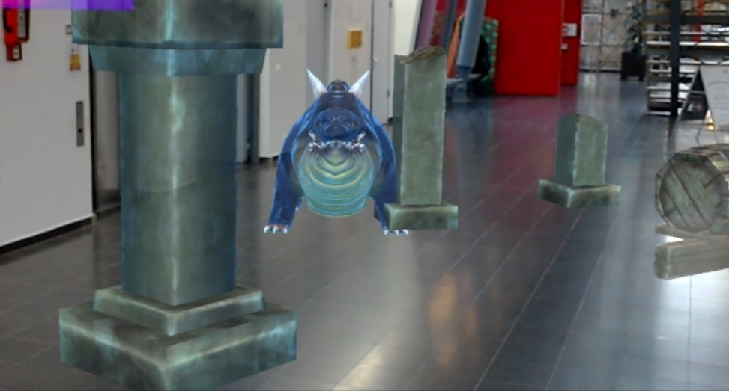
Existing Solutions / Related Work
Dungeon crawlers like „Legend of Grimrock“
VR-Games especially Pavlov VR
The Void
Other bachelor
and master theses
Newest addition Blade and sorcery

Slide 5
Goals of this Thesis
Creating a working prototype for a mixes realities dungeon crawler
Free Movement
Stationary threat detection
Immersive control device
Creating a platform for future projects

Slide 6
Critical Research Issues
Tracking
Threat detection
Spatial mapping
Depth perception
Motion sickness

Slide 7
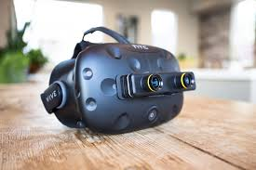
Proposed Work / Approach
Unreal engine
Vive
ZED Mini
Different control mechanics

Slide 8
Implementation
Five steps for the implementaion:
1. Get the hardware to work
2. Spatial mapping and first prototype
3. Second prototype and transportation
4. Developing a final prototype with controls
5. Bug fixing and polishing

Slide 9
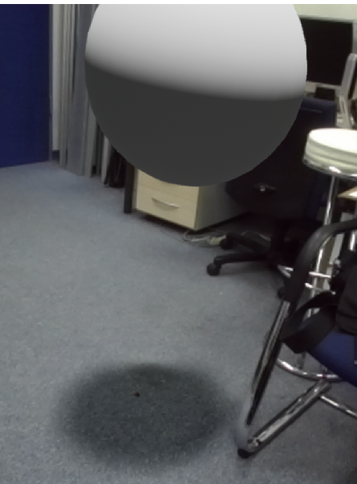
1. Get the hardware to work
Had to use a special Unreal Engine
Every system had a different fault
Plugins for everything
Movement limited at first
Updates are bad

Slide 10
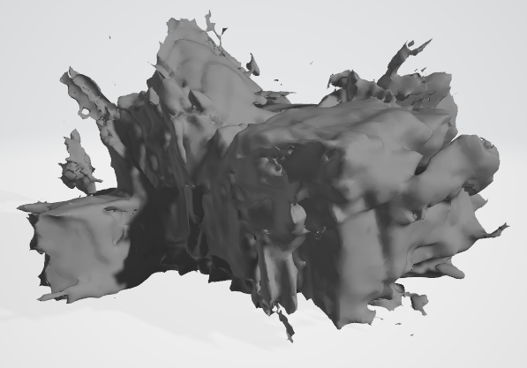
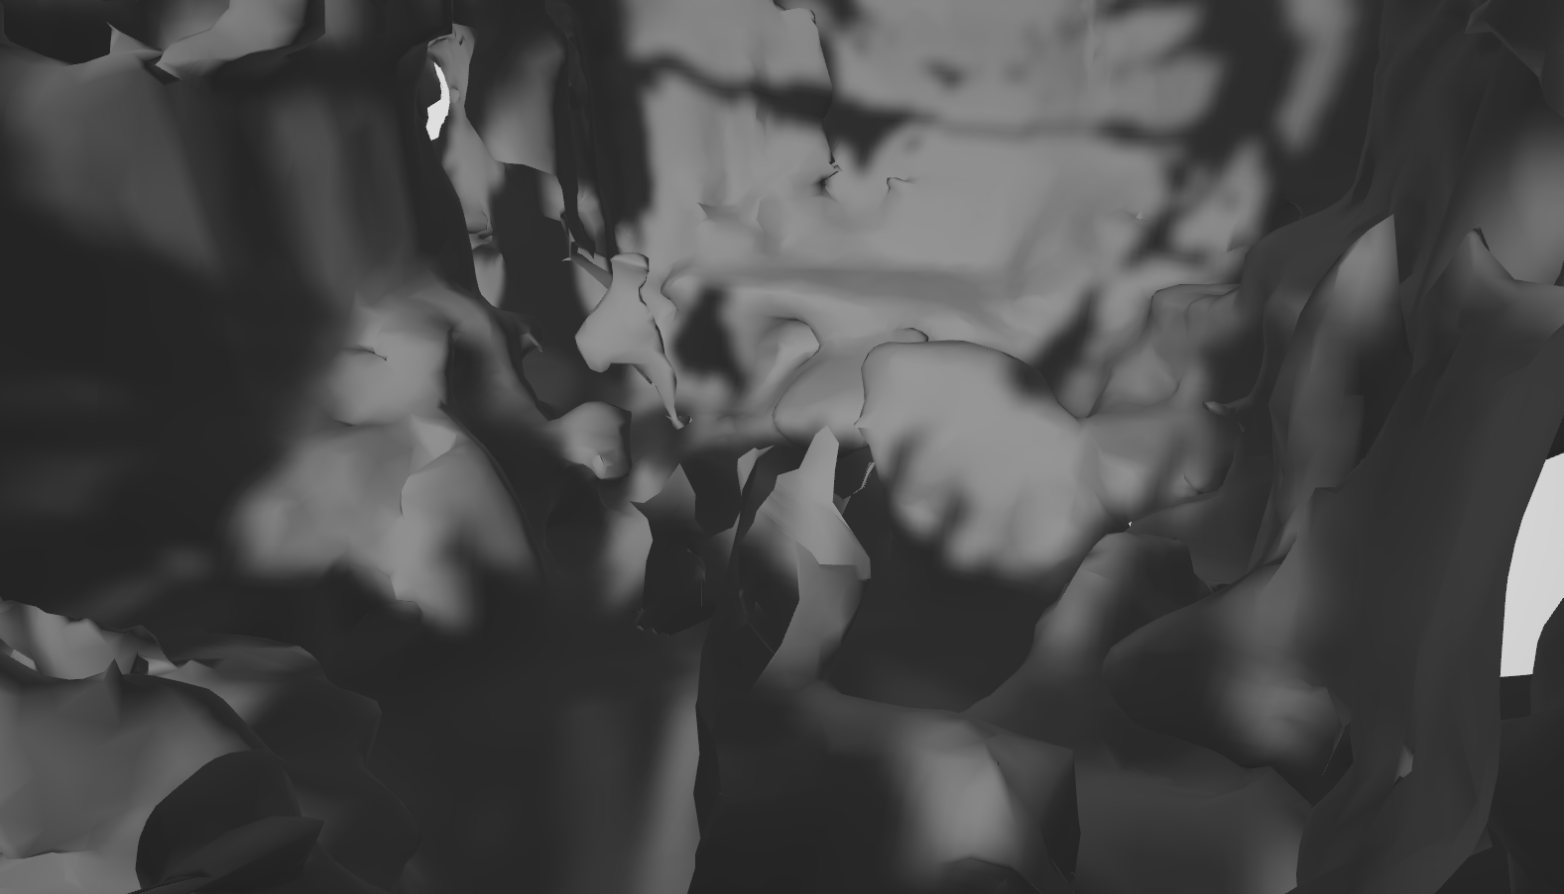
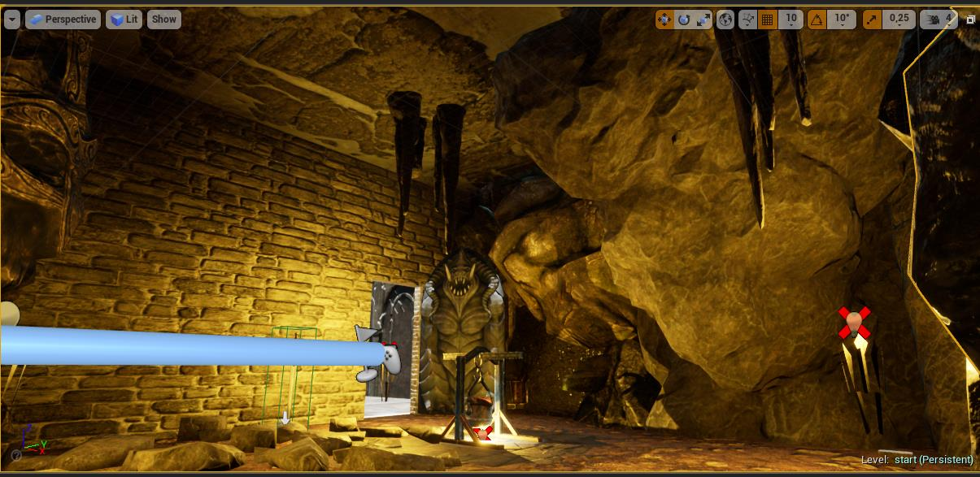
2. Spatial mapping and first prototype
Just the laboratory
Spatial mapping to adjust virtual room
Too cluttered to work

Slide 11
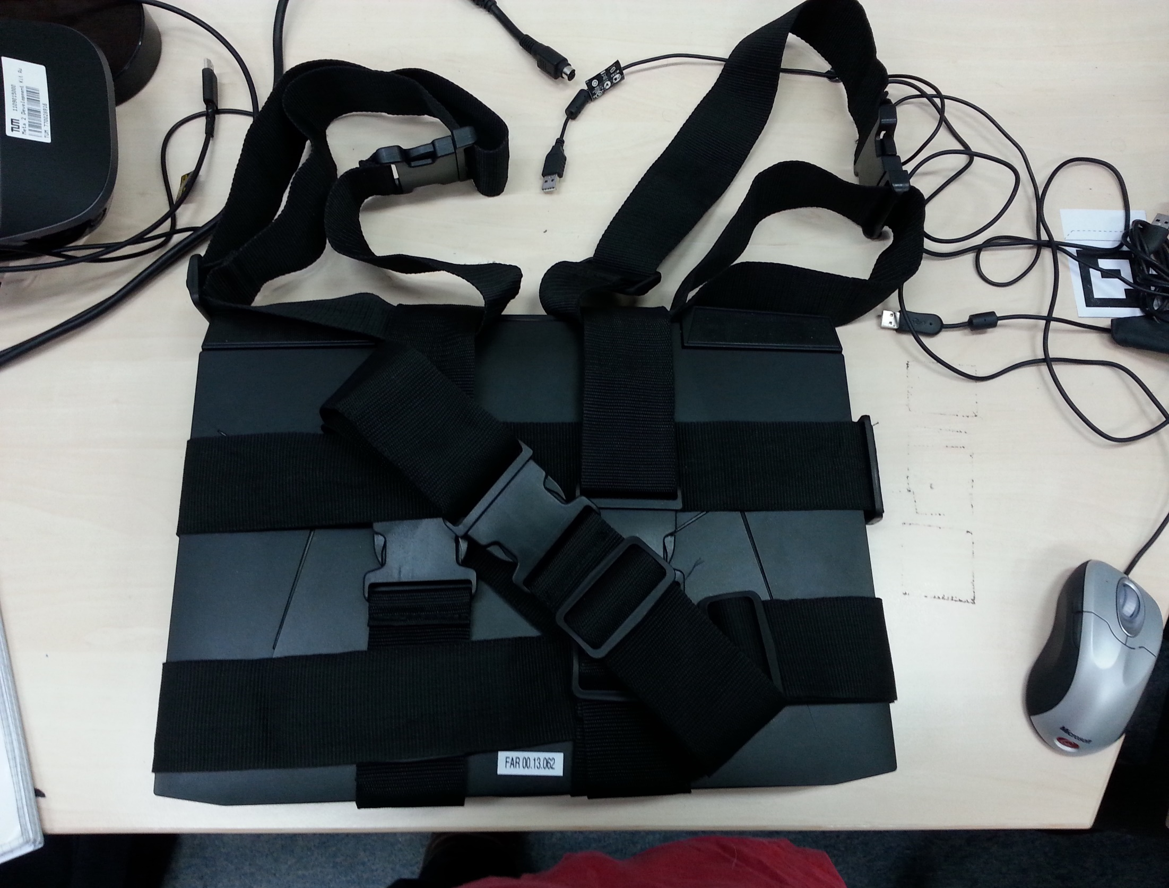
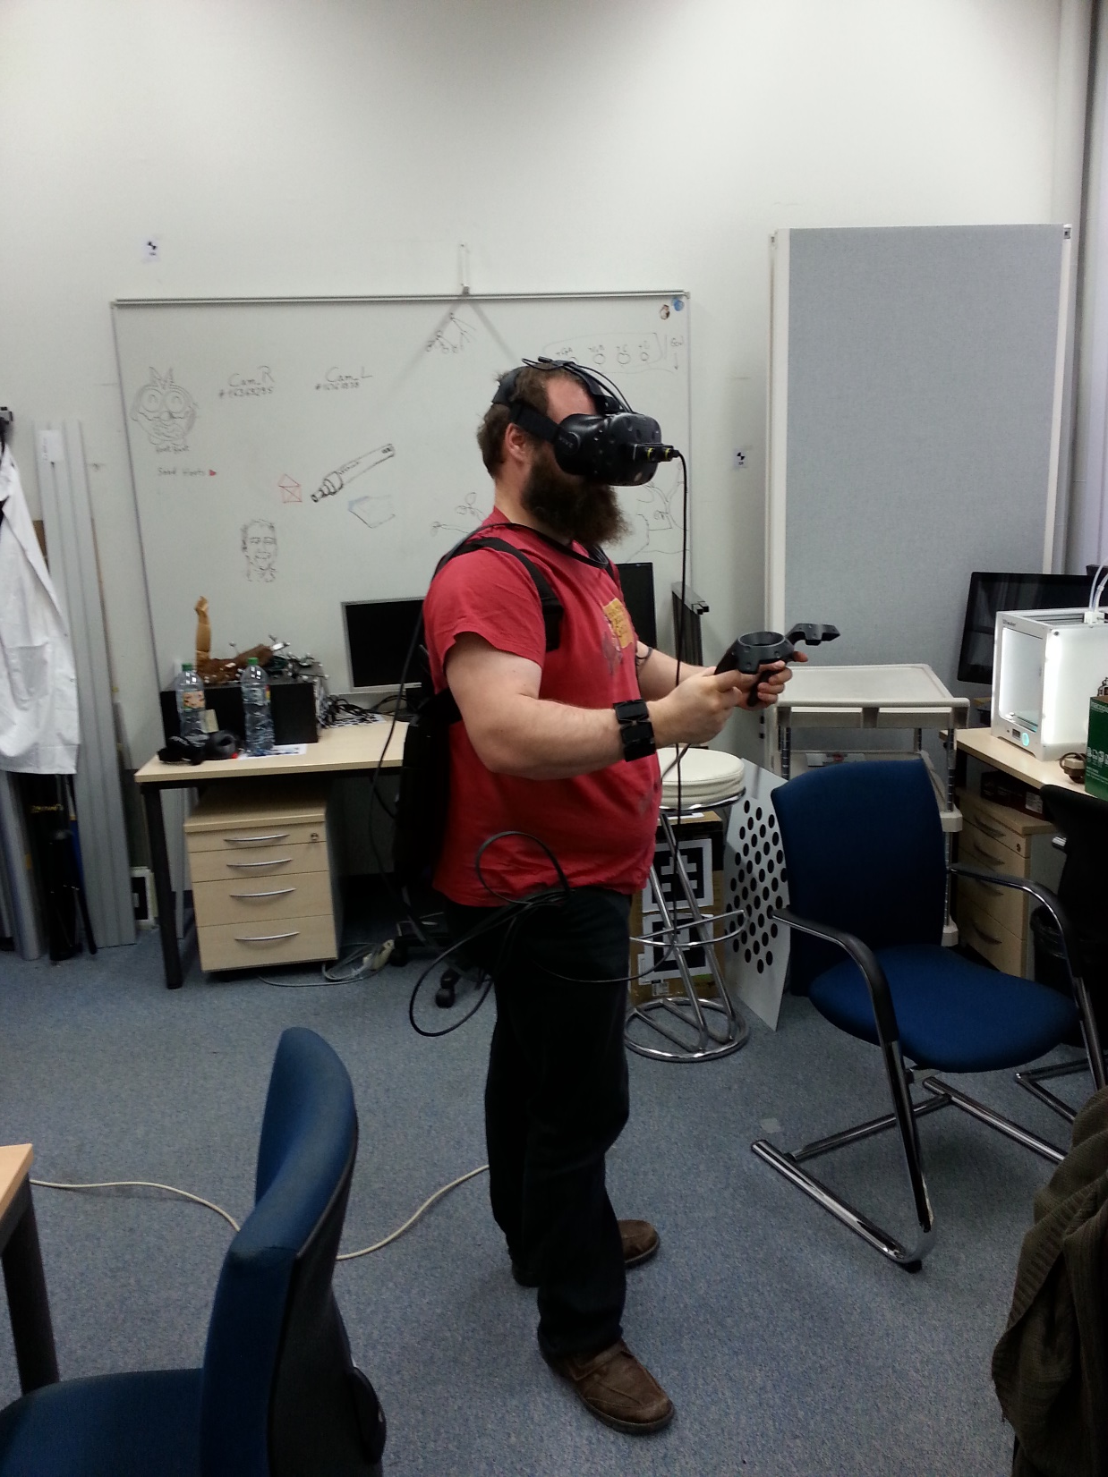
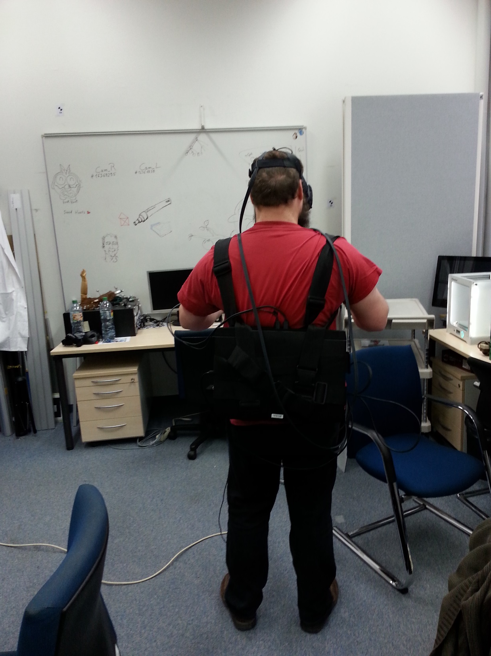
3. Second prototype and transportation
Adding the corridor
Second level to test even more ideas
Strapped in notebook for movement

Slide 12
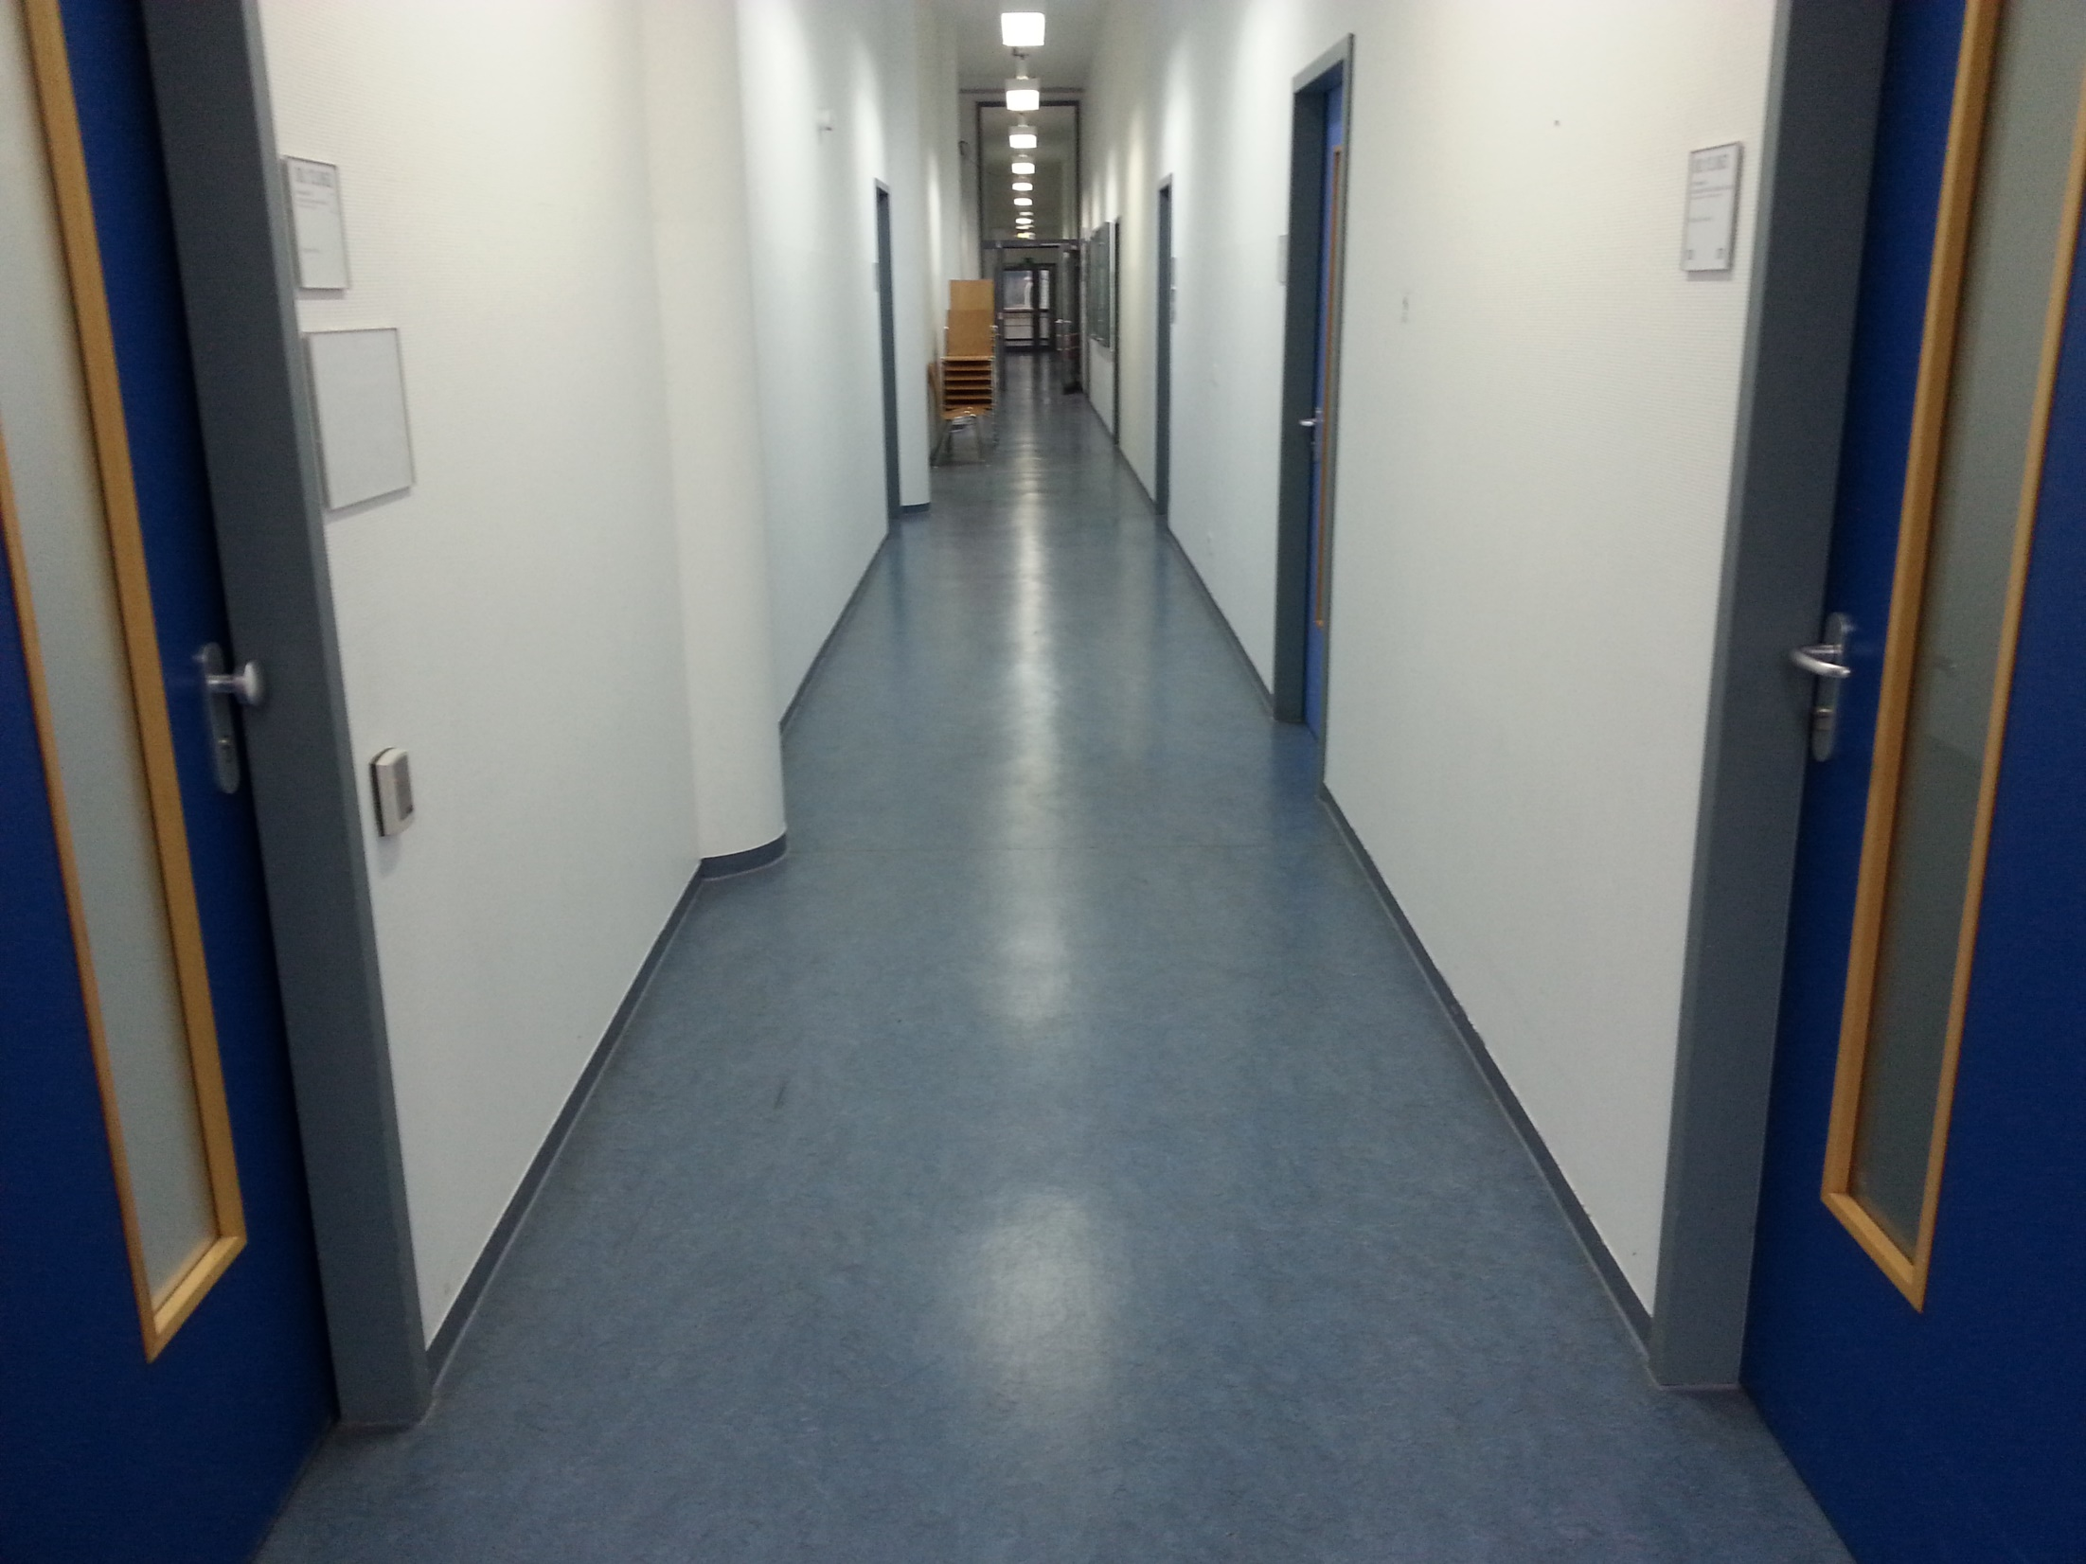
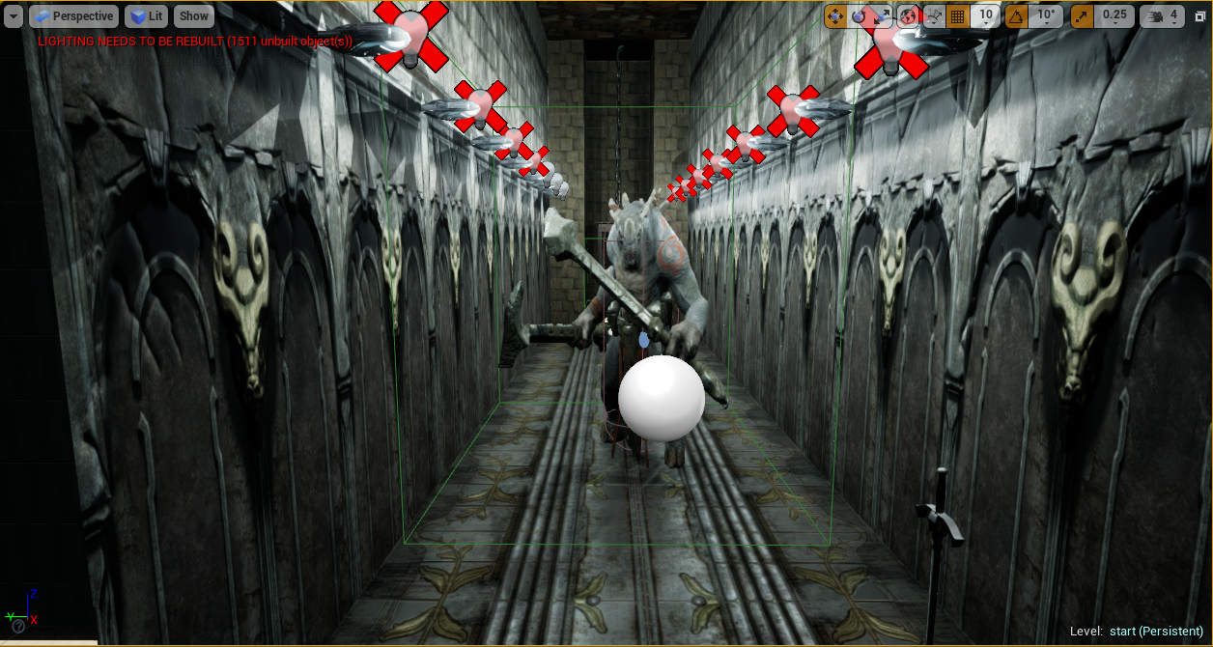
4. Developing a final prototype with controls
Just the corridor
Better game feeling
Functionable in a large space
Not enough time to implement complete controls

Slide 13
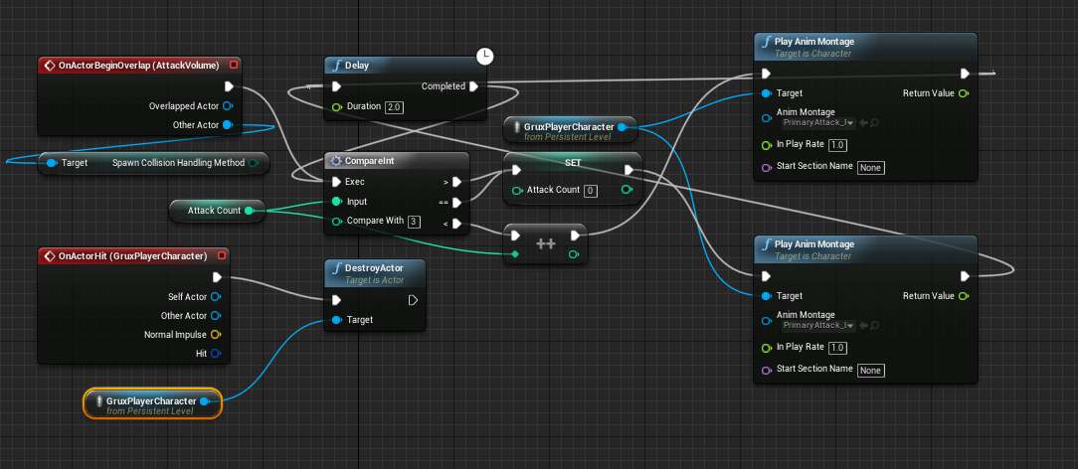
5. Bug fixing and polishing
Every step needed bug fixing
Animations
Sounds

Slide 14
Evaluation
Test after every prototype
Most of the ideas not possible to test
No motion sickness

Slide 15
Discussion / Suggested Future Work
Three main parts
1. Creating a better game
2. Further research projects
3. New game ideas

Slide 16
1. Creating a better game
Story
UI/HUD
Inventory/Items
Better combat mechanics
More control mechanism

Slide 17
1. Creating a better game
Multiplayer
Non player characters
Housing/Towns
Classes
Events

Slide 18
2. Further research projects
Avatar
Procedural generating with spatial mapping
Wider threat detection
AI
Voice command
User evaluations

Slide 19
3. New game ideas
Haunted house
Endless tower

Slide 20
Conclusion
Tracking and threat detection of the ZED Mini is functionable
Large spaces needed
Not feasible for a standard user
Most goals reached

Slide 21
List of References
The VOID
http://www.abitare.it/wp-content/uploads/2015/06/The-Void_m01a_p1-630x527.jpg
Blade and sorcery
https://www.gamersglobal.de/sites/gamersglobal.de/files/galerie/280/Blade&Sorcery_10.jpg
Legend of Grimrock
https://de.wikipedia.org/wiki/Datei:Legend_of_Grimrock_screenshot_01.jpg

Slide 22
List of References
HoloRPG
https://wiki.tum.de/download/attachments/63080942/Decoration.jpg?version=1&modificationDate=1523482079340&api=v2
Pavlov VR
https://s3.amazonaws.com/ebaumsworld.prod/uploads1524609011999-CounterStrikeVR-02.jpg
ZED Mini
https://cdn.uploadvr.com/wp-content/uploads/2017/12/ZED-Mini_HTC_side-768x512.jpg

