Slide 1
On the Trail of Jack the Ripper
A Serious Game about a Cold Case
Andrea Müller
01.07.2021
Final: Master Games Engineering
Supervisor(s): Dr. rer. nat. David A. Plecher, M.A.

Slide 2
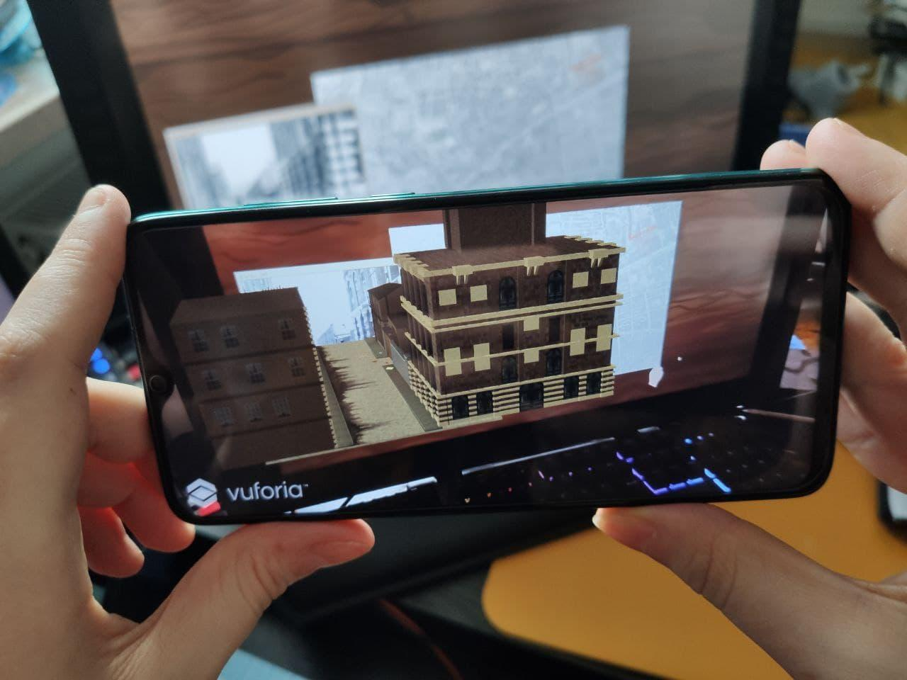
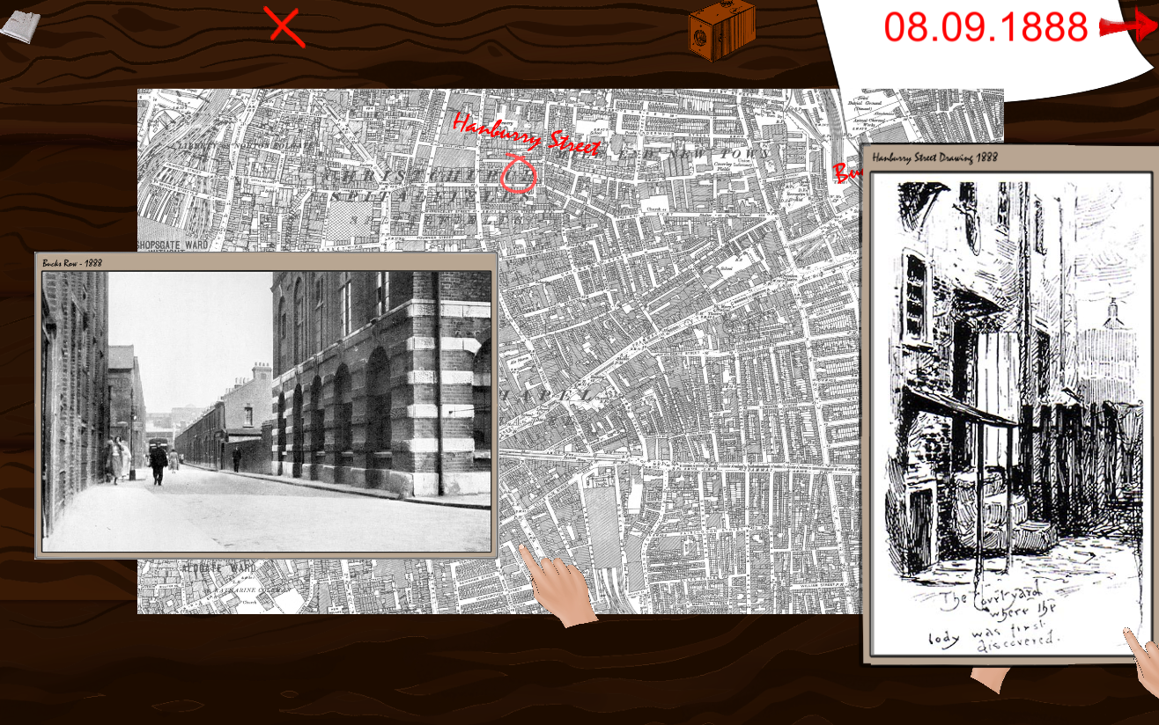
Introduction
Serious Heritage Detective AR Game

Slide 3
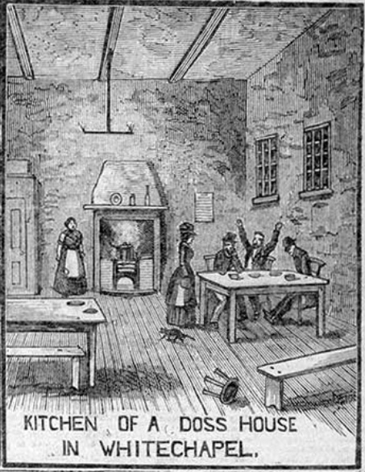
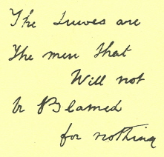
Introduction - Cultural Computing
Cultural Heritage:
Cultural Awareness
Historical Reconstruction
Heritage Awareness

Slide 4
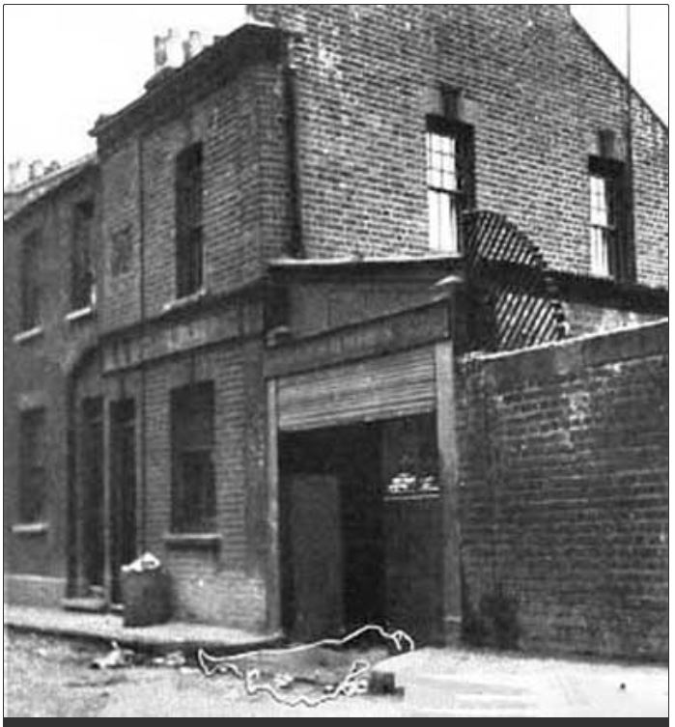
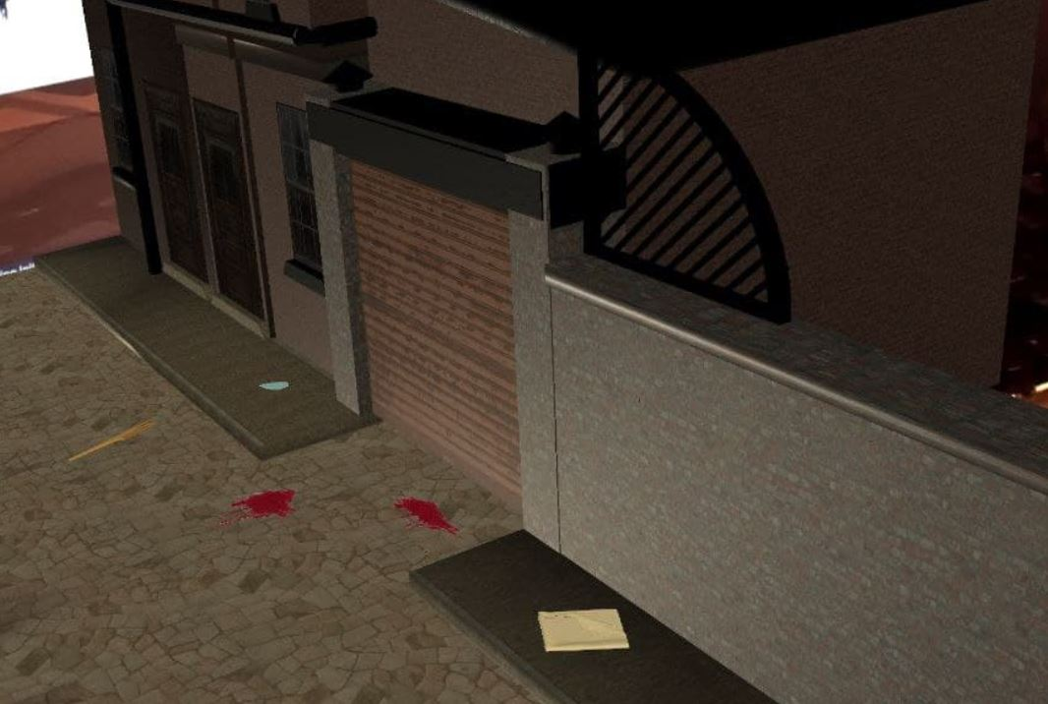
Introduction - Cultural Computing
Cultural Heritage:
Cultural Awareness
Historical Reconstruction
Heritage Awareness

Slide 5

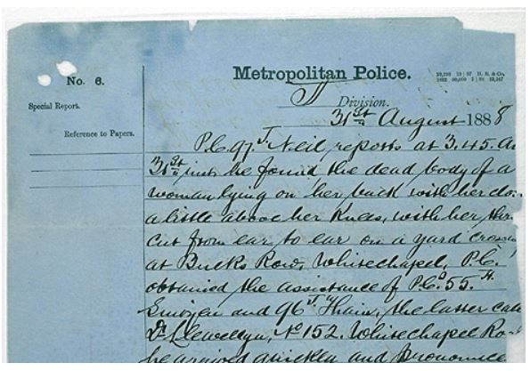
Introduction - Cultural Computing
Cultural Heritage:
Cultural Awareness
Historical Reconstruction
Heritage Awareness

Slide 6
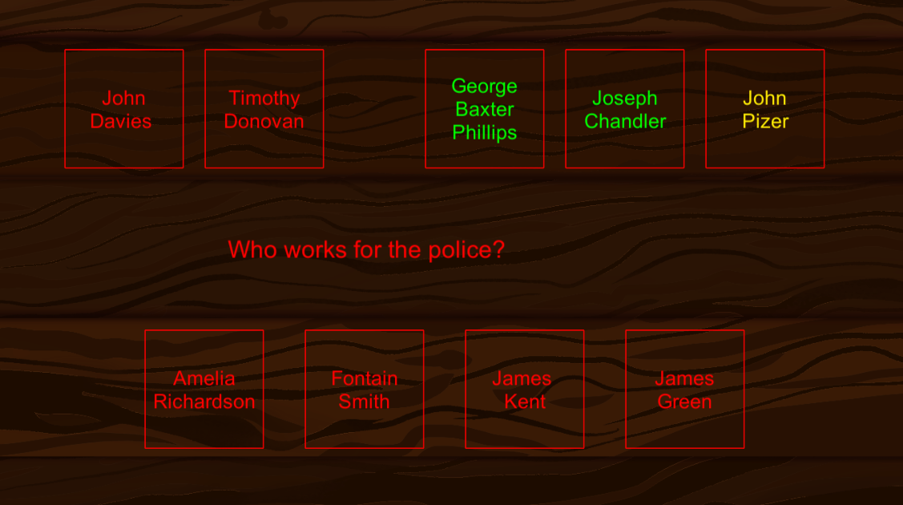
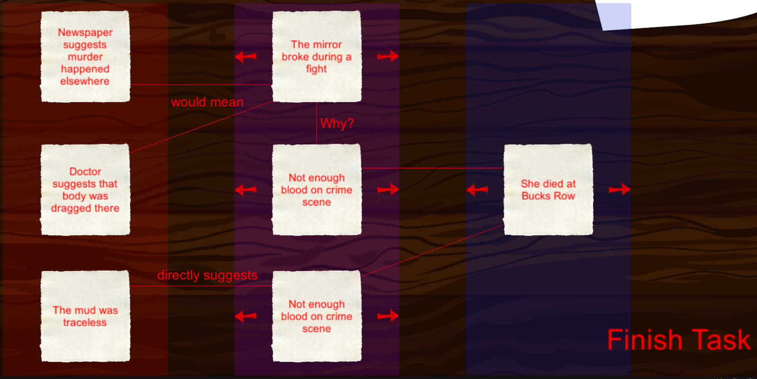
Introduction - Serious Game
Combination of Entertainment & Serious Content
Diversity and Score
Detective Theme
AR

Slide 7
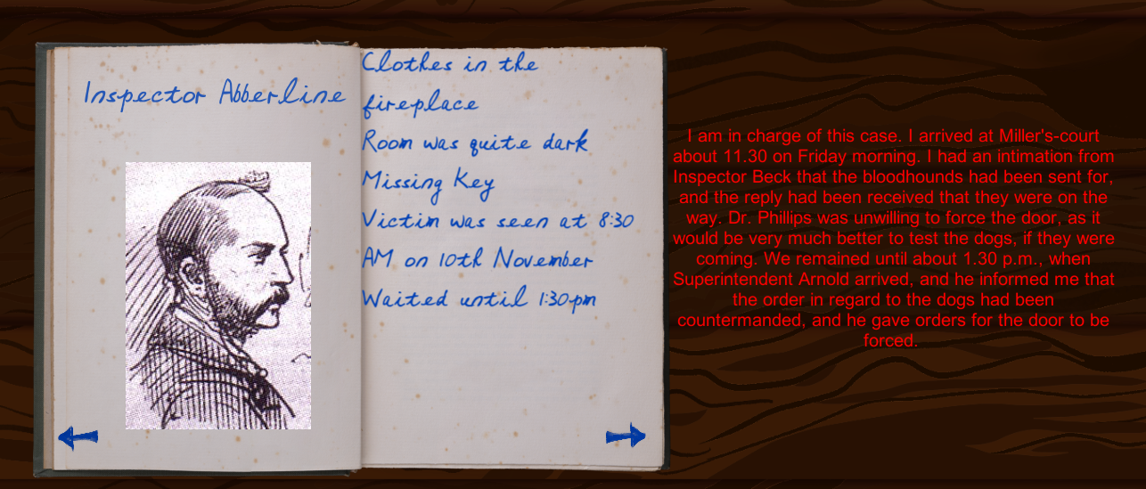
Introduction - Serious Game
Combination of Entertainment & Serious Content
Diversity and Score
Detective Theme
AR

Slide 8
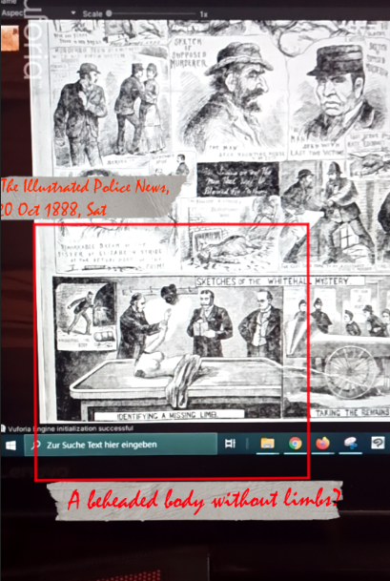
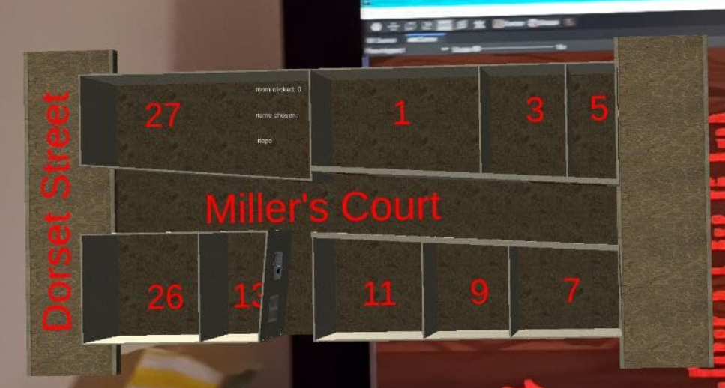
Introduction - Serious Game
Combination of Entertainment & Serious Content
Diversity and Score
Detective Theme
AR

Slide 9
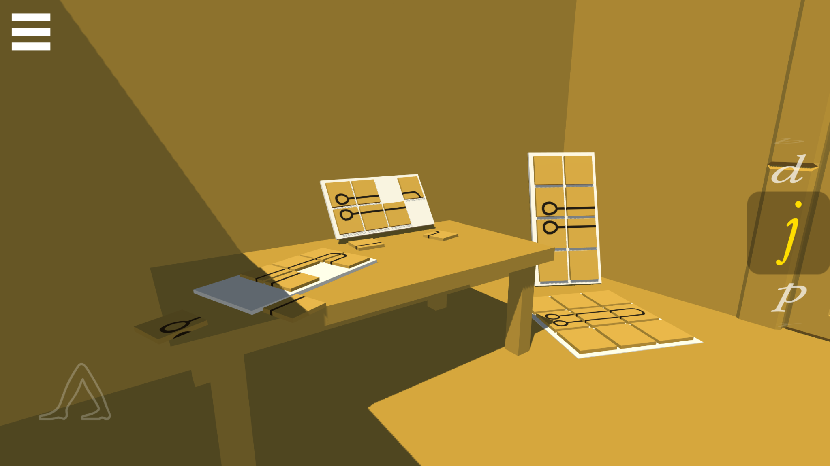
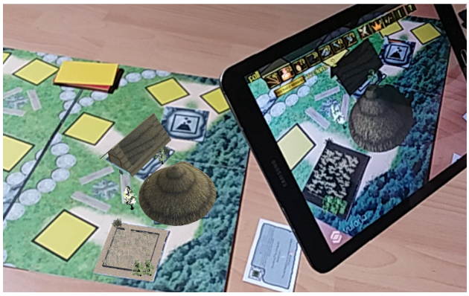
Related Work - Serious Heritage Games
Language
  HieroQuest
  Dragon Tale
Architectural Reconstruction
  Temples & Excavation Sites
  Museum Guides
Oppidum
  Reconstruction
  Ritual Recreation
  Augmented Reality

Slide 10
Related Work - Ripper / Detective Games
Excessive Jack the Ripper Media Coverage
  Few Serious Approaches
  Ripper as the Anti-Hero
  Mixture of Fiction and Facts
No Serious Ripper Game
Almost no Serious Detective Game
  Her Story
  Obra Dinn
  SherLocked

Slide 11
Goals of this Thesis
Adaption of a Serious Game
  Circumstances
  Dissolving Myths
  Learning Effect
Integrate Cultural Computing
Immersion
  Augmented Reality
  Detective Work
Does this combination work as effectively?

Slide 12
Approach
Computer Application vs. Smartphone
Five Cases
  Part 1: Mary Ann Nichols & Annie Chapman
  Part 2: Elizabeth Stride & Catherine Eddowes
  Part 3: Mary Kelly
Divided into Inquest Days
  Events
  Quiz / Riddle /Task
  Diversity!
2-4 Hours of Playing Time

Slide 13
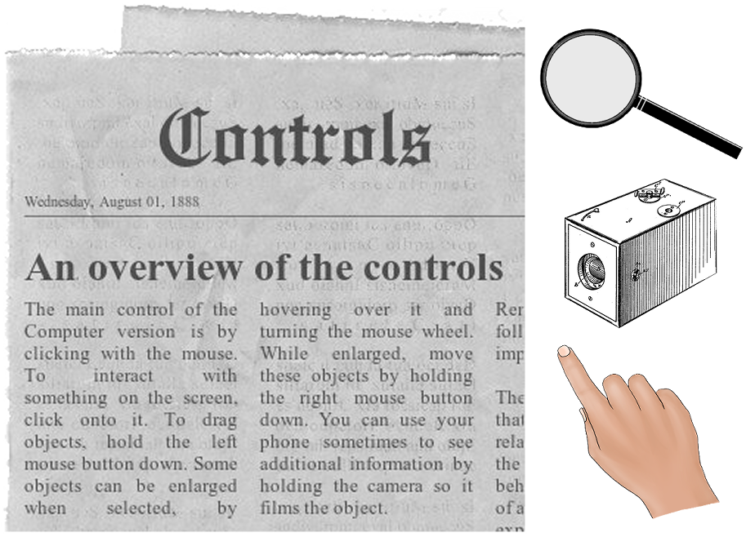
Approach

Slide 14
Implementation - Reconstruction

Slide 15
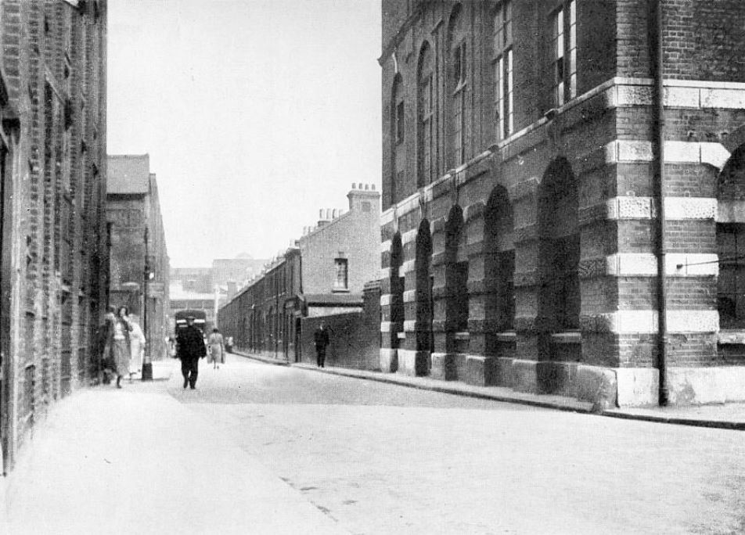
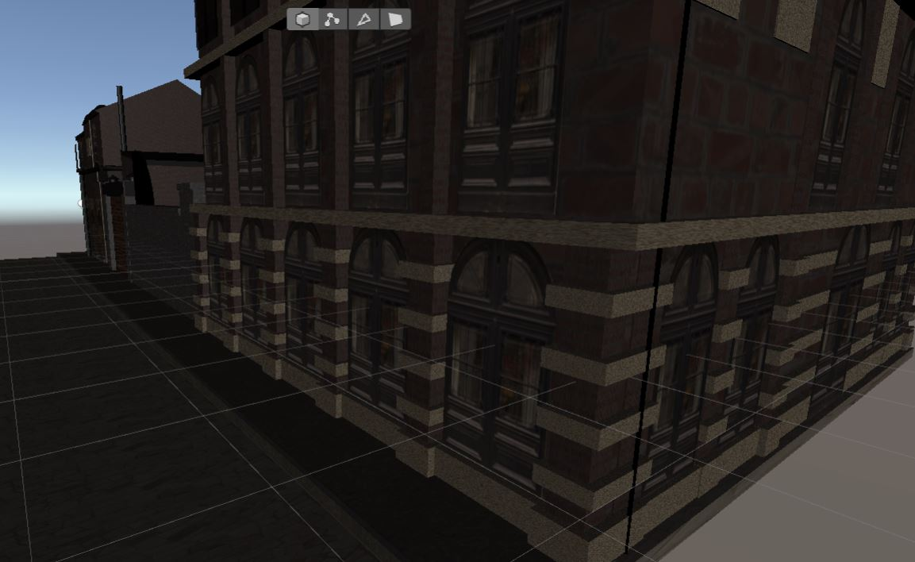
Implementation - Reconstruction

Slide 16
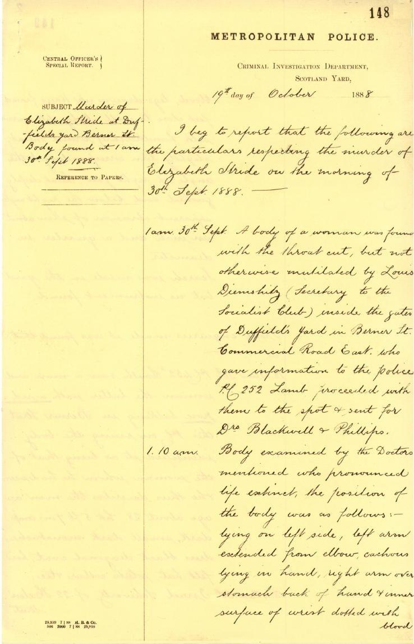
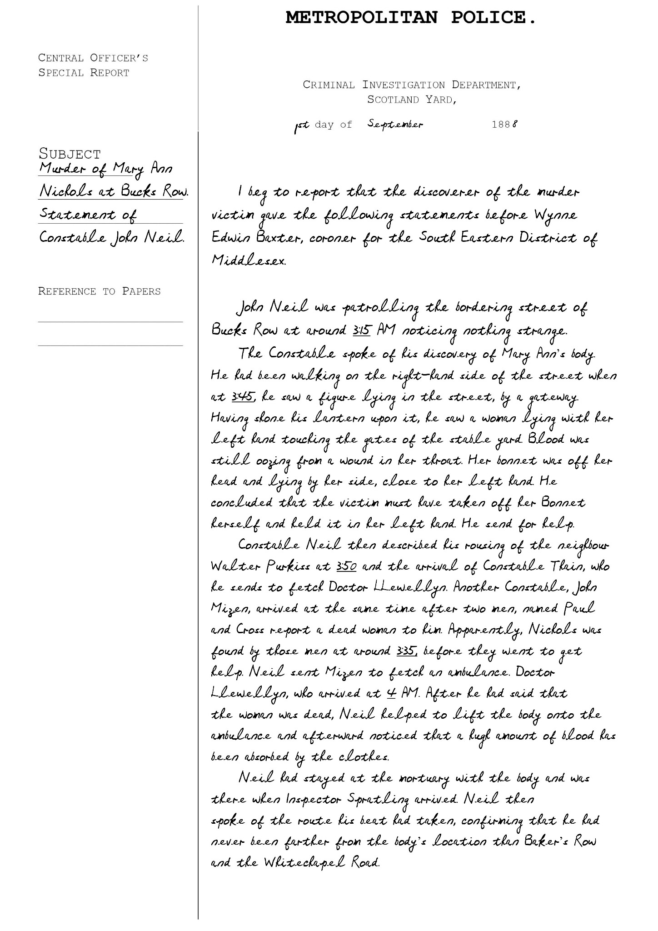
Implementation - Recreation

Slide 17
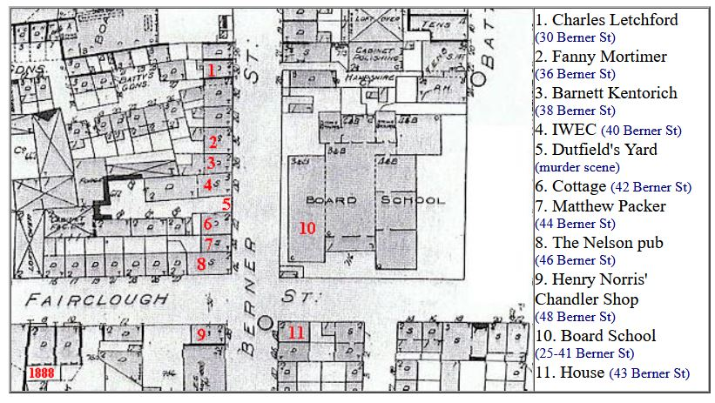
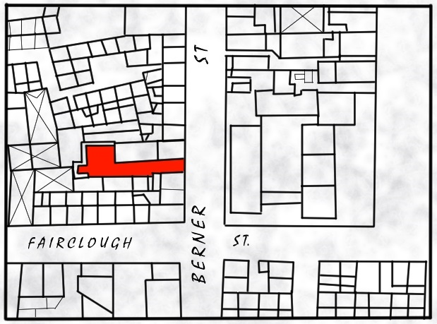
Implementation - Recreation

Slide 18
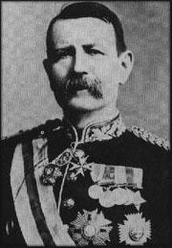
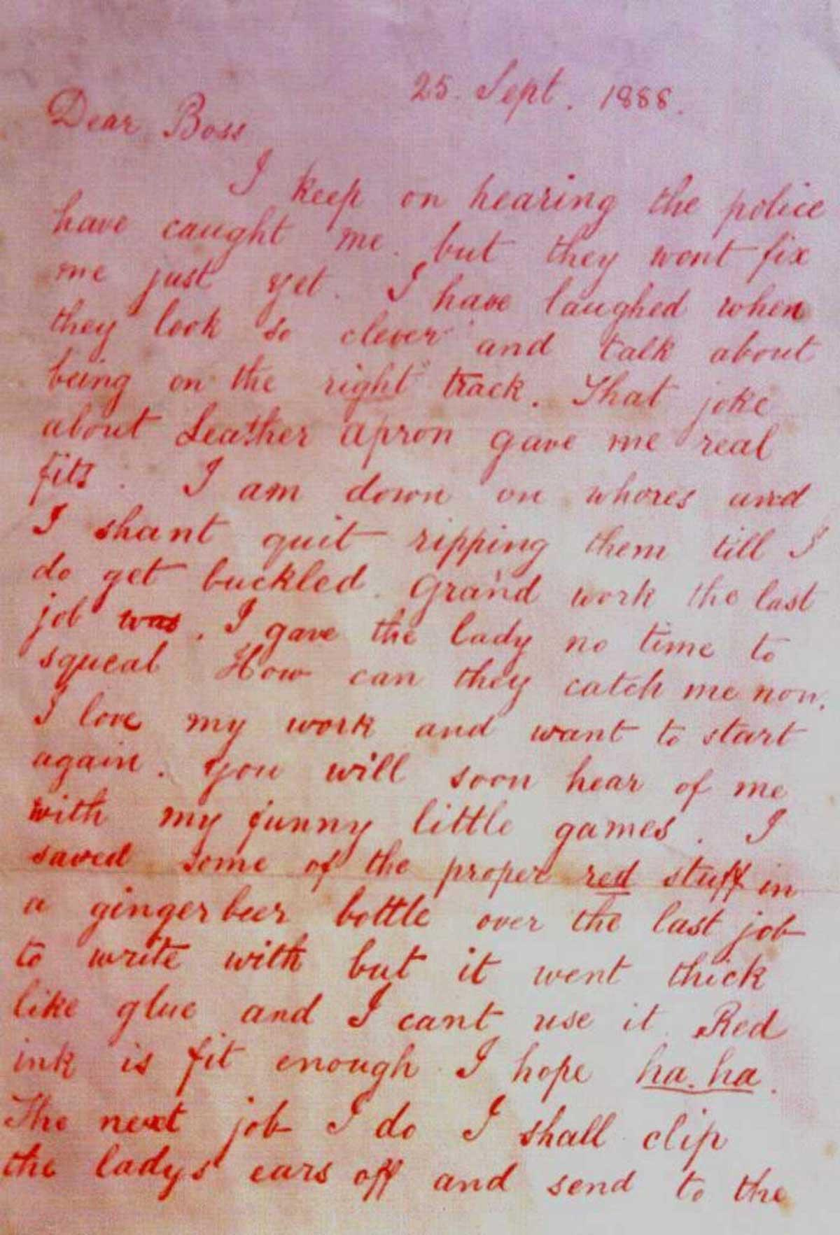
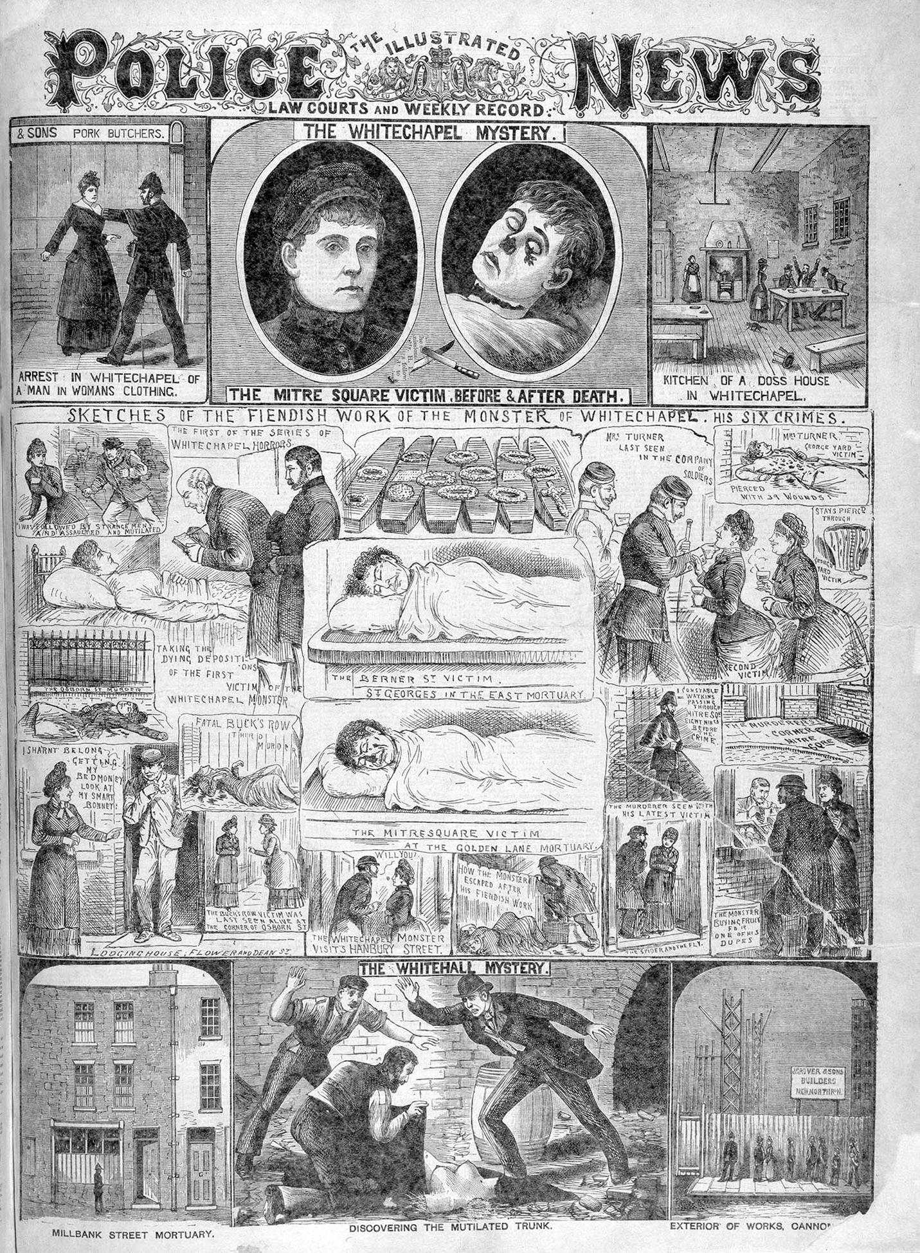
Implementation - Originals

Slide 19
Implementation - Augmented Reality

Slide 20
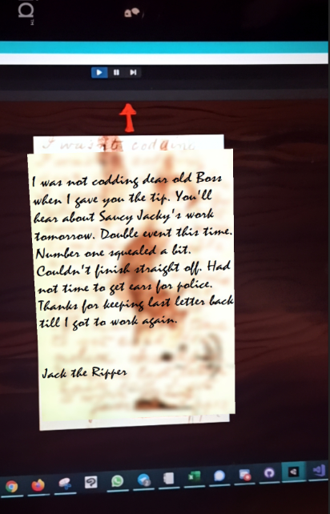
Implementation - Augmented Reality

Slide 21
Implementation - Detective Work

Slide 22
Implementation - Detective Work

Slide 23
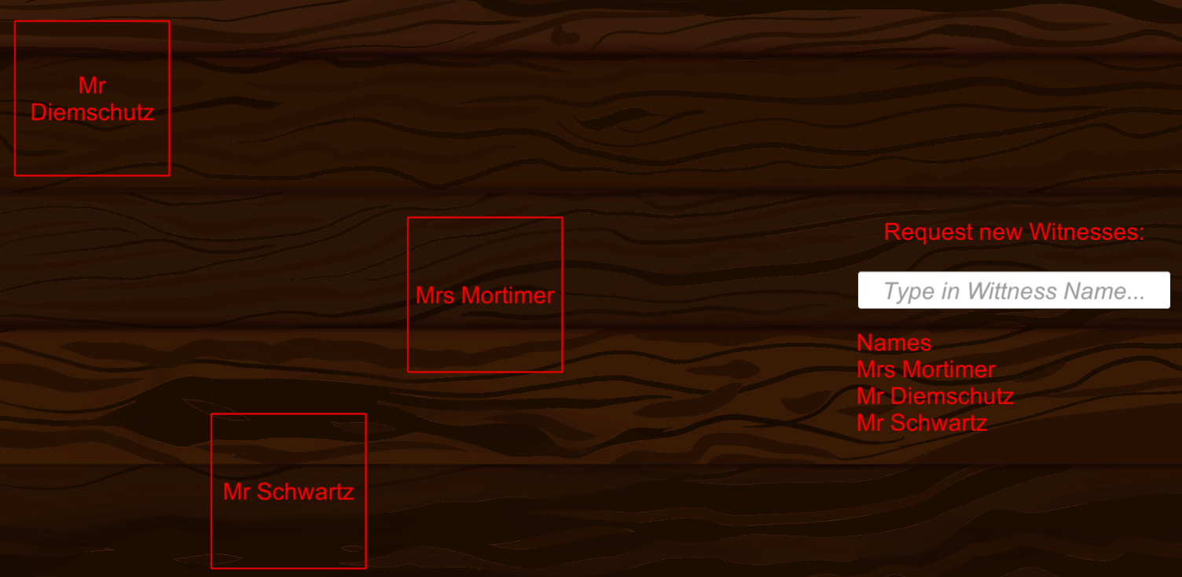
Implementation - Detective Work

Slide 24
Implementation - Detective Work

Slide 25
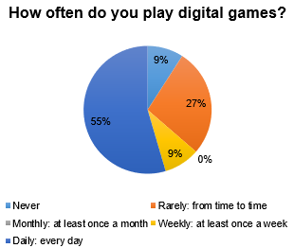
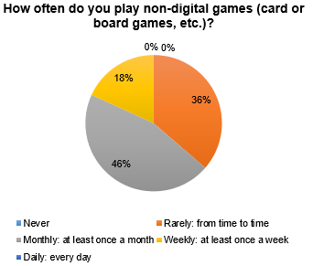
Evaluation
11 Testers: 6 Male, 4 Female
Median Age of 32

Slide 26
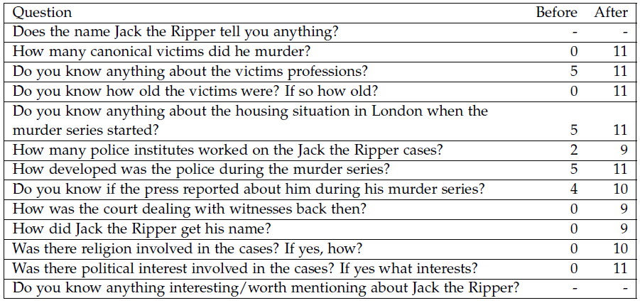
Evaluation - Open Questions

Slide 27
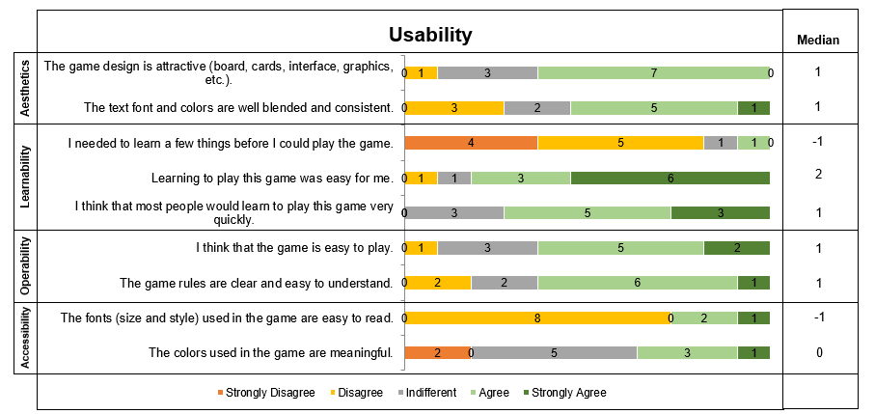
Evaluation - Usability

Slide 28
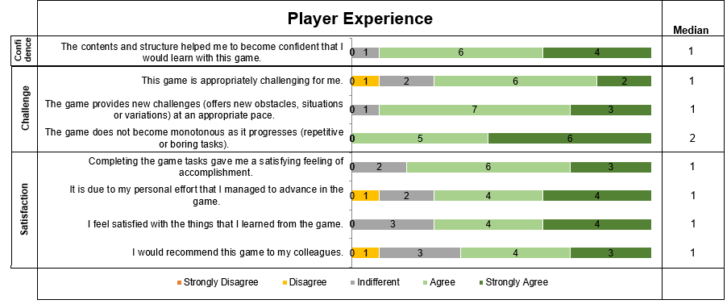
Evaluation - Player Experience

Slide 29
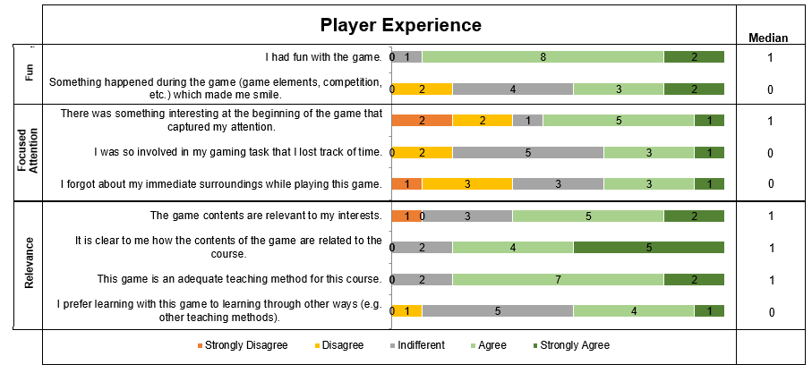
Evaluation - Player Experience

Slide 30
Evaluation - Positive Feedback
Augmented Reality Features
  Interactable
  Explorable
Variety of Exercises
Visual Task
  Newspaper Information
  Map Searching
  Puzzle assembling

Slide 31
Evaluation - Negative Feedback
Too much Textual Information
Length of the Game
Hardware Problems
  Lighting problems
  Vuforia incompatibilities

Slide 32
Future Work
Further testing
  Psychological Questionnaire
  Evaluation of Individual Tasks/Events
Appearance and Style
  Color of Text
  Adjustable Settings
  Playing Time
Information Output
  Audio Output
  Graphical Output

Slide 33
Future Work
Tutorial
  Smartphone Usage
  Prominent Hint System
Autonomy
  Allow more Freedom
  More Possible Ways of Solving Tasks
Multiplayer
  Cooperation: Dividing workload
  Competition: Score, Time

Slide 34
Conclusion
Learning Effect?
> Yes
AR as a Supporting Factor?
> Yes
Detective Theme as a Supporting Factor?
> Maybe
Space for Improvement?
> Yes

Slide 35
Gameplay

Slide 36
List of References - Images
Slide 2, 15: https://www.jack-the-ripper-tour.com/wp-content/uploads/2017/09/04.jpg
Slide 3, 18: https://www.newspapers.com/clip/24865201/illustrated-police-news-page-about-the/
Slide 3: https://upload.wikimedia.org/wikipedia/commons/5/56/Juives.jpg
Slide 4, 14: https://www.jack-the-ripper-tour.com/wp-content/uploads/2012/03/bucks-row-full.jpg

Slide 37
List of References - Images
Slide 5: https://silentthrill.files.wordpress.com/2012/08/jtr10_470x320.jpg?w=1750&h=
Slide 5: https://www.thegreatcoursesdaily.com/wp-content/uploads/2017/10/Wanted_poster-768x989.jpg
Slide 7, 24: https://www.wienerzeitung.at/_em_daten/_cache/image/1xJ3tAKnW0fgPV75_WRfSs47bFMvgaBih_WcGknYJjWx2zPgEUOROyeLpdD_ntI-eH359gNl45ra6oaQembV7a0ulcU8ZcUg8N/130725-1729-948-0960-105961.jpg

Slide 38
List of References - Images
Slide 8, 20: https://upload.wikimedia.org/wikipedia/commons/thumb/2/20/The_Illustrated_Police_News_-_20_October_1888_-_Jack_the_Ripper.jpg/666px-The_Illustrated_Police_News_-_20_October_1888_-_Jack_the_Ripper.jpg
Slide 16: https://www.paperlessarchives.com/JackTheRipper1.jpg
Slide 17: https://jfiles00.tripod.com/explore/maps/bernerstreet/berner.htm

Slide 39
List of References - Images
Slide 18: https://www.nationalarchives.gov.uk/museum/additional_image_types.asp?item_id=39&image_id=50&extra_image_type_id=1
Slide 18: https://jacktheripper.de/images/ermittler/thumbnails/warren_th.jpg

Slide 40
List of References - Others
Questionnaire:
C. V. Wangenheim and A. Borgatto. “MEEGA + : A Method for the Evaluation of Educational Games for Computing Education”. In: 2018.
Her Story:
https://www.herstorygame.com/.
SherLOCKED:
A. Jaffray, C. Finn, and J. R. C. Nurse. SherLOCKED: A Detective-themed Serious Game for Cyber Security Education. 2021
Return of the Obra Dinn:
https://obradinn.com/

Slide 41
List of References - Others
Dragon tale:
In 2018 CHIPlay Companion Extended Abstracts, pages 577– 583, 2018
Oppidum:
In International Conference on Games and Learning Alliance, pages 550–559. Springer, 2019
Hieroquest:
JOCCH, 13(4), pages 1–20, 2020

