Slide 1
Deep Learning Approach for Motion Control of a Physically Simulated Humanoid Avatar in VR
Lukas Goll
07.01.2021
Final: Master Informatik : Games Engineering
Supervisor(s): Klinker, Gudrun Johanna; Prof. Dr.
…space for additional comments… (e.g.: collaboration with a company or a research project)

Slide 2
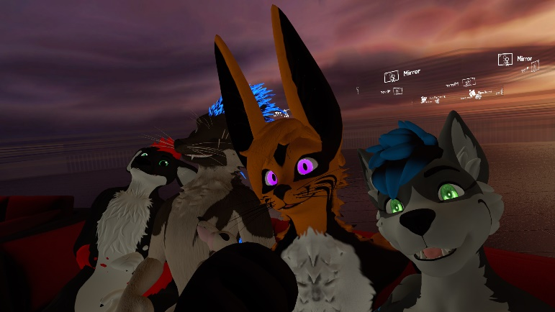
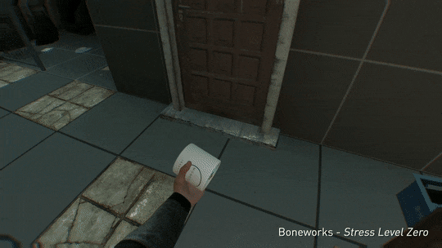
Introduction / Motivation
VR ! High demand for social interaction
But interactions lack physical feedback
Notes:
VR ! Importance more then ever
Interactions lack physical finesse
Motion control avatar physical?

Slide 3
Problem Description: Issues
  Humanoid Avatar Design
    Multiple segments / physical body description
    Should represent the user’s body as close as possible [1]
  Physical Motion in Unity (PhysX)
    Real time and stable solution
    Use Force and Torque [9]
Notes:
Adaptive and physical motion control of humanoid avatar difficult:

Slide 4
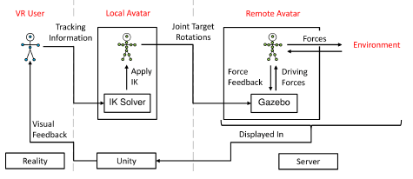
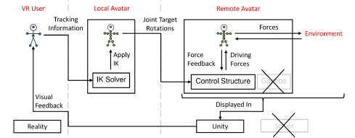
Existing Solutions
Sandro Weber [8]:
Konstantin Karas [8]:

Slide 5
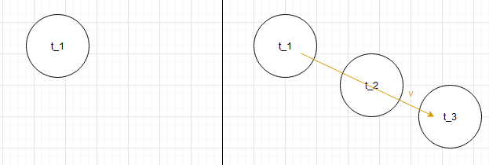
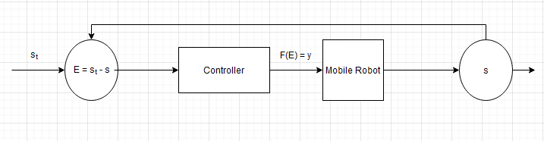
Related Work
Virtual Reality theory
  Humanoid avatar important for effectiveness of VR applications [2,3]
Neural network research
  NN approximation theorem [6]
  Recurrent Neural networks [7]
Adaptive Motion Control System
  Robot with feedback loop [4,5]
Notes:
Karas: Motion control with PD solver

Slide 6
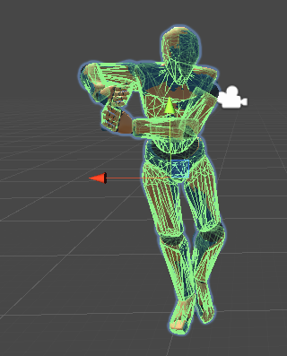
Goals of this Thesis
Adaptively Motion control avatar with a neural network as controller.
Learn motion trained supervised from exsisting animation data

Slide 7
Critical Research Issues
Defining a Machine learning problem with data model
Training the neural network and hyperparameter tuning
Using that Tensorflow model in Unity with Ubi Connect

Slide 8
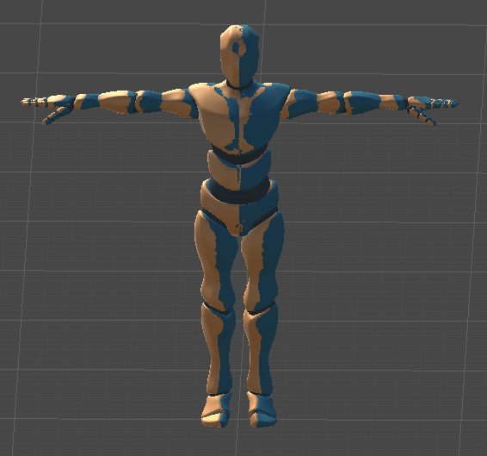
Proposed Work / Approach
2 Rigidbody Avatars -> multiple unhinged segments
Recording the dataset
Experiment with different neural network architectures

Slide 9
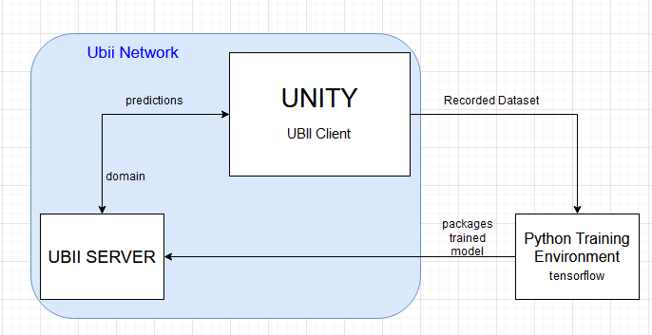
Implementation : Overview
Unity
  As client in the network
  Records dataset
  Receives predictions from the server
Python Training Environment
  Traning sessions and hyperparameter tuning
Ubi Server
  Loads trained neural network model
  Processes avatar state and sends acutators

Slide 10
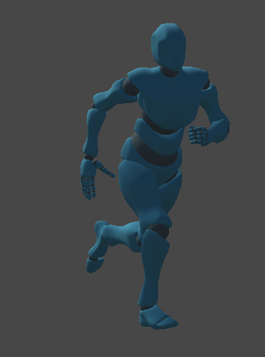
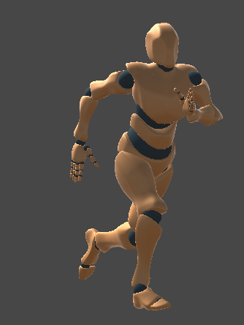
Implementation : Record
Follows
Groundtruth
Follower
By arithmetics : distance (position/rotation) -> force/torque

Slide 11
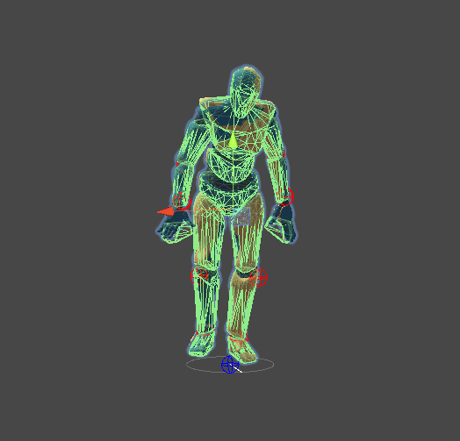
Demo : Record

Slide 12
Defining the function
Follows
Groundtruth
Follower
F:
X : positional error, rotational error
y : force, torque
Per segment

Slide 13
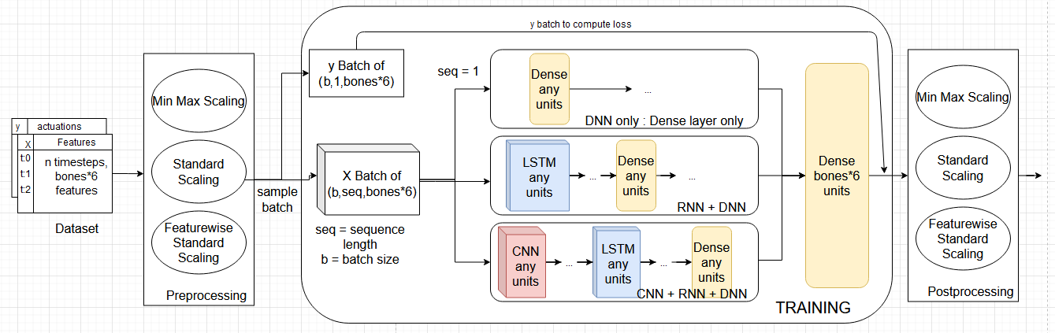
Implementation : ActNet Training
Optional pre and postprocessing
Construct multiple ActNet architectures based on hyperparametrization

Slide 14
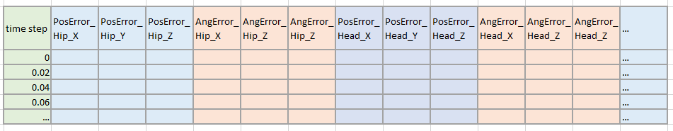
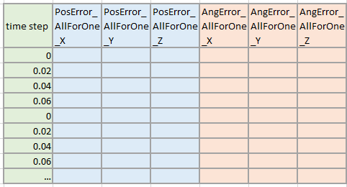
Implementation : All For One

Slide 15
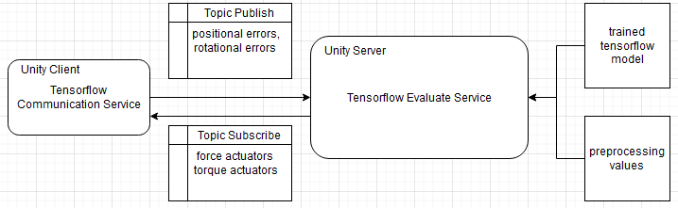
Implementation : Server
Ubi Server

Slide 16
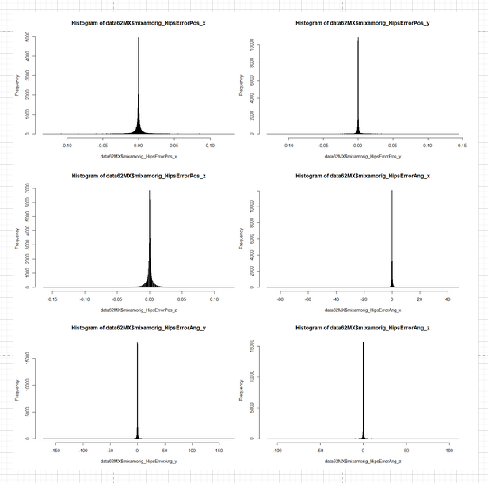
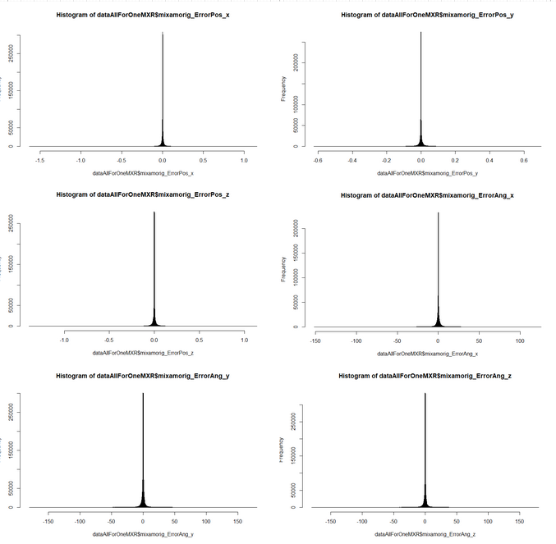
Experimentation : Data Anaysis

Slide 17
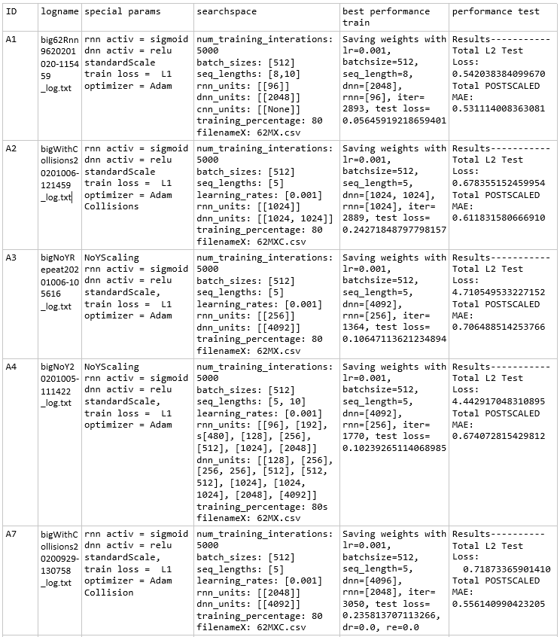
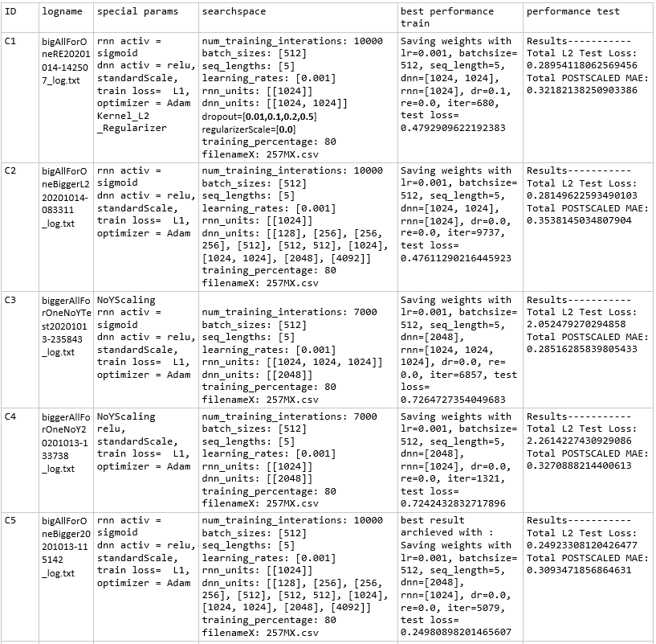
Experimentation : Perfomance Analysis

Slide 18
Experiment Outcomes
Standard scaling performs better then MinMax scaling
  Scale X and y data
L1 Loss performs better then L2 loss
Increase X data with velocity information did not improve the result
Adding more variance to the data with collisions did not improve the result
Increasing the dataset from 62 animations to 257 animations did not improve
ActNet AllForOne scores lower MAE, but is unfeasible on Server

Slide 19
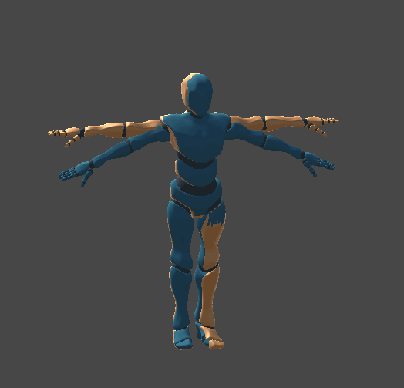
Evaluation :

Slide 20
Discussion / Suggested Future Work
Constrains : During training or on avatar -> enforce stability
Controller Switch system
More work towards better synch between Client & Server

Slide 21
Conclusion
We found some hyperparameter settings which are objectively better
Good training did not translate into good performance in runtime
Increasing model complexity did not result in better performance

Slide 22
List of References
M. Slater. “Place illusion and plausibility can lead to realistic behaviour in immersive virtual environments.” In: Philosophical Transactions of the Royal Society B: Biological Sciences 364.1535 (2009), pp. 3549–3557.
T. B. Sheridan. “Musings on telepresence and virtual presence.” In: Presence: Teleoperators & Virtual Environments 1.1 (1992), pp. 120–126.
M. Slater, B. Spanlang, and D. Corominas. “Simulating virtual environments within virtual environments as the basis for a psychophysics of presence.” In: ACM Transactions on Graphics (TOG) 29.4 (2010), pp. 1–9.
R. Ooe, I. Suzuki, M. Yamamoto, and M. Furukawa. “Study on evolution of the artificial flying creature controlled by neuro-evolution.” In: ArtificialLife and Robotics 17.3-4 (2013), pp. 470–475.
M. Araki. “Control Systems, Robotics and Automation—vol II—PID Control.” In: Kyoto University, Japan (2010).
B. C. Csáji et al. “Approximation with artificial neural networks.” In: Faculty of Sciences, Etvs Lornd University, Hungary 24.48 (2001), p. 7.
S. Hochreiter and J. Schmidhuber. “Long short-term memory.” In: Neural computation 9.8 (1997), pp. 1735–1780.
K. Karas. “VR Re-Embodiment: Establishing a Control Structure to enablePhysic-based Movement of the Human Body in Unity 3D.” Bachelor’sThesis in Informatics: Games Engineering. TUM, Apr. 15, 2020.
Nvdia. Corporation. Rigid Body Dynamics. url: https://docs.nvidia.com/gameworks/content/gameworkslibrary/physx/guide/Manual/RigidBodyDynamics.html (visited on 11/16/2020).

