Slide 1
Teaching Optical Principles in XR
Tobias Zengerle
06.07.2023
Final: Master Informatics
Supervisors: Prof. Gudrun Klinker, David Plecher
Thesis project was created in collaboration with the LMU Munich
Notes:
Hello and welcome everyone, today I will talk about my master‘s thesis, titled…

Slide 2
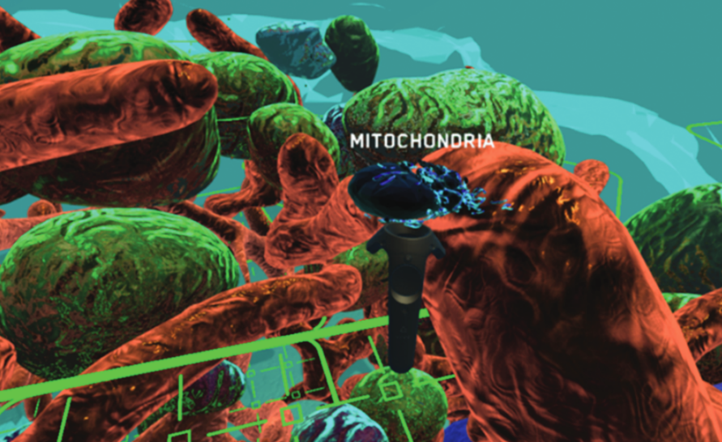
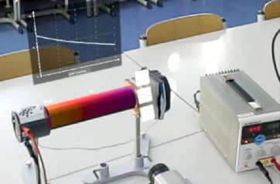
Motivation
Both AR and VR are very well suited for science education:
  versatile visualizations
  „hands on“ interaction
Great fit for lab course environments
Source: Johnston et. al.¹
Source: Strzys et. al.¹
Notes:
So first of all, Extended Reality and both of it‘s main sub-branches…
One reason for this is that they provide vast options to visualize all sorts of content, including elements…
Or even things that are usually invisible altogether, like magnetic field lines or heat transfer
AR and VR also allow for very natural, „hands on“ sorts of interactions with these elements…
This combination of strong visualization capabilities and the direct hands on interactions makes XR an especially great fit for lab course environments in the natural sciences, where school or university students engage with an experiment to explore some scientific principles on their own

Slide 3
Problem Statement
How can existing experimental setups be translated into XR?
Cooperation with LMU Munich Department of Physics Education:
  Creation of a VR application for a lab course on optical physics for students of human medicine
  Replacement for the current analogous experiment
Notes:
When we now look at introducing Extended Reality Technology into these lab course settings, the questions comes up, how we can take the existing setups and experiments from these lab courses and tranlate them into XR settings in a way that makes full use of the advantages we talked about.
To dive deeper into this problem, we entered a cooperation with the LMU Department of …
And as part of this thesis we created a VR learning application for …
… where the students learn about the physical principles underlying the human eye and how elements like the eye lens affect incoming light so that we see a sharp image
The resulting application is set to fully replace the current analogous experimental setup of this lab course module

Slide 4
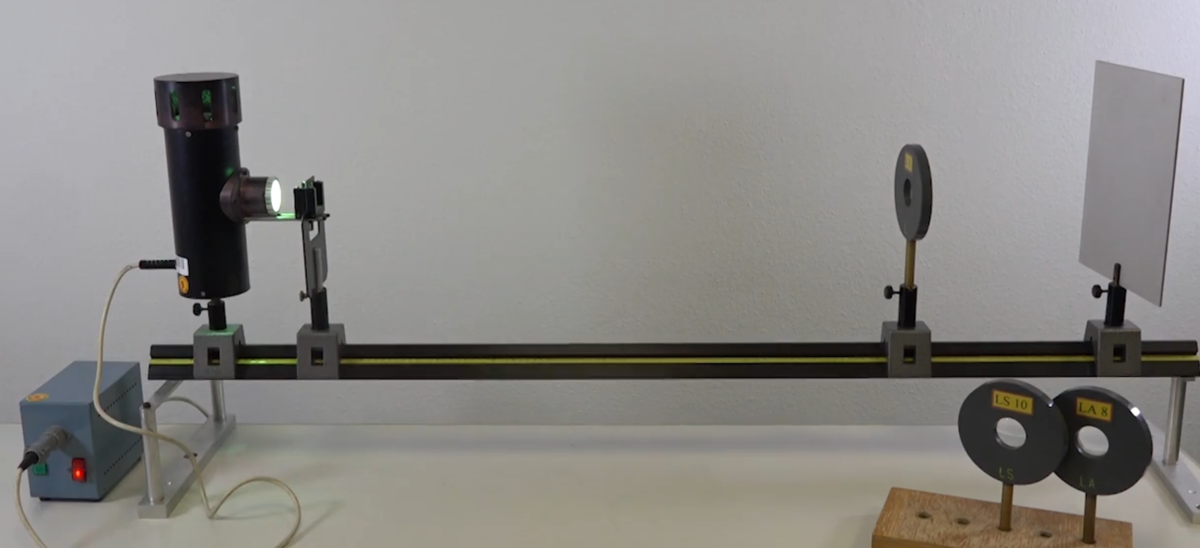
Problem Statement
Existing approach: optical rail experiment
Source: https://www.praktikum.physik.uni-muenchen.de/humanmed/index.html
(visited on 05/23/2023)
Notes:
Here, up until now, Students worked with the so called „optical rail experiment“, where you can slide different optical elements along a metal rail.
These include for example a light source, a projector slide, different types of lenses and a white screen where you can observe the projected image
During experimentation, they can change the distances between the elements and observe how the projected image
Now before I talk about the approach we took to transfer this into the virtual realm, I want to quickly take a look at some related work to see how other authors went about this sort of task

Slide 5
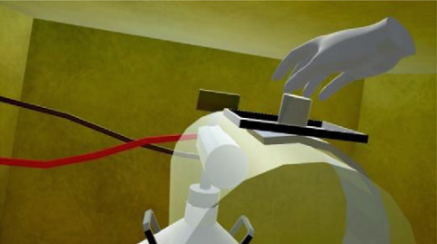
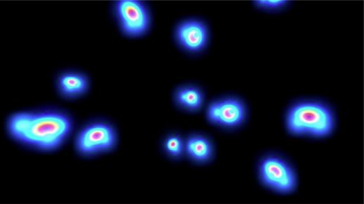
Related Work
Sidanin et. al.¹ (2020) :
Recreation of a nuclear physics lab experiment to determine the mass of the deuteron
Swap between regular interaction with the experiment and a „zoomed in“ view of what happens on the atomic level
Source: Sidanin et. al.¹
Source: Sidanin et. al.¹
Notes:
First up, in a 2020 work Sidanin and colleagues recreated a nuclear physics laboratory experiment to determine the mass of the deuteron in VR
One of their motivations was to enable students to perform this kind of experiment, without the need for the highly specialized and extremely expensive equipment thats usually needed, which in fact not all universities have access to
In their application the students can switch between performing the experiment, just as they would in the real world and a „zoomed in“ view of the experiment apparatus to see whats happening on the atomic level

Slide 6
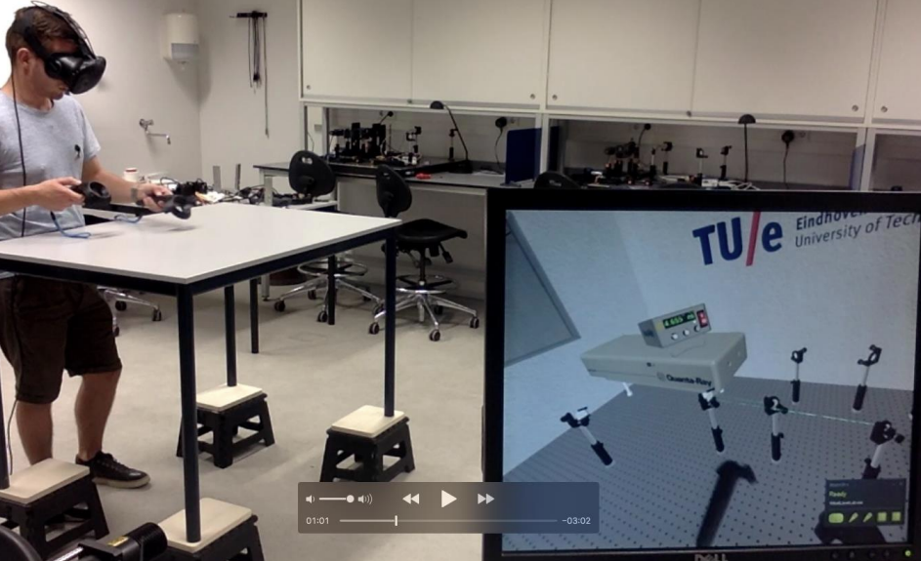
Related Work
Engeln and Gómez Puente¹ (2019) :
Virtual lab to safely engage with lasers and try out different optical measurement techniques
Source: Engeln and Gómez Puente¹

Slide 7
Goals of this Thesis
Transfer of the physical principles seen in the optical rail experiment into a representation that‘s more relevant to the medical students
An application that is easy to use and accessible enough for real teaching practice
Notes:
In these two particular works, the original experiment was more or less faithfully recreated within a virtual environment, with some additional visualizations
In our case however, when we look back at the optical rail experiment, while it is a good way to engage with optical phenomena, it is also very abstract and there is a rather large transfer gap between the rail setup and the actual domain of the human eye, that the students ultimately should learn about.
One of the main goals of this thesis therefore was to take the same underlying principles seen in the optical rail, and transfer them into a new representation that‘s a lot more relevant to the medical students
We also wanted to produce an application that is easy to use and highly accessible, so it can properly be used in real teaching practice

Slide 8
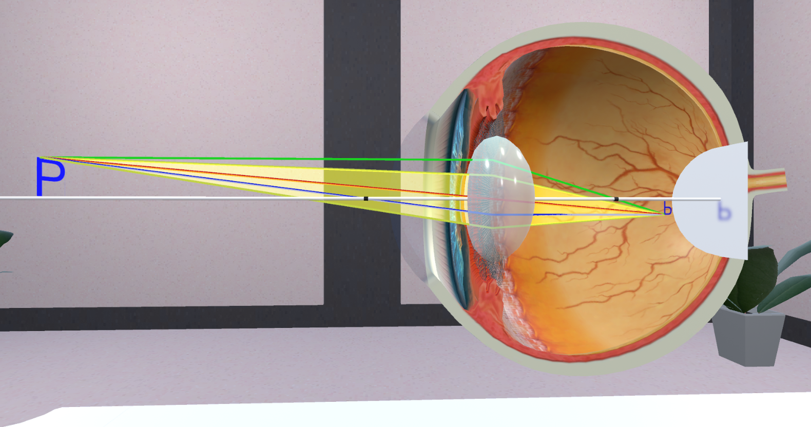
LIN-VR Application
Students engage with an interactive model of the human eye to explore optical phenomena
Notes:
To address this first concern of a context relevant presentation, in our application the students instead perform their optical experiments for a cross-sectional model of the human eye
Here we still have this sort of „rail like“ optical axis, along which we can slide, for example, the observed object and see how the projected image at the back of the eye changes
Not only does the eye model simulate the basic physical processes of image formation, it is also equipped with simulated physiological behavior, which could not be portrayed by the optical rail, like for example the deformation of the eye lens to focus on objects at varying distances
This way we bridge the gap between physics and medicine, which, after all, is the whole point of the lab course

Slide 9
LIN-VR Application
The application was created using Unity¹
Hardware: HP Reverb G2 VR Headset²
The starting point was a VR demo room on optical physics content from the RPTU Kaiserslautern-Landau
The project is part of a larger cooperation between LMU and RPTU
Notes:
The overall application was created…

Slide 10
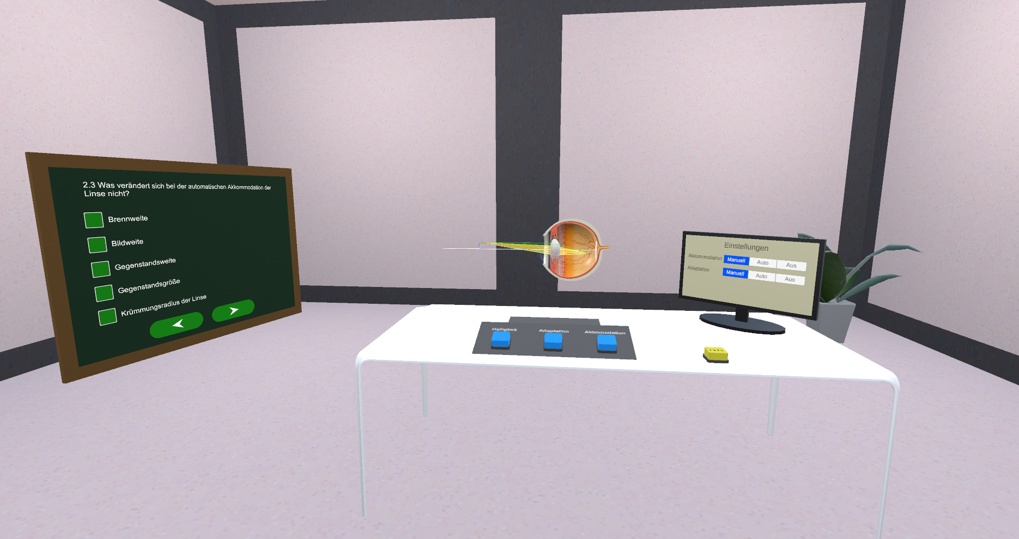
LIN-VR Application

Slide 11
Evaluation
Two stage evaluation:
  First Stage: Usability Study for a small number of preliminary testers (part of the thesis)
  Second Stage: large scale study on learning benefit of the VR application vs. analogous experiment (subject to future work)
Goal of the first stage: identify any bugs or poorly usable interactions ahead of the learning benefit study
Notes:
Next up, the evaluation of this application is split into two stages
The first stage is included in this thesis and here we conducted a usability study for a small number of participants
The second stage will consist of a large scale study planned for later this year on the potential learning benefits of the use of the VR application, as opposed to the conventional optical rail experiment
This study will be conducted during real teaching practice of the respective lab course during that semester with over 800 medical students expected to participate
Given this background the goal of the first evaluation stage performed in this thesis is to identify any existing bugs or poorly usable interactions ahead of time, before the learning benefit study starts

Slide 12
Evaluation - Participants
10 Students (2 female, 8 male) from various academic backgrounds
3 out of 10 participants indicated to have no prior VR experience

Slide 13
Evaluation - Questionnaire
Usability: System Usability Scale¹ (SUS)
  10 Items
  outputs a usability score between 0-100
Presence: Igroup Presence Questionnaire² (IPQ)
  14 Items
  Gives a score from 0-6 in the three sub-categories: Spatial Presence, Involvement and Experienced Realism
Open Questions
Notes:
During the study the students engaged with the application for 15-20 minutes working through all the existing exercises
And afterwards they were presented with a short questionnaire on their experience.
First an foremost this questionnaire included the 10 items of the System Usability Scale, short SUS
The result is a usability score between 0 and 100
Next, while not being our main concern during development, we wanted to asses how present the users feel within the virtual environment of our application
We therefore added the Igroup Presence Questionnaire or IPQ for short, which consists of 14 items total and provides a score from 0 to 6 in three sub-categories of presence:
spatial presence is concerned with how much the user feels they are actually spatially located within the environment
involvement about how much of the users attention is drawn into…
And the experienced realism score indicates how real and lifelike the virtual world felt to the user
To gather some additional feedback we also included 3 qualitative open questions concerning what the participants liked and disliked about the application

Slide 14
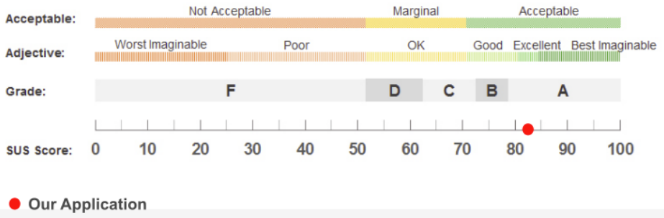
Evaluation - Results
Average SUS score: 82.53
Comparative Benchmark^{1,2} :
  „Excellent“ Rating with Grade A
  90-95 percentile range of all applications
Source (pre-annotation): https://measuringu.com/interpret-sus-score/

Slide 15
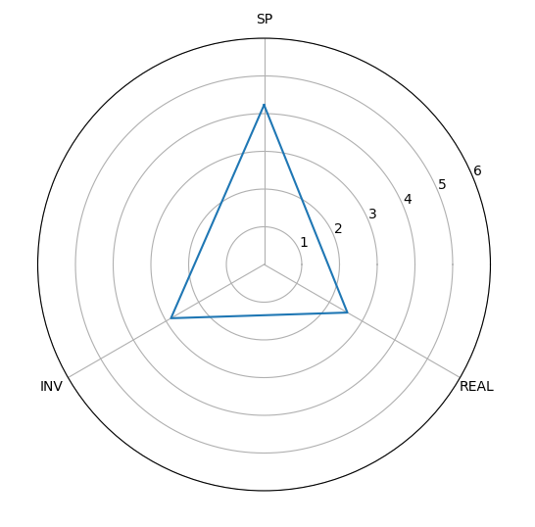

Evaluation - Results
Comparative Benchmark¹ :
  Overall Presence: Grade F – „Not Acceptable“
  Spatial Presence: Grade E – „Marginally Acceptable“
  Involvement: Grade F – „Not Acceptable“
  Experienced Realism: Grade F – „Not Acceptable“

Slide 16
Evaluation - Results
What could be the reasons for these sub-par results?
Spatial Presence:
  Close to no active movement of the user within the environment
  Lack of clear environmental features
Involvement:
  Largely untapped potential in terms of immersion (e.g. sound, haptic feedback)
Experienced Realism:
  The stylized graphics and overall experimental setup might not lend themselves to lifelike realism

Slide 17
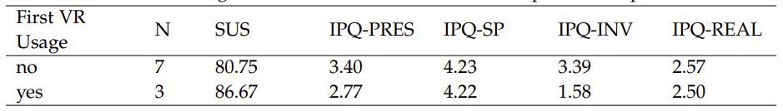
Evaluation - Results
Higher average SUS score given by first-time VR users
Large gap in Involvement between the two groups
→ first-time users focused way more on their physical surroundings

Slide 18
Discussion & Future Work
Great usability score
  Additional feedback revealed two small areas where interactions could be improved
Room for improvement in terms of presence:
  Address more senses to draw the user‘s attention into the virtual environment
  Add more spatial reference points to the room
Additional exercises on further topics (e.g. eyeglasses)
Learning benefit study in the upcoming winter semester

Slide 19
Conclusion
We created a VR learning application that presents the basics of optical physics in a form thats accessible and relevant to medical students
The conducted study revealed a strong level of usability
The gathered feedback will be used to further improve the application ahead of the upcoming field-study, which will see it getting compared to the classic optical rail experiment

Slide 20
List of References
J. Brooke. “SUS: A quick and dirty usability scale”. In: Usability Evaluation In Industry 189 (Nov. 1995)
R. A. Engeln and S. M. Gómez Puente. “Does virtual reality help students learn to use optical measurement techniques?” In: 10th International Conference on Physics Teaching in Engineering Education PTEE 2019 (May 2019)
A. P. Johnston, J. Rae, N. Ariotti, et. al. “Journey to the centre of the cell: Virtual reality immersion into scientific data”. In: Traffic 19.2 (Feb. 2018)
M. Melo, G. Gonçalves, J. Vasconcelos-Raposo, and M. Bessa. “How Much Presence is Enough? Qualitative Scales for Interpreting the Igroup Presence Questionnaire Score”. In: IEEE Access 11 (2023)
J. Sauro. “A practical guide to the system usability scale: Background, benchmarks & best practices”. Denver: Measuring Usability LLC, 2011
T. Schubert, F. Friedmann, and H. Regenbrecht. “The Experience of Presence: Factor Analytic Insights”. In: Presence: Teleoperators and Virtual Environments 10.3 (June 2001)
P. Šiđanin, J. Plavšić, I. Arsenić, and M. Krmar. “Virtual reality (VR) simulation of a nuclear physics laboratory exercise”. In: European Journal of Physics 41.6 (Oct. 2020)
M. P. Strzys, S. Kapp, M. Thees, et. al. “Physics holo.lab learning experience: using smartglasses for augmented reality labwork to foster the concepts of heat conduction”. In: European Journal of Physics 39.3 (Mar. 2018)
Web Sources:
https://www.praktikum.physik.uni-muenchen.de/humanmed/index.html (visited on 05/23/2023)
https://unity.com/
https://support.hp.com/rs-en/product/hp-reverb-g2-virtual-reality-headset/33835976/document/c06938191#AbT3
https://measuringu.com/interpret-sus-score/ (visited on 06/10/2023)
Notes:
Thank you for your time. With this we have reached the end of my official presentation. If you would like a glimpse at the application in action, I also brought a short 3 minute pre-recorded demo I could show you, or we can of course move straight ahead to your questions. Whichever you prefer.

