Slide 1
Design and Evaluation of a Remote Guidance Application by using 3D Augmentation to Enhance Spatial Understanding of a Problem by means of Mixed Reality Technology
Florian Philipp
13 February 2019
Kickoff: Master Informatics
Supervisor: Sven Liedtke

Slide 2

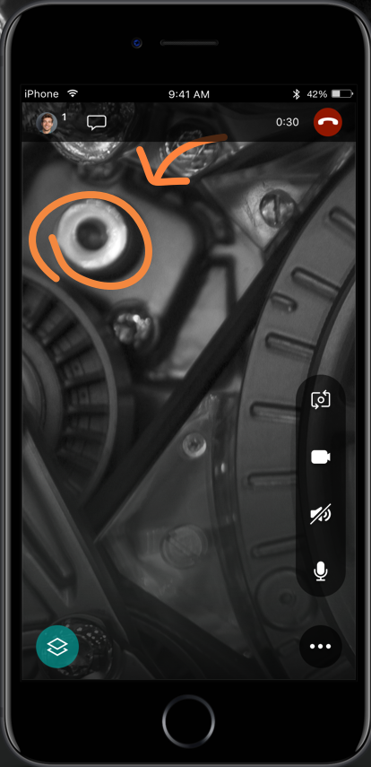
Introduction / Motivation
UI Instructions

Slide 3
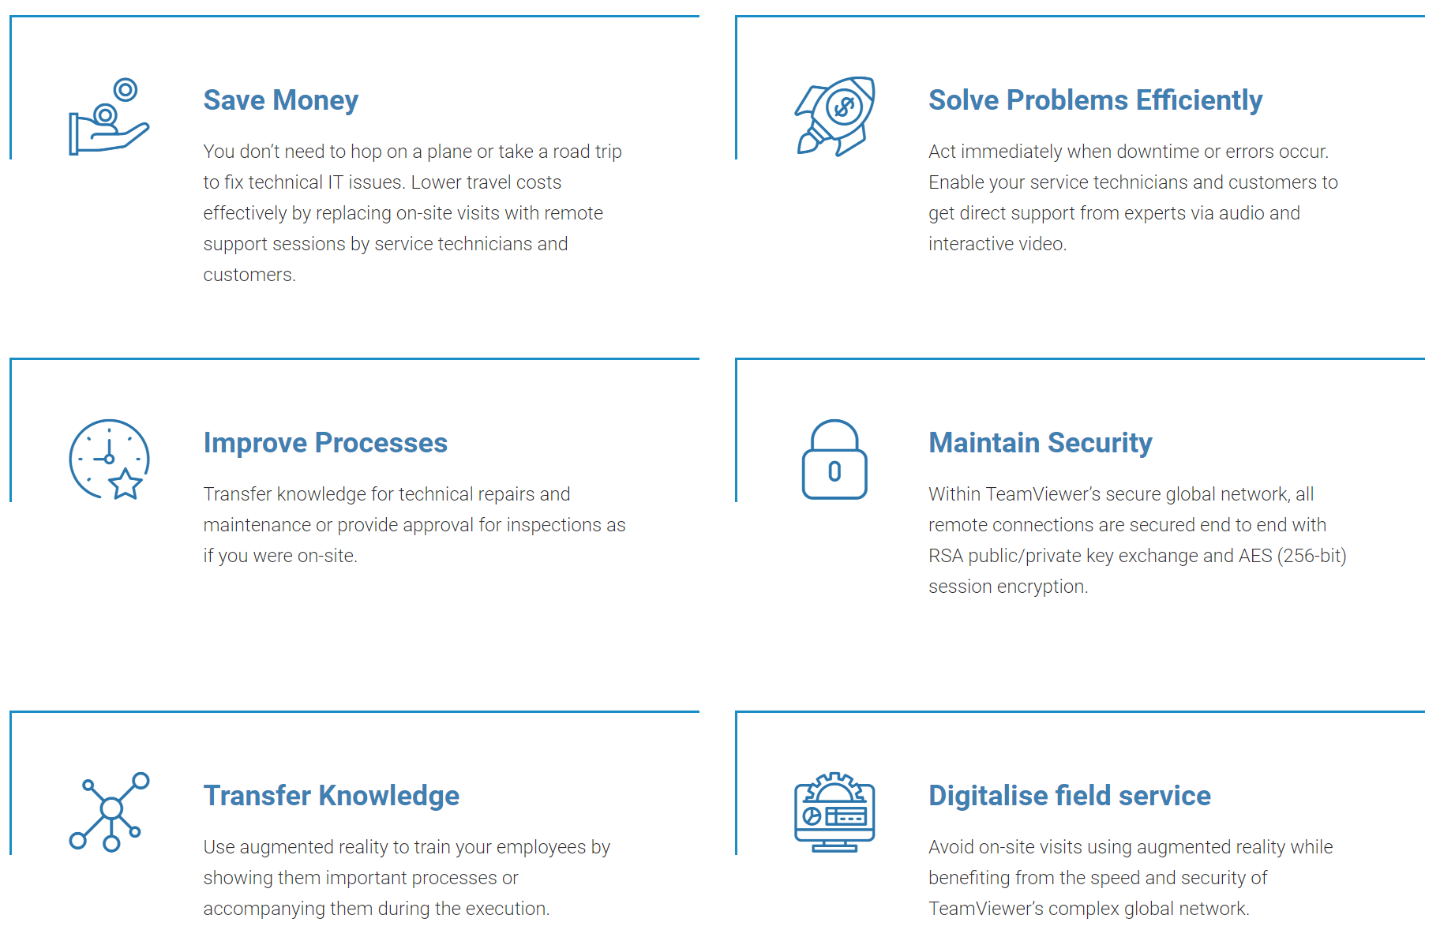
Introduction / Motivation
XR Remote Guidance System

Slide 4
Problem Description: Issues
AR Augmentation with real objects
VR interaction with virtual objects
Realtime data transmission
UI elements for information transport

Slide 5
Existing Solutions / Related Work
Enterprise Solutions:
  Teamviewer Pilot
  Microsoft Dynamics 365 Remote Assist
  Remote AR
Research Papers:
  Knowledge Transfer
  Feature Tracking
  Robust Augmentations
Notes:
https://lh3.googleusercontent.com/5fMVhdjh3iCiHRxJhykXxH8hAbweX4p0upB6y-EGkpW1BF7H_Ho1w2wUrJQxb3h4E8c

Slide 6
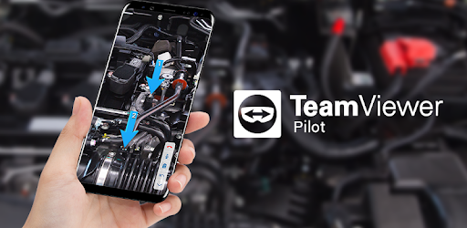
Existing Solutions / Related Work
Teamviewer Pilot

Slide 7
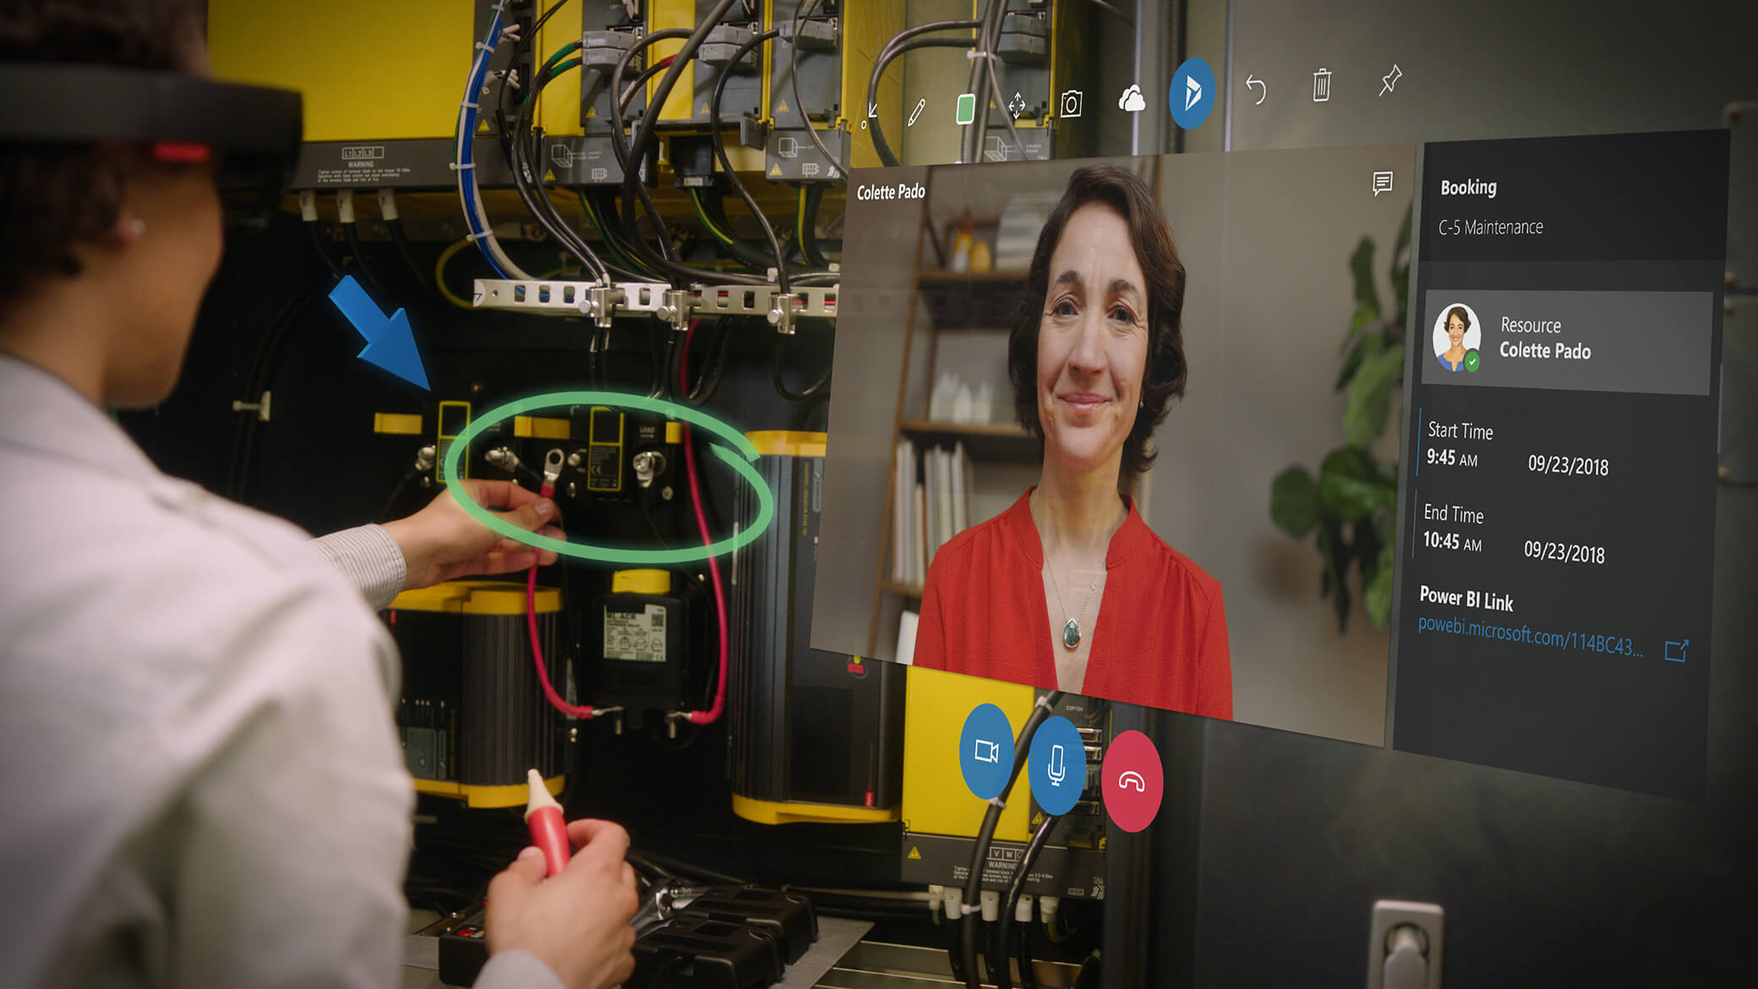
Existing Solutions / Related Work
Microsoft Dynamics 365 Remote Assist

Slide 8
Goals of this Thesis
Lab experiment with rubik’s cube
Full XR remote guidance system
Scanning real issued object
converting into virtual object
Manipulatable virtual object
transmitting manipulation instructions to real object trough augmentation
UI for visual feedback

Slide 9


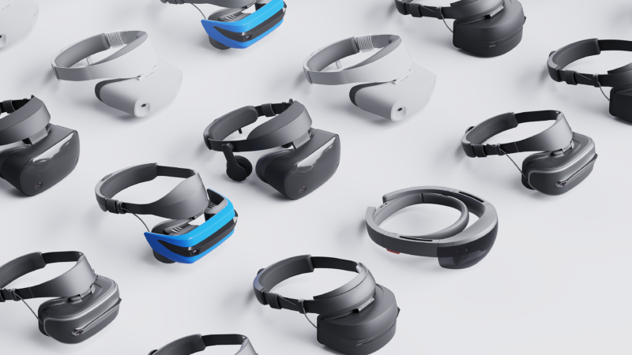
Proposed Work / Approach
Notes:
Mutatable and omnidirectional viewable
virtual issued object in XR instructor view
Transferable to other XR devices

Slide 10
Discussion of Potential Issues
Client view video streaming
Fully manipulatable object with virtual
hand controllers
Readable UI text
Good UI for visual feedback
Unity policy changes regarding networking?
No fixed environmental variables
  Light condition
  Latency

Slide 11
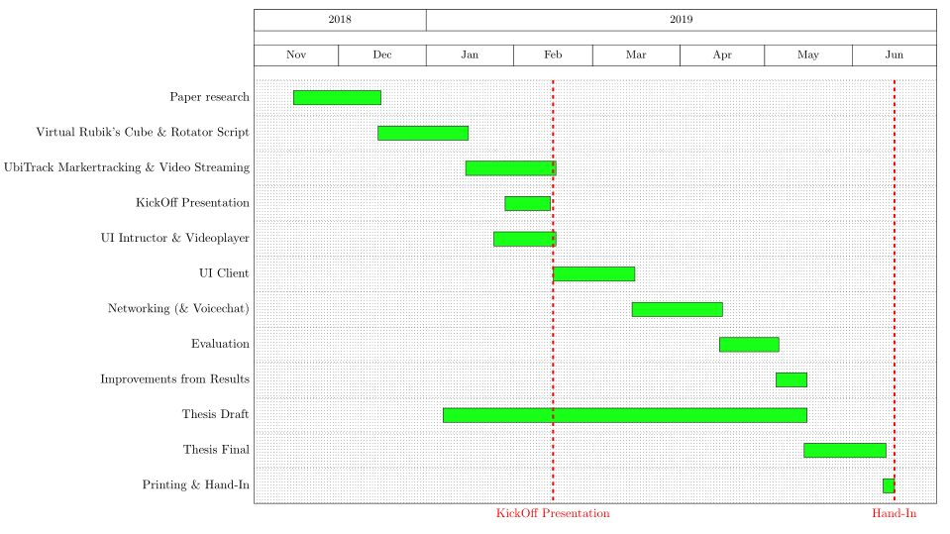
Time Line
Notes:
Networking shifted to Feb
Eval:
- knowledge transfer
- Voice com needed?

Slide 12

Questions?

Slide 13
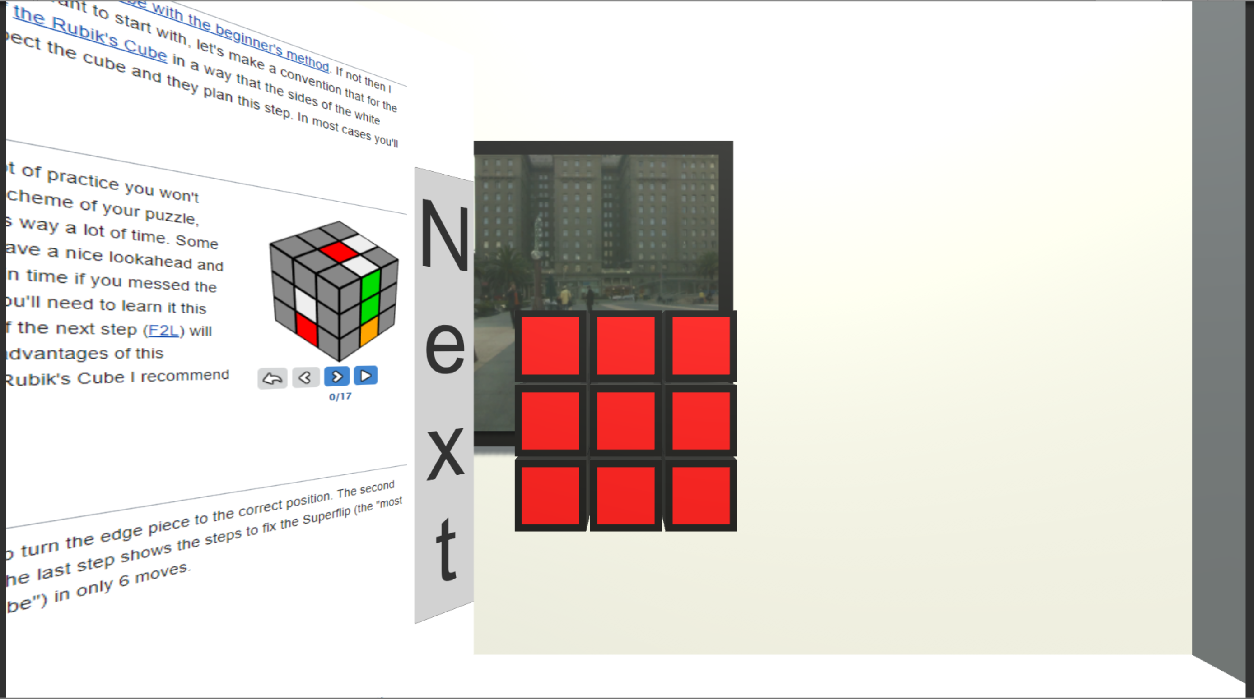
Questions?

Slide 14
Questions?

Slide 15
List of References
https://www.re-flekt.com/reflekt-remote
https://www.teamviewer.com/de/loesungen/augmented-reality
https://dynamics.microsoft.com/en-ca/mixed-reality/remote-assist/
http://grafikartes.com/rotation-360.html

Slide 16
List of References
https://www.re-flekt.com/reflekt-remote
https://www.teamviewer.com/de/loesungen/augmented-reality
https://dynamics.microsoft.com/en-ca/mixed-reality/remote-assist/
http://grafikartes.com/rotation-360.html
https://media.npr.org/assets/img/2017/10/12/trh_manipulation_artwork1_wide-b3b9648e2f6fb9a829cc1d800adf7dada2e5f57e-s900-c85.jpg
https://arstechnica.com/gadgets/2017/10/windows-mixed-reality-headsets-expected-to-sell-pretty-well-or-quite-badly/
https://www.machinedesign.com/community/what-questions-should-you-ask-during-product-lifecycle

