Slide 1
Acoustic Wayfinding Support in Real Environments without the Sense of Sight
Mehmet Dereli
22.04.2020
Final: Bachelor‘s Thesis
Supervisor: Prof. Dr. Gudrun Johanna Klinker

Slide 2
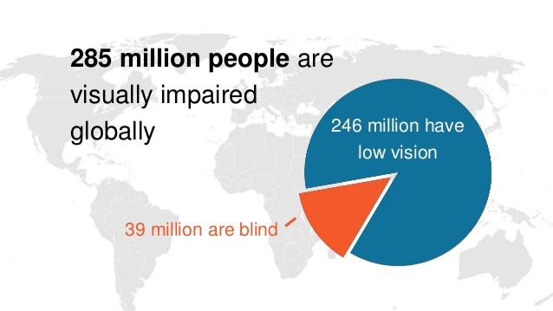
Motivation

Slide 3
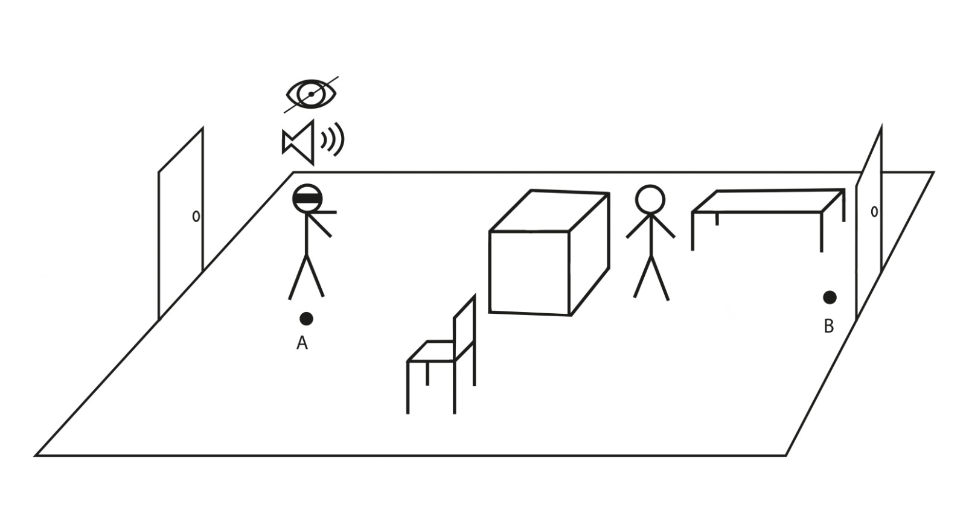
Initial Situation
Find the way from A to B
without the sense of sight
Understand the structure of the room
  Where are objects ?
Goal: Research the feasability of acoustic wayfinding support !
Mehmet Dereli: Acoustic Wayfinding Support in Real Environments without the Sense of Sight

Slide 4
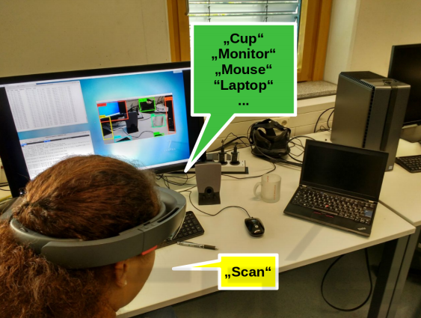
Related Work
Object Detection Featuring 3D Audio Localization for Microsoft HoloLens [E+18]
  Client-Server Architecture
  Server detect Objects by analyzing 2D RGB images
  Client calculates the corresponding 3D coordinates with spatial mapping
Mehmet Dereli: Acoustic Wayfinding Support in Real Environments without the Sense of Sight

Slide 5
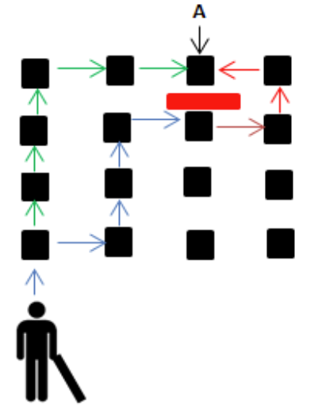
Related Work
RFID Based Indoor Navigation with Obstacle Detection [SYC15]
  Path calculated via A* Alogrithm
  Path following by scanning
  RFID tags with a cane
  Object detection with an ultrasonic obstacle detection sensor
Mehmet Dereli: Acoustic Wayfinding Support in Real Environments without the Sense of Sight

Slide 6
Wayfinding
“Wayfinding is the cognitive process of
defining a path through an environment, using and acquiring spatial knowledge, aided
by both natural and artificial cues"
[Bow+14a]
Mehmet Dereli: Acoustic Wayfinding Support in Real Environments without the Sense of Sight
Notes:
2 Parts
acquirement and use of spatial knowledge
Spatial knowledge → What structure does the environment have ? As well as ones position and viewing direction
→ Different Levels (Landmark, Route, Survey)

Slide 7
Wayfinding
Tasks:
  Exploration
  Search
  Specified Trajectory Movement
  (Maneuvering)
Support:
  User-Centered:
    Targeted to human sensory systems
    Mostly technology oriented
  Environment-Centered:
    → Based upon Artificial Cues, e.g. Maps, Compasses
Mehmet Dereli: Acoustic Wayfinding Support in Real Environments without the Sense of Sight

Slide 8
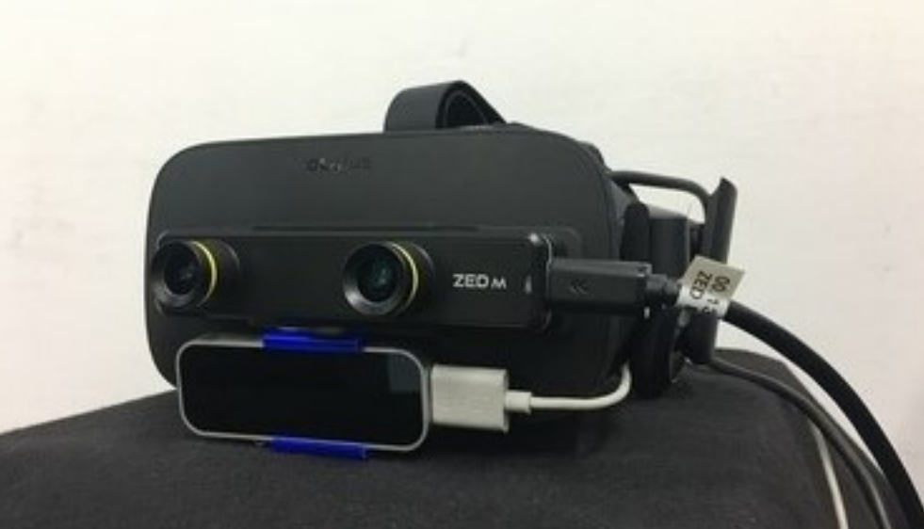
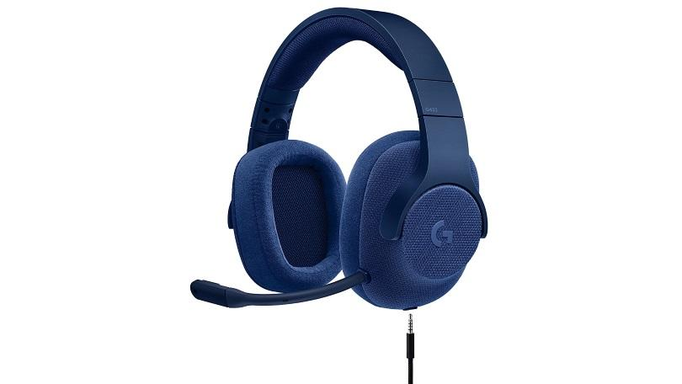
Setup
ZED Mini
  Spatial Mapping of the environment
LEAP Motion
  → Hand tracking and Gesture recognition for User Input
Headset
  → Surround Sound to locate sounds
Mehmet Dereli: Acoustic Wayfinding Support in Real Environments without the Sense of Sight

Slide 9
System Design
The system has 3 modes:
  2 User-Centered Wayfinding support modes
  1 Environment Centered Wayfinding support mode
Sounds are used to convey information:
  Distance: Volume of sound
  Direction: Position of the sound in relation to user‘s viewing direction
User Interface:
  → Users can select the different modes with hand gestures
Mehmet Dereli: Acoustic Wayfinding Support in Real Environments without the Sense of Sight

Slide 10
User- Centered Wayfinding Support
Scanner Mode
  Activated by Flat Hand gesture
  Scan the environment in a 180°angle
  Divide the area into four smaller areas
  Calculate the closest point within each area
  Play sound from that point
Mehmet Dereli: Acoustic Wayfinding Support in Real Environments without the Sense of Sight

Slide 11
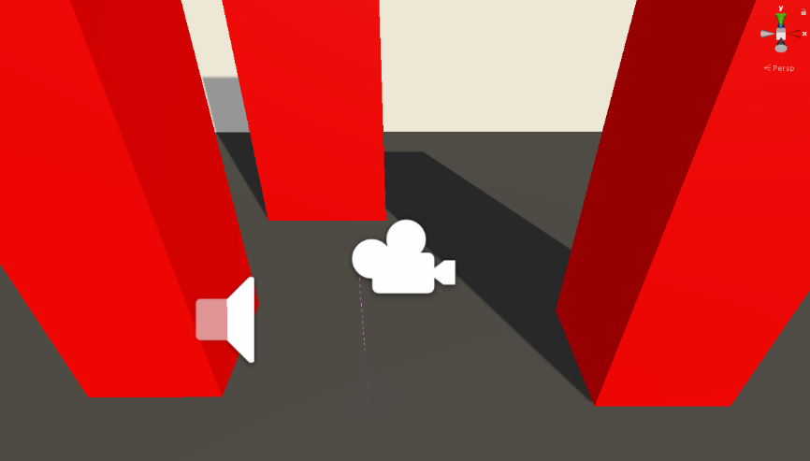
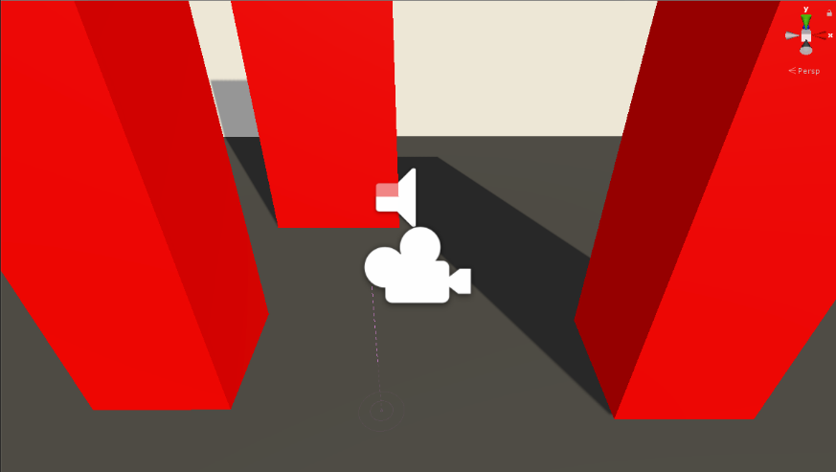
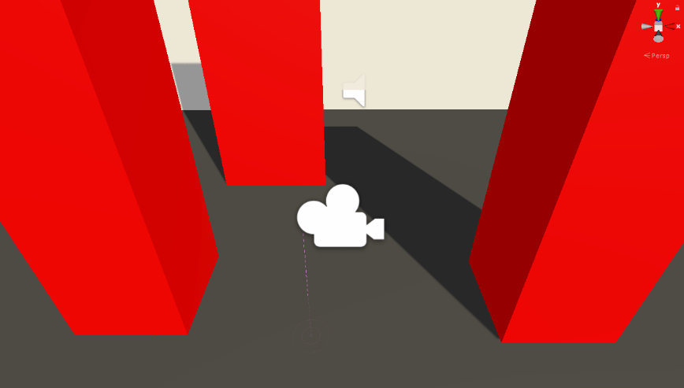
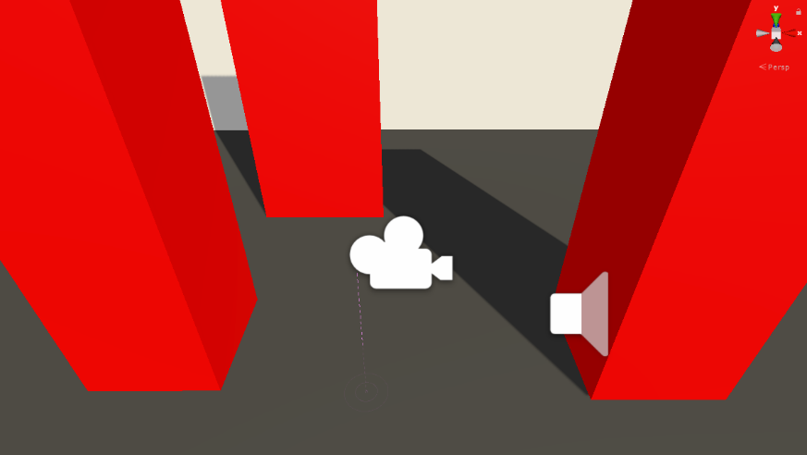
User- Centered Wayfinding Support
Scanner Mode Example
Mehmet Dereli: Acoustic Wayfinding Support in Real Environments without the Sense of Sight

Slide 12
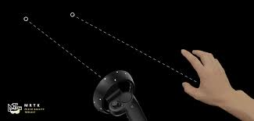
User- Centered Wayfinding Support
Pointer Mode
  Point into a direction with your finger
  Get acoustic feedback from
  that direction
Mehmet Dereli: Acoustic Wayfinding Support in Real Environments without the Sense of Sight

Slide 13
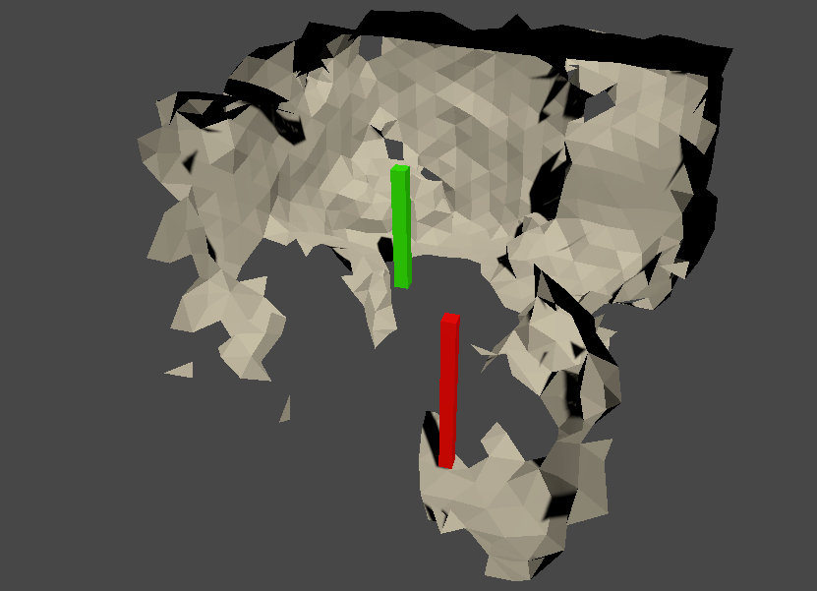
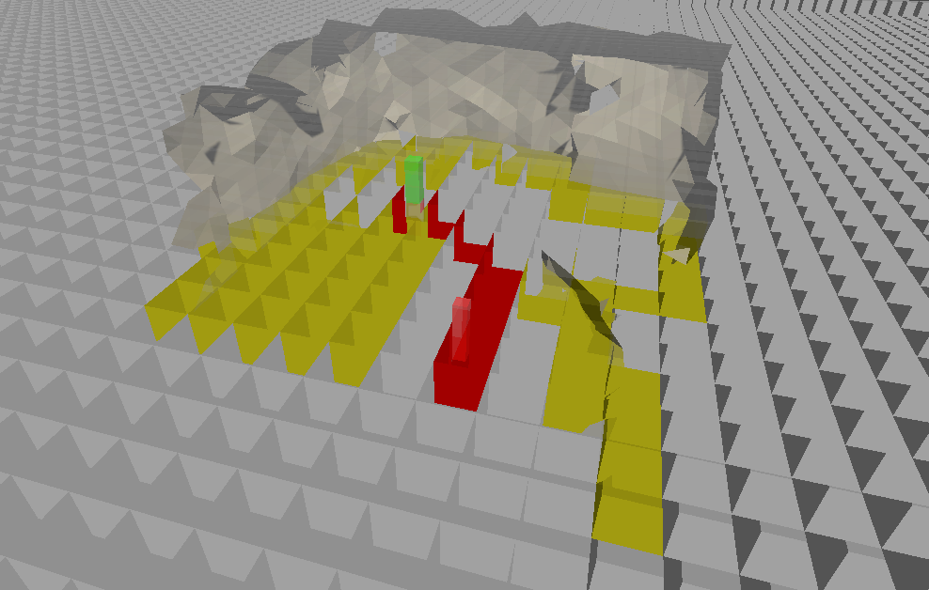
Environment-Centered Wayfinding Support
Path Following:
  Calculate the path between user and goal via A* Alg.
  Play sound from the closest node and thus guide the
  user
Mehmet Dereli: Acoustic Wayfinding Support in Real Environments without the Sense of Sight

Slide 14
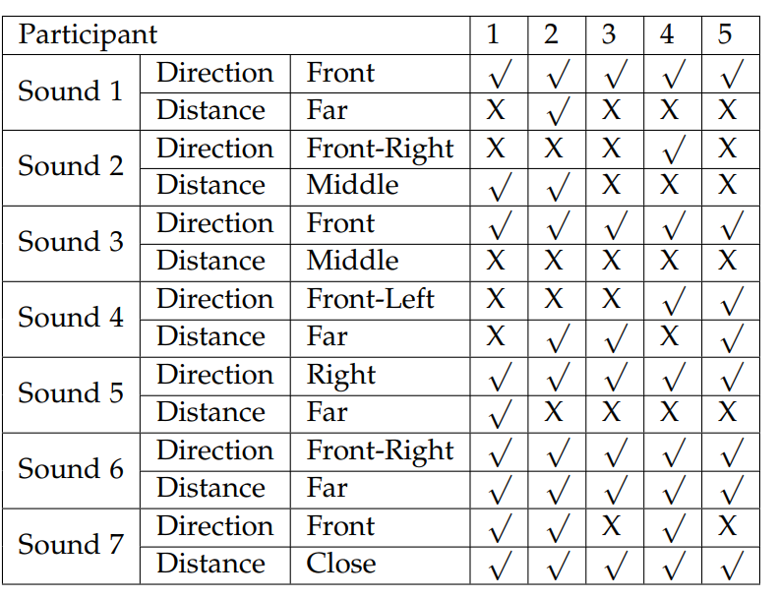
Pre-Study
Test 1: Participant has to guess directions and distances of the sounds that are played
Distinction of general direction (front, left, right) was most accurate
Front-Right improved over time as the users got more references
→ Learning curve !
User’s state that they are confident in direction but not distance
Mehmet Dereli: Acoustic Wayfinding Support in Real Environments without the Sense of Sight

Slide 15
Pre-Study
Test 2: Participant has to identify three objects that are spread in the room with the pointer and scanner mode
Mehmet Dereli: Acoustic Wayfinding Support in Real Environments without the Sense of Sight

Slide 16
Pre-Study
Test 2: Participant has to identify three objects that are spread in the room with the pointer and scanner mode
Participant Statements:
  Scanner mode:
    Not very confident (Lack of feedback)
  Pointer mode:
    Very confident
    Intuitive feedback in regards to direction
    Very accurate
Mehmet Dereli: Acoustic Wayfinding Support in Real Environments without the Sense of Sight

Slide 17
Pre-Study
Test 3: Path Following
All participants completed the course without any difficulty
Average time of 30 seconds
Gauging distances is easier now that they can move
Mehmet Dereli: Acoustic Wayfinding Support in Real Environments without the Sense of Sight

Slide 18
Conclusion
The results of the Pre-Study indicate that sound can indeed be used for wayfinding support
Volume is not a good stand alone indicator in regards to distance
Mehmet Dereli: Acoustic Wayfinding Support in Real Environments without the Sense of Sight

Slide 19
References
[Bow+14a] D. A. Bowman, E. Kruijff, J. J. Jr. LaViola, and I. P. Poupyrev. “3D UserInterfaces: Theory and Practice.” In: 1st ed. Addison-Wesley Professional,2014, p. 227.
[Bow+14b] D. A. Bowman, E. Kruijff, J. J. Jr. LaViola, and I. P. Poupyrev. “3D User Interfaces: Theory and Practice.” In: 1st ed. Addison-Wesley Professional, 2014. Chap. 7 - Wayfinding, pp. 227–250.
[E+18] M. Eckert, M. Blex, C. M. Friedrich, et al. “Object detection featuring 3D audio localization for Microsoft HoloLens.” In: Proc. 11th Int. Joint Conf. on Biomedical Engineering Systems and Technologies. Vol. 5. 2018, pp. 555–561.
[SYC15] J. Sanchez, A. Yumang, and F. Caluyo. “Rfid based indoor navigation with obstacle detection based on a* algorithm for the visually impaired.” In: International Journal of Information and Electronics Engineering 5.6 (2015),p. 428.
[Wie+09] J. Wiener, Simon, J. Büchner, C. Hölscher, and S. Büchner. “Taxonomy of Human Wayfinding Tasks: A Knowledge-Based Approach.” In: Spatial Cognition Computation 9 (May 2009), pp. 152–165. doi: 10 . 1080 /13875860902906496.
Mehmet Dereli: Acoustic Wayfinding Support in Real Environments without the Sense of Sight

