Slide 1
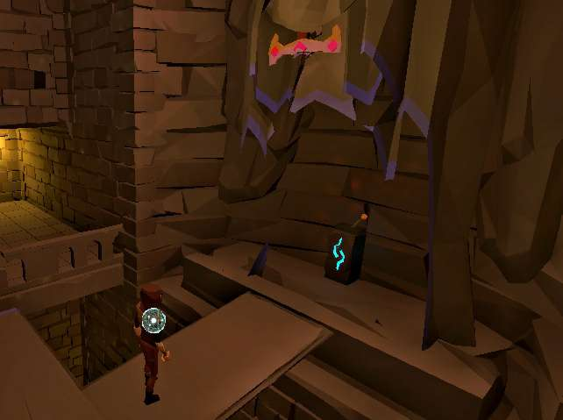
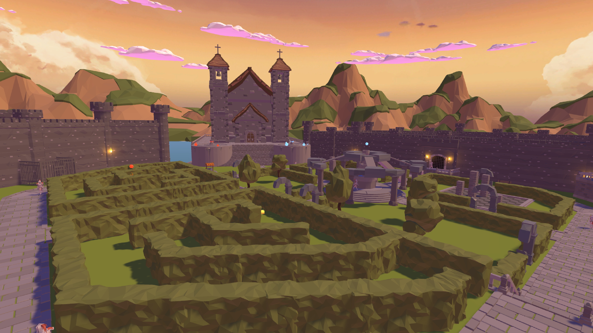
Between Worlds
Solve riddles to
escape from a magic caslte
Change between two worlds
with a Magic Orb

