Slide 1
TUM School of Engineering and Design
Technical University of Munich
B.Sc. Aerospace:
Electives, Lab Courses, Engineering Project
Bachelor Thesis and Transition to Master
Dr Dimitri Franz
Pema Mauser-Sherpa, M.A.
Status SoSe 2025

Slide 2
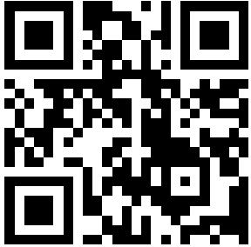
Agenda
Electives requirements
Lab Courses
Engineering Project
Bachelor thesis
Transition to Master
Tweedback questionnaire
https://tweedback.de/2569/quiz

Slide 3
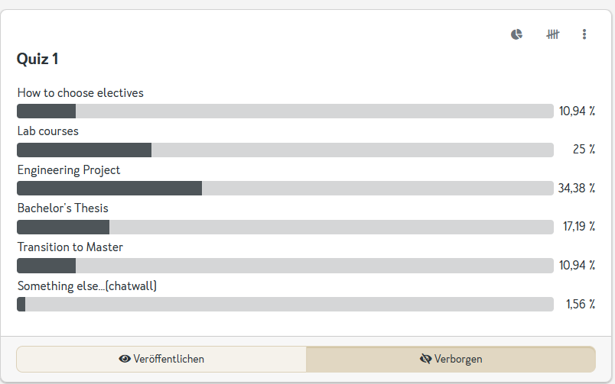
Results tweedback

Slide 4
Important information
Always register for your exams via your curriculum in TUMonline (not as a „Freifach“)
No late registrations for exams are possible! This also applies to lab courses even if you have already obtained your grade.
Counceling hours including updates: https://collab.dvb.bayern/x/1tdfB.
Stick to the hours on the Wiki!

Slide 5
Electives requirements and structure
Area | Credits
Engineering electives System elective Modeling elective Optional engineering elective | 20
Engineering supplementary courses | 6
Free electives | 5

Slide 6
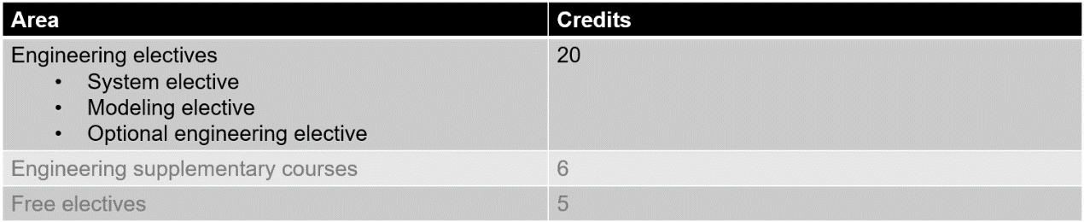
Engineering electives
You must choose at least one module from system and one from modeling electives
Remaining 10 credits can either come from optional engineering electives, system elective or modeling electives
Typically, each module is worth 5 credits → Pass 4 modules to complete the engineering area
Optional
Optional, but highly suggested: Try to choose modules from two of the following subject areas
- System
- Dynamics
- Propulsion
→ Modules can be chosen from all 3 sub-areas (system, modeling, optional)
→ Some modules have hints about their subject areas in their title: For instance
„Aeronautic Propulsion Systems“
„Computational Aerodynamics“
→ Some modules do fit into any of the 3 subject areas. In case you are unsure, ask the responsible lecturer.

Slide 7
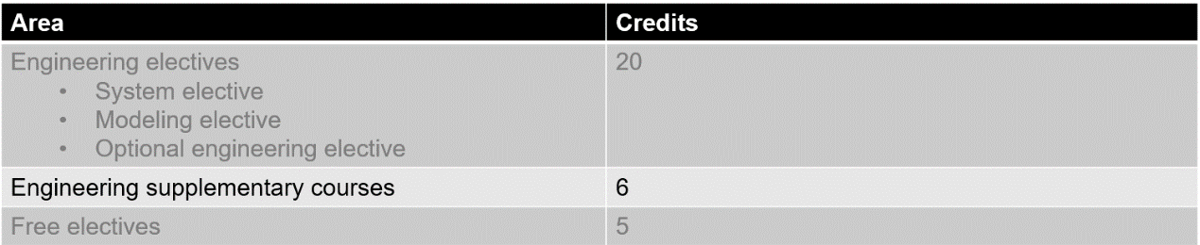
Engineering supplementary courses
Goal: Supplement basic knowledge/competencies in addition to the required modules during semesters 1-4
Majority of supplementary courses are worth 3 credits → Pass two modules to complete this elective area
The list of supplementary courses has been significantly expanded in SoSe24

Slide 8
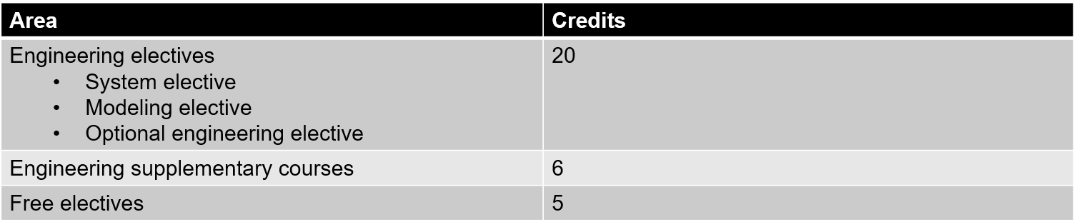
Free electives
Module must be included to get the credits (see next slide)
Any School/Department of TUM, excluding
  Courses that are part of the MSc Aerospace
  ASG department courses
  Other ED courses
Soft skills or foreign language courses (NB: language course cannot be a language which is your native language)
From other universities, esp. from exchange semester(s)
For more information:
  General TUM module handbook: https://campus.tum.de/tumonline/ee/ui/ca2/app/desktop/#/pl/ui/$ctx/wbModHb.wbShow?$ctx=design=ca2;header=max;lang=de&pOrgNr=1
  Center for Key Competences: https://wiki.tum.de/x/7gm_QQ
  Munich Center for Technology in Society/WTG@MCTS: https://www.cvl-a.mcts.tum.de/english-speaking-seminars/
  TUM Language Center: https://www.sprachenzentrum.tum.de/en/sprachenzentrum/languages/

Slide 9
Inclusion of free elective courses
You can apply to the board of examiners for inclusion of modules to be included as a free elective
Things we check
  No limit on the number of participants → module is designed such that more students can participate
  Module will take place long-term
  General agreement from the person responsible for the module
When: The sooner, the better, but before the term start
  Summer term: 1.3. – 31.3.
  Winter term: 1.9. – 30.9.
Applications have to be made via e-mail to the examination office: examination.asg@ed.tum.de
Keep in mind, there is no guarantee that modules will be included as a free elective and that you get the credits. → Talk to us instead of simply registering for a random module!
Modules already listed in the free electives have already been checked and can be chosen.
!

Slide 10


ZSK
Center for Key Competencies
TUM SCHOOL OF ENGINEERING AND DESIGN

Slide 11
ZSK modules
A good overview can be found here: https://collab.dvb.bayern/x/-z--O
ZSK modules (Zentrum für Schlüsselkompetenzen, engl. center for key competencies) are part of the free electives
Portfolio includes the following topics
Data Perspectives
Human & Society
Regulatory & Governance
Entrepreneurship
Sustainable Development
Empathy & Personality
  Digital key competences
  Data analytics & KI
  Big data
  Opportunities and challenges of digitalisation
  Automatization
  Human-technology interaction
  Technological progress and social challenges
  Human behavior (from a sociological and psychological perspective)
  Legal framework
  Political interdependencies
  Politics and future technologies
Entrepreneurial and business management thinking and behavior
Importance of entrepreneurship for society
  Planetary boundaries as a challenge
  Interaction between technology and the environment
  Soft Skills
  Interculturality
  Reflective personal development
Efficient use of technology, critical handling of data, orientation and active participation in the digital environment
Taking moral and ethical responsibility for the safety, health and well-being of people and the environment
Respect for law and democracy; understanding of political decision-making processes Critical advice on the development of technical specifications and technologies
Understanding of business processes, profitability and organizational cultures Innovative spirit Marketing of knowledge and products
Developing sustainable solutions and mindsets
Personal development for empathetic and effective action in a dynamic and complex world

Slide 12
Free electives
Some ZSK modules are not graded → The credits of these modules count towards your curriculum but are not considered in the average grade.
In exceptional cases, if you do one or two additional credits, e.g. 2x 3 credits (ZSK or other) or 1x 6 credits, these additional credits are counted towards your curriculum.

Slide 13
Aerospace Lab Courses
Goal: Introduction to practical methods in engineering
Projects in small groups
You must choose two modules from the lab course electives (in total at least 8 credits)
Some practical courses take place similar to normal courses during the semester; whereas others are block seminars at the end of the term
Registration periods
  Bachelor specific courses (mostly Lab Courses I): Either part of the general registration or individual registration period (contact chair for more details)
  General lab courses
    Winter term:
      Courses accompanying the semester and block-courses (beginning until 31.12.): end of Aug – early Sep
      Block-courses (beginning between 01.01. and 31.03.): late Nov – early Dec
    Summer term:
      Courses accompanying the semester and block-courses (beginning until 30.06.): late Feb - early Mar
      Block-courses (beginning between 01.07 and 31.09.): late May - early June

Slide 14
Engineering Project (LRG0202) (Link)
Ideally to be completed in 5th semester, but can be done in 4th or 6th semester as well. However, knowledge from semesters 1 to 4 recommended
Practical (research) project with a chair from mostly from Aerospace & Geodesy, but other ED chairs also possible (architecture and environmental engineering excluded)
Group projects and projects with students groups are possible (ask lecturers).
Similar to a „mini Bachelor thesis“
Topic has to be found and arranged by the students
  Contact chairs for possible topics or speak to a lecturer after a lecture or tutorial
  Even better: Inform yourself about an area and contact a chair with an idea
  Avoid e-mail similar to „I need an engineering project, can you please offer me one?“
  We compiled a list of all chairs and their websites on the wiki, https://collab.dvb.bayern/x/1pSHVg

Slide 15
Master modules? – Important to know
Generally, Master modules which are included in the Bachelor curriculum: Modules were pre-selected and reviewed. → You‘re free to choose these modules
Additional Master module cannot be included.
But: If a Master‘s module contributes to your Bachelor‘s degree (i.e. credits and marks), you cannot choose these same Master‘s modules in the M.Sc. Aerospace program!
You can check in the module description in TUMonline whether a particular module is part of the M.Sc. Aerospace curriculum (-> open module desicription, then click on „Allocations to SPO versions“)
You can always register and pass exams of any modules as „Freifach“, i.e. any master module

Slide 16
Bachelor´s thesis (12 Credits)
  Mandotary Prerequisite: 120 credits in total, at least 99 credits from the compulsory modules (Pflichtmodulen), and a pre-study internship (coursework [pass/fail] is not counted towards the 120 credits)
  Registration of the thesis by the thesis supervisor in the ED portal at https://portal.ed.tum.de/en/Theses/
  You will then receive an e-mail asking you to confirm the registration of the thesis and the data provided in the portal.
  Only if you confirm the registration will it be reviewed by the examination board, and you will receive the topic's approval or rejection by e-mail.
  You find all necessary information in the wiki of the ED portal
  A topic can be provided by a university lecturer or habilitation candidate from all departments of the School of Engineering and Design - except Architecture & Design and Civil and Environmental Engineering: TUM School of Engineering and Design - TUM School of Engineering and Design - BayernCollab (dvb.bayern)
  Other thesis supervisors are NOT possible

Slide 17
Bachelor´s thesis
The composition/supervision of a thesis can also be carried out externally or at another department /school, provided the thesis registration takes place via an approved TUM thesis supervisor. The grading will also only be done by this approved thesis supervisor.
Maximum completion time: six months
If the last possible submission date of your Bachelor‘s thesis falls on a non-working day (weekend/holiday), the actual submission must occur on the next working day at the latest.
Submission: Upload in ED portal. The Bachelor‘s thesis must be signed either by hand or digitally by you.
How to use the ED portal: https://collab.dvb.bayern/display/TUMedschooloffice/Final+Theses
See also FAQs https://collab.dvb.bayern/x/IorWGg

Slide 18
Bachelor´s thesis
The Bachelor‘s thesis is only completed when the final presentation has been given
Final presentation can be held before or after submission (the 6-month deadline does NOT apply)
A failed thesis may be repeated once (with a new topic)
If you do not register your Bachelor Thesis within the regular study period of the B.Sc. Aerospace Study program (8th Semester) submission after this semester is guaranteed, but you will then lose the option of a second attempt.

Slide 19
Bachelor´s degree
As soon as all the requirements for graduation are valid and your degree program has been set to be passed in TUMonline (green „P“ on the degree program), you will be notified by email within a few days.
It is recommended that you check your data in TUMonline (results, thesis title, assignments)
After confirmation, the Examination Office ASG will release your final documents
→ further processing will then be carried out by the CST – Graduation Office Garching: Graduation Documents – TUM
(Written) notification by the CST - Graduation Office, as soon as the documents are ready for collection or delivery (approx. 4-6 weeks – please keep your address in TUMonline up to date)
Central information on the graduation documents can be found here: Graduation Documents - TUM

Slide 20
Bachelor´s degree
Calculation of the overall grade
Total (module grade * credits) / total credits (only graded modules)
The thesis is included twice in the overall grade, i.e., with a value of 24 credits
Optional subjects / additional subjects
In addition to the modules required for graduation, students can voluntarily take additional exams
The grades and credits of these additional exams are not included in the total credits and grade of the degree program

Slide 21
Final documents
The certificate date is the date the last requirement (exam) was completed for graduation
The transcript of records contains the positive modules in the degree program and, as an additional document, all additional requirements passed (layout is similar to the transcript of records in TUMonline)
There is no indication of the (subject) semester number, number of examination attempts, or negative results on the diploma certificate

Slide 22
Disenrollment after finishing the degree
Students are automatically disenrolled at the end of the semester in which the certificate is issued
In the final semester, examinations on optional subjects (Freifächer) can still be taken until the end of the semester.
→ Once the process to issue the Bachelor certificate is initiated, optional subjects will not be listed on the certificate.
https://www.tum.de/en/studies/graduation/disenrollment

Slide 23
Transition to Master‘s degree
An early application for an M.Sc. Aerospace can be made after 140 credits or more have been completed during the Bachelor’s degree
! International non-EU students: Fees apply when no Bachelor certificate can be submitted at the beginning of the Master’s.
https://www.tum.de/en/studies/fees/tuition: Prove the successful completion of the Bachelor's program before the enrollment deadline (winter semester 2024: 15.11.2024, summer semester 2025: 27.05.2025). A preliminary certificate is sufficient.
For a successful admission, you have to apply regularly via TUMonline and submit all required documents
The Bachelor's degree must be submitted no later than one year after the start of the Master's program → Otherwise, automatical disenrollment after 2nd Master term

Slide 24
Aptitude assessment
Admission:
Application via TUMonline is mandatory
As a graduate of the B.Sc. Aerospace, you will be admitted directly to the M.Sc. Aerospace program without having to go through the aptitude assessment procedure. Nevertheless, you have to upload a complete application and also register in our Tool Master EV (https://masterev.sgb-as.ed.tum.de).
Your grades are not relevant for admission to the Master Aerospace → BSc Aerospace will always be admitted.
Please note the application deadlines:
Application period for studies beginning in the winter semester: 01.04. - 31.05.
Application period for studies starting in the summer semester: 01.09. - 30.11.
For general questions on formal aspects of the application, please get in touch with studium@tum.de
Please send any questions about the aptitude assessment procedure to applications.asg@ed.tum.de

Slide 25
Important links
Important information for the Aerospace degree program can be found here:
B.Sc. Aerospace - TUM School of Engineering and Design - BayernCollab (dvb.bayern)
Formulare / Forms B.Sc. Aerospace - TUM School of Engineering and Design - BayernCollab (dvb.bayern)
If you have any questions about study and examination matters, please also take a look at the following link
Prüfungsangelegenheiten / Examination Affairs B.Sc. Aerospace - TUM School of Engineering and Design - BayernCollab (dvb.bayern)

Slide 26
Contact persons
Board of Examiners ASG (room MW2606): Daniel Hartenstein M.A. examination.asg@ed.tum.de
Final theses/research practice examination.asg@ed.tum.de
Coordination/academic advising B.Sc. Aerospace (room MW0026b): Dr. Dimitri Franz coordination.asg@ed.tum.de
Coordination/academic advising M.Sc. Aerospace (room MW2606): Daniel Hartenstein M.A.
International Affairs and semester abroad (zoom): Dr. Markus Eblenkamp as.international@ed.tum.de
Please inform yourself here about the current situation regarding consultation hours and consultations:
Ansprechpersonen / Contact Persons - B.Sc. Aerospace - TUM School of Engineering and Design - BayernCollab (dvb.bayern)
If you have any questions or problems, please get in touch with the Student Advisory Service and/or the Examination Office in good time for advice.
We will be happy to help you.

Slide 27
Questions and answers
Electives:
Q: Would it be possible for the professors to offer a short introduction to their elective courses, as course descriptions in TUMonline can be rather uninformative?
A: Unfortunately, not. In case of questions, please contact the lecturers directly.
Q: Some electives were said to be project-oriented while others require an exam, will we know beforehand which assessment type an elective will have? How to check that on TUM online?
A: Check the module descriptions of the electives to get information about course contents and exam types.
Q: Where are the lab courses going to take place?
A: Depending on the chair, either in Garching (~aero) or Ottobrunn (~space).
Q: Can we do two lab courses in the fifth semester?
A: Yes, provided they are offered in this semester (some courses are only offered in summer, and some only in winter semester).

Slide 28
Questions and answers
Engineering Project:
Q: Is it possible to suggest an individual topic to the professors?
A: Yes, this is possible if the professor agrees to the topic.
Q: Is there a deadline for the registration of topics?
A: The timetable states that the Engineering Project is to be taken in the 5th semester. But you may attend it earlier or later. There is no deadline for the registration in
TUMonline, except for the one that applies to all exams. Students have to register for it via TUMonline since it is a module exam like any other exam.
Q: Is it possible to suggest a theme/topic as a group/team of students?
A: The professor has to decide whether this is possible: It is to be clarified between students and the respective professor, who will also set the limit of participants.
Q: Is there a list of topics?
A: We are working on some kind of overview.

Slide 29


