Slide 1
Game Idea Pitch
Practical course: Game Programming

Slide 2
Define Arcade
Google
(Define Arcade)
a covered passageway with arches along one or both sides.
  a covered walk with stores along one or both sides.
  a series of arches supporting a wall, or set along it.
short for video arcade.
Wikipedia
(Arcade game)
Other types of arcade-style games include […] beat 'em up games (including fast-paced hack and slash games […].

Slide 3
Ideas
Theme: Arcade
  Dungeon
    Connected rooms → islands
    Enemies
    Obstacles
Genre
  Hack ‘n’ Slay
    Two attacks
    Additional non-damage abilities
Seriousness
  Not serious in style
  But in gameplay
Duration
  Arcade like
  Until death

Slide 4
Inspirations
Roguelike
  Diablo
  Path of Exile
  The Binding of Isaac
Puzzle
  Prince of Persia
  The Legend of Zelda (Temples)
Action-adventure
  Magicka
  Castlevania
  Terranigma
Shoot 'em up
  Contra
  Metal Slug

Slide 5
Concept - Gameplay
Semi-Random Grid-Based
Recursive Level-Generation (SRGBRLG)
  Islands
  Bridges between islands
Islands vary
  Size
  Active Moving Enemies
    Count
    Strength
  Active Static Enemies
  Passive Enemies
  Rewards

Slide 6
Concept - Gameplay
Active Moving Enemies (Monsters)
  Normal
  Strong
  Elite
  Boss
Passive Enemies (Puzzles)
  Lever / Button order
  Push / Pull obstacles
Active Static Enemies (Traps)
  From above
  From side
  From bottom
Rewards
  Items
  Score points

Slide 7
Concept - Gameplay
Stages
  Harder enemies
  Better loot
  Better score
Score
  Enemies
  Rewards
  Survivor

Slide 8
Concept - Gameplay
Roguelike
  New exciting levels every time
  The further the better / harder
  Different character classes
Puzzle
  Logical mechanisms
  Remember solution approaches
Action-adventure
  Supporting abilities
  Character – altering stats
  Stat – altering items
Shoot 'em up
  Simple attack system
  Attack – altering items

Slide 9
Specialties
Semi – Random
  Every cell can be a different
  But all cells are connected
  There is always a path
  There are no cross-sections
Grid – Based
  Cells have fixed sizes
  Easy to traverse for adding extras
Recursive
  Quad – tree partitioning
  Variation in island size
Level – Generator
  Templates everywhere
  Better: Stage generator

Slide 10
Specialties
Hot seat
  Up to 4 players
  Highscore lists based on player count

Slide 11

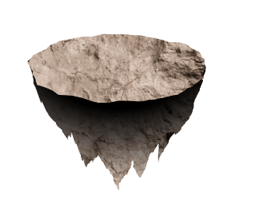
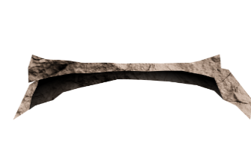
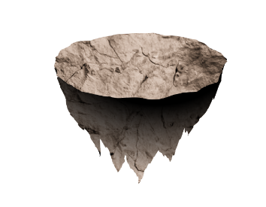


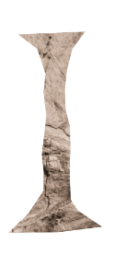


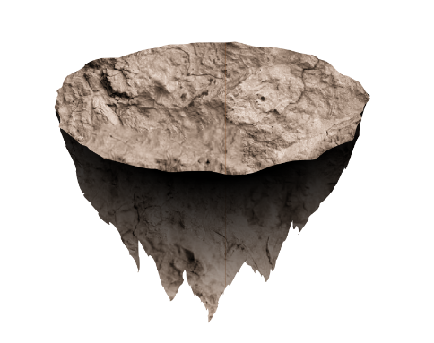
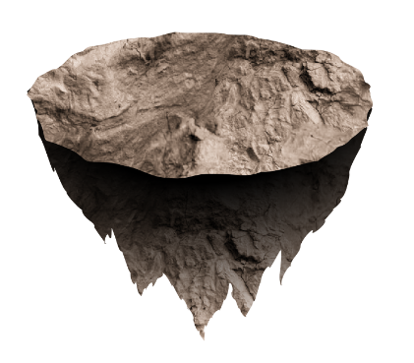


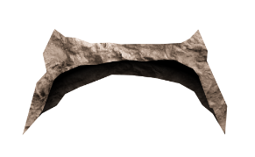

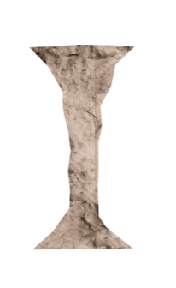
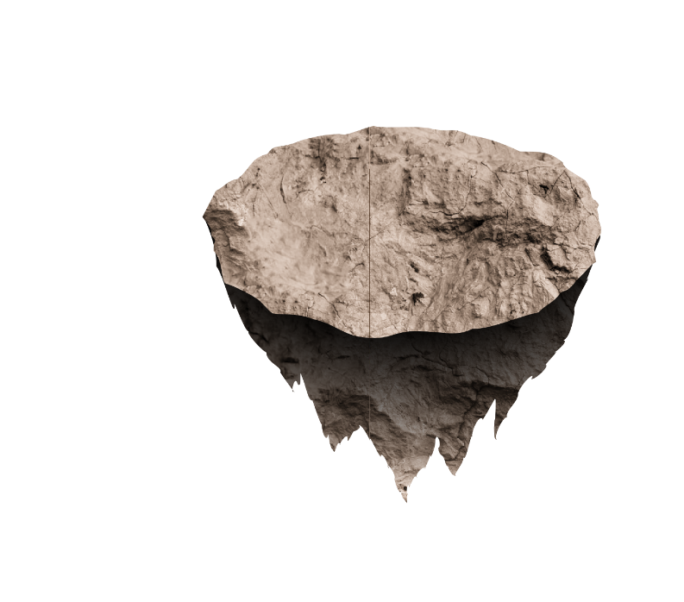
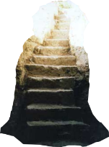

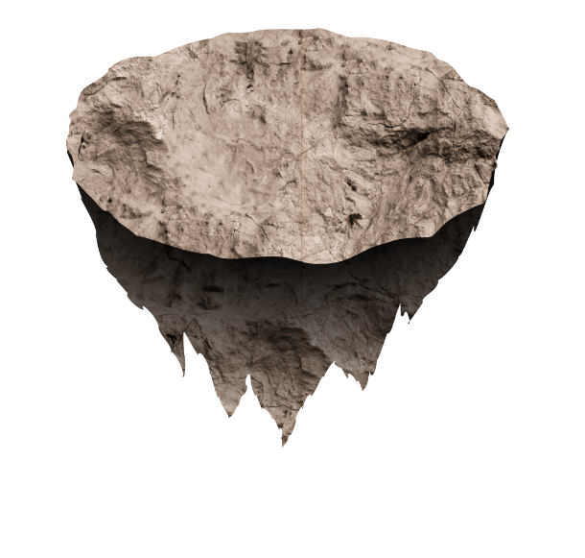
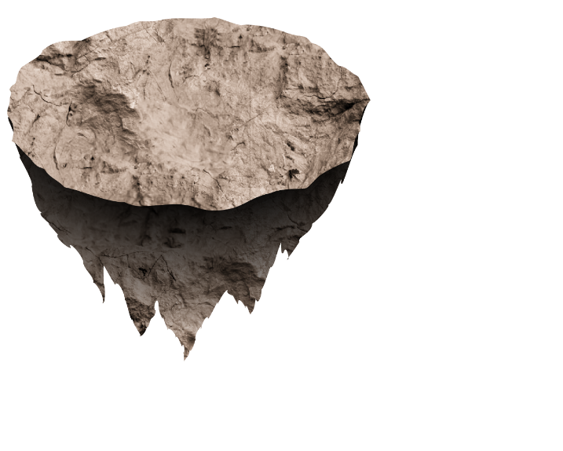
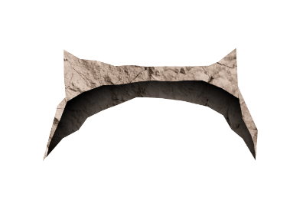

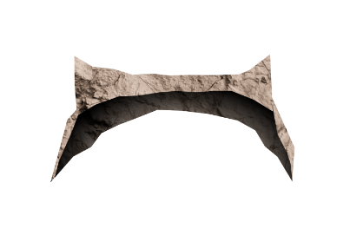



Slide 12


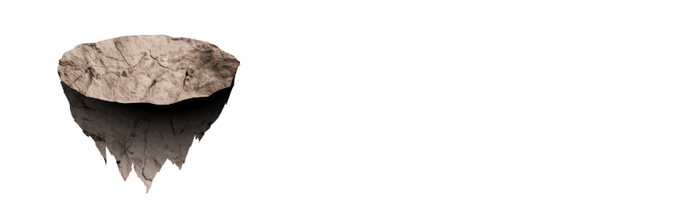
















300P
800P
820P
100P
810P
50P
0P
+10P
+10P
+500P
+200P
+3STR
+40HP
+50P
+50P
Player 0
Player 1
Player 2
Player 3

Slide 13


Stage 1
Stage 2
Stage 4
Stage 3

Slide 14
Thank you for listening
Any questions?

