Slide 1
Conclusion
Practical course: Game Programming

Slide 2
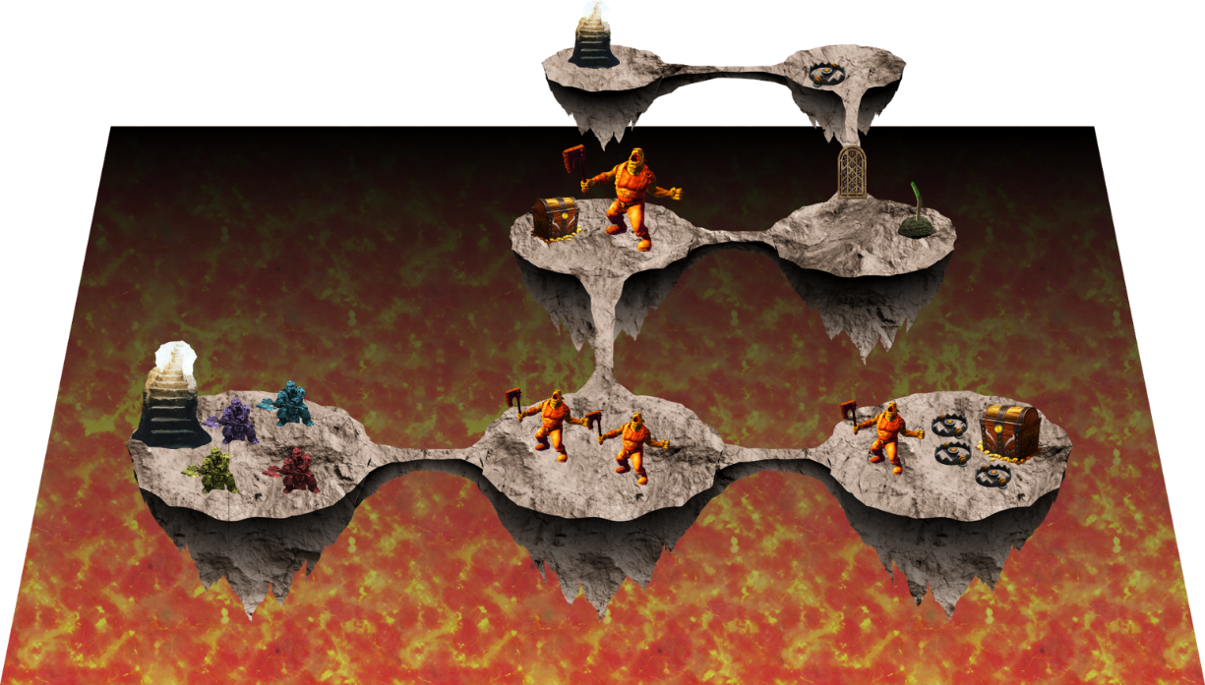
Pitch
Proposal
Interim
Beta
(Release)
Alpha
Playtesting
Theme: Arcade
  Dungeon
    Connected rooms → islands
    Enemies
    Obstacles
Hack ‘n’ Slay by combining
  Roguelike (Dungeon-crawler)
with
  Action-Adventure
  Puzzle

Slide 3
Pitch
Proposal
Interim
Beta
(Release)
Alpha
Playtesting
4 Player local multiplayer
Highscore
Stage-Generator
Different types of
  Enemies
  Traps
  Puzzles
  Rewards

Slide 4
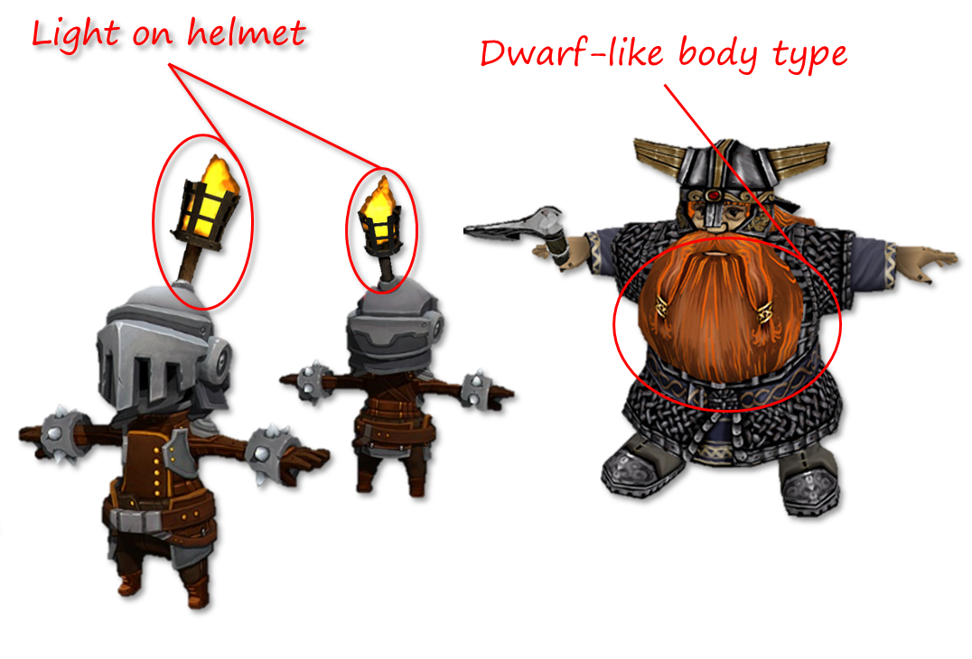
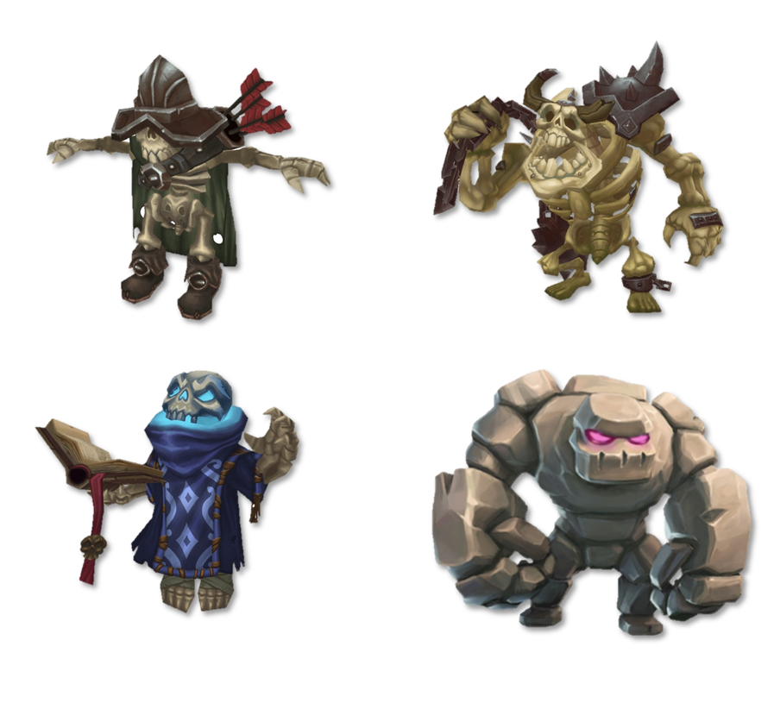
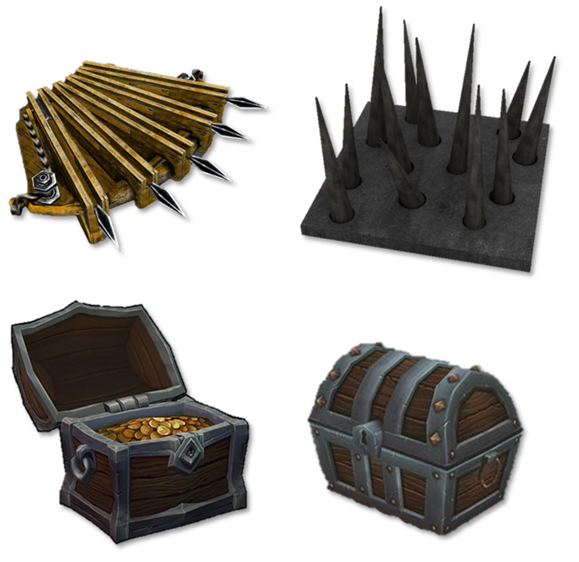
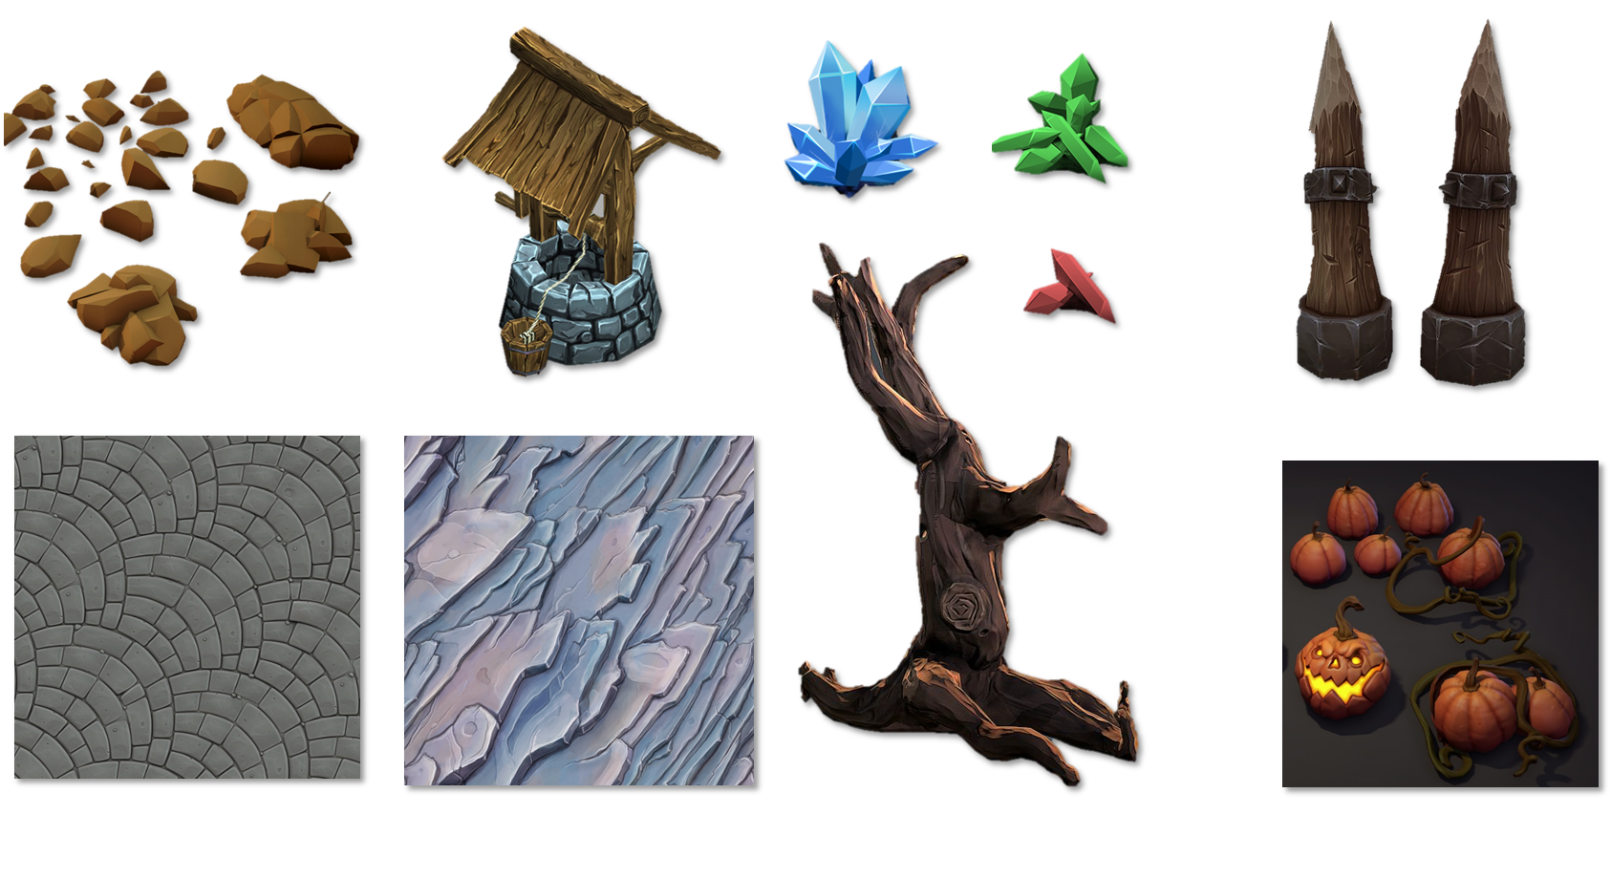
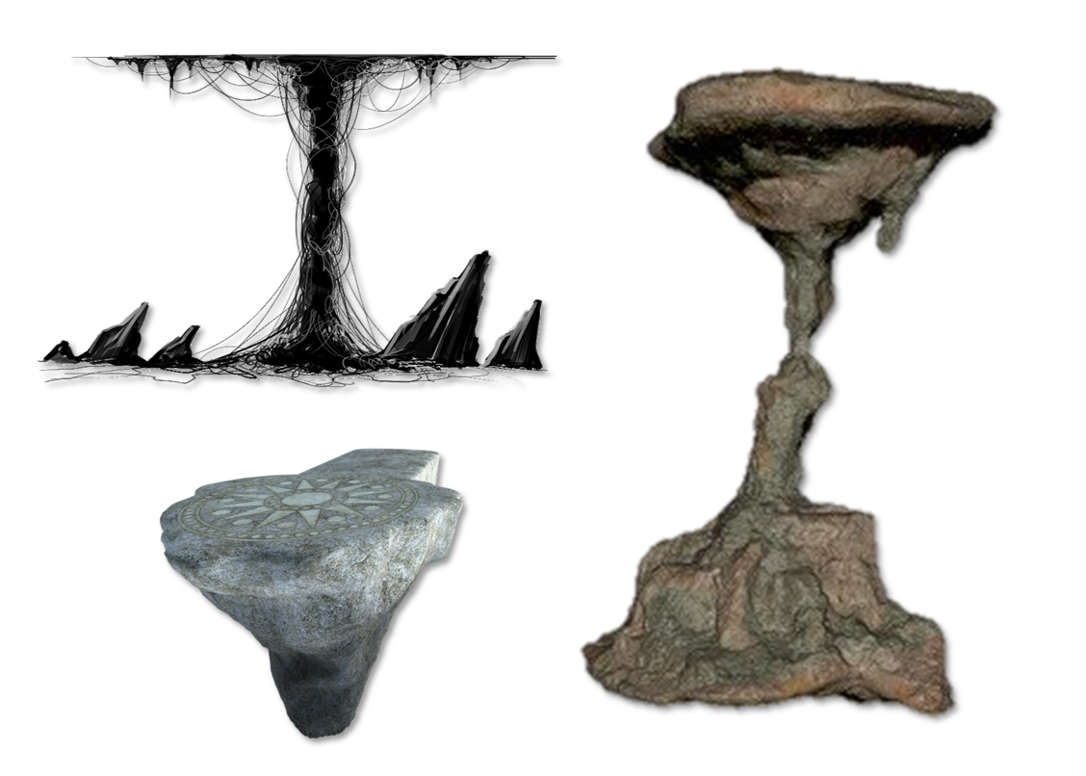
Pitch
Proposal
Interim
Beta
(Release)
Alpha
Playtesting
Definition of
  Player
  Art style
  Enemies
  Islands
  Traps and Treasure

Slide 5
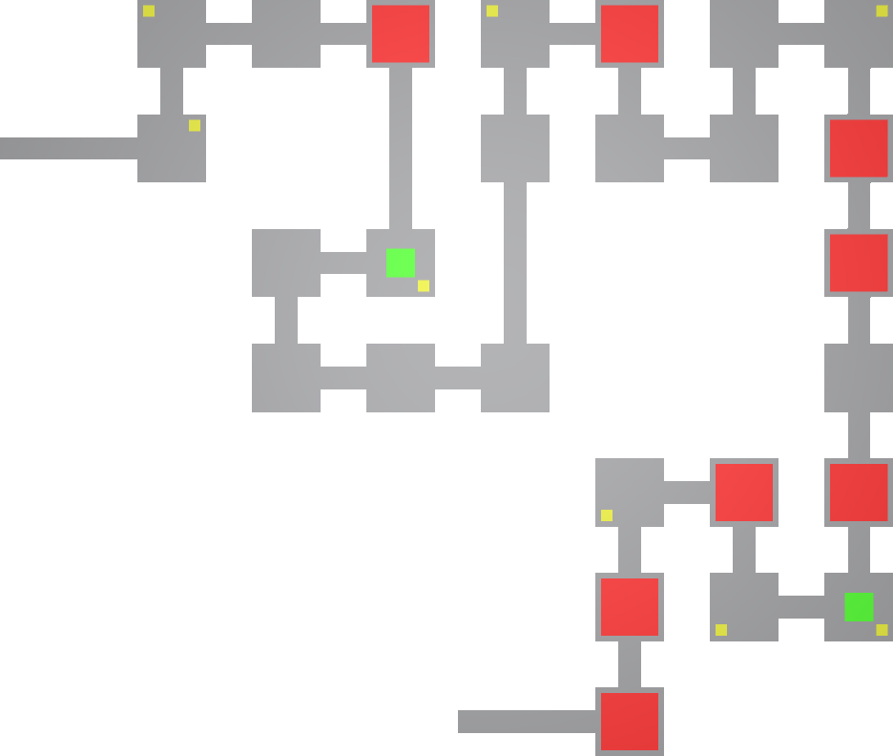
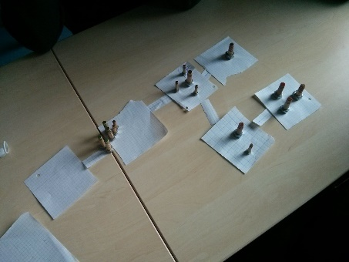
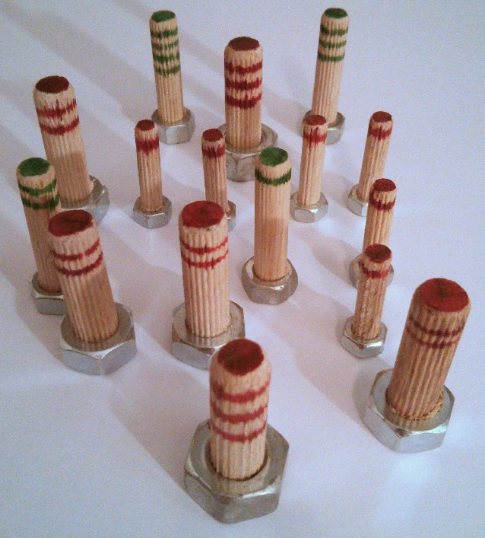
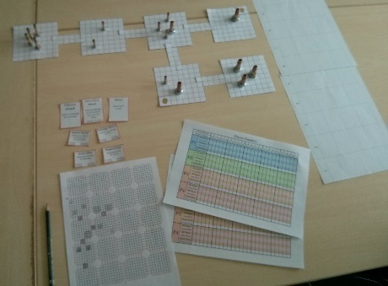
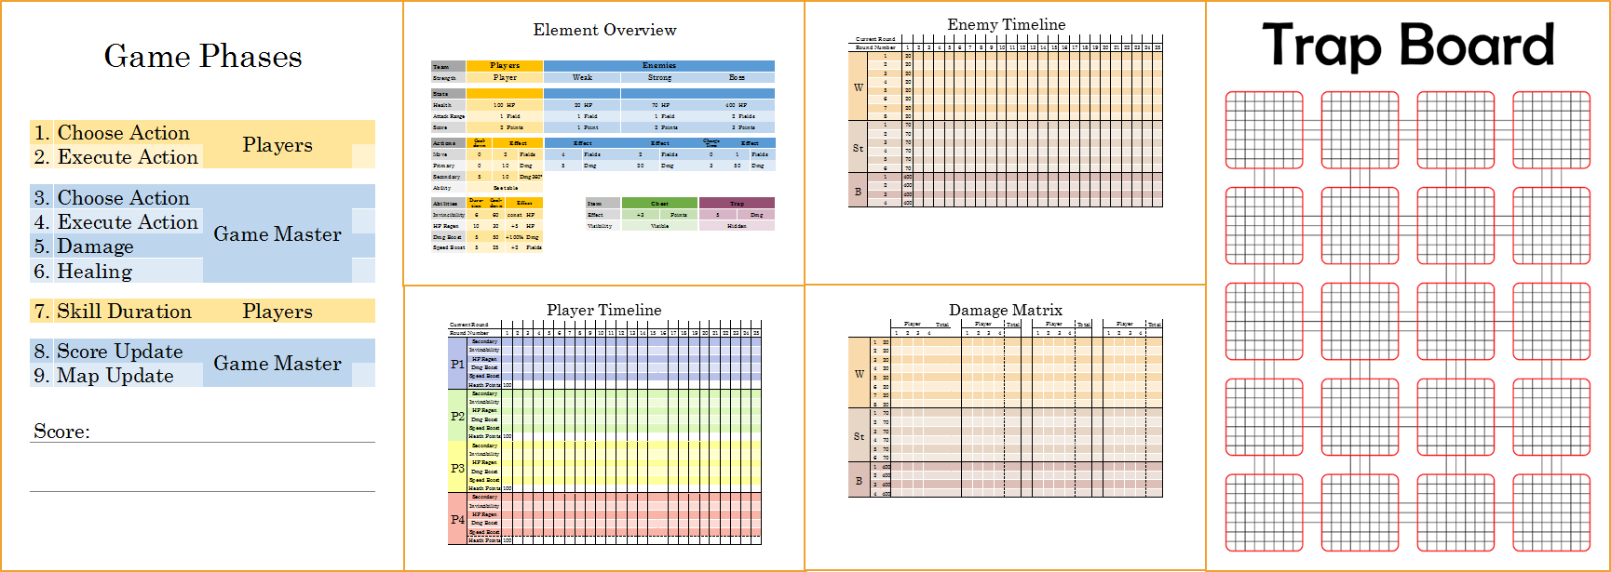
Pitch
Proposal
Interim
Beta
(Release)
Alpha
Playtesting
Stage Generator
Creation and testing of the
physical prototype

Slide 6
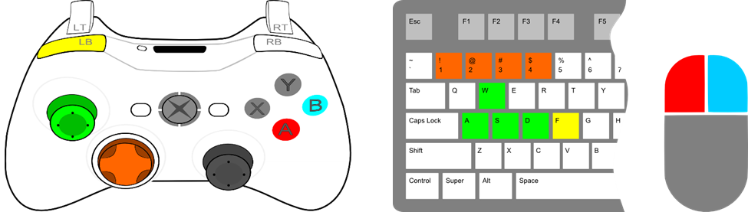
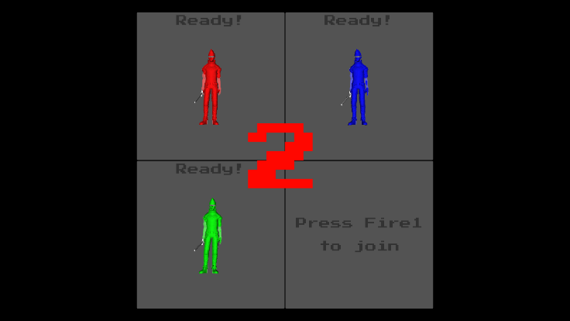
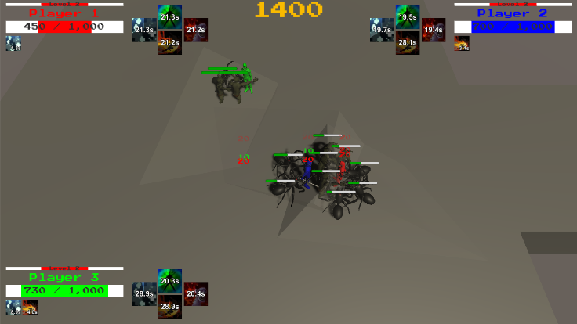
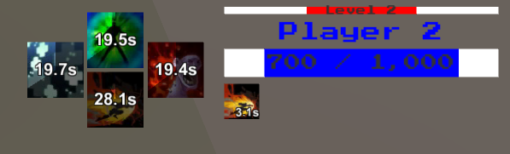
Pitch
Proposal
Interim
Beta
(Release)
Alpha
Playtesting
Unit Mechanics/Controls
Basic UI

Slide 7
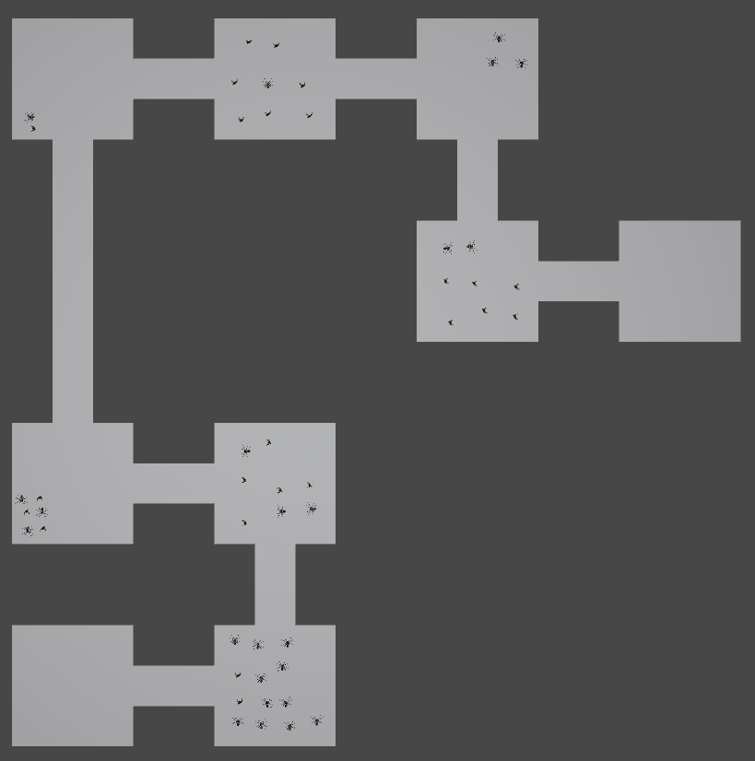
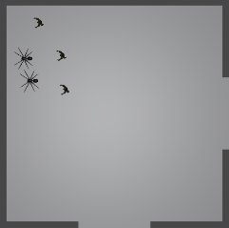
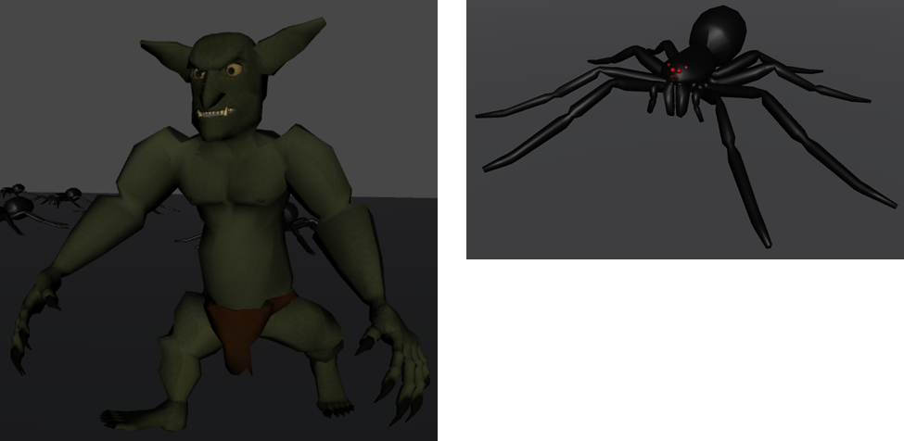
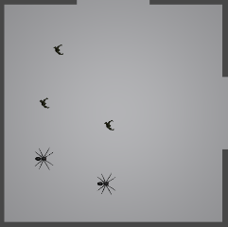
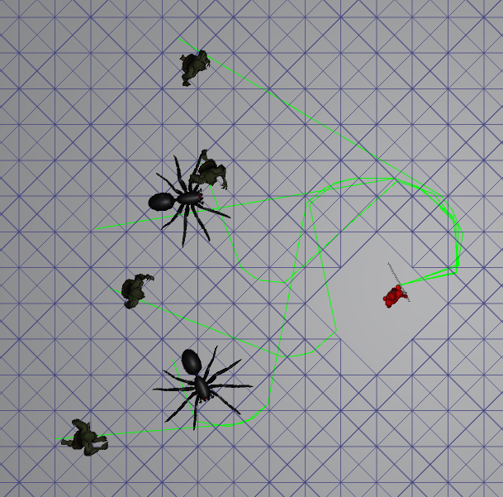
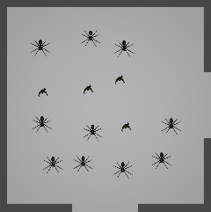
Pitch
Proposal
Interim
Beta
(Release)
Alpha
Playtesting
Stage Generator
Enemies

Slide 8
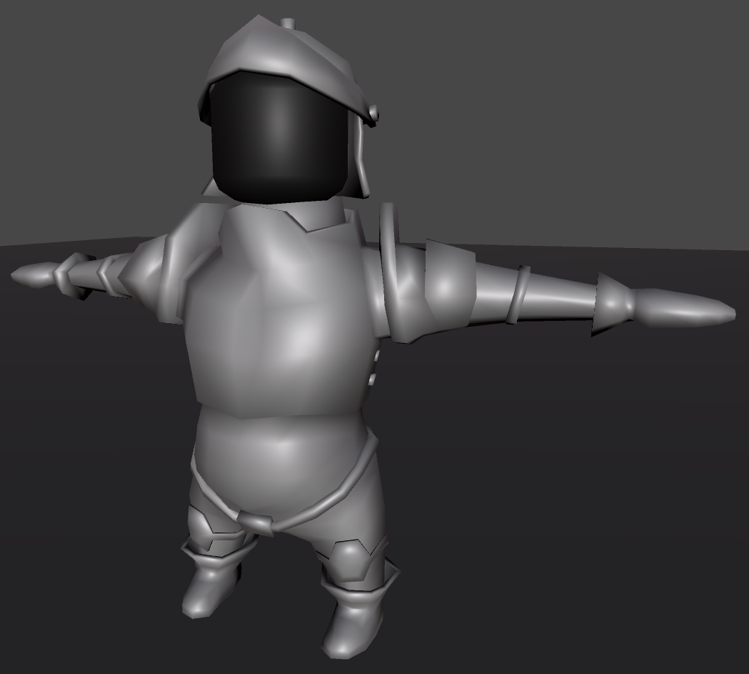
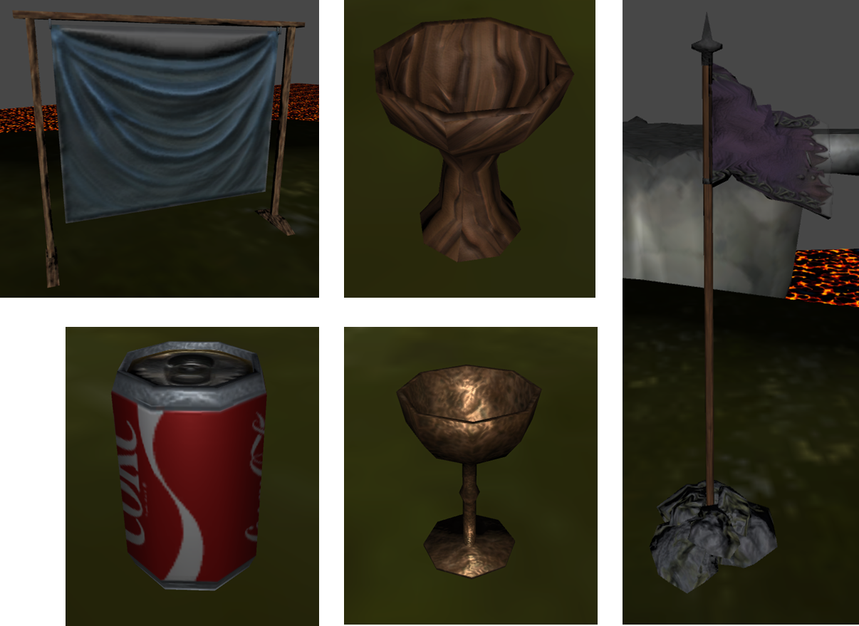
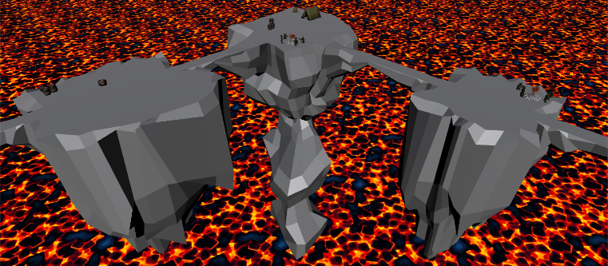
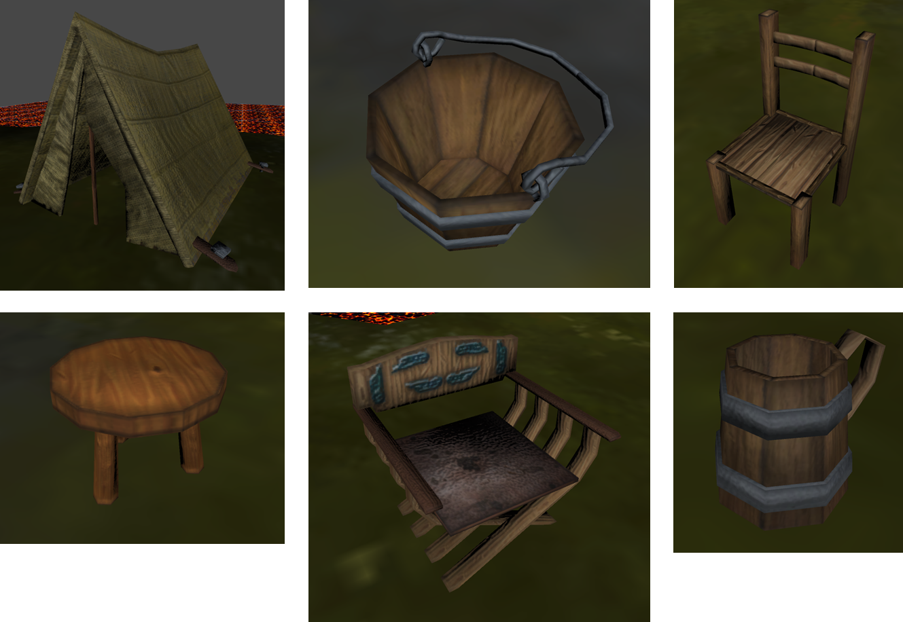
Pitch
Proposal
Interim
Beta
(Release)
Alpha
Playtesting
Player model
Other Models

Slide 9
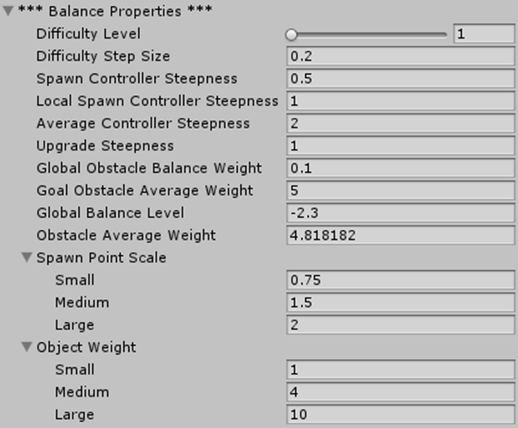
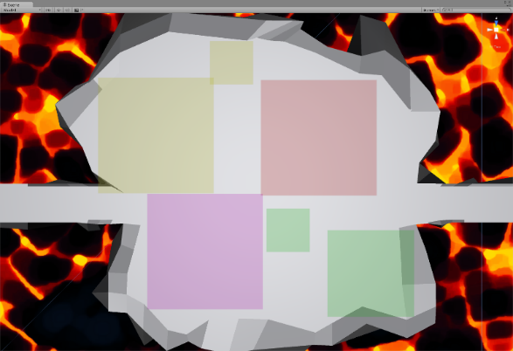
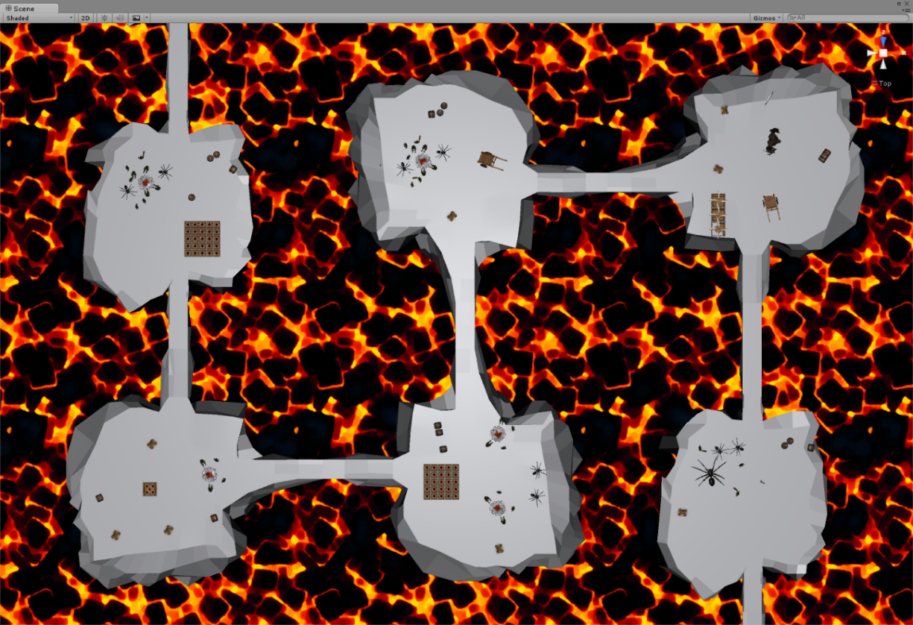
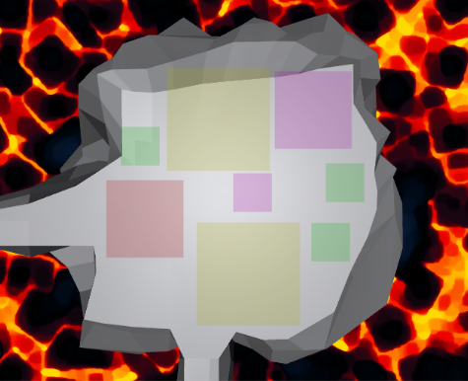
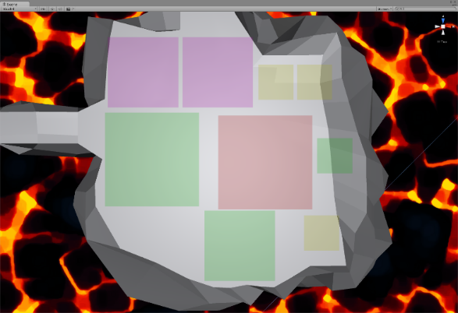
Pitch
Proposal
Interim
Beta
(Release)
Alpha
Playtesting
StageGen Balancing

Slide 10
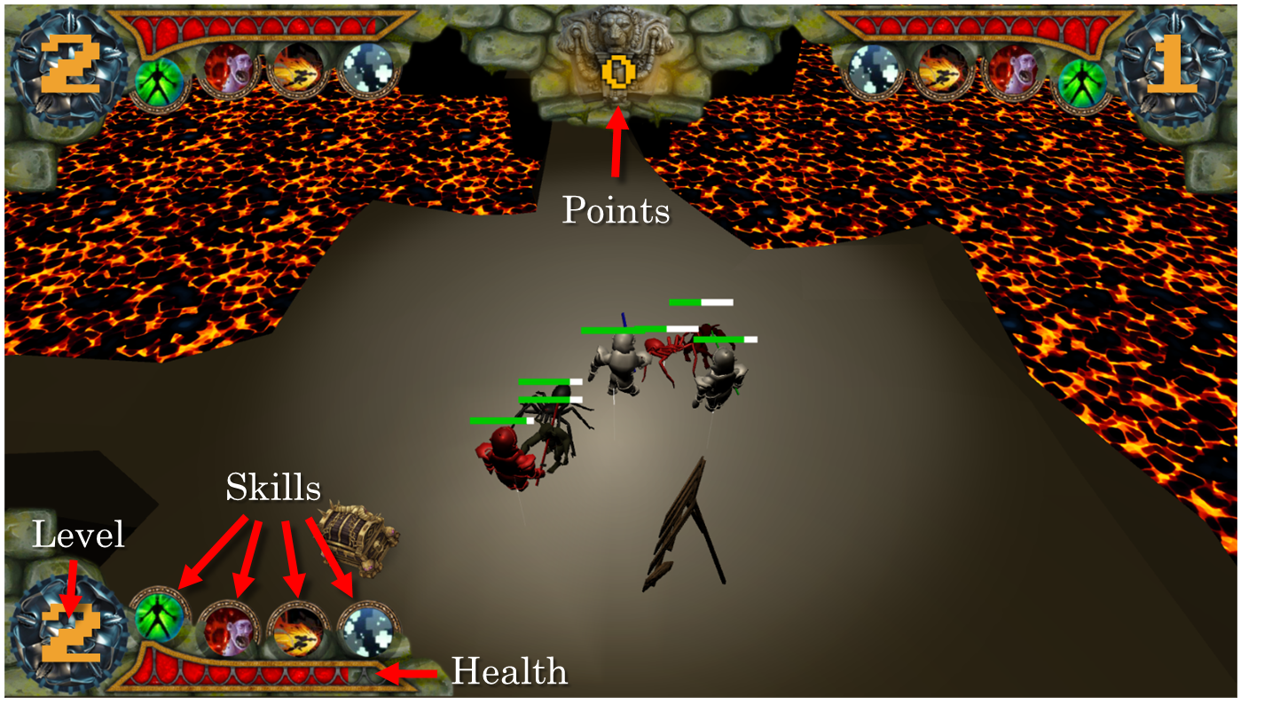
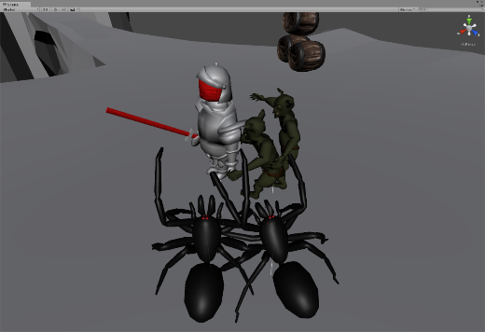
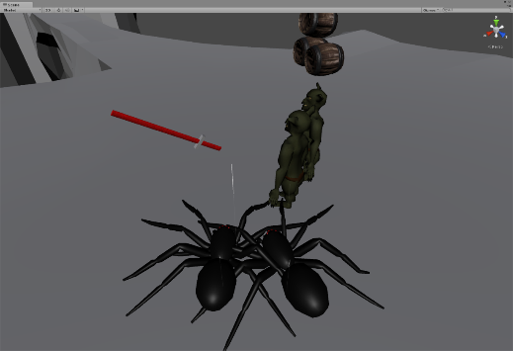
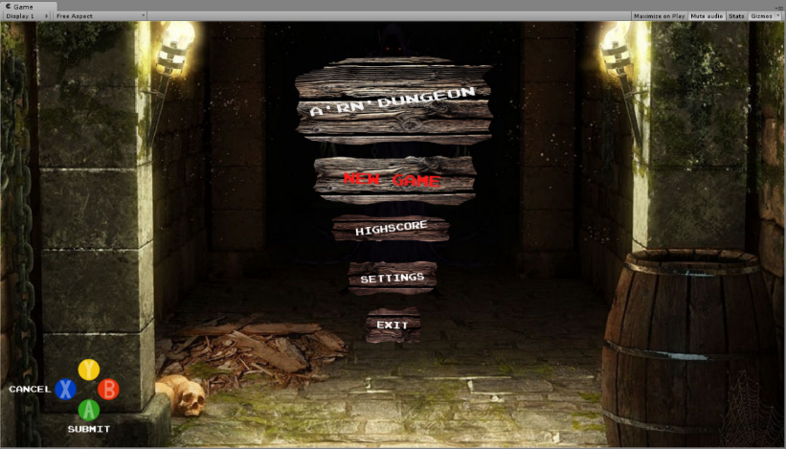
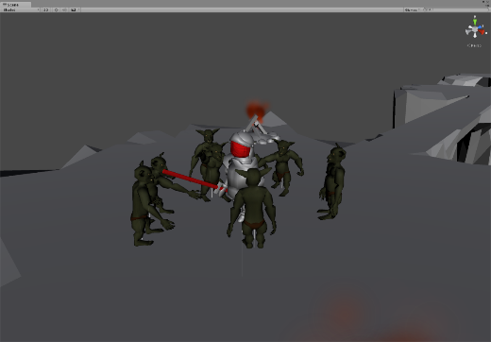
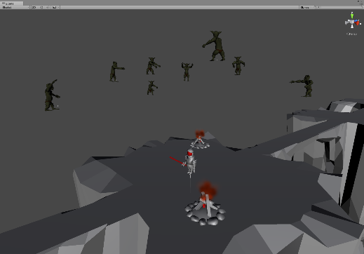
Pitch
Proposal
Interim
Beta
(Release)
Alpha
Playtesting
Intermediate UI
Skill revised
    Invincibility → Invisibility
    Damage Boost → Shockwave

Slide 11
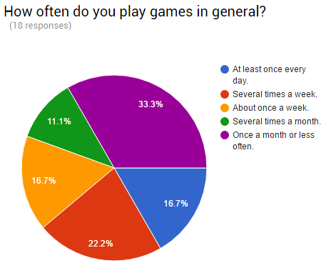
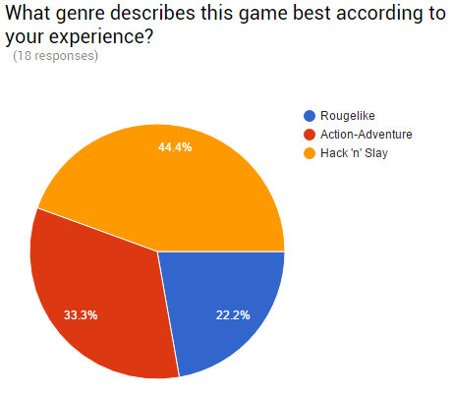
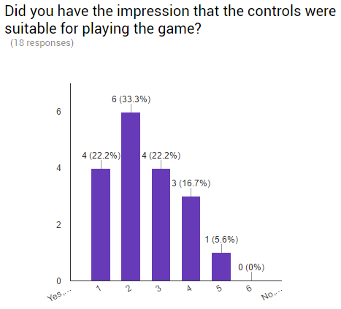
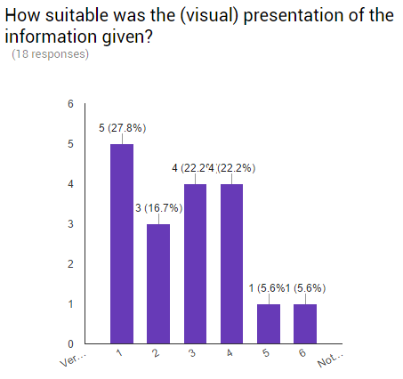
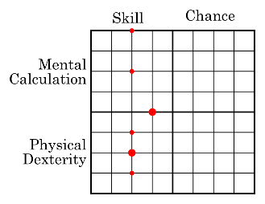
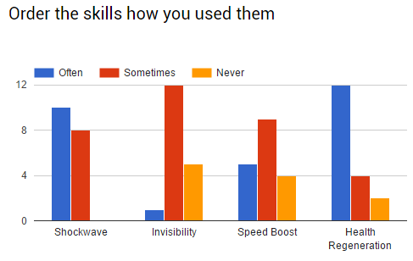
Pitch
Proposal
Interim
Beta
(Release)
Alpha
Play-testing
Future Changes
  Better highlighting of
    Player character
    Active skills
  More effects/animations regarding player status
  Remapping of skills keys
  More and stronger enemies
  …

Slide 12
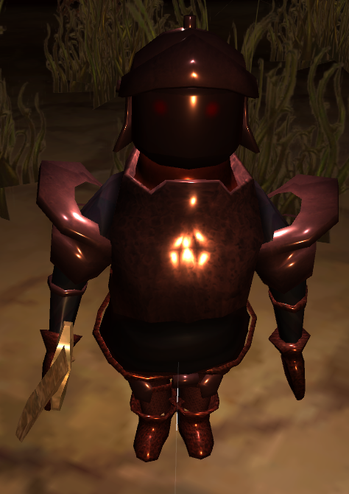
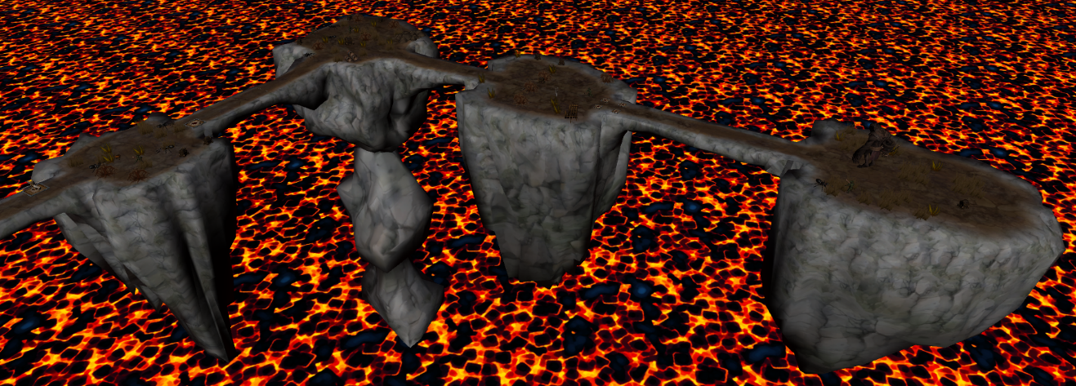
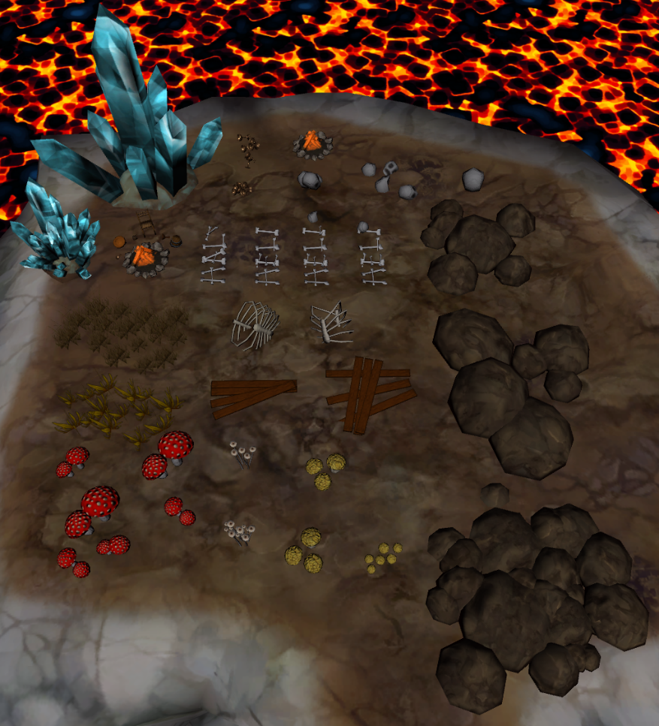
Pitch
Proposal
Interim
Beta
(Release)
Alpha
Playtesting
Prefabs, Models, Materials and Textures

Slide 13
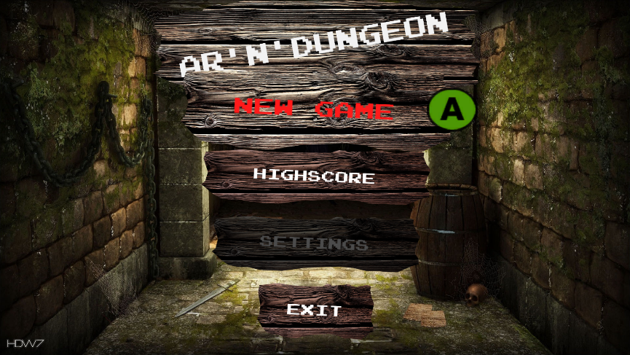
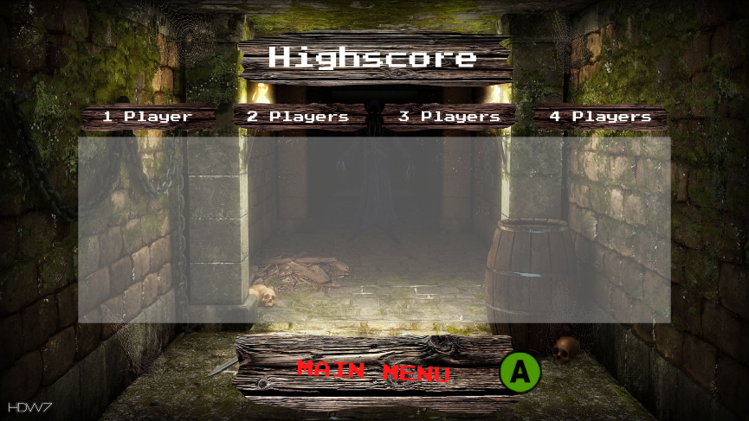
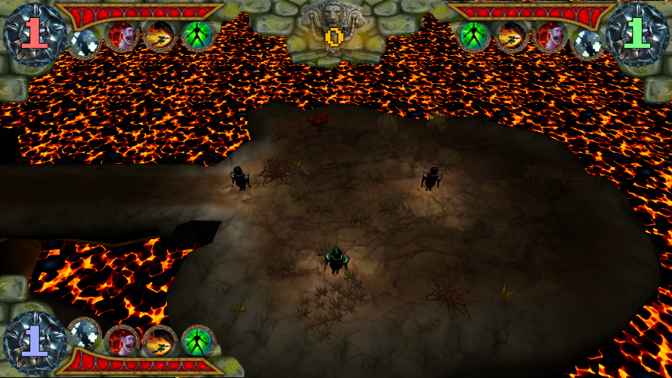
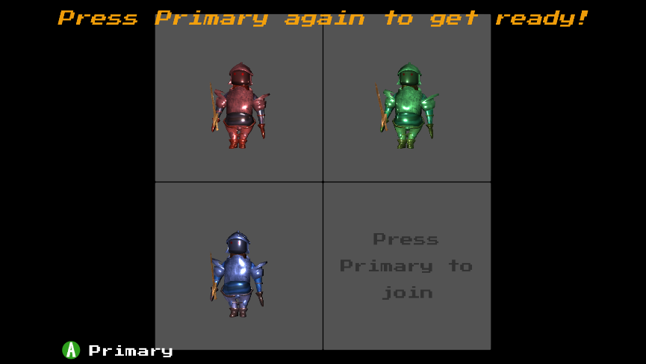
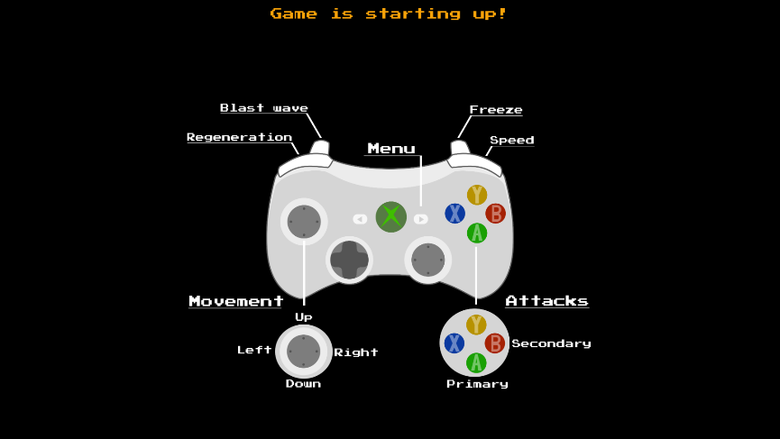

Pitch
Proposal
Interim
Beta
(Release)
Alpha
Playtesting
Advanced UI

Slide 14



Pitch
Proposal
Interim
Beta
(Release)
Alpha
Playtesting
Traps and Balancing

Slide 15
DEMO

Slide 16
Thank you for listening
Any questions?

