Slide 1
Playtesting
Practical course: Game Programming

Slide 2
Setup
Where
  GamesLab (00.13.010)
Who
  Friends and Family
Via
  Facebook posts
  Personal interaction
Session Procedure
  Introduction
  Multiplayer
  Survey

Slide 3
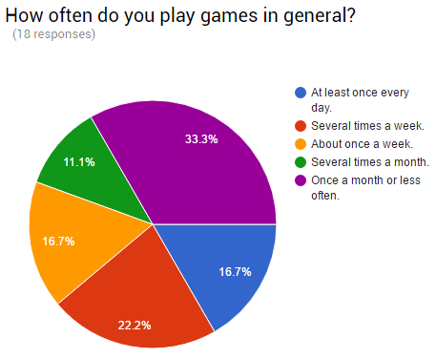
About the testers
18 Testers
Varying weekly playing behavior
Varying favorite genres
  Dominated by Shooter and RPG

Slide 4
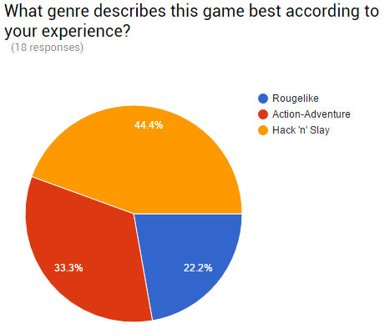
Genre
Overall right direction
For more Action-Adventure
  Classes
  Item loot
  Puzzles
For more Roguelike
  Additional dead end paths

Slide 5
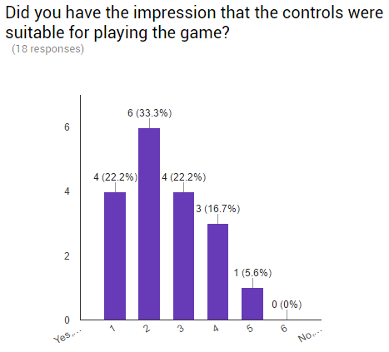
Controls
Seemed to fit to the game
But
  Skills on DPad not practical
  Cant move while activating skill

Slide 6
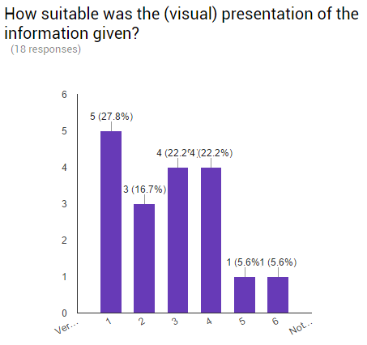
User Interface
The given information was alright
But
  The visual representation was not clear
  Confusion of the tester

Slide 7
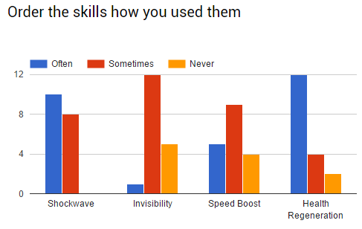
Skills
Shockwave and Health regeneration very popular
Invisibility unpopular
  Character vanishes and player tends to fall of the edge

Slide 8
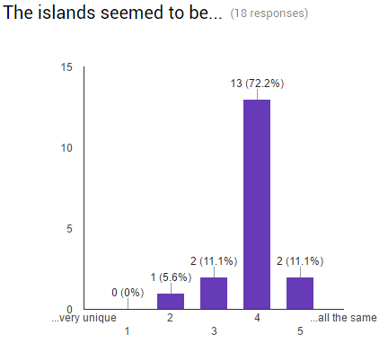
Level generation
The islands seemed very similar
Requested
  The more the better
  Even enemies

Slide 9
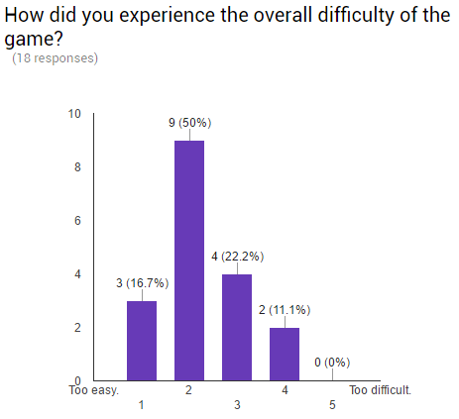
Gameplay
Game was too easy
  Testers didn’t felt challenged
Overall
  The game was fun

Slide 10
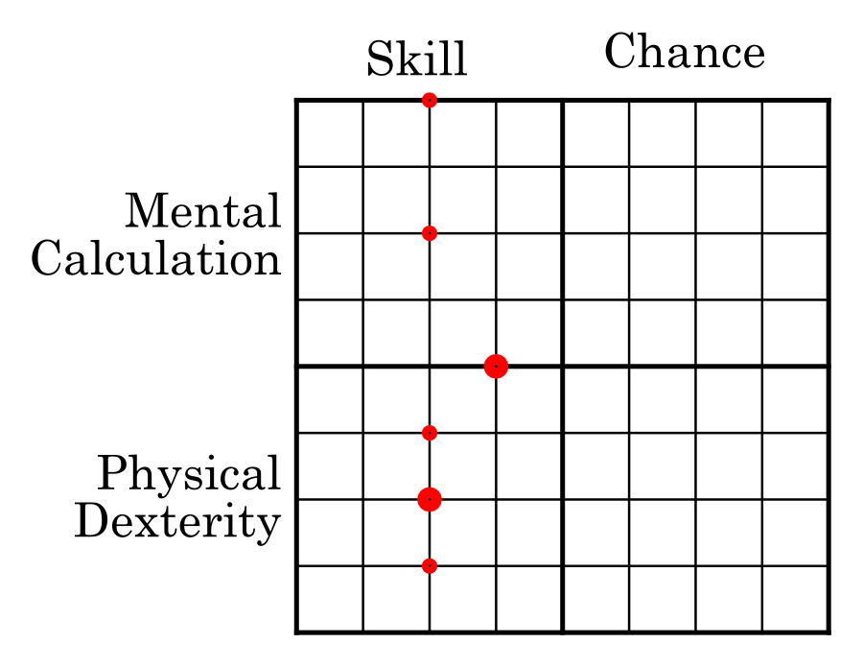
Play matrix
Only 8 of 15 valid results
  No chance
  Low to Medium skill

Slide 11
Future Changes
Better highlighting of
  Player character
  Active skills
More effects/animations regarding player status
Remapping of skills keys
GUI extension regarding the skills
Broader bridges
More and stronger enemies
More interesting placement of traps

Slide 12
Thank you for listening
Any questions?

