Slide 1
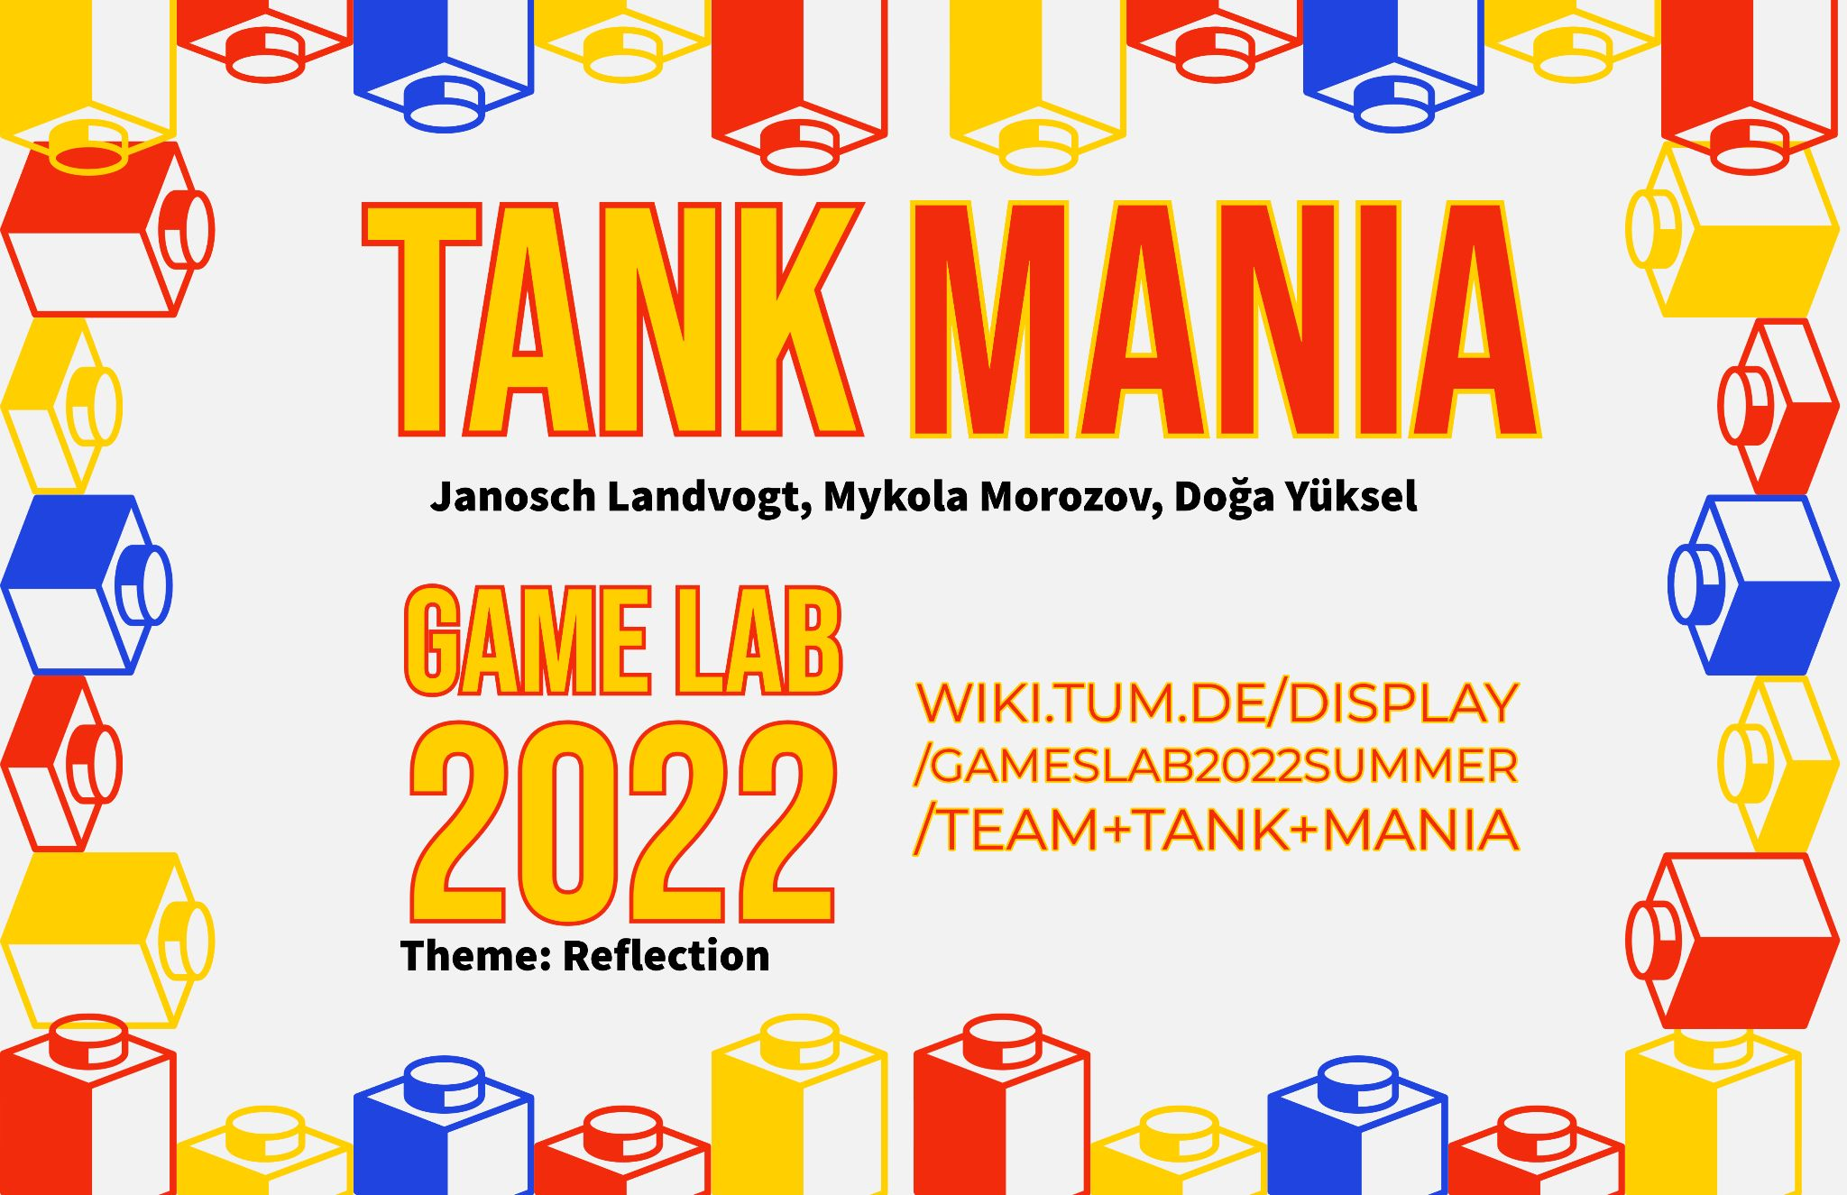
Notes:
Janosch

Slide 2
Agenda
Bugfixing
The questions
The answers
What to change
Notes:
Janosch
I totally forgot to talk about visual updates in the doc too

Slide 3
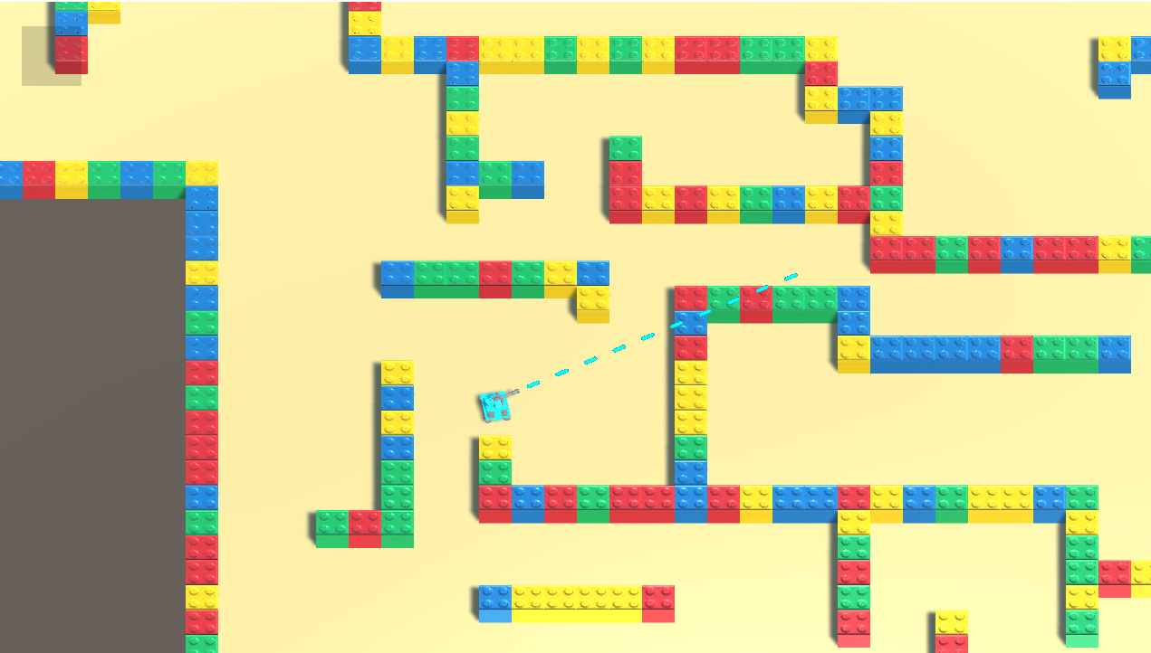
Bugfixes and Improvements
VISUALS!

Slide 4
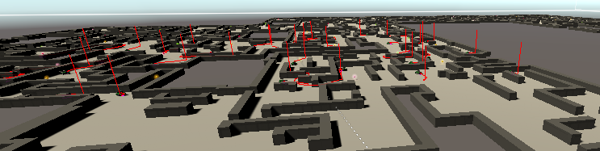
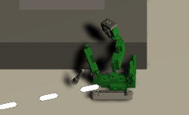
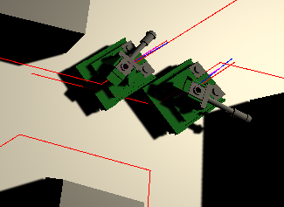
Tank AI and Networking
Enemy spawning and destruction
Enemy patrolling avoidance
Enemy destruction
Enemy shooting

Slide 5
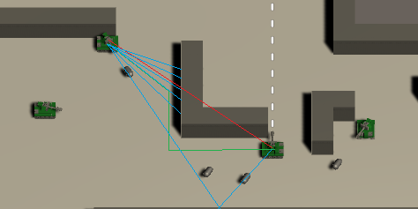
Tank AI Shooting

Slide 6
Our Survey
Rate 1-5 on various general gameplay aspects
Controls, shooting feel, the enemies
Questions on the general experience
Performance, visuals
Learning to play, understanding objective
General enjoyment

Slide 7
Our Survey
Additional notes field on each section if testers want to add more
Open questions at the end:
First impressions
How did it change as you played?
What could be improved?
One addition you’d like to see

Slide 8
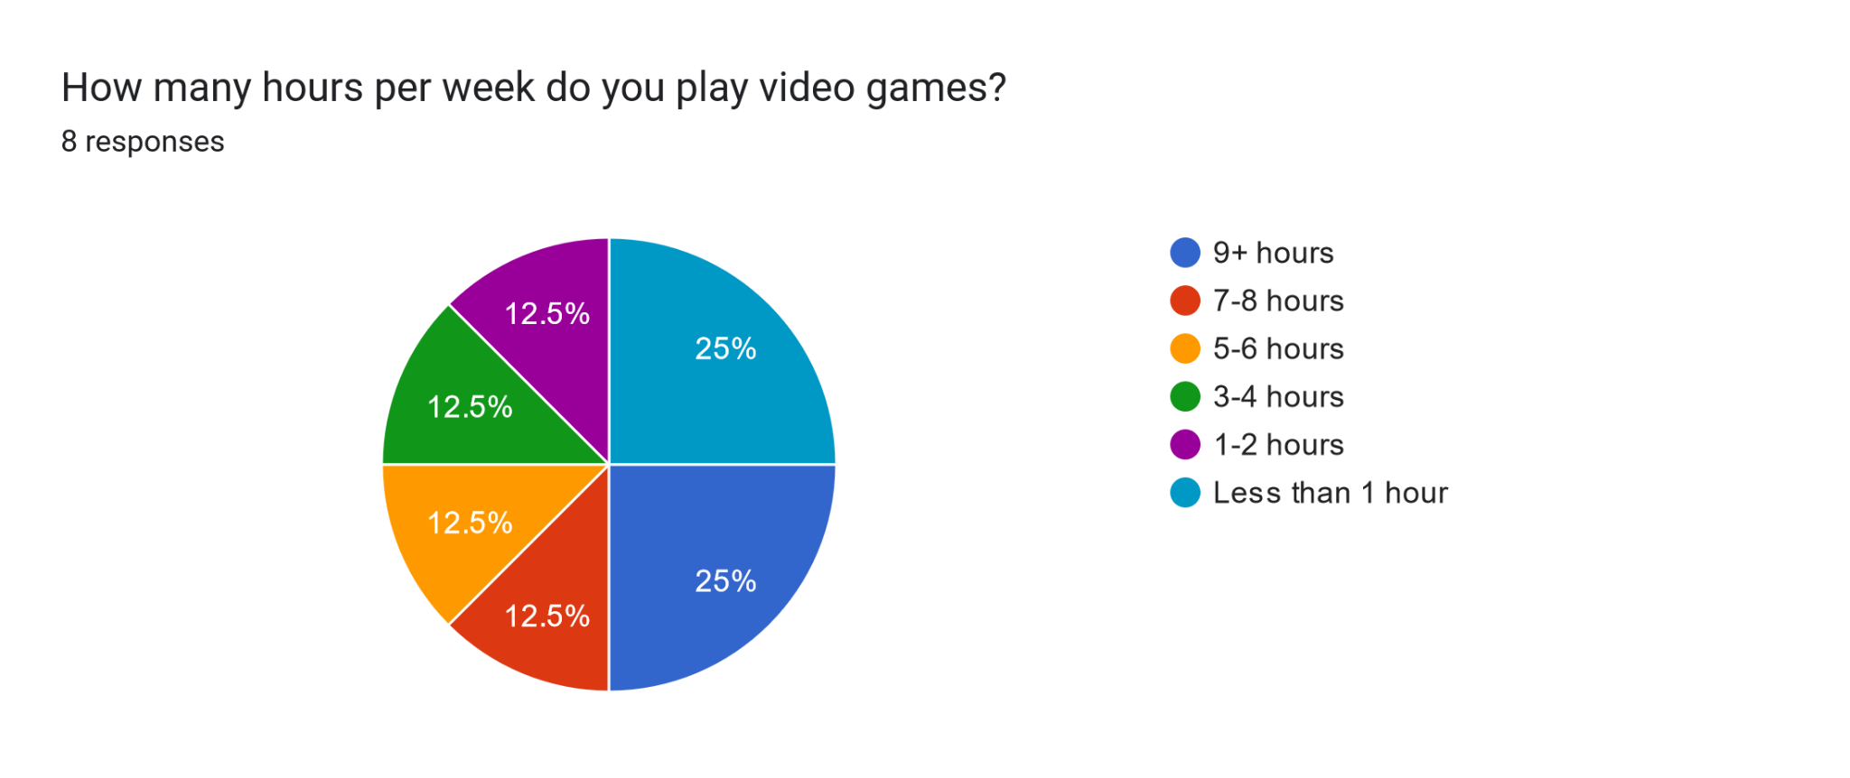
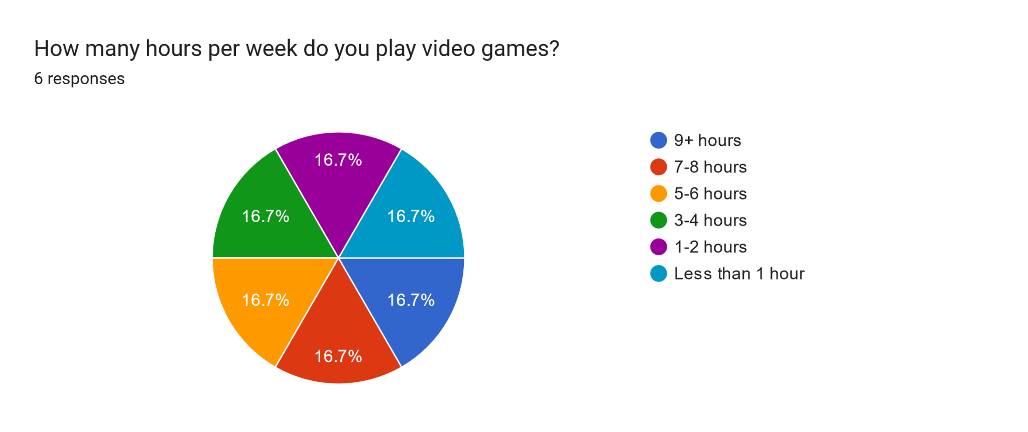
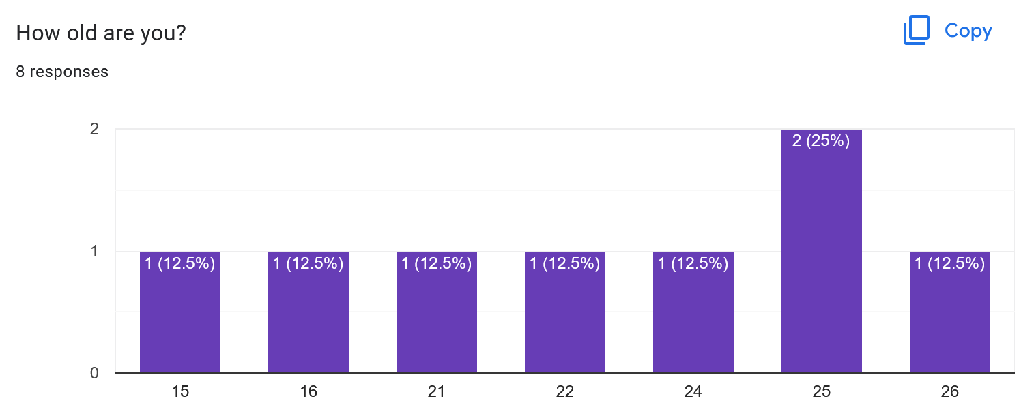
Responses
Demographic:

Slide 9
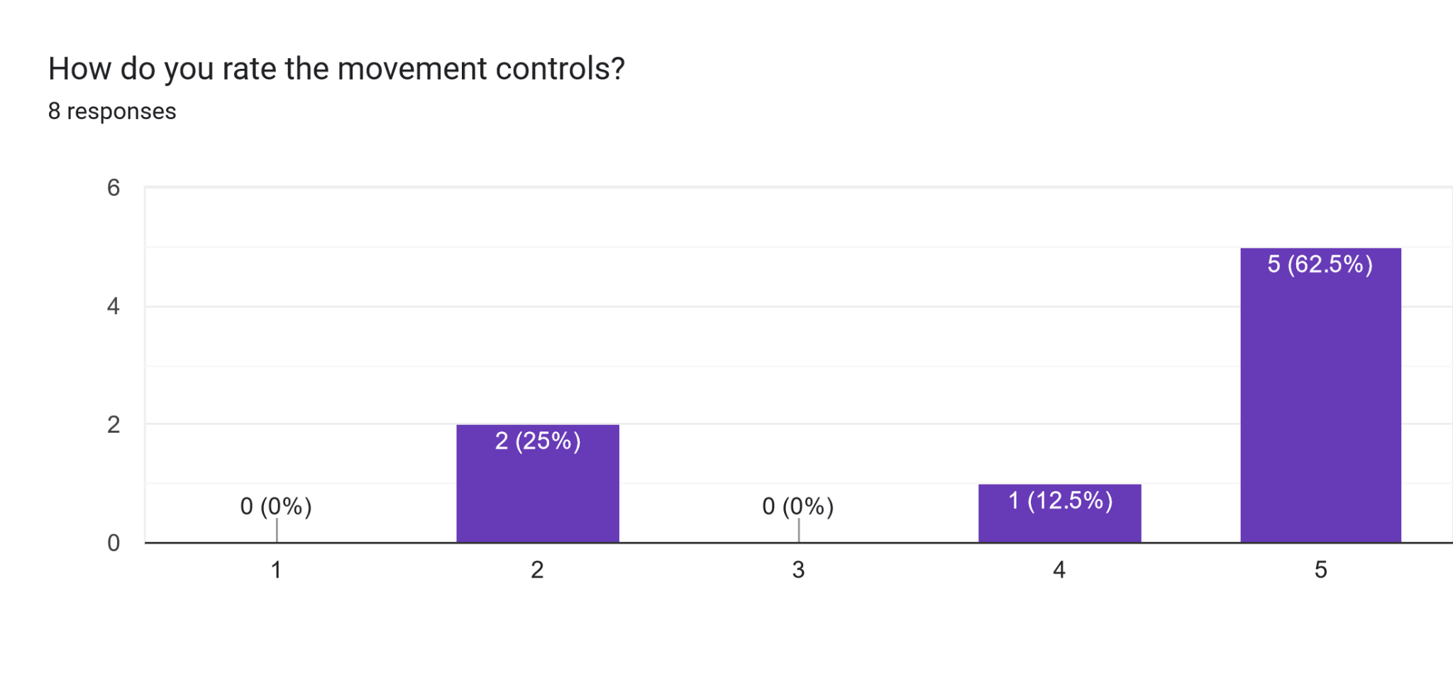
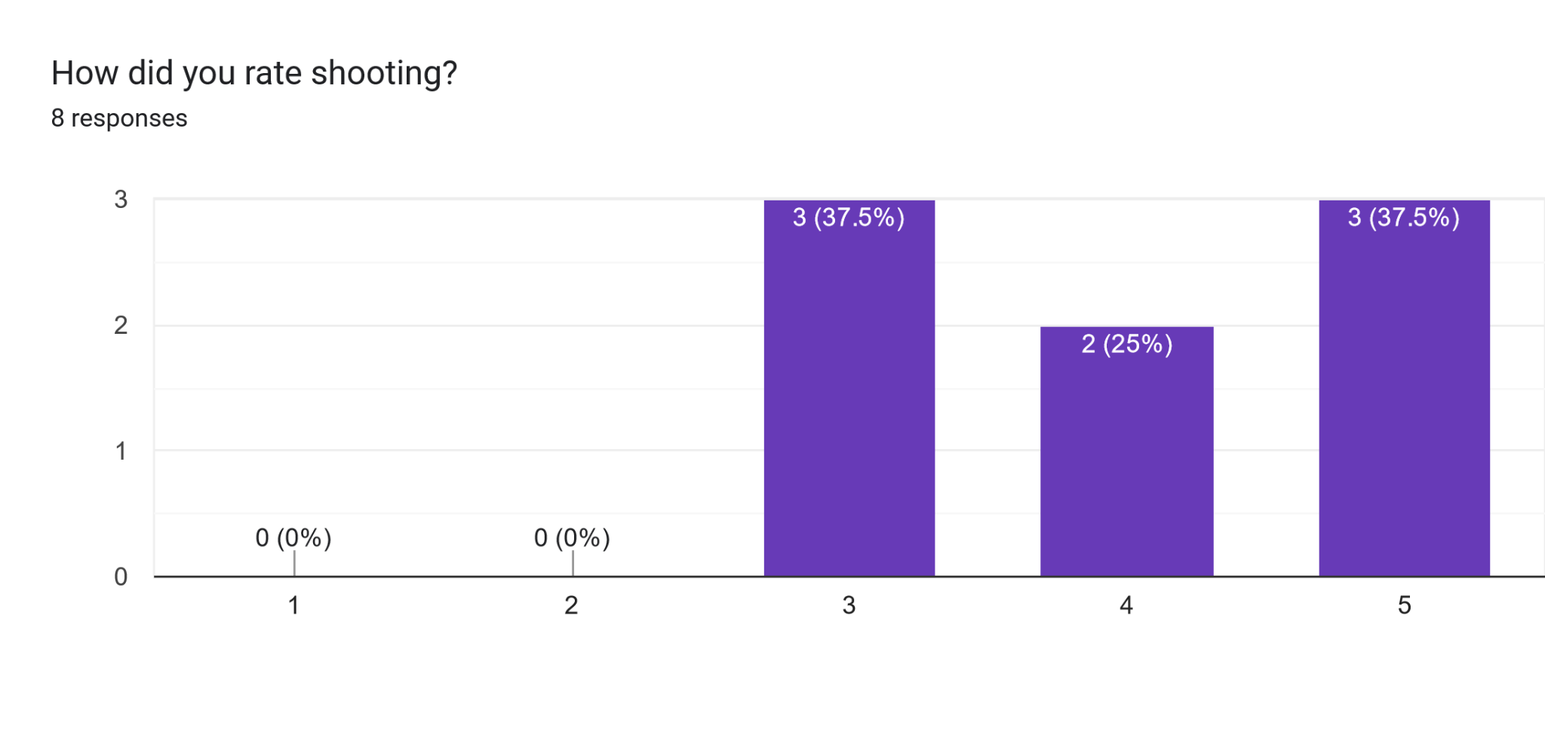
Responses
Criticisms:
“Didn’t feel fluid” / “...clunky”
Levels too large / low speed
Can’t differentiate bullets
Positive too:
“Looked fun and tank-like”

Slide 10
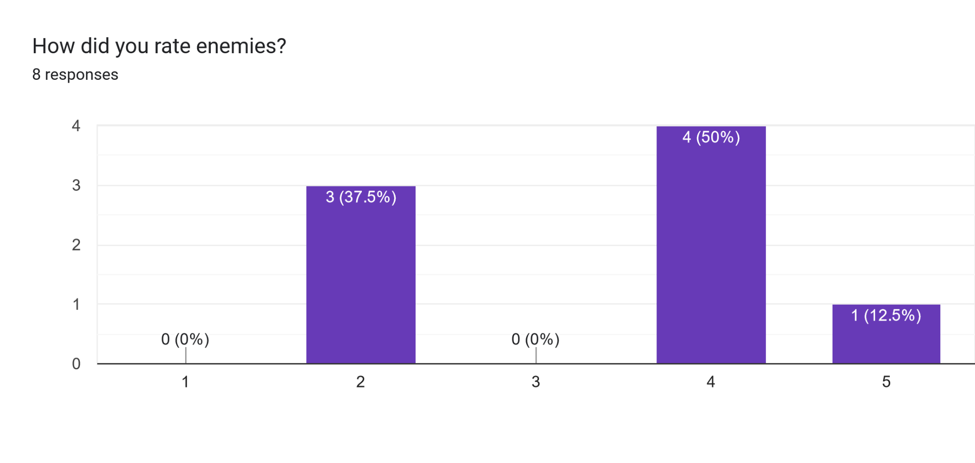
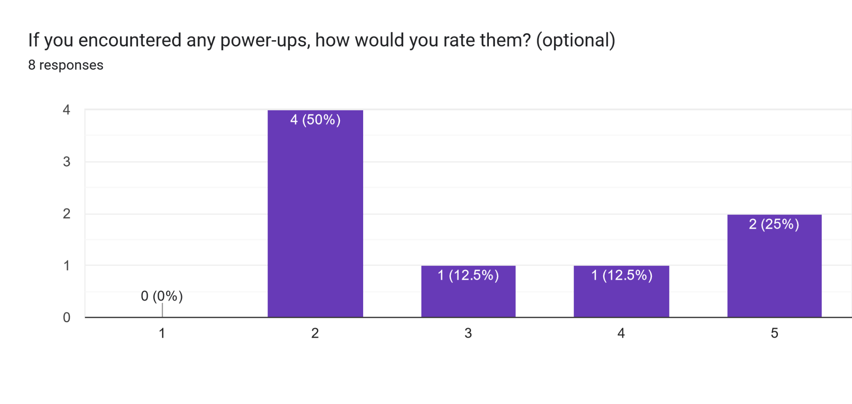
Responses
Criticisms:
Overwhelming / difficult to track
Bullet hell
Some power-ups were useless / confusing
Positive comments:
“Perfectly challenging enough”
Enemies tried to stop my bullets
Movement boosting power-ups

Slide 11
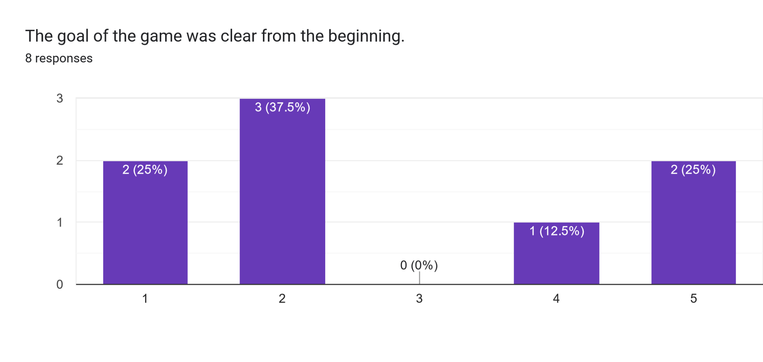
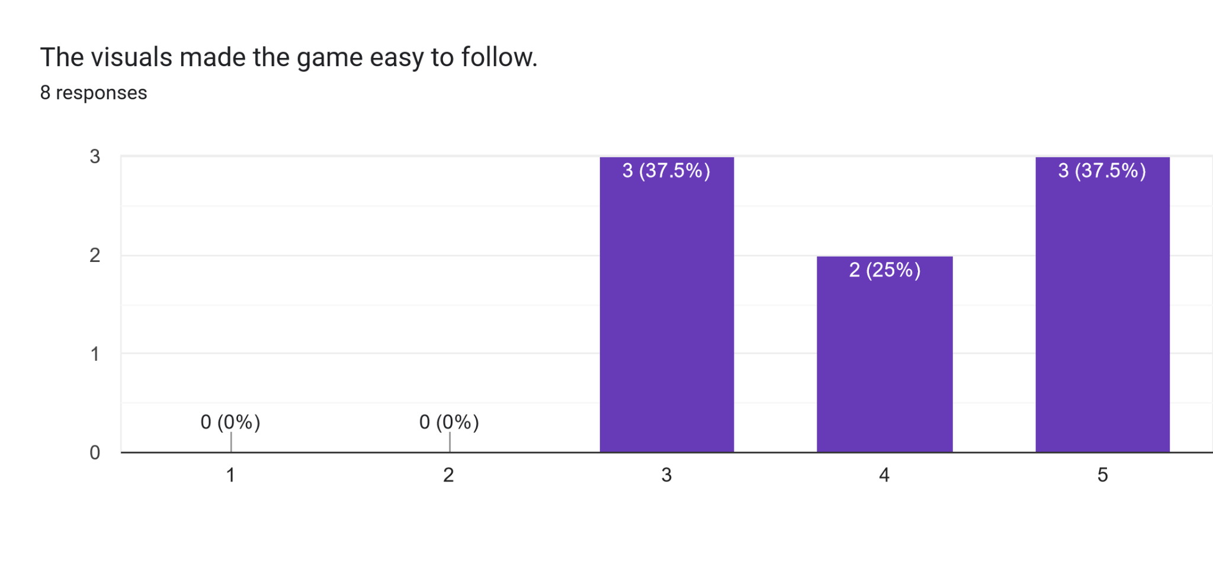
Responses
Lack of tutorialization
Button controls were not shown
To survive or to reach somewhere … ?

Slide 12
Gameplay Analysis
Controls
  Discovered all and quite intuitive
  Not sure about all controls
Spamming shooting
  More kills
  Easier challenge
  More aggressive
  Quicker death
  Not intended gameplay
Visuals confusing
  Bullets (Player/Enemy)
  Tank color
  Item meaning

Slide 13
Gameplay Analysis
Items
  Icon was not always noticed
  Hard to understand
  Not helpful with timing
Task unclear
  No scoring (yet)
  No enemy, bullets or direction indication (yeet)
Gameplay restrictions
  More restrictions seemed to help with understanding gameplay
Bullets
  Bullets out of nowhere were deadly
  Long trajectories were deadly

Slide 14
Gameplay Analysis
Difficulty
  Overall too hard or too easy, no flow
  Deaths were hard to understand -> Ragequits

