Slide 1

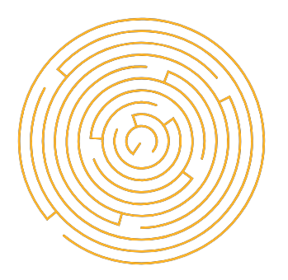
Light of Daedalus
Games Lab Summer 2022
Tobias Mesmer, Tim Simecek, Imen Hellali

Slide 2

Playtest Structure
1-on-1 sessions
Test devices (Oculus Rift & Quest 2)
Playtest structure document ensuring similar playtests
Structure:
Briefing(5 min)
Playtest(30 min)
Survey(15-20 min)
Games Lab summer 2022: Tobias Mesmer, Tim Simecek, Imen Hellali
Notes:
Briefing: Setup for VR (lense distance etc.)

Slide 3
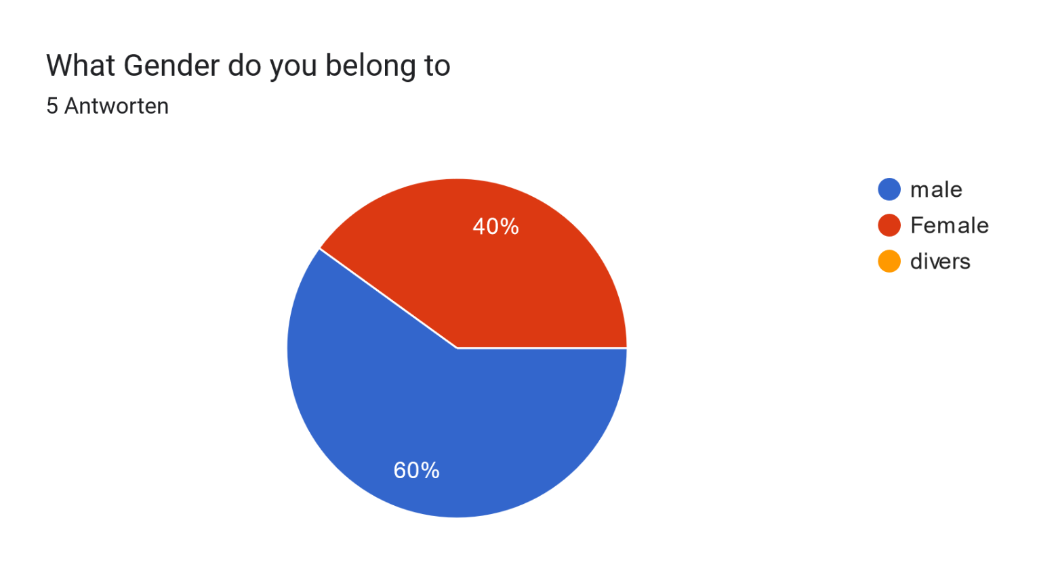
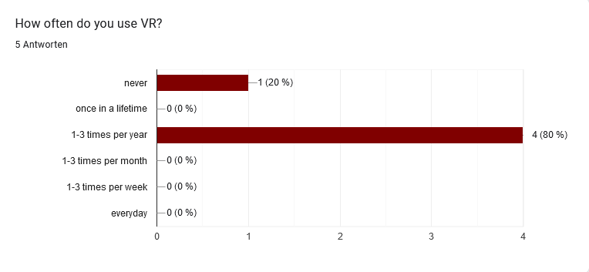
Participants
Friends & Family
5 Participants
Age: 18-26
Games Lab summer 2022: Tobias Mesmer, Tim Simecek, Imen Hellali
Notes:
Gender distribution almost equal.
Only testers who are not very familiar/experienced with VR.

Slide 4
Results & Planned Changes
Overall positive impression
1-2 features worsened playthrough
“If these things are fixed, it is a great game”
Games Lab summer 2022: Tobias Mesmer, Tim Simecek, Imen Hellali
Notes:
Learning about current color that you have and possibility of unlocking new ones that you can use in next levels….
how reflective surface work and how they change the outgoing color

Slide 5
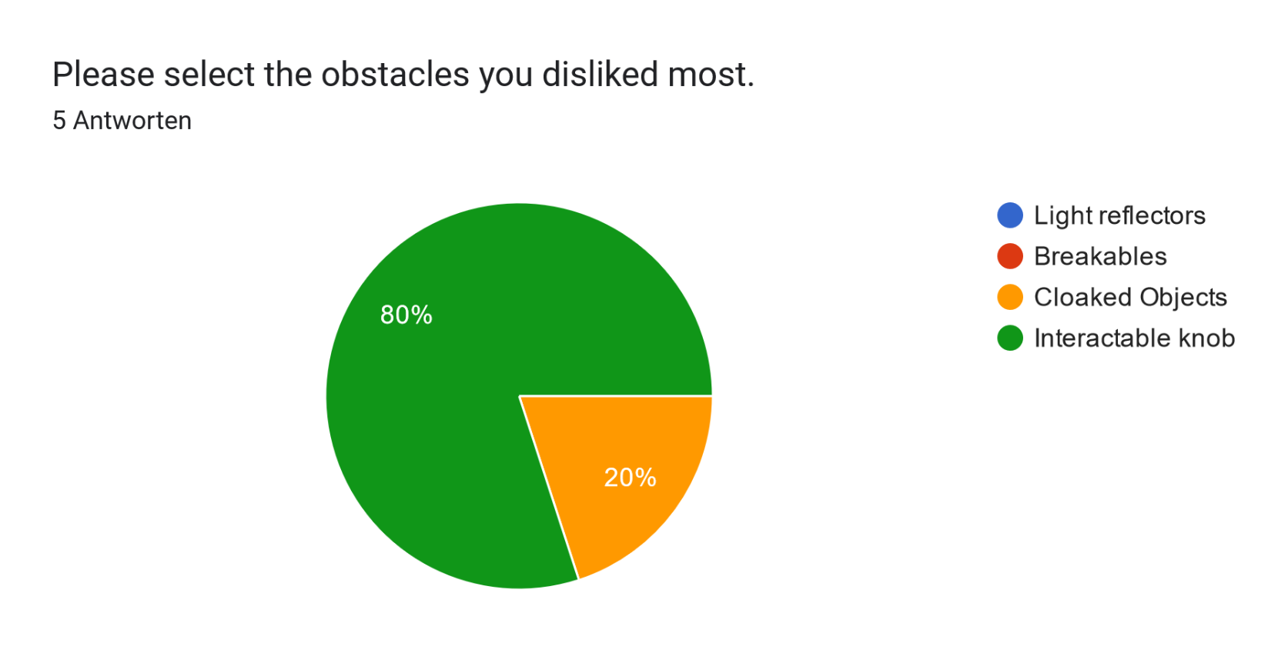
Results & Planned Changes
Games Lab summer 2022: Tobias Mesmer, Tim Simecek, Imen Hellali
Notes:
Learning about current color that you have and possibility of unlocking new ones that you can use in next levels….
how reflective surface work and how they change the outgoing color

Slide 6
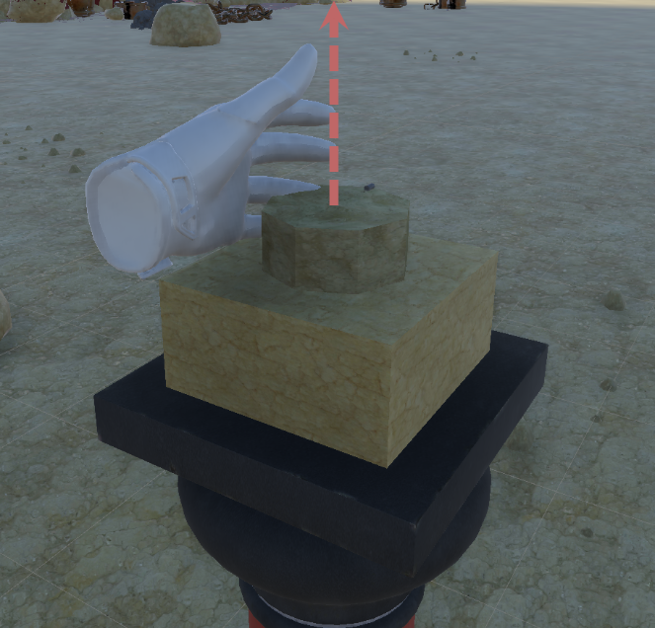
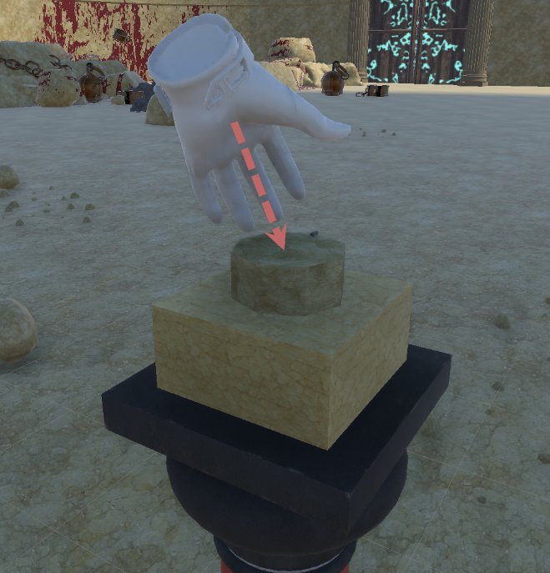
Results & Planned Changes
Interactable:
Disappearing hand on correct interaction confused
Participants grabbed horizontally (not considered initially)
Planned Changes:
Rotation depending on global rotation -> horizontal &
vertical interaction possible
Keep Hand visible during interaction
Add interactable to main menu
Games Lab summer 2022: Tobias Mesmer, Tim Simecek, Imen Hellali
Notes:
Learning about current color that you have and possibility of unlocking new ones that you can use in next levels….
how reflective surface work and how they change the outgoing color

Slide 7
Results & Planned Changes
Cloaked Objects & corresponding mirrors:
Participants were confused by the obstacle
Cloaked objects were hardly recognizable
Confusion/Frustration due to feeling of “randomness”
Planned Changes:
Glowing outline to guide player view
Add very basic tutorial level
Increase size further
Games Lab summer 2022: Tobias Mesmer, Tim Simecek, Imen Hellali
Notes:
Learning about current color that you have and possibility of unlocking new ones that you can use in next levels….
how reflective surface work and how they change the outgoing color

Slide 8
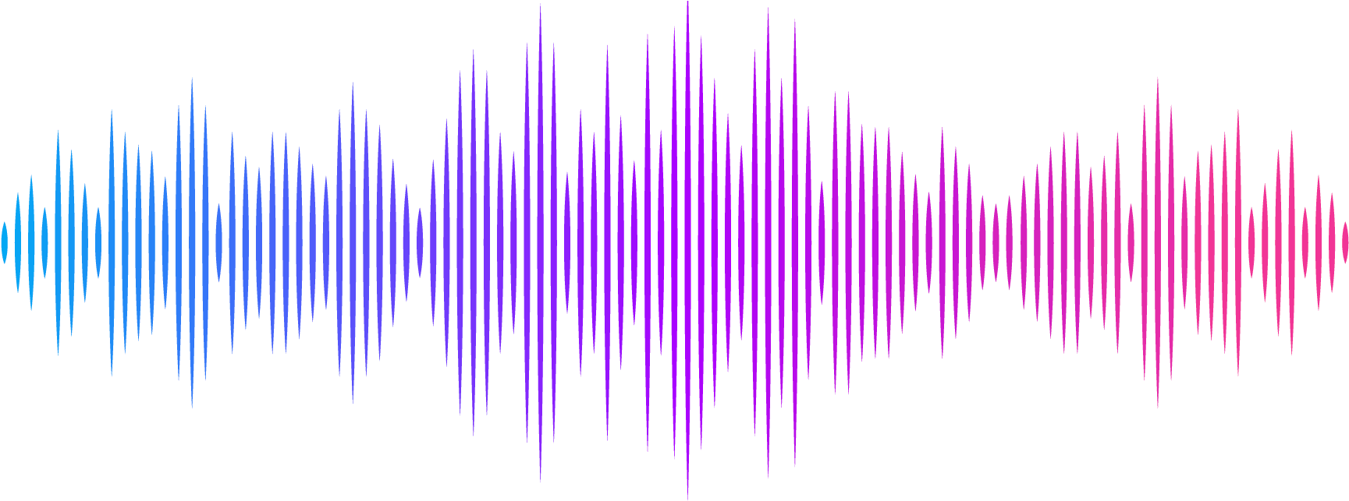
Results & Planned Changes
Sound:
Ambient of main menu & L1 too loud
Sound effects too loud
Ambient of dungeon levels too quiet
Planned Changes: Simply attune sounds correctly
Games Lab summer 2022: Tobias Mesmer, Tim Simecek, Imen Hellali
Notes:
Learning about current color that you have and possibility of unlocking new ones that you can use in next levels….
how reflective surface work and how they change the outgoing color

Slide 9
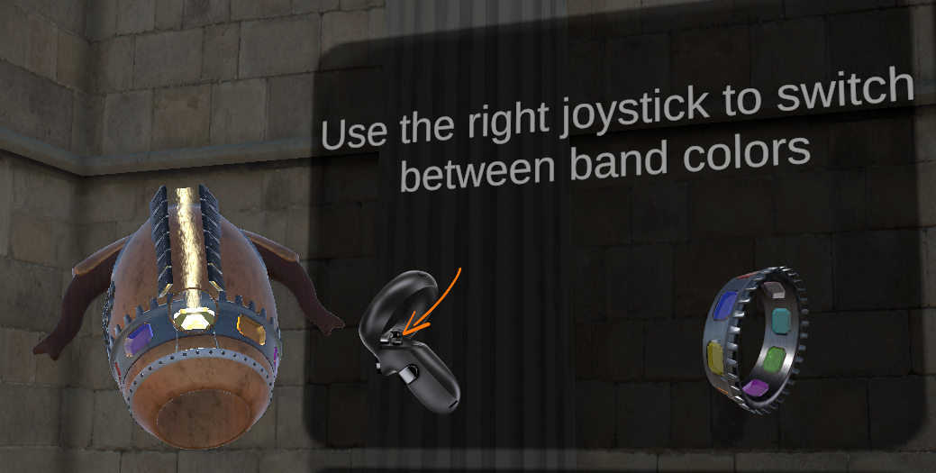
Results & Planned Changes
Further findings:
Only 1 color at the beginning confused (color change not possible)
Exit game button assignment problematic
Story was irrelevant for everyone -> Focus only on gameplay
Planned Changes:
Add second color already at the beginning to enable switch
Exit the game by UI Element in main menu
Make light beam colors more distinguishable
Emphasize creepy look by light changes
Games Lab summer 2022: Tobias Mesmer, Tim Simecek, Imen Hellali
Notes:
Learning about current color that you have and possibility of unlocking new ones that you can use in next levels….
how reflective surface work and how they change the outgoing color

Slide 10
Polishing list
Unlock second color at beginning
Remove “exit game” button from controller
Add Interactable to main menu
Rotate Interactable according to global rotation
Glowing outline for cloaked objects
(Increase size of mirror)
Attune Sound
Exit game by main menu UI
More distinguishable Light colors
Change lighting for creepiness
Games Lab summer 2022: Tobias Mesmer, Tim Simecek, Imen Hellali
Notes:
Learning about current color that you have and possibility of unlocking new ones that you can use in next levels….
how reflective surface work and how they change the outgoing color

Slide 11
Thanks!
Games Lab summer 2022
Tobias Mesmer, Tim Simecek, Imen Hellali
Maze: Example Generated maze from Leoche/Svg-Circular-Maze-Generator: Svg Circular Maze Generator (github.com) Minotaur image by bapabst Minotaur by bapabst on DeviantArt

