Slide 1

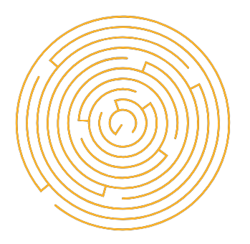
Light of Daedalus
Games Lab summer 2022
Tobias Mesmer, Tim Simecek, Imen Hellali

Slide 2

Game Idea
Game genre
As a warrior from Athens during a siege by Spartans, determinate to defend the city, you embark on a journey to free Daedalus’s soul and inherit his wisdom, to ensure the survival of your people.
As you dive into the depths of the maze, using the guiding light of daedalus, you pass different levels until you reach his soul where the minotaur resides.
Virtual Reality, Puzzle Game
Games Lab summer 2022: Tobias Mesmer, Tim Simecek, Imen Hellali

Slide 3
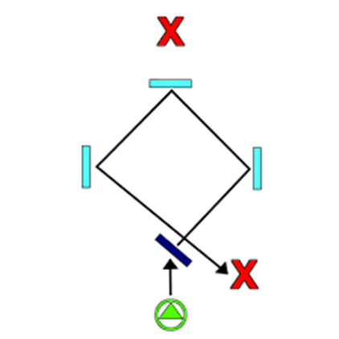
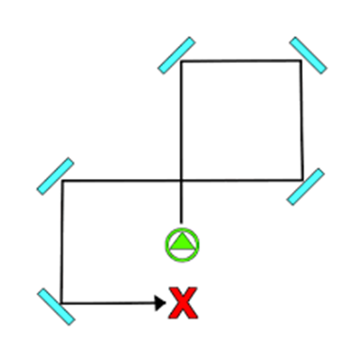
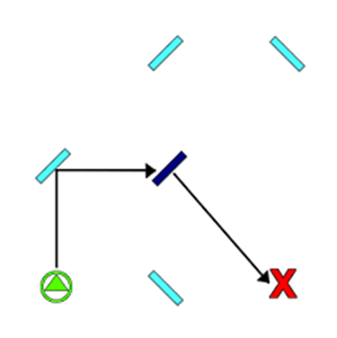
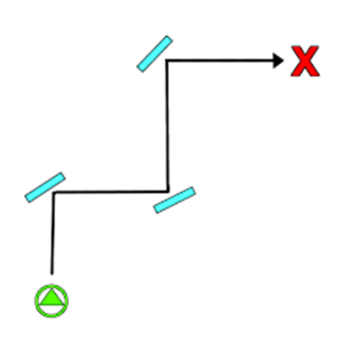
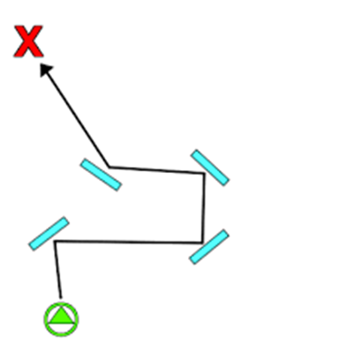
Game Walkthrough
You progress to each level by hitting the target with the correct color and using the correct combination of reflective objects to determine the path of the shot ray.
Puzzle solution from Genshin Impact, ice water puzzles: Решение всех 11 головоломок Водное и Ледяное Зеркало в Genshin Impact 2.5(portalvirtualreality.ru)
Games Lab summer 2022: Tobias Mesmer, Tim Simecek, Imen Hellali

Slide 4
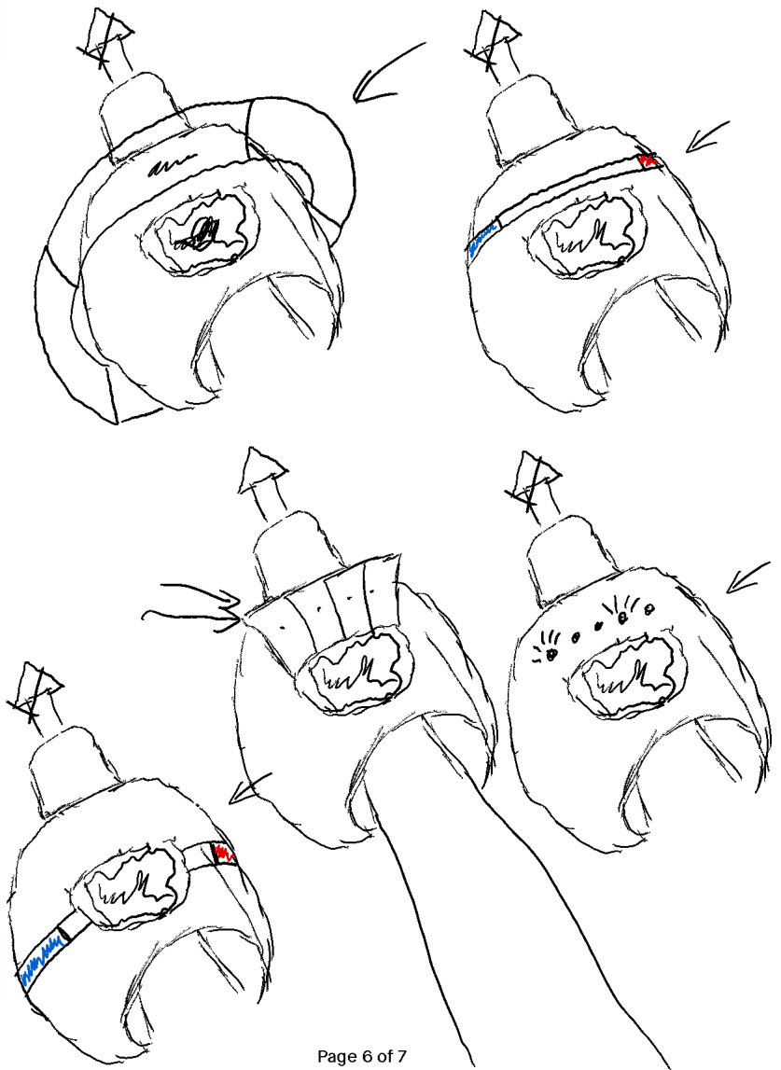
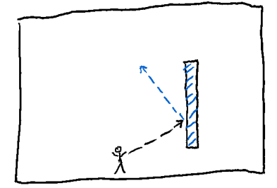
Game Mechanics
Equipment: Light of Daedalus (Ray shooting device with possibility to change color progressively)
Target object: Hit with specific color allows to continue with the next level
Color reflective objects: Reflects incoming ray and may add a specific color
Games Lab summer 2022: Tobias Mesmer, Tim Simecek, Imen Hellali

Slide 5
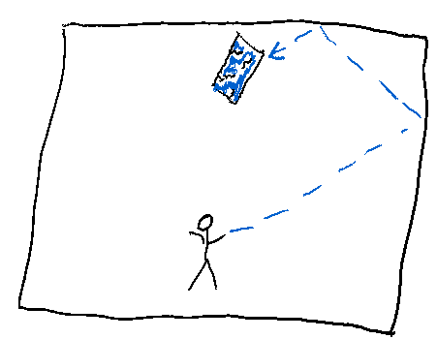
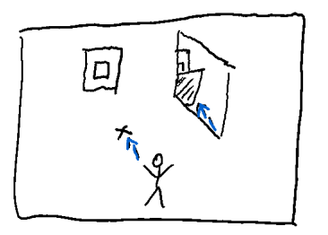
Game Mechanics
Breakable objects: Hit with specific color destroys it
Cloaked objects: Objects only visible through mirrors
Interactables: Interactions start translating/rotating specific Obstacles
Games Lab summer 2022: Tobias Mesmer, Tim Simecek, Imen Hellali

Slide 6
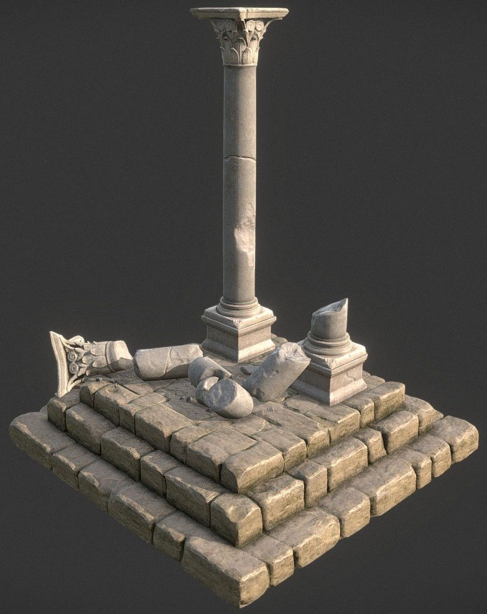
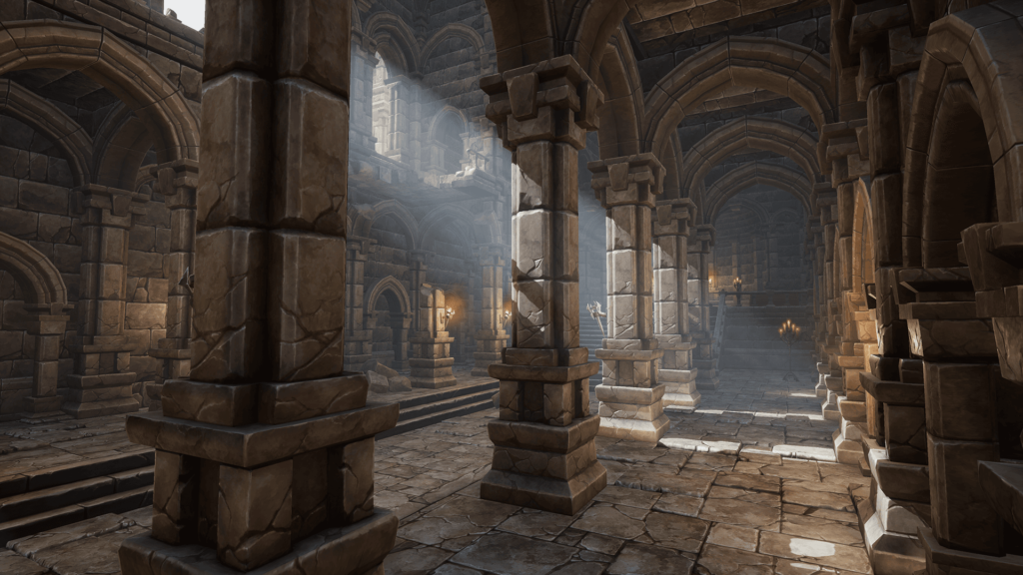
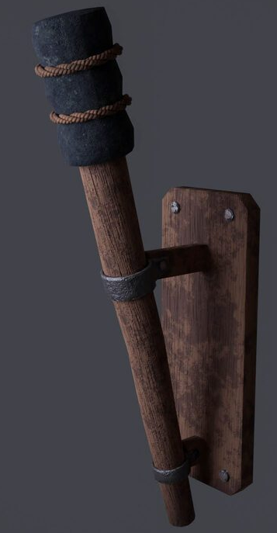
Game World: Design choice
Greek Ruins Diorama by Roumen Flipov: Greek Ruins Diorama - Buy Royalty Free 3D model by roumen.filipov (@roumen.filipov) [26d0eb4] (sketchfab.com)
Dungeon example image from Dungeon Asset: Free Dungeon Pack for Unreal (80.lv)
Wall Torch example image by iLLusianist: Wall torch (119422) 3D model - Download 3D model Wall torch (119422) | 119422 | 3dbaza.com
Games Lab summer 2022: Tobias Mesmer, Tim Simecek, Imen Hellali

Slide 7
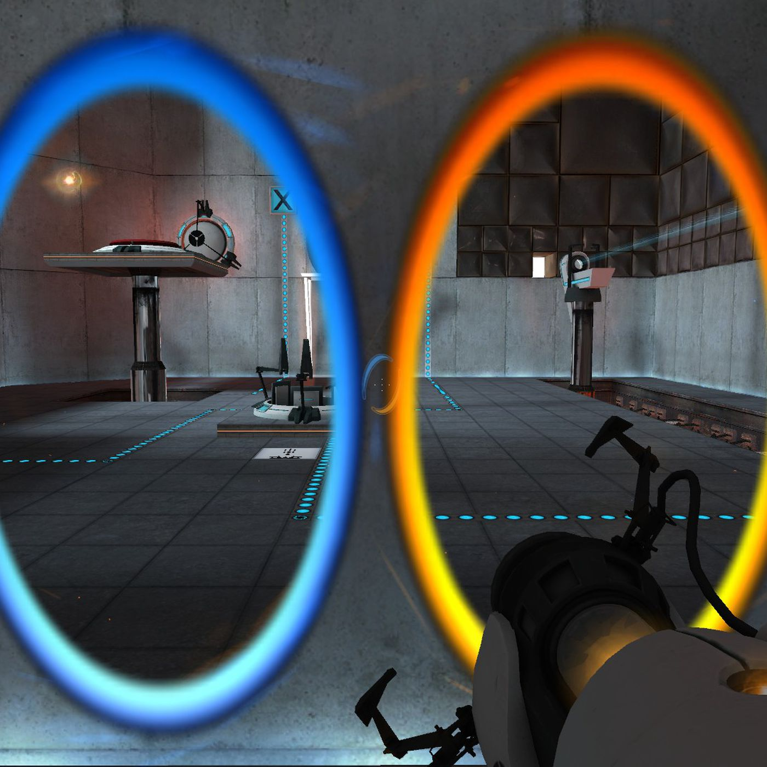
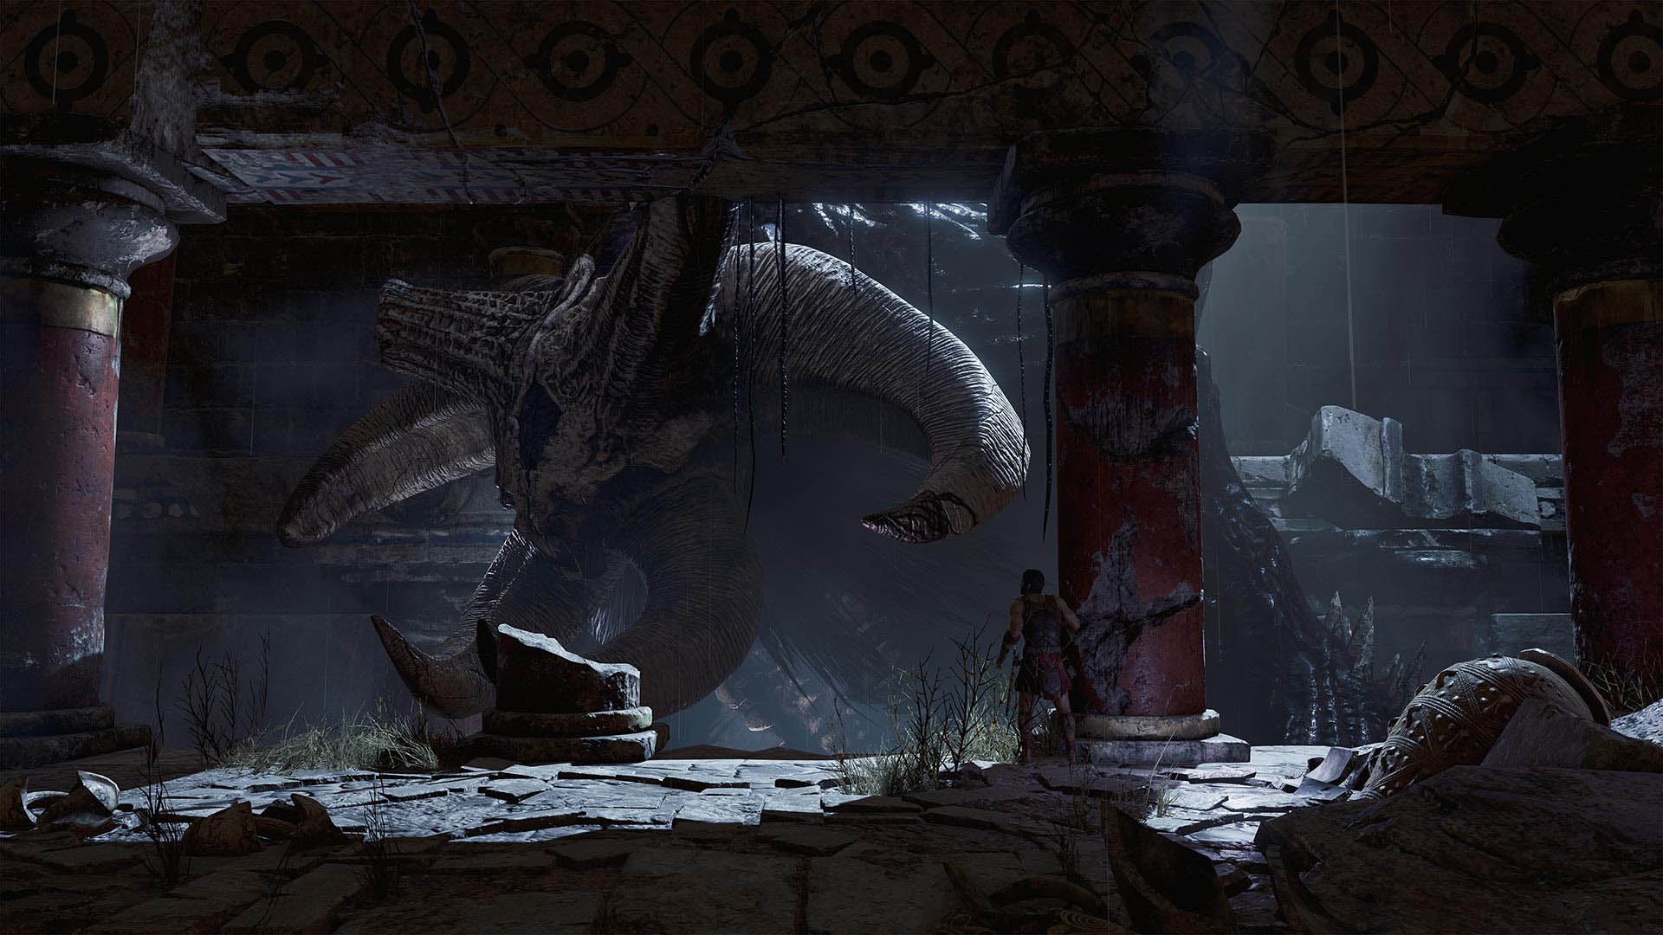
Game Inspirations
“Theseus”
https://www.4players.de/4players.php/dispbericht/Allgemein/Test/38525/82658/0/Theseus.html
“Portal”
https://www.theverge.com/2021/6/21/22544018/microsoft-xbox-hire-portal-developer-kim-swift-cloud-native-games
Games Lab summer 2022: Tobias Mesmer, Tim Simecek, Imen Hellali

Slide 8
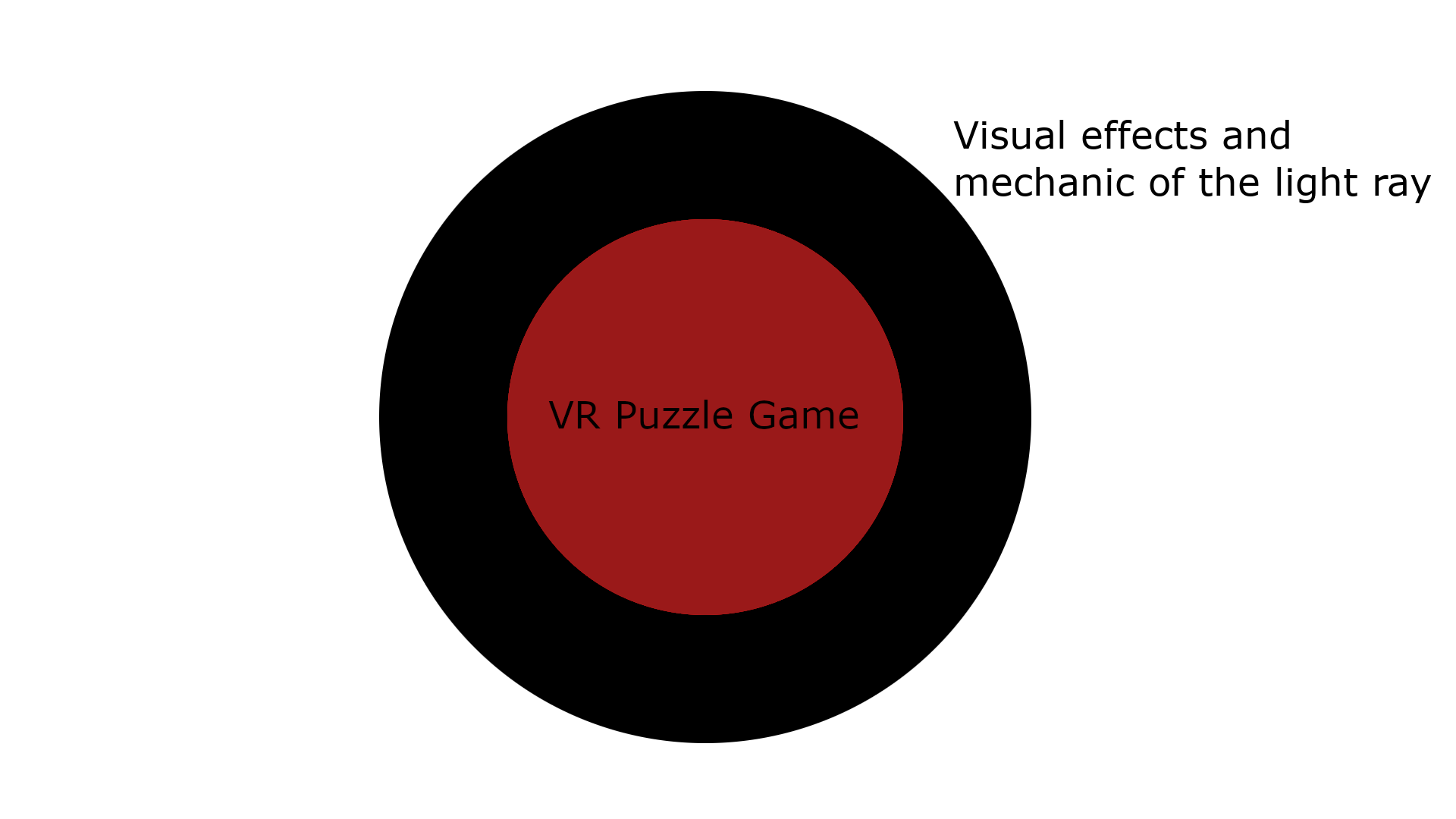
Bullseye
Games Lab summer 2022: Tobias Mesmer, Tim Simecek, Imen Hellali

Slide 9
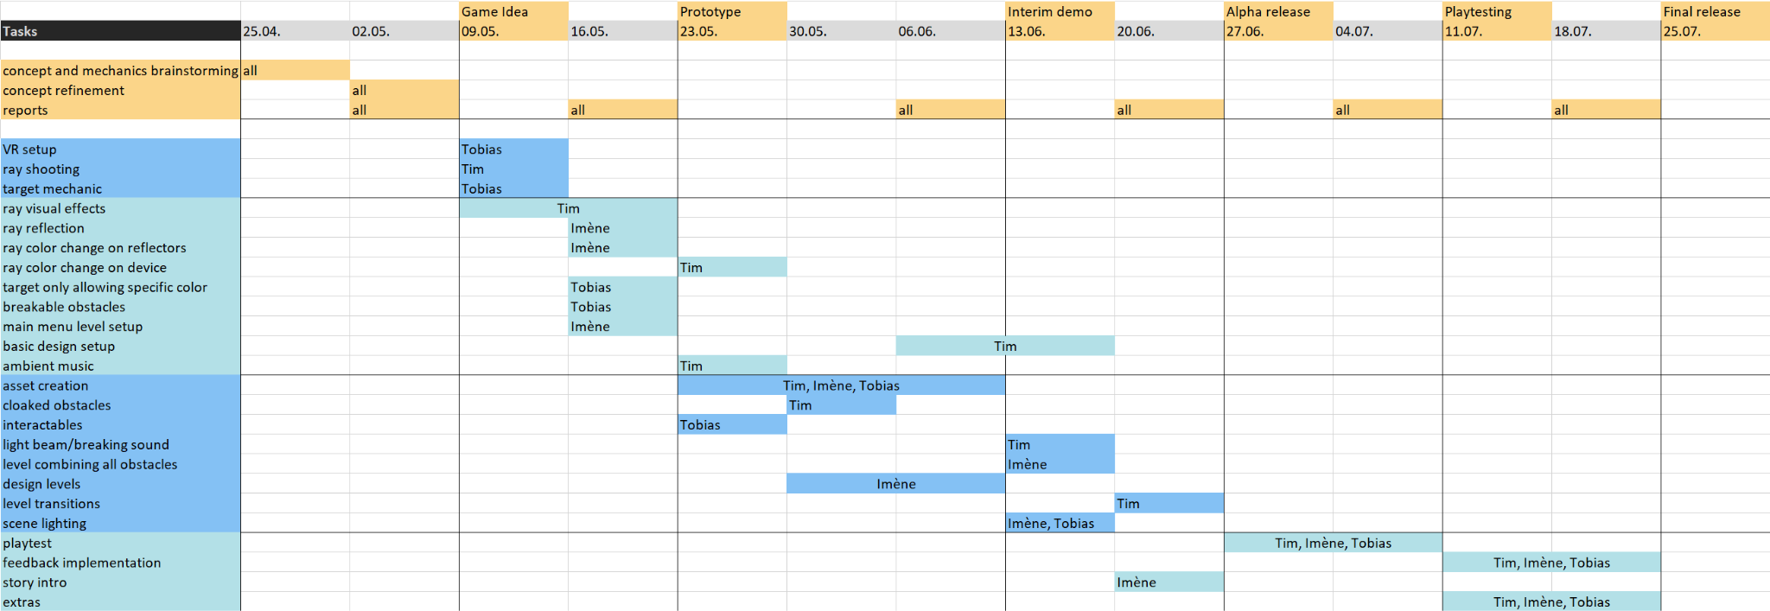
Timeline
Games Lab summer 2022: Tobias Mesmer, Tim Simecek, Imen Hellali

Slide 10
Thanks!
Games Lab summer 2022
Tobias Mesmer, Tim Simecek, Imen Hellali
Maze: Example Generated maze from Leoche/Svg-Circular-Maze-Generator: Svg Circular Maze Generator (github.com) Minotaur image by bapabst Minotaur by bapabst on DeviantArt

