Slide 1

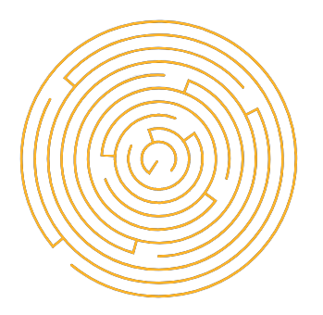
Light of Daedalus
Games Lab summer 2022
Tobias Mesmer, Tim Simecek, Imen Hellali

Slide 2
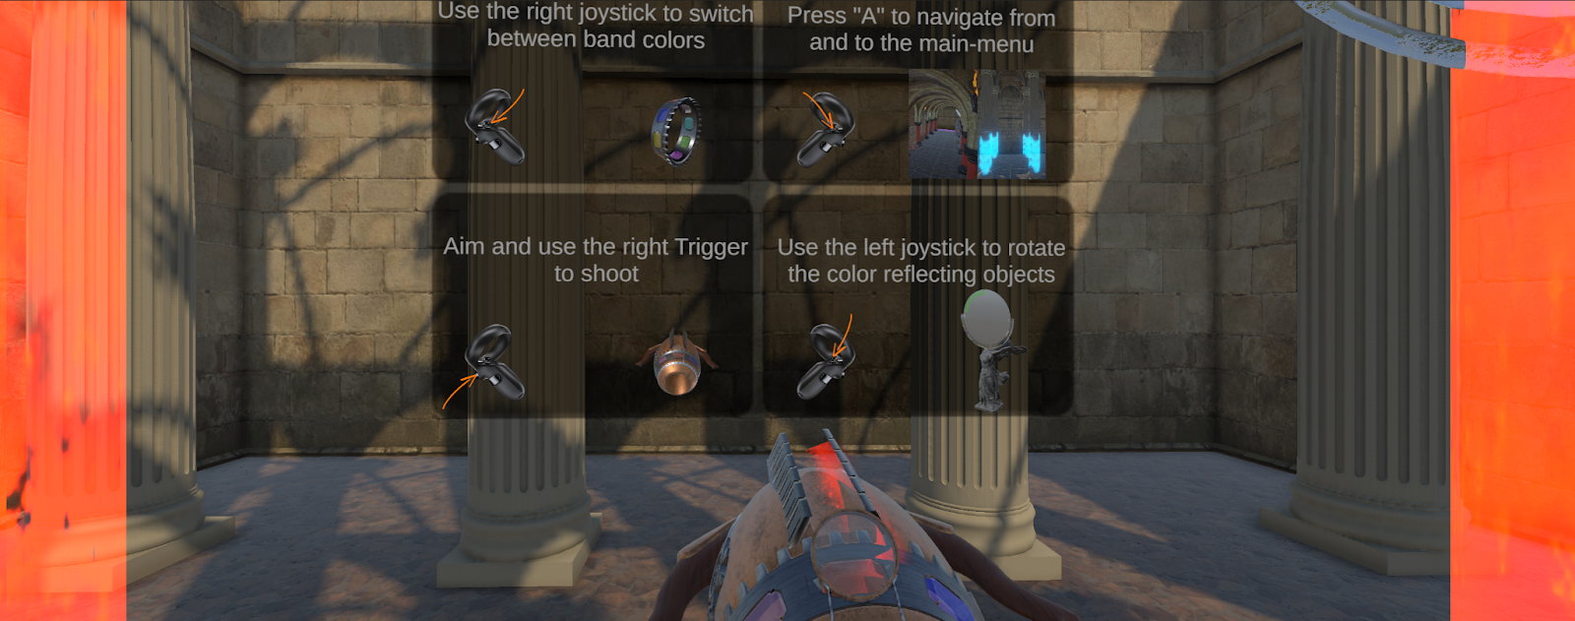
Tutorial
Games Lab summer 2022: Tobias Mesmer, Tim Simecek, Imen Hellali
Notes:
Learning about current color that you have and possibility of unlocking new ones that you can use in next levels….
how reflective surface work and how they change the outgoing color

Slide 3
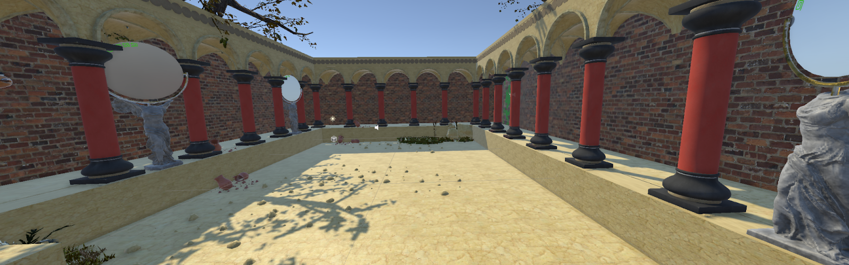
Level Overview - L1
Games Lab summer 2022: Tobias Mesmer, Tim Simecek, Imen Hellali
Notes:
Learning about current color that you have and possibility of unlocking new ones that you can use in next levels….
how reflective surface work and how they change the outgoing color

Slide 4
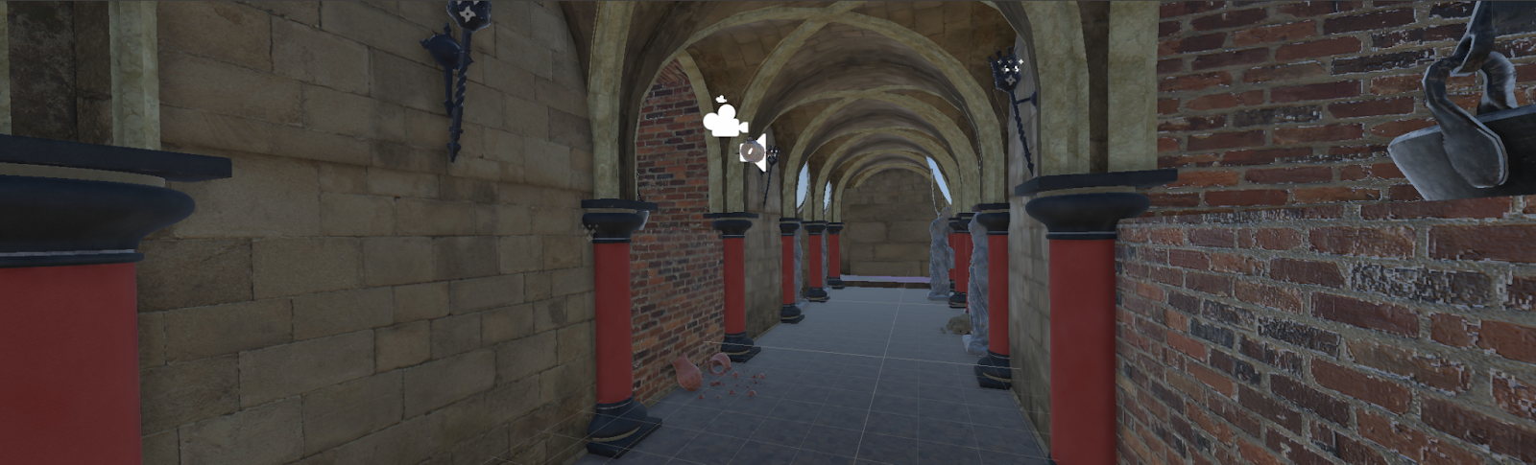
Level Overview - L2
Games Lab summer 2022: Tobias Mesmer, Tim Simecek, Imen Hellali
Notes:
Learning about current color that you have and possibility of unlocking new ones that you can use in next levels….
how reflective surface work and how they change the outgoing color

Slide 5
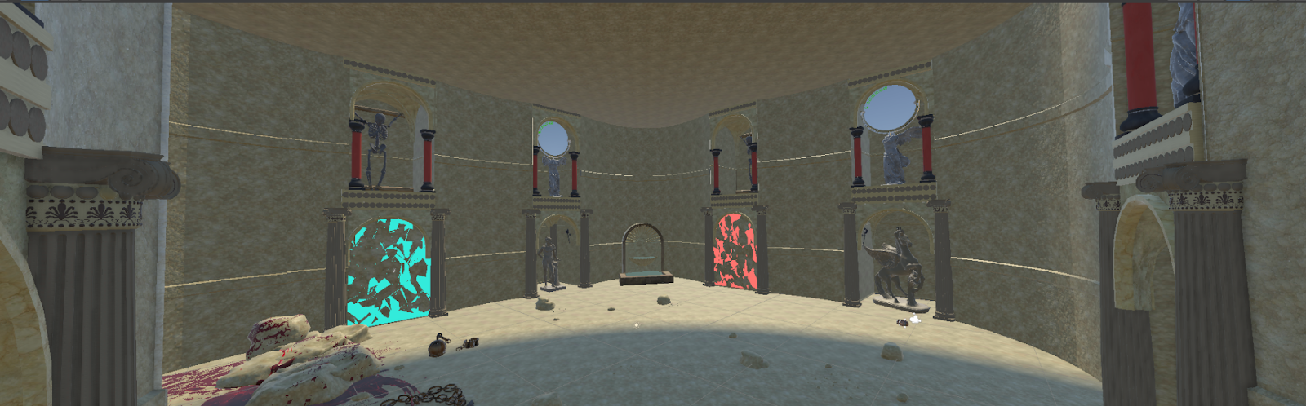
Level Overview - L3
Games Lab summer 2022: Tobias Mesmer, Tim Simecek, Imen Hellali
Notes:
Learning about current color that you have and possibility of unlocking new ones that you can use in next levels….
how reflective surface work and how they change the outgoing color

Slide 6
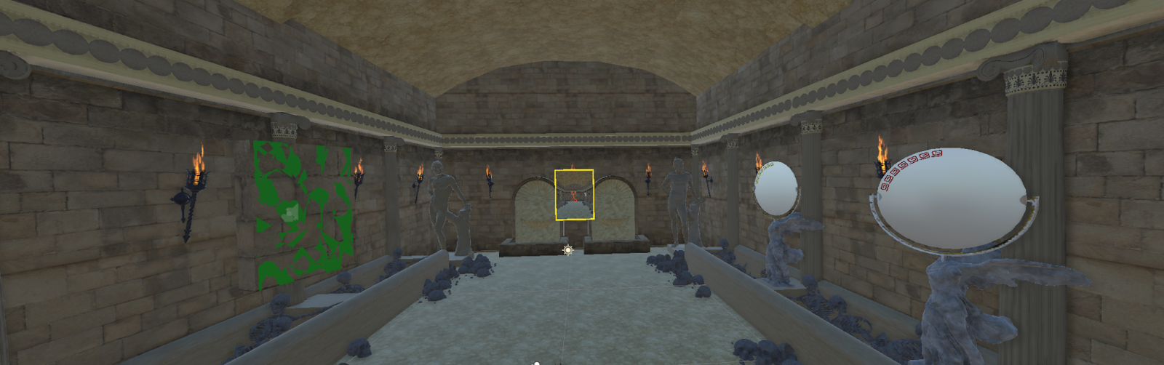
Level Overview - L4
Games Lab summer 2022: Tobias Mesmer, Tim Simecek, Imen Hellali
Notes:
Learning about current color that you have and possibility of unlocking new ones that you can use in next levels….
how reflective surface work and how they change the outgoing color

Slide 7
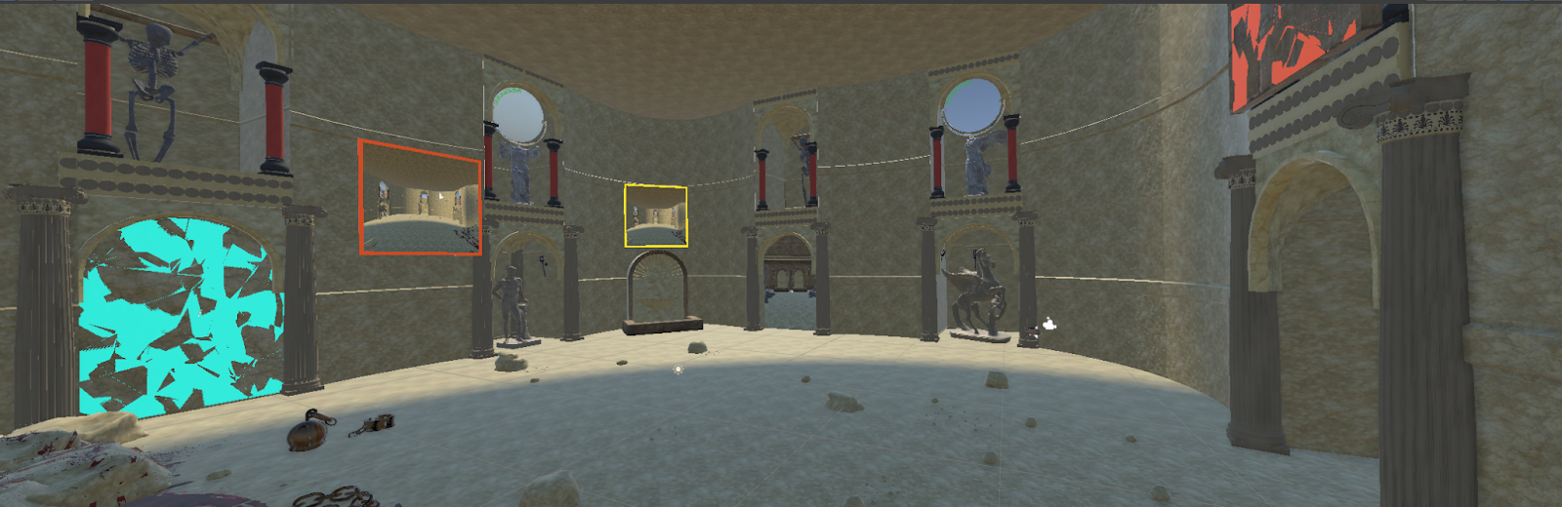
Level Overview - L5
Games Lab summer 2022: Tobias Mesmer, Tim Simecek, Imen Hellali
Notes:
Learning about current color that you have and possibility of unlocking new ones that you can use in next levels….
how reflective surface work and how they change the outgoing color

Slide 8
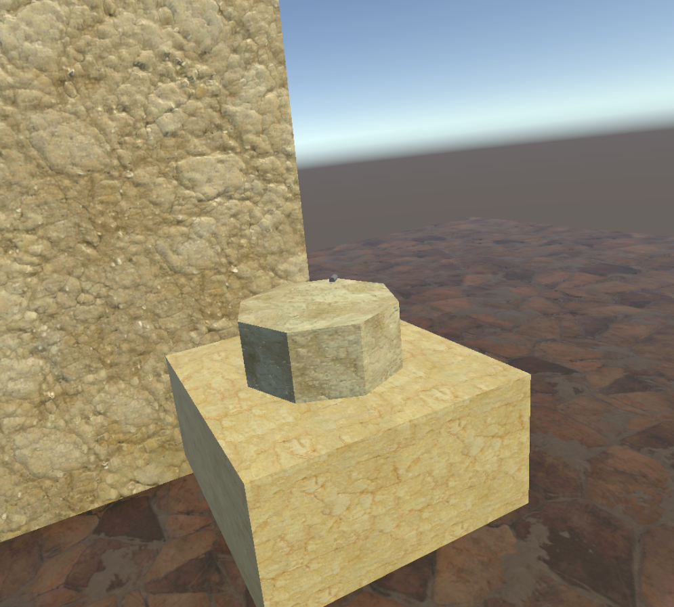
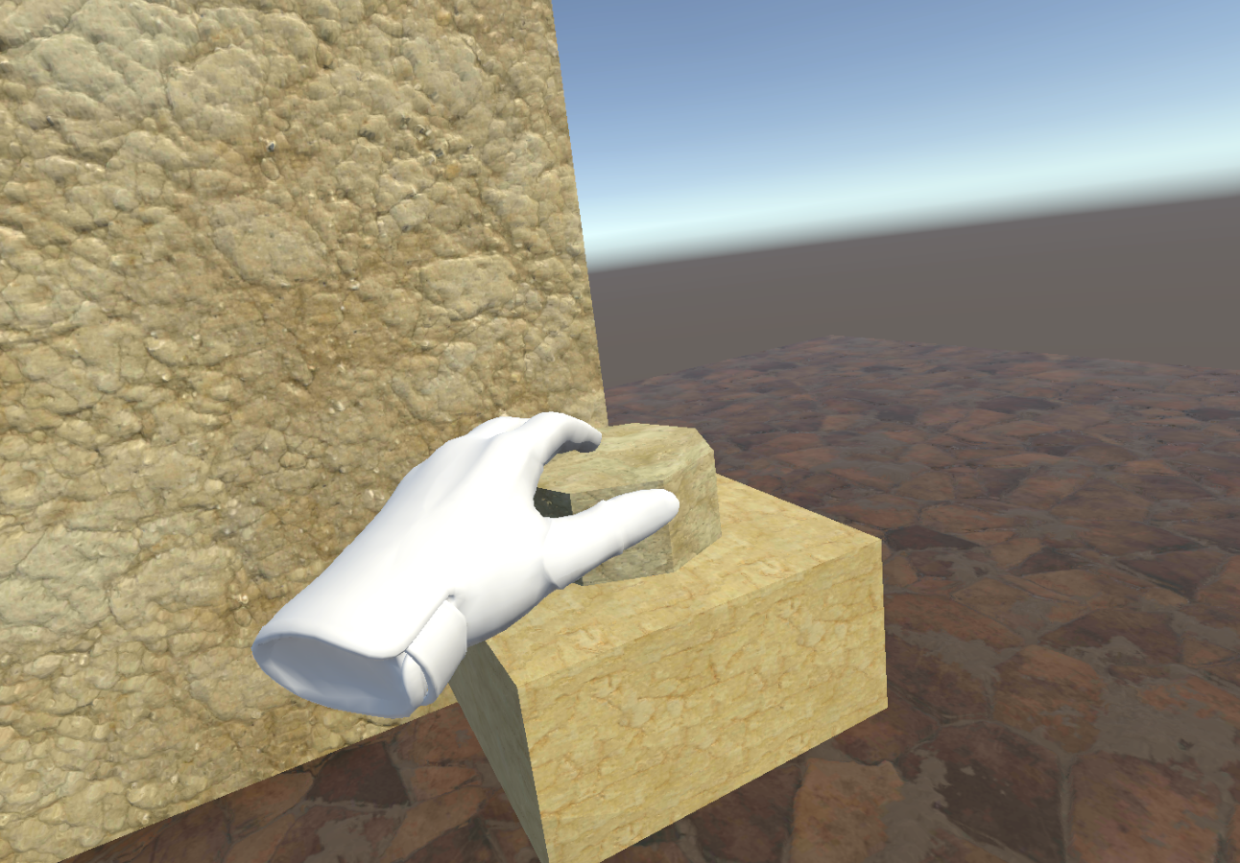
Interactables
Games Lab summer 2022: Tobias Mesmer, Tim Simecek, Imen Hellali
Notes:
Learning about current color that you have and possibility of unlocking new ones that you can use in next levels….
how reflective surface work and how they change the outgoing color

Slide 9
Sounds
Ambient sounds:
  Ocean
  Dungeon
  No music
Sound effects:
  Light of Daedalus
  Torch
  Interactables
Games Lab summer 2022: Tobias Mesmer, Tim Simecek, Imen Hellali
Notes:
Learning about current color that you have and possibility of unlocking new ones that you can use in next levels….
how reflective surface work and how they change the outgoing color

Slide 10
Thanks!
Games Lab summer 2022
Tobias Mesmer, Tim Simecek, Imen Hellali
Maze: Example Generated maze from Leoche/Svg-Circular-Maze-Generator: Svg Circular Maze Generator (github.com) Minotaur image by bapabst Minotaur by bapabst on DeviantArt

