Slide 1

Prop Clash
Playtesting
Created by Code Wizards
Denitsa Asova, Janna Elghabaty, Omar Khaled, Bassant Elnaggar

Slide 2
Outline

Slide 3
Outline
Pre-testing Changes
Playtesting Setup
Questionnaire Overview
Feedback Overview
Future Game Changes

Slide 4
Pre-testing Changes

Slide 5
Pre-testing Changes
Camera Shake for prop if hit

Slide 6
Pre-testing Changes
Camera Shake for prop if hit
Score feedback if increased or decreased

Slide 7

Pre-testing Changes
Camera Shake for prop if hit
Score feedback if increased or decreased
Blood effect if the right prop is hit.

Slide 8
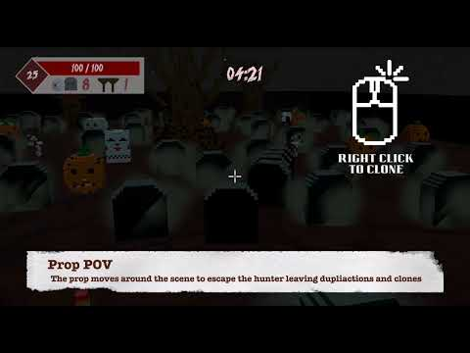
Pre-testing Changes
Camera Shake for prop if hit
Score feedback if increased or decreased
Blood effect if the right prop is hit
Tutorial Scene

Slide 9
Playtesting Setup

Slide 10
Playtesting Setup
2 testing sessions
In - person
4 testers per session
Google Form survey

Slide 11
Questionnaire Overview

Slide 12
Questionnaire Overview
Overall 23 questions
The questions are divided into 4 groups:
  Questions focusing on the gameplay
    E.g.: What were you able to do from the controls?, Did the game feel too long, too short or just about right?
  Questions focusing on the gamescene
    E.g.: Was there too many assets/objects in the scene?, What elements of the game attracted you?
  Questions for suggestions and fixes
    E.g.: Did you discover any bugs while playing the game?, Are there constraints you want to add?
  General questions
    E.g.: Would you call yourself a gamer?, How old are you?

Slide 13
Feedback Overview

Slide 14
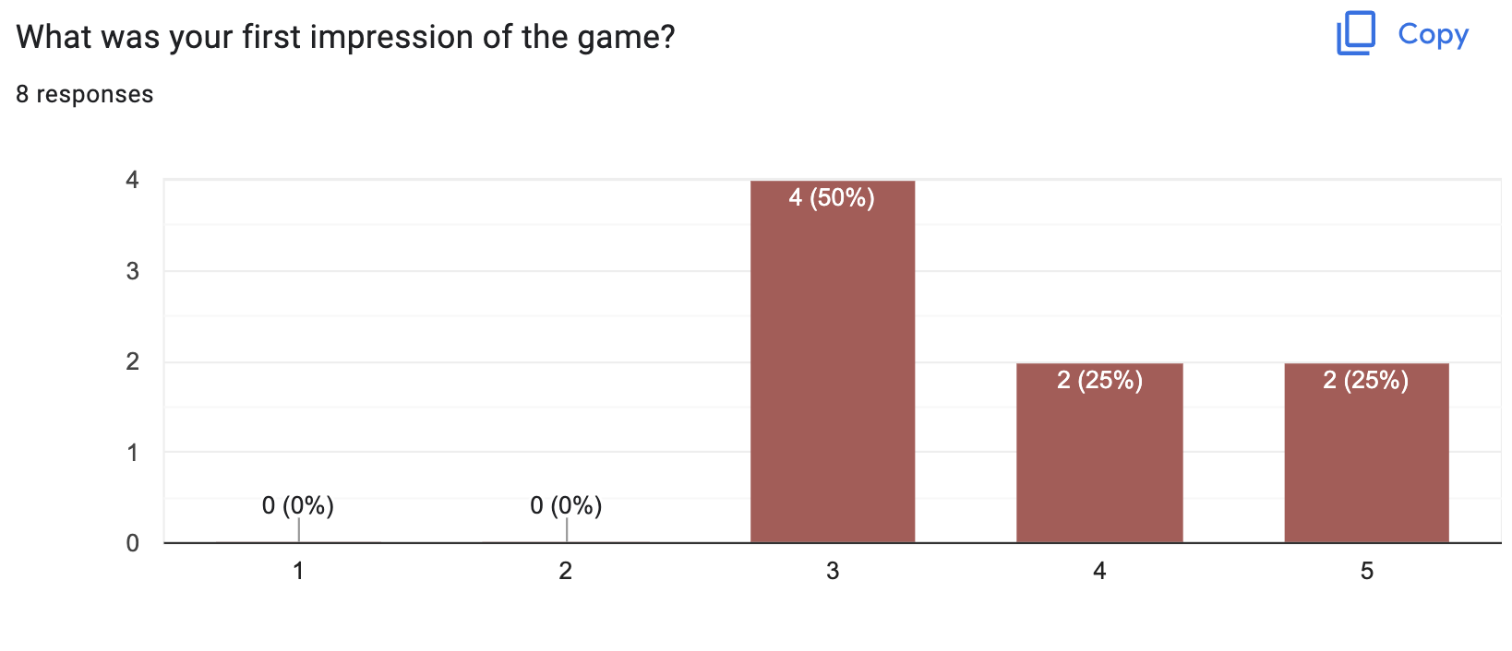
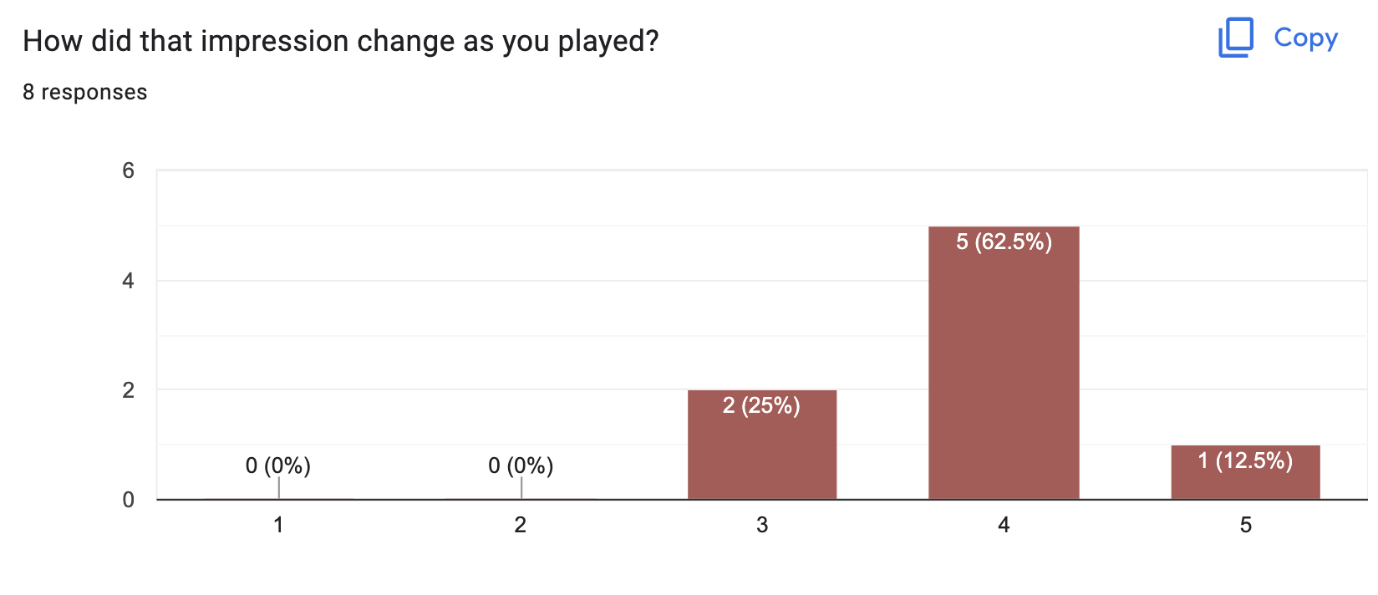
Feedback Overview

Slide 15
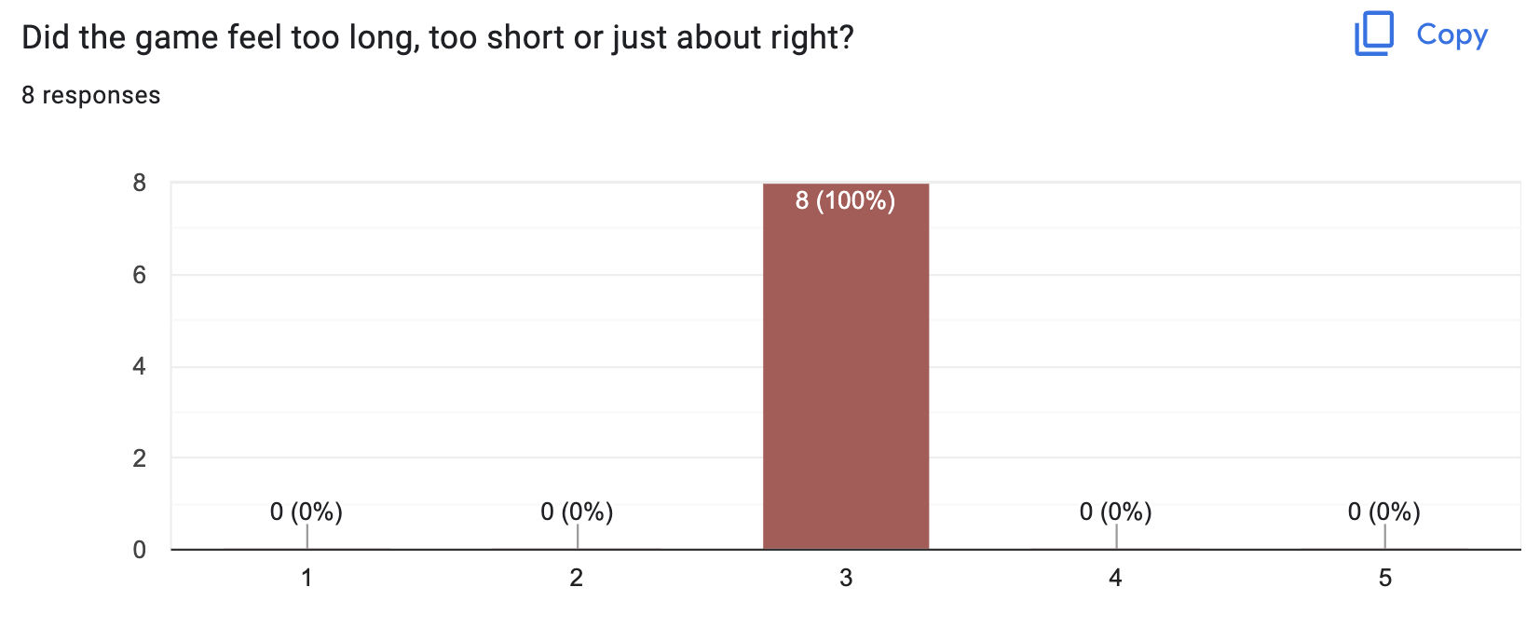
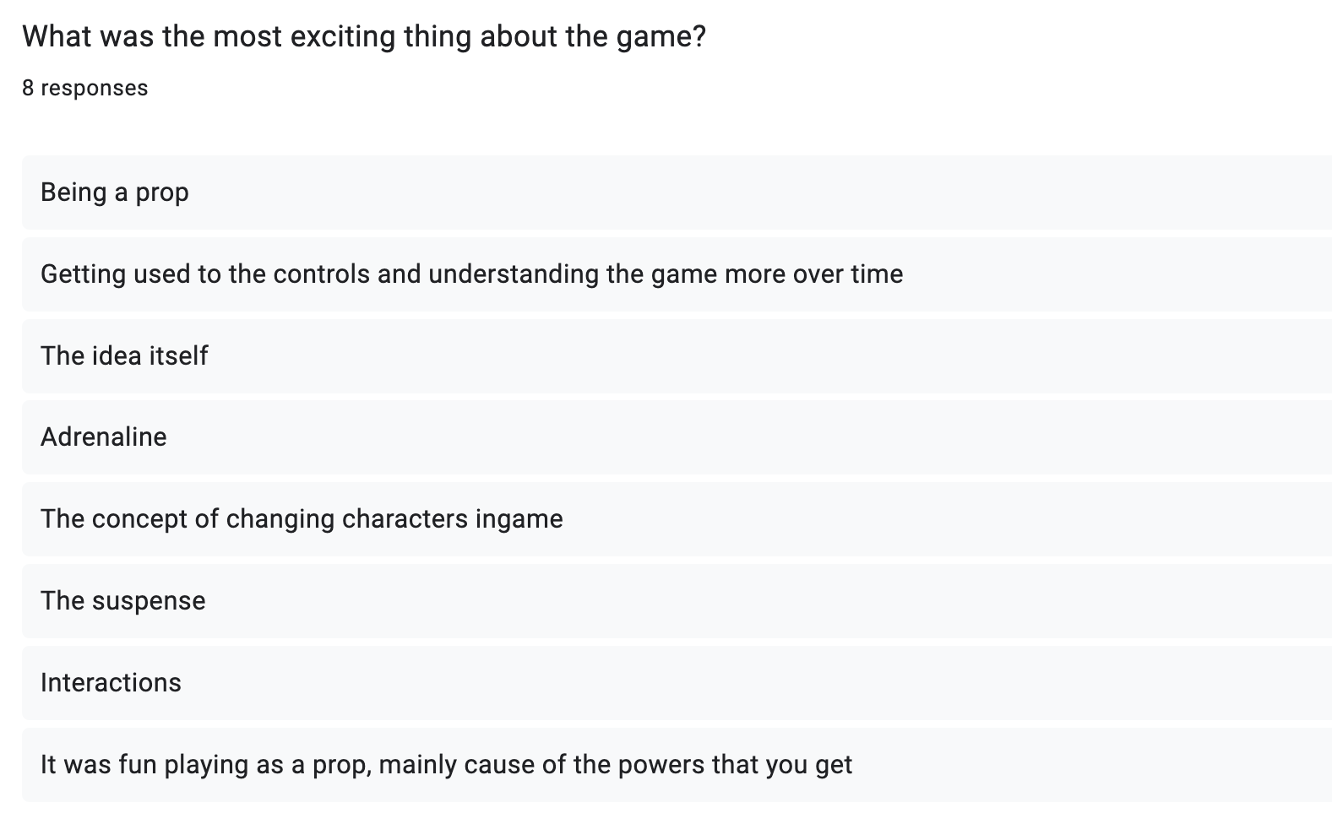
Feedback Overview

Slide 16
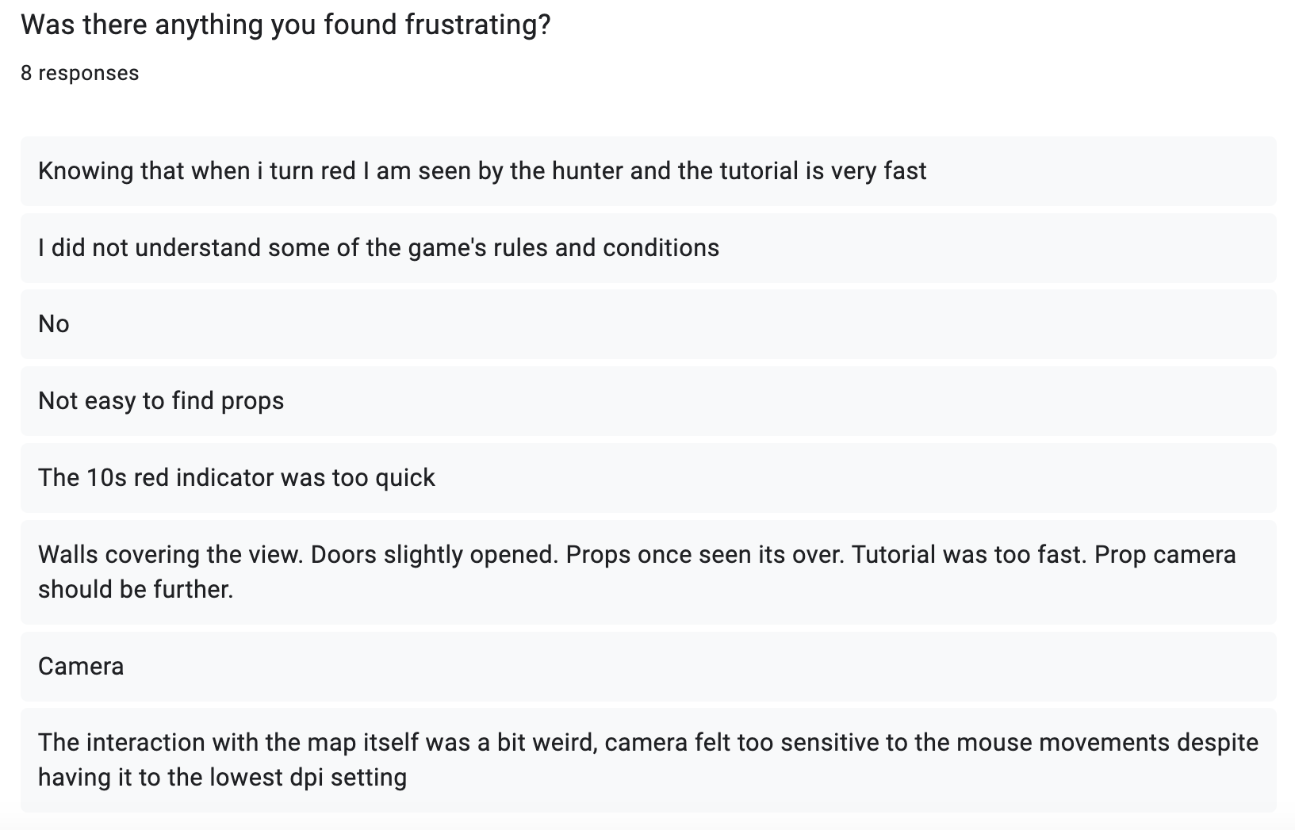
Feedback Overview

Slide 17
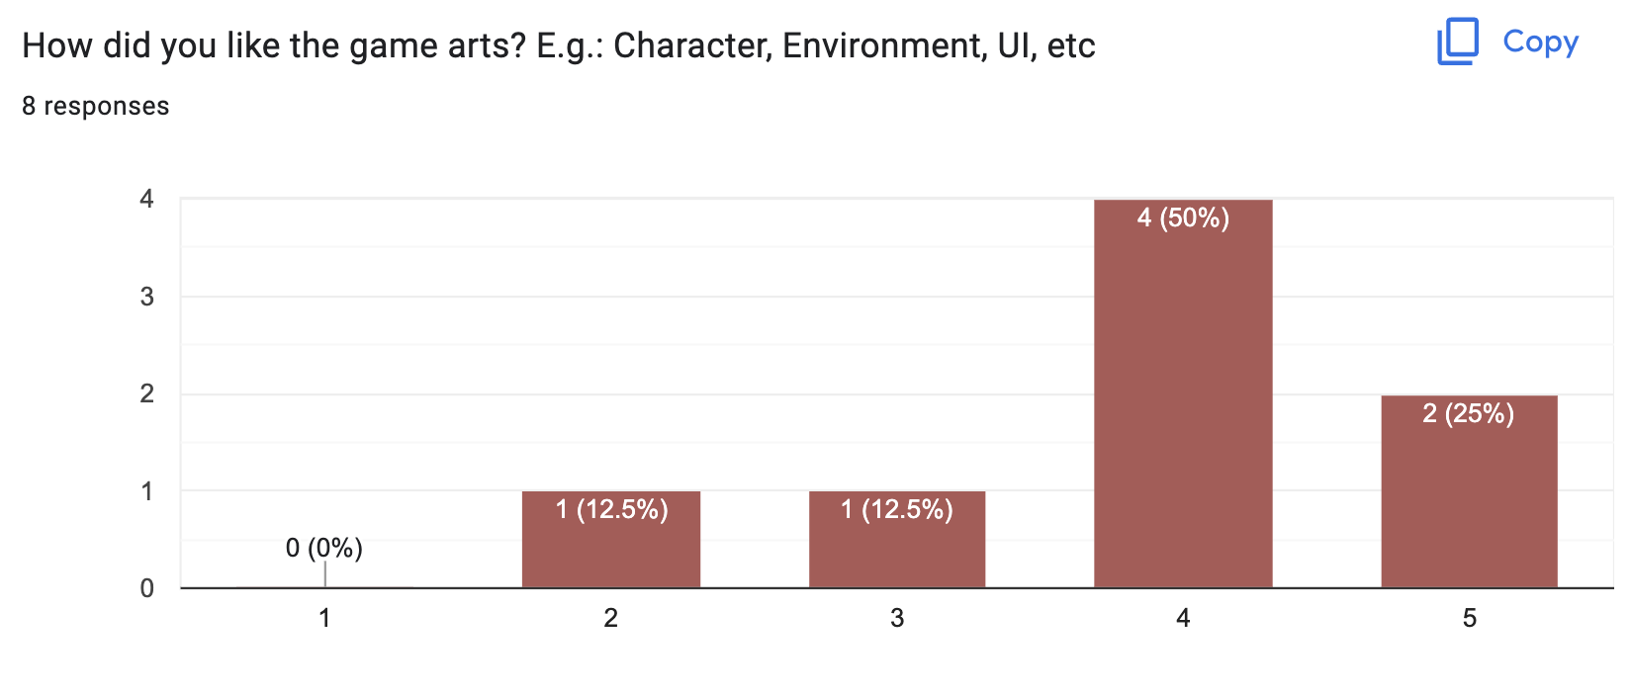
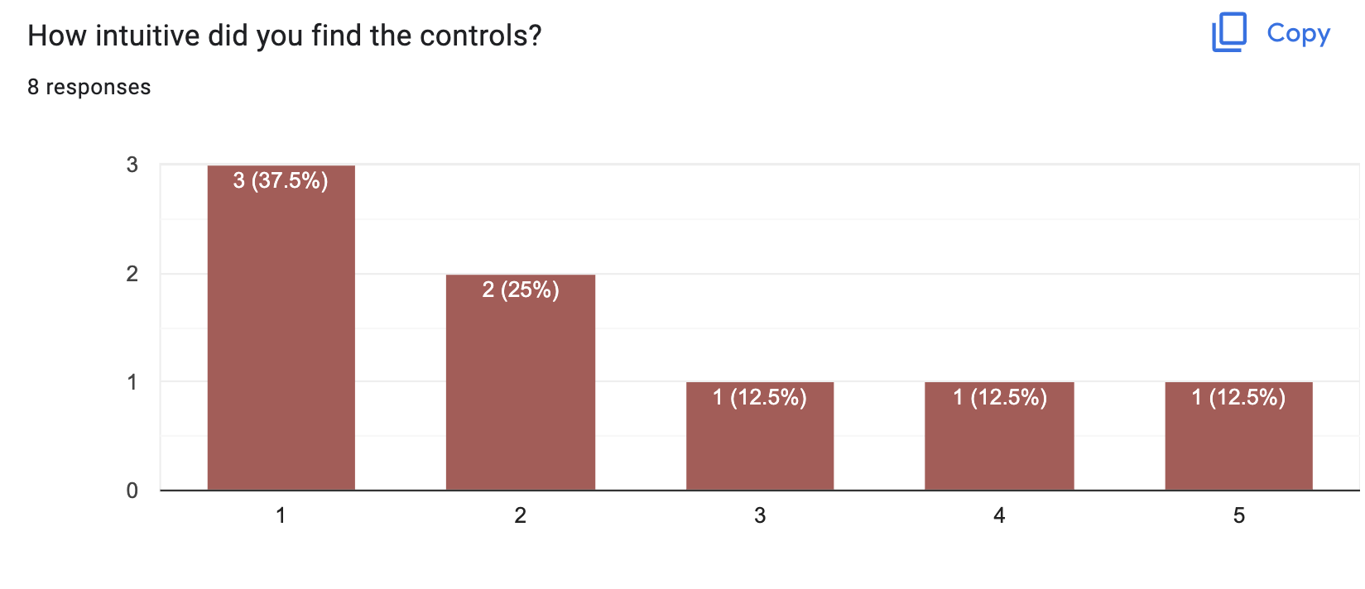
Feedback Overview

Slide 18
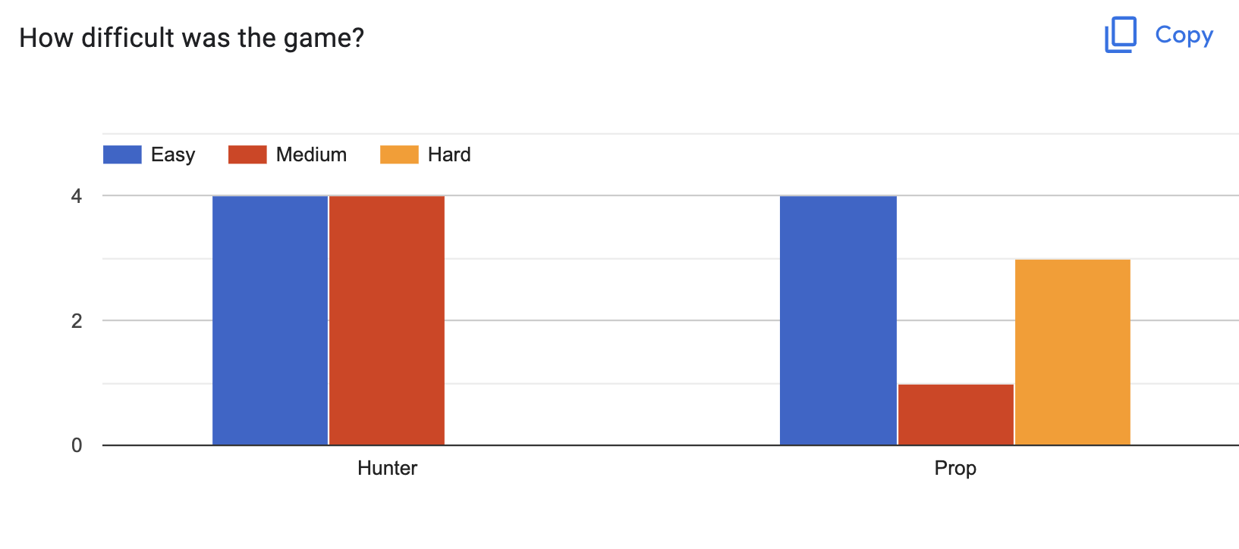
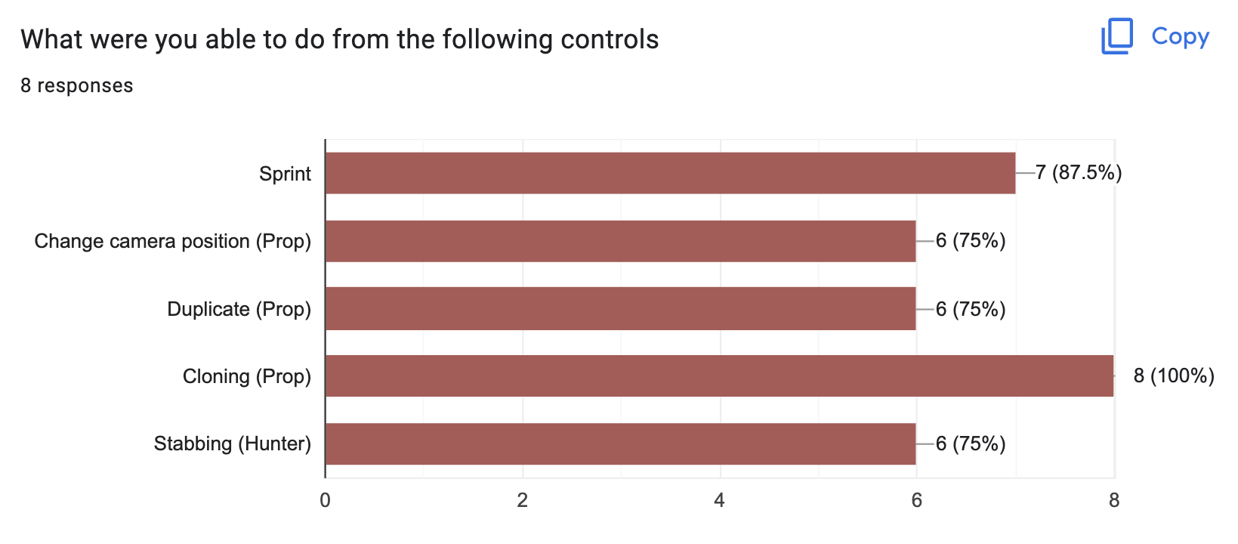
Feedback Overview

Slide 19
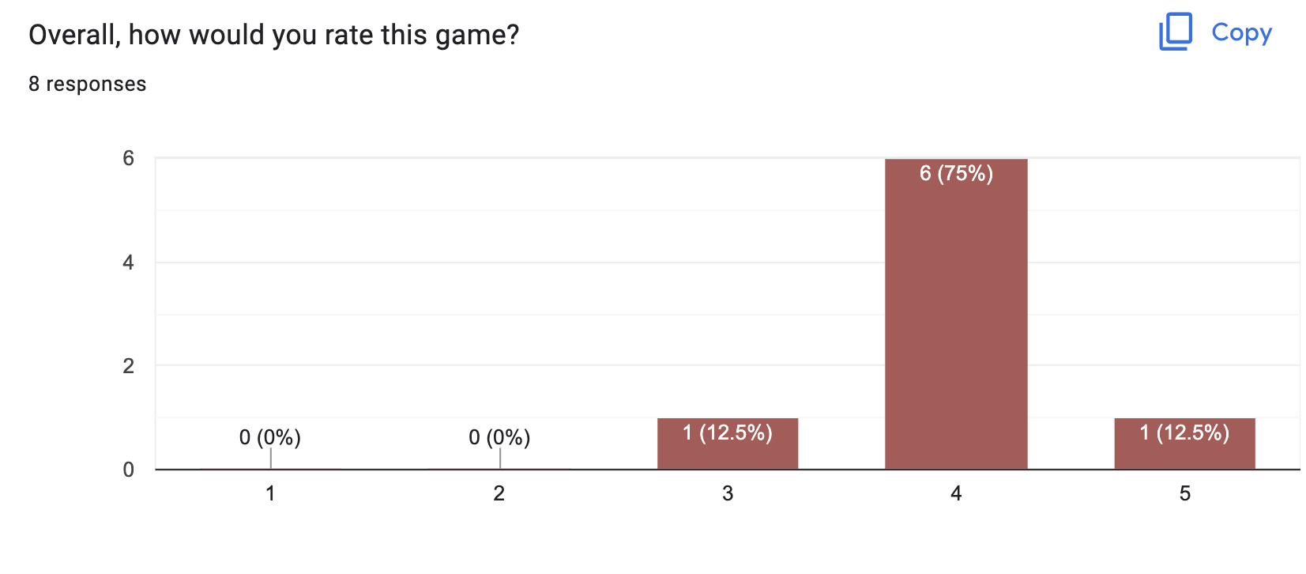
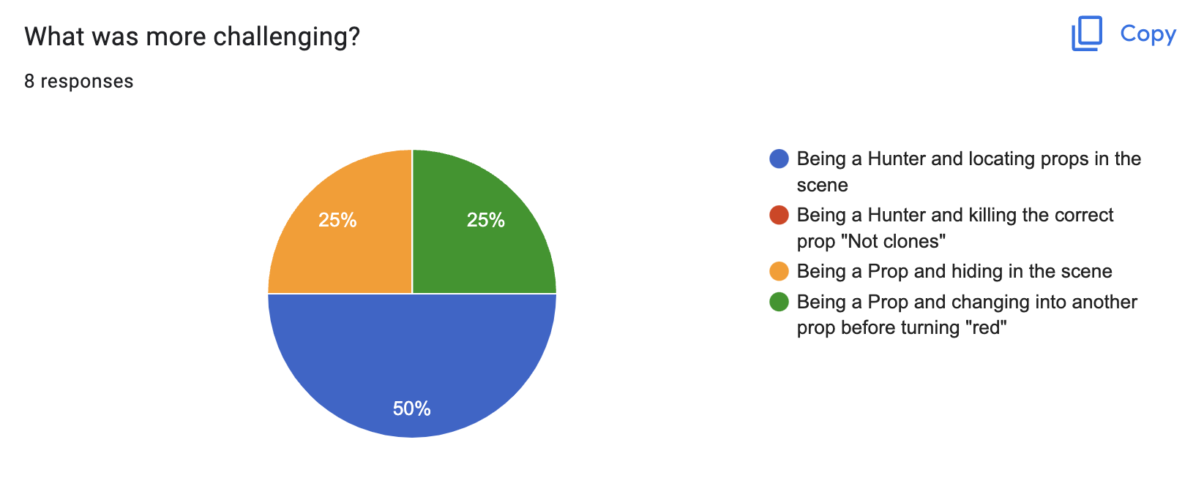
Feedback Overview

Slide 20
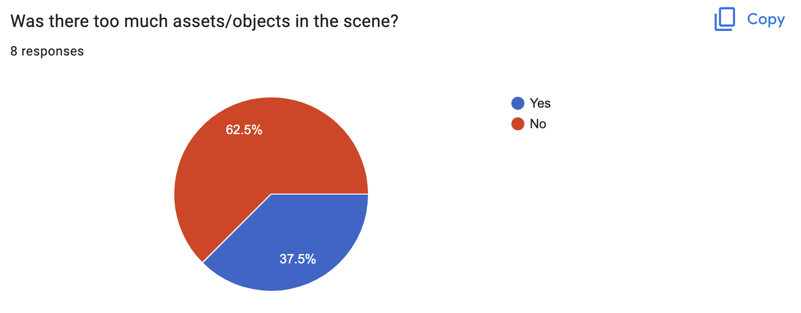
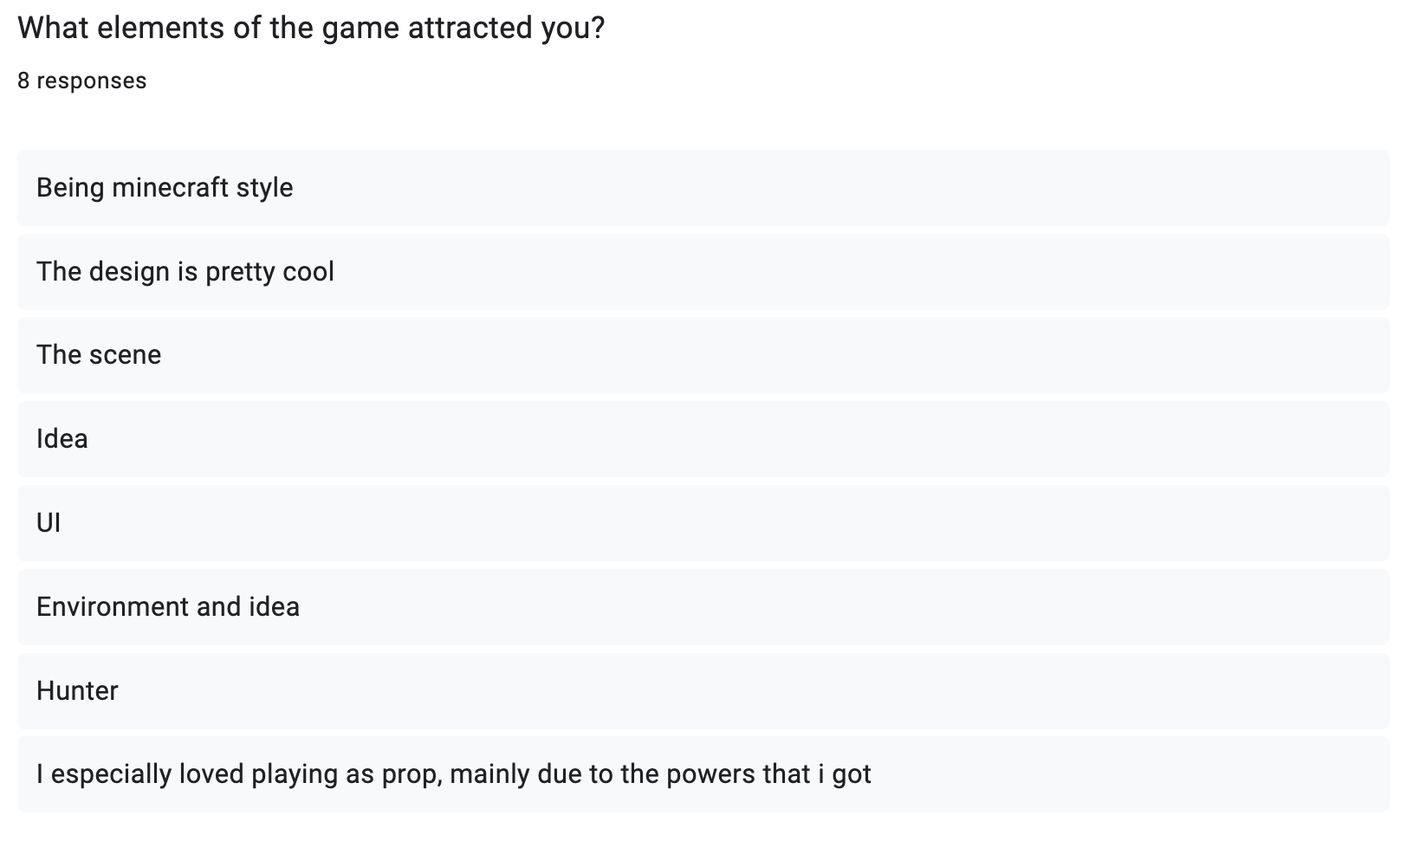
Feedback Overview

Slide 21
Future Game Changes

Slide 22
Future Game Changes
Add post-processing effects to scene
Implement a camera zoom for props
Design one more map with smaller sized rooms
Add sound effects
Make the tutorial more interactive and detailed
Add settings to customize the game experience

Slide 23


