Slide 1
O‘zapft is!
Dominik Baumeister, Jing Yi Wang,
Marten Schwarzmann, Christoph Winter

Slide 2
Critiques
Sounds like a fun game!
Thanks!

Slide 3
Critiques
But after paying 60€ you can safely travel
without paying for another ticket!
Bad News: Sepp is very unlucky in that regard…

Slide 4
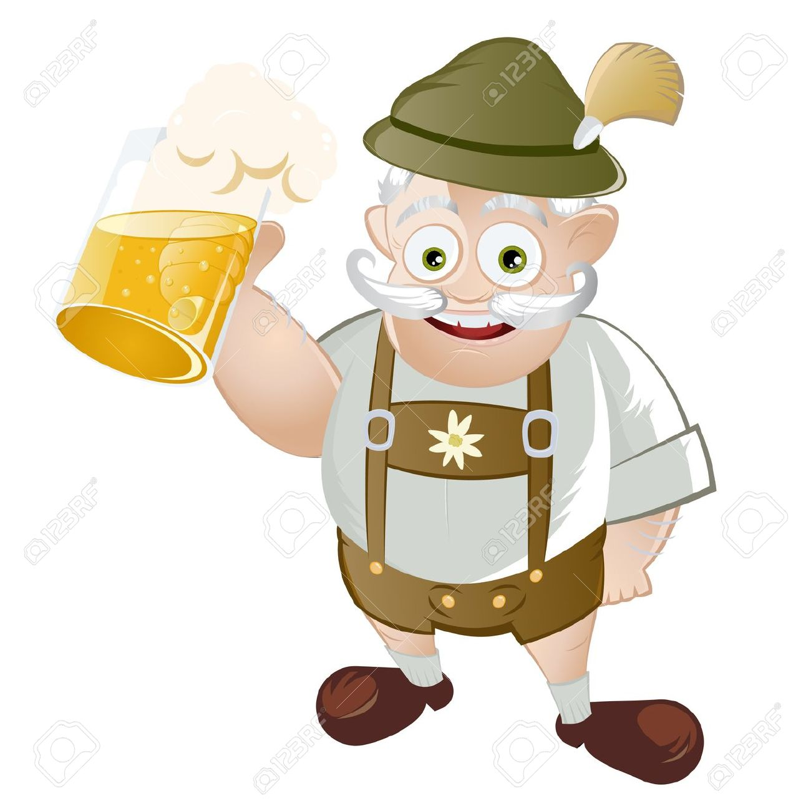
Critiques
Why do the ticket inspectors only follow the player?
They don‘t.
However, Sepp looks rather suspicious.

Slide 5
Critiques
But ticket inspectors only check for tickets in the train!
Ever heard of the infamous “Bahnsteigticket”?

Slide 6

Critiques
Prost!
Prost!

Slide 7
Critiques
How do you plan to implement
vision impairment?
With a blurred cone of view in front of the player.

Slide 8

MVG
Repetitive gameplay because of only
one subway system?
Yeah...

Slide 9
MVG
Why add ticket machines when they are not useable?
This frustrates the user.
…that’s...

Slide 10
MVG
Some outer metro lines are boring.
…the...

Slide 11
MVG
Scrap correct train departure times for
a more fun experience!
…point!

Slide 12
MVG
You could always have somebody standing there
[at the ticket machine], who will fiddle with the machine until the dawn of time, or have it be under maintenance.
This guy gets it!

Slide 13
Improvement Ideas
GTA like star system.

Slide 14
Improvement Ideas
Better use 2.5D instead of top-down view.

Slide 15
Improvement Ideas
Implement a race versus the AI.

Slide 16

Improvement Ideas
I like the idea of WhazzApp,
maybe add Mini-Games?

Slide 17
Improvement Ideas
Make it competitive!

Slide 18
Improvement Ideas
Let Sepp interact with other NPCs while waiting!

Slide 19
Improvement Ideas
Add more objectives, other than just reaching the Theresienwiese.

Slide 20
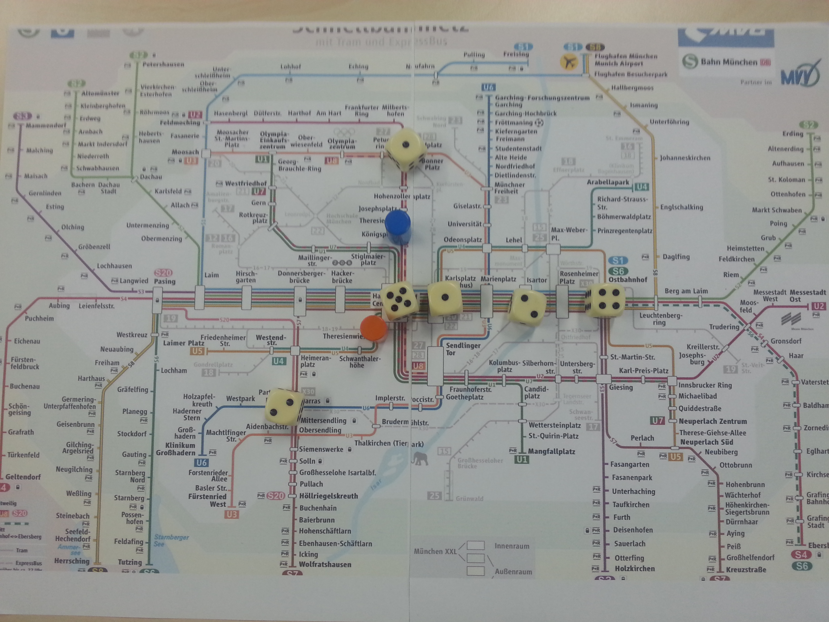
Physical Prototype

Slide 21
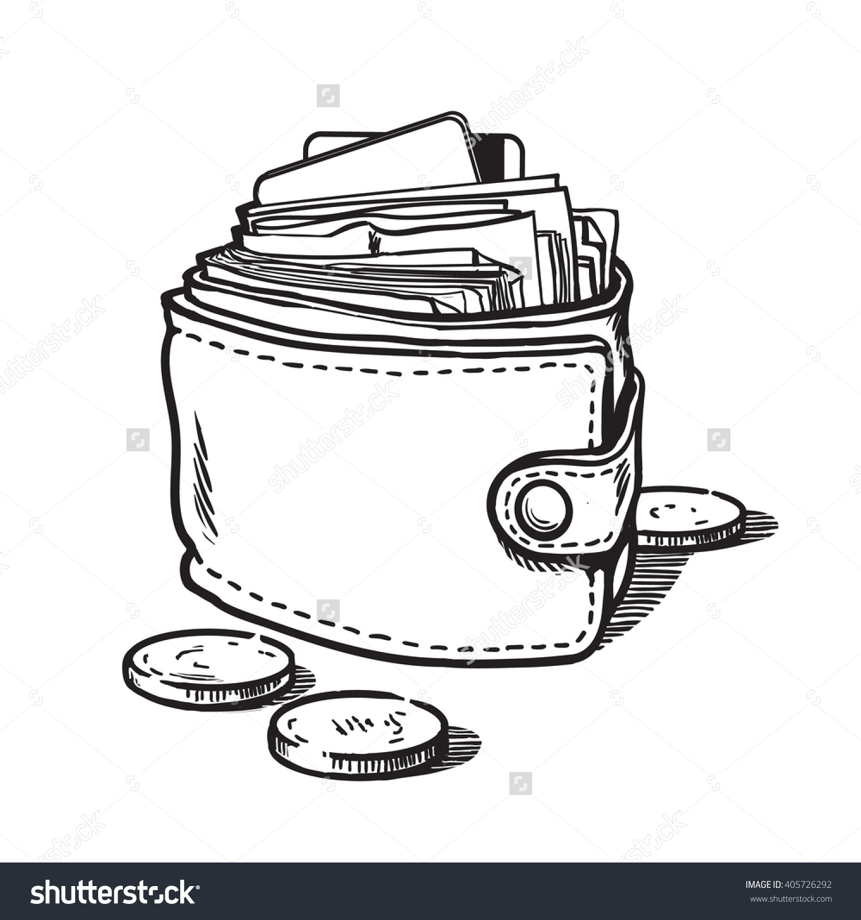
Physical Prototype
Spawning Sepp at random stations changes
the games difficulty.
We address that by making beer cheaper
in the outer zones.

Slide 22

Physical Prototype
Proper balancing of the alcohol level
may be too tedious for the player.
The alcohol level decreases only slowly.

Slide 23
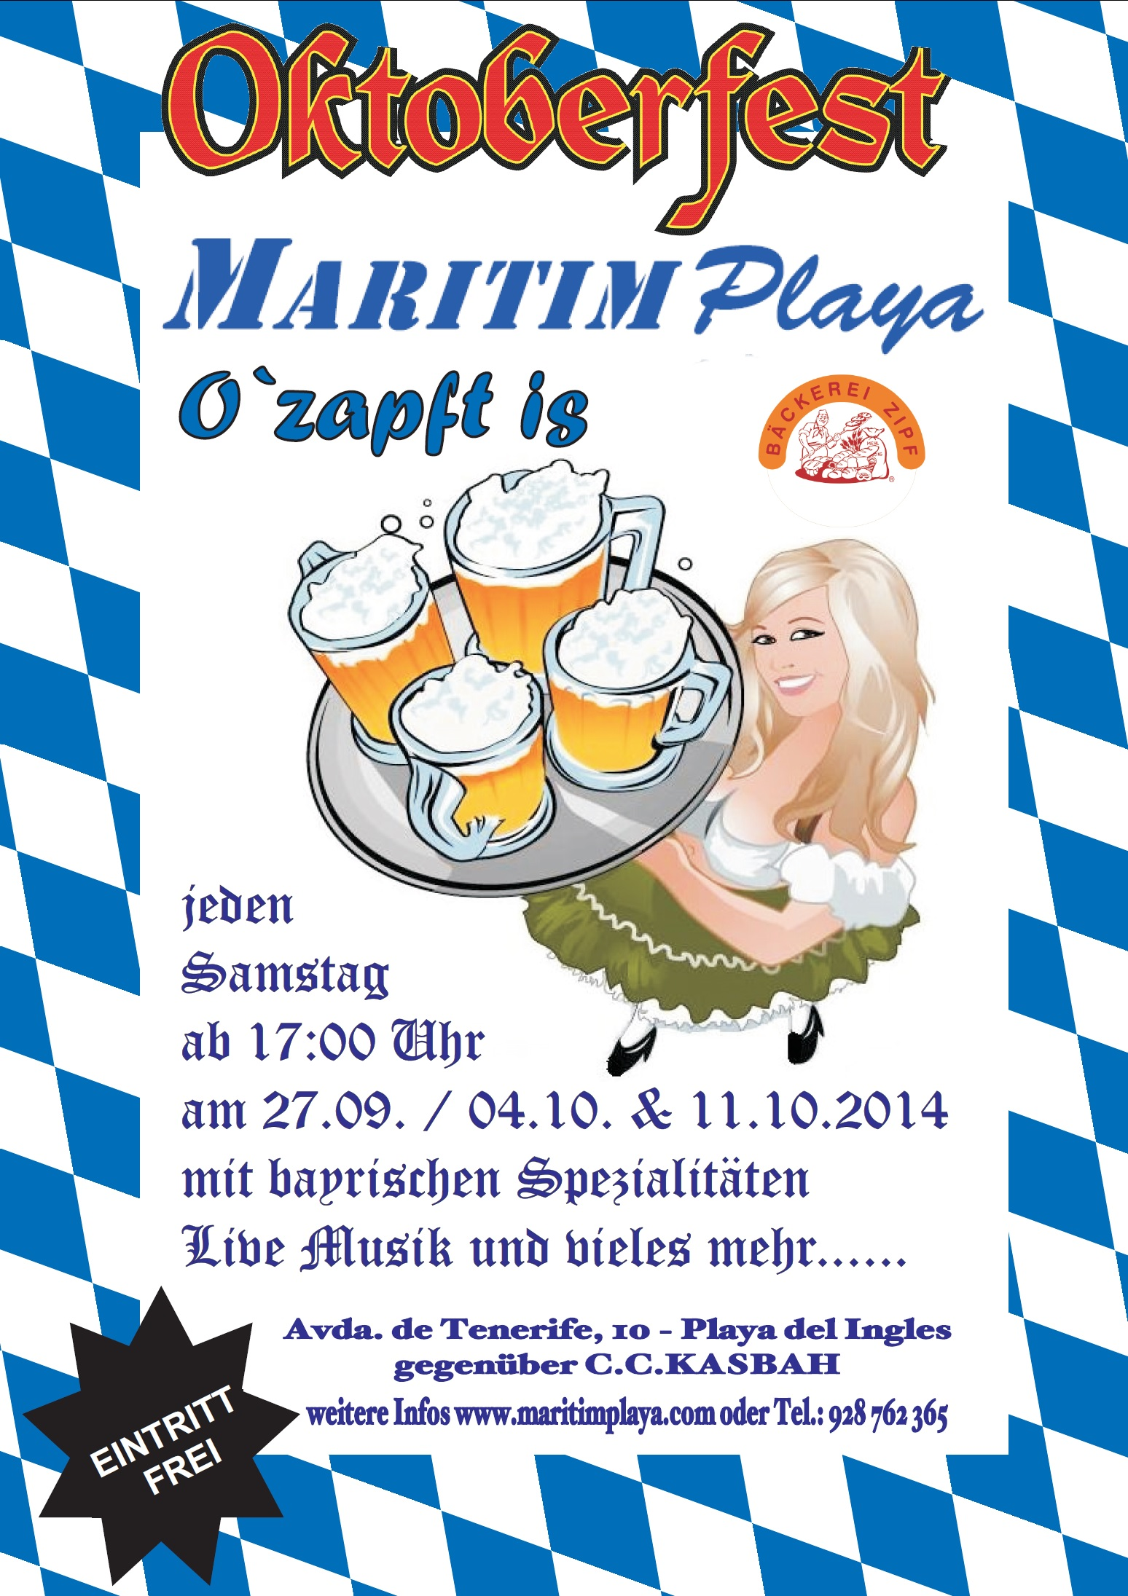
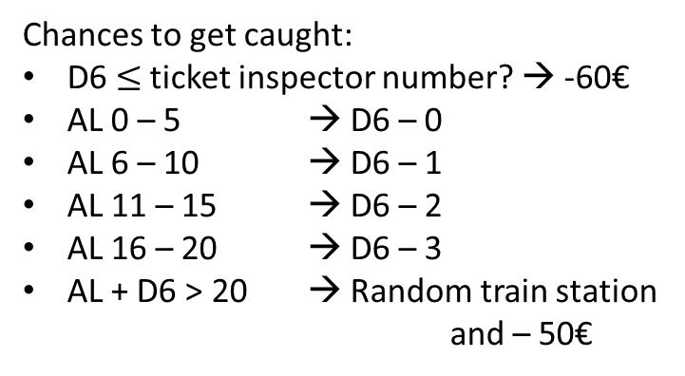
Cheat Sheet
Initial Wealth: 200€
Costs of a Beer:
Zone 4: 1€
Zone 3: 2€
Zone 2: 3€
Zone 1: 4€
Wiesn: 10€
Alcohol Level (AL):
Initial Level AL = 1
Drink Beer AL + 3
Per Round AL - 1
Wiesn Goal AL = 15
Chances to get caught:
D6 $≤$ ticket inspector number? → -60€
AL 0 – 5 → D6 – 0
AL 6 – 10 → D6 – 1
AL 11 – 15 → D6 – 2
AL 16 – 20 → D6 – 3
AL + D6 > 20 → Random train station
and – 50€

Slide 24
Thank you!
Questions?

Slide 25
Video

