Slide 1
Interpreting Graph Neural Networks for NLP with Differentiable Edge Masking
Seminar: Graph Deep Learning for Medical Applications
Presenter: Jingpei Wu
Tutor: Yousef
30.11.2021

Slide 2
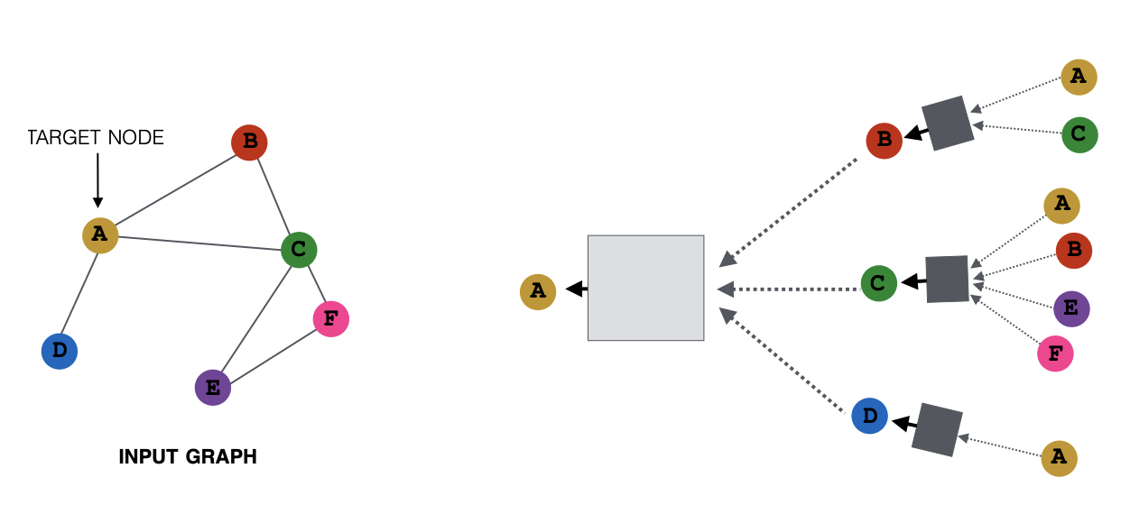
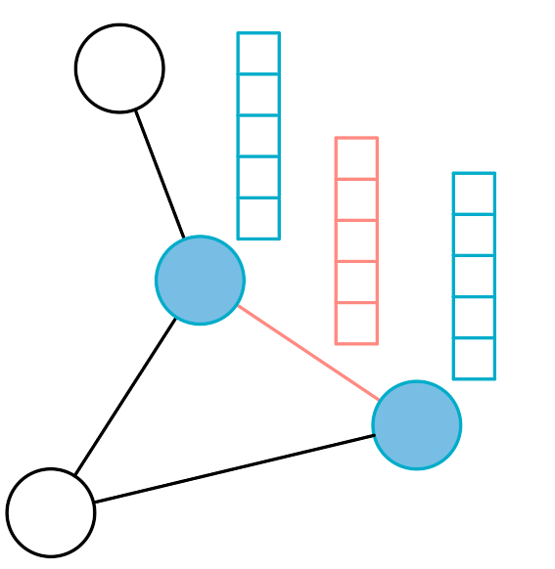

In a Nutshell
target: find out which edges in every layer can be dropped, while keep performance
?
?
?
?
?
?
method: classifier on top of message feature
message
aggregation
classifier
drop/retain?
optimal subgraph
[1] Interpreting Graph Neural Networks for NLP with Differentiable Edge Masking, Schlichtkrull et al.
[2] https://snap-stanford.github.io/cs224w-notes/machine-learning-with-networks/graph-neural-networks

Slide 3
Interpreting Graph Neural Networks for NLP with Differentiable Edge Masking
Introduction
Methodology
Experimental Result
Discussion

Slide 4
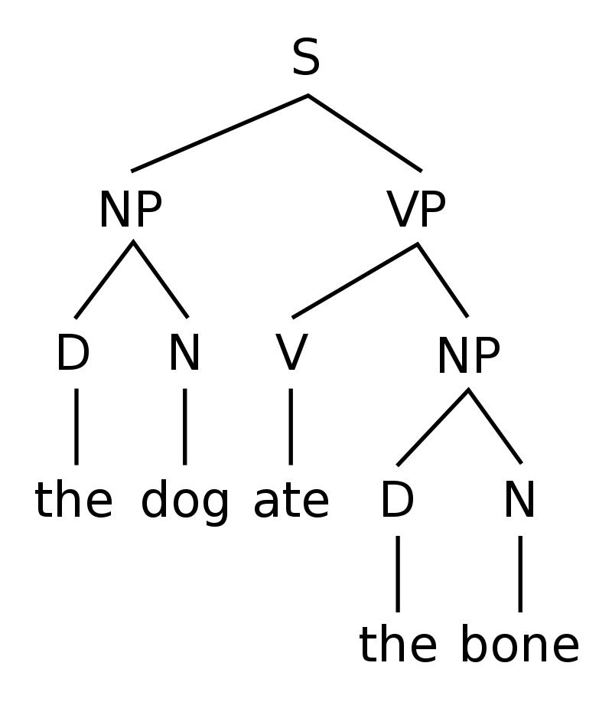
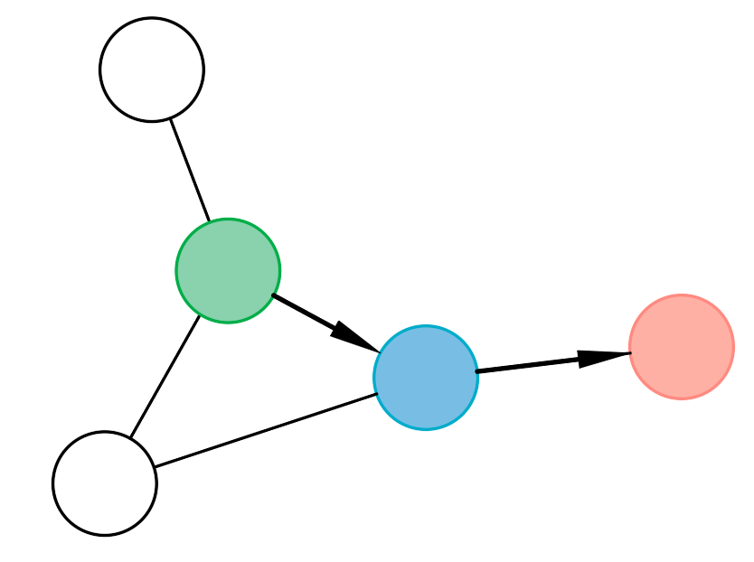
Introduction
Motivation
strong performance vs. interpretability
identification of necessary sub-graph, e.g. syntactic trees in NLP
user trust, error analysis
Task and solution
understand usage of input graph in GNN: which edges, in which layer?
GraphMask
Criteria for interpretation method
able to identify relevant paths
computational efficient
as faithful as possible

Slide 5
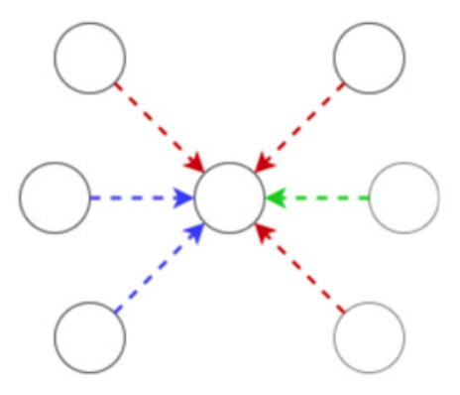
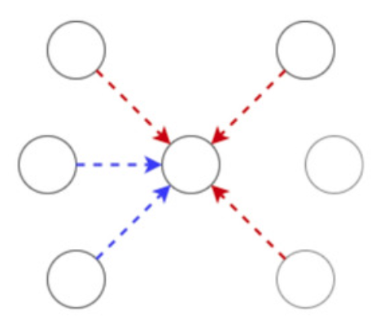
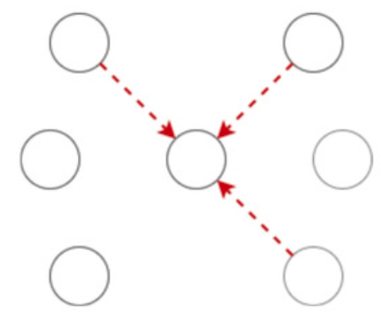
Hindsight Bias
an alternative smaller graph get a similar prediction -> non-superfluous edges are pruned
A common failure mode where the optimizer cheats by using information “from the future”
example
  count: #Red > #Blue
original graph
non-superfluous edges
alternative fake subgraph

Slide 6
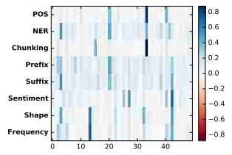
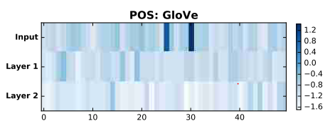
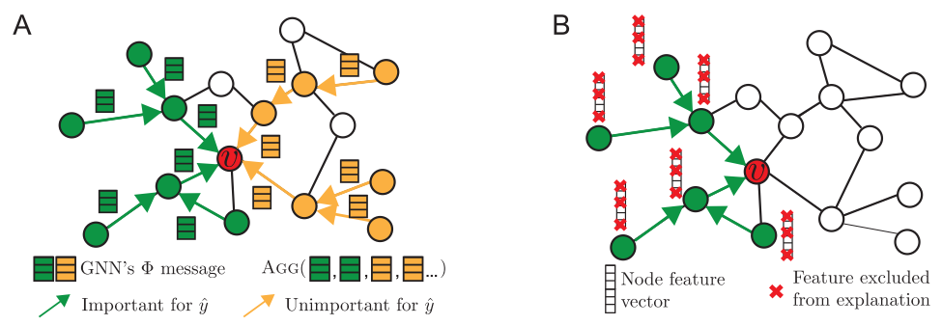
Related Works
erasure search
GNNExplainer
[1] Understanding Neural Networks through Representation Erasure, Li et al.
[2] GNNExplainer: Generating Explanations for Graph Neural Networks, Ying et al.

Slide 7
Interpreting Graph Neural Networks for NLP with Differentiable Edge Masking
Introduction
Methodology
Experimental Result
Discussion

Slide 8
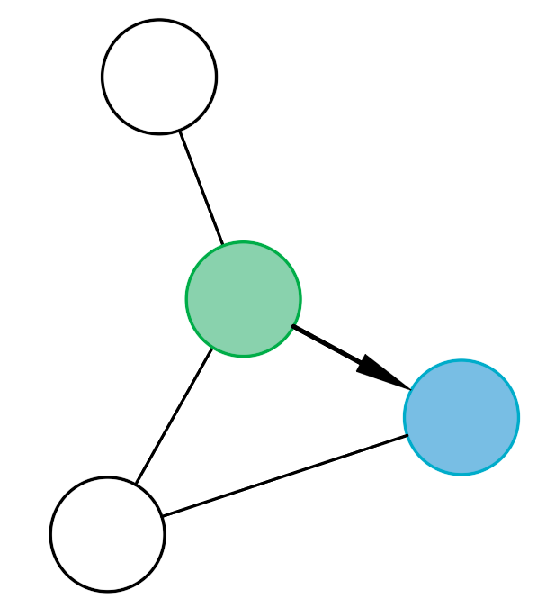
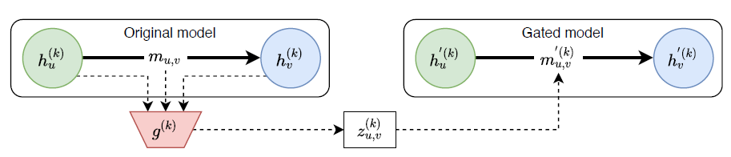







GraphMask
$$y$$
$$y≈y′$$
$$y′$$
sampling
erasure function
$${\tilde{m}}_{u,v}^{(k)}=z_{u,v}^{(k)}∙m_{u,v}^{\left(k\right)}+ b^{(k)}∙\left(1−z_{u,v}^{(k)}\right)$$
$$γ_{u,v}^{(k)}=\text{MLP}\left(h_{u}^{(k)},h_{v}^{(k)},m_{u,v}^{(k)}\right)$$
baseline
$$z_{u,v}^{(k)}\sim \text{HardConcrete}\left(γ_{u,v}^{(k)},τ\right)$$
avoid hindsight bias
amortization
no look-ahead
$z_{u,v}^{(k)}= g_{π}\left(h_{u}^{(k)},h_{v}^{(k)},m_{u,v}^{(k)}\right)∈\left\{0,1\right\}$

Slide 9
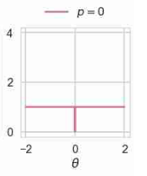
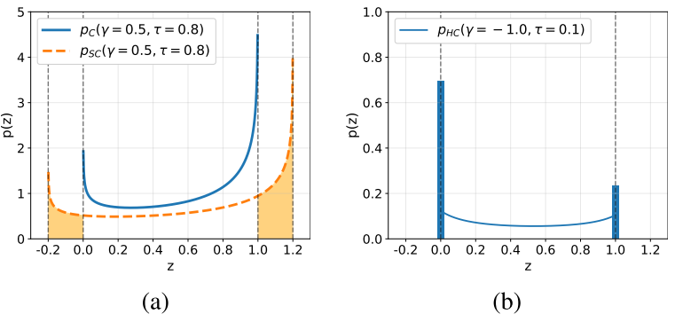

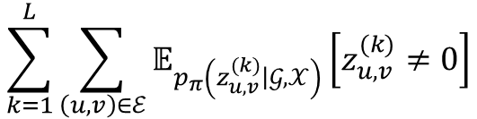
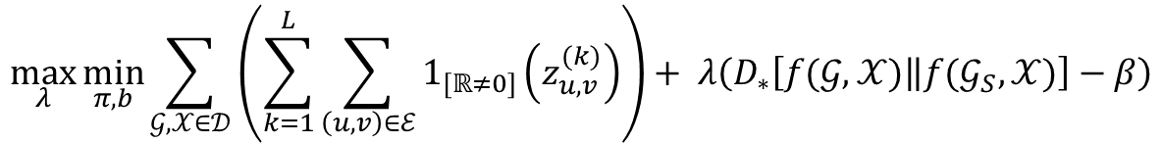

Training
loss function:
objective
constraint
$$\max_{λ}{\min_{π, b}{\sum_{𝒢, 𝒳∈𝒟}{\left(\sum_{k=1}^{L}{\sum_{\left(u,v\right)∈ℰ}{1_{[ℝ≠0]}\left(z_{u,v}^{(k)}\right)}}\right)+ λ\left(D_{∗}\left[f(𝒢,𝒳)\left\|f(𝒢_{S},𝒳)\right.\right]−β\right)}}}$$
$$\sum_{k=1}^{L}{\sum_{\left(u,v\right)∈ℰ}{𝔼_{p_{π}\left(z_{u,v}^{(k)}\left|𝒢,𝒳\right.\right)}\left[z_{u,v}^{(k)}≠0\right]}}$$
$L_{0}$-norm
hard concrete distribution with $γ$ and $τ$
[1] Learning Sparse Neural Networks through $L_{0}$ Regularization, Louizos et al.

Slide 10
Interpreting Graph Neural Networks for NLP with Differentiable Edge Masking
Introduction
Methodology
Experimental Result
Discussion
Synthetic Experiments
Question Answering
Semantic Role Labeling

Slide 11
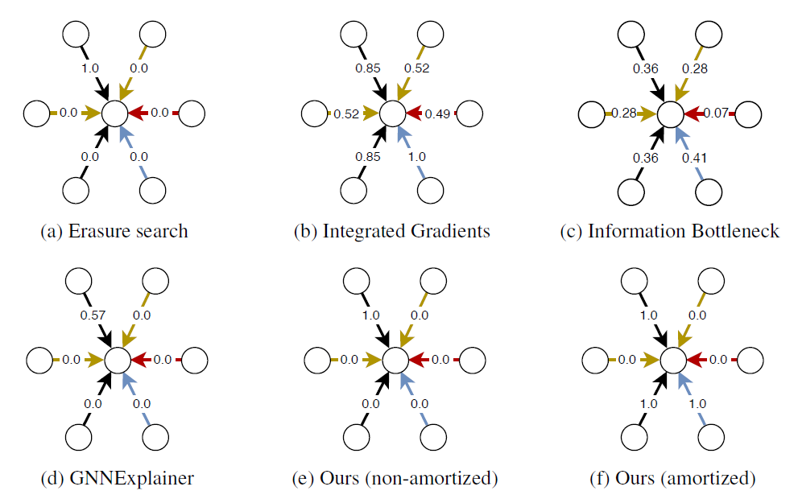
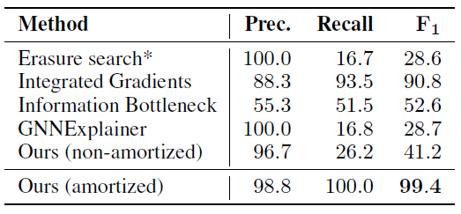
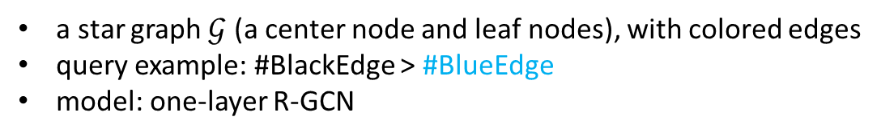
Synthetic Experiment
a star graph $𝒢$ (a center node and leaf nodes), with colored edges
query example: #BlackEdge > #BlueEdge
model: one-layer R-GCN
best

Slide 12
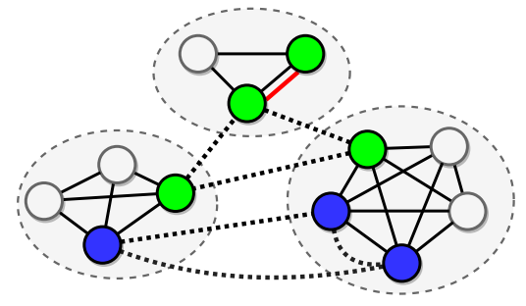
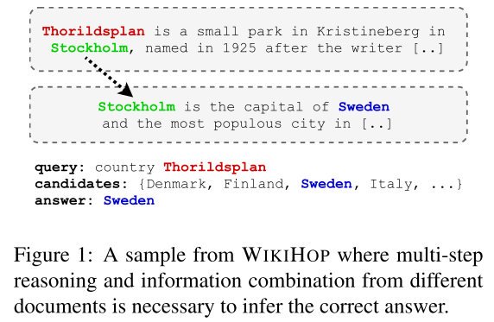
Question Answering
paper: Question Answering by Reasoning Across Documents with Graph Convolutional Networks, Cao et al.
Dataset: WikiHop
problem definition
Graph Architecture
node: mentions of entities
edge type | line style
DOC-BASED | solid
MATCH | dashed
COREF | bold-red
COMPLEMENT
[1] Question Answering by Reasoning Across Documents with Graph Convolutional Networks, Cao et al.

Slide 13
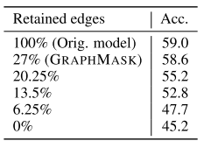
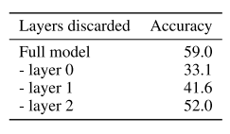
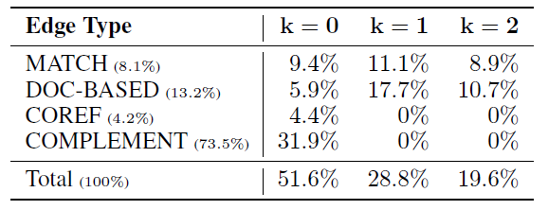
Question Answering
general: -0.4% accuracy, 27% retained edges
Interpretation w.r.t.
layer position
  bottom layers matter
edge type:
  superfluous COREF, important COMPLEMENT
reasoning path
  COMPLEMENT -> MATCH/DOC-BASED
continuing dropping edges
individual layer removed
percentage of retained edges

Slide 14
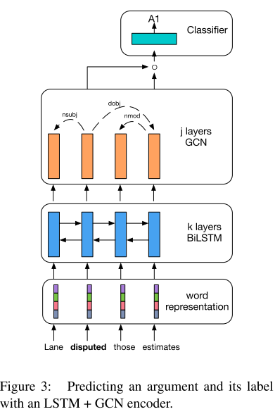
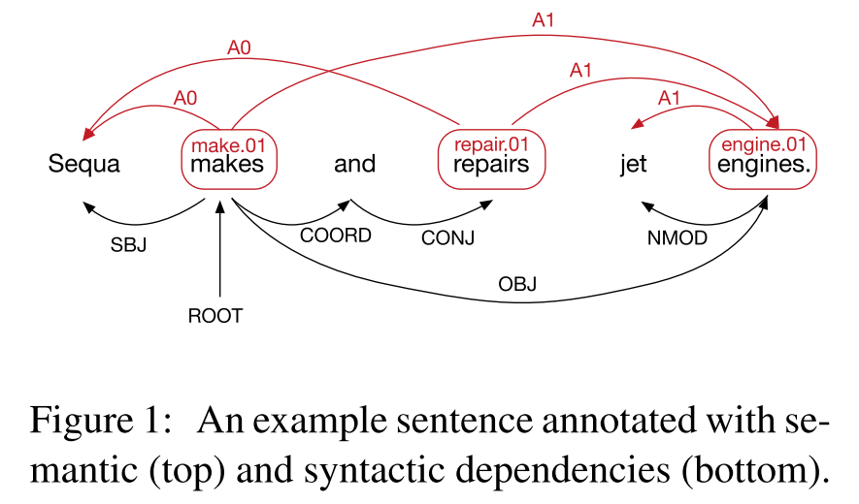
Semantic Role Labeling
paper: Encoding Sentences with Graph Convolutional Networks for Semantic Role Labeling, Marcheggiani et al.
Dataset: CoNLL-2009
task description: label arguments of verbs with semantic roles
graph: syntactic dependency tree
[1] Encoding Sentences with Graph Convolutional Networks for Semantic Role Labeling, Marcheggiani et al.
[2] Introduction to the CoNLL-2004 Shared Task: Semantic Role Labeling, Carreras et al.

Slide 15
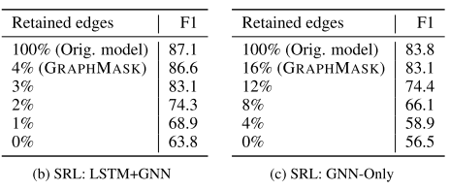
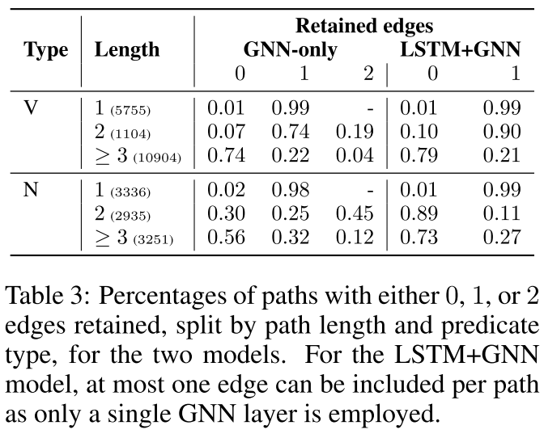
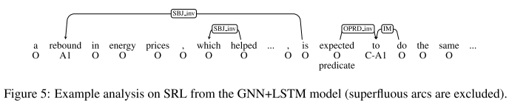
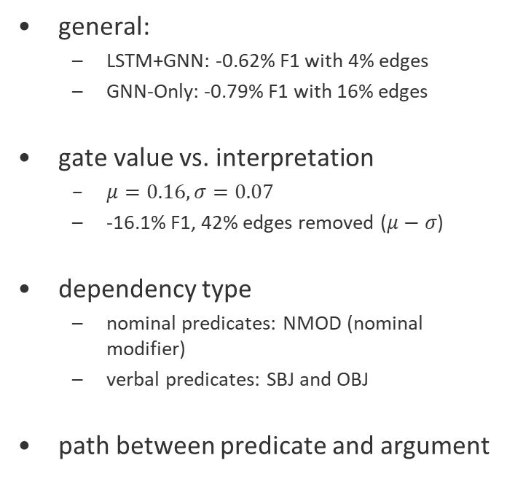
Semantic Role Labeling
general:
  LSTM+GNN: -0.62% F1 with 4% edges
  GNN-Only: -0.79% F1 with 16% edges
gate value vs. interpretation
  $μ=0.16, σ=0.07$
  -16.1% F1, 42% edges removed ($μ−σ$)
dependency type
  nominal predicates: NMOD (nominal modifier)
  verbal predicates: SBJ and OBJ
path between predicate and argument

Slide 16
Interpreting Graph Neural Networks for NLP with Differentiable Edge Masking
Introduction
Methodology
Experimental Result
Discussion

Slide 17
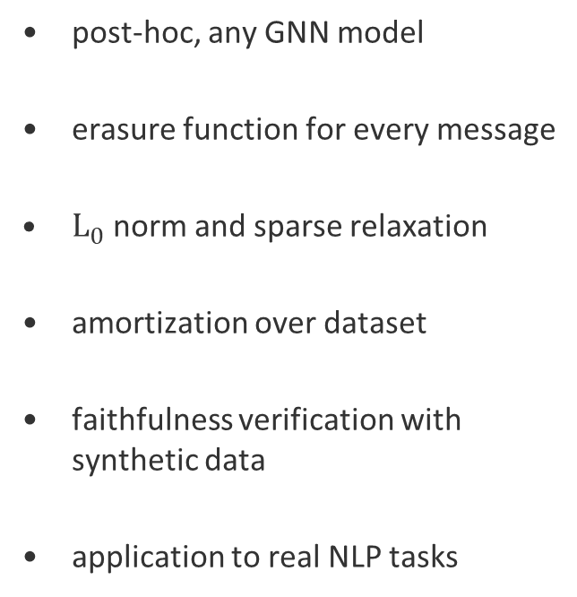
Take-home Message
Comments
post-hoc, any GNN model
erasure function for every message
$L_{0}$ norm and sparse relaxation
amortization over dataset
faithfulness verification with synthetic data
application to real NLP tasks
elegant model:
  model-agnostic
  simple and straightforward idea
  not for single instance
interesting experiment setting
  synthetic data with gold standard
  real scenario NLP task
complex mathematics
black-box NN to interpret another one
inherent interpretation

Slide 18
Thank You!
& Questions ?

