Slide 1
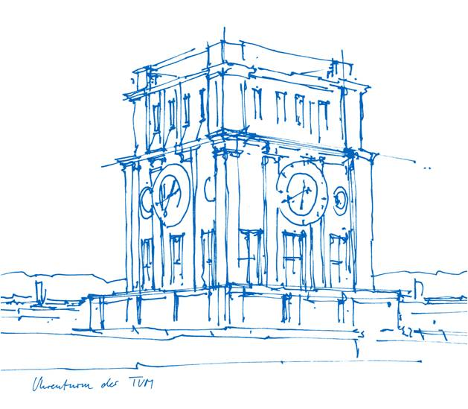
Multi-head GAGNN: A Multi-head Guided Attention Graph Neural Network for Modeling Spatio-temporal Patterns of Holistic Brain Functional Networks
Jiadong Yan, Yuzhong Chen, Shimin Yang, Shu Zhang, Mingxin Jiang, Zhongbo Zhao, Tuo Zhang, Yu Zhao, Benjamin Becker, Tianming Liu, Keith Kendrick, and Xi Jiang
Technische Universität München
Erekle Shishniashvili
Seminar - Graph Deep Learning In Medical Imaging

Slide 2
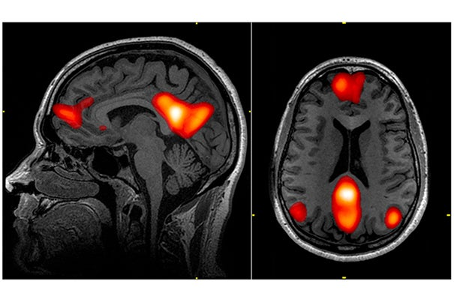
Functional-MRI
Complex messages from different
regions
Brain Functioning Study
Analysis Of Temporal and Spatial
data together

Slide 3
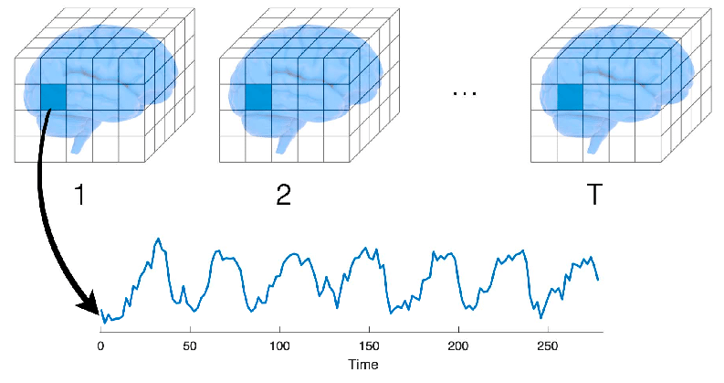
Methodology & Set Up
Resting State Network (RSN) – Recorded mind when doing nothing during F-MRI.
F-MRI data is 4D, example : 48x76x48x176
First 3 Dimension – Spatial Dimension Voxels (3D Pixels)
Intensity depends on nearby neural activity
4th Dimension – Temporal, 176 different signals

Slide 4
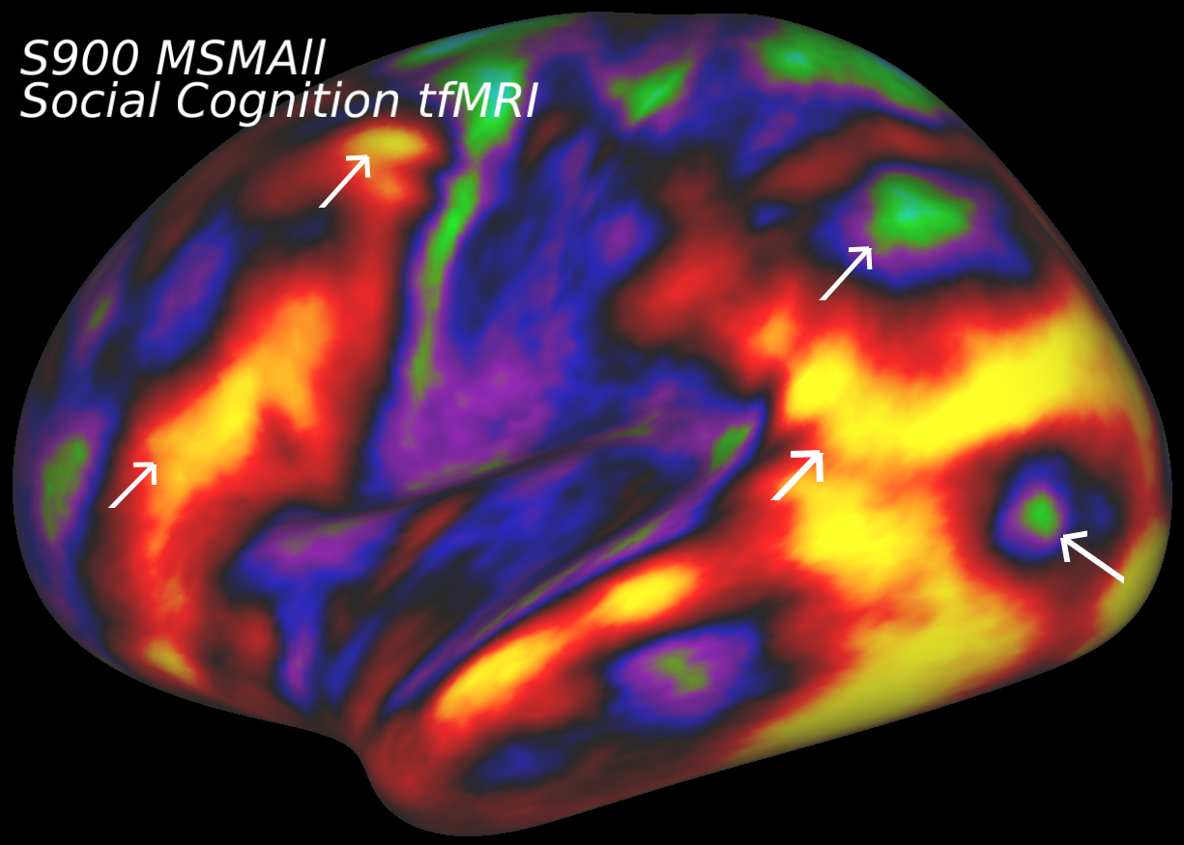
Datasets
From Human Connectome Project (HCP) S900 release
200 Randomly selected subjects.
Emotion and motor T-FMRI data from those same 200 subjects
Normalized in 0 – 1 distribution
Down-sampled to 48x56x48 for faster computation and GPU memory limitations
Temporal size – 176
10 Most representative RSNs were used

Slide 5
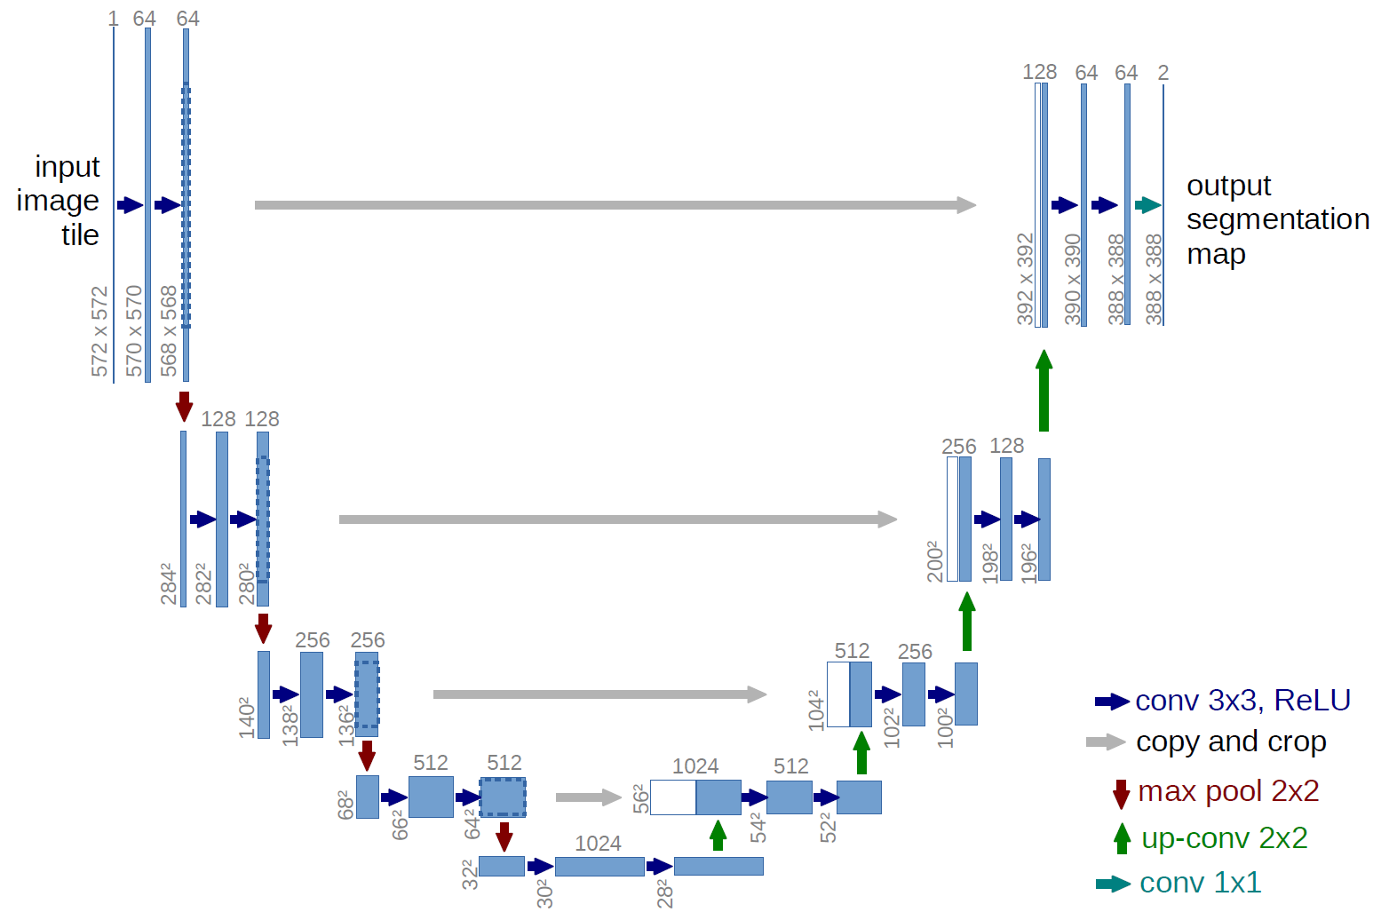
Recap – U-Net Architecture

Slide 6
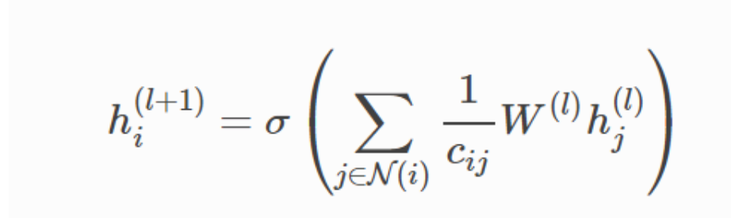
Graph Attention – Default GCN
- Recall

Slide 7
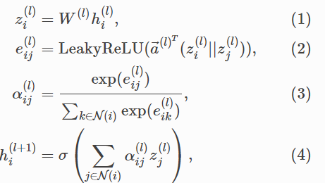
Graph Attention – Graph Attention Module
Linear transformation of the lower layer embedding learnable weight matrix.
Computes a pair-wise un-normalized attention score between two neighbors. First concatenates z embeddings of the 2 nodes.
Softmax for normalization.
GCN – embeddings from neighbors are aggregated together, scaled by attention scores.

Slide 8
Related Methods
Limited to Modeling Spatially Overlapping Brain Networks
  General Linear Model (GLM)
  PCA
  Sparse Representation (SR)
Limitation of Modeling Spatial and Temporal part Together
  RNN
  Convolutional Autoencoder (CAE)
  Restricted Boltzmann machine (RBM)
  Spatio-Temporal CNN (STCNN)
    1D CAE + 3D U-Net

Slide 9
Method

Slide 10
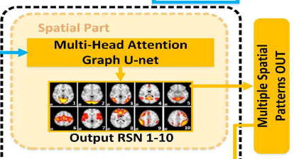
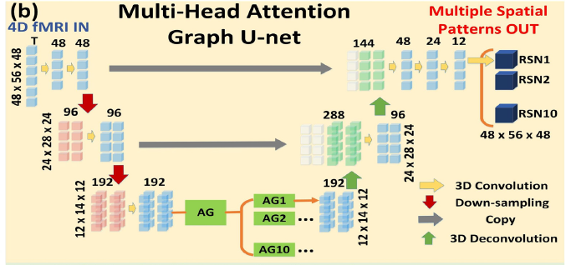
Part 1 – Spatial Part
Input – 4D FMRI
UNET architecture
3D Convolutions
3D Deconvolutions
Graph Attention Encounter – AG (AG1 … AG10)
10 Different Spatial Outputs

Slide 11


Part 1 – Attention Graph
unfold() - changes the 4D matrix with size D*H*W*T to 2D one with size (D*H*W)*T
fold() - changes the 2D matrix with size (D*H*W)*T to 4D one with size D*H*W*T

Slide 12
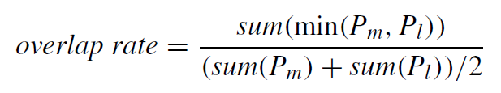


Part 1 – Spatial Part Loss
$$P_{m} −Modeled Patterned$$
$$P_{l} −Training Label$$

Slide 13
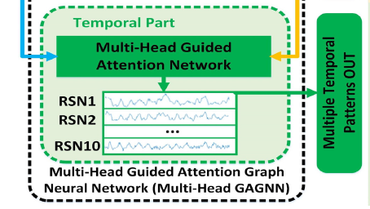
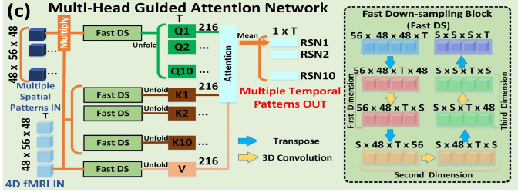
Part 2 – Temporal Part
Input – 4D FMRI data + Patterned Spatial output from Part 1
Fast DS to quickly down-sample the data (S*S*S*T)
All Share same V but different Q and K
Attention Output – (S*S*S)*T – 2D
Final 10 outputs with 1*T size

Slide 14
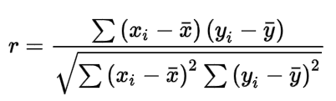
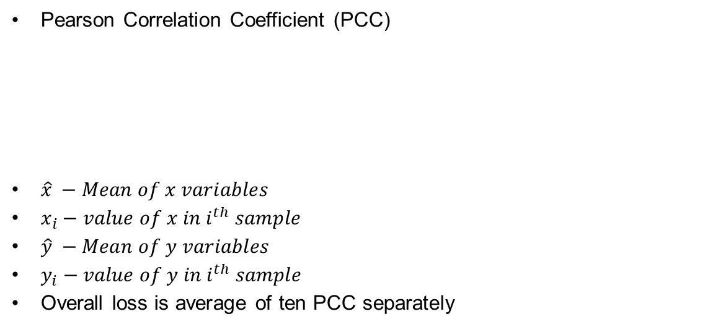
Part 2 – Temporal Part Loss
Pearson Correlation Coefficient (PCC)
$\hat{x} −Mean of x variables$
$x_{i}−value of x in i^{th} sample$
$\hat{y} −Mean of y variables$
$y_{i}−value of y in i^{th} sample$
Overall loss is average of ten PCC separately

Slide 15
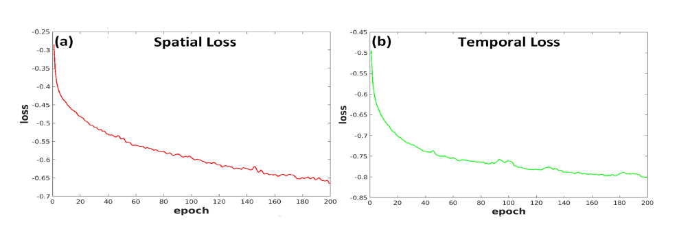
Training
Emotion t-FMRI data 200 Subjects – 160 Training – 40 Testing
Motor t-FMRI data 200 subjects for independent testing
2 Stages for Spatial and Temporal parts 1) Learning rate 0.00001 2) Learning rate – 0.001
Adam Optimizer
Multi-head GAGNN: A Multi-head Guided Attention Graph Neural Network for Modeling Spatio-temporal Patterns of Holistic Brain Functional Networks

Slide 16
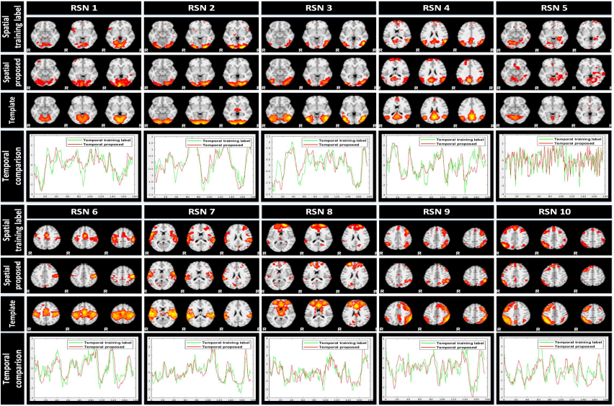
Experiment - Results

Slide 17
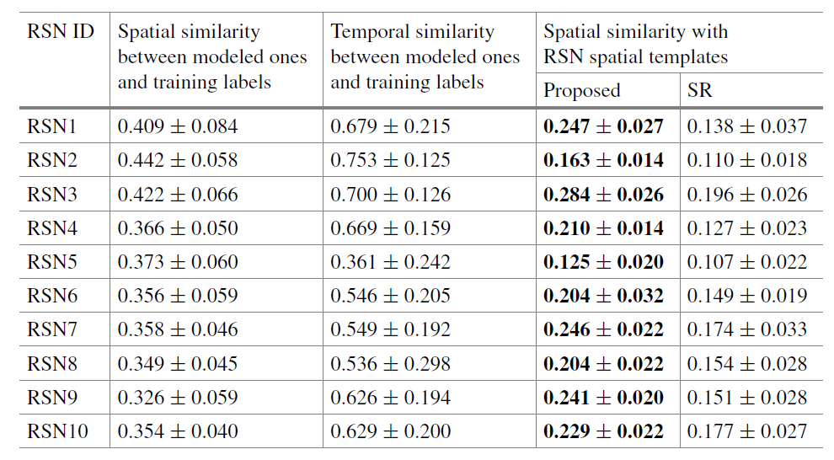
Experiment – Numbers

Slide 18
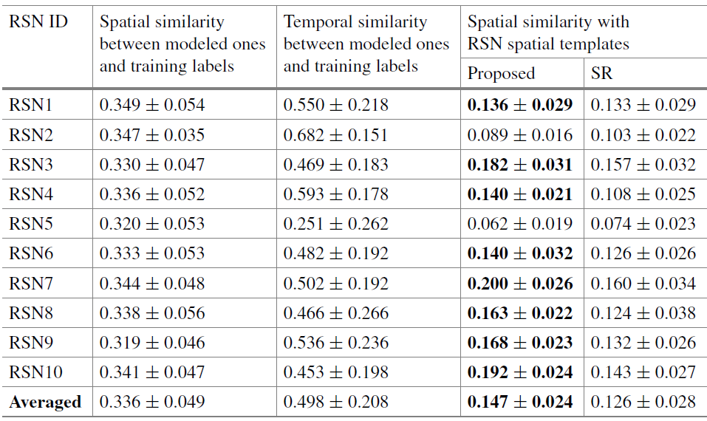
Experiment – Motor T-FMRI
Higher mean and lower standard deviation
Superior performance in modelling spatial pattern, more clustered areas and less noise

Slide 19
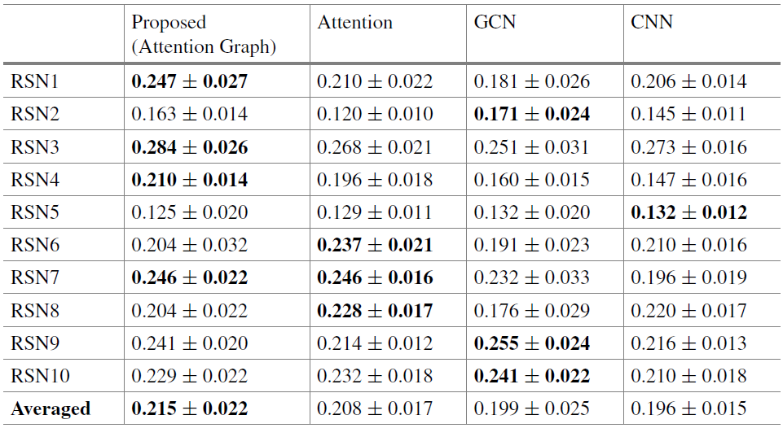
Experiment – Different Methods

Slide 20
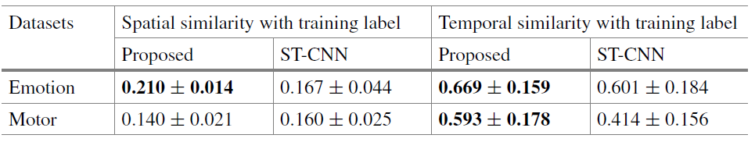
Experiment – SOTA Comparison
ST-CNN can only model one targeted brain network at one time, authors randomly selected RSN 4. Table shows that Multi-Head GAGNN has a superior or at least comparable spatial and temporal similarity compared to ST-CNN, which merely focus on modeling only one targeted brain network.

Slide 21
Take Home Message
Graph NNs can be combined with SOTA architectures as additional feature extractors and can have much better results (U-Net + GAT)
Graph Attention Networks performs better than GCN when dealing with sequential tasks
GAT also does better job at capturing global connections as well as local connections and is huge for future research

Slide 22
Discussion
Advantages
Simple language structure
Independent Experimentation
Good drawings for model and result
Disadvantages
No explanation of why they decided to use any approach
No ablation study
Changing default method implementations with their own
Poor explanation of their implemented innovative method
Poor review of related methods

Slide 23
Thank you
Questions ???

