Slide 1
Pose2Mesh: Graph Convolutional Network for 3D Human Pose and Mesh Recovery from a 2D Human Pose
Deep Learning for Medical Applications
Hongsuk Choi, Gyeongsik Moon and Kyoung Mu Lee
16.11.2021
Presenter: Dominik Schneider
Advisor: Lennart Bastian

Slide 2
1. Introduction

Slide 3
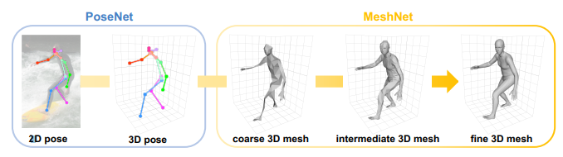
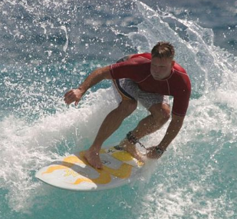
Topic
1 From 2D Human Pose
  Input information: Raster graphic
  (GraphCNN)-based system without the use of mesh models
2 Creating a 3D Human Pose
    Estimating the 3D coordinates of human mesh vertices directly from the 2D human pose.
    Recover 3D Human joint and mesh vertex locations.

Slide 4
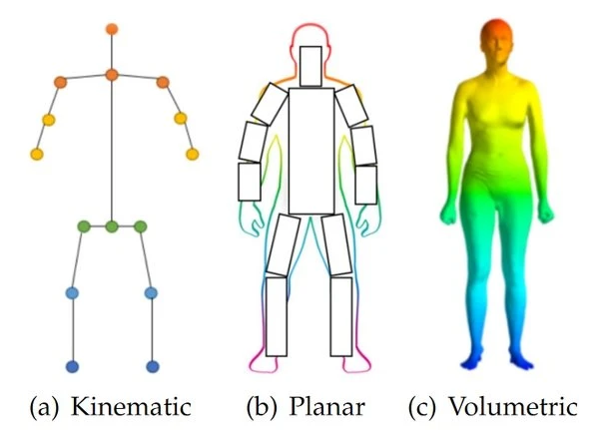
Motivation
Problem: Estimating Human Pose
  Goal is to recover 3D human joint and mesh vertex locations simultaneously.
  Challenging task due to the depth and scale ambiguity
Model Based approaches
    Recent strategies: SMPL and MANO
    Using visual input data to set parameters of human mesh models

Slide 5
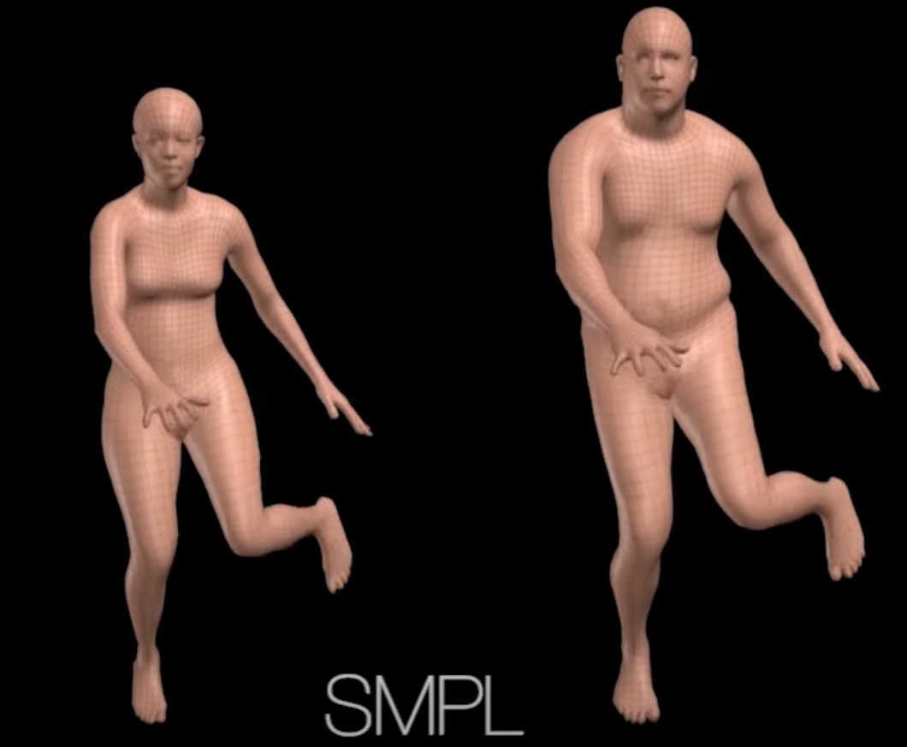
Current Approaches: Model Based
Weaknesses
    Gap between controlled and in-the-wild environment data
    Pose parameters represent 3D rotations in an axis angle, which can suffer from the non-unique problem
Notes:
The data captured from the controlled environments [22, 26] is valuable train data in 3D human pose and estimation, because it has accurate 3D annotations. However, due to the significant difference of image appearance between the two domains, such as backgrounds and clothes, an image-based approach cannot fully benefit from the data
The SMPL pose parameters, for example, represent 3D rotations in an axisangle, which can suffer from the non-unique problem (i.e., periodicity). While many works [27, 33, 47] tried to avoid the periodicity by using a rotation matrix as the prediction target, it still has a non-minimal representation issue

Slide 6
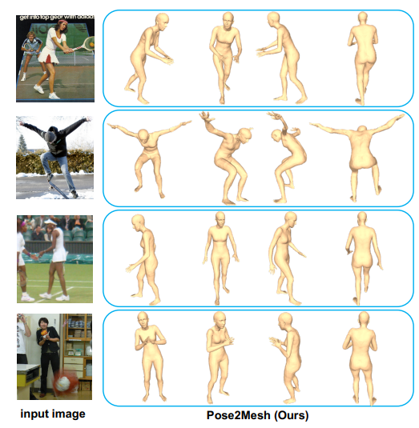
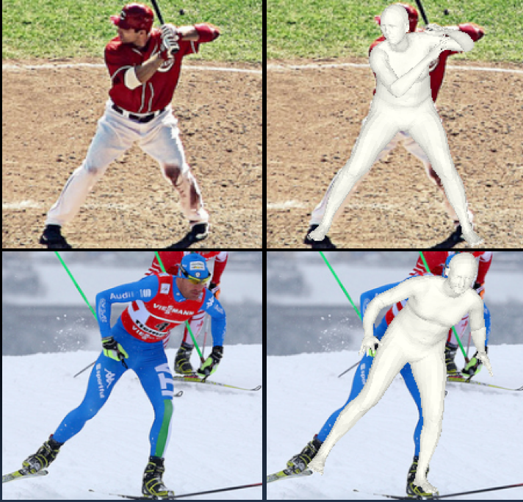
Solution: Pose2Mesh
Features
Graph convolutional system
Recovers 3D human pose and mesh from the 2D human pose
Model-free approach
Compensates the two weaknesses of model-based approaches

Slide 7
Advantages I
Consistent Performance
  Relatively homogeneous geometric property from controlled and in-the-wild environments
  Trained on large-scale in-the-wild datasets
  Accurate estimations outside lab enviromnent

Slide 8
Advantages II
Direct Regression
  3D coordinates regressed of mesh vertices using a GraphCNN
  Avoids the representation issues of the pose parameters
  Still exploiting the human mesh topology (no finesses loss)
  (i.e. face and edge information)
  Provide essential geometric information on the human articulation

Slide 9
2. Related Work

Slide 10
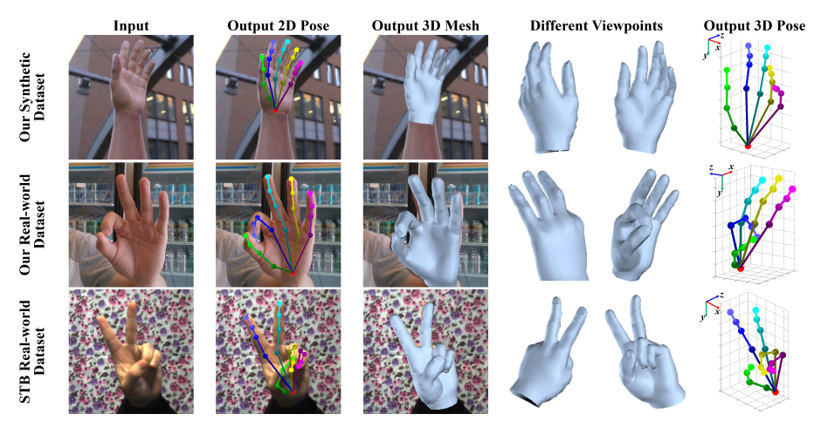
3D human body and hand pose mesh estimation
Generator:
Model-based approach (SMPL and MANO)
Neural Network, trained to estimate pose and hand model parameters
Differences
SMPL and MANO using image input
Pose2Mesh uses 2D human pose input
Notes:
Gestures

Slide 11
3. Methodology

Slide 12
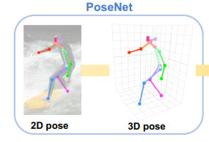
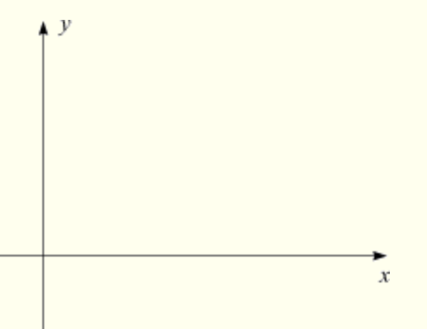
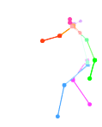
Step 1: PoseNet Pose 2D
Generating 𝐏2D
Fixed number of joints
Defined Root joints (hand, wrist, etc.)
Applying standard normalisation.
Input:
Pose Images
Output:
2D Pose
Notes:
Takes 2D image
define the root joint of the human body (hand, wrist)
The estimated 2D pose often contains errors (occlusions, hiddenbody parts, or challenging poses)
normalization is necessary for the next step,
P3D is independent of scale and location of the 2D input pose P2D.

Slide 13
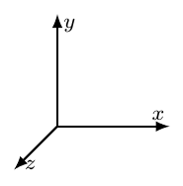

Step 1: PoseNet Pose 3D
Generating 𝐏3D
Normalized P2D is converted to a 4096-dimensional feature vector.
Network estimates depth coordinates
Graph is lifted to 3D space
Input:
2D Pose
Output:
3D Pose
Notes:
Takes 2D image
define the root joint of the human body (hand, wrist)
The estimated 2D pose often contains errors (occlusions, hiddenbody parts, or challenging poses)
normalization is necessary for the next step,
P3D is independent of scale and location of the 2D input pose P2D.

Slide 14
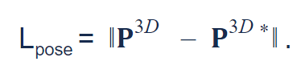
Step 1: PoseNet Training
Training Details
Network trains to minimize loss function Lpose
Lpose is the “Absolute spatial distance” of all points to their groundtruth
Images with occluded body parts and complicated poses are inserted
Notes:
When training the network, data with occluded body parts and complicated poses are specifically inserted to make the network sensitive to these special cases. To quantitatively evaluate the quality of the estimates, we calculate the absolute spatial distance of all points to their groundtruth. The network is trained to minimize this distance.

Slide 15
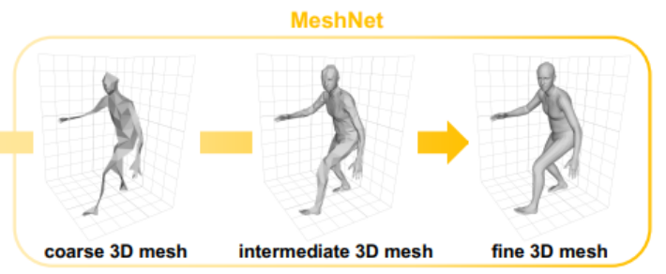
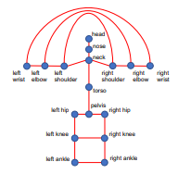



Step 2: MeshNet
Generating Pose Graph
Preparing for the spectral graph convolution network
Adjacency Matrix is first normalized
Then the scaled laplacian is computed
Input:
PoseNet Results
Output:
Pose Graph
Normalized scaled Laplacian
https://github.com/nkolot/GraphCMR

Slide 16
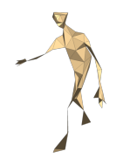

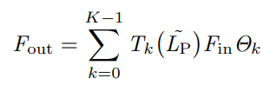
Step 2: MeshNet
Generating Mesh 3D
MeshNet uses the spectral graph convolution to estimate 3D Mesh
Signal x is multiplicated with a filter
Input:
Pose Graph
Output:
Coarse mesh
Spectral Graph convolution

Slide 17
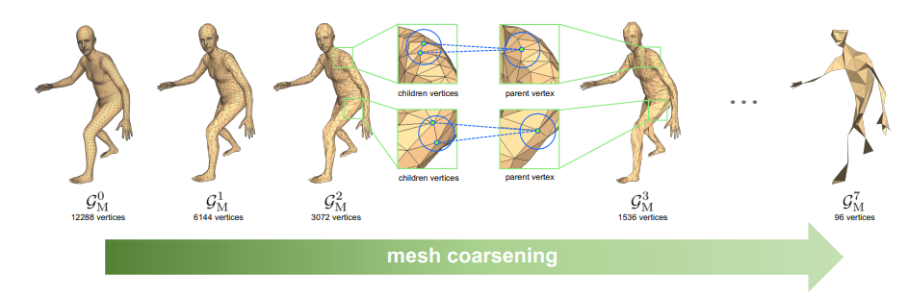
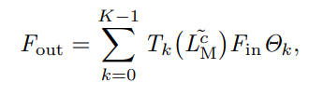
Step 2: MeshNet
Generating Mesh 3D
Upsampling by copying features of each parent vertex
Inheriting children vertices
binary tree structure
Input:
Coarse Mesh
Output:
Fine Mesh
Coarse-to-fine mesh upsampling

Slide 18




Step 2: MeshNet Training
Vertex coordinate loss
Strategy: minimize L1 distance (mesh coordinates predicted vs groundtruth)
Joint coordinate loss
Strategy: minimize L1 distance (3D pose predicted vs groundtruth)
Goal: mesh vertices should be aligned with joint locations
Surface normal loss
Strategy: minimize deviation (normal vectors predicted vs groundtruth)
Surface edge loss
Strategy: minimize edge length deviations
Recovering smoothness of dense body parts
1.)
3.)
3.)
4.)

Slide 19
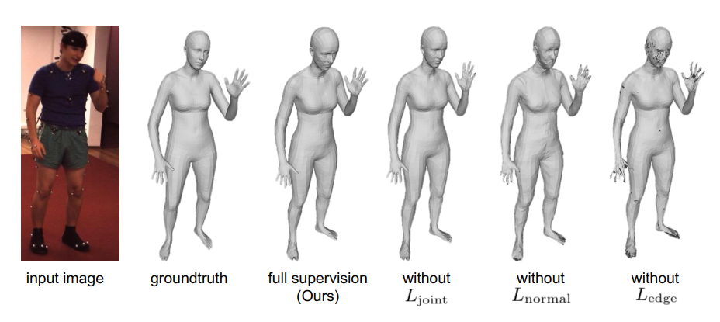


Step 2: MeshNet Training

Slide 20
4. Experiments & Results

Slide 21
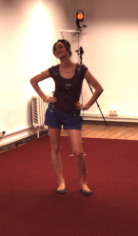
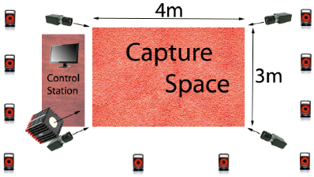
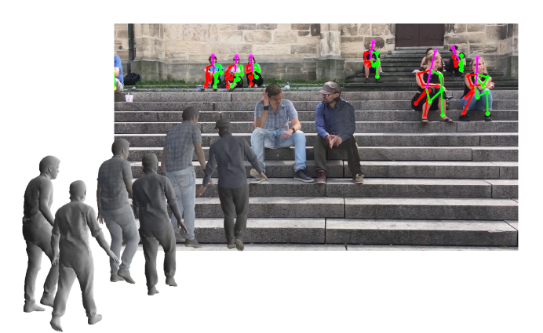
Datasets
Human3.6M
Size: 3.6 Million video frames
Groundtruth captured by 3D laser body scanner
Only Indoor Poses
3DPW
51K video frames
Groundtruth captured by 3D laser body scanner
Image type: In-the-wild
Notes:
Difference Labor & Wild

Slide 22
Evaluation metrics
Regarding performance of Pose2Mesh we clarify the following evaluation parameters.
MPJPE (Mean per joint position error)
  Euclidean distance in millimeters between the estimated and groundtruth joint coordinates
PA-MPJPE (Procrustes analysis - MPJPE [10])
  is calculated from MPJPE after further alignment.
Notes:
Difference Labor & Wild

Slide 23
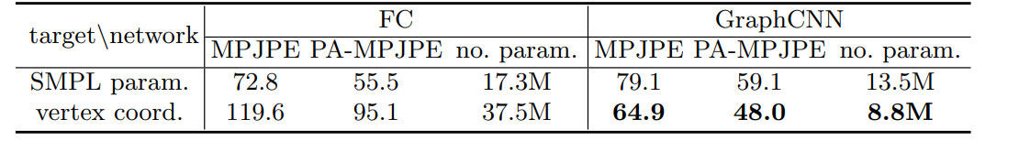
Performance Measurement
Experiment 1
  Testing new approach GraphCNN vs vertex-Fully Connected Layers (regressing the vertices)
  Testing SMPL param. Vs vertex coordinates.
  Measures evaluation metrics
  performance improvement of GraphCNN
  Pose2Mesh more precise results can be estimated
Notes:
VERTEX FC regresses vertex coordinates with a network of fully-connected layers

Slide 24

Performance Measurement
Experiment 2
  Comparison: Pose2Mesh vs direct mesh upsampling scheme
  Only slightly reduced joint error
  Core advantage: 1.5x speed increase with halved GPU memory usage
Notes:
VERTEX FC regresses vertex coordinates with a network of fully-connected layers

Slide 25
5. Conclusion

Slide 26
Conclusion
Notes
Pose2Mesh outperforms several state-of-the art approaches
Convinces with wide applicability
the model-free approach was able to produce more precise, reliable results
Pose2Mesh was able to compensate the disadvantages of the predecessors
  (Rotation uniqueness + Gap between controlled and in-the-wild environment)
Advantages in runtime performance and saving of graphics memory make the system additionally interesting for real-time applications.

Slide 27
6. Personal Opinion

Slide 28
Personal Opinion
Strengths
Performance is impressive
Model free approach is a really new concept
Tested on a variety of datasets in laboratory and wild
Great appendix information
Source Code publicly available on GitHub
Future Vision: Realtime Applications
Weaknesses
Paper structure very complicated
Images and tables at random places and not aligned with the text
Very much background information needed to understand
Mesh upsampling is imaged very misleading

Slide 29
Take-Home-Message
keep the concept of Pose Estimating in mind:
  Can your car understand hand gestures?
  Does your phone scan your face to unlock?
Deep learning got reality in many of todays applications. If you want to get more into GraphCNN, I definetly recommend this paper.

