Slide 1
Graph Deep Learning for Medical Applications
Learning Graph Convolutional Networks for Multi-Label Recognition and Applications
Zhao-Min Chen, Xiu-Shen Wei, Peng Wang, and Yanwen Guo
IEEE Transactions on Pattern Analysis and Machine Intelligence (TPAMI)
2021
Student: Simay SANLI
Advisor: Mahsa Ghorbani
December 14,
2021

Slide 2
Introduction
Related Works
Methodology
Experiments
Conclusion
Student’s Review
Reference

Slide 3
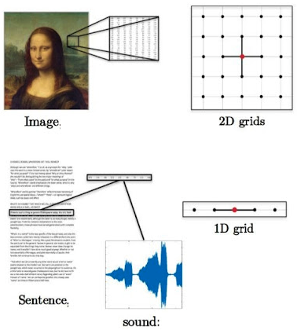
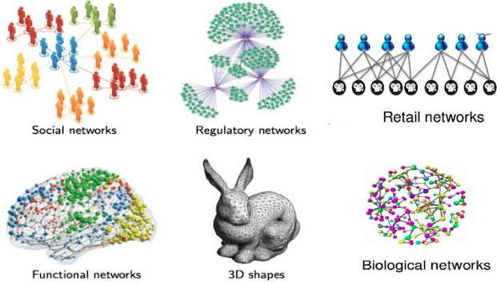
Introduction
Figure 1. Euclidean Data [1] Figure 2. Non-Euclidean Data [1]
Why graph learning model?
  Convolutional Neural Networks is very powerful in many problems which include euclidean data.
  Non-Euclidean data does not have any specific structure.
  Convolutional Neural Networks do not provide an efficient way to solve label correlations.
  Propagate information between labels.
[1] M. Defferrard, X. Bresson, en P. Vandergheynst, “Convolutional Neural Networks on Graphs with Fast Localized Spectral Filtering”, CoRR, vol abs/1606.09375, 2016.

Slide 4
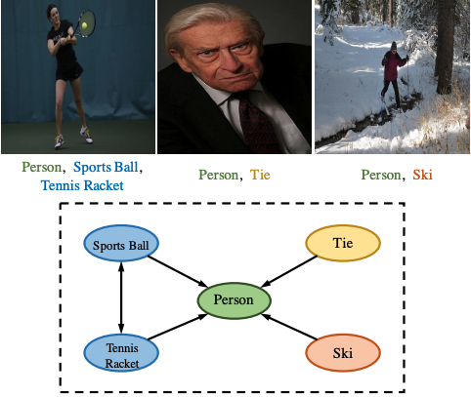
Motivation
Why multi-label?
  Relationships between labels and recognize multiple image in one image.
  Capture and explore label correlation dependency using multi-label graph.
Figure 3. Multi-Label Graph [2]
[2] B. Chen, J. Li, G. Lu, H. Yu and D. Zhang, "Label Co-Occurrence Learning With Graph Convolutional Networks for Multi-Label Chest X-Ray Image Classification," in IEEE Journal of Biomedical and Health Informatics, vol. 24, no. 8, pp. 2292-2302, Aug. 2020, doi: 10.1109/JBHI.2020.2967084.

Slide 5
Related Works
Multi-label Image Recognition
  Large scale hand-labeled datasets: ImageNet[3], MS-COCO[4] and PASCAL VOC[5]
  Many efforts on deep convolutional networks.
Graph Representation Learning
  Deep Convolutional Neural Networks with the ranking based strategy and the weighted approximated ranking loss, Recurrent Neural Network, LSTM
    Inefficient for label correlations and discriminate labels.
  Graph Convolutional Networks (GCN)
    Applications and concepts of Convolutional Neural Networks (CNN)
    High potential of Graph Convolutional Networks in computer vision and pattern recognition problems.
[3] T.-S. Chua, J. Tang, R. Hong, H. Li, Z. Luo, and Y. Zheng, “NUSWIDE: a real-world web image database from national university of singapore,” in Proceedings of Conseil Interprofessionnel des Vins du Roussillon, 2009, pp. 1–9.
[4] J. Deng, W. Dong, R. Socher, L.-J. Li, K. Li, and L. Fei-Fei, “ImageNet: A large-scale hierarchical image database,” in Proceedings of IEEE Conference on Computer Vision and Pattern Recognition, 2009, pp. 248–255.
[5] T.-Y. Lin, M. Maire, S. Belongie, J. Hays, P. Perona, D. Ramanan, P. Dollar, and C. L. Zitnick, “Microsoft COCO: Common objects in ´ context,” in Proceedings of European Conference on Computer Vision, 2014, pp. 740–755.

Slide 6
Graph Convolutional Network (GCN)
Classifier Learning Graph Convolutional Network (C-GCN)
Prediction Learning Graph Convolutional Network (P-GCN)
Methodology

Slide 7

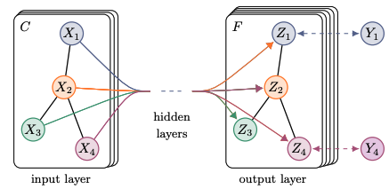

Graph Convolutional Network (GCN)
Update the node representations by propagating information between nodes
Every GCN layer can be written as non-linear function
𝙃 ^{𝑙} ϵ 𝐑 ^{𝑛⤬𝑛} : Previous node representations
𝑨 ϵ 𝐑 ^{𝑛⤬𝑛}: Correlation matrix
𝙃 ^{𝑙 +1} ϵ 𝐑 ^{𝑛⤬𝑛}: New node representations
𝑛: Number of nodes
𝑑: Dimensionality of node features
The goal of GCN is to learn 𝑓 function.
After the convolutional operation as shown in Equation 1
𝑾 ^{𝑙} ϵ 𝐑 ^{𝑑⤬𝑑}: Transformation matrix
𝙃 ^{𝑙} ϵ 𝐑 ^{𝑛⤬𝑛}: Previous node representations
𝙃 ^{𝑙 +1} ϵ 𝐑 ^{𝑛⤬𝑛}: New node representations
Figure 2. Graph Convolutional Network [6]
[6] T. N. Kipf and M. Welling, “Semi-supervised classification with graph convolutional networks,” in Proceedings of International Conference on Learning Representations, 2017, pp. 1–10.

Slide 8
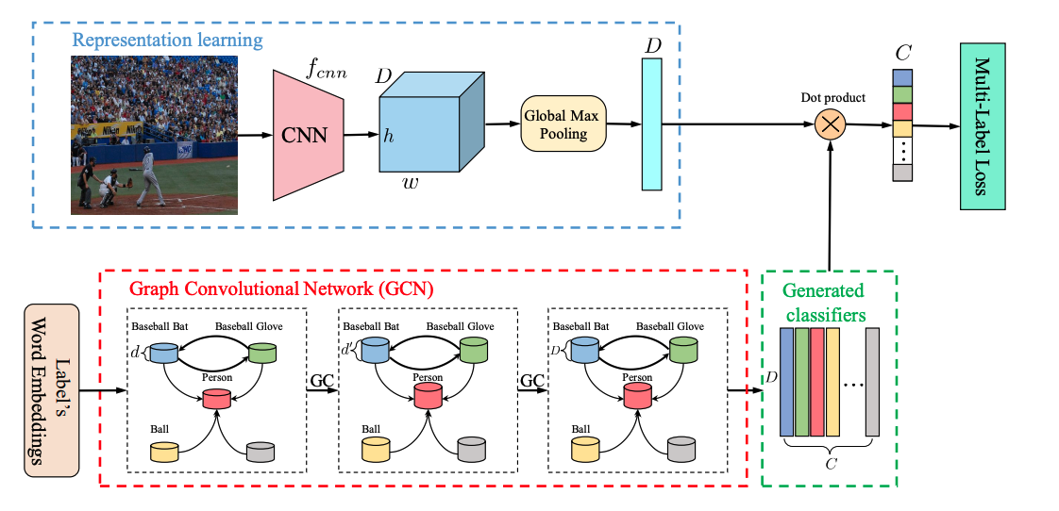
Classifier Learning Graph Convolutional Network (C-GCN)
Figure 3. Classifier Learning GCN (C-GCN) model [7]
Mapping class-level representations to inter-dependent classifiers.
Labels are represented by word embeddings.
Combined of two modules: Image Representation Learning and Graph Convolutional Neural Networks Based Classifier Learning.
[7] B. Chen, J. Li, G. Lu, H. Yu and D. Zhang, "Label Co-Occurrence Learning With Graph Convolutional Networks for Multi-Label Chest X-Ray Image Classification," in IEEE Journal of Biomedical and Health Informatics, vol. 24, no. 8, pp. 2292-2302, Aug. 2020, doi: 10.1109/JBHI.2020.2967084.

Slide 9

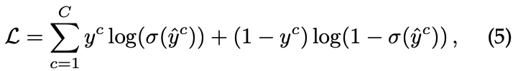

Classifier Learning Graph Convolutional Network (C-GCN)
Image Representation Learning
  Using Global Max Pooling for image level feature
  The image-level feature 𝑥:
Model parameters are shown as 𝛳 _{cnn} in (3).
GCN Based Classifier Learning
  Learning inter-dependent object classifier 𝙒 = {𝑤_{𝑖}}_{𝑖=1}^{𝐶}
  Applying the learned classifiers to global image representations
  Prediction scores:
Multi-Label Classification Loss
ground truth label of image

Slide 10
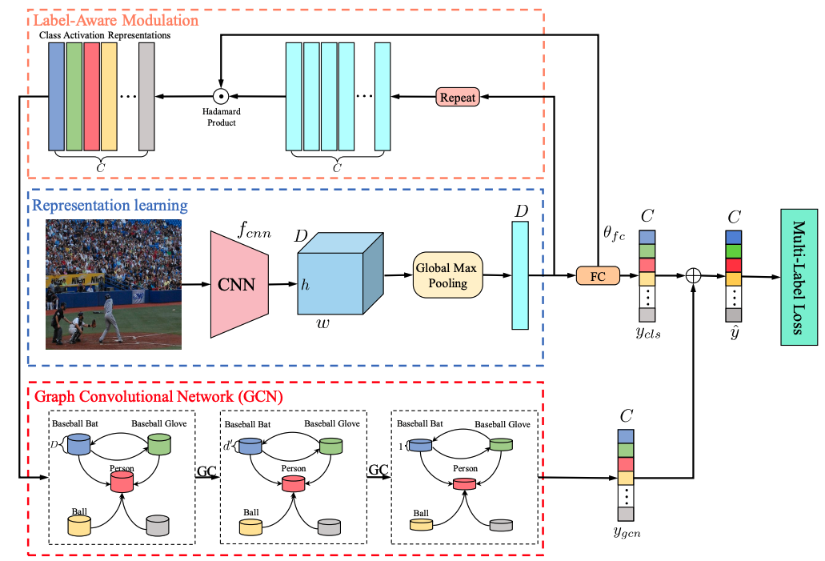
Prediction Learning Graph Convolutional Network (P-GCN)
which is mainly combination of three modules: the image representation learning module, the label-aware modulation module and the GCN based inter-dependent prediction score learning module.

Slide 11
Prediction Learning Graph Convolutional Network (P-GCN)
Image Representation Learning
  Similar to image representation learning of C-GCN
Label Aware Modulation
  Untangled the global image representation 𝑥 of an image into a set of label-specific features.
  Applied plain classifiers to 𝑥:
is parameter of the plain classifier
  Obtained the disentangled label-relevant features and modulated the image feature x to captures the information.
copies 𝑥 ϵ 𝐑 ^{D} C times to form [𝑥, …., 𝑥] ^{T}
Hadamard product
GCN Based Image-Level Prediction Score Learning
  Mapped the modulated feature into the prediction scores
  Combined the prediction scores from label aware modulation and the GCNs for the final scores

Slide 12

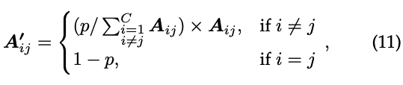
Correlation Matrix
Conditional probability matrix
Overfitting Problem
  solve problem using binarized correlation 𝑷 and threshold to filter noisy edges
Over-smoothing Problem
  caused by node from different clusters (e.g., kitchen related vs. living room related)
  proposed re-weighted correlation matrix

Slide 13
C-GCN vs P-GCN
the purpose of the two proposed model is to model label correlations on multi-label image recognition problems using labelled datasets.
There are two main differences between them:
  C-GCN captures interdependent class relationships by learning interdependent classifiers and it uses word-embedding to construct graphs.
  P-GCN learns interdependent prediction scores to model label correlations. It uses content of image to learn interdependent features.
  P-GCN proves better results than C-GCN especially on partially labeled dataset.

Slide 14
Experiments
Different implementations:
Generic Multi-Label Image Recognition
Partial Label Problem
Multi-Label Face Attributes Recognition
Multi-Label Human Attributes Recognition

Slide 15
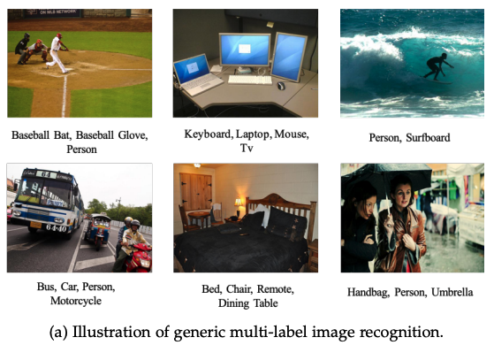
Generic Multi-Label Image Recognition
In both C-GCN and P-GCN experiments:
  Pytorch library with Intel Xeon E5-2660, 120G main memory and 8 GTX1080Ti GPU is used for implementation
  Data augmentation on training set (random horizontal flips)
  Optimizer: Stochastic Gradient Descent
  weight decay: 10 ⁻⁴, momentum: 0.9 and initial learning rate 0.01
  Datasets:
    MS-COCO dataset
    PASCAL VOC 2007
    NUS-WIDE

Slide 16
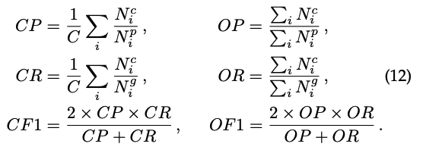
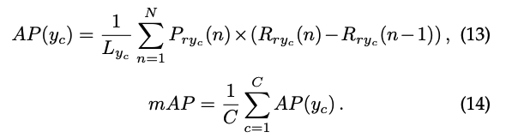
Evaluation Metrics
For performance evaluation: the average per-class precision (CP), recall (CR), F1 (CF1) and the average overall precision (OP), recall (OR), F1 (OF1) are calculated.
For accuracy evaluation: the average precision (AP) and the mean average precision (mAP) are calculated.

Slide 17
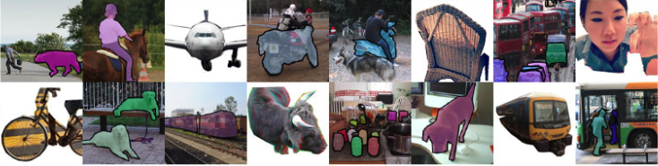
MS COCO
Large-scale object detection, segmentation, and captioning dataset.
COCO has several features:
  Recognition in context
  Superpixel stuff segmentation
  330K images (>200K labeled)
  1.5 million object instances
  80 object categories
  91 stuff categories
  5 captions per image
  250,000 people with keypoints

Slide 18
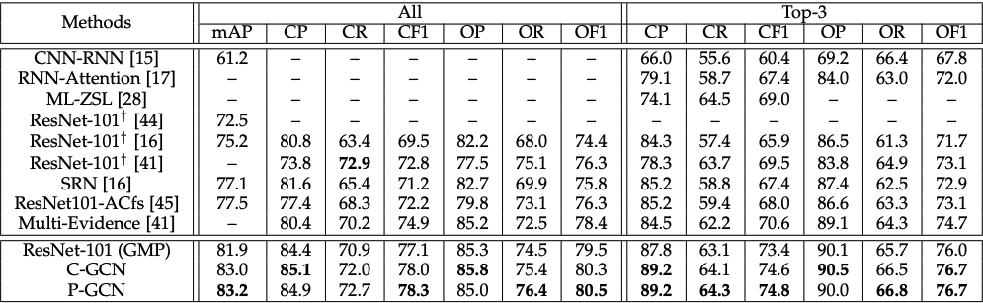
Results
Table 1. Comparisons P-GCN and C-GCN with state-of-the-art methods on MS-COCO dataset.

Slide 19
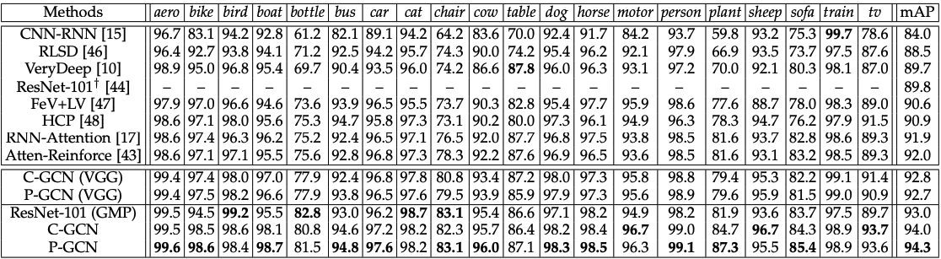
Results
VOC 2007: 9,963 images from 20 object categories
Table 2. Comparisons P-GCN and C-GCN with state-of-the-art methods on VOC 2007 dataset.

Slide 20
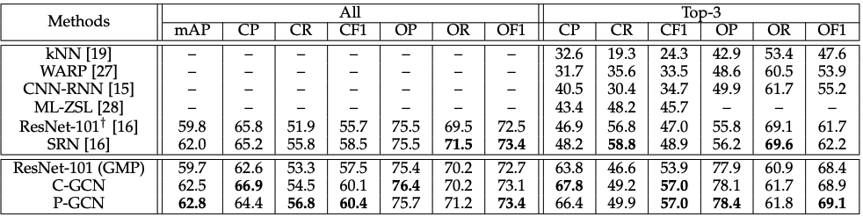
Results
NUS-WIDE : 269,648 images, 80 classes
Table 3. Comparisons P-GCN and C-GCN with state-of-the-art methods on NUS-WIDE dataset.
NUS-WIDE contains non-negligible levels of label noise.
The proposed models work robustly under noisy labels.

Slide 21
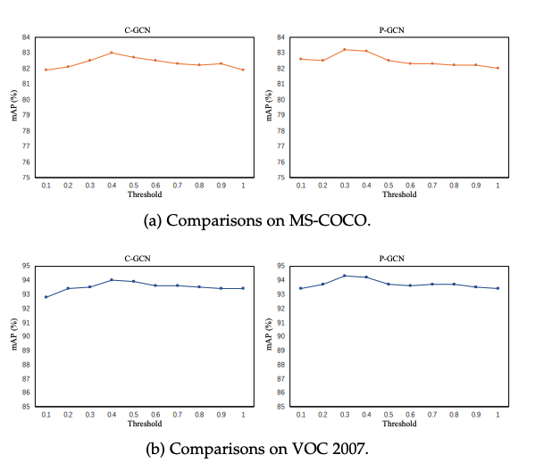
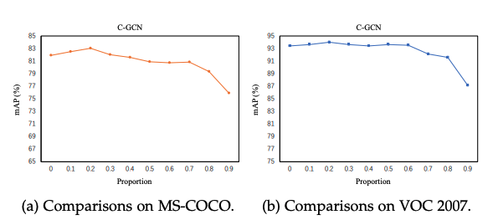
Ablation Studies
Explore effect of different threshold values for correlation matrix construction and effect of different p for re-weighted correlation matrix on multi-label recognition
Performance evaluation with different values of p
Performance evaluation with different threshold
Evaluated performance of C-GCN for different types of word embeddings such as GloVe, GoogleNews, FastText, one-hot word embedding.
Evaluated performance of P-GCN for different prediction methods such as classification prediction, GCN prediction and joint prediction on MS-COCO, VOC 2007 and NUS-WIDE.

Slide 22
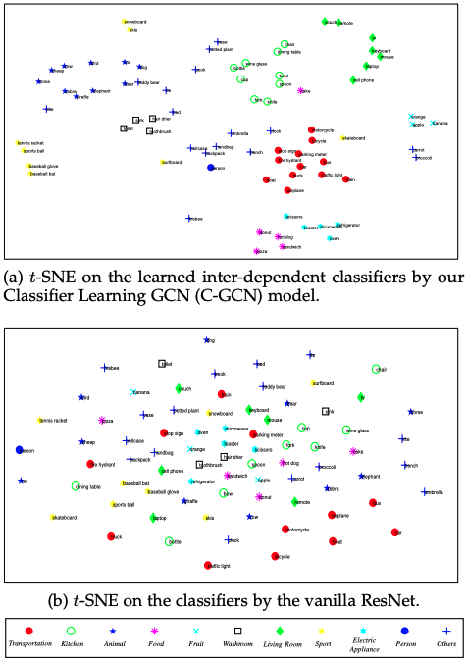
Visualization and Qualitative Analyses
evaluated effectiveness of the C-GCN on the learned inter-dependent classifiers.
obtained meaningful semantic using C-GCN.
k-NN algorithm was used to validate the discriminative ability.

Slide 23
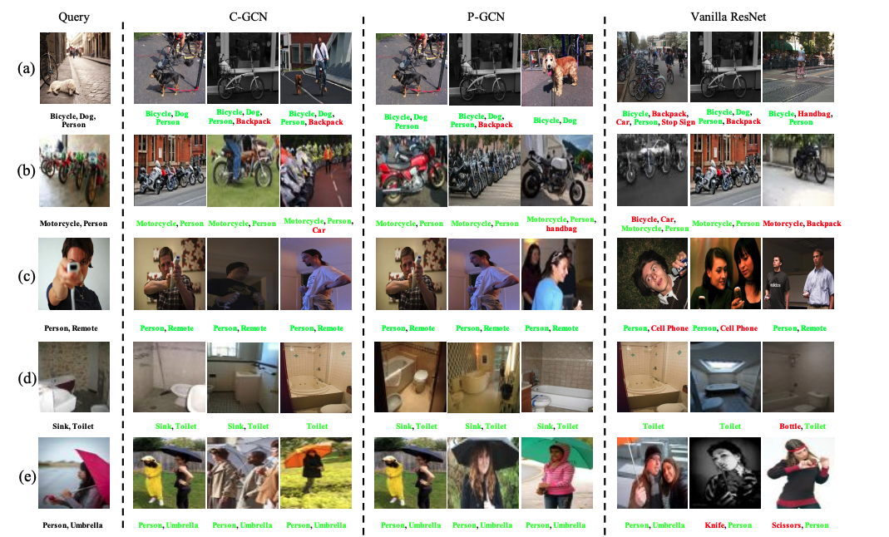
Visualization and Qualitative Analyses

Slide 24
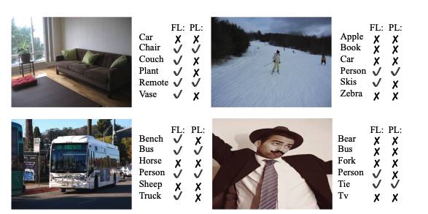
Partial Label Problem
used partially labeled dataset and fully labeled dataset on construction of correlation matrix and performance evaluation of P-GCN and C-GCN.
In both C-GCN and P-GCN experiments:
  Datasets:
    MS-COCO
    VOC 2007
    NUS-WIDE

Slide 25
Results
mAP |  |  | 10% | 20% | 30% | 40% | 50% | 60% | 70% | 80% | 90%
Datasets
Methods | MS COCO | ResNet-101 (Baseline) | 77.1 | 75.7 | 74.7 | 73.2 | 71.7 | 70.2 | 68.9 | 66.6 | 62.4
 |  | C-GCN (Partial) C-GCN (Full) | 80.8 80.9 | 79.7 80.0 | 78.9 79.0 | 78.1 77.9 | 76.6 76.5 | 75.3 75.4 | 73.7 73.5 | 71.2 71.1 | 66.4 66.9
 |  | P-GCN (Partial) P-GCN (Full) | 81.5 81.6 | 80.7 80.7 | 79.5 79.7 | 78.4 78.6 | 77.4 77.9 | 75.5 76.3 | 73.8 74.4 | 71.6 72.3 | 67.5 68.3
 | VOC 2007 | ResNet-101 (Baseline) | 90.3 | 90.2 | 89.5 | 89.8 | 88.8 | 88.2 | 86.5 | 82.5 | 75.4
 |  | C-GCN (Partial) C-GCN (Full) | 92.7 92.8 | 91.1 91.1 | 89.7 90.5 | 90.4 90.4 | 89.9 90.1 | 88.8 89.7 | 86.8 87.2 | 84.8 85.4 | 81.9 82.5
 |  | P-GCN (Partial) P-GCN (Full) | 93.1 93.0 | 92.5 92.7 | 91.6 92.0 | 90.9 91.3 | 90.0 90.1 | 89.8 89.2 | 88.2 87.9 | 85.4 85.9 | 82.5 83.1
 | NUS WIDE | ResNet-101 (Baseline) | 59.8 | 59.1 | 58.2 | 57.4 | 56.1 | 54.8 | 53.6 | 49.8 | 46.3
 |  | C-GCN (Partial) C-GCN (Full) | 60.7 60.9 | 60.3 60.4 | 59.7 59.4 | 58.5 58.6 | 57.7 57.6 | 56.3 56.3 | 54.8 54.7 | 52.3 52.1 | 47.5 48.4
 |  | P-GCN (Partial) P-GCN (Full) | 61.1 61.2 | 60.6 60.6 | 60.1 60.0 | 59.3 59.3 | 58.2 58.1 | 57.0 57.2 | 55.3 55.5 | 52.0 52.6 | 48.9 49.0

Slide 26
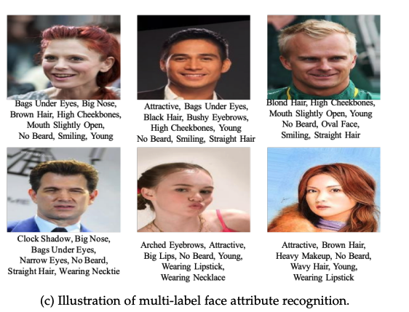
Multi-Label Face Attributes Recognition
In both C-GCN and P-GCN experiments:
  Dataset: CelebFaces Attributes Dataset
  Evaluation metrics: mean accuracy
Computer Aided Medical Procedures
December 14, 2021

Slide 27
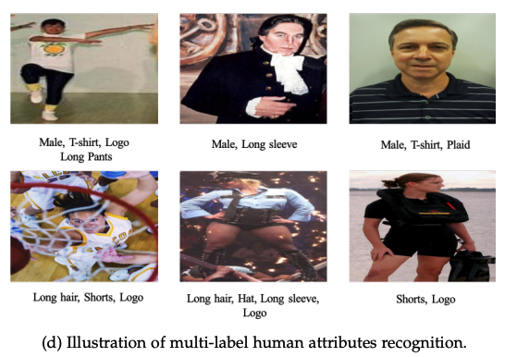
Multi-Label Human Attributes Recognition
In both C-GCN and P-GCN experiments:
  Dataset: WIDER Attribute Dataset
Computer Aided Medical Procedures
December 14, 2021

Slide 28
Conclusion

Slide 29
Conclusion and Future Works
C-GCN and P-GCN are proposed to solve multi-label image recognition problems with label information, label correlation and graph structures.
C-GCN and P-GCN aim to capture label correlation using different ways.
C-GCN focuses on interdependent relationships and word embedding while P-GCN focuses on interdependent prediction scores.
This paper is about a new aspect of multi-label recognition with the proposed methods.
Experiments done with 3 different datasets and 4 different multi-label problem have shown that the proposed models work better than the state-of-the-art model.
However, there still are areas that need to be improved in C-GCN and P-GCN models in several implementations. More complex applications may be handled by C-GCN and P-GCN in image-label recognition.
Computer Aided Medical Procedures
December 14, 2021

Slide 30
Student’s Review
Strengths
Weakness

Slide 31
Strengths
The paper is well defined in terms of approaches and experiments.
The C-GCN and P-GCN models are trained in several implementations using several datasets.
The performance of the two proposed models is compared with popular state-of-the-art models and evaluated practically in real-world applications.
Authors construct their own correlation matrix for multi-label recognition because of input problems in multi-label recognition.
Correlation matrix is updated as binarized and re-weighted matrix.
Effects of parameters are experienced on the different datasets.
Computer Aided Medical Procedures
December 14, 2021

Slide 32
Weakness
However, some parts of this paper should be pointed out in terms of structure, experiments, and writing style.
According to the structure of this paper, some parts are repeated in different sections. For example, C-GCN and P-GCN are introduced in the introduction section but similar explanations are made in discussions of C-GCN and P-GCN.
Some explained details are not understandable. For example, local correlations and global correlations.
The structure of correlation matrix are not available in this paper.
In experiments, the proposed models are handled in several implementations but the details are not understandable from this paper. For example, multi-label face attributes recognition and multi-label human attributes recognition.
According to the writing style of this paper, some figure descriptions and equations may cause a negative impact on the structure of the paper. For example, repeat function and hadamard product.
Computer Aided Medical Procedures
December 14, 2021

Slide 33
References
[7] X. Li, F. Zhao, and Y. Guo, “Multi-label image classification with a probabilistic label enhancement model,” in Proceedings of Conference on Uncertainty in Artificial Intelligence, 2014, pp. 1–10.
[8] Q. Li, M. Qiao, W. Bian, and D. Tao, “Conditional graphical lasso for multi-label image classification,” in Proceedings of IEEE Conference on Computer Vision and Pattern Recognition, 2016, pp. 2977–2986.
[9] J. Wang, Y. Yang, J. Mao, Z. Huang, C. Huang, and W. Xu, “CNNRNN: A unified framework for multi-label image classification,” in Proceedings of IEEE Conference on Computer Vision and Pattern Recognition, 2016, pp. 2285–2294.
[10] K. He, X. Zhang, S. Ren, and J. Sun, “Deep residual learning for image recognition,” in Proceedings of IEEE Conference on Computer Vision and Pattern Recognition, 2016, pp. 770–778.
[11] J. Hu, L. Shen, and G. Sun, “Squeeze-and-excitation networks,” in Proceedings of IEEE Conference on Computer Vision and Pattern Recognition, 2018, pp. 7132–7141.
[12] X. Zhang, X. Zhou, M. Li, and J. Sun, “ShuffleNet: an extremely efficient convolutional neural network for mobile devices,” in Proceedings of IEEE Conference on Computer Vision and Pattern Recognition, 2018, pp. 6848–6856.
[13] F. Chollet, “Xception: Deep learning with depthwise separable convolutions,” in Proceedings of IEEE Conference on Computer Vision and Pattern Recognition, 2017, pp. 1251–1258.
[14] S. Xie, R. Girshick, P. Dollar, Z. Tu, and K. He, “Aggregated residual ´ transformations for deep neural networks,” in Proceedings of IEEE Conference on Computer Vision and Pattern Recognition, 2017, pp. 5987–5995.
[15] Y. Gong, Y. Jia, T. Leung, A. Toshev, and S. Ioffe, “Deep convolutional ranking for multi-label image annotation,” arXiv preprint arXiv:1312.4894, pp. 1–9, 2013.
[16] J. Wang, Y. Yang, J. Mao, Z. Huang, C. Huang, and W. Xu, “CNNRNN: A unified framework for multi-label image classification,” in Proceedings of IEEE Conference on Computer Vision and Pattern Recognition, 2016, pp. 2285–2294
Computer Aided Medical Procedures
December 14, 2021

Slide 34
[17] Z. Wang, T. Chen, G. Li, R. Xu, and L. Lin, “Multi-label image recognition by recurrently discovering attentional regions,” in Proceedings of IEEE Conference on International Conference on Computer Vision, 2017, pp. 464–472
[18] J. Yang, J. Lu, S. Lee, D. Batra, and D. Parikh, “Graph R-CNN for scene graph generation,” in Proceedings of European Conference on Computer Vision, 2018, pp. 670–685.
[19] T. N. Kipf and M. Welling, “Semi-supervised classification with graph convolutional networks,” in Proceedings of International Conference on Learning Representations, 2017, pp. 1–10.
[20] A. L. Maas, A. Y. Hannun, and A. Y. Ng, “Rectifier nonlinearities improve neural network acoustic models,” in Proceedings of International Conference on Machine Learning., 2013, pp. 1–6.
[21] K. He, X. Zhang, S. Ren, and J. Sun, “Deep residual learning for image recognition,” in Proceedings of IEEE Conference on Computer Vision and Pattern Recognition, 2016, pp. 770–778.
[22] J. Pennington, R. Socher, and C. Manning, “GloVe: Global vectors for word representation,” in Proceedings of Empirical Methods in Natural Language Processing, 2014, pp. 1532–1543.
[23] T. Mikolov, K. Chen, G. Corrado, and J. Dean, “Efficient estimation of word representations in vector space,” in Proceedings of International Conference on Learning Representations, 2013, pp. 1–12.
[24] A. Joulin, E. Grave, P. Bojanowski, M. Douze, H. Jegou, and ´ T. Mikolov, “Fasttext.zip: Compressing text classification models,” arXiv preprint arXiv:1612.03651, pp. 1–13, 2016.
[25] L. Maaten and G. Hinton, “Visualizing data using t-SNE,” Journal of Machine Learning Research, vol. 9, no. 11, pp. 2579–2605, 2008.
[26] T. Durand, N. Mehrasa, and G. Mori, “Learning a deep convnet for multi-label classification with partial labels,” in Proceedings of IEEE Conference on Computer Vision and Pattern Recognition, 2019, pp. 647–657.
Computer Aided Medical Procedures
December 14, 2021

Slide 35
Any Questions?

