Slide 1
Disentangled Graph Convolutional Networks
Graph Deep Learning for Medical Imaging
Jianxin Ma, P. Cui, Kun Kuang, X. Wang, and Wenwu Zhu. Disentangled graph convolutional networks. In ICML, 2019
Ahmed Alaaeldin Ghita
TU Munich, Germany

Slide 2
Introduction

Slide 3
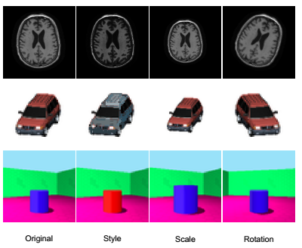
Motivation
Robustness
Data Limitations
Disentangled Representation Learning

Slide 4
Motivation
Deep Learning
Music
Football
Holistic
Disentangled - Clustered

Slide 5
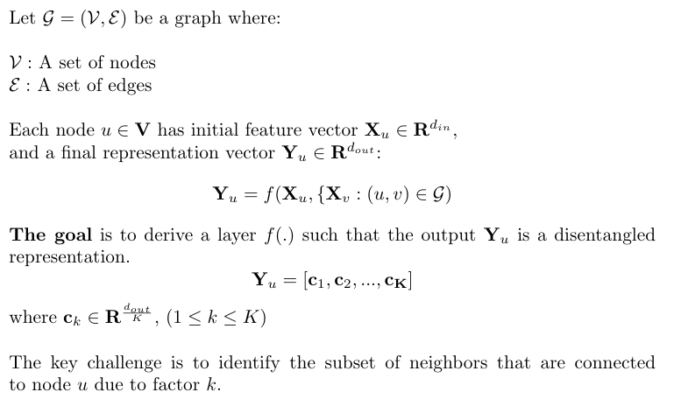
Problem Formulation

Slide 6
Related Work
Graph Spectral Theory and Graph Fourier Transform [1]
Polynomial Spectral Filters [2]
Further simplifications using linear filters. [3]
The Attention Mechanism (GAT) [4] : Adaptively specifies weights to the node’s neighbors pruning out irrelevant nodes.
Capsule Networks (CapsNet) [5] and Dynamic Routing between Capsules [6] : replace scalar-valued neurons by vector-valued ones “capsules”, and group low-level capsules into high-level ones.
Drawbacks:
Holistic neighbor convolution/aggregation
Over-smoothing

Slide 7
Methodology

Slide 8
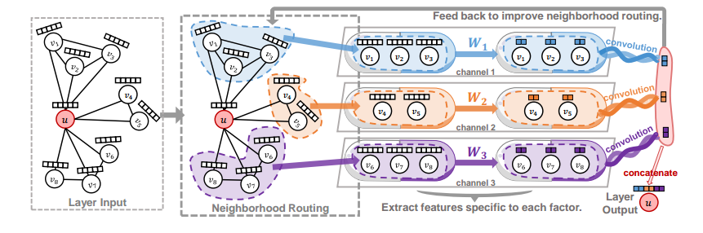
The DisenConv Layer

Slide 9
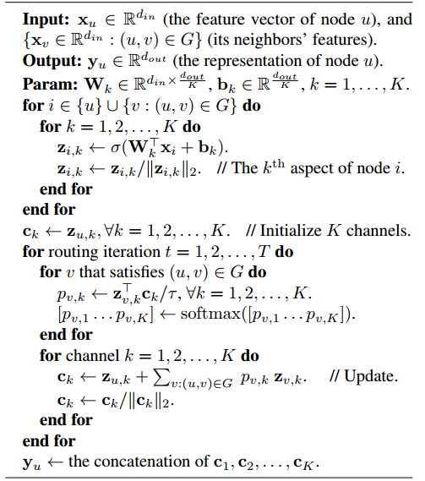
The DisenConv Layer
Random Initialization
K projections
Neighborhood routing

Slide 10

Neighborhood Routing
Inspired by Dynamic Routing between Capsules
Boat
x =
y =
angle =
Triangle
x =
y =
angle =
House
x =
y =
angle =
Rectangle
x =
y =
angle =
Input image
The coupling coefficient

Slide 11
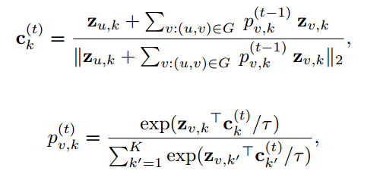

Neighborhood Routing

Slide 12
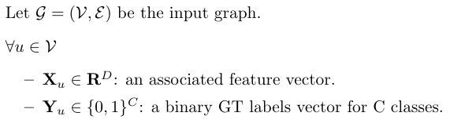
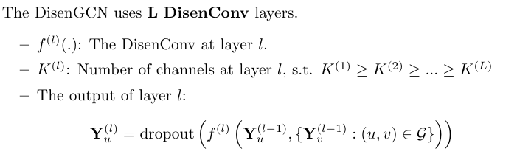
Network Architecture

Slide 13
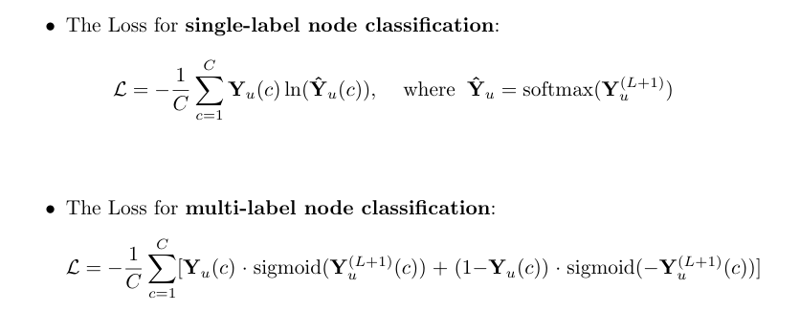
Losses

Slide 14
Experimental Setup

Slide 15
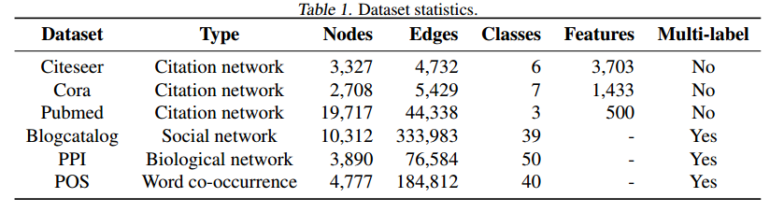
Baseline and Datasets
Baselines:
Graph Convolutional Network (GCN) [3]
Graph Attention Network (GAT) [4]
Node embedding algorithms: DeepWalk [7], LINE [8] and node2vec [9]
Datasets:

Slide 16

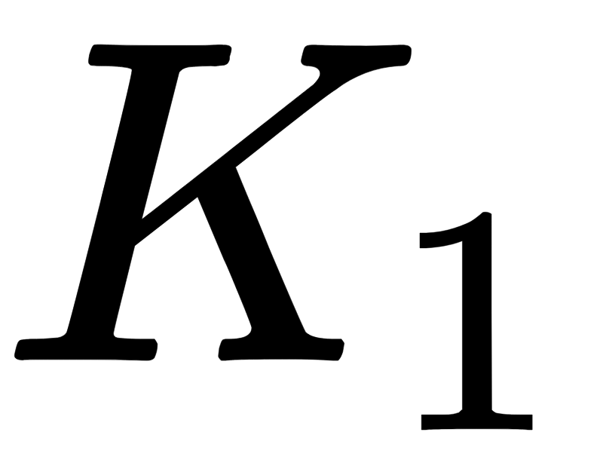





Hyperparameters
Hyperparameter | symbol | Search space
Output dimension of GNN 1st layer |  | d = 64 : semi-supervised classification (GAT) d = 128 : multi-label classification (node2vec)
Number of channels at 1st layer |  | {4, 8, …, 32}
Difference in number of channels for following layer |  | {0, 2, …, 8}
Number of routing iterations | T | T = 7
The hardness assignment |  | tau = 1 (0.1 for better interpretability)
Number of layers | L | {1, 2, …, 6}
learning rate |  | loguniform [e-8, 1]
L2 regularization term |  | loguniform [e-10, 1]
dropout rate |  | {0.05, 0.10, …, 0.95}

Slide 17
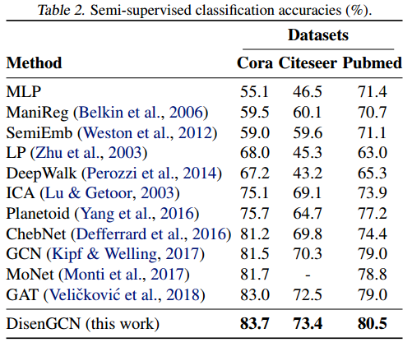
Result: Semi-Supervised Node Classification

Slide 18
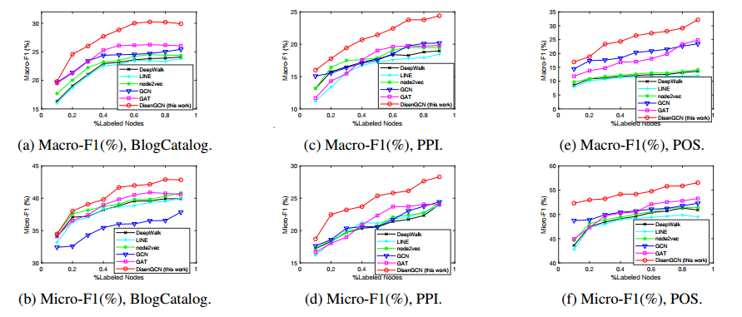
Results: Multi-label Node Classification
Varying the number of nodes labeled for training from 10%|V| to 90% |V|

Slide 19
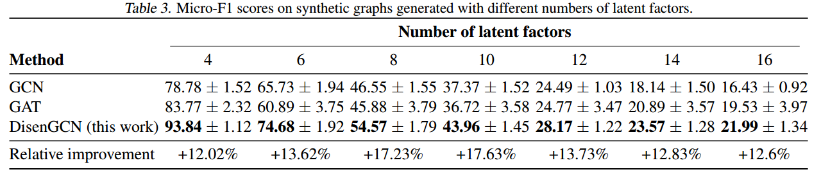
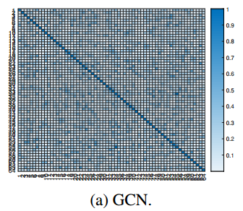
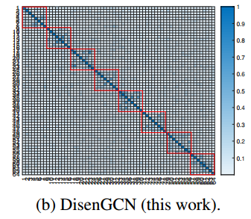
Results: Synthetic graphs

Slide 20
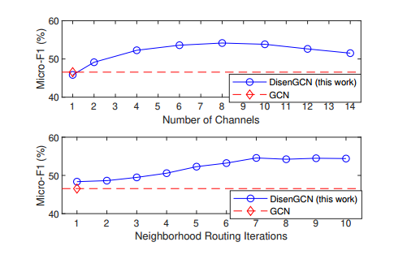
Results: Hyperparameter sensitivity
Most important hyperparameters for DisenGCN:
The number of channels K
The number of routing iterations T

Slide 21
Conclusion
In Disentangled Representation Learning (DRL), one learns to encode the underlying factors of variation into separate latent variables.
Characteristics of graphs pose great challenges to DRL
The DisenGCN model is a GNN that learns disentangled node representations.
The key element of DisenGCN is a neighborhood routing mechanism that is inspired by the original routing mechanism in capsule networks.

Slide 22
Future Work
Investigate the possibility to leverage the disentangled node representation for a single graph representation.
Investigate the Intra-factor consistency and the Inter-factory diversity of DisenGCN.
Medical Applications:
  Analysis of large electronic health datasets (e.g. COVID) based on age, sex, allergies, previous infections, etc.

Slide 23
References
[1] Shuman, D. I., Narang, S. K., Frossard, P., Ortega, A., and Vandergheynst, P. The emerging field of signal processing on graphs: Extending high-dimensional data analysis to networks and other irregular domains. IEEE Signal Processing Magazine, 2013
[2] Defferrard, M., Bresson, X., and Vandergheynst, P. Convolutional neural networks on graphs with fast localized spectral filtering. In Proceedings of NIPS 2016, 2016.
[3] Kipf, T. N. and Welling, M. Semi-supervised classification with graph convolutional networks. In Proceedings of ICLR 2017, 2017
[4] Velickovi ˇ c, P., Cucurull, G., Casanova, A., Romero, A., ´ Lio, P., and Bengio, Y. Graph attention networks. In ` Proceedings of ICLR 2018, 2018
[5] Hinton, G. E., Krizhevsky, A., and Wang, S. D. Transforming auto-encoders. In Proceedings of ICANN 2011, 2011
[6] Hinton, G. E., Sabour, S., and Frosst, N. Matrix capsules with EM routing. In Proceedings of ICLR 2018, 2018
[7] Perozzi, B., Al-Rfou, R., and Skiena, S. DeepWalk: Online learning of social representations. In Proceedings of KDD 2014, 2014.
[8] Tang, J., Qu, M., Wang, M., Zhang, M., Yan, J., and Mei, Q. LINE: Large-scale information network embedding. In Proceedings of WWW 2015, 2015.
[9] Grover, A. and Leskovec, J. node2vec: Scalable feature learning for networks. In Proceedings of KDD 2016, 2016.

Slide 24
Thank you!
Questions

