Slide 1
Hybrid graph convolutional neural networks for landmark-based anatomical segmentation
Graph Deep Learning for Medical Applications
Nicolás Gaggion, Lucas Mansilla, Diego Milone and Enzo Ferrante
International Conference on Medical Image Computing and Computer Assisted Intervention (MICCAI) 2021
Student: Farid Razai
Tutor: Tariq Bdair
25.01.2022

Slide 2
Introduction

Slide 3
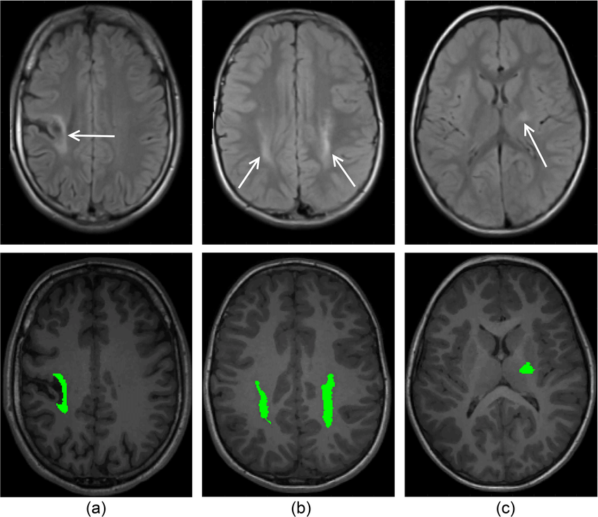
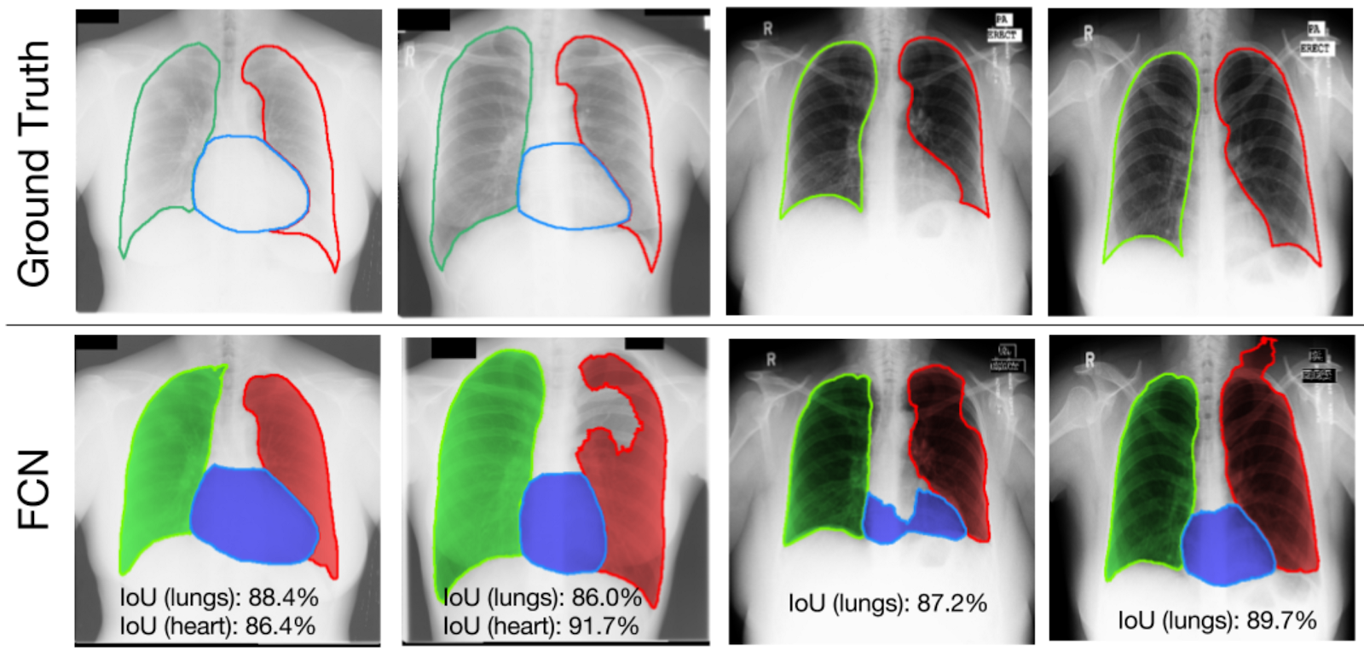
Medical Image Segmentation
Lesion segmentation [1]
Anatomical segmentation [2]
[1] Pagnozzi, A.M., Dowson, N.D., Doecke, J.D., Fiori, S., Bradley, A.P., Boyd, R.N., & Rose, S.E.: Identifying relevant biomarkers of brain injury from structural MRI: Validation using automated approaches in children with unilateral cerebral palsy. PLoS ONE, 12. (2017).
[2] Dai W., Dong N., Wang Z., Liang X., Zhang H., Xing E.P. (2018) SCAN: Structure Correcting Adversarial Network for Organ Segmentation in Chest X-Rays. In: Stoyanov D. et al. (eds) Deep Learning in Medical Image Analysis and Multimodal Learning for Clinical Decision Support. DLMIA 2018, ML-CDS 2018. Lecture Notes in Computer Science, vol 11045. Springer (2018)
Notes:
Image segmentation:
for a given image: segment different regions
in medical context different possiblities
Left: Lesion segmentation:
- irregular shape and size across different images of different individuals
- Location may vary from image to image
Makes sense to look at locally -> train loss function on pixel level -> dense segmentation mask
Right: Anatomical segmentation or Organ Segmentation:
Organs typically have regular structure, shape and location
Look at ”bigger picture” i.e. consider global context -> constrain space of solutions
-> landmark based segmentation
Depicted is current state of the art: convolutional neural network creating dense segmentation

Slide 4
Current State of the Art and related work
Current Practice: Standard CNN trained to minimize pixel level loss function with dense segmentation masks as ground truth
Deep fully convolutional networks
  U-Net [3]
  Constrained CNNs
    ACNN [4]
    Post-DAE [5]
[3] Ronneberger, O., Fischer, P., Brox, T.: U-net: Convolutional networks for biomedi- cal image segmentation. In: International Conference on Medical image computing and computer-assisted intervention. pp. 234–241. Springer (2015)
[4] Oktay, O., Ferrante, E., Kamnitsas, K., Heinrich, M., Bai, W., Caballero, J., Cook, S.A., De Marvao, A., Dawes, T., O‘Regan, D.P., et al.: Anatomically constrained neural networks (acnns): application to cardiac image enhancement and segmen- tation. IEEE transactions on medical imaging 37(2), 384–395 (2017)
[5] Larrazabal,A.J.,Martinez,C.,Ferrante,E.:Anatomicalpriorsforimagesegmenta- tion via post-processing with denoising autoencoders. In: International Conference on Medical Image Computing and Computer-Assisted Intervention. pp. 585–593. Springer (2019)
Notes:
ACNN: modified decoder layers of a U-Net-like structure in order to incorporate anatomical prior knowledge into CNNs through new regularisation model
( -> difficult to engineer with limited or specific use)
Post-DAE: post-processing method based on denoising autoencoders (DAE) trained using only segmentation masks
Learn low-dimensional space of anatomically plausible segmentations, and use as post-processing step to impose shape constraints (on resulting masks obtained with arbitrary segmentation methods)

Slide 5
Methodology

Slide 6
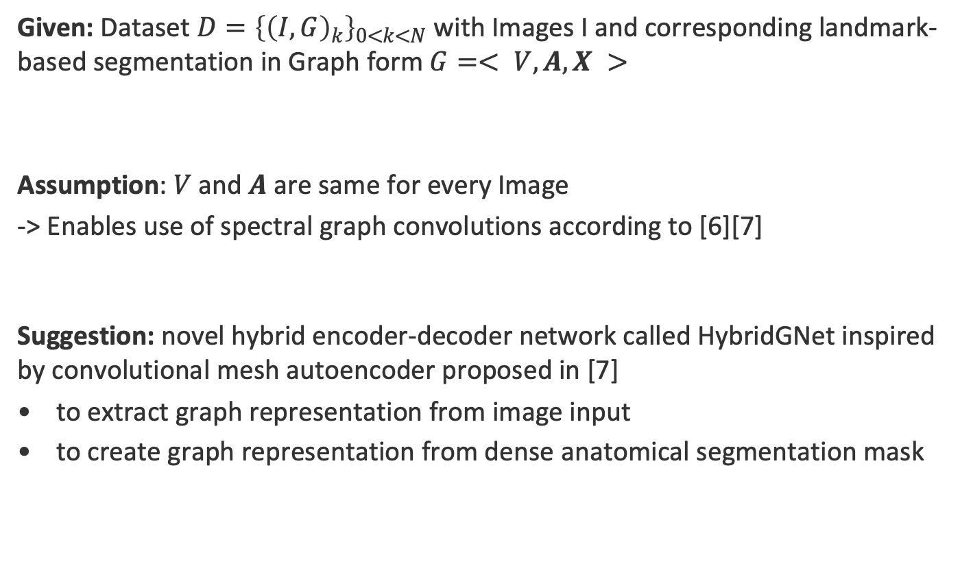
Problem Setting and related work
Given: Dataset $D={\left\{{\left(I,G\right)}_{k}\right\}}_{0<k<N}$ with Images I and corresponding landmark-based segmentation in Graph form $G=< V, A, X >$
Assumption: $V$and $A$ are same for every Image
-> Enables use of spectral graph convolutions according to [6][7]
Suggestion: novel hybrid encoder-decoder network called HybridGNet inspired by convolutional mesh autoencoder proposed in [7]
to extract graph representation from image input
to create graph representation from dense anatomical segmentation mask
[6] Defferrard, M., Bresson, X., Vandergheynst, P.: Convolutional neural networks on graphs with fast localized spectral filtering. arXiv preprint arXiv:1606.09375 (2016)
[7] Ranjan, A., Bolkart, T., Sanyal, S., Black, M.J.: Generating 3d faces using convolutional mesh autoencoders. In: Proceedings of the European Conference on Computer Vision (ECCV). pp. 704–720 (2018)
Notes:
Landmarks: set of nodes V
A: Adjacency matrix containing connectivity information
V and A is same for every image: same fixed number of nodes and same connectivity -> typical in context of landmark-based segmentation (manual annotations)
Only X, exact position of landmarks differs

Slide 7
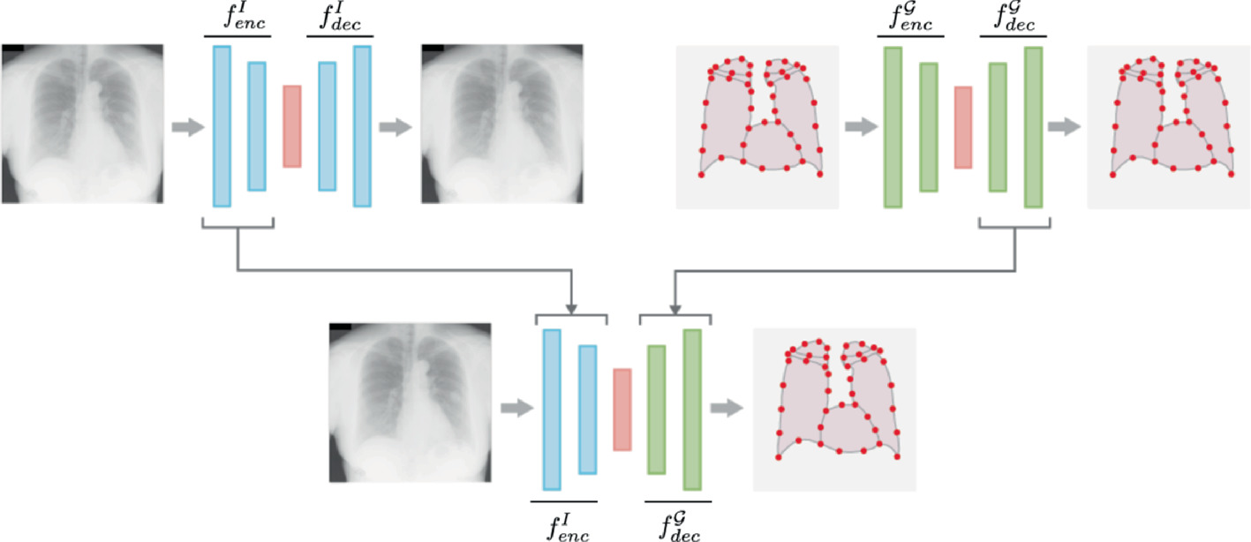
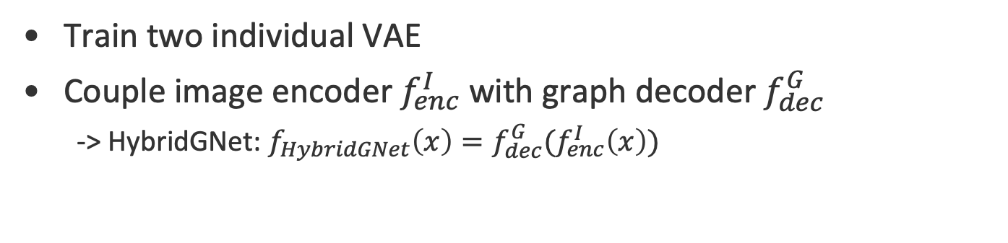
Hybrid graph convolutional neural network
Train two individual VAE
Couple image encoder $f_{enc}^{I}$ with graph decoder $f_{dec}^{G}$
  -> HybridGNet: $f_{HybridGNet}\left(x\right)=f_{dec}^{G}(f_{enc}^{I}\left(x\right))$
January 25, 2022
Notes:
Two individual VAE
Fully connected
One trained on image data: standard convolutions
One trained on graph data: spectral convolutions
Both reduce input to same sized latent space of 64 features

Slide 8
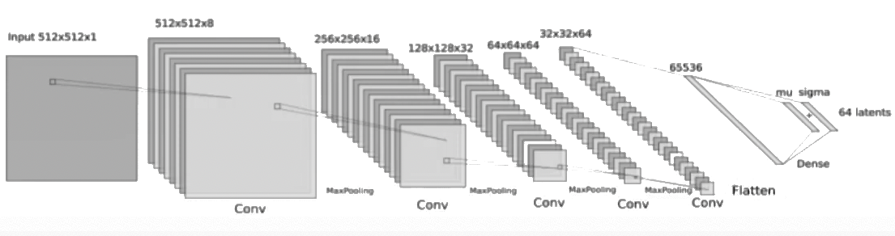
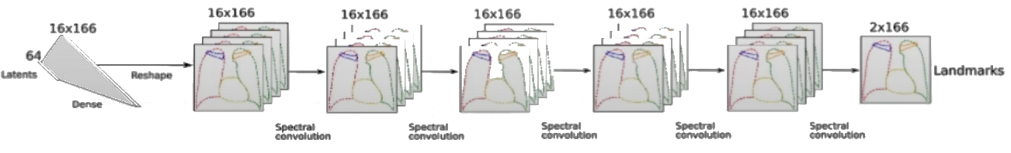
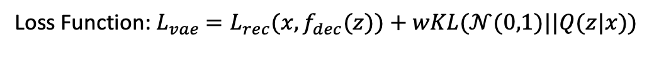
HybridGNet Architecture
Loss Function:${ L}_{vae} =L_{rec}(x,f_{dec}(z))+wKL(𝒩(0,1)||Q(z|x))$
https://www.youtube.com/watch?v=NAJkpf1fk8w
Notes:
Reduce input to same sized latent space of 64 features
Image Encoder: 5 residual blocks altemated with 4 max pooling operations -> decoder is mirrored version
Graph Autoencoder: 4 Chebyshev layers and 5 layers for decoder with 16 feature maps and polynomial order of 6
Reconstruction loss: landmark MSE
Regularization: KL Divergence (imposes unit Gaussian Prior)
Initialized with pre-trained weights and refined for 2000 epochs
- Adam Optimizer

Slide 9
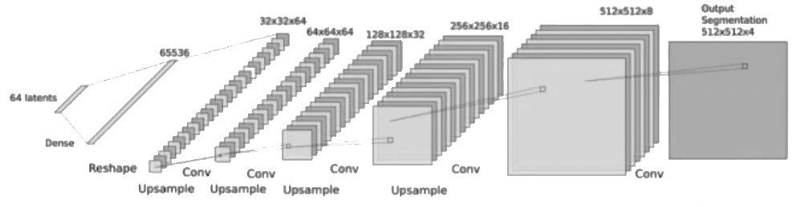

Dual Models: HybridGNet Dual & HybridGNet Dual SC
Dual Loss $L_{dual}=L_{rec}+L_{seg}$
Hybrid GNet Dual SC additionally includes Skip Connections as Sums
https://www.youtube.com/watch?v=NAJkpf1fk8w
Notes:
Dual models created to explore effect of inclusion of dense segmentation masks during training
-> HybridGnet Dual and HybridGNet Dual SC include additional decoder for dense probabilistic segmentation
dataset only contains contours: segmentation masks for training were created by filling contours and labeling them
Dual loss: landmark localization error and dense segmentation error
$L_{seg}$ term based on average between soft Dice [x] and Cross Entropy

Slide 10
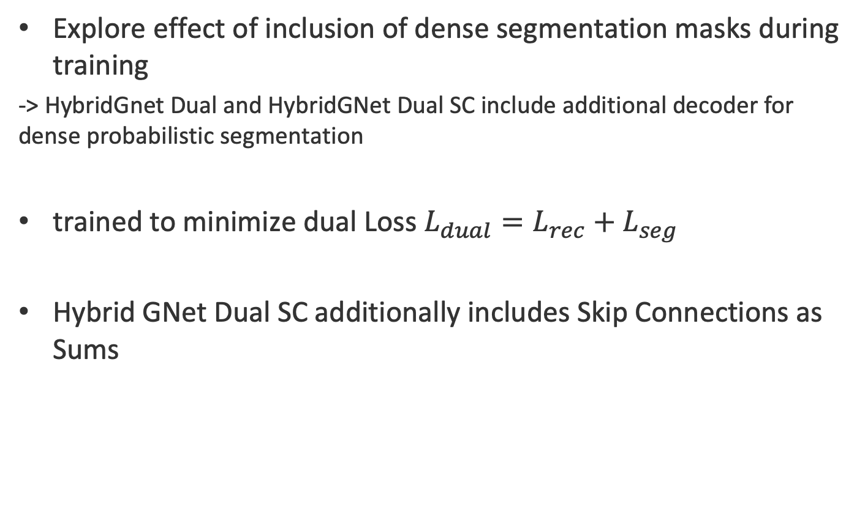
Dual Models: HybridGNet Dual & HybridGNet Dual SC
Explore effect of inclusion of dense segmentation masks during training
-> HybridGnet Dual and HybridGNet Dual SC include additional decoder for dense probabilistic segmentation
trained to minimize dual Loss $L_{dual}=L_{rec}+L_{seg}$
Hybrid GNet Dual SC additionally includes Skip Connections as Sums
https://www.youtube.com/watch?v=NAJkpf1fk8w
Notes:
dataset only contains contours: segmentation masks for training were created by filling contours and labeling them
Dual loss: landmark localization error and dense segmentation error

Slide 11
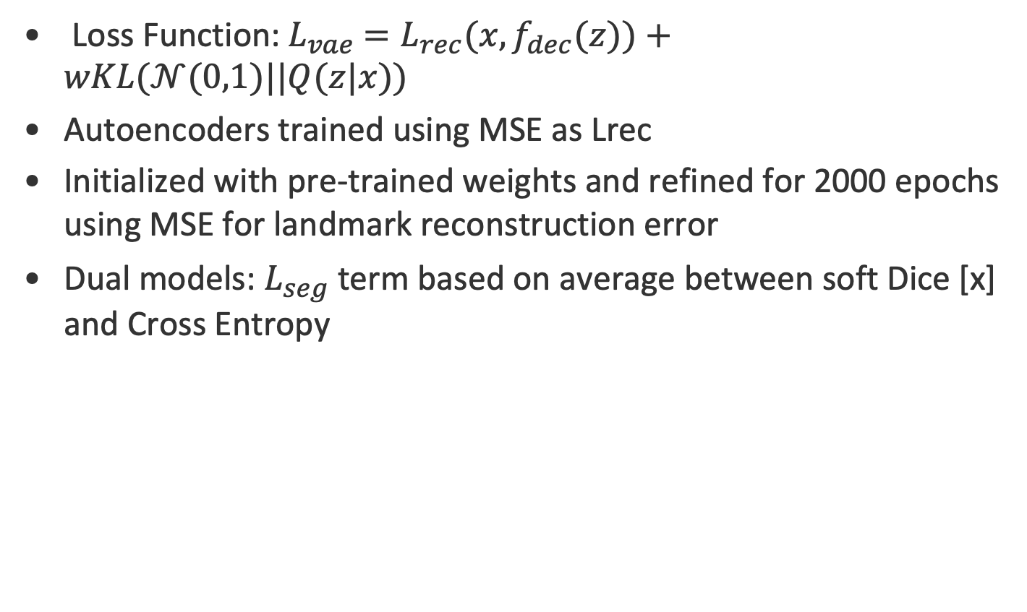
Training
Loss Function:${ L}_{vae} =L_{rec}(x,f_{dec}(z))+wKL(𝒩(0,1)||Q(z|x))$
Autoencoders trained using MSE as Lrec
Initialized with pre-trained weights and refined for 2000 epochs using MSE for landmark reconstruction error
Dual models: $L_{seg}$ term based on average between soft Dice [x] and Cross Entropy
[x] Milletari, F., Navab, N., Ahmadi, S.A.: V-net: Fully convolutional neural networks for volumetric medical image segmentation. In: 2016 fourth international confer- ence on 3D vision (3DV). pp. 565–571. IEEE (2016)

Slide 12
Experiments

Slide 13
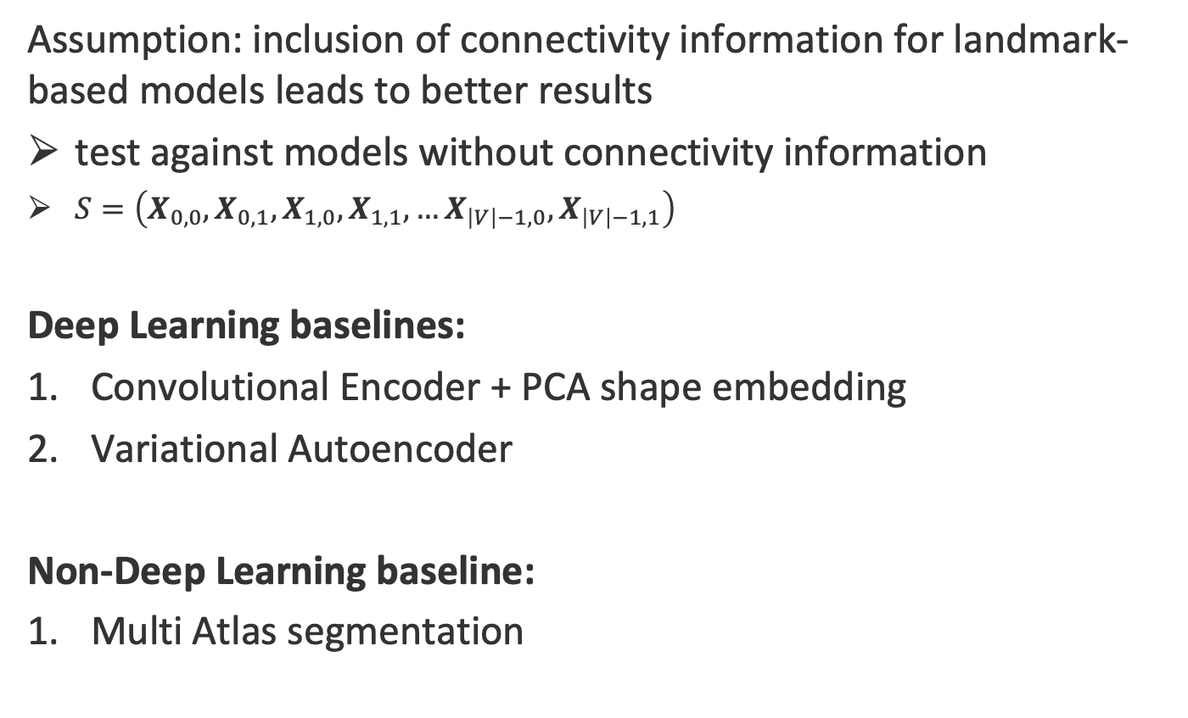
Baseline Models
Assumption: inclusion of connectivity information for landmark-based models leads to better results
test against models without connectivity information
$S=\left(X_{0,0},X_{0,1},X_{1,0},X_{1,1},…X_{\left|V\right|−1,0},X_{\left|V\right|−1,1}\right)$
Deep Learning baselines:
Convolutional Encoder + PCA shape embedding
Variational Autoencoder
Non-Deep Learning baseline:
Multi Atlas segmentation
Notes:
S contains concatenated rows of X in single vector
VAE exactly like HybridGNet, just without connectivity info
VAE and PCA only use positions of landmarks without knowledge about connectivity

Slide 14
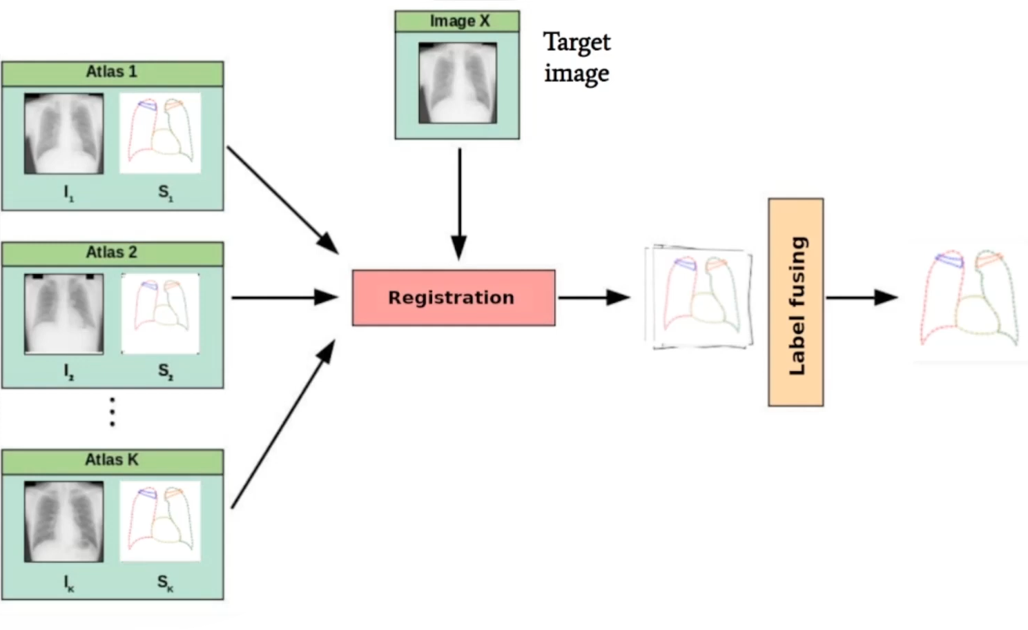
Multi Atlas Segmentation (MAS) [8][9]
https://www.youtube.com/watch?v=NAJkpf1fk8w
[8] Alvén, J., Kahl, F., Landgren, M., Larsson, V., Ulén, J.: Shape-aware multi- atlas segmentation. In: 2016 23rd International Conference on Pattern Recognition (Icpr). pp. 1101–1106. IEEE (2016)
[9] Alvén, J., Kahl, F., Landgren, M., Larsson, V., Ulén, J., Enqvist, O.: Shape-aware label fusion for multi-atlas frameworks. Pattern Recognition Letters 124, 109–117 (2019)
Notes:
Given test image, MultiAtlas averages Landmark position of 5 most similar images/atlases from training set
Pairwise non-rigid registration to find corresponding landmarks

Slide 15
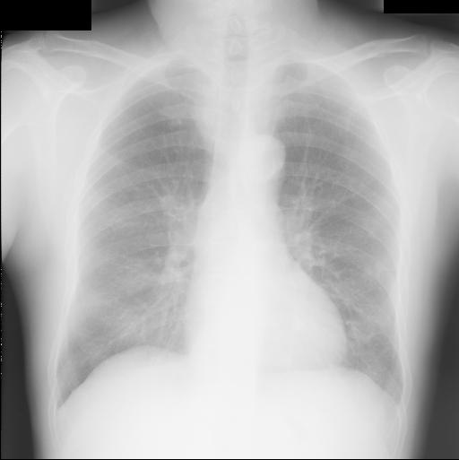
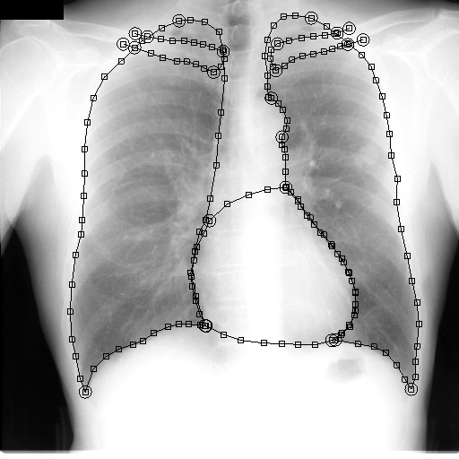
Dataset
JSRT Dataset [10]
247 high resolution x-ray images of lung, heart and clavicles
SCR expert annotations [11]:
  166 landmarks per image
80:20 split
[10] Shiraishi, J., Katsuragawa, S., Ikezoe, J., Matsumoto, T., Kobayashi, T., Komatsu, K.i., Matsui, M., Fujita, H., Kodera, Y., Doi, K.: Development of a digital image database for chest radiographs with and without a lung nodule: receiver operating characteristic analysis of radiologists’ detection of pulmonary nodules. American Journal of Roentgenology 174(1), 71–74 (2000)
[11] van Ginneken, B., Stegmann, M., Loog, M.: Segmentation of anatomical structures in chest radiographs using supervised methods: a comparative study on a public database. Medical Image Analysis 10(1), 19–40 (2006)
Notes:
JSRT: Japanese Society of Radiological Technology Chest X-Ray Dataset
247 high resolution x-ray images of lung, heart and clavicles
- Clavicle: collarbone = Schlüsselbein
- Segmentation in Chest X-Ray (SCR) dataset: 166 landmarks
Landmarks follow same pattern in every image
-> shared Adjacency Matrix for every image
70 % training, 10% validation, 20% testing

Slide 16
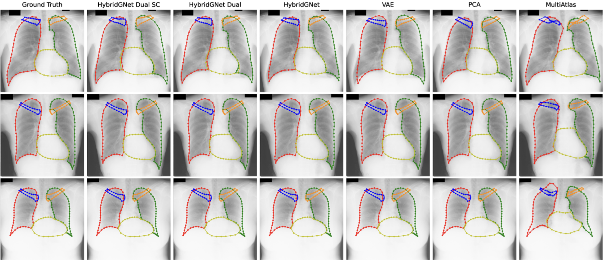
Experiment 1 - Anatomical landmark-based segmentation
Notes:
Do segmentation based on given landmarks
HybridGnets leverage connectivity information

Slide 17
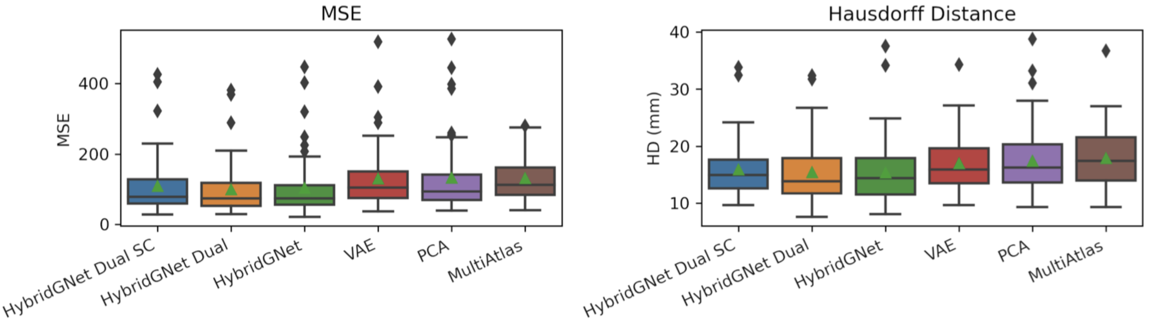
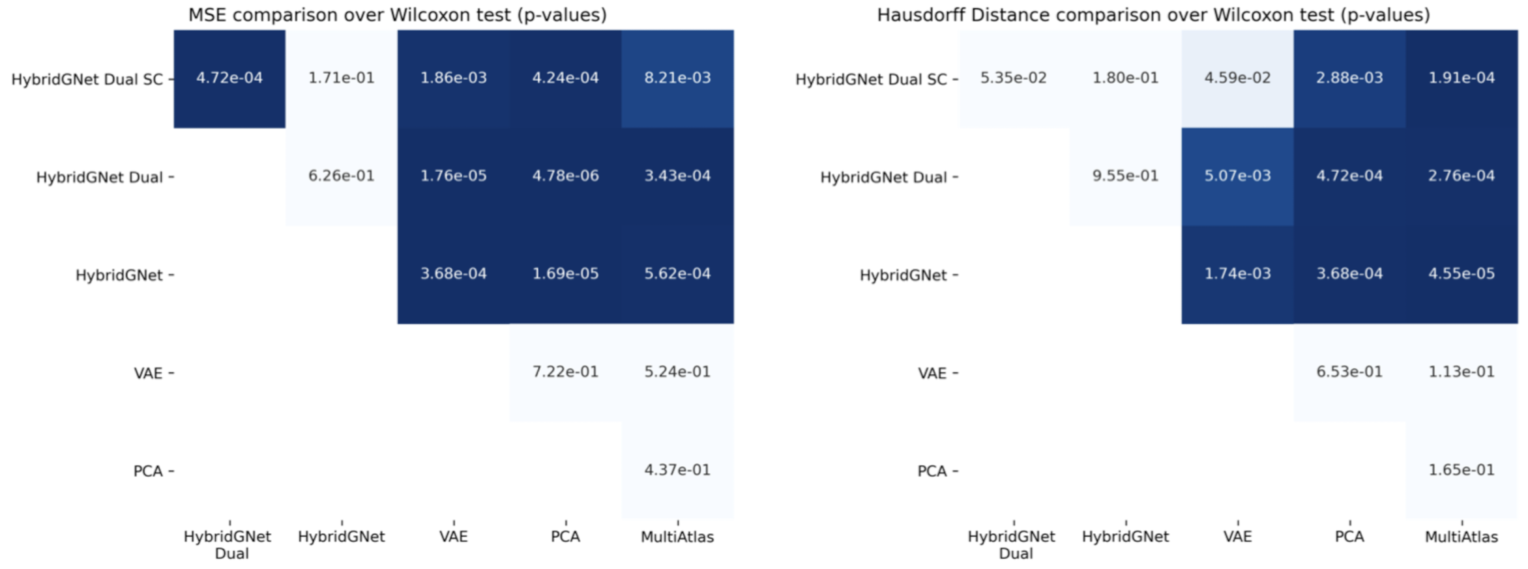
Experiment 1 - Results
Notes:
Evaluation:
MSE in pixel space over vectorized landmark locations
Hausdorff Distance: maximum perpendicular distance between points on the contour
Hybrid Models perform better than Baselines
Dual models with segmentation masks during learning phase don’t perform better
Can be seen through Wilcoxon test
- P-value < 0.05: significant differences between the means

Slide 18
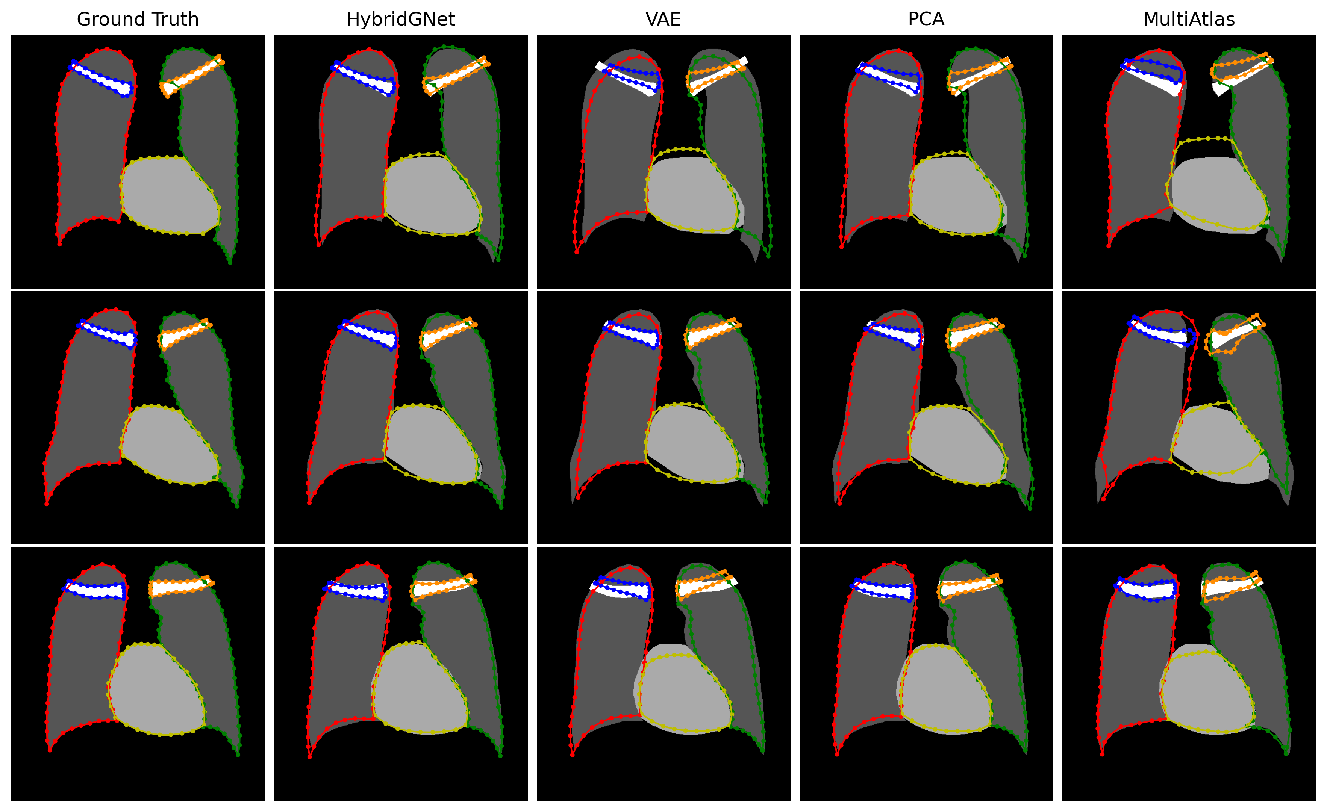
Experiment 2 - Generating landmark-based representations from dense segmentations
Notes:
- HybridGnet can obtain landmark based representation from given segmentation mask
- Useful if matched landmarks are necessary for statistical shape analysis but only segmentation masks are available

Slide 19
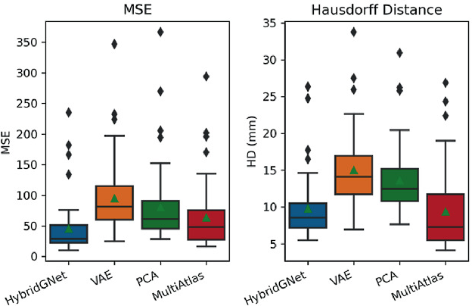
Experiment 2 – Results
Notes:
Again Mean Square Error and Hausdorff Distance as evaluation measures
HybridGNet has lowest error

Slide 20
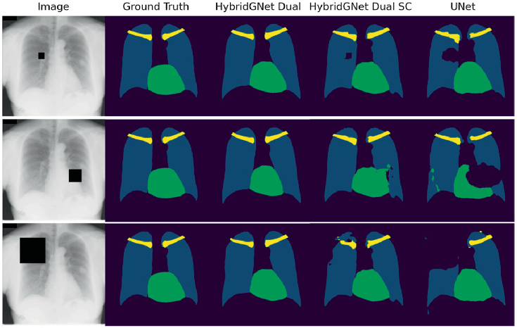
Experiment 3 - Robustness study
Robustness to occlusions e.g. for anonymity reasons
UNet as baseline
Notes:
Artificial occlusions: randomly generated black boxes with different sizes
Unet is like HybridGnet SC just without Graph Decoder

Slide 21
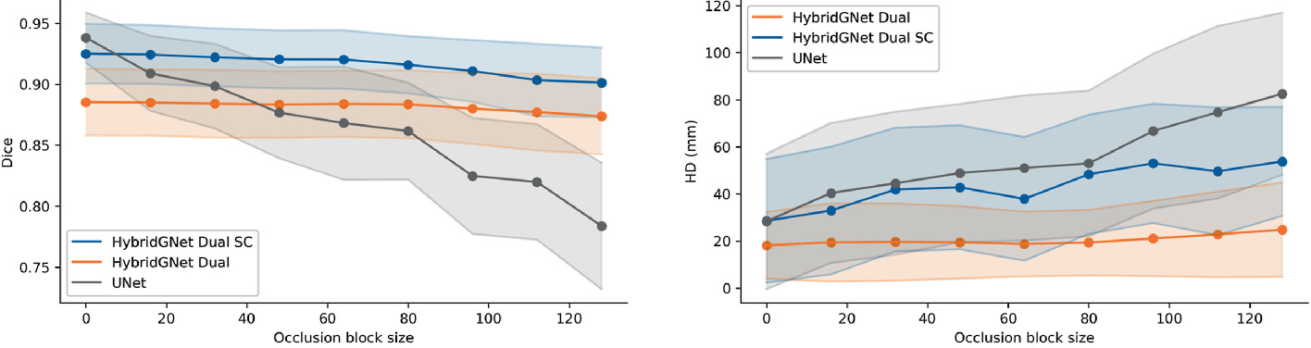
Experiment 3 - Results
Notes:
Landmark MSE not possible for dense segmentations
Dice Coefficient: index of overlap of two different volumes
Unet performs worse with larger occlusions

Slide 22
Personal Review and Take-Home Message

Slide 23
Personal Review
Strengths
Weaknesses
Interesting novel concept of hybrid model
Nice leveraging of connectivity information and landmarks
Code is available on Github
Current state of the art in landmark-based segmentation is not presented
Often misleadingly written and difficult to understand
Only tested on JSRT dataset which is comparatively simple
Unrealistic occlusion scenario in robustness experiment

Slide 24
Take-Home Message
Leveraging connectivity information through adjacency matrix increases accuracy of anatomical landmark-based segmentation
More testing on different datasets and with different baselines is necessary

Slide 25
Thank you for your attention!
Questions?

