Slide 1
Graph Deep Learning for Medical Imaging
BrainGNN: Interpretable Brain Graph Neural
Network for fMRI Analysis
Li, X. et al. : BrainGNN: Interpretable Brain Graph Neural Network for fMRI Analysis
Student: Amine Chaabouni
Tutor: Shahrouz Faghihrouhi

Slide 2
Introduction

Slide 3
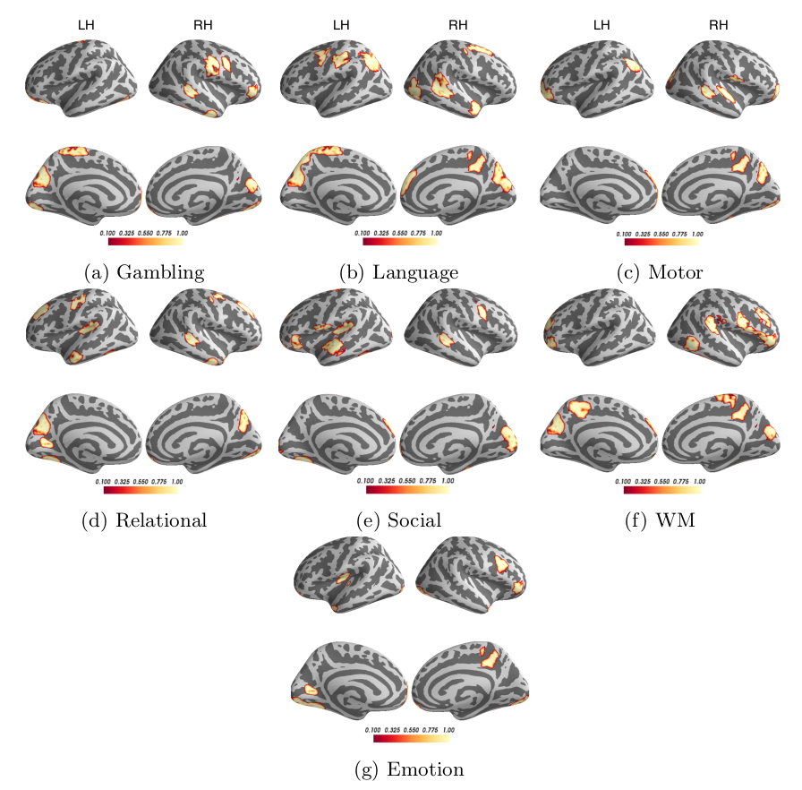
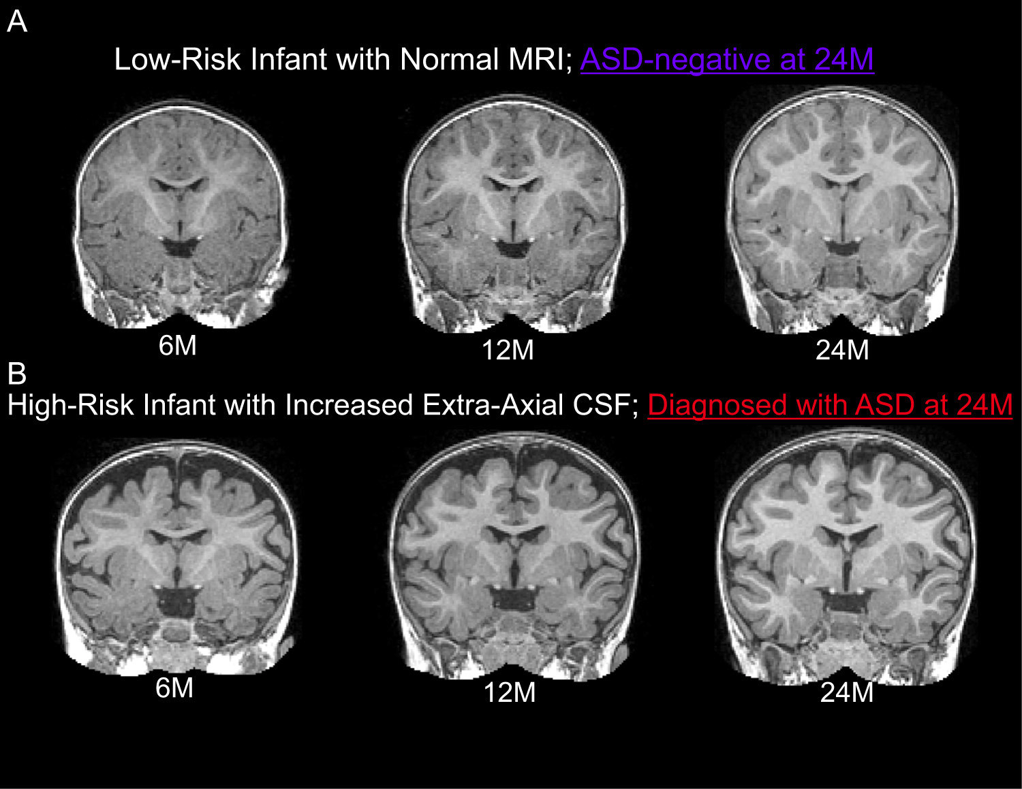
Motivation
Classifying neurodisorder patients
Cognitive task decoding
Mark D. Shen et al. 2017​, Increased Extra-axial Cerebrospinal Fluid in High-Risk Infants Who Later Develop Autism
Computer Aided Medical Procedures
12/14/21
Slide <number>

Slide 4
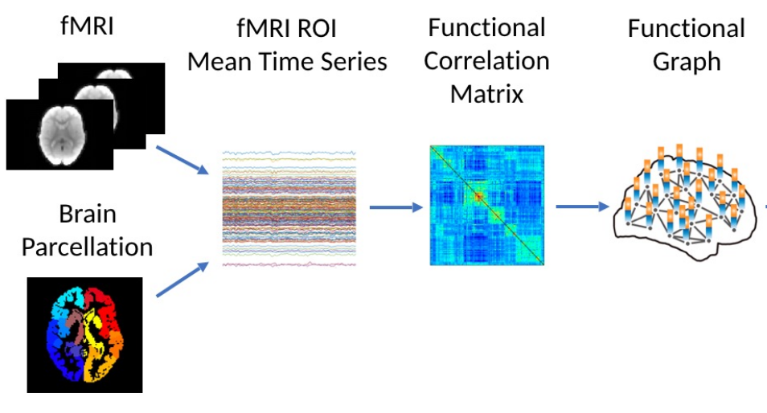
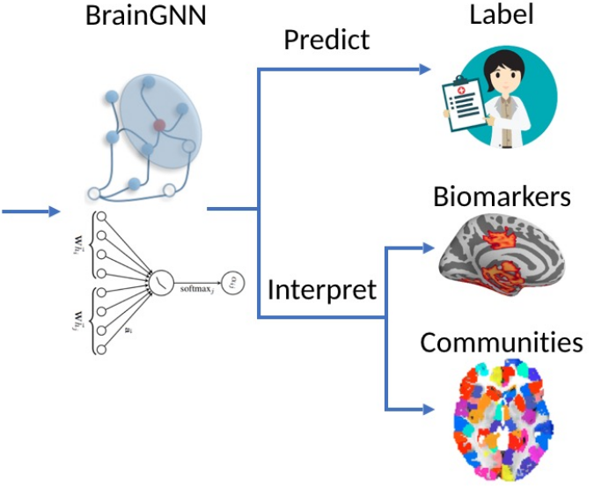
Brain as a Graph
Computer Aided Medical Procedures
12/14/21
Slide <number>

Slide 5
Related Work
BrainNetCNN[1]: Predict cognitive and motor development outcomes
      Adapt CNN to leverage the topological structure from adjacency matrices
InceptionGCN[2]: Disease prediction (Autism Syndrom Disorder)
      Spectral convolution and varying filter size
      GCN where each patient in a node
PR-GNN[3]: group-level neurological biomarkers
      Adapt GAT to add the edge weights
fMRI-GNN[4]: individual-level neurological biomarkers
Computer Aided Medical Procedures
12/14/21
Slide <number>

Slide 6
Methodology

Slide 7
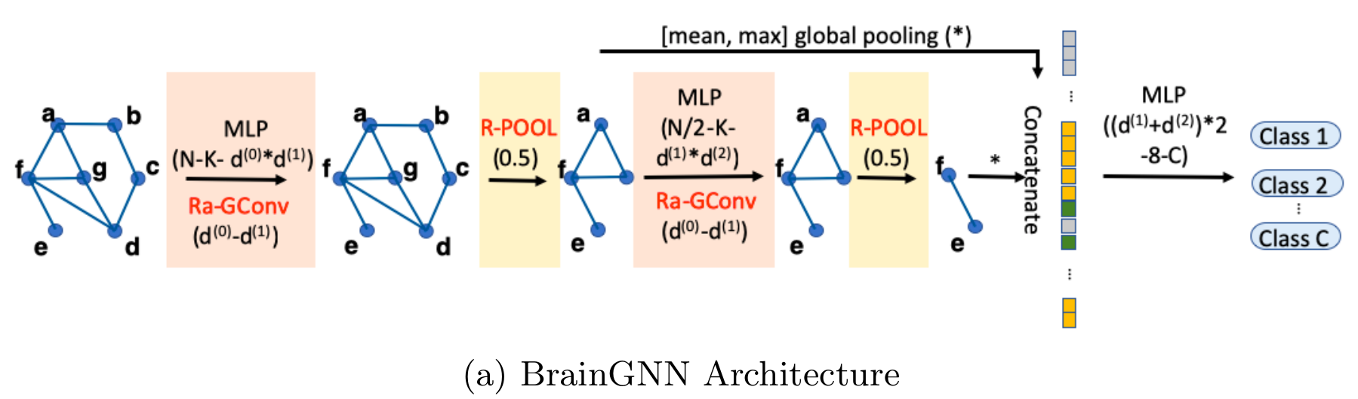
Graph Neural Network Architecture
Computer Aided Medical Procedures
12/14/21
Slide <number>

Slide 8
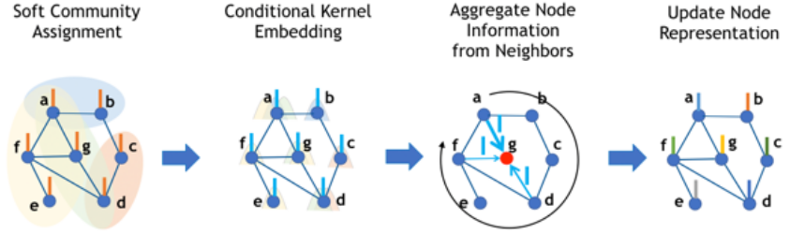
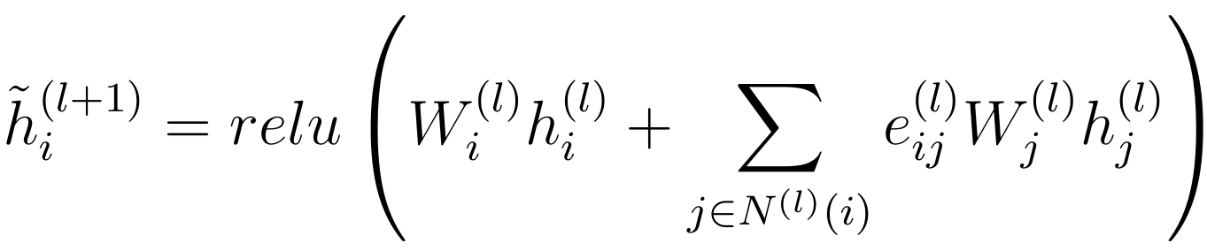
ROI aware Graph Convolutional layer
Computer Aided Medical Procedures
12/14/21
Slide <number>

Slide 9
Graph Neural Network Architecture
Computer Aided Medical Procedures
12/14/21
Slide <number>

Slide 10
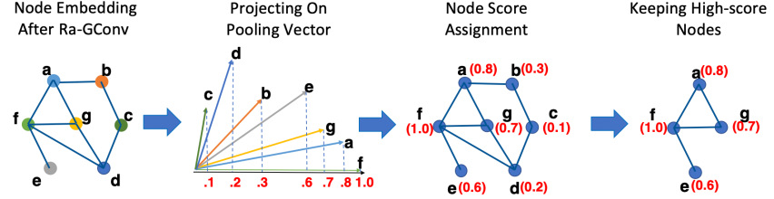
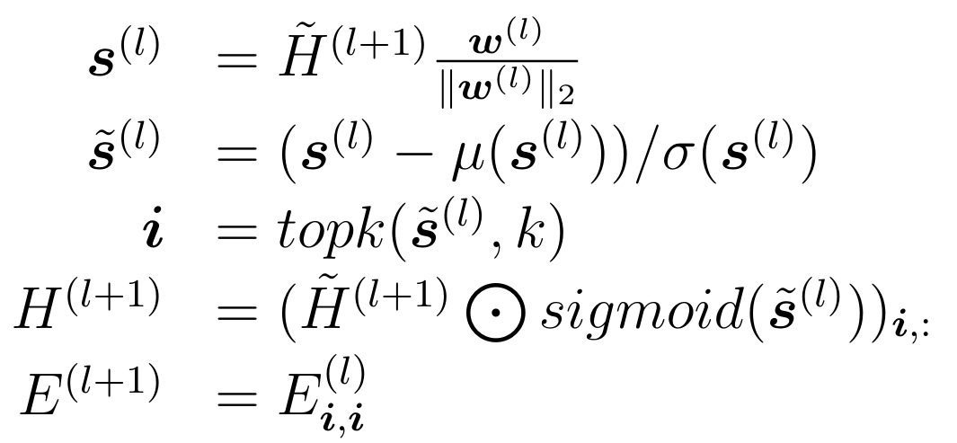
ROI-selection pooling layer
Computer Aided Medical Procedures
12/14/21
Slide <number>

Slide 11
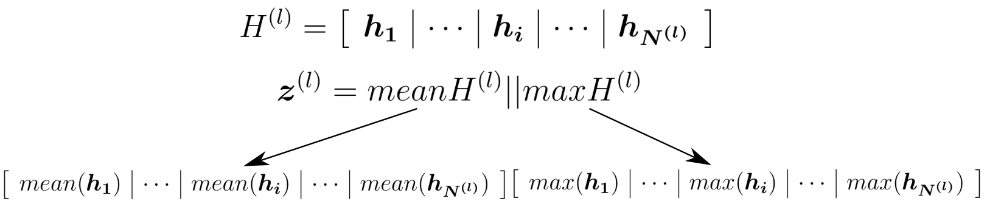
Readout layer
Computer Aided Medical Procedures
12/14/21
Slide <number>

Slide 12
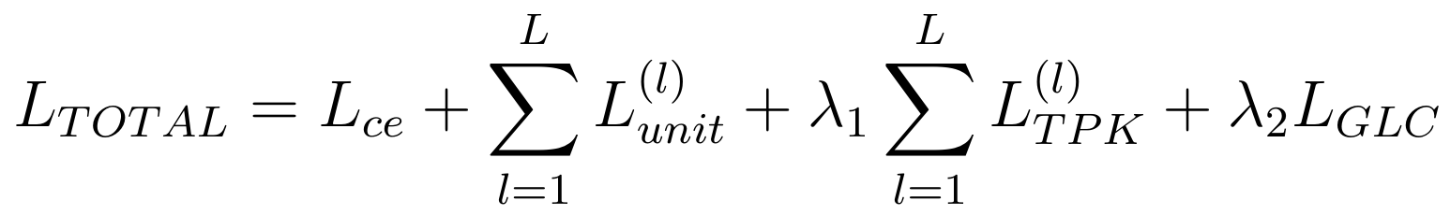
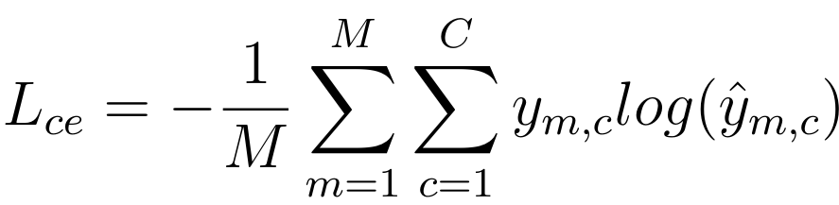
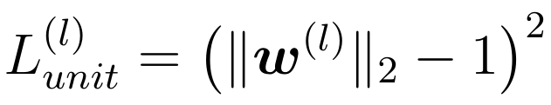
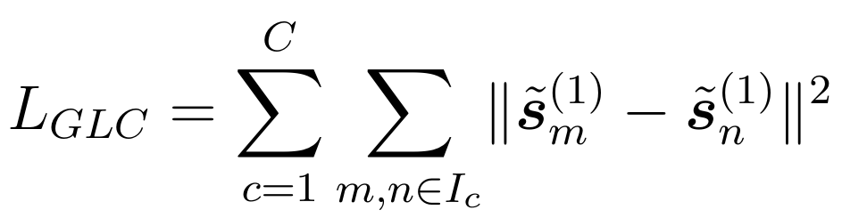
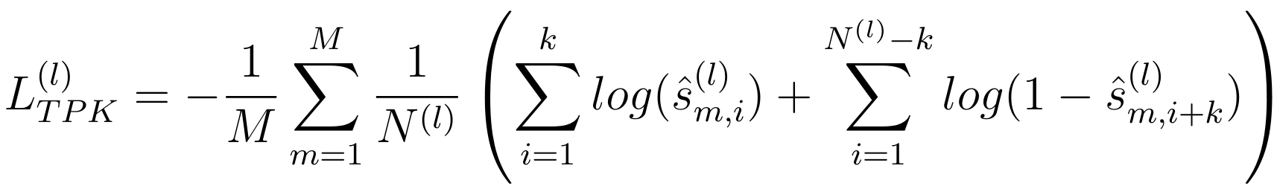
Loss function
Cross Entropy loss:
Unit Loss
Group-level consistency loss
TopK loss
Computer Aided Medical Procedures
12/14/21
Slide <number>

Slide 13
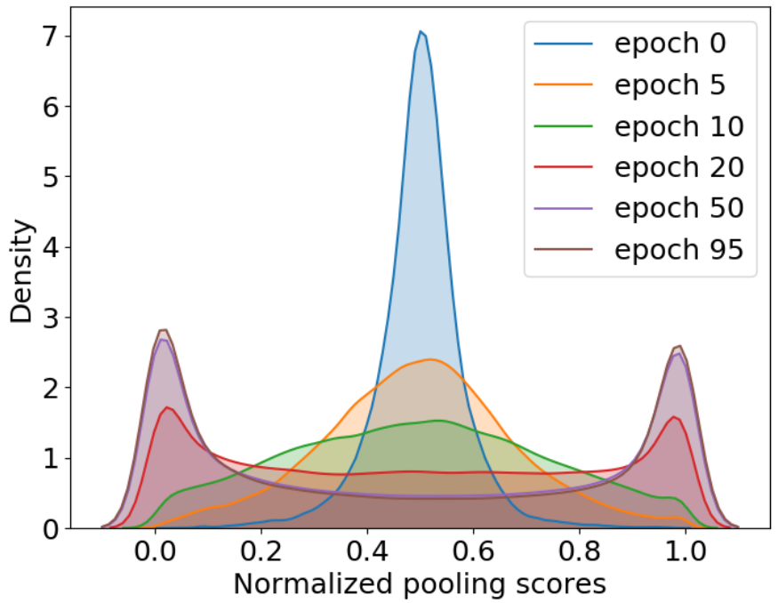
Pooling scores
Computer Aided Medical Procedures
12/14/21
Slide <number>

Slide 14
Experimental Setup

Slide 15
Datasets
Dataset | Task | Number of ROIs | Number of Subjects | Number of Graphs
Biopoint Autism Study Dataset | Classify into "Autism Spectrum Disorder" or "Healthy Control" | 84 | 115 | 3450
Human Connectome Project 900 Subject Release | Map 7 cognitive tasks to human brain | 268 | 506 | 3542
Set | Biopoint | HCP | Proportion
Testing | 690 | 707-714 | 1/5
Training | 2070 | 2121-2128 | 3/5
Validation | 690 | 707-714 | 1/5
Computer Aided Medical Procedures
12/14/21
Slide <number>

Slide 16
Setup
Hardware
  Nvidia Geforce GTC1080Ti with 11GB GPU
Library
  Pytorch
Optimizer
  Adam
Learning rate
  0.001
  Annealed by half every
  20 epoch
GNN architecture
  2 GNN-blocks
Parameter | Biopoint | HCP
N | 84 | 268
K⁽⁰⁾ | 8 | 8
K⁽¹⁾ | 8 | 8
d⁽⁰⁾ | 84 | 268
d⁽¹⁾ | 16 | 32
d⁽²⁾ | 16 | 32
C | 2 | 7
k | 50% | 50%
Batch | 400 graphs | 200 graphs
Computer Aided Medical Procedures
12/14/21
Slide <number>

Slide 17
Experimental Results

Slide 18
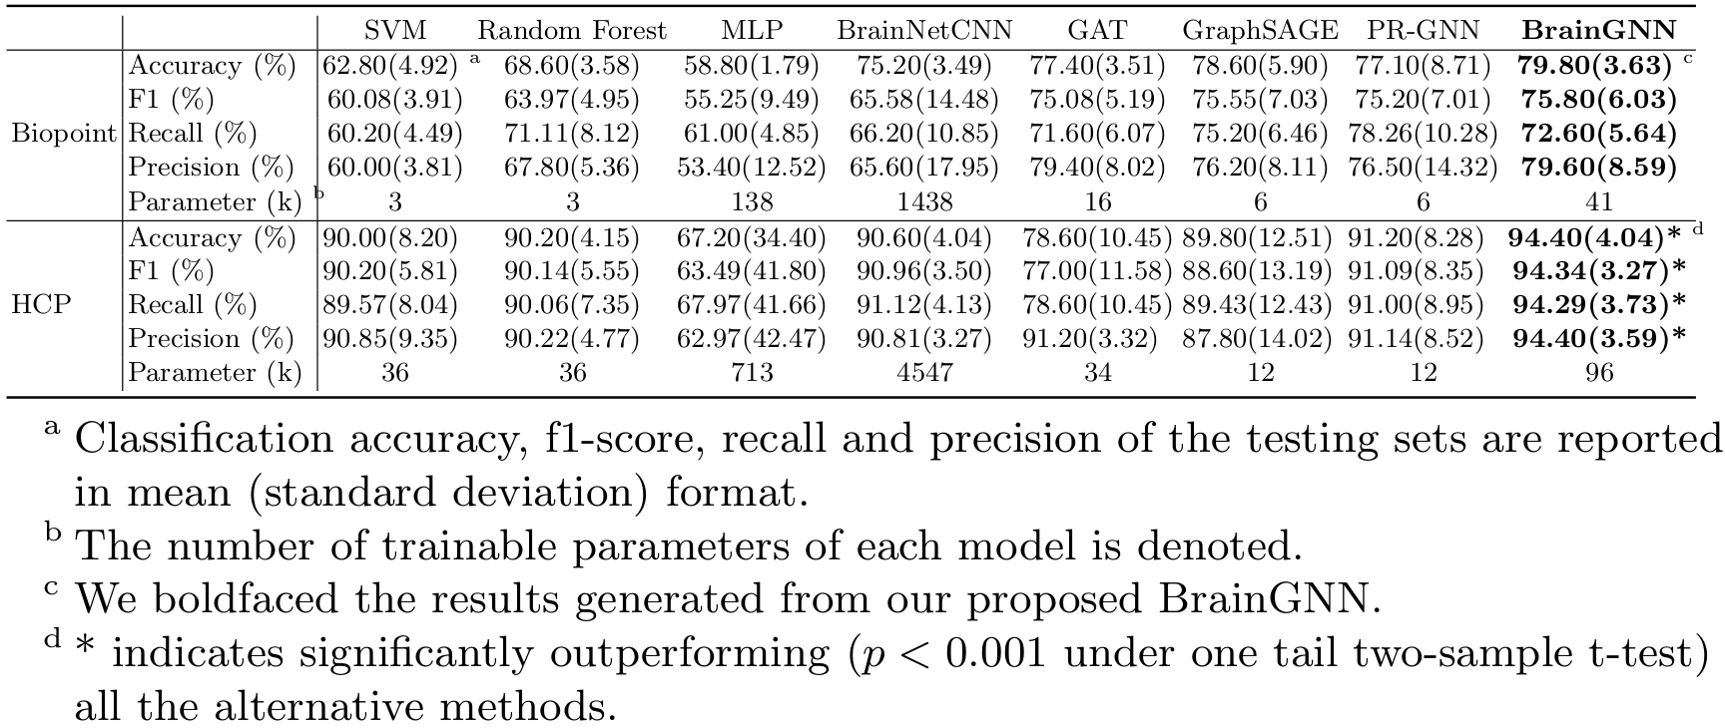
Results
Computer Aided Medical Procedures
12/14/21
Slide <number>

Slide 19
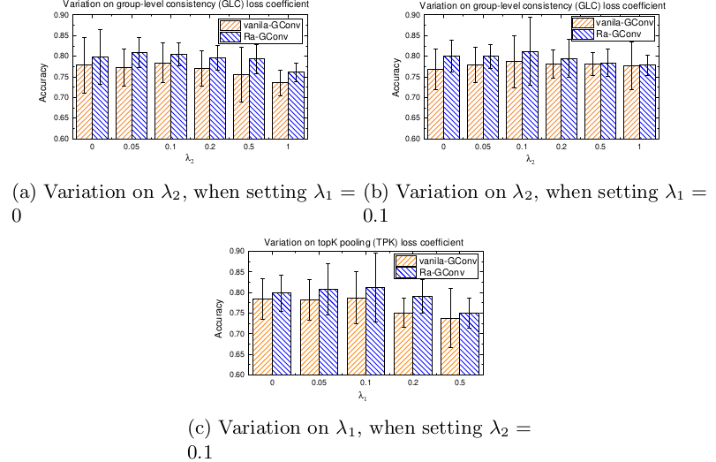
Hyper-parameters
Computer Aided Medical Procedures
12/14/21
Slide <number>

Slide 20
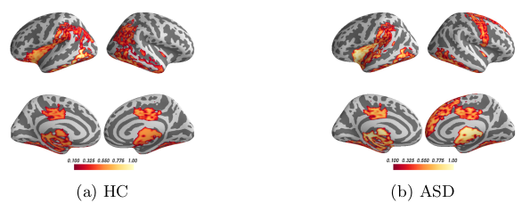
Identification of salient ROIs
Fig1. Biopoint task
Fig2. HCP task
Computer Aided Medical Procedures
12/14/21
Slide <number>

Slide 21
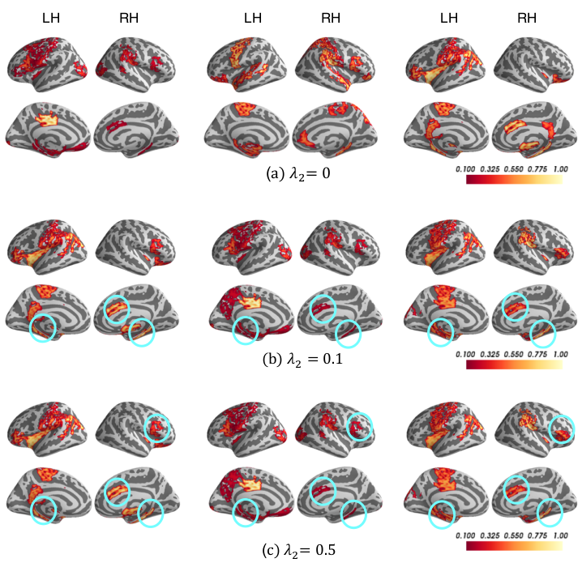
interpretability
Computer Aided Medical Procedures
12/14/21
Slide <number>

Slide 22
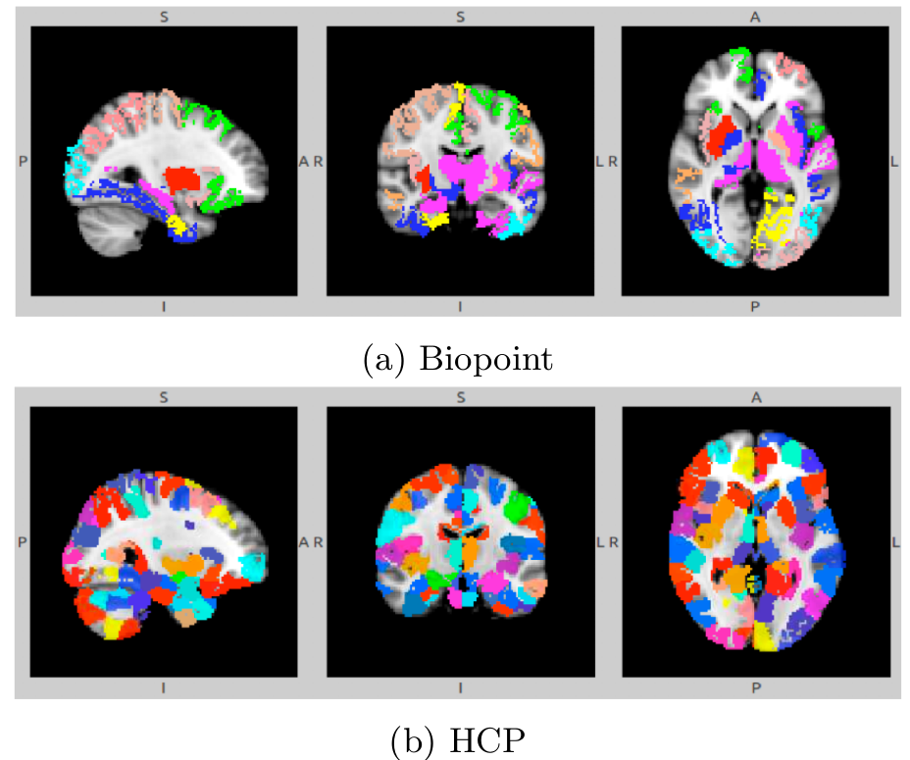
Clustering

Slide 23
Take Home Message

Slide 24
Take Home Message
New framework for fMRI analysis
  Group- and Individual-level biomarker interpretation
Newly conceived convolutional layer
  Nodes embedded differently
BrainGNN performs well in selecting salient ROIs.
Computer Aided Medical Procedures
12/14/21
Slide <number>

Slide 25
Discussion

Slide 26
Discussion
Strengths
Well written paper.
Explains the neurological interpretation of the results.
Improved previous papers.
      A new convolutional layer
      New task
      Better and more focused presentation
Weaknesses
The code is not present on GitHub.
The results depend on the values of λ₂ which was chosen to maximize accuracy. Changing λ₂ for interpretability may change the performance of BrainGNN.
Computer Aided Medical Procedures
12/14/21
Slide <number>

Slide 27
Bibliography
[1] Kawahara, J., Brown, C.J., Miller, S.P., Booth, B.G., Chau, V., Grunau, R.E., Zwicker, J.G., Hamarneh, G.: Brainnetcnn: Convolutional neural networks for brain networks; towards predicting neurodevelopment. NeuroImage 146, 1038–1049 (2017)
[2] Kazi, A., Shekarforoush, S., Krishna, S.A., Burwinkel, H., Vivar, G., Kortüm, K., Ahmadi, S.A., Albarqouni, S., Navab, N.: Inceptiongcn: receptive field aware graph convolutional network for disease prediction. In: International Conference on Information Processing in Medical Imaging. pp. 73–85. Springer (2019)
[3] Li, X., Zhou, Y., Dvornek, N.C., Zhang, M., Zhuang, J., Ventola, P., Duncan, J.S.: Pooling regularized graph neural network for fmri biomarker analysis. In: International Conference on Medical Image Computing and Computer-Assisted Intervention. pp. 625–635. Springer (2020)
[4] Li, X., Dvornek, N.C., Zhou, Y., Zhuang, J., Ventola, P., Duncan, J.S.: Graph neural network for interpreting task-fmri biomarkers. In: International Conference on Medical Image Computing and Computer-Assisted Intervention. pp. 485–493. Springer (2019)

Slide 28
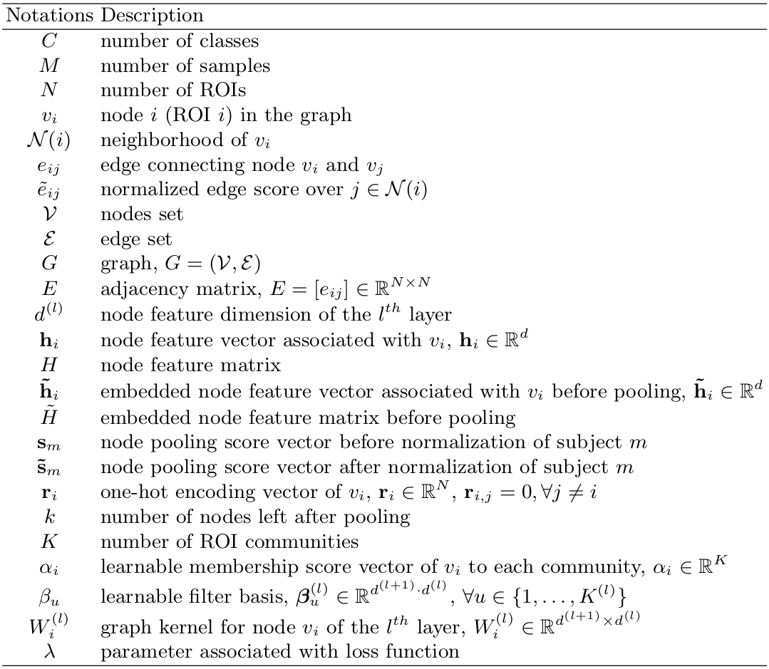
Notations

Slide 29
Thank you for your attention

Slide 30
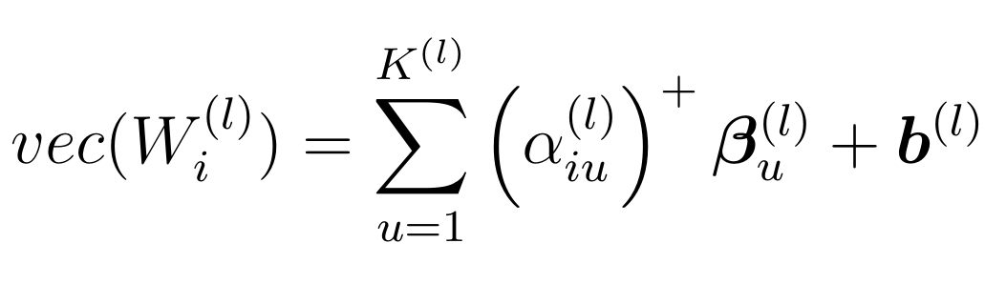
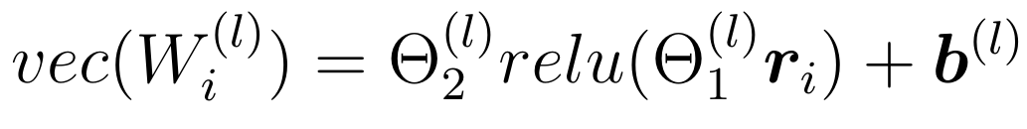
ROI aware Graph Convolutional layer
Computer Aided Medical Procedures
12/14/21
Slide <number>

Slide 31
Loss Function

Slide 32
In addition, the low signal-to-noise ratio of f MRI and its high dimensionality impose another limitation on using fMRI for graph level classification and detection of functional differences between ASD and HC groups. Li et al. [91] dealt with this challenge by modeling the the whole brain f MRI as a graph. This allowed them to preserve the geometrical and temporal information and learn a better graph embedding.

