Slide 1
Multi-label zero-shot learning with graph convolutional networks
Guangjin Ou, Guoxian Yu, Carlotta Domeniconi, Xuequan Lu, Xiangliang Zhang
Master Seminar: Graph Deep Learning for Medical Applications
Computer Aided Medical Procedures
Student: Mohamed Taieb Ben Haddej
Tutor: Anees Kazi
December 14th, 2021

Slide 2
Table of Contents
Introduction
Proposed Method
Experiments
Results
Personal Review

Slide 3
Introduction
Multi-Label Classification
Zero-Shot Learning
Motivation and Problem Statement
Related Work

Slide 4
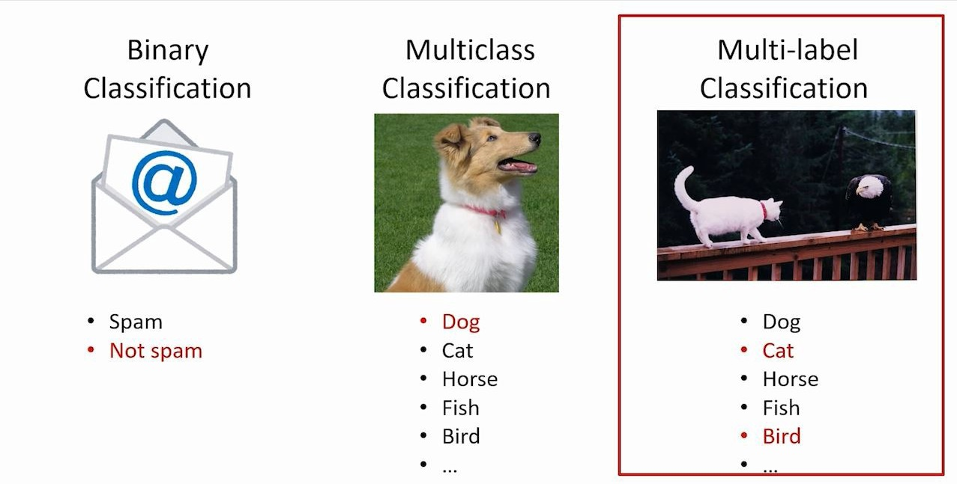
Introduction
Multi-Label Classification
Data can have more than one label
The classifier can predict different classes for one given input

Slide 5
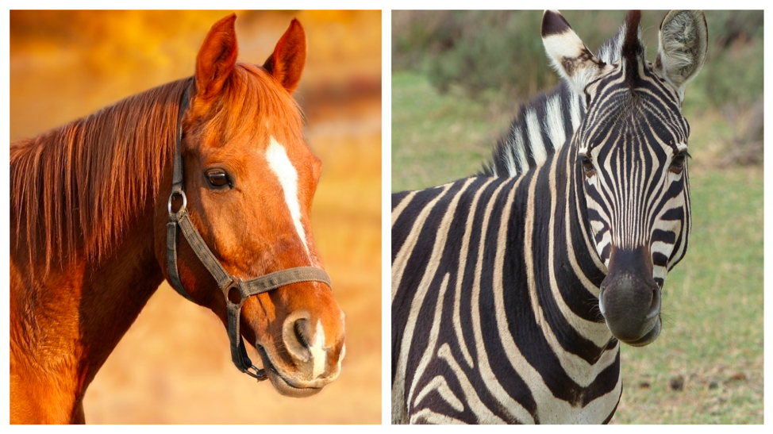
Introduction
Zero-Shot Learning
No corresponding annotated training data
Unsupervised (Transfer Learning)
Example:
  Given:
  A set of images of animals to be classified
  Textual descriptions of what animals look like

Slide 6
Motivation and Problem Statement
The manual annotations of data is very costly and difficult to achieve
MZSL has received far less attention compared to the single-label ZSL
Existing multi-label zero shot learning approaches have weaknesses
Goal: Remedy these problems by creating a Multi-based zero shot learning model based on Graph Convolutional Networks

Slide 7
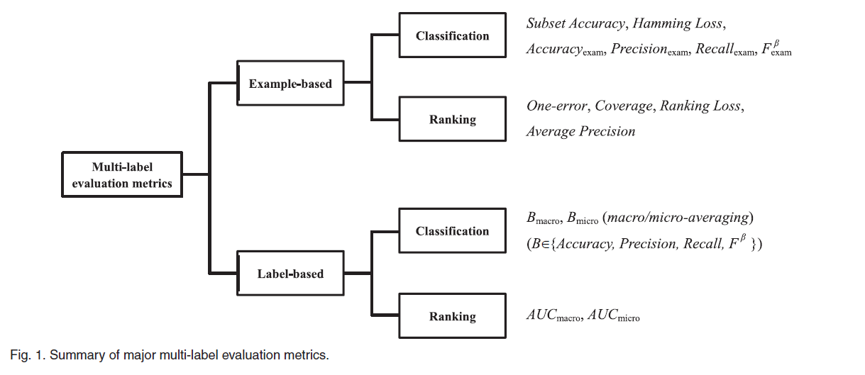
Related Work – Multi-Label Learning
A Review on Multi-Label Learning Algorithms (2014)
Goal: Providing a timely review on the
Multi-Label Algorithms
Fundamentals on multi-label learning including formal definition and evaluation metrics
The idea of exploiting label correlations have been employed by various multi-label learning techniques
Zhang, M. L., & Zhou, Z. H. (2014). A review on multi-label learning algorithms. IEEE Transactions on Knowledge and Data Engineering, 26(8), 1819–1837.

Slide 8
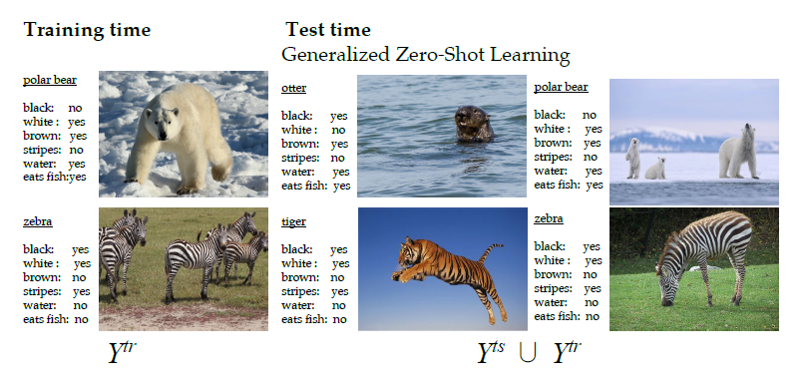
Related Work – Zero-Shot Learning
Zero-Shot Learning - A Comprehensive Evaluation of the Good, the Bad and the Ugly (2019)
Goal: Evaluating state-of-the-art zero-shot learning methods
    → Generative models have an edge over learning independent attribute classifiers
    → Unlabeled data of unseen classes can further improve the zero-shot learning results
Xian, Y., Lampert, C. H., Schiele, B., & Akata, Z. (2019). Zero-shot learning-a comprehensive evaluation of the good, the bad and the ugly. IEEE Transactions on Pattern Analysis and Machine Intelligence, 41(9), 2251–2265.

Slide 9
Proposed Method
MZSL-GCN Framework
Problem Formulation
GCN Learning
Image Representation
Loss Function of the MZSL-GCN

Slide 10
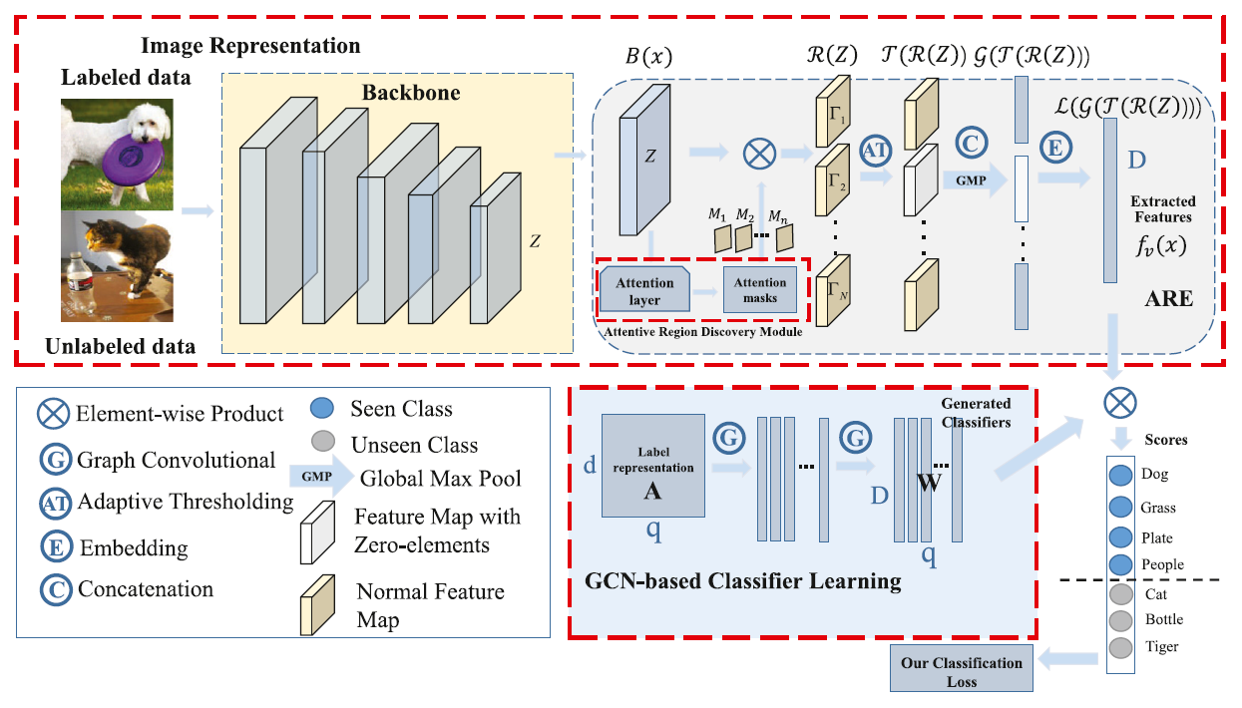
MZSL-GCN Framework
An end-to-end trainable multi-label zero-shot learning (MZSL-GCN) framework, which consists of:
  The Image Representation subnet
  The GCN-based learning subnet

Slide 11
Problem Formulation
Goal: Learn a multi-label classification model using the training data to achieve good performance not only in the conventional setting, but also in the generalized setting of MZSL
Training Data: D^{s} = {X^{s}, Y}
  X^{s} ∈ R^{ns×d}: d-dimensional ns training instances
  Y ∈ {0, 1}^{ns×s}: Label matrix across a set of seen classes (Multi labels)
Test Data: D^{t} = {X^{t}}
  Labels of samples in D^{t} are not available for training
Semantic embedding: A ∈ R^{q×m}
  For seen and unseen classes

Slide 12
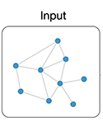
GCN Architecture
Goal: Map the label embeddings into a set of interdependent classifiers
Each node of the graph is represented as word embeddings of the label
The GCN will learn a classification model f that takes a class label embeddings A^{l} ∈ R ^{q x m} and a label correlation matrix S ∈ R ^{q x q} as inputs

Slide 13

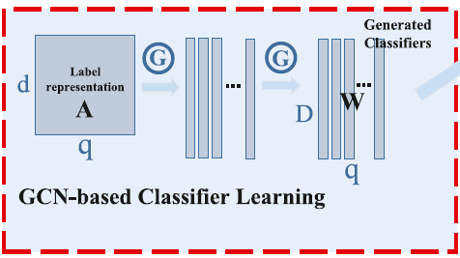


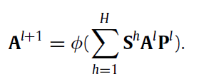

GCN Architecture
Updating rule of GCN:
It can be further represented as:
We consider higher-order label correlations:
                - We use a 300-D GloVe word embedding for the first layer
                Vector A ∈ R ^{q x 300} as the input
For the last layer, the output W ∈ R ^{q x D} - Predicted score:

Slide 14


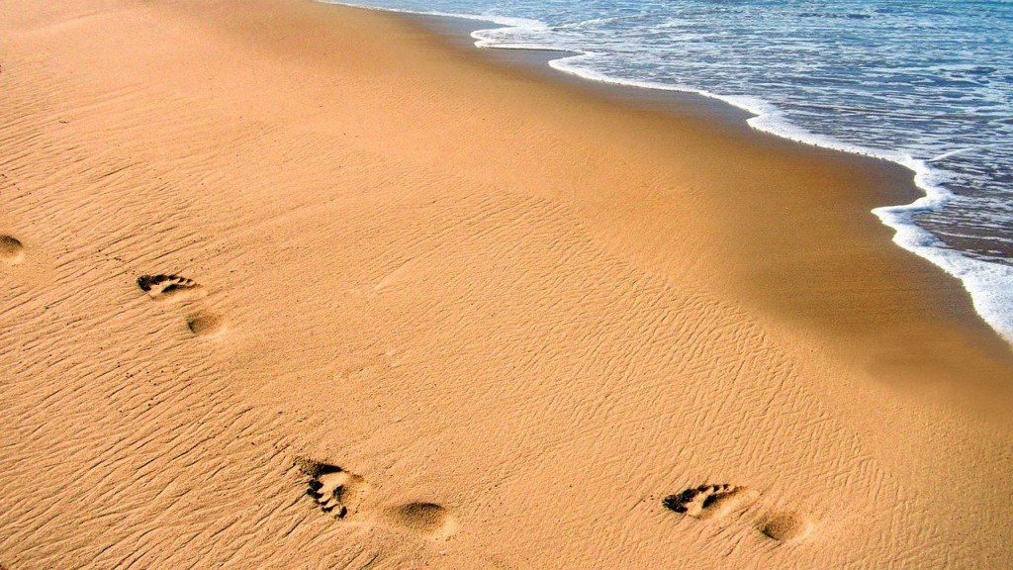
Correlation Matrix S
How to get the correlation matrix S?
  A binary correlation matrix is defined via a threshold τ to filter out noisy edges:
    Let n^{c} denote the number of training samples with label c
    Let n^{cs} denote the number of training samples with label c & s
    - Example: Label c : Sea & Label s : Sand
    - The quotient n^{cs}/n^{c} is high
    → High correlation between ‘Sea’ & ‘Sand’

Slide 15

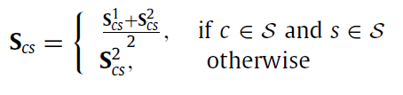
Correlation Matrix S
Issue: The graph nodes correspond to both seen and unseen classes.
However, the unseen labels do not appear in the training data
Solution: Use semantic similarity to construct a label similarity matrix
  Specifically, the 300-D GloVe embedding is used to calculate the Euclidian distance between labels
Combine the co-occurrence statistics with the semantic similarity to get the the complete matrix S

Slide 16
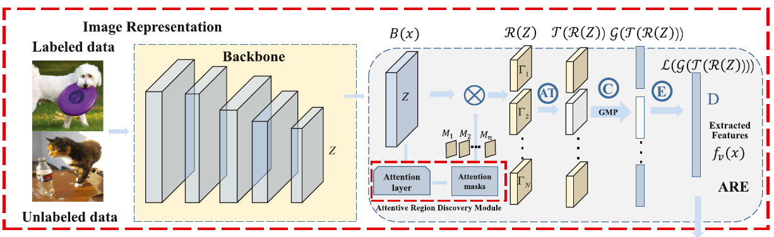
Image Representation
Goal: Learning adaptive local and global visual features and assisting the semantic transfer between seen/unseen classes.
Backbone
  Any CNN-based model for image input data (ResNet101 in the experiment)
Attention Region Embedding (ARE)

Slide 17

Attention Region Embedding (ARE)
ARD: Attention Region Discovery
  Takes as input the last convolutional feature map Z of the backbone
  Highlights the attention regions
AT: Adaptive Thresholding
  Filters out the regions with low attentive strength
GMP: Global Maximum Pooling
  Preservers the most salient features more than global average pooling
Fully Connected Layer:
  Matches the final image representation f_{v}(x) of image x with the dimension of class classifiers

Slide 18
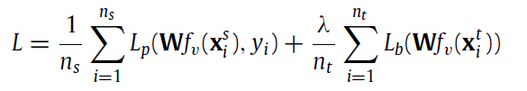


Loss Function of the MZSL-GCN
Issue: Only the data for seen classes are labeled and the data for unseen classes are unlabeled.
Solution: A quasi-fully supervised learning loss as:
  With L_{p} the traditional multi-label classification loss:
  And L_{b} the balance term to reduce the bias to unseen classes on unlabeled data

Slide 19
Experiments
- Datasets
- Experimental Setup

Slide 20
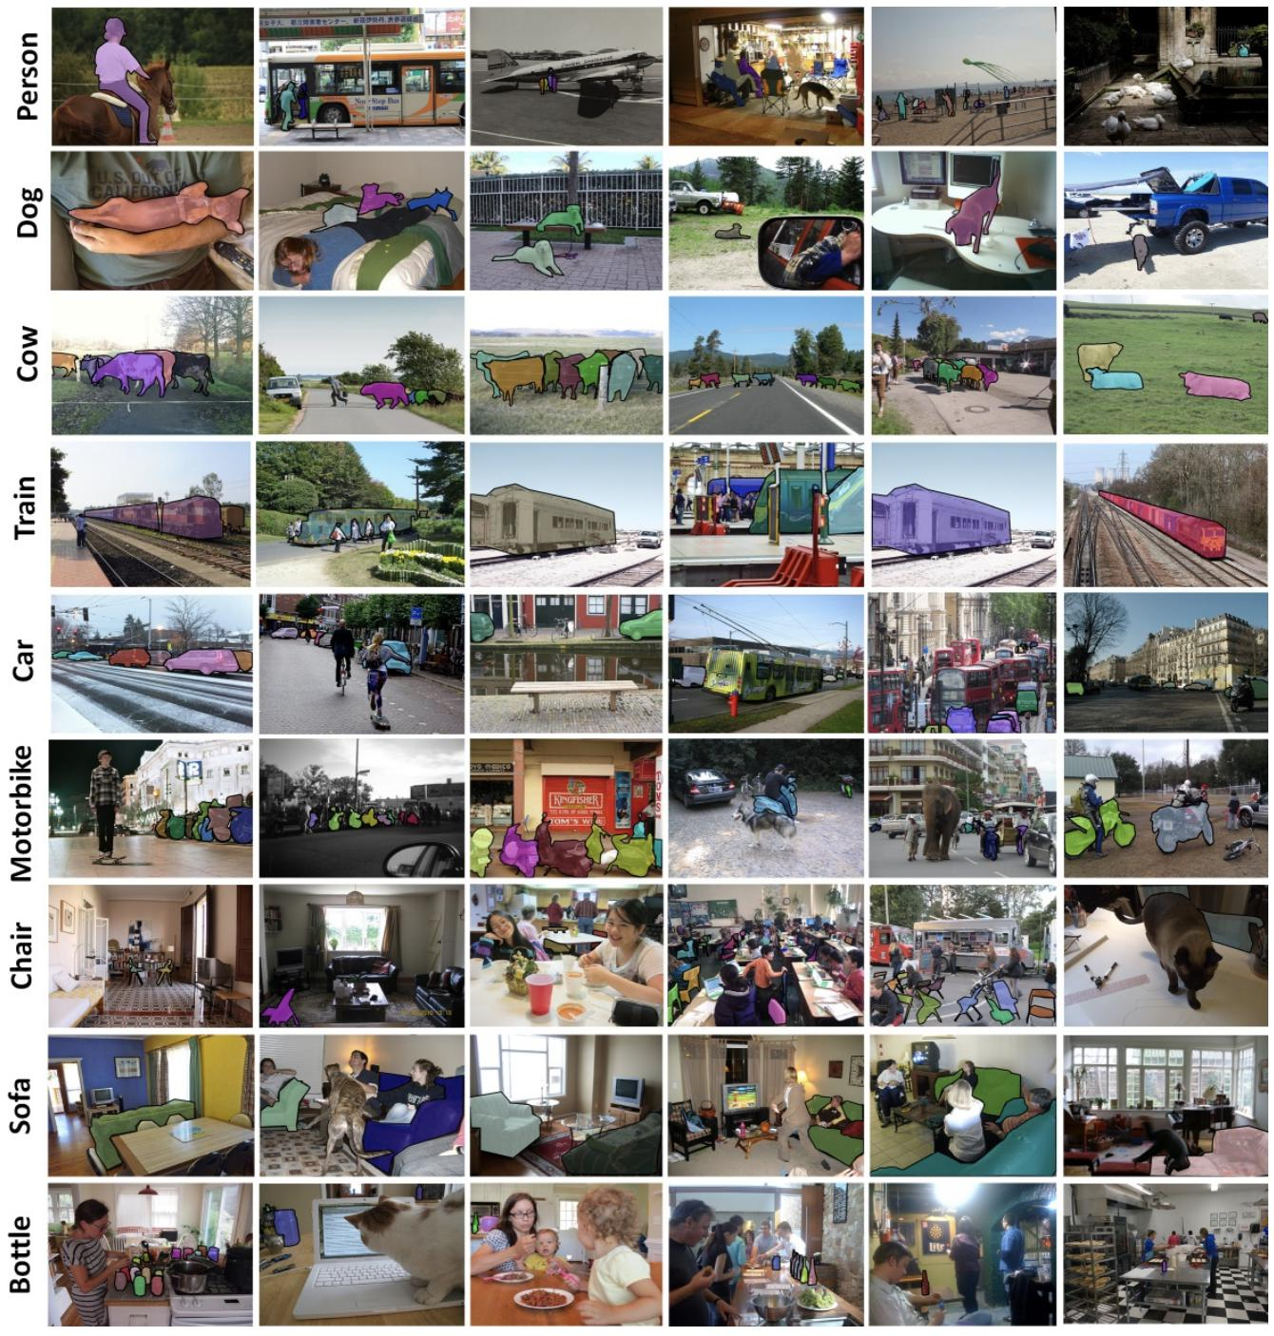
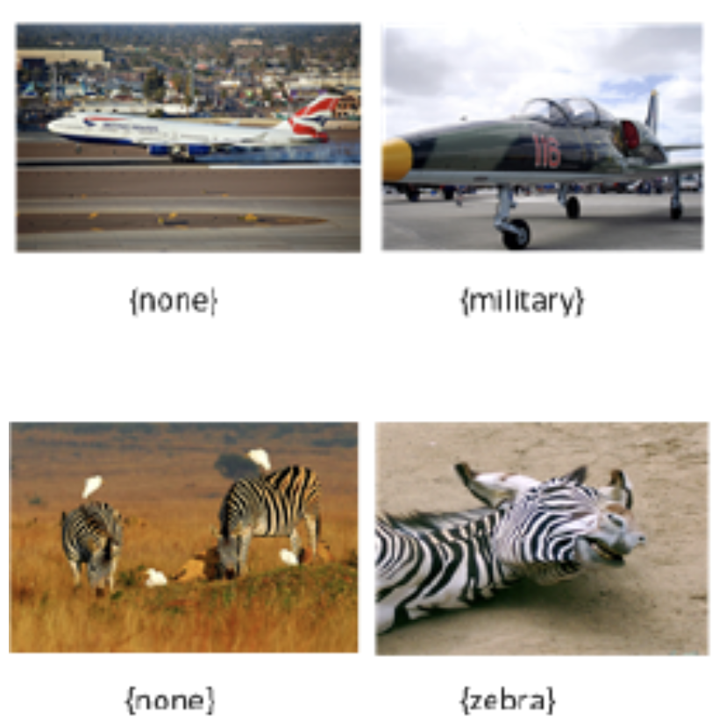
Datasets
MS-COCO
NUS-WIDE
Multi-label Image dataset
80 different classes
Multi-label Image dataset
81 classes (NUS-1000, 1000 classes)
330K images
270K images

Slide 21
Experimental Setup
Data preprocessing:
  Input images resized into 448 x 448
  Batch size: 32
  Random horizontal flips & crops → as data augmentation
Base model architecture
ResNet101 pretrained on ImageNet as backbone
  Outputs: Feature map Z size 2048 × 14 × 14
Training data
Validation data
Test data
  NUS-WIDE (100k)
  MS-COCO (~78k)
  Mixed labeled and unlabeled data
  NUS-WIDE (~ 10k)
  MS-COCO (4k)
  NUS-WIDE (20k)
  MS-COCO (~40k)

Slide 22
Experimental Setup
GCN-based Subnet
  - 2 GCN layers with output dimentionality of 1024 and 2048
Hyperparameters:
→ Attention Region Embedding Module
We apply cross-validation to get these hyper-parameters:
  The number of regions N {N ∈ N₊ |4 ≤ N ≤ 12}
  AT parameter α is selected from {0.5, 0.6, 0.7, 0.8, 0.9, 1.0}
Label correlation matrix: τ = 0.4
Network trained for 200 epochs
SGD optimizer
Learning Rate: Initially set to 0.1
Momentum is fixed to: 0.9
Weight decay is fixed to: 10⁻⁵

Slide 23
Results
Multi-label Classification Task
MZSL and Generalized MZSL Task
Futher Analysis
Classifier Visualization

Slide 24
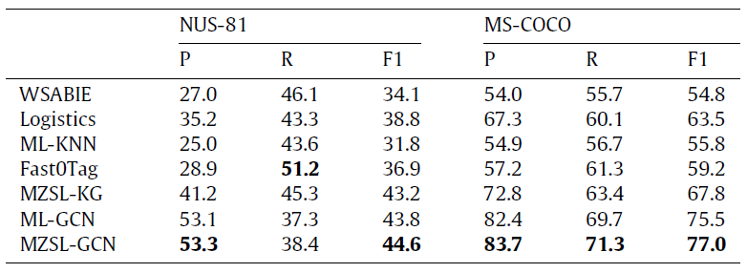
Multi-label Classification Task
Evaluation of the performance on MS-COCO and NUS-WIDE of the model against representative multi-label classification methods
Considered metrics: Precision (P) recall (R) and F1-measure (F1)

Slide 25
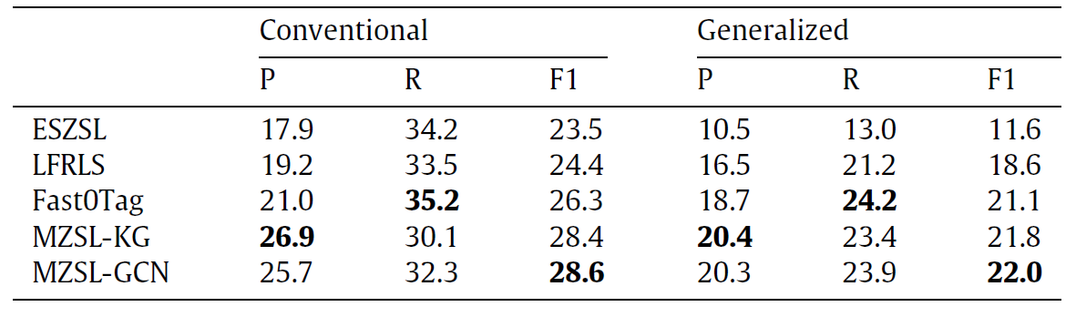
MZSL and Generalized MZSL Task
Evaluation of the performance on NUS-1000 (81 unseen labels and 925 seen labels)
Considered tasks: conventional and generalized MZSL tasks

Slide 26
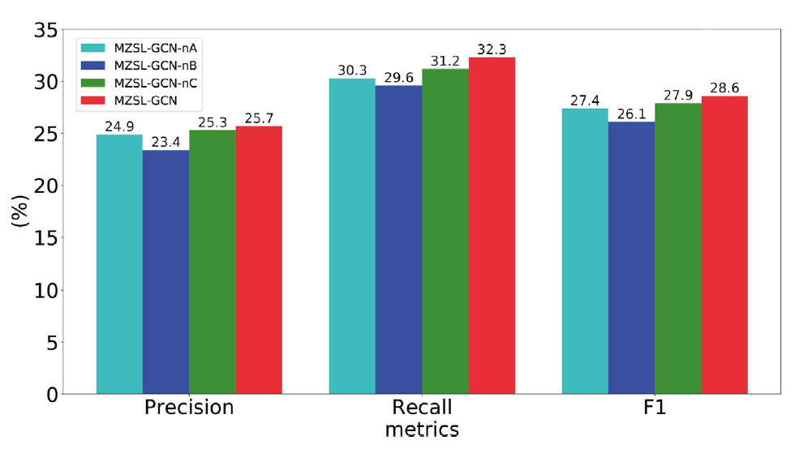
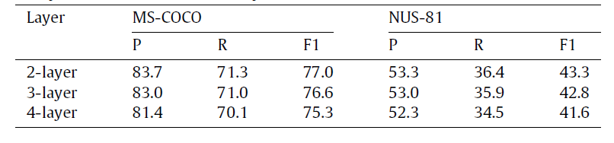
Further Analysis
Ablation study by removing key components from the model and measure how the performance is affected.
  Remove ARD module
  Train only with labeled data
  Replace correlation matrix S with the identity matrix
Further evaluation by increasing the number of GCN layers.

Slide 27
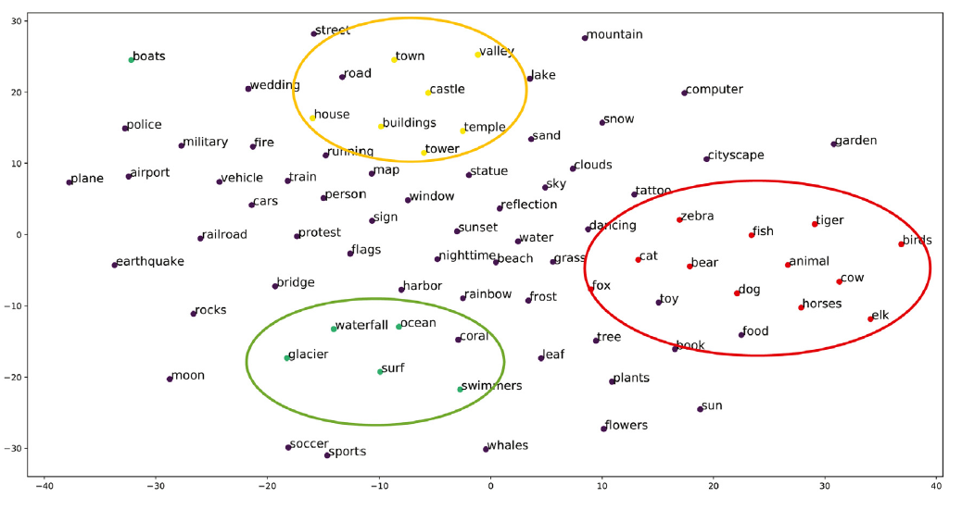
Classifier Visualization
Using Stochastic Neighbor Embedding (t-SNE), the semantic topology can be visualized in 2D plot.

Slide 28
Personal Review

Slide 29
Personal Review
Strengths
Weaknesses
Structured main paper
Necessity of strong prior knowledge
Detailed experiments and evaluation
They gloss over GCN architecture
Interesting results
No discussion/future work mentioned

Slide 30
References
[1] Zhang, M. L., & Zhou, Z. H. (2014). A review on multi-label learning algorithms. IEEE Transactions on Knowledge and Data Engineering, 26(8), 1819–1837.
[2] Xian, Y., Lampert, C. H., Schiele, B., & Akata, Z. (2019). Zero-shot learning-a comprehensive evaluation of the good, the bad and the ugly. IEEE Transactions on Pattern Analysis and Machine Intelligence, 41(9), 2251–2265.
[3] Ou, Guangjin, Yu, Guoxian, Domeniconi, Carlotta, Lu, Xuequan and Zhang, Xangliang 2020, Multi-label zero-shot learning with graph convolutional networks, Neural networks, vol. 132, pp. 333-341, doi: 10.1016/j.neunet.2020.09.010.

Slide 31
References
Dataset Sample Pictures:
[4] https://tkipf.github.io/
[5] https://www.microsoft.com/en-us/research/uploads/prod/2017/12/40250.jpg
[6] https://analyticsindiamag.com/what-is-zero-shot-learning/
[7] https://paperswithcode.com/dataset/nus-wide
[8] https://paperswithcode.com/dataset/coco

Slide 32
Thank you for listening!

