Slide 1
Early Detection of Liver Fibrosis Using Graph Convolutional Networks
Master Seminar: Graph Deep Learning in Medical Imaging
M. Wojciechowska, S. Malacrino, M. G. Martin, H. Fehri and J. Rittscher
Presentation - 25.01.2022
Tutor: Mahsa Ghorbani
Presented by: Arda Sener
arda.sener@tum.de

Slide 2
Introduction

Slide 3
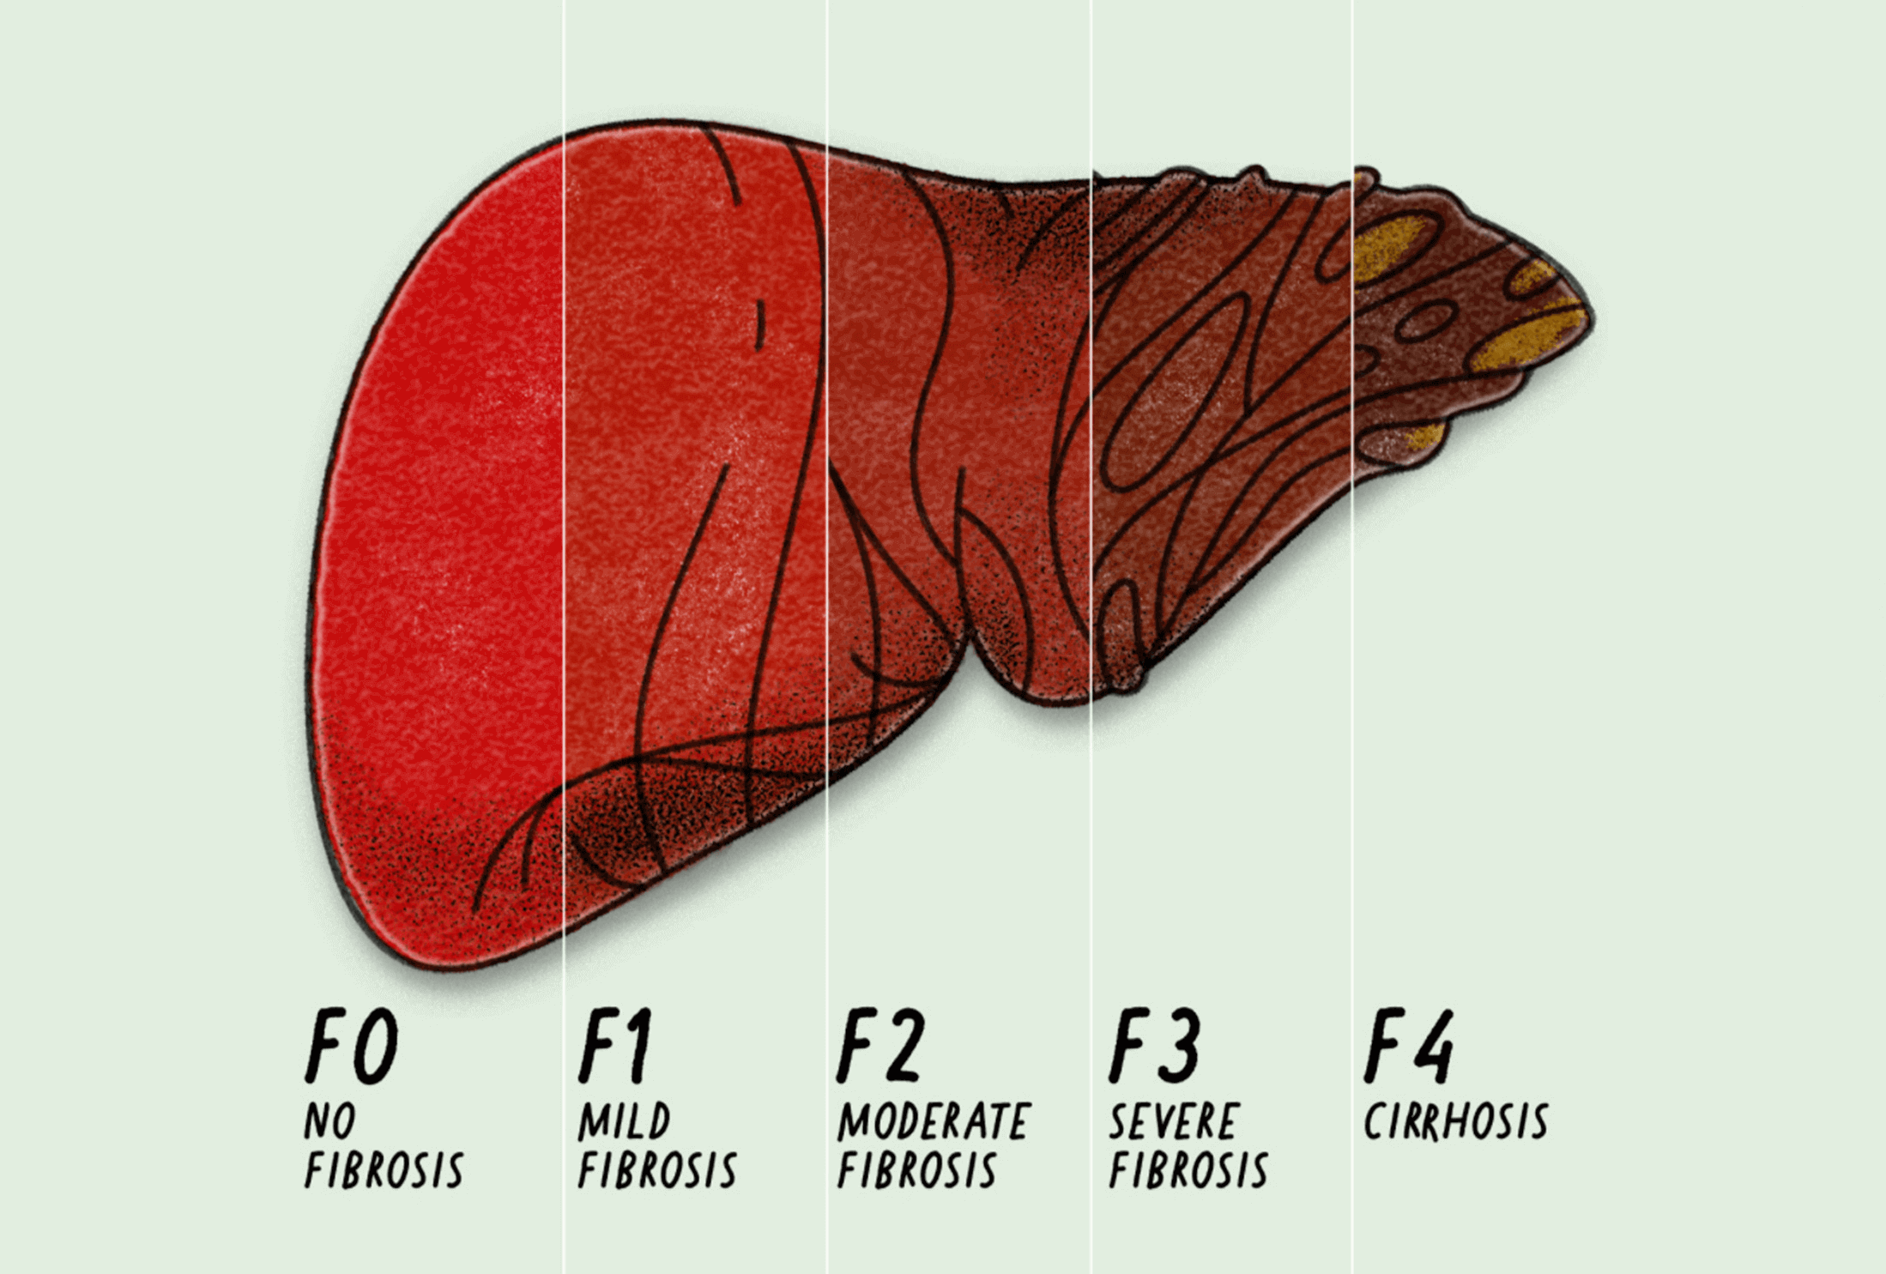
Basics of Liver Fibrosis
High risk of liver fibrosis through occurence of collagen
Detection through observation of collagen in tissue
Classification of fibrosis level through METAVIR staging system
Figure 1: Different Stages of Liver Fibrosis [9]
[9] https://www.mavyret.com/how-hep-c-affects-liver
Computer Aided Medical Procedures
Notes:
Reasons for occurence of collagen: HCV infection, alcohol abuse, or nonalcoholic steatohepatitis NASH
Typical measurement is collagen porportion per area – amount of collagen in a specific area
METAVIR- pathology staging system used by expert pathologist. F0-F4 (almost) healthy liver – late stage of a scarring liver

Slide 4
Motivation
Previous approaches:
  did not consider topology at macroscopic level
  used large patches of tissue for biopsy
  downsampled Whole Slide Images (WSIs)
The approach of Graph Convolution Network (GCNs) in combination with Deep Learning are suited for this problem
Two core pipelines which resolve this issue
Notes:
The so-called bridging (= change of microscopic structure) is only visible at microscopic level.
Large patches: not practical in a clinical setting => cant take out too much in a biopsy obviously
Downsampled the WSIs need more patch of biopsy too
GCNs consider the structure and large patches are not needed because of the proposed pipelines

Slide 5
Related Work
Spatial relationship in histopathological tasks [2]
Nodes in GCNs describing important biological information [3],[4],[5]
Downsampling of WSIs to obtain scoring of liver fibrosis [6]
Patch-based methods without tissue topology in macroscopic scale [7]
Deep learning enables pathologist-like scoring of NASH models [8]
[2] Sharma, H., Zerbe, N., Lohmann, S., Kayser, K., Hellwich, O., Hufnagl, P.: A review of graph-based methods for image analysis in digital histopathology. Diagnost. Pathol. 1(1), 1{51 (2015)
[3] Zhou, Y., Graham, S., Alemi Koohbanani, N., Shaban, M., Heng, P.A., Rajpoot, N.: CGC-net: cell graph convolutional network for grading of colorectal cancer histology images. In: Proceedings - 2019 International Conference on Computer Vision Workshop, ICCVW 2019, pp. 388{398 (2019)
[4] Pati, P., et al.: HACT-Net: a hierarchical cell-to-tissue graph neural network for histopathological image classi cation. In: Sudre, C.H., et al. (eds.) UNSURE/GRAIL -2020. LNCS, vol. 12443, pp. 208{219. Springer, Cham (2020). https://doi.org/10.1007/978-3-030-60365-6 20
[5] Zheng, Y., Jiang, B., Shi, J., Zhang, H., Xie, F.: Encoding histopathological WSIS using GNN for scalable diagnostically relevant regions retrieval. In: Shen, D., et al. (eds.) MICCAI 2019. LNCS, vol. 11764, pp. 550{558. Springer, Cham (2019). https://doi.org/10.1007/978-3-030-32239-7 61
[6] Yu, Y., et al.: Deep learning enables automated scoring of liver fibrosis stages. Sci. Rep. 8(1), 1–10 (2018)
[7] Xu, S., et al.: QFibrosis: a fully-quantitative innovative method incorporating histological features to facilitate accurate fibrosis scoring in animal model and chronic hepatitis B patients. J. Hepatol. 61(2), 260–269 (2014)
[8] Heinemann, F., Birk, G., Stierstorfer, B.: Deep learning enables pathologist-like scoring of NASH models. Sci. Rep. 9(1), 1–10 (2019)
Computer Aided Medical Procedures
Notes:
2:
[3]: Use some cancer dataset. Each node is represented by a nucleus.
[4]: Represent structures of tissues by cell-graphs where the nodes are represented by those cells.
[5]: Also used some tumor images and features as nodes

Slide 6
Methodology

Slide 7
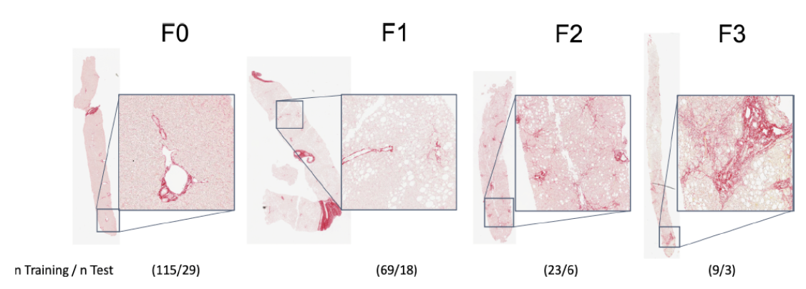
Data
271 percutaneous liver biopsies
Collagen dyed to red color (Picrosirius Red)
4 METAVIR stages: F0, F1, F2 and F3
Training/Test ratio: 80/20
Figure 2: Examples of each fibrosis stages with their corresponding proportion in dataset [1]
[1] Wojciechowska M., et. al. (2021) Early Detection of Liver Fibrosis Using Graph Convolutional Networks. In: de Bruijne M. et al. (eds) Medical Image Computing and Computer Assisted Intervention { MICCAI 2021. Lecture Notes in Computer Science, vol 12908.
Notes:
3): Note that F4 is not present in data
FIGURE: Examples of each stage and a magnitification on the right of each slide. Collagen in dyed red.

Slide 8
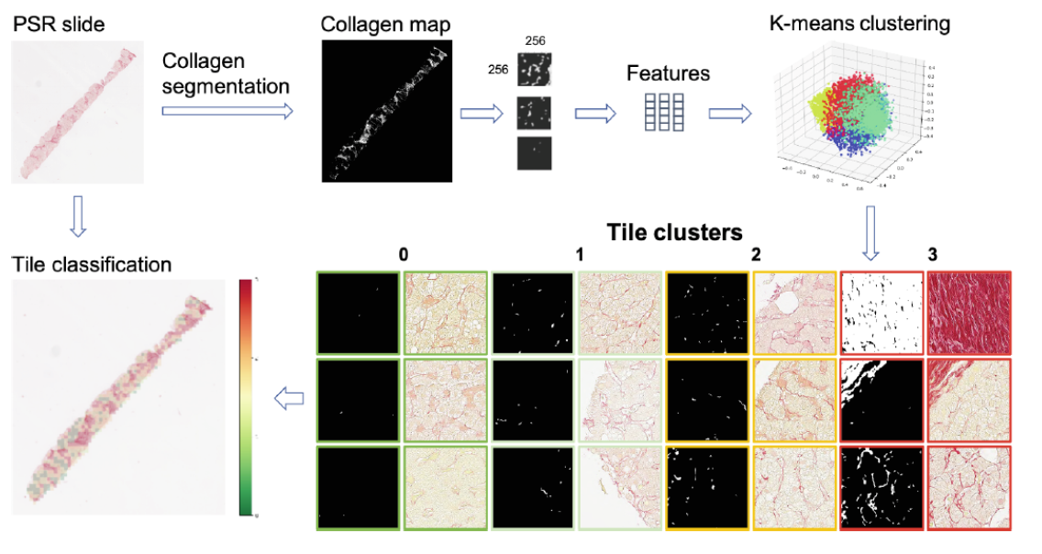
Tile Subtyping Pipeline
Figure 3: Subtyping Pipeline. Outputs landmarks by clustering each tile. [1]
[1] Wojciechowska M., et. al. (2021) Early Detection of Liver Fibrosis Using Graph Convolutional Networks. In: de Bruijne M. et al. (eds) Medical Image Computing and Computer Assisted Intervention { MICCAI 2021. Lecture Notes in Computer Science, vol 12908.
Notes:
PSR Slide as a whole in full resolution
Special CNN preprocessing to binarize image into collagen map
Split binarized image into equally sized small tiles
ResNet18 pretrained with ImageNet dataset for feature extraction for each tile
K Means Clustering with K=4 (authors tried different K‘s and thought that 4 lead to best results and more interpretable)
Tile clusters result where each tile has a lable 0 to 3. 0 no collagen up to 3 where high collagen
Landmarks are marked on the PSR slide by using the tiles of label 3 (highest occurence of collagen)

Slide 9
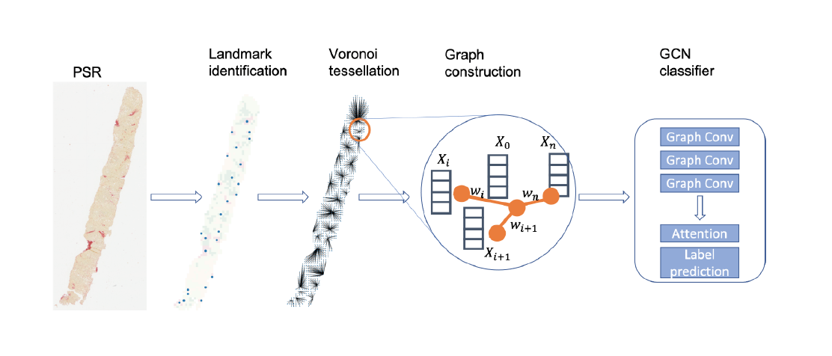
Graph Construction Pipeline
Figure 4: Graph construction pipeline. [1]
[1] Wojciechowska M., et. al. (2021) Early Detection of Liver Fibrosis Using Graph Convolutional Networks. In: de Bruijne M. et al. (eds) Medical Image Computing and Computer Assisted Intervention { MICCAI 2021. Lecture Notes in Computer Science, vol 12908.
Notes:
Second Pipeline starts with the landmark classification from previous pipeline
Landmarks act as a voronoi centre for a voronoi tessellation algorithm => Leads to star-like shape where each tile is connected to its nearest voronoi centre
Then a Graph is constructed where the nodes represent the features from each tile which were extracted from the pipeline before and the edges are the described by the inverse distance of each tile to its voronoi center
The graph structure with its features as nodes will be the input for an GCN classifier which has 3 Graph Convolution Layers, A Attention Layer and a final classifying layer

Slide 10

Graph Convolution Layer
G*: convolution layer for each layer
X: feature vector of each node (512 features for each node)
A: adjacency matrix
$Y_{output}$: final node features (64 for each node)
Notes:
G,X,A,Y_output reading
Tanh is the last non linear activation. Inbetween we have ReLUs

Slide 11


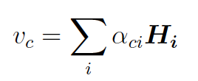


Attention Layer
More important tiles will get more attention in terms of collagen occurence
Final classification is achieved by
Notes:
Tiles with high collagen should get more attention, because these tiles are more likely to determine the stage of fibrosis of its corresponding slide
First we get the attention scores by multiplying the query vector with the matrix which contains the input sequences
After normalizing these scores we get the attention weights
The final node representations are obtained through the multiplication of attention weights with the input matrix
Final classification is achieved by using this node representation in a linear transformation and applying a softmax over all outputs
We‘ll get a probability distribution which tells us how likely it is that a certain slide is a specific class

Slide 12
Results

Slide 13
Settings for Training
Framework: Pytorch and Pytorch geometric
Optimizer: Adam
Weight decay: 1-e05
Epochs: 300 (with early stopping)
Dropout: 0.2
Batchsize GCN/ResNet: 64/1
Loss: Cross-Entropy Loss

Slide 14
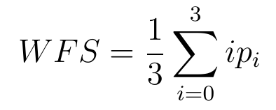
Results
Goals:
  Classify a PSR Slide as one of the METAVIR stages
  Studying the distribution of tile subtypes in different stages
Evaluation metrics:
  Weighted fibrosis score
  F1-score for classification
Notes:
Two Goals: First: classifying a psr slide as one of those stages. Second: Studying the distribution of tiles which are labelled for each stage
Evaluation: WFS: Weighted fibrosis score WFS . P_i: number of tiles of class i/number of all tiles. i is a specific class. So its just weighting each class with the fraction of tiles given in that class.

Slide 15
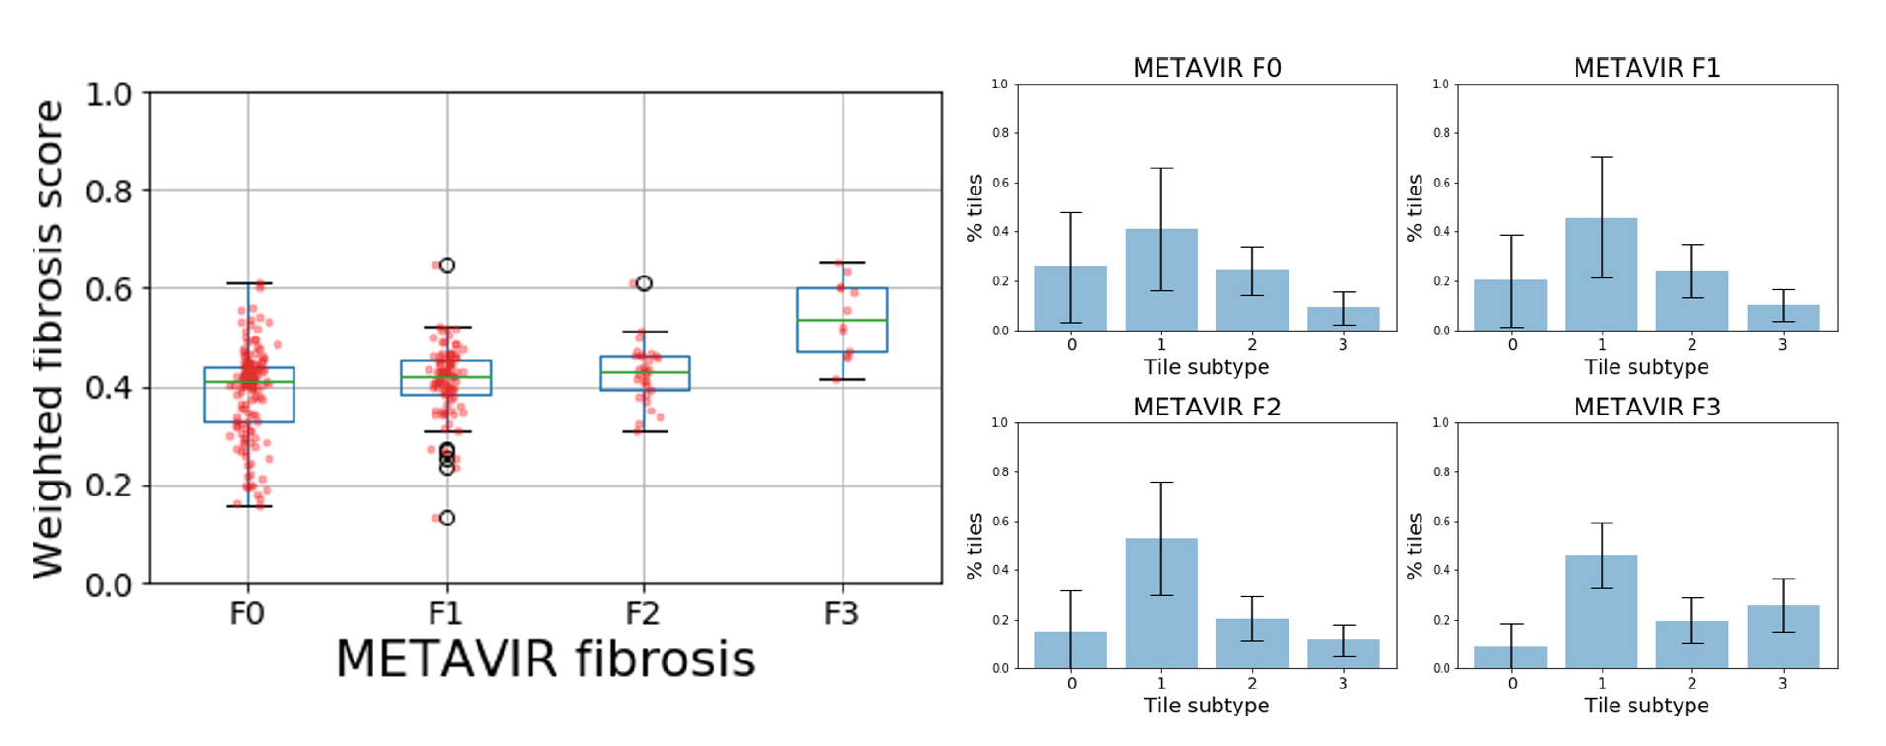
Weighted Fibrosis Score and Analysis of Tile Subtypes
Figure 5: Graph construction pipeline. [1]
[1] Wojciechowska M., et. al. (2021) Early Detection of Liver Fibrosis Using Graph Convolutional Networks. In: de Bruijne M. et al. (eds) Medical Image Computing and Computer Assisted Intervention { MICCAI 2021. Lecture Notes in Computer Science, vol 12908.
Notes:
Left Side: x-Axis different stages. Y-Axis. As we can see not easy to distinguish between F0,F1,F2. F3 is easier to distinguish => higher weighted fibrosis score. Green line is mean, blue box is the quantile, black lines variation, circles are outliers.
Right side: x-Axis Tile subtype from clustering process. Y-Axis percent of tiles which have this tile subtype. Most predicted tile subtype in all stages is from cluster 1. The porportion of all tile subtypes among all stages is roughly the same, except for F3. Tile subtype of cluster 3 is much higher there => makes sense because F3 has a much more occurence of collagen.

Slide 16
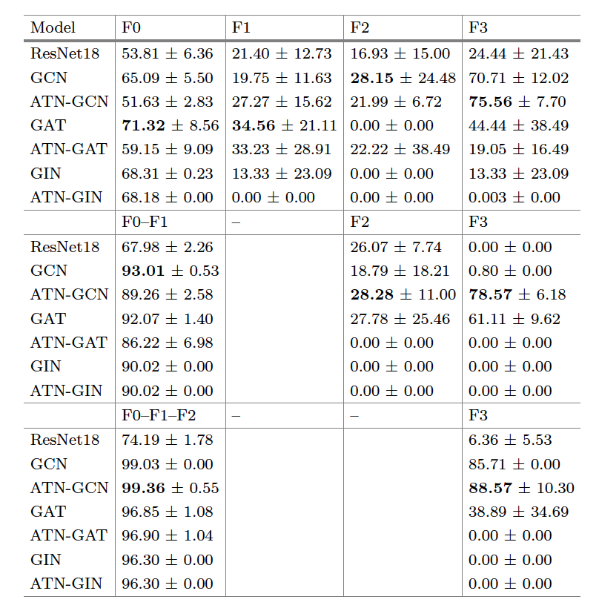
Classification Task
Table 1: F1-Score for different setups. [1]
[1] Wojciechowska M., et. al. (2021) Early Detection of Liver Fibrosis Using Graph Convolutional Networks. In: de Bruijne M. et al. (eds) Medical Image Computing and Computer Assisted Intervention { MICCAI 2021. Lecture Notes in Computer Science, vol 12908.
Notes:
3 Setups: each stage compared, f0-f1 merged and compared against f2,f3. F0-F2 merged and compared against F3
Result: outperforms resnet18

Slide 17
Take Home Message

Slide 18
Take Home Message
Combination of deep learning algorithms and GCNs lead to powerful models which can be used to analyze complex structured data
GCNs can be used to help experts who have difficult tasks to solve
Foundation for analysis of other organs or diseases

Slide 19
Discussion

Slide 20
Disscussion
Well-written and understandable
Clear problem definition
Self-explaining drawings
Source code is online
Deeper details for some approaches
More information about the node representation
Much prior knowledge needed

Slide 21
References

Slide 22
References
[1] Wojciechowska M., et. al. (2021) Early Detection of Liver Fibrosis Using Graph Convolutional Networks. In: de Bruijne M. et al. (eds) Medical Image Computing and Computer Assisted Intervention { MICCAI 2021. Lecture Notes in Computer Science, vol 12908.
[2] Sharma, H., Zerbe, N., Lohmann, S., Kayser, K., Hellwich, O., Hufnagl, P.: A review of graph-based methods for image analysis in digital histopathology. Diagnost. Pathol. 1(1), 1{51 (2015)
[3] Zhou, Y., Graham, S., Alemi Koohbanani, N., Shaban, M., Heng, P.A., Rajpoot, N.: CGC-net: cell graph convolutional network for grading of colorectal cancer histology images. In: Proceedings - 2019 International Conference on Computer Vision Workshop, ICCVW 2019, pp. 388{398 (2019)
[4] Pati, P., et al.: HACT-Net: a hierarchical cell-to-tissue graph neural network for histopathological image classi cation. In: Sudre, C.H., et al. (eds.) UNSURE/GRAIL -2020. LNCS, vol. 12443, pp. 208{219. Springer, Cham (2020). https://doi.org/10.1007/978-3-030-60365-6 20
[5] Zheng, Y., Jiang, B., Shi, J., Zhang, H., Xie, F.: Encoding histopathological WSIS using GNN for scalable diagnostically relevant regions retrieval. In: Shen, D., et al. (eds.) MICCAI 2019. LNCS, vol. 11764, pp. 550{558. Springer, Cham (2019). https://doi.org/10.1007/978-3-030-32239-7 61
[6] Yu, Y., et al.: Deep learning enables automated scoring of liver fibrosis stages. Sci. Rep. 8(1), 1–10 (2018)
[7] Xu, S., et al.: QFibrosis: a fully-quantitative innovative method incorporating histological features to facilitate accurate fibrosis scoring in animal model and chronic hepatitis B patients. J. Hepatol. 61(2), 260–269 (2014)
[8] Heinemann, F., Birk, G., Stierstorfer, B.: Deep learning enables pathologist-like scoring of NASH models. Sci. Rep. 9(1), 1–10 (2019)
[9] https://www.mavyret.com/how-hep-c-affects-liver

Slide 23
Thank you for your attention!
Questions?

