Slide 1
Context Matters: Graph-based Self-supervised Representation Learning for Medical Images
Graph Deep Learning for Medical Applications
Li Sun, Ke Yu, and Kayhan Batmanghelich
24.05.2022
Presenter: Xinyue Zhang
Advisor: Mahsa Ghorbani

Slide 2
Problem Statement
Medical Images
Labeled
Unlabeled
Radiologist supervision
Time-consuming, expensive
Limited amount
Easily accessible
Large quantities

Slide 3
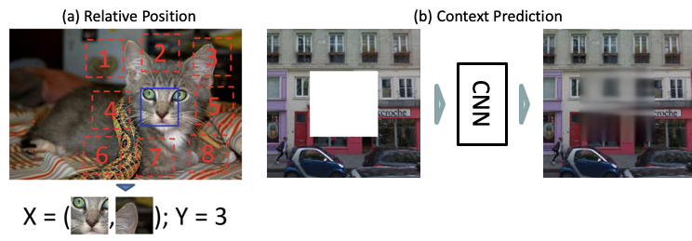
Self-supervised learning
Solving auxiliary tasks
Demonstration of the Relative Position(a) and Context Prediction(b) Methods. [1][2]
[1] Doersch, C., Gupta, A., Efros, A. A., 2015. Unsupervised visual representation learning by context prediction. In: Proceedings of the IEEE International Conference on Computer Vision. pp. 1422–1430. URL https://arxiv.org/abs/1505.05192.
[2] Pathak, D., Krahenbuhl, P., Donahue, J., Darrell, T., Efros, A. A., 2016. Context encoders: Feature learning by inpainting. In: Proceedings of the IEEE Conference on Computer Vision and Pattern Recognition. pp. 2536–2544. URL https://arxiv.org/abs/1604.07379.

Slide 4
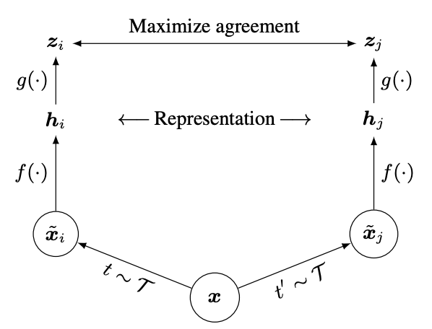
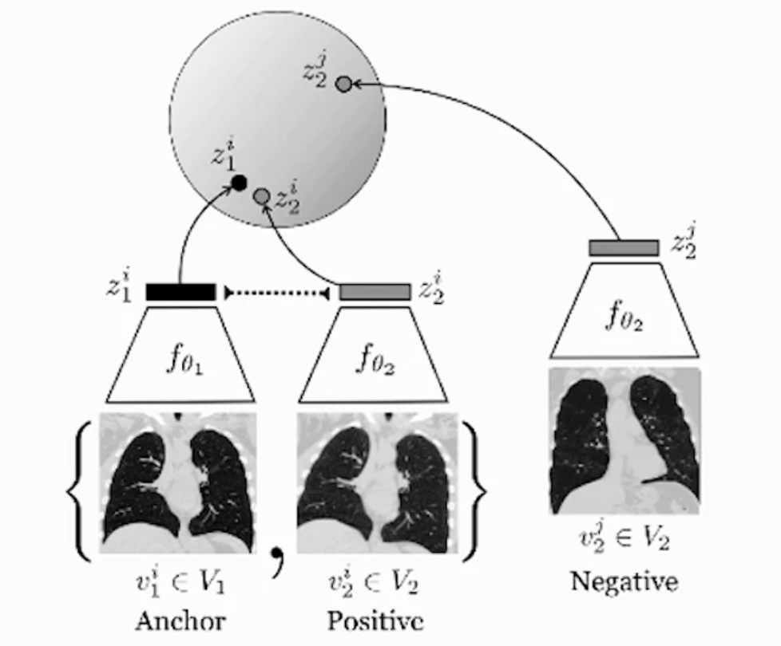
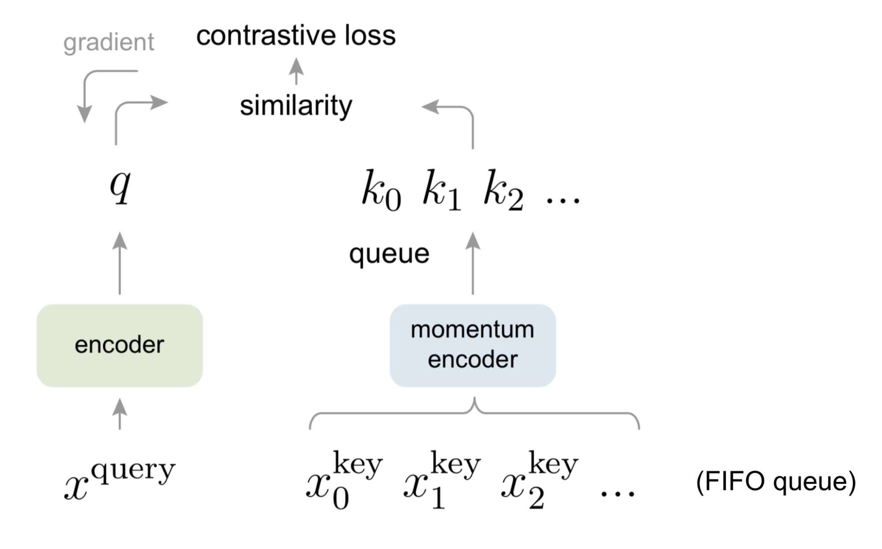
Contrastive Learning
A simple framework for contrastive learning of visual representations. (SimCLR) [2]
Positive Pair
Negative Pair
Contrastive Learning [1]
[1] Tian, Yonglong, Dilip Krishnan, and Phillip Isola. "Contrastive multiview coding." European conference on computer vision. Springer, Cham, 2020.
[2] Chen, Ting, et al. "A simple framework for contrastive learning of visual representations." International conference on machine learning. PMLR, 2020.
[3] He, Kaiming, et al. "Momentum contrast for unsupervised visual representation learning." Proceedings of the IEEE/CVF conference on computer vision and pattern recognition. 2020.
Momentum Contrast for Unsupervised Visual Representation Learning. (MoCo)[3]

Slide 5
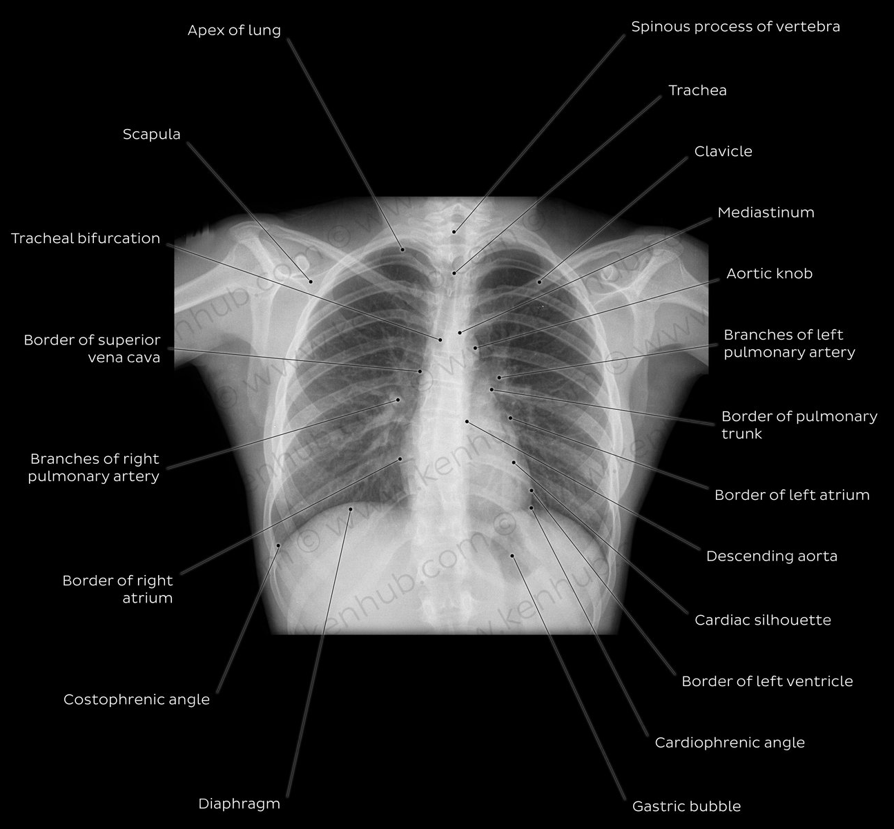
CHALLANGES
Do not account for anatomical context
Rely on fix-sized input, resize medical images may introduce undesired artifacts
TO OVERCOME
Represent 3D image as a graph of patches centered at landmarks defined by an anatomical atlas.
Propose a hierarchical model to learn representations at patch level and graph level
Chest X Ray Radiological anatomy. [1]
[1] https://www.kenhub.com/en/library/anatomy/medical-imaging-and-radiological-anatomy

Slide 6
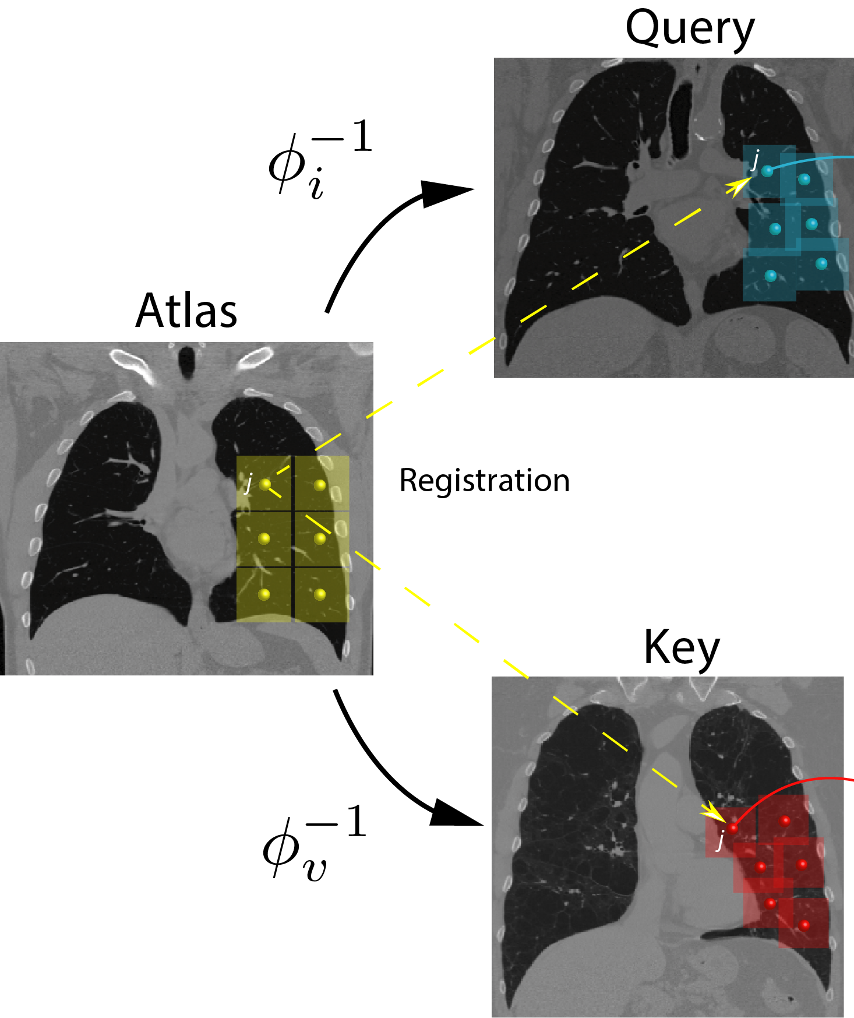
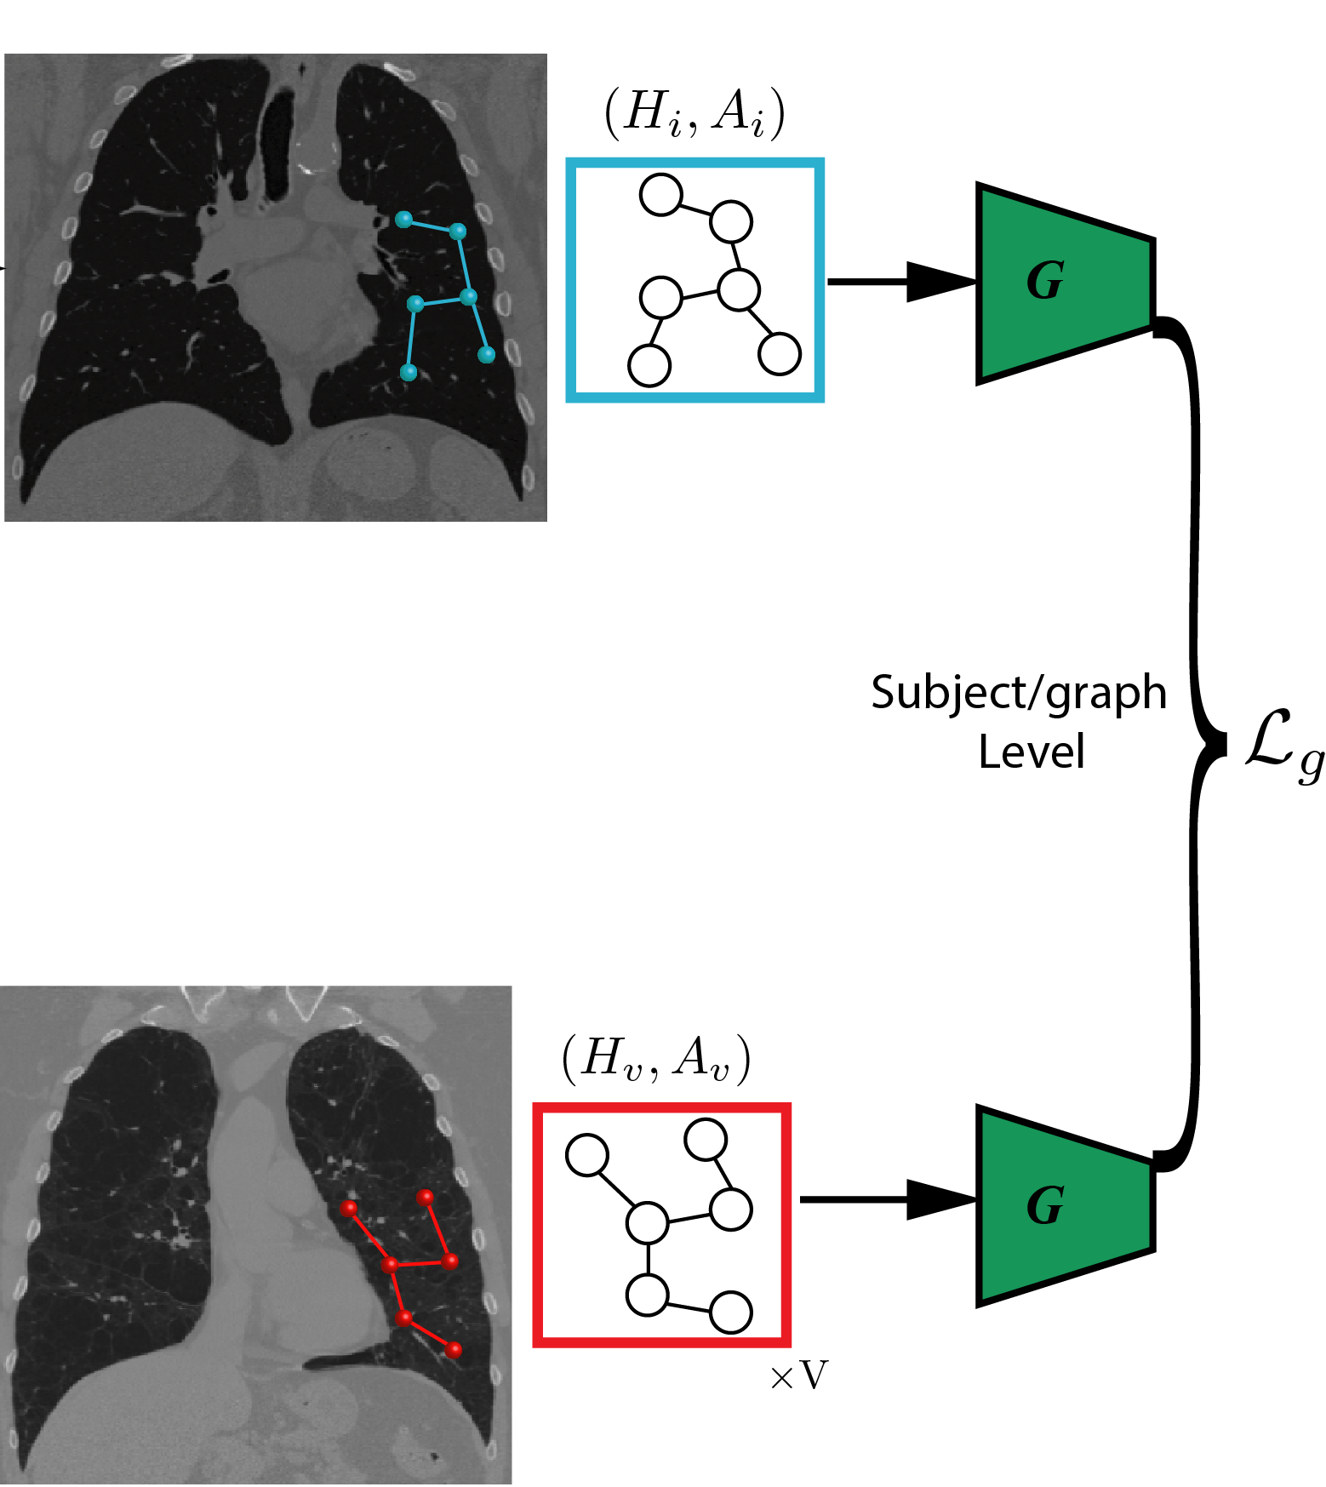
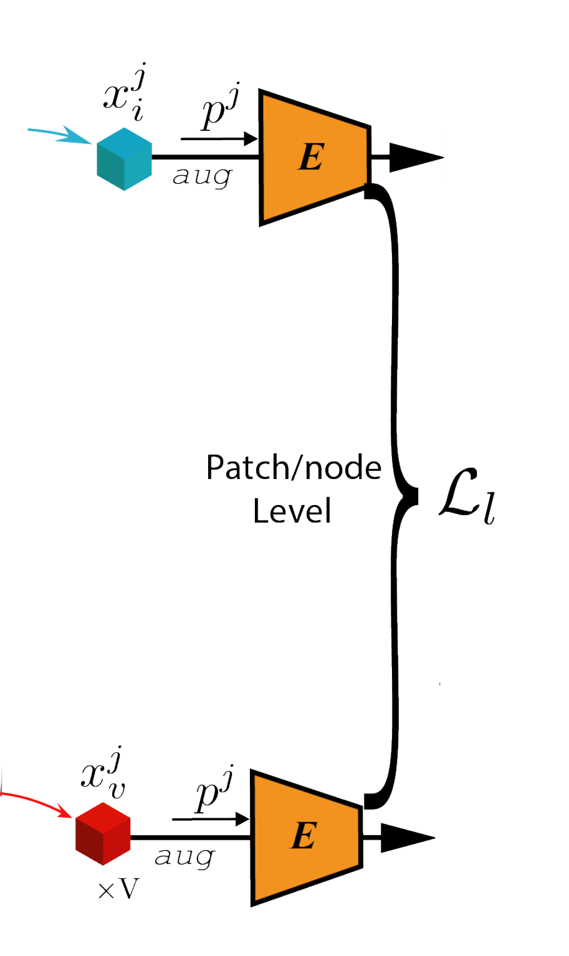
Methodology
Registration
Patch-level Contrastive Learning
Graph-level Contrastive Learning

Slide 7
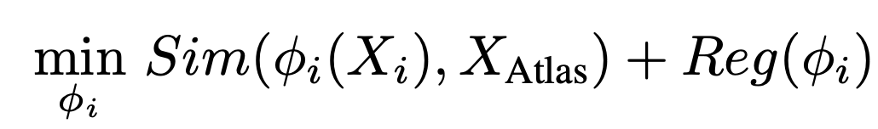
Image Registration
Divide the atlas image into a set of N equally spaced 3D patches with some overlap.
Map all these patches to their corresponding location for each patient.
Fitting subject-specific transformation
Image of patient i
Regularization, to make sure the transformation smooth enough

Slide 8
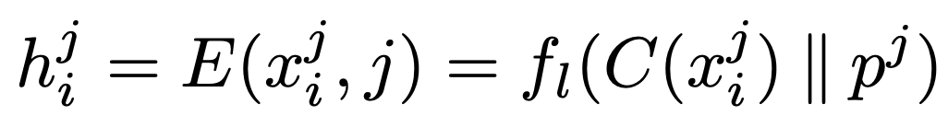
Learning Patch-level Representation
Conditional Encoder
Patch-level Representations
Patch j of subject i
Location of Patch j
Patch-level Representations
Registration
Patch-level Contrastive Learning

Slide 9

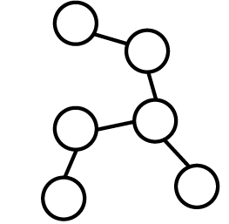
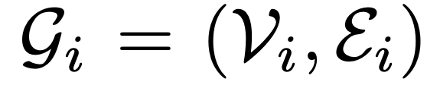
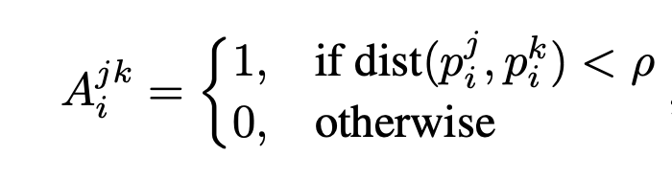

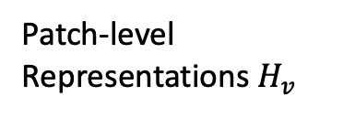
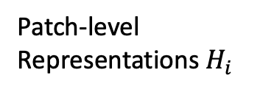
Learning Graph-level Representation
Image
Patch-level Representations${ H}_{i}$
Patch
Edge Connectivity between patches
Adjacency matrix
Patch-level Representations${ H}_{v}$

Slide 10
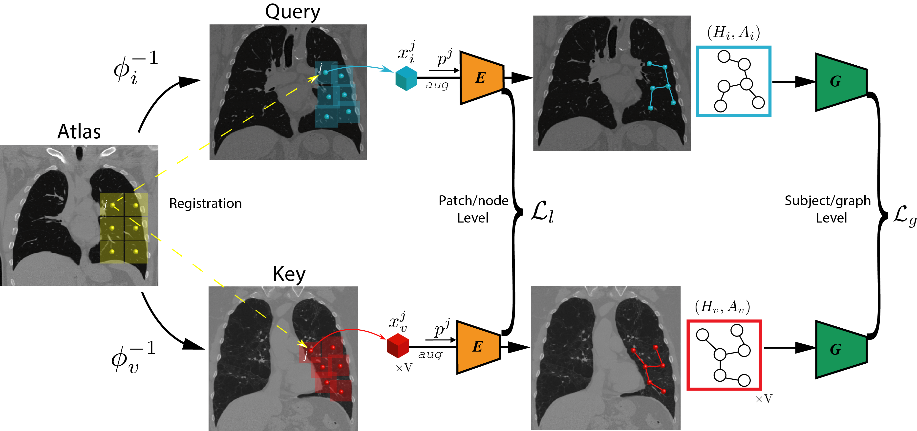
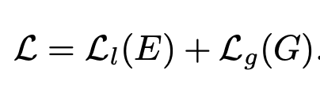
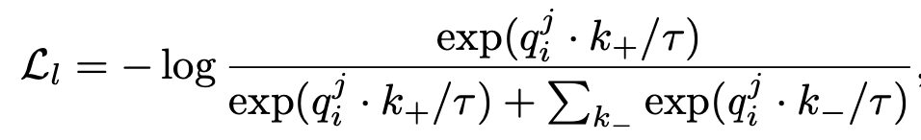
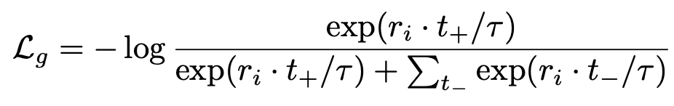
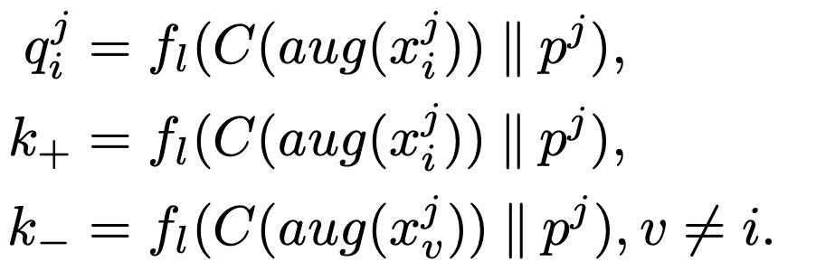
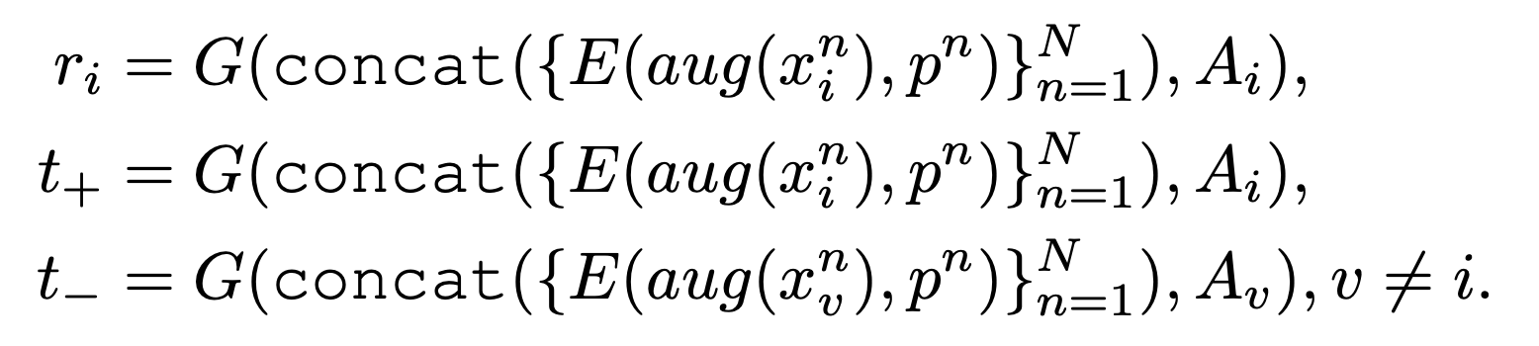
Loss Function
InfoNCE loss[1],
a loss function for contrastive training
Positive Pair
Negative Pair
[1] Oord, Aaron van den, Yazhe Li, and Oriol Vinyals. "Representation learning with contrastive predictive coding." arXiv preprint arXiv:1807.03748 (2018).

Slide 11
Hyperparameter
Patch size (32×32×32), Step size -> control the number of patches
Number of negative samples (4096)
GCN: ρ is the threshold hyperparameter -> controls the density of graph
InfoNCE loss: τ denotes the temperature hyperparameter (0.2)
Image Augmentation
Random elastic transformation
Random Gaussian blur
Random contrast adjustment

Slide 12
Experiments and Results

Slide 13
Datasets
COPDGene dataset
COPD is a lung disease that makes it difficult to breathe.
Designed to identify the underlying genetic factors of COPD.
Use 3D thorax CT images of over 9k subjects from this dataset.
MosMed dataset
Use 3D CT scans of over 1k subjects from the MosMed dataset.
Five-grade categorical variable based on the severity of lung tissues abnormalities related with COVID-19.
COVID-19 CT Dataset
Selected from multiple publicly available COVID-19 datasets.
Multi-hospital 3D thorax CT images of 80 subjects.

Slide 14
Quantitative Evaluation
COPDGene dataset
Perform self-supervised pre-training, freeze the extracted subject-level features.
Train a linear regression model to predict two continuous clinical variables:
FEV1pp, FEV1/FVC
Train a logistic regression model for each of the six categorical variables:
Global Initiative for Chronic Obstructive Lung Disease (GOLD) score
Centrilobular emphysema (CLE) visual score
Paraseptal emphysema (Para-septal) visual score
Acute Exacerbation history (AE history)
Future Acute Exacerbation (Future AE)
Medical Research Council Dyspnea Score (mMRC)
MosMed dataset
Same procedure as training COPDGene dataset
Train a logistic regression model to predict five-grade categorical variable

Slide 15
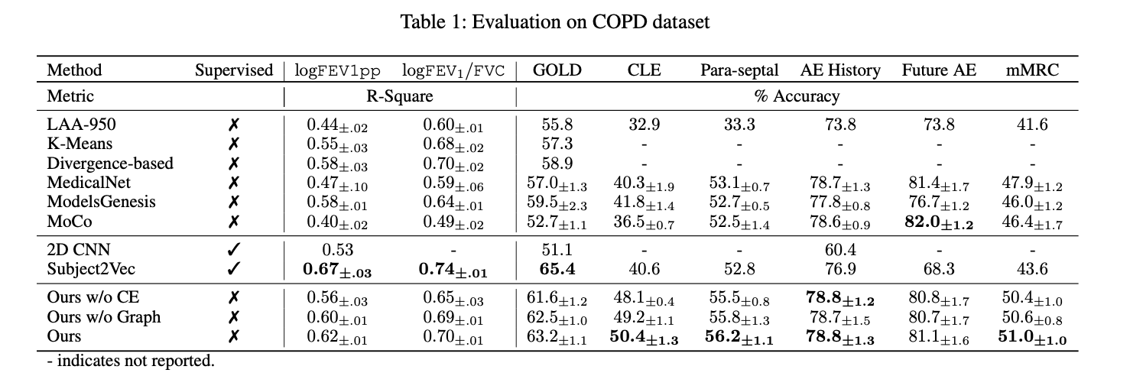
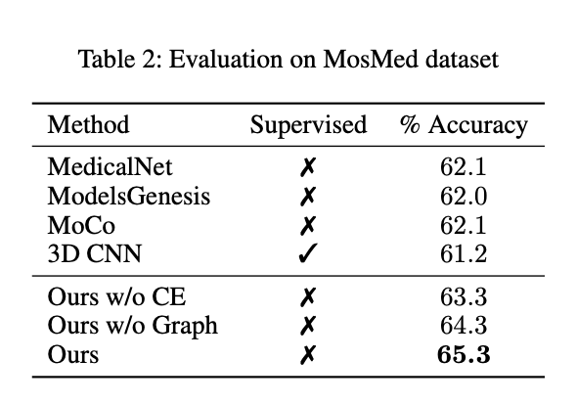
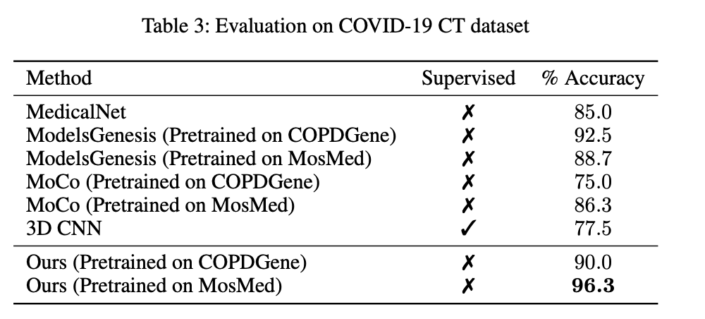
Result

Slide 16
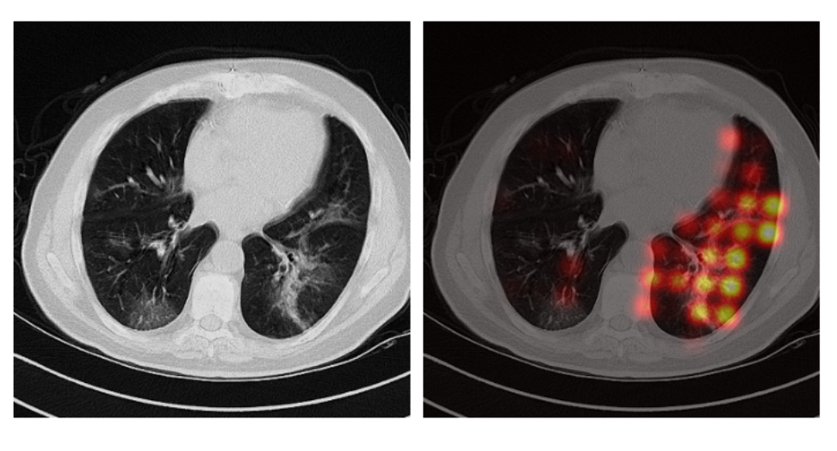
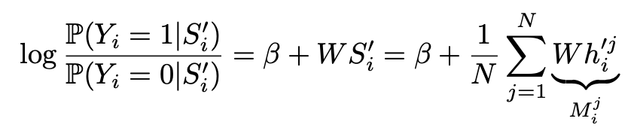
Model Explaination and Visualization
Class activation maps (CAM)
Fit a logistic regresssion model for binary classification
Subject Level Feature
Activation score of anatomical region j to the target classfication
An axial view of the activation heatmap on a COVID-19 positive subject in the COVID-19 CT dataset.

Slide 17
Take Home Message
Contrastive Learning is to learn such an embedding space in which similar sample pairs stay close to each other while dissimilar ones are far apart.
Images can be viewed as a set of nodes where nodes corresponds to image patches.
Sometimes big model is hard to training because of the excessive memory footprint. Using an interleaving algorithm that alternates the training between different model parts to solve this issue.

Slide 18
Discussion
The model incorporates richer context information -- anatomical context
The model explanation and visualization could be used to show how the model made the decision.
The model supports images with arbitrary sizes in full resolution by design, which may prevent information loss and image distortion during pre-processing.
Directly using Average Pooling to get subject-level representation might lose important information in specific nodes.

Slide 19
Citation
[1] Sun, Li, Ke Yu, and Kayhan Batmanghelich. "Context matters: Graph-based self-supervised representation learning for medical images." Proceedings of the... AAAI Conference on Artificial Intelligence. AAAI Conference on Artificial Intelligence. Vol. 35. No. 6. NIH Public Access, 2021.
[2] Pathak, D., Krahenbuhl, P., Donahue, J., Darrell, T., Efros, A. A., 2016. Context encoders: Feature learning by inpainting. In: Proceedings of the IEEE Conference on Computer Vision and Pattern Recognition. pp. 2536–2544. URL https://arxiv.org/abs/1604.07379.
[3] Tian, Yonglong, Dilip Krishnan, and Phillip Isola. "Contrastive multiview coding." European conference on computer vision. Springer, Cham, 2020.
[4] Chen, Ting, et al. "A simple framework for contrastive learning of visual representations." International conference on machine learning. PMLR, 2020.
[5] He, Kaiming, et al. "Momentum contrast for unsupervised visual representation learning." Proceedings of the IEEE/CVF conference on computer vision and pattern recognition. 2020.
[6] https://www.kenhub.com/en/library/anatomy/medical-imaging-and-radiological-anatomy
[7] Oord, Aaron van den, Yazhe Li, and Oriol Vinyals. "Representation learning with contrastive predictive coding." arXiv preprint arXiv:1807.03748 (2018).
[8] Doersch, C., Gupta, A., Efros, A. A., 2015. Unsupervised visual representation learning by context prediction. In: Proceedings of the IEEE International Conference on Computer Vision. pp. 1422–1430. URL https://arxiv.org/abs/1505.05192.

