Slide 1
8th Sense
Alpha Report
Daniel Hook, Marian Ludwig, Felix Neumeyer, Jakob Raith

Slide 2
Overview
Target
Problems
Solutions
Demo Alpha version

Slide 3
Targets
Shader optimization
Sound effects, Music
Story
Refine UI
Tiny bots reset player
Improve Enemy AI
Several levels
Save/Load spawn points

Slide 4
Problems
Many levels not polished enough
A lot of script changing for save/load mechanic
Tiny bots + NavMesh + Rigidbody results in some bugs

Slide 5
Solutions
Shader and sounds
Shader are finished
Soundscape with a little editing
Story
Story prototype condensed to written dialogue

Slide 6
Solutions
Levels & Gameplay
Level design finalizing on playtesting, iterating and polishing later

Slide 7
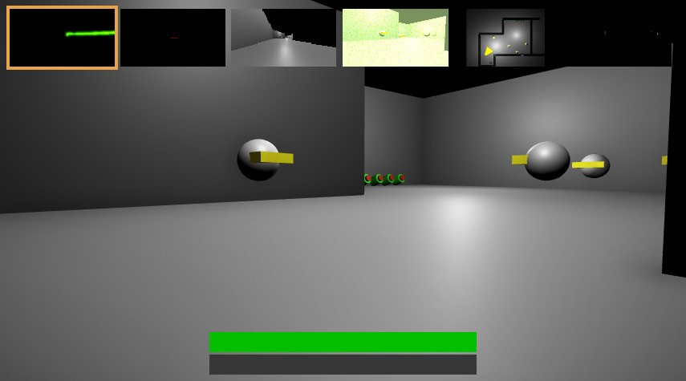
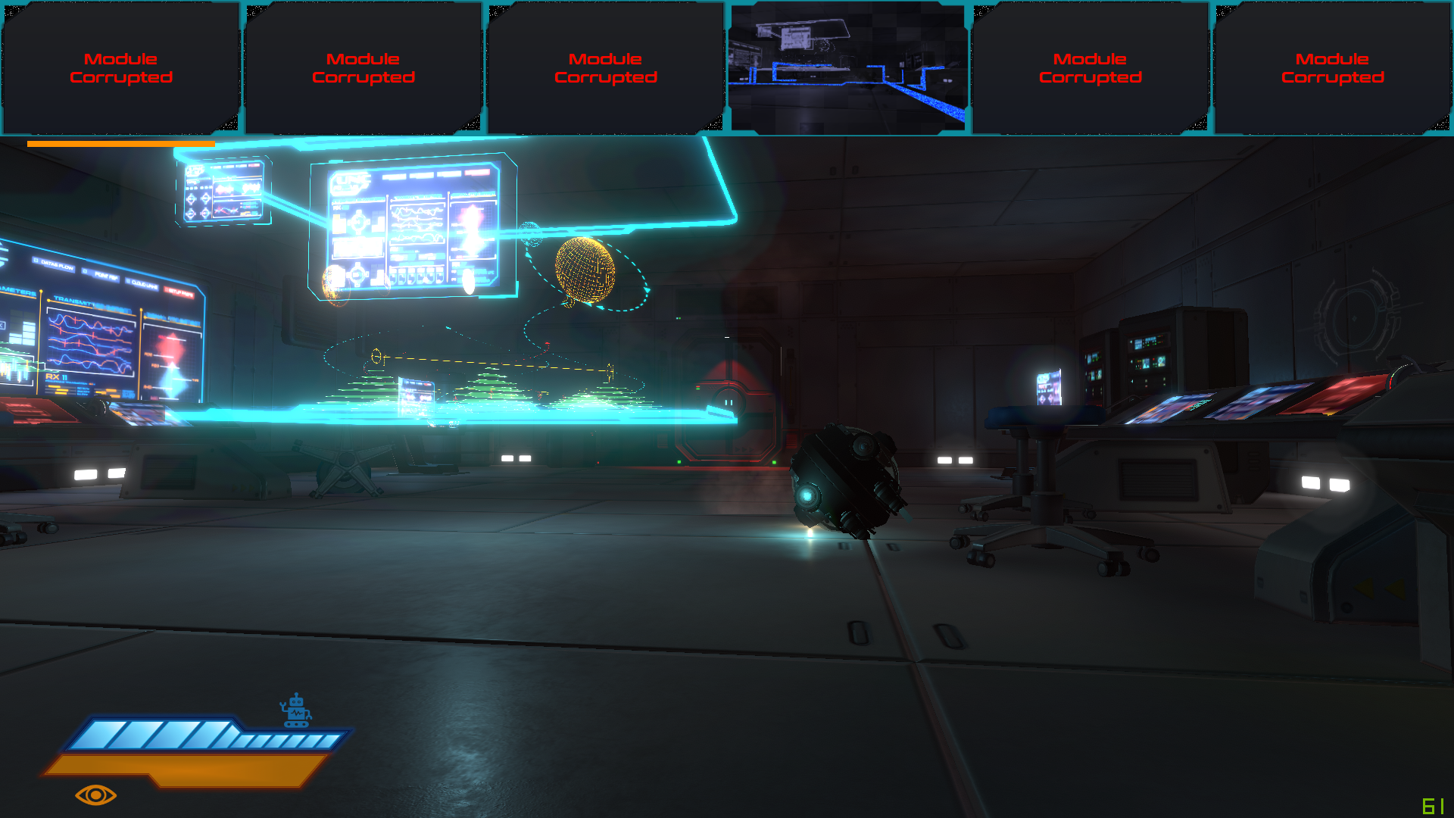
Early Prototype vs. Alpha Release

Slide 8
Demo

Slide 9
Thank you for your attention

