Slide 1
8th Sense
Final Release
Daniel Hook, Marian Ludwig, Felix Neumeyer, Jakob Raith

Slide 2
Overview
Timeline
Achievements
Setbacks
Final result
Demo

Slide 3
Timeline

Slide 4
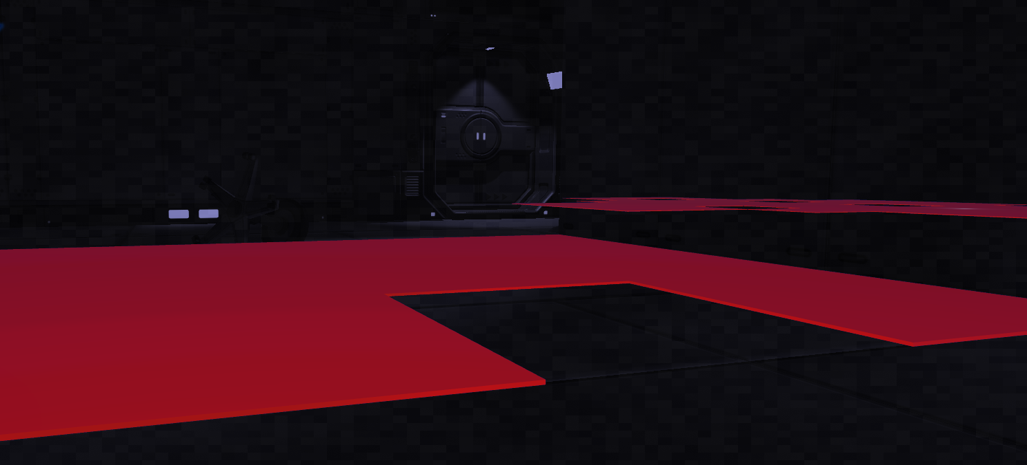
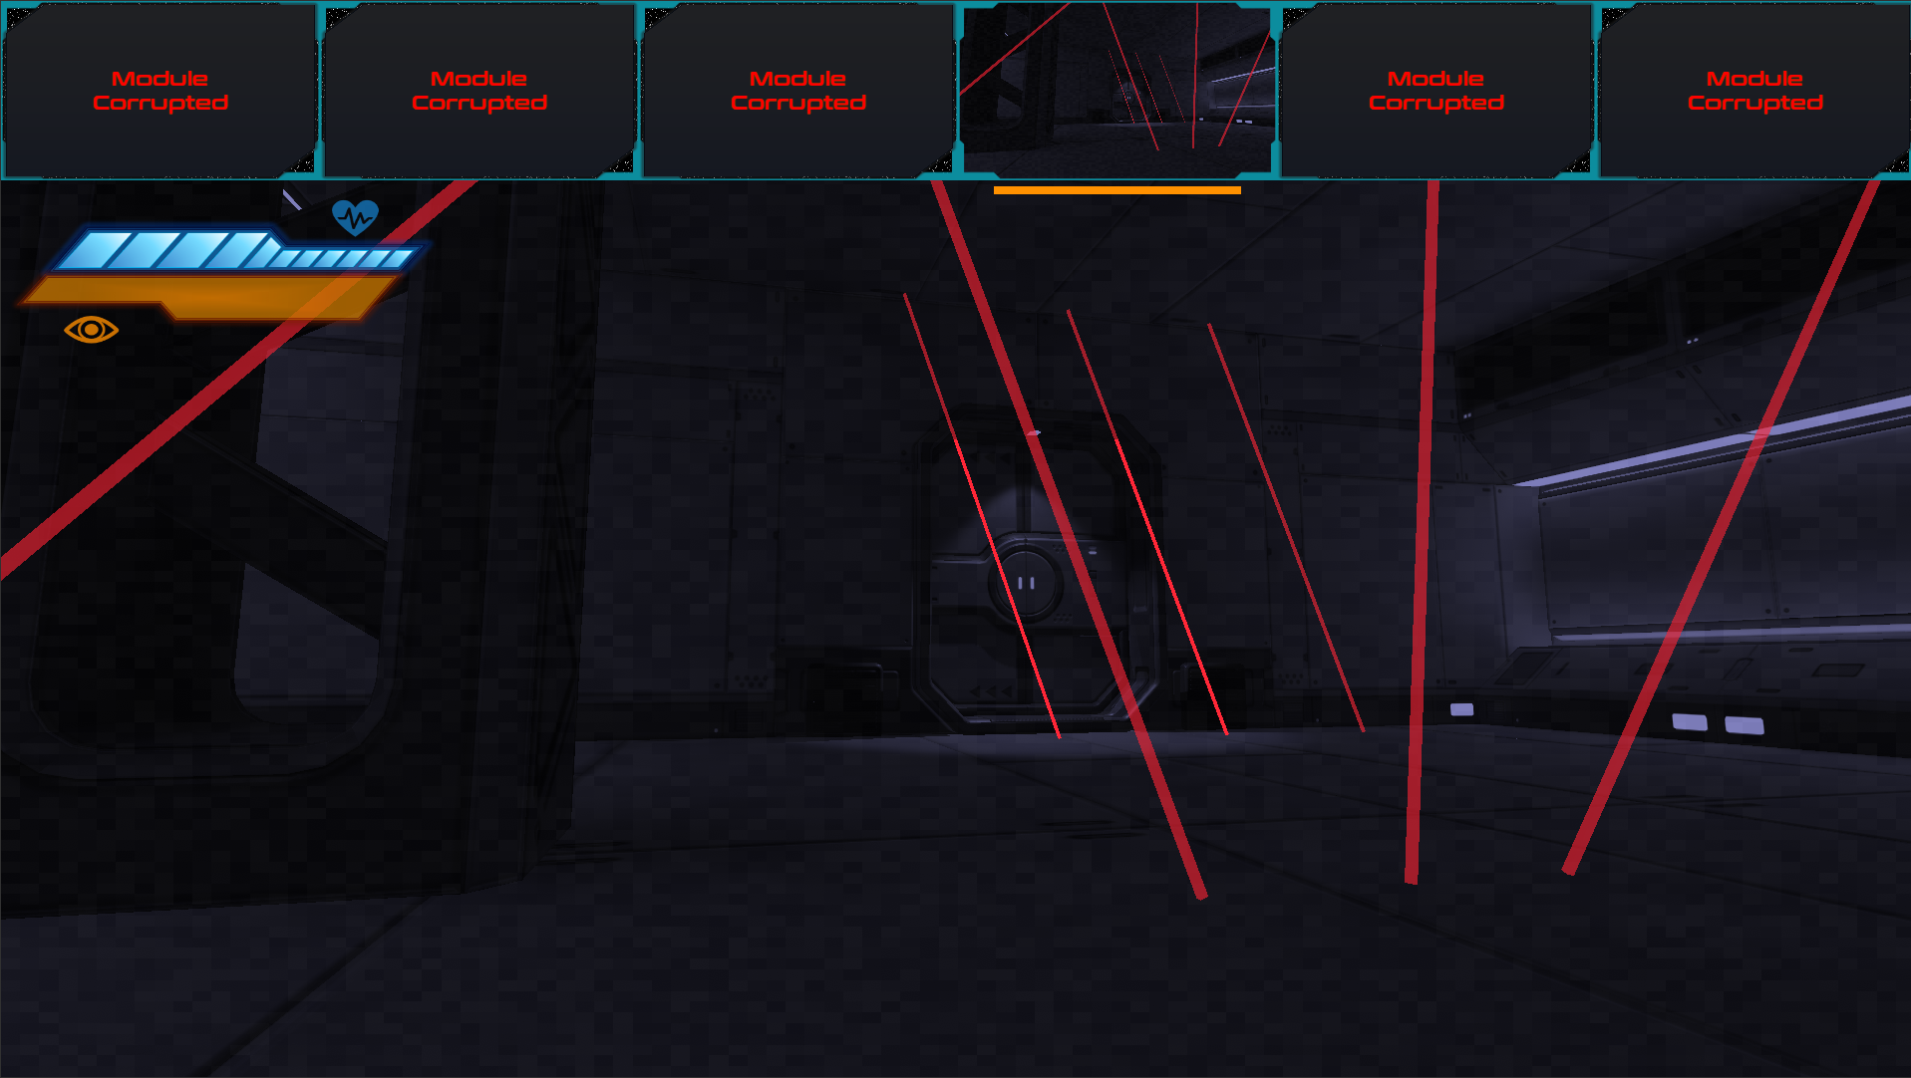
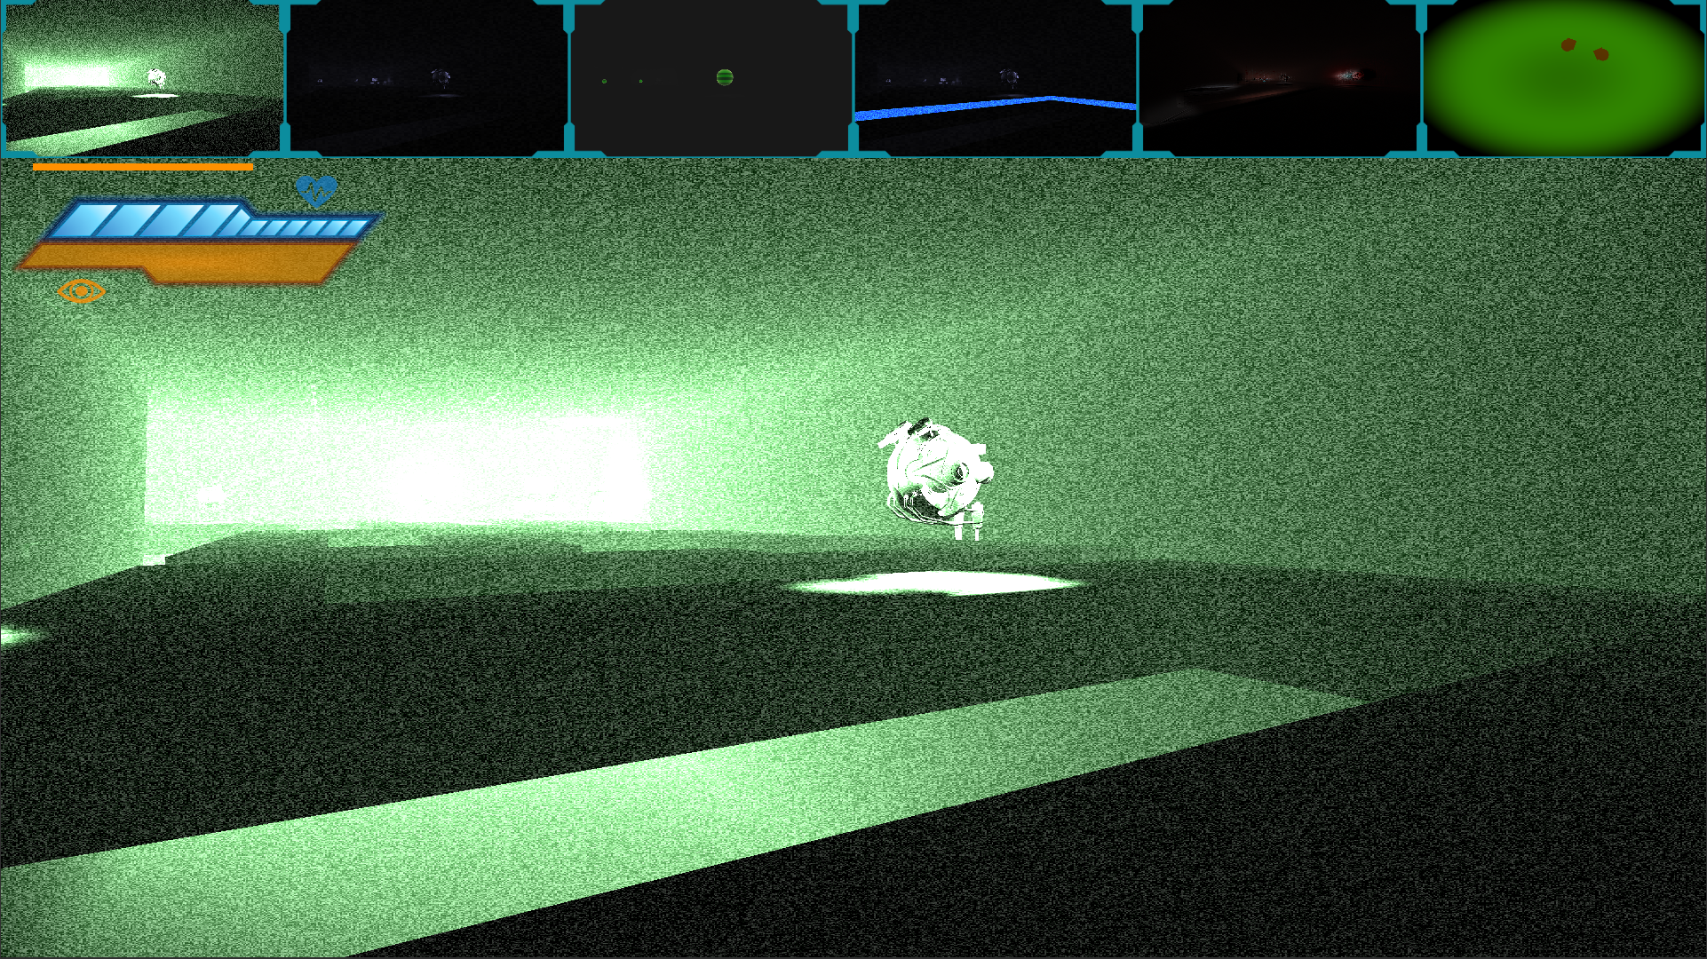
Achievements
Shaders
Performance improvements
Functional Enemy AI
Core mechanics
Story
Polished levels

Slide 5
Setbacks
Level design difficult
Need for more/better tutorials
Performance problems
Putting everything together

Slide 6
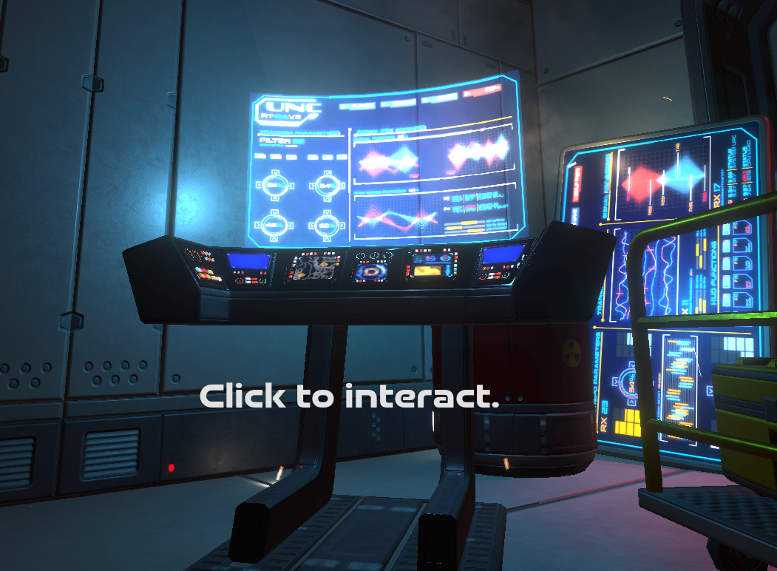
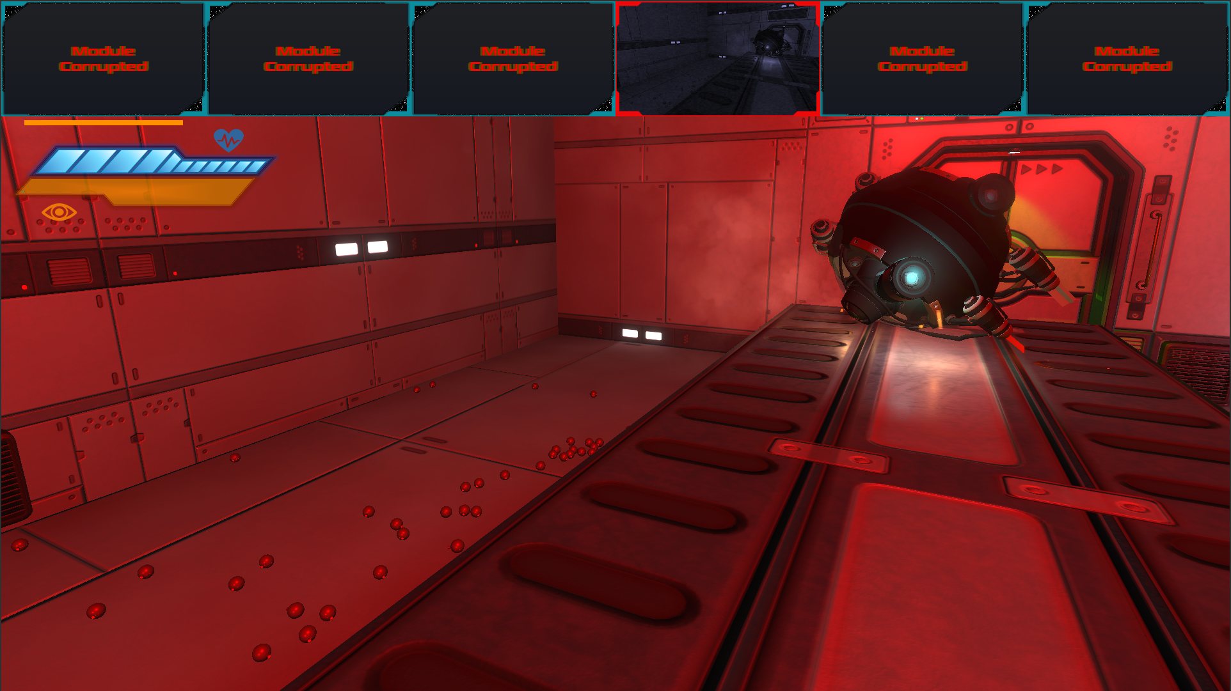
Final result
High target almost completely reached
15 almost fully polished levels
Story implemented
Added more tutorials and user friendly introduction into story and game
Game runs pretty smoothly even on older hardware

Slide 7
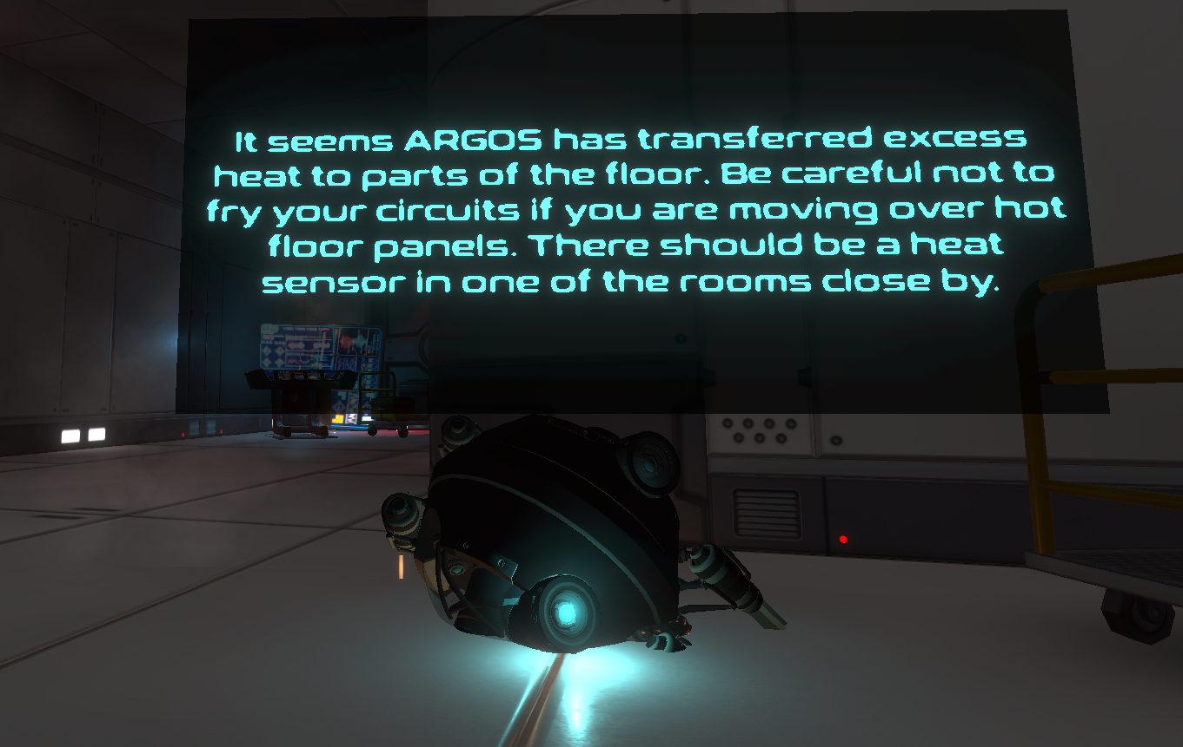
Final result - What could have been better?
Even more polishing: Game design, Interior
No voiceover, merely cinematic elements implemented

Slide 8
Demo

Slide 9
Thank you for your attention

