Slide 1
Towards a Distributed Digital Twin of the
Agricultural Landscape
Mandana Moshrefzadeh ^{1,2}
Munich, 3. June 2020
Co-authors:
Thomas Machl ¹
David Gackstetter ¹
Andreas Donaubauer ²
Thomas H. Kolbe ^{1,2}
1 TU Munich, Hans Eisenmann-Forum
2 TU Munich, Chair of Geoinformatics
21st Annual International Digital Landscape Architecture Online Conference
Notes:
Hi, I‘m Mandana Moshrefzadeh presenting „Towards a Distributed Digital Twin of the Agricultural Landscape”
This is a joined work with my colleagues, TM, DG, Dr. AD, Prof. TK.

Slide 2
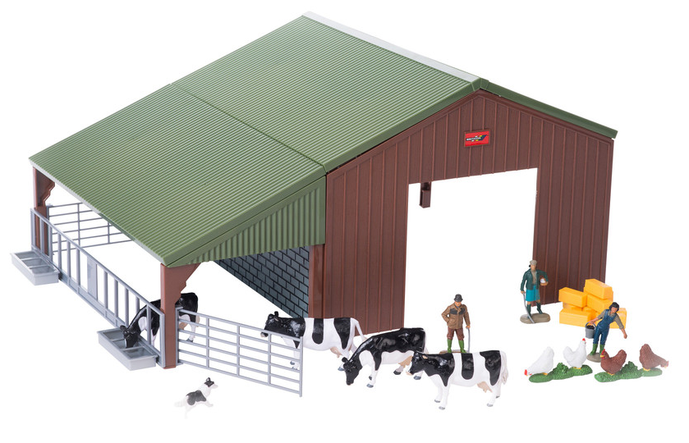
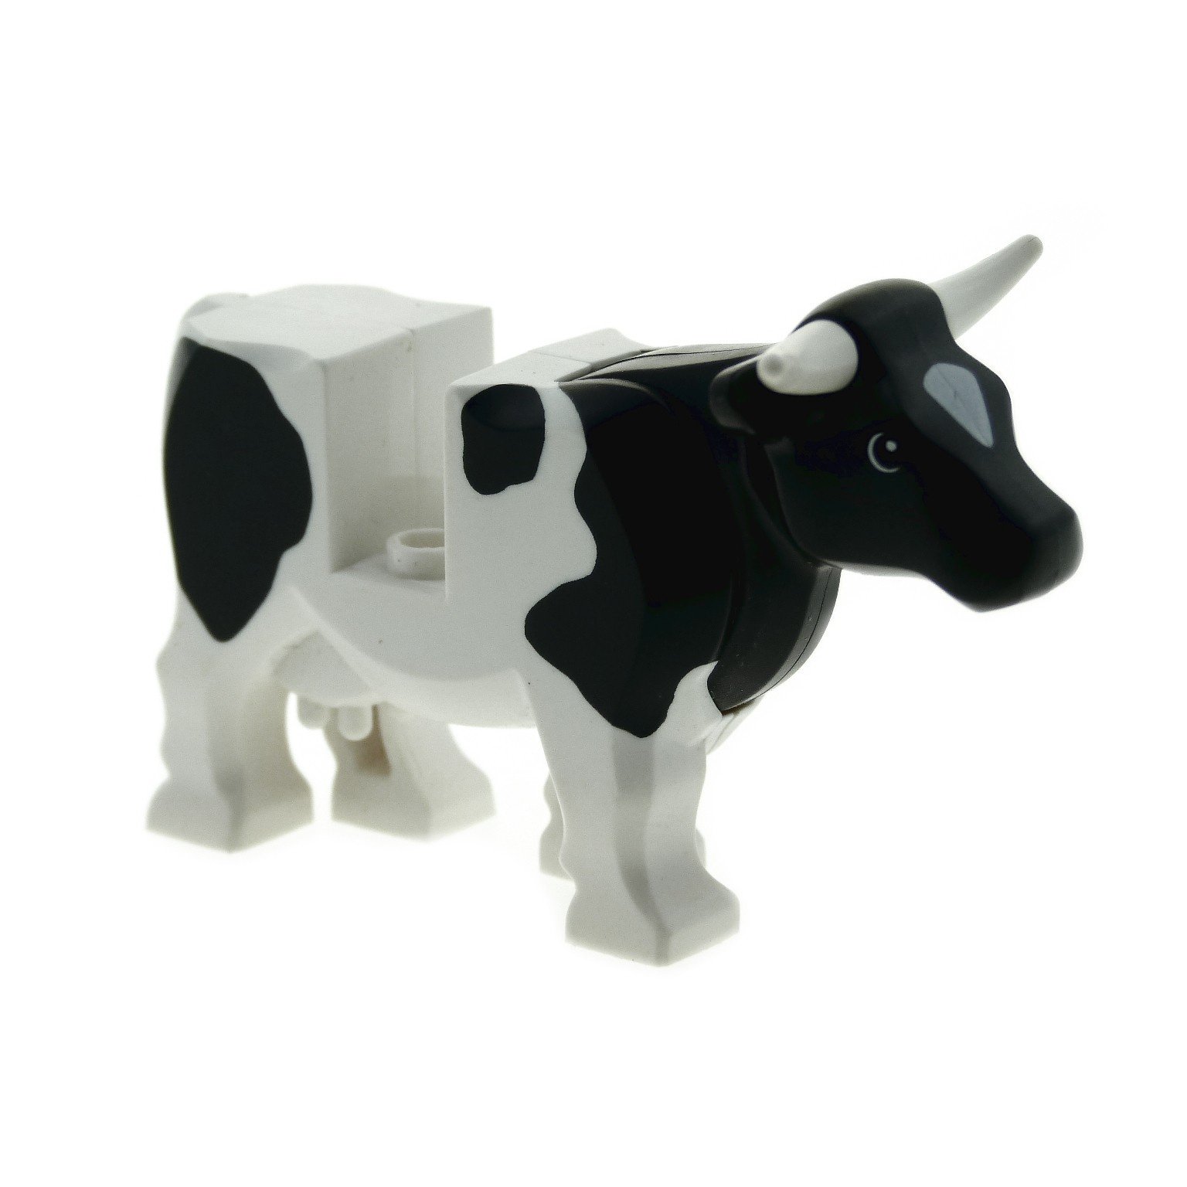
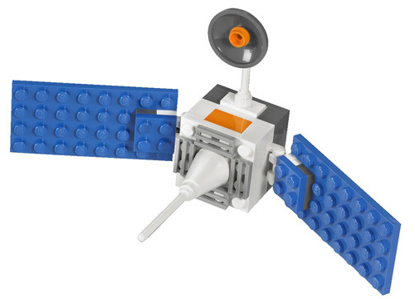

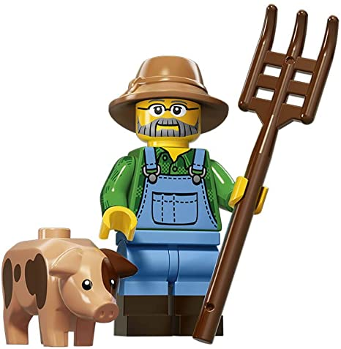

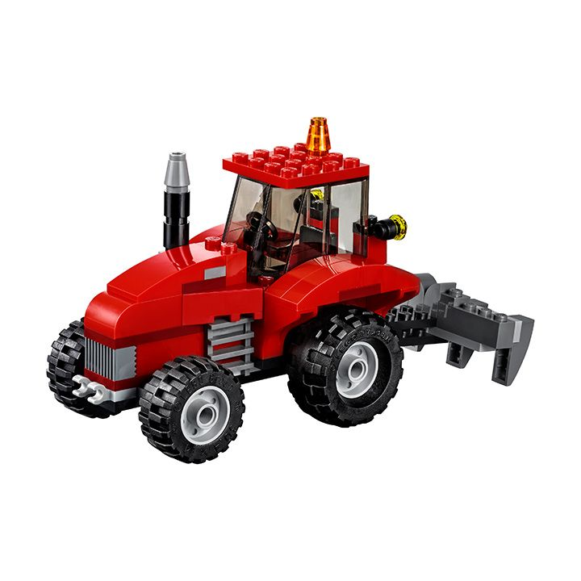
Resource Management in the Agricultural Landscape
Two key challenges:
Lack of transparency
Data integration in a multidisciplinary, distributed environment
Source: shopping website of Lego
Stakeholder 3
Stakeholder 1
Stakeholder 2
To address these challenges, we introduce the notion of distributed Digital Twins of the cultural landscape.
We aim at optimizing the data integration process as well as the whole process of stakeholder engagement, for example, as required in any Geodesign process.
Notes:
Agricultural landscapes, form a complex system of interacting and changing elements. They involve stakeholders from varying disciplines each with their own resources, perspectives, roles, requirements, and so on, who need to closely interact with each other.
To help stakeholders establish a common understanding of the landscape and its components in order to reach coordinated decision-making, we should make the resources available to them in a form that meets their needs.
This requires integration of scattered information from distributed sources. To do so, we often face two main challenges:
The 1st is Lack of transparency: Different stakeholders have different information about the same real-world objects. They typically do not know what data is available from others.
The 2nd challenge is the Data integration in a multidisciplinary and distributed environment: Different stakeholders do not always define and refer to a specific real-world object in the same way. This makes integration of information difficult and causes problems when linking the data of multiple actors.
To address these challenges, we introduce the notion of distributed Digital Twins of the cultural landscape, which aims at optimizing the data integration process as well as the whole process of stakeholder engagement required in any Geodesign process

Slide 3
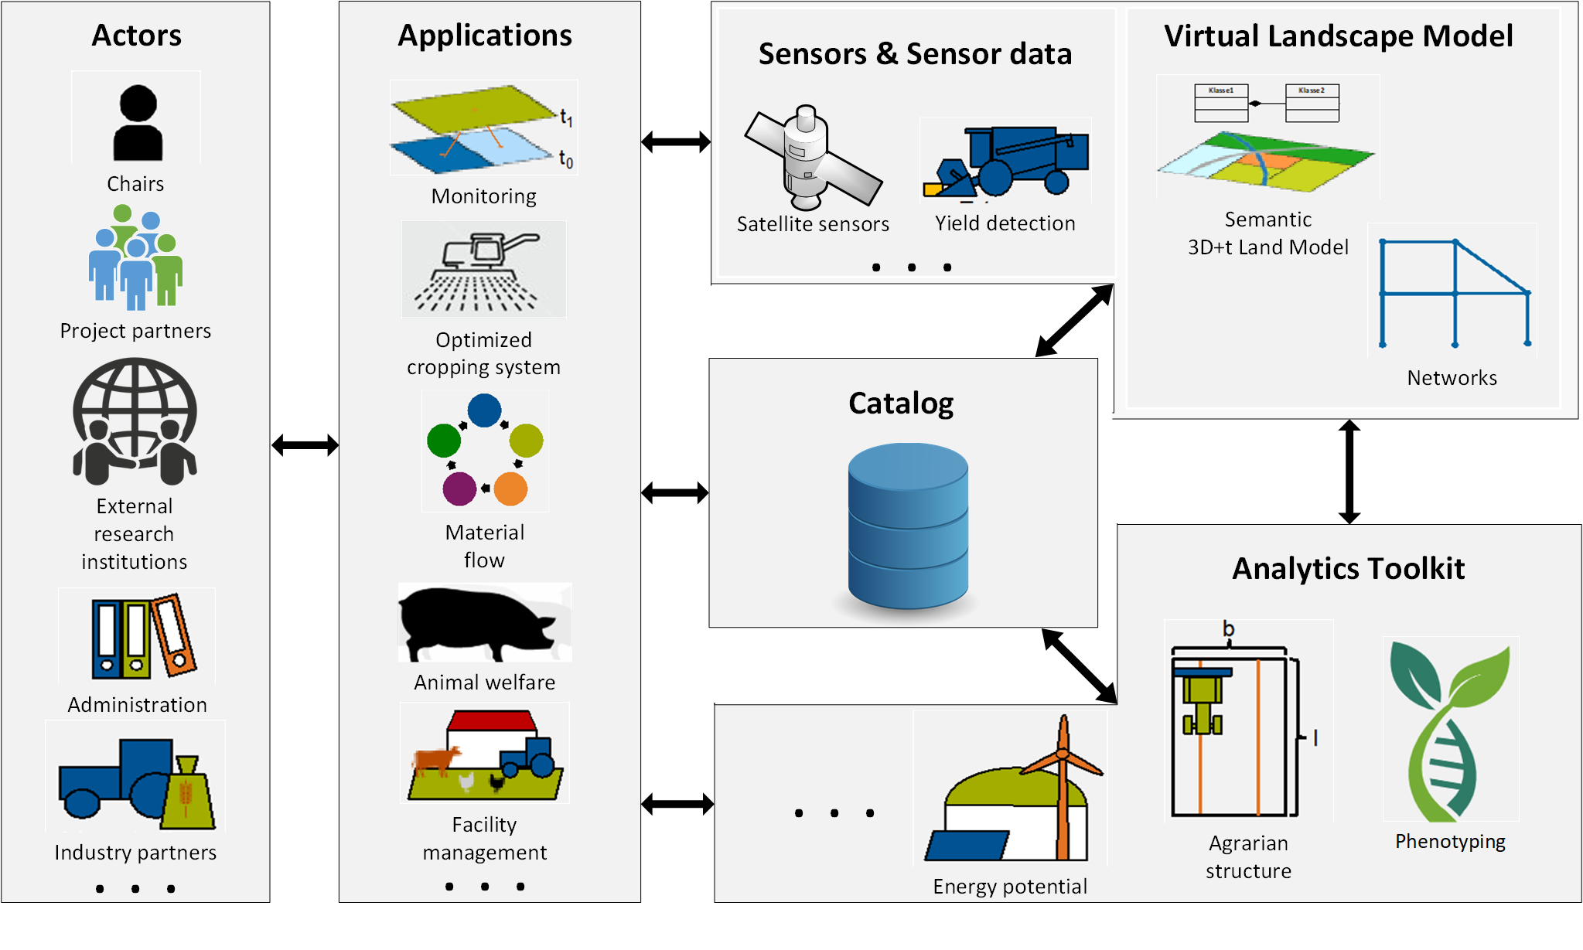
Smart Rural Area Data Infrastructure - SRADI
Multidisciplinary information infrastructure
  Multiple Stakeholders – Multiple Applications – Distributed Information Resources
  Consequent usage of international standards of the Open Geospatial Consortium (and others) to facilitate interoperability
  No single platform! – rather an infrastructure of platforms / resources
Actors
Value
Adding
Services
Distributed Digital Twin
Catalog
Core component of the distributed Digital Twin
Establishes semantic relations between diverse distributed resources
Manages information on “individual physical things” level
Manages stakeholders and organizations
Notes:
This is part of the concept „Smart Rural Area Data Infrastructure” (SRADI), that we have developed. SRADI is a multidisciplinary information infrastructure which handles various stakeholders, multiple applications and distributed information resources.
Interoperability, is an important aspect of SRADI achieved by using international standards such as the ones from OGC. More importantly, SRADI is not a single platform, but rather an infrastructure of various platforms and resources.
The SRADI concept consists of 3 main pillars. The actors or stakeholders from various disciplines, the applications which form an interface between actors and the other components and the other components put together which make the distributed digital twin.
Here I focus on the Catalog component which is the core component of the distributed DT.
It establishes semantic relations between diverse distributed resources
Unlike typical catalogs, in for example spatial data infrastructures, it manages not only datasets and services but also “individual physical things”.
It also manages stakeholders and organizations

Slide 4
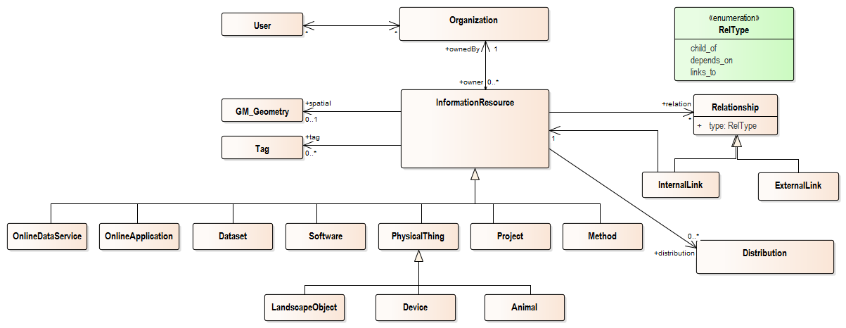
Catalog of the Distributed Digital Twin
Covers datasets, services, all individual physical things, organizations and stakeholders
Specialized information resource types
Improved structuring and retrieval of information in the catalog
Possibility to register physical objects
All landscape objects have stable identifiers
Relationships between resources of the distributed Digital Twin and with external resources is represented by three different types
Notes:
So, what is special about our catalog?
Information resource types are specialized. This means that our catalog assembles more diverse resources relevant to distributed DTs of agricultural landscapes such as online services and applications, datasets, software, projects, methods, and also physical things including landscape objects, devices, or even animals.
By explicitly defining the type of a resource, we add specific semantics related to the DT of the agricultural landscape which improves the structuring and retrieval of information in the catalog.
Another feature is the links between resources. Relationships between resources of the distributed DT and with external resources can be represented and specialized by three different types: child_of, depends_on and links_to.
Removed part due to the time shortage:
We can register individual physical objects.
For the landscape objects, we use data provided by the government (geo base data) where all objects have stable identifiers. This helps for stable and sustainable linking of various resources to each other through the landscape objects.

Slide 5
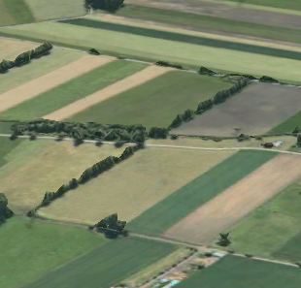
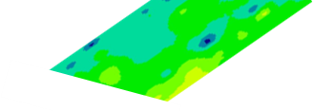
ID Parcel_BY1234
ID Sensor_SQ17
Group: Landscape Object
Land parcel BY1234
Group: Device
Soil quality; Sensor_SQ17 Placed within land parcel BY1234
Owner: Faculty Administration
Geometry: 0103000020797F00000100000005000000295C8FC2F5A842C0EC51…
Area: 0.76 ha
Morphology: Rectangular
links_to
BY1234
Owner: Chair of Soil Science
Brand: XXX
Model: XY019s
Location:
<49.643301, 11.976554, 418>
Depends_on
Depends_on
links_to
ID Extension_9876
ID Extension_4567
ID SensorService_23
Group: Dataset
Yield data for land parcel BY123g
In raster format
Group: Dataset
Economic data for land parcel BY1234
Group: Online Service
Sensor data platform using an OGC sensorThings API compliant software
Owner: Chair of Agricultural Production and Resource Economics
Distance_from_main_road: 2.6 km
Appraised_value: 36480 €
Crop_yield: 8000 kg/ha
Owner: Chair of Soil Science
Yield:
Owner: Agricultural Research Center
Base_URL: http:// demo.com
List of registered sensors: http://demo.re.com
Notes:
Here is an example.
Imagine these are land parcels where some agricultural research experiments are carried out.
Let’s have a look at one of these parcels:
In the catalog this parcel is registered as an individual entry with the resource type “LandscapeObject” and it is owned by the faculty administration. Some additional information such as geometry is also given for this entry.
For the same parcel, two datasets owned by two different chairs exist. They are represented by two additional catalog entries of type “Dataset” which have their own corresponding owners. Here comes the interesting part:
These are linked to the catalog entry of the land parcel using outgoing relationships of type “Depends_on” which means these two resources are dependent on this particular land parcel.
In addition, there is a soil quality sensor installed on the land parcel that belongs to another chair. This resource has the type “Device”.
The sensor data from this device, are stored in a sensor data platform operated by the Agricultural Research Center with the group type “Online service”.
Now, the resource representing the sensor device is linked both to the land parcel and the sensor data platform which shows the linkage of independent resources.
Please note each organisation manages the access permission related to their own resources.

Slide 6
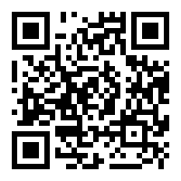
Conclusions
Information on real world objects in agriculture is distributed among various stakeholders and systems
SRADI is a concept for setting up a Distributed Digital Twin of the agricultural landscape
Core of the Distributed Digital Twin is a resource registry / catalog
Developed a metadata model supporting management of distributed resources
Provided links between real-world objects and real time information from different sources
Communication and data modeling is based on open standards e.g. ISO, OGC and W3C (DCAT, DCAT2, RDF) resulting in interoperability
Demo video of the
Catalog instance:
https://bit.ly/3eGgwA1
Notes:
A short wrap-up
Information on real world objects in agriculture is distributed among various stakeholders and systems.
SRADI manages this distributed information by providing a Distributed Digital Twin of the agricultural landscape.
We developed a metadata model supporting management of distributed information resources with different kinds of data, format, ownership, privacy level, etc.
This metadata model as the basis of a catalog, promotes transparency and information integration.
Due to its unique ability to link landscape objects and owners of information on these objects, the DT of the agricultural landscape can also improve data preparation and stakeholder engagement within Geodesign processes.
A DT can only be created if the components are able to interoperate. Communication and data modeling is therefore based on open standards such as the ones from ISO, OGC and W3C such as DCAT2 which we specifically took into account while designing our metadata model.
If you would like to see more, I prepared a short demo video of our catalog instance so that you can see how it functions.
Thank you all for your attention. [1 min, 20 sec]

