Slide 1
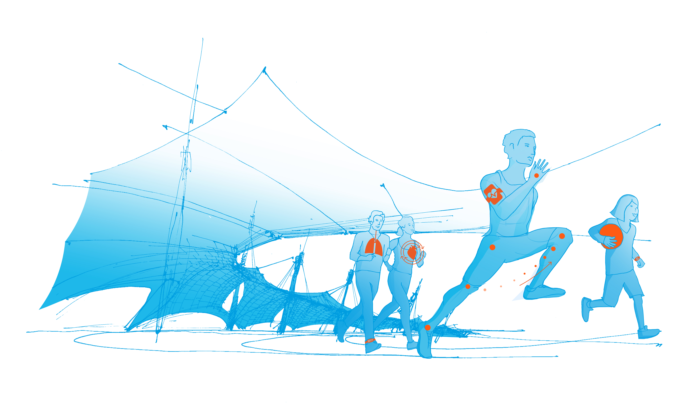
Summerschool
“Sustainable Sport/Science” within the joint doctoral program “Problemorientierte Sportwissenschaft” of the University of Bern, Karlsruhe Institute of Technology, Eberhard Karls Universität Tübingen and the Technical University of Munich
TUM Department of Sport and Health Sciences
Notes:
Dear doctoral candidates from the universities of Bern, Karlsruhe, Tübingen and, of course, TUM – as the Speaker of the Graduate Center it is with great pleasure that I welcome you to the Summerschool “Sustainable Sport/Science”
Before I hand over to Felix to start the program, I would like to introduce you a bit to our Institution – as its history and future tells you a little bit about the topic of this joint doctoral program and possibly “sustainability” as well.

Slide 2
Reflection Exercise
We had four different activities:
  The Workshops
  The Keynotes
  The Arbeitskreise
  Informal exchange (e.g., coffee breaks, train ride, Biergarten….)
What insights did you get, what did you learn?
Are these “just” insights, or do they (also, further) ask you to act?
with respect to
1 | 2 | 3
your thesis, work towards doctorate? | … teaching and supervising, advising students? | … outside immediate research and teaching (project management, career, other work…)

Slide 3
laws of sticky notes
First Law:
One idea per post-it!
Second Law:
Tear off sideways, not bottom-up!

Slide 4
Colour = Activitiy
  The Arbeitskreise
  The Keynote
  The Workshops
  Informal
  exchange

