Slide 1
Graph diffusion models
Computer Aided Medical Procedures

Slide 2
Outline
Introduction
Presentation of three state of the art models
Experimental results
Discussion

Slide 3
Introduction
Computer Aided Medical Procedures

Slide 4
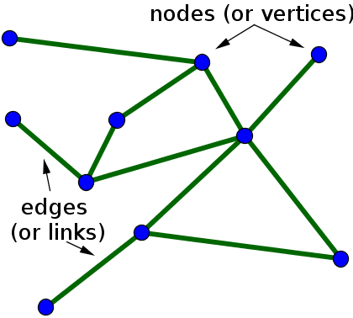
Motivation
Diffusion models → SoTA results
Graphs manipulation:
  Molecules / Polymers
  Social media
  Traffic modelisation
  Others (eg. Yu, H. et al., Reverse logistics network design for effective management of medical waste in epidemic outbreaks: Insights from the coronavirus disease 2019 (covid-19) outbreak in Wuhan)

Slide 5
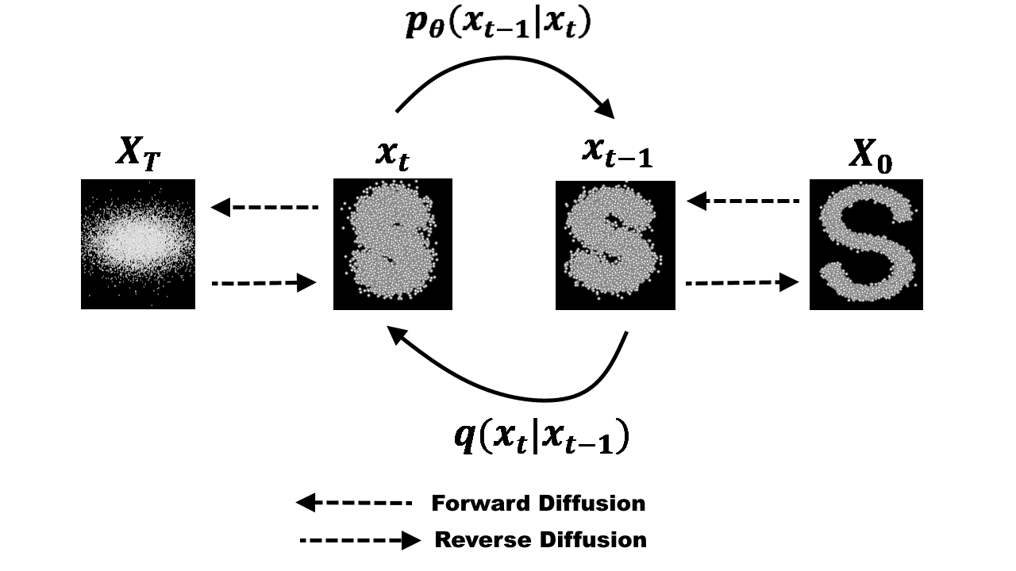
Challenges
Why not manipulating graphs with diffusion models?
  Not adapted for graphs
  Not easily constrainable
  Slow

Slide 6
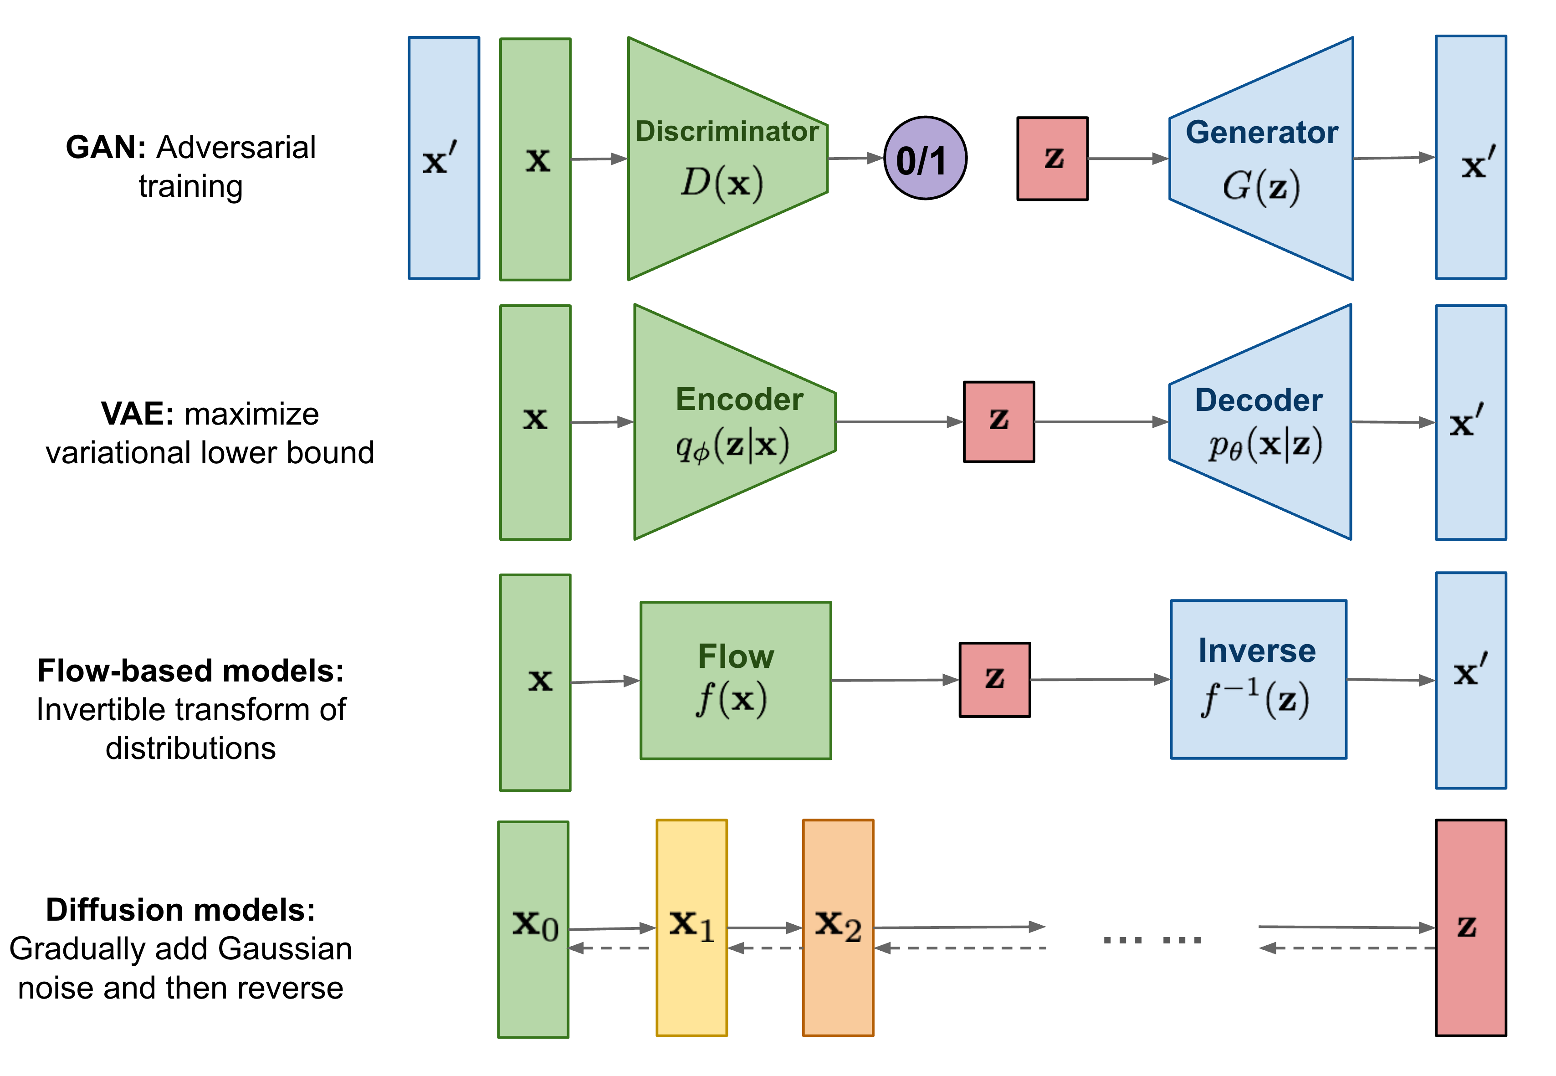
Presentation: Diffusion model
New evolution of generative models

Slide 7

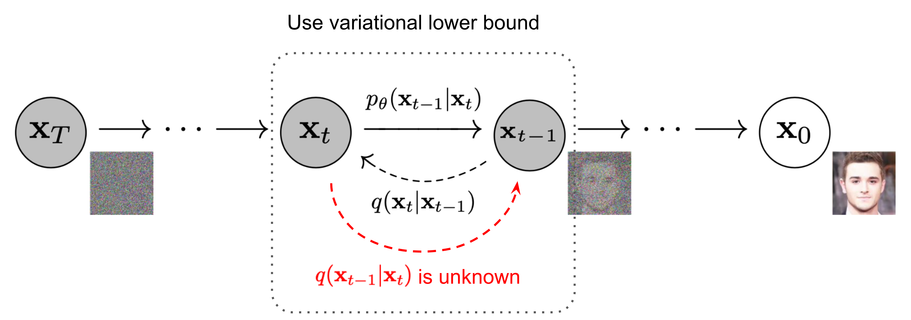
Presentation: Diffusion model
Framework

Slide 8
Diffusion models and graphs
Work already done:
  Jo, J., Lee, S., and Hwang, S. J. Score-based generative modeling of graphs via the system of stochastic differential equations (2022)
  Niu, C., Song, Y., Song, J., Zhao, S., Grover, A., and Ermon, S. Permutation invariant graph generation via score-based generative modeling (2020)
  …
→ Bad performance due to difference between graphs and images / videos data

Slide 9
Presentation of three state of the art models
Computer Aided Medical Procedures

Slide 10
General overview
Data-Centric Learning from Unlabeled Graphs with Diffusion Model (Liu et al., 2023)
Autoregressive Diffusion Model for Graph Generation (Kong et al., 2023)
DiGress - Discrete Denoising diffusion for graph generation (Vignac et al., 2023)

Slide 11
Data-Centric Learning from Unlabeled Graphs with Diffusion Model (Liu et al., 2023)
Computer Aided Medical Procedures

Slide 12
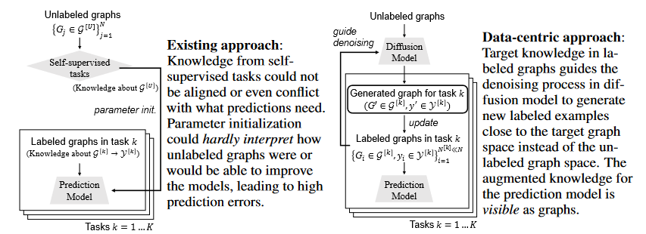
Motivation
New data augmentation technique
  Unsupervised graph generation
  Graph generation from labelled dataset of downstream prediction task
  Prediction task

Slide 13
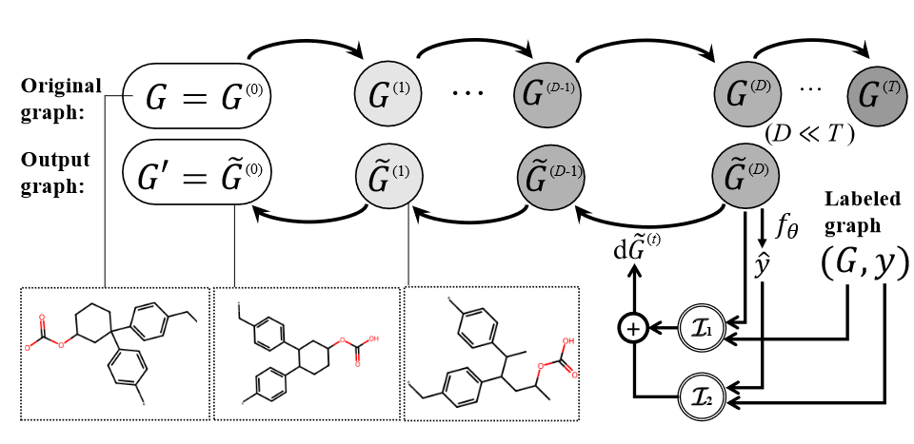
Framework
Diffusion model of DCT

Slide 14

Unsupervised graph generation
Standard Wiener process
Diffusion process
Denoising process
Drifting coefficient
Diffusion coefficient
Reverse standard Wiener process

Slide 15

Adaptation to downstream prediction task
Based on minimal sufficient transferred knowledge
Used loss to minimise the quantity above
New denoising process

Slide 16
Autoregressive Diffusion Model for Graph Generation (Kong et al., 2023)
Computer Aided Medical Procedures

Slide 17
Motivation
Use efficiently diffusion models to manipulate graphs
  Adapted for graphs
  Easily constrainable
  Quicker

Slide 18
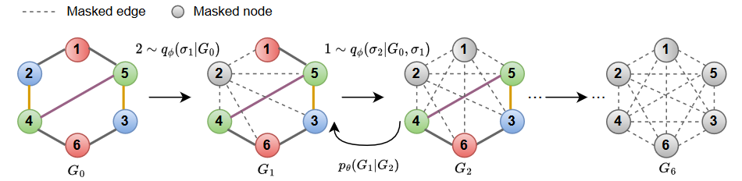
Diffusion process
Adaptation to the sparcity of graph data
→ Removal of one node at a time
→ Order matters

Slide 19
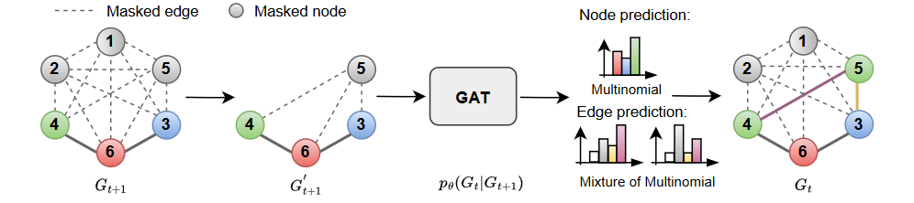
Denoising process
Adaptation to the diffusion process

Slide 20
DiGress - Discrete Denoising diffusion for graph generation (Vignac et al., 2023)
Computer Aided Medical Procedures

Slide 21
Motivation
Same as GraphARM
  Adapted for graphs
  Easily constrainable
  Quicker

Slide 22
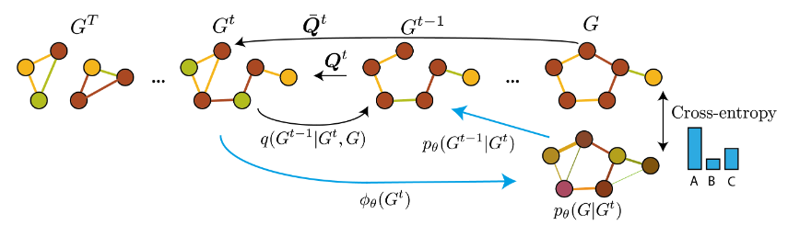
Diffusion process
Adaptation to the sparcity of graph data
→ Removal or reinsertion of edges + change of nodes and edges category
→ Choice of the actions to do matter

Slide 23
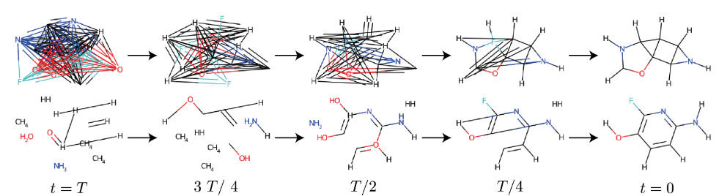
Diffusion process
Adaptation to the sparcity of graph data
→ Removal or reinsertion of edges + change of nodes and edges category
→ Choice of the actions to do matter

Slide 24
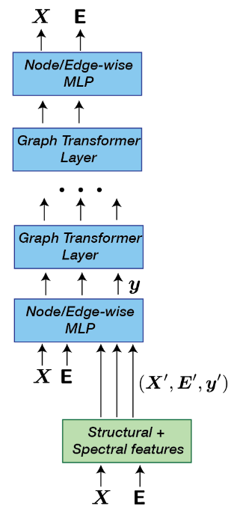
Denoising process
Use of a modified version of Graph Transformer Network
  Additional features taken into account
  Regressor to guide the denoising process included

Slide 25
Experimental results
Computer Aided Medical Procedures

Slide 26
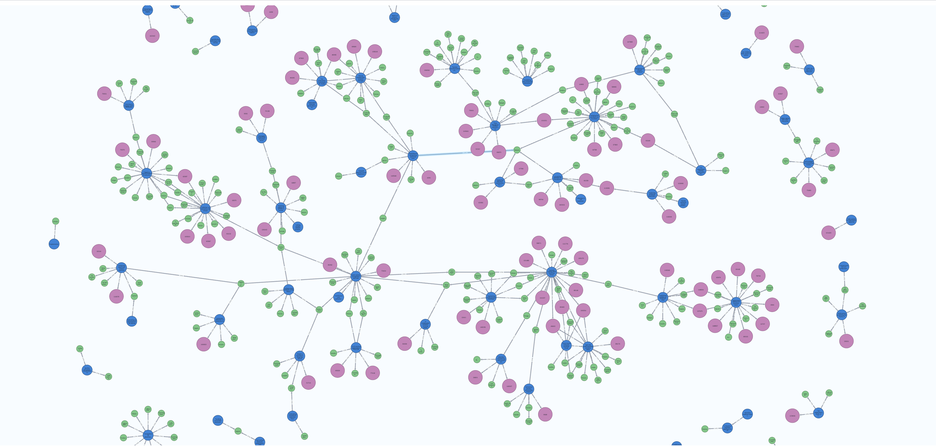
Graph generation - Datasets
Multiple different fields represented:
Community-small: Community detection and social networks.
Caveman: Synthetic graph generation and social networks.
Cora: Citation networks (academic publications).
Breast: Biomedical (breast cancer research).
Enzymes: Biochemical (enzyme structures and functions).
Ego-small: Social networks (ego networks).

Slide 27
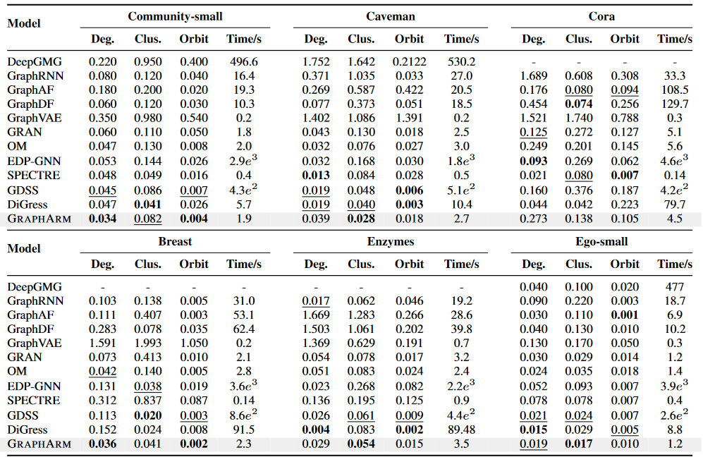
Graph generation - Results
Deg. : Degree score
Clus. Clustering coefficient
Orbit : Orbit

Slide 28
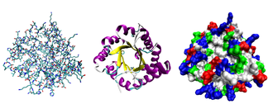
Prediction task - Datasets
Chemistry, material science and biology represented :
Ogbg: Molecular properties prediction (eg. Toxicity prediction, HIV activity prediction…)
MeltingTemp: Polymer properties prediction
PPI: Protein function prediction

Slide 29
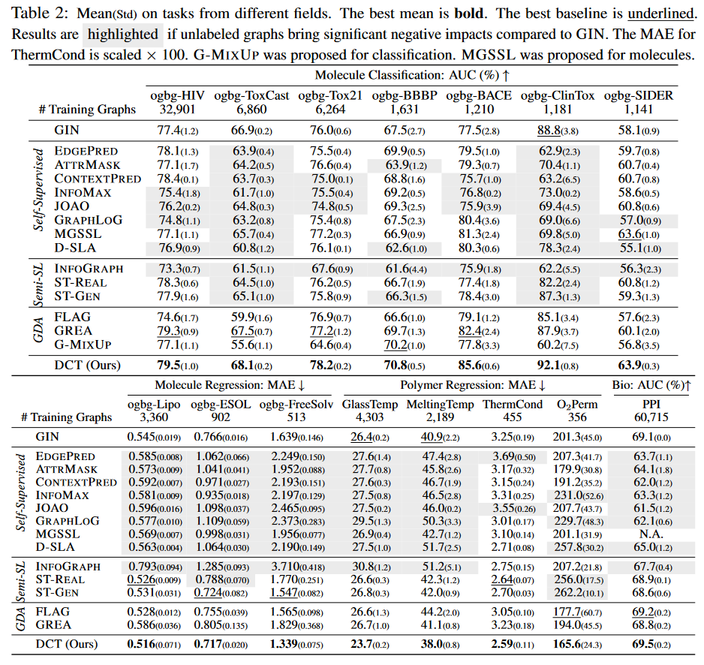
Prediction task - Results

Slide 30
Discussion
Computer Aided Medical Procedures

Slide 31
Discussion
Which model to choose?
  Downstream tasks needed: DCT
  Non conditional graph generation: GraphARM
  Conditional graph generation: DiGress
Possible improvements
  DCT: Use a diffusion process adapted to graphs
  GraphARM: Incorporate a universal regressor for conditional generation
  DiGress: Replace the transformer based denoising process by a lighter one

