Slide 1
Handling motion in Medical Imaging with Spatio-Temporal Generative Models
Deep Learning in Medical Applications

Slide 2
Motivation

Slide 3


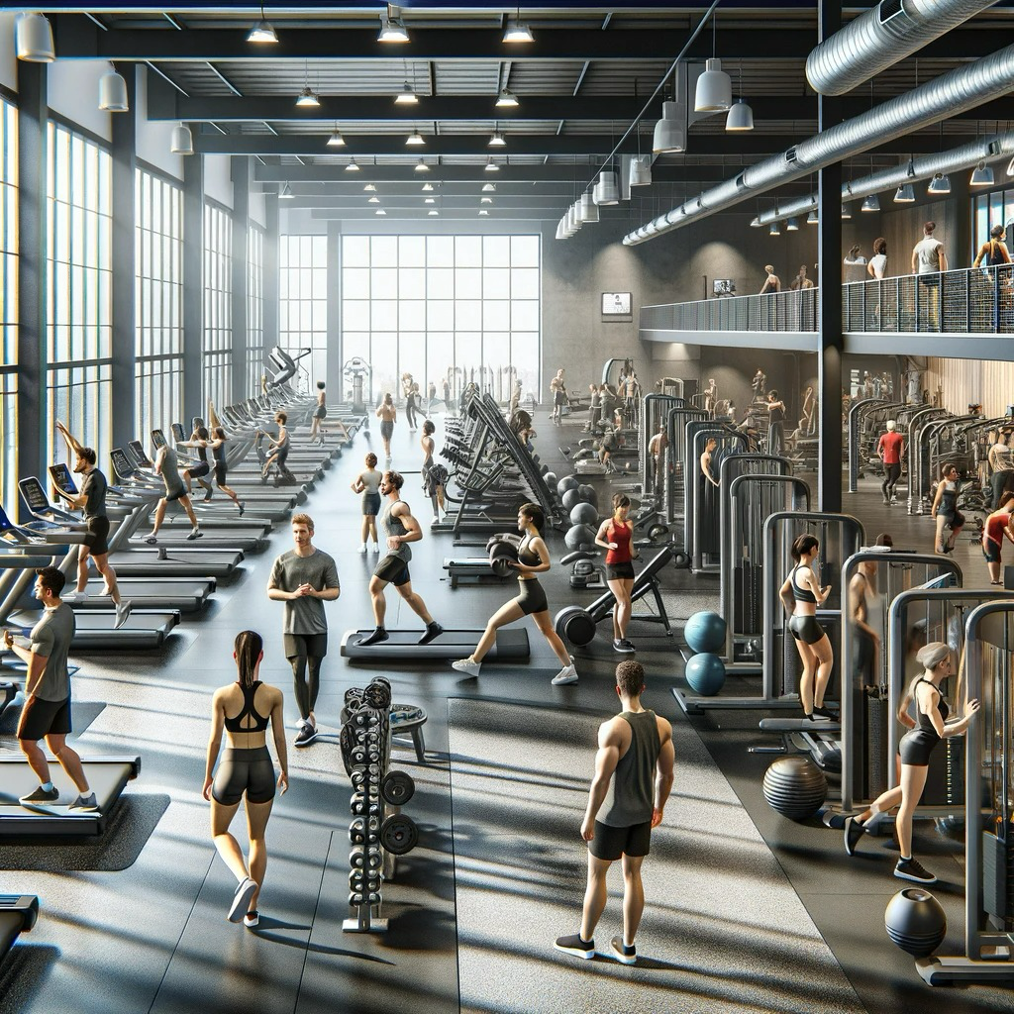
Human Motion
Notes:
Human motion:
our bodies are constantly in motion
consciously:
playing tennis
running for the bus
working out at the local gym
or unconsciously:
breathing
pumping blood

Slide 4
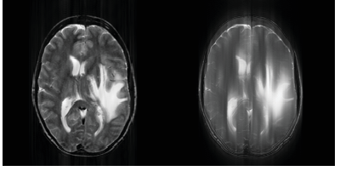
Motion in Medical Imaging
Motion Artefact:
Su, H. R., Lee, T. Y., Lai, S. H., & Chang, T. C. (2010). MRI motion artifact correction based on spectral extrapolation with generalized series. Proceedings - International Conference on Image Processing, ICIP, 1133–1136. https://doi.org/10.1109/ICIP.2010.5651304
Notes:
Motion in medical imaging:
Can be:
a nuisance -> source of artifacts (blurriness or ghosting)
mainly cardiac & respiratory functions
an important source of information (functional imaging & physiology)
Accurate modeling promises:
accelerated acquisition times
understanding
better diagnosis (more information)
treatment/ surgery planning
privacy preserving and publicly available training data
Will focus on the heart
non-imaging alternatives exist for observing function (ECG)
-> provide temporal data without spatial information -> useful for diagnosis (Atrial Fibrillation, Heart Failure, …)
-> BUT: sometimes positional information necessary -> spatio temporal models
Could also work on other organs

Slide 5
Outline
Background Knowledge
  Anatomy of the heart
  Generative Models
  Non-generative Alternatives
Proposed Solutions
  SADM
  Latent Motion Matrix CVAE
  CHeart
Discussion
Notes:
Topics:
cover some background knowledge
overview of existing cutting-edge methods
discussion
Will not go into every technical detail unless necessary
if it is not where the innovation happens (foundational architectures etc.)
easier to follow -> give intuitions & provide understanding of high level concepts

Slide 6
Background Knowledge
Anatomy of the heart
Generative Models
Non-generative alternatives
Notes:
Will not go into every technical detail unless necessary
if it is not where the innovation happens (foundational architectures etc.)
easier to follow -> give intuitions & provide understanding of high level concepts

Slide 7
Background Knowledge
Anatomy of the heart
Generative Models
Non-generative alternatives

Slide 8
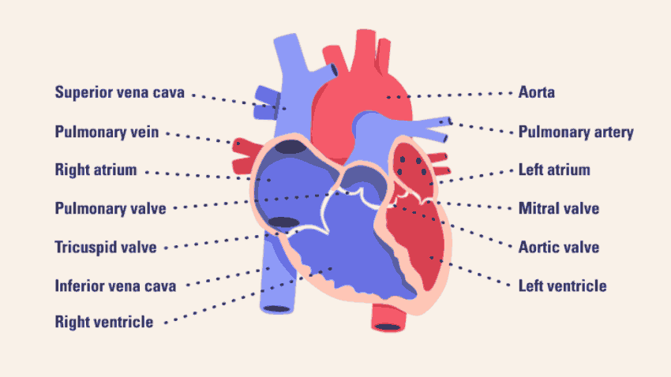
Anatomy of the Heart
Michigan Medicine. (n.d.). Anatomy of the human heart. Health Lab. https://www.michiganmedicine.org/health-lab/anatomy-human-heart
Notes:
not every name relevant (atrium & ventricle)
everything separated by valves (only let it pass in one direction)
Best to go over an example:
(deoxygenated) right atrium (on the left) -> right ventricle -> pulmonary artery -> lungs
(oxygenated) -> left atrium -> left ventricle -> Aorta -> body
-> (superior/ inferior) vena cava -> right atrium

Slide 9
Anatomy of the Heart
End Diastolic (ED):
Ventricles maximally filled
Michigan Medicine. (n.d.). Anatomy of the human heart. Health Lab. https://www.michiganmedicine.org/health-lab/anatomy-human-heart
Notes:
End Diastolic:
- ventricles maximally filled
- maximum blood pressure
End Systolic:
- Ventricles completely empty
- least amount of pressure

Slide 10
Anatomy of the Heart
End Diastolic (ED):
Ventricles maximally filled
End Systolic (ES):
Ventricles completely depleted
Michigan Medicine. (n.d.). Anatomy of the human heart. Health Lab. https://www.michiganmedicine.org/health-lab/anatomy-human-heart
Notes:
End Diastolic:
- ventricles maximally filled
- maximum blood pressure
End Systolic:
- Ventricles completely empty
- least amount of pressure

Slide 11
Background Knowledge
Anatomy of the heart
Generative Models
Non-generative alternatives

Slide 12
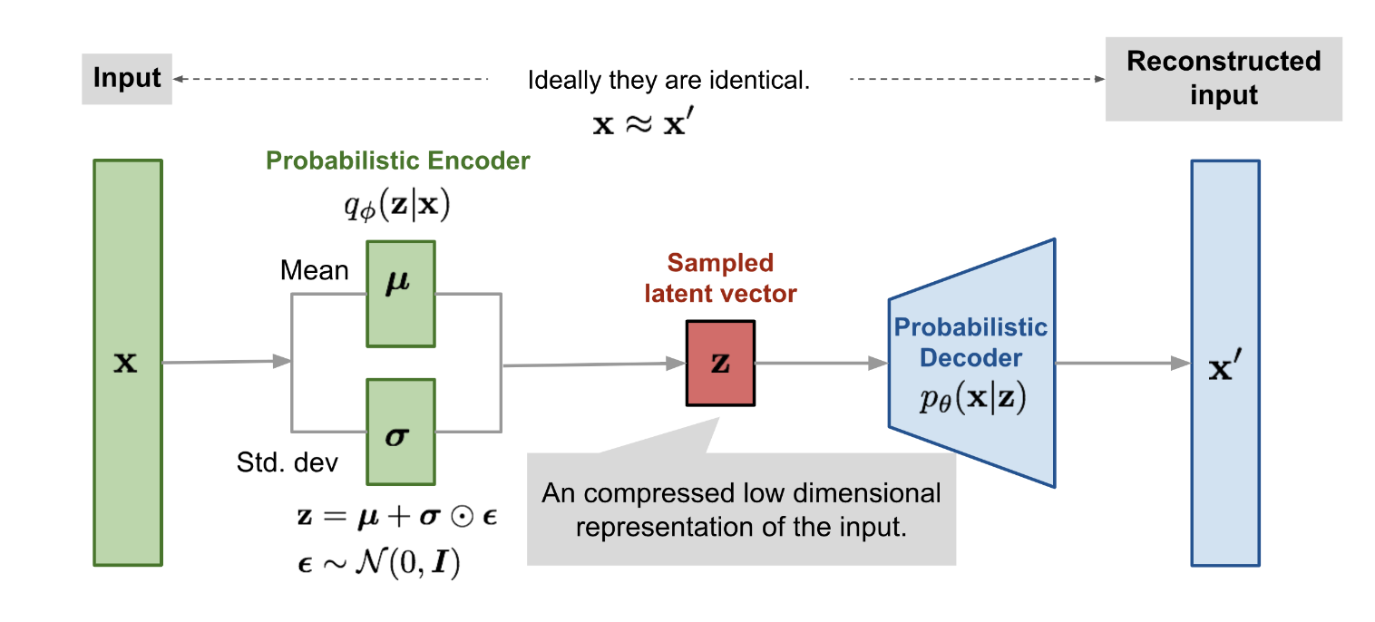
Variational Autoencoders
Weng, L. (2018, August 12). VAE: A Type of Artificial Neural Network. Lil’Log. https://lilianweng.github.io/posts/2018-08-12-vae/
Notes:
VAE: encoder + decoder
encoder: reduce dimensionality to latent representation
latent space: probability distribution p(x) -> gaussian -> predict mean/ std. dev
decoder: reconstruct image from sampled z
Inference: sample new z & decode

Slide 13
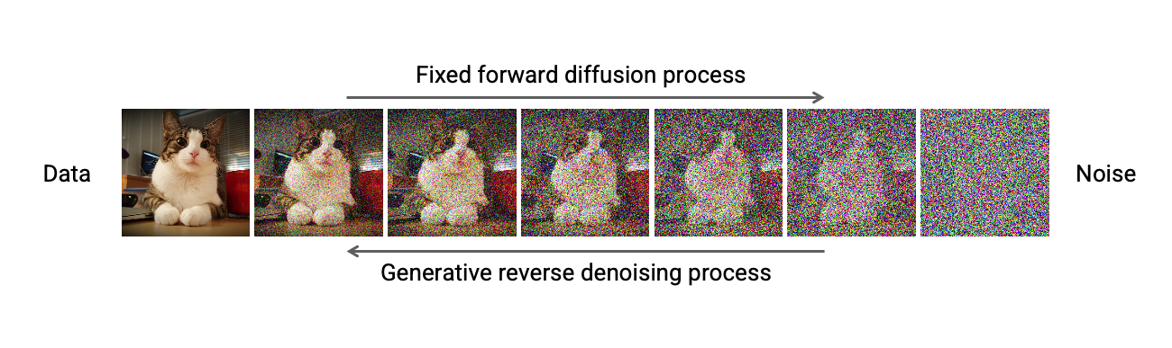
Diffusion Models
CVPR 2022 Tutorial on Diffusion Models. (n.d.). CVPR 2022 Tutorial on Diffusion Models. https://cvpr2022-tutorial-diffusion-models.github.io/
Notes:
Keeping it brief (technical details not relevant here)
forward process:
add noise step by step
-> only (gaussian) noise left
reverse process:
learn to remove noise step by step -> structured image/ data
different implementations exist
Inference:
sample noise -> reverse process
combined with conditioning (extra inputs) for guidance
High quality & high diversity image & video generation
Dall-e
Sora AI
Midjourney
…
Other generative Models - GAN - not relevant the following papers.

Slide 14
Background Knowledge
Anatomy of the heart
Generative Models
Non-generative alternatives

Slide 15
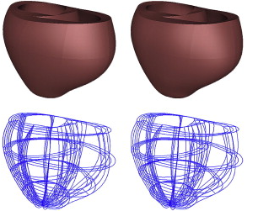
Biomechanical Models
provide high bio-physical accuracy
more expensive
Aguado-Sierra, J., Krishnamurthy, A., Villongco, C., Chuang, J., Howard, E., Gonzales, M. J., Omens, J., Krummen, D. E., Narayan, S., Kerckhoffs, R. C. P., & McCulloch, A. D. (2011). Patient-specific modeling of dyssynchronous heart failure: A case study. Progress in Biophysics and Molecular Biology, 107(1), 147–155. https://doi.org/10.1016/J.PBIOMOLBIO.2011.06.014
Notes:
Biomechanical Models:
simulate mechanical behavior (deformations, strains, …) of the biological system
use geometric representations of anatomy & material properties.
-> High physical accuracy & consistency
useful in research
predict effects of interventions/ treatments
improve the understanding of cardiac functions
Build patient specific model:
require large scale computations & a lot of patient specific clinical recordings
-> May be worth in some cases
-> generative models : light-weight alternative for the rest

Slide 16
Proposed Solutions
SADM
Latent Motion Matrix CVAE
CHeart
Notes:
Three papers

Slide 17
Proposed Solutions
SADM
Latent Motion Matrix CVAE
CHeart

Slide 18
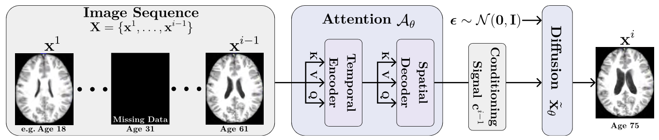
SADM
Yoon, J. S., Zhang, C., Suk, H.-I., Guo, J., & Li, X. (2022). SADM: Sequence-Aware Diffusion Model for Longitudinal Medical Image Generation. Lecture Notes in Computer Science (Including Subseries Lecture Notes in Artificial Intelligence and Lecture Notes in Bioinformatics), 13939 LNCS, 388–400. https://doi.org/10.1007/978-3-031-34048-2_30
Notes:
Sequence Aware Diffusion Models (SADM)
Yoon et al.
Applications
model anatomic changes in human body
short term: cardiac cycle
long term brain aging
Input: as much of a sequence as possible
Output: A complete Sequence, based on previous data
Full overview:
will go over ever part in detail

Slide 19
SADM
Yoon, J. S., Zhang, C., Suk, H.-I., Guo, J., & Li, X. (2022). SADM: Sequence-Aware Diffusion Model for Longitudinal Medical Image Generation. Lecture Notes in Computer Science (Including Subseries Lecture Notes in Artificial Intelligence and Lecture Notes in Bioinformatics), 13939 LNCS, 388–400. https://doi.org/10.1007/978-3-031-34048-2_30
Notes:
Image Sequence (fixed length):
drop frames
add frames
split into:
missing
future
conditioning images

Slide 20
SADM
Yoon, J. S., Zhang, C., Suk, H.-I., Guo, J., & Li, X. (2022). SADM: Sequence-Aware Diffusion Model for Longitudinal Medical Image Generation. Lecture Notes in Computer Science (Including Subseries Lecture Notes in Artificial Intelligence and Lecture Notes in Bioinformatics), 13939 LNCS, 388–400. https://doi.org/10.1007/978-3-031-34048-2_30
Notes:
main novel factor:
zoom in on next slide

Slide 21
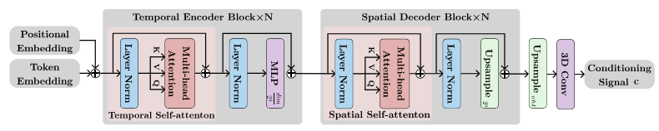
SADM
R^{(w*h*d) x L x dim}
R^{L x (w*h*d) x dim}
R^{L x w x h x d x dim}
Temporal Encoder:
Self-attention between tokens at different points in time
MLP reduces spatial dimensions by factor 2
Yoon, J. S., Zhang, C., Suk, H.-I., Guo, J., & Li, X. (2022). SADM: Sequence-Aware Diffusion Model for Longitudinal Medical Image Generation. Lecture Notes in Computer Science (Including Subseries Lecture Notes in Artificial Intelligence and Lecture Notes in Bioinformatics), 13939 LNCS, 388–400. https://doi.org/10.1007/978-3-031-34048-2_30
Notes:
reshape from R1 to R2
Normalize
Spatial dimensions in batch dimension
-> self attention calculated between tokens @ same position in space — different point in time
Normalize
MLP encoding -> halves spatial dimensions

Slide 22
SADM
R^{(w*h*d) x L x dim}
R^{L x (w*h*d) x dim}
R^{L x w x h x d x dim}
Spatial Decoder:
Self-attention between tokens at different positions in space
Upsample spatial dimensions by factor 2
Yoon, J. S., Zhang, C., Suk, H.-I., Guo, J., & Li, X. (2022). SADM: Sequence-Aware Diffusion Model for Longitudinal Medical Image Generation. Lecture Notes in Computer Science (Including Subseries Lecture Notes in Artificial Intelligence and Lecture Notes in Bioinformatics), 13939 LNCS, 388–400. https://doi.org/10.1007/978-3-031-34048-2_30
Notes:
analogous to Temporal Encoder
reshape from R2 to R3
Normalize
Temporal dimension L in batch dimension
-> self attention calculated between tokens @ same point in time — different voxel
Normalize
Upsample spatial dimensions by factor 2
After attention both:
reshape to original shape
Upsample
3D conv
output = conditioning signal

Slide 23
SADM
The diffusion process is defined as:
,
w allows to tune the tradeoff between sample quality & diversity.
Yoon, J. S., Zhang, C., Suk, H.-I., Guo, J., & Li, X. (2022). SADM: Sequence-Aware Diffusion Model for Longitudinal Medical Image Generation. Lecture Notes in Computer Science (Including Subseries Lecture Notes in Artificial Intelligence and Lecture Notes in Bioinformatics), 13939 LNCS, 388–400. https://doi.org/10.1007/978-3-031-34048-2_30
Notes:
Input:
c + noise
Formula:
weighted sum:
conditional model
unconditional model
-> Tradeoff - sample Quality vs Diversity
regulated via parameter w
high w: high quality
low w: high diversity
While training : set c = 0-tensor, with p_{uncond}

Slide 24
SADM
Yoon, J. S., Zhang, C., Suk, H.-I., Guo, J., & Li, X. (2022). SADM: Sequence-Aware Diffusion Model for Longitudinal Medical Image Generation. Lecture Notes in Computer Science (Including Subseries Lecture Notes in Artificial Intelligence and Lecture Notes in Bioinformatics), 13939 LNCS, 388–400. https://doi.org/10.1007/978-3-031-34048-2_30
Notes:
Training: end to end >> Training modules seperately
Inference process:
goal: generate Missing & Future images autoregressively
Sequence up to that point -> attention module -> conditioning signal
sample noise vector -> Diffusion

Slide 25
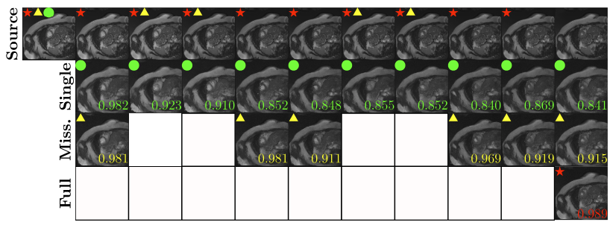
SADM
Yoon, J. S., Zhang, C., Suk, H.-I., Guo, J., & Li, X. (2022). SADM: Sequence-Aware Diffusion Model for Longitudinal Medical Image Generation. Lecture Notes in Computer Science (Including Subseries Lecture Notes in Artificial Intelligence and Lecture Notes in Bioinformatics), 13939 LNCS, 388–400. https://doi.org/10.1007/978-3-031-34048-2_30
Notes:
Sequence Generation from ED to ES
Ground truth
Only ED frame given
random missing frames
Only ES frame missing
white frames: given
number in the corner: SSIM (measures structural similarity)
SSIM is better after real data & decreases with prediction length
-> sequential information being used

Slide 26
SADM
Useful to:
interpolate missing frames
speed up data acquisition
generate synthetic data
Drawback:
limited use-cases
Notes:
Useful to:
interpolate missing frames
speed up data acquisition
generate synthetic data
Drawback:
limited use-cases

Slide 27
Proposed Solutions
SADM
Latent Motion Matrix CVAE
CHeart

Slide 28
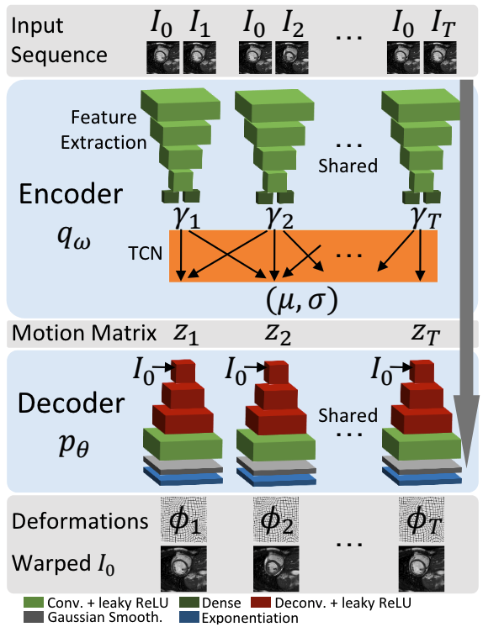
Latent Motion Matrix CVAE
Krebs, J., Delingette, H., Ayache, N., & Mansi, T. (2021). Learning a Generative Motion Model from Image Sequences Based on a Latent Motion Matrix. IEEE Transactions on Medical Imaging, 40(5), 1405–1416. https://doi.org/10.1109/TMI.2021.3056531
Notes:
Krebs et al.
Learning a Generative Motion Model from Image Sequences Based on a Latent Motion Matrix
architecture in image
will go over every part separately
adapted Conditional VAE structure

Slide 29
Latent Motion Matrix CVAE
Krebs, J., Delingette, H., Ayache, N., & Mansi, T. (2021). Learning a Generative Motion Model from Image Sequences Based on a Latent Motion Matrix. IEEE Transactions on Medical Imaging, 40(5), 1405–1416. https://doi.org/10.1109/TMI.2021.3056531
Notes:
sequences must have length T
T set before training ( usually max length in dataset)

Slide 30
Latent Motion Matrix CVAE
Goal:
compress Image pair to a joint latent space
Split into:
Feature Extractor
Temporal Convolutional Network (TCN)
Krebs, J., Delingette, H., Ayache, N., & Mansi, T. (2021). Learning a Generative Motion Model from Image Sequences Based on a Latent Motion Matrix. IEEE Transactions on Medical Imaging, 40(5), 1405–1416. https://doi.org/10.1109/TMI.2021.3056531
Notes:
Encoder (compress Image pair to joint latent space
Feature Extraction (Convolutional + Dense Layers)
Temporal Convolutional Network:
temporal convolutions = 1D convolution on temporal dimension only.

Slide 31
Latent Motion Matrix CVAE
Goal:
compress Image pair to a joint latent space
Split into:
Feature Extractor
Temporal Convolutional Network (TCN)
1D Convolutions over temporal dimension
Krebs, J., Delingette, H., Ayache, N., & Mansi, T. (2021). Learning a Generative Motion Model from Image Sequences Based on a Latent Motion Matrix. IEEE Transactions on Medical Imaging, 40(5), 1405–1416. https://doi.org/10.1109/TMI.2021.3056531
Notes:
Encoder (compress Image pair to joint latent space
Feature Extraction (Convolutional + Dense Layers)
Temporal Convolutional Network:
temporal convolutions = 1D convolution on temporal dimension only.

Slide 32

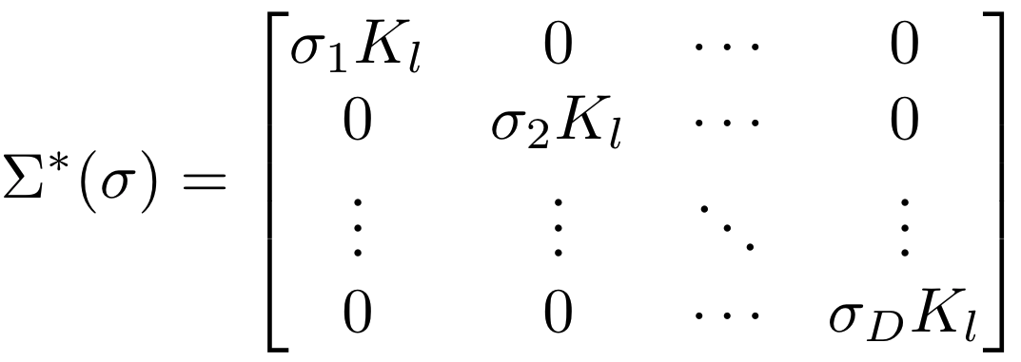
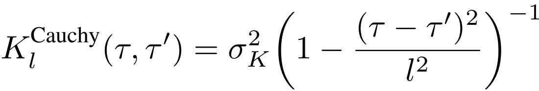
Latent Motion Matrix CVAE
Sample z_{t} from:
,
with: ,
and:
Krebs, J., Delingette, H., Ayache, N., & Mansi, T. (2021). Learning a Generative Motion Model from Image Sequences Based on a Latent Motion Matrix. IEEE Transactions on Medical Imaging, 40(5), 1405–1416. https://doi.org/10.1109/TMI.2021.3056531
Notes:
Motion Matrix:
sample motion matrix z from q
Sigma = covariance matrix Diag(K_{l})
K_{l} choosable -> chose Cauchy Kernel
resistant to outliers
long range dependencies

Slide 33
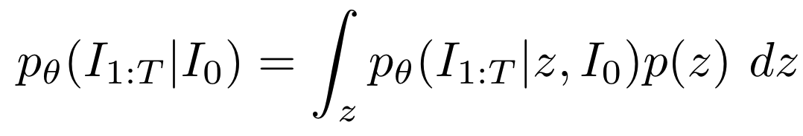
Latent Motion Matrix CVAE
The decoder models:
Krebs, J., Delingette, H., Ayache, N., & Mansi, T. (2021). Learning a Generative Motion Model from Image Sequences Based on a Latent Motion Matrix. IEEE Transactions on Medical Imaging, 40(5), 1405–1416. https://doi.org/10.1109/TMI.2021.3056531
Notes:
Decoder:
upsample with Deconvolutional layers
Size preserving Convolutions
Gaussian Smoothing (smoother motion -> better)
(Exponentiation: integrate over time (Velocity field -> deformation field))
then:
output (=motion) applied to initial frame I₀ -> I_{t}

Slide 34
Latent Motion Matrix CVAE
Optimized by ELBO objective:
 | 𝔼𝑧∼𝑞_{𝜔}(⋅|𝐼_{0:𝑇})[log𝑝_{𝜃}(𝐼_{1:𝑇}|𝑧,𝐼₀)]−KL[𝑞_{𝜔}(𝑧|𝐼_{0:𝑇})||𝑝(𝑧)]
Krebs, J., Delingette, H., Ayache, N., & Mansi, T. (2021). Learning a Generative Motion Model from Image Sequences Based on a Latent Motion Matrix. IEEE Transactions on Medical Imaging, 40(5), 1405–1416. https://doi.org/10.1109/TMI.2021.3056531
Notes:
Optimized by Evidence Lower Bound (ELBO) objective:
log likelihood -> ensure initial frame is correctly registered to following frames
KL Divergence posterior q — prior p (assumed real distribution)
measures similarity between distributions

Slide 35
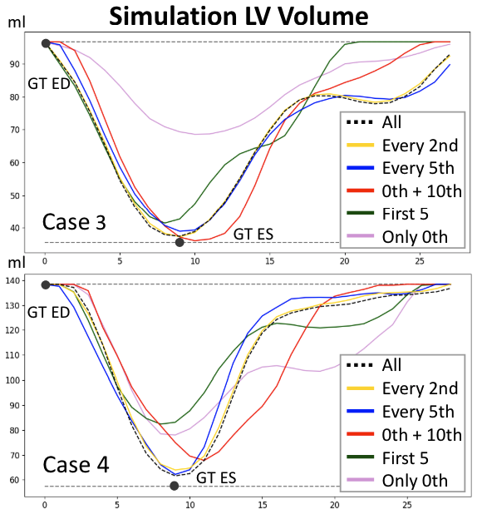
Latent Motion Matrix CVAE
Observations:
Seems realistic overall
can handle some degree of missing data (every 2nd to 5th)
Potential for faster acquisitions
Krebs, J., Delingette, H., Ayache, N., & Mansi, T. (2021). Learning a Generative Motion Model from Image Sequences Based on a Latent Motion Matrix. IEEE Transactions on Medical Imaging, 40(5), 1405–1416. https://doi.org/10.1109/TMI.2021.3056531
Notes:
Simulation of Left Ventricle Volume
Explanation:
black points: Ground truth ED/ ES Volume in LV
different lines: different rates of missing frames
Results:
seems realistic overall (could be better at GT ES
reduction by factor 2 to 5 is fine
-> reduce acquisition rate / time
others: too far off

Slide 36
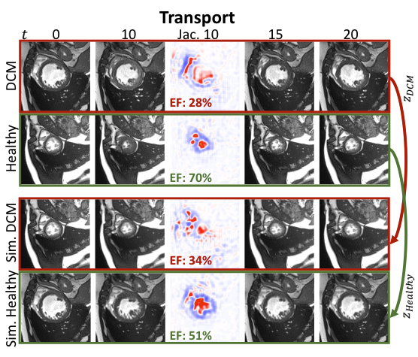
Latent Motion Matrix CVAE
Application: Motion Transport
Krebs, J., Delingette, H., Ayache, N., & Mansi, T. (2021). Learning a Generative Motion Model from Image Sequences Based on a Latent Motion Matrix. IEEE Transactions on Medical Imaging, 40(5), 1405–1416. https://doi.org/10.1109/TMI.2021.3056531
Notes:
Example: Motion Transfer
A healthy and a diseased patient
Motion:
diseased -> healthy
& healthy -> diseased
EF in the middle ( % of blood pushed out of LV / heartbeat)
low for diseased
high for healthy
-> holds true for simulated as well

Slide 37
Latent Motion Matrix CVAE
Useful to:
transfer motion
interpolate missing frames
speed up data acquisition
generate synthetic data
Drawback:
computationally expensive
limited complexity of generated motions
Notes:
Useful to:
transfer motion
interpolate missing frames
speed up data acquisition
generate synthetic data
Drawback:
computationally expensive
limited complexity of generated motions

Slide 38
Proposed Solutions
SADM
Latent Motion Matrix CVAE
CHeart

Slide 39
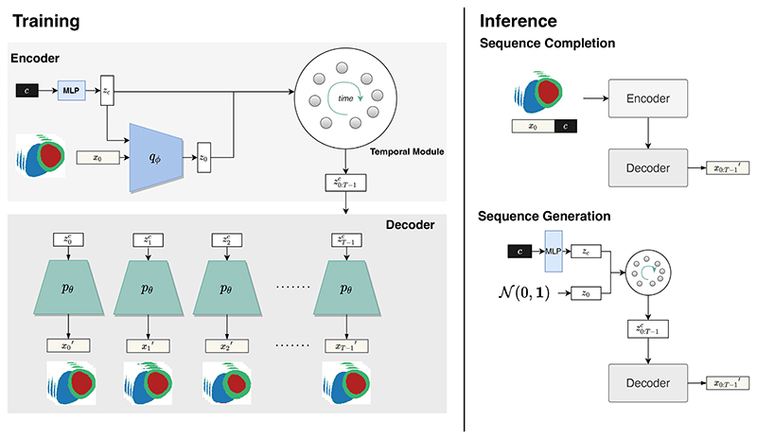
CHeart
Goal:
model & visualize the anatomy & physiology of the heart from metadata
understand effects of non-imaging features on the heart
Qiao, M., Wang, S., Qiu, H., de Marvao, A., O’Regan, D. P., Rueckert, D., & Bai, W. (2024). CHeart: A Conditional Spatio-Temporal Generative Model for Cardiac Anatomy. IEEE Transactions on Medical Imaging, 43(3), 1259–1269. https://doi.org/10.1109/TMI.2023.3331982
Notes:
CHeart, by Qiao et al.
Also based on Conditional VAE
Goal:
model & visualize the anatomy & physiology of the heart from/ with metadata
to better understand effects of non-imaging features (age, gender, disease, blood pressure, …) on the heart
Parts:
Encoding Process -> generates conditioning signals
Decoding Process -> generates an image for each conditioning signal

Slide 40
CHeart
MLP
generate latent representation for clinical factors c
Encoder q_{ɸ}
generate latent representation for initial frame x₀ conditioned on z_{c}
Temporal Module (LSTM)
extend latent representation to a full sequence
Qiao, M., Wang, S., Qiu, H., de Marvao, A., O’Regan, D. P., Rueckert, D., & Bai, W. (2024). CHeart: A Conditional Spatio-Temporal Generative Model for Cardiac Anatomy. IEEE Transactions on Medical Imaging, 43(3), 1259–1269. https://doi.org/10.1109/TMI.2023.3331982
Notes:
Encoding Process:
MLP: non-imaging clinical features c -> latent representation z_c
Encoder q: first frame x_0 -> learns distribution -> sample latent vector z_0
Temporal module: extends z_0 + z_c -> time series of latent vectors z^c_0:T-1

Slide 41
CHeart
MLP
generate latent representation for clinical factors c
Encoder q_{ɸ}
generate latent representation for initial frame x₀ conditioned on z_{c}
Temporal Module (LSTM)
extend latent representation to a full sequence
Qiao, M., Wang, S., Qiu, H., de Marvao, A., O’Regan, D. P., Rueckert, D., & Bai, W. (2024). CHeart: A Conditional Spatio-Temporal Generative Model for Cardiac Anatomy. IEEE Transactions on Medical Imaging, 43(3), 1259–1269. https://doi.org/10.1109/TMI.2023.3331982
Notes:
… Temporal module:
extends initial frame z_0 + clinical factors z_c
-> time series of latent vectors z^c_0:T-1
is modeled as a Long-Short-Term-Memory

Slide 42
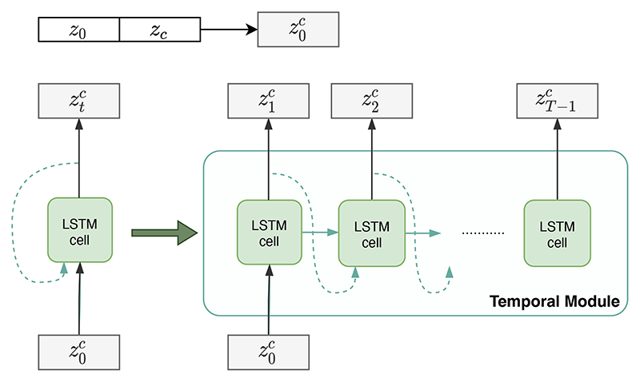
CHeart
Temporal Module
Long-Short-Term-Memory:
each latent vector depends on the previous
Qiao, M., Wang, S., Qiu, H., de Marvao, A., O’Regan, D. P., Rueckert, D., & Bai, W. (2024). CHeart: A Conditional Spatio-Temporal Generative Model for Cardiac Anatomy. IEEE Transactions on Medical Imaging, 43(3), 1259–1269. https://doi.org/10.1109/TMI.2023.3331982
Notes:
… Consists of a LSTM
This is where the magic happens!
LSTM
popular fundamental architecture
extension of RNNs
calculates each zc_t from previous z for all t
Output: sequence of latent representations for decoder

Slide 43
CHeart
Qiao, M., Wang, S., Qiu, H., de Marvao, A., O’Regan, D. P., Rueckert, D., & Bai, W. (2024). CHeart: A Conditional Spatio-Temporal Generative Model for Cardiac Anatomy. IEEE Transactions on Medical Imaging, 43(3), 1259–1269. https://doi.org/10.1109/TMI.2023.3331982
Notes:
zoom out

Slide 44
CHeart
Qiao, M., Wang, S., Qiu, H., de Marvao, A., O’Regan, D. P., Rueckert, D., & Bai, W. (2024). CHeart: A Conditional Spatio-Temporal Generative Model for Cardiac Anatomy. IEEE Transactions on Medical Imaging, 43(3), 1259–1269. https://doi.org/10.1109/TMI.2023.3331982
Notes:
zoom out some more
Now have: latent representation for the whole sequence
-> let’s look at the decoder to generate the anatomy

Slide 45
CHeart
Decoder
learns to reconstruct a sequence x’_{t} that resembles the original x_{t}
Qiao, M., Wang, S., Qiu, H., de Marvao, A., O’Regan, D. P., Rueckert, D., & Bai, W. (2024). CHeart: A Conditional Spatio-Temporal Generative Model for Cardiac Anatomy. IEEE Transactions on Medical Imaging, 43(3), 1259–1269. https://doi.org/10.1109/TMI.2023.3331982
Notes:
Standard decoder -> generates images via. deconvolutions
learns to reconstruct sequence

Slide 46
CHeart
Inference
Qiao, M., Wang, S., Qiu, H., de Marvao, A., O’Regan, D. P., Rueckert, D., & Bai, W. (2024). CHeart: A Conditional Spatio-Temporal Generative Model for Cardiac Anatomy. IEEE Transactions on Medical Imaging, 43(3), 1259–1269. https://doi.org/10.1109/TMI.2023.3331982
Notes:
Inference on 2 tasks:
Sequence Completion: initial frame given
-> run through full pipeline
Sequence Generation - no image given
-> directly sample at posterior q after Encoder

Slide 47
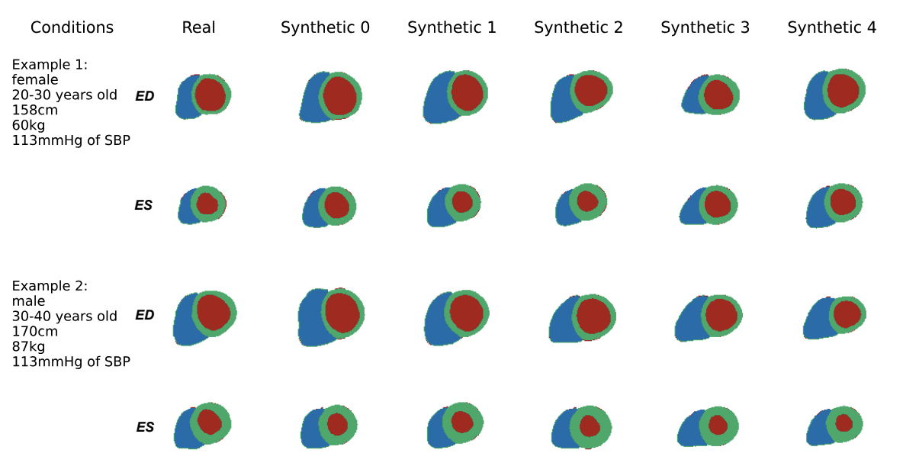
CHeart
Qiao, M., Wang, S., Qiu, H., de Marvao, A., O’Regan, D. P., Rueckert, D., & Bai, W. (2024). CHeart: A Conditional Spatio-Temporal Generative Model for Cardiac Anatomy. IEEE Transactions on Medical Imaging, 43(3), 1259–1269. https://doi.org/10.1109/TMI.2023.3331982
Notes:
Two examples
young female, 158cm, 60kg, systolic bloodpressure of 113 milimiters per mercury
fairly young male: 170 cm, 87kg, 113 bloodpressure
comparison of real & synthetic samples @ ED & ES frames
only segmentation map

Slide 48
CHeart
Useful to:
detect anomalies
simulate effects of clinical factors
find patterns in data
generate synthetic data
complete sequences
Drawback:
only generates segmentation maps
only uses the first frame
Notes:
Useful to:
detect anomalies
simulate effects of clinical factors
find patterns in data
generate synthetic data
complete sequences
Drawback:
only generates segmentation maps
only uses the first frame -> unused information

Slide 49
Discussion

Slide 50
Discussion
Many benefits & use cases:
Interpolating missing frames
abundant synthetic data
anomaly & pattern detection
better understanding of physiology
Potential Future Work:
application to other organs & types of motion
combine with biomechanical models / physics based approaches
Notes:
Three different approaches
Diffusion model
Variational Autoencoders registration
VAE generation with LSTM
Many benefits & use cases:
Interpolating missing frames
abundant public data
anomaly & pattern detection
better understanding of physiology
…but also some drawbacks
Future work:
Application to other organs
Combine with Biomechanical models
Physics informed Networks

Slide 51

What are your Questions?
More details under:
For later questions, don’t to hesitate to ask:
E-Mail: julien.schulz@tum.de
Notes:
References at the end & on blog post (scan)
What are your questions?

Slide 52
References
Wallis, D. E., O’Connell, J. B., Henkin, R. E., Costanzo-Nordin, M. R., & Scanlon, P. J. (1984). Segmental wall motion abnormalities in dilated cardiomyopathy: A common finding and good prognostic sign. Journal of the American College of Cardiology, 4(4), 674–679. https://doi.org/10.1016/S0735-1097(84)80392-7
Collins, M., Hsieh, A., Ohazama, C. J., Ota, T., Stetten, G., Donovan, C. L., Kisslo, J., & Ryan, T. (1999). Assessment of Regional Wall Motion Abnormalities with Real-Time 3-Dimensional Echocardiography. Journal of the American Society of Echocardiography, 12(1), 7–14. https://doi.org/10.1016/S0894-7317(99)70167-7
Van de Walle, R., Lemahieu, I., & Achten, E. (1997). Magnetic resonance imaging and the reduction of motion artifacts: review of the principles. Technology and health care : official journal of the European Society for Engineering and Medicine, 5(6), 419–435.
Wood, M. L., & Henkelman, R. M. (1985). MR image artifacts from periodic motion. Medical Physics, 12(2), 143-151. https://doi.org/10.1118/1.595782
Blackall, J. M., Ahmad, S., Miquel, M. E., McClelland, J. R., Landau, D. B., & Hawkes, D. J. (2006). MRI-based measurements of respiratory motion variability and assessment of imaging strategies for radiotherapy planning. Physics in Medicine & Biology, 51(17), 4147. https://doi.org/10.1088/0031-9155/51/17/003
Pakela, J. M., Knopf, A., Dong, L., Rucinski, A., & Zou, W. (2022). Management of Motion and Anatomical Variations in Charged Particle Therapy: Past, Present, and Into the Future. Frontiers in oncology, 12, 806153. https://doi.org/10.3389/fonc.2022.806153
Keall, P. J., Mageras, G. S., Balter, J. M., Emery, R. S., Forster, K. M., Jiang, S. B., Kapatoes, J. M., Low, D. A., Murphy, M. J., Murray, B. R., Ramsey, C. R., van Herk, M. B., Vedam, S. S., Wong, J. W., & Yorke, E. (2006). The management of respiratory motion in radiation oncology report of AAPM Task Group 76. Medical Physics, 33(10), 3874–3900. https://doi.org/10.1118/1.2349696
Liu, G., Hu, F., Ding, X., Li, X., Shao, Q., Wang, Y., Yang, J., & Quan, H. (2019). Simulation of dosimetry impact of 4DCT uncertainty in 4D dose calculation for lung SBRT. Radiation Oncology, 14(1), 1–12. https://doi.org/10.1186/s13014-018-1191-y
Krebs, J., Delingette, H., Ayache, N., & Mansi, T. (2021). Learning a Generative Motion Model from Image Sequences Based on a Latent Motion Matrix. IEEE Transactions on Medical Imaging, 40(5), 1405–1416. https://doi.org/10.1109/TMI.2021.3056531
Bai, W., Suzuki, H., Huang, J., Francis, C., Wang, S., Tarroni, G., Guitton, F., Aung, N., Fung, K., Petersen, S. E., Piechnik, S. K., Neubauer, S., Evangelou, E., Dehghan, A., O'Regan, D. P., Wilkins, M. R., Guo, Y., Matthews, P. M., & Rueckert, D. (2020). A population-based phenome-wide association study of cardiac and aortic structure and function. Nature medicine, 26(10), 1654–1662. https://doi.org/10.1038/s41591-020-1009-y
Qiao, M., Wang, S., Qiu, H., de Marvao, A., O’Regan, D. P., Rueckert, D., & Bai, W. (2024). CHeart: A Conditional Spatio-Temporal Generative Model for Cardiac Anatomy. IEEE Transactions on Medical Imaging, 43(3), 1259–1269. https://doi.org/10.1109/TMI.2023.3331982
Mauger, C. A., Govil, S., Chabiniok, R., Gilbert, K., Hegde, S., Hussain, T., McCulloch, A. D., Occleshaw, C. J., Omens, J., Perry, J. C., Pushparajah, K., Suinesiaputra, A., Zhong, L., & Young, A. A. (2021). Right-left ventricular shape variations in tetralogy of Fallot: associations with pulmonary regurgitation. Journal of Cardiovascular Magnetic Resonance, 23(1), 1–14. https://doi.org/10.1186/s12968-021-00780-x
Gilbert, K., Mauger, C., Young, A. A., & Suinesiaputra, A. (2020). Artificial intelligence in cardiac imaging with statistical atlases of cardiac anatomy. Frontiers in Cardiovascular Medicine, 7, 102. https://doi.org/10.3389/fcvm.2020.00102
Smiseth, O. A., Torp, H., Opdahl, A., Haugaa, K. H., & Urheim, S. (2016). Myocardial strain imaging: how useful is it in clinical decision making?. European heart journal, 37(15), 1196–1207. https://doi.org/10.1093/eurheartj/ehv529
Ouyang, D., He, B., Ghorbani, A., Yuan, N., Ebinger, J., Langlotz, C. P., Heidenreich, P. A., Harrington, R. A., Liang, D. H., Ashley, E. A., & Zou, J. Y. (2020). Video-based AI for beat-to-beat assessment of cardiac function. Nature 2020 580:7802, 580(7802), 252–256. https://doi.org/10.1038/s41586-020-2145-8
Waugh, A., & Grant, A. (2001). Ross and Wilson Anatomy and Physiology in Health and Illness (9th ed, pp. 85-88). Churchill Livingstone.
Mada, R. O., Lysyansky, P., Daraban, A. M., Duchenne, J., & Voigt, J. U. (2015). How to Define End-Diastole and End-Systole?: Impact of Timing on Strain Measurements. JACC: Cardiovascular Imaging, 8(2), 148–157. https://doi.org/10.1016/J.JCMG.2014.10.010
Yoon, J. S., Zhang, C., Suk, H.-I., Guo, J., & Li, X. (2022). SADM: Sequence-Aware Diffusion Model for Longitudinal Medical Image Generation. Lecture Notes in Computer Science (Including Subseries Lecture Notes in Artificial Intelligence and Lecture Notes in Bioinformatics), 13939 LNCS, 388–400. https://doi.org/10.1007/978-3-031-34048-2_30
Arnab, A., Dehghani, M., Heigold, G., Sun, C., Lučić, M., & Schmid, C. (2021). ViViT: A Video Vision Transformer. Proceedings of the IEEE International Conference on Computer Vision, 6816–6826. https://doi.org/10.1109/ICCV48922.2021.00676
Mirza, M., & Osindero, S. (2014). Conditional generative adversarial nets. arXiv preprint arXiv:1411.1784v1. DOI: https://doi.org/10.48550/arXiv.1411.1784

Slide 53
References
Sohn, K., Lee, H., & Yan, X. (2015). Learning Structured Output Representation using Deep Conditional Generative Models. Advances in Neural Information Processing Systems, 28.
Bao, J., Chen, D., Wen, F., Li, H., & Hua, G. (2017). CVAE-GAN: Fine-Grained Image Generation Through Asymmetric Training (pp. 2745–2754).
Jolliffe IT. Principal component analysis for special types of data. Springer; 2002. https://doi.org/10.1007/0-387-22440-8_13
Rasmussen, C. E. (2003). Gaussian processes in machine learning. In Summer School on Machine Learning (pp. 63–71). Springer.
Fortuin, V., Ratsch, G., & Mandt, S. (2019). Multivariate time series imputation with variational autoencoders. arXiv preprint arXiv:1907.04155. DOI: https://doi.org/10.48550/arXiv.1907.04155
Bernard O, Lalande A, Zotti C, Cervenansky F, Yang X, Heng P, Cetin I, Lekadir K, Camara O, Gonzalez Ballester M, Sanroma G, Napel S, Petersen S, Tziritas G, Grinias E, Khened M, Kollerathu V, Krishnamurthi G, Rohe M, Pennec X, Sermesant M, Isensee F, Jager P, Maier-Hein K, Full P, Wolf I, Engelhardt S, Baumgartner C, Koch L, Wolterink J, Isgum I, Jang Y, Hong Y, Patravali J, Jain S, Humbert O, Jodoin P (2018). Deep Learning Techniques for Automatic MRI Cardiac Multi-Structures Segmentation and Diagnosis: Is the Problem Solved? IEEE Transactions on Medical Imaging, 37(11), 2514–2525. https://doi.org/10.1109/TMI.2018.2837502
Campello, V. M., et al. (2022). Cardiac aging synthesis from cross-sectional data with conditional generative adversarial networks. Frontiers in Cardiovascular Medicine, 9. https://doi.org/10.3389/fcvm.2022.983091
Kim, B., Han, I., & Ye, J. C. (2022). DiffuseMorph: Unsupervised deformable image registration using diffusion model. In S. Avidan, G. Brostow, M. Cissé, G. M. Farinella, & T. Hassner (Eds.), Computer Vision (ECCV 2022) (pp. 347–364). Springer, Cham. https://doi.org/10.1007/978-3-031-19821-2_20
Ouyang, D., He, B., Ghorbani, A., Yuan, N., Ebinger, J., Langlotz, C. P., Heidenreich, P. A., Harrington, R. A., Liang, D. H., Ashley, E. A., & Zou, J. Y. (2020). Video-based AI for beat-to-beat assessment of cardiac function. Nature 2020 580:7802, 580(7802), 252–256. https://doi.org/10.1038/s41586-020-2145-8
Aguado-Sierra, J., Krishnamurthy, A., Villongco, C., Chuang, J., Howard, E., Gonzales, M. J., Omens, J., Krummen, D. E., Narayan, S., Kerckhoffs, R. C. P., & McCulloch, A. D. (2011). Patient-specific modeling of dyssynchronous heart failure: A case study. Progress in Biophysics and Molecular Biology, 107(1), 147–155. https://doi.org/10.1016/J.PBIOMOLBIO.2011.06.014
Weng, L. (2018, August 12). VAE: A Type of Artificial Neural Network. Lil’Log. https://lilianweng.github.io/posts/2018-08-12-vae/
Michigan Medicine. (n.d.). Anatomy of the human heart. Health Lab. https://www.michiganmedicine.org/health-lab/anatomy-human-heart
Babaeizadeh, S., Gregg, R. E., Helfenbein, E. D., Lindauer, J. M., & Zhou, S. H. (2009). Improvements in atrial fibrillation detection for real-time monitoring. Journal of Electrocardiology, 42(6), 522–526. https://doi.org/10.1016/J.JELECTROCARD.2009.06.006
Kwon, J. M., Jeon, K. H., Kim, H. M., Kim, M. J., Lim, S. M., Kim, K. H., Song, P. S., Park, J., Choi, R. K., & Oh, B. H. (2020). Comparing the performance of artificial intelligence and conventional diagnosis criteria for detecting left ventricular hypertrophy using electrocardiography. EP Europace, 22(3), 412–419. https://doi.org/10.1093/EUROPACE/EUZ324
Liu, X., Wang, H., Li, Z., & Qin, L. (2021). Deep learning in ECG diagnosis: A review. Knowledge-Based Systems, 227, 107187. https://doi.org/10.1016/J.KNOSYS.2021.107187
Lih, O. S., Jahmunah, V., San, T. R., Ciaccio, E. J., Yamakawa, T., Tanabe, M., Kobayashi, M., Faust, O., & Acharya, U. R. (2020). Comprehensive electrocardiographic diagnosis based on deep learning. Artificial Intelligence in Medicine, 103, 101789. https://doi.org/10.1016/J.ARTMED.2019.101789
Pyakillya, B., Kazachenko, N., & Mikhailovsky, N. (2017). Deep Learning for ECG Classification. Journal of Physics: Conference Series, 913(1), 012004. https://doi.org/10.1088/1742-6596/913/1/012004
Ebrahimi, Z., Loni, M., Daneshtalab, M., & Gharehbaghi, A. (2020). A review on deep learning methods for ECG arrhythmia classification. Expert Systems with Applications: X, 7, 100033. https://doi.org/10.1016/J.ESWAX.2020.100033
Ho, J., Jain, A., & Abbeel, P. (2020). Denoising Diffusion Probabilistic Models. Advances in Neural Information Processing Systems, 33, 6840–6851. https://github.com/hojonathanho/diffusion.
Chahal, P. (2022). Exploring Transformer Backbones for Image Diffusion Models. https://arxiv.org/abs/2212.14678v1
Saharia, C., Chan, W., Chang, H., Lee, C. A., Ho, J., Salimans, T., Fleet, D., & Norouzi, M. (2022). Palette: Image-to-Image Diffusion Models. 1–10. https://doi.org/10.1145/3528233.3530757
Hertz, A., Mokady, R., Tenenbaum, J., Aberman, K., Pritch, Y., & Cohen-Or, D. (2022). Prompt-to-Prompt Image Editing with Cross Attention Control. https://arxiv.org/abs/2208.01626v1
Saharia, C., Chan, W., Saxena, S., Li, L., Whang, J., Denton, E., Kamyar Seyed Ghasemipour, S., Karagol Ayan, B., Sara Mahdavi, S., Gontijo-Lopes, R., Salimans, T., Ho, J., Fleet, D. J., & Norouzi, M. (2022). Photorealistic Text-to-Image Diffusion Models with Deep Language Understanding. Advances in Neural Information Processing Systems, 35, 36479–36494.

Slide 54
Appendix
Handling motion in Medical Imaging with Spatio-Temporal Generative Models

Slide 55
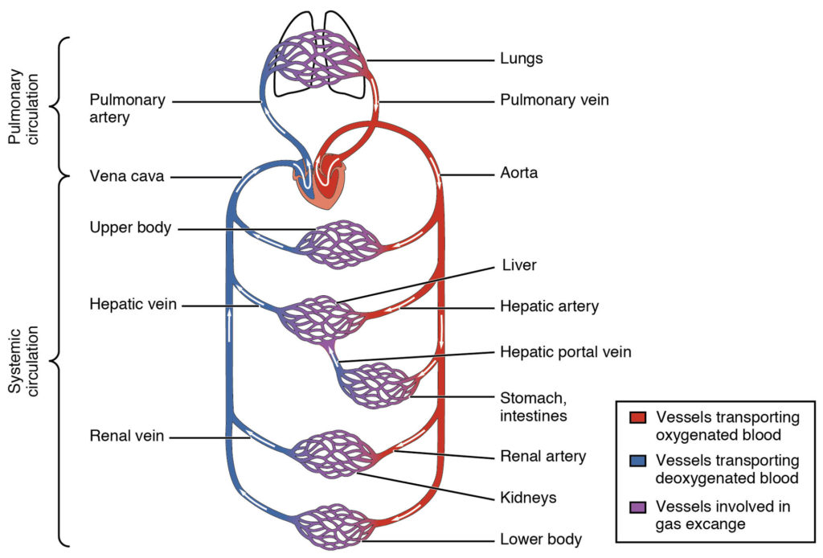
Appendix - Heart Anatomy
Image from “The Circulatory System” by Langara College, Nutrition and Food Service Management Program is licensed under a Creative Commons Attribution-NonCommercialShareAlike 4.0 International License,

Slide 56
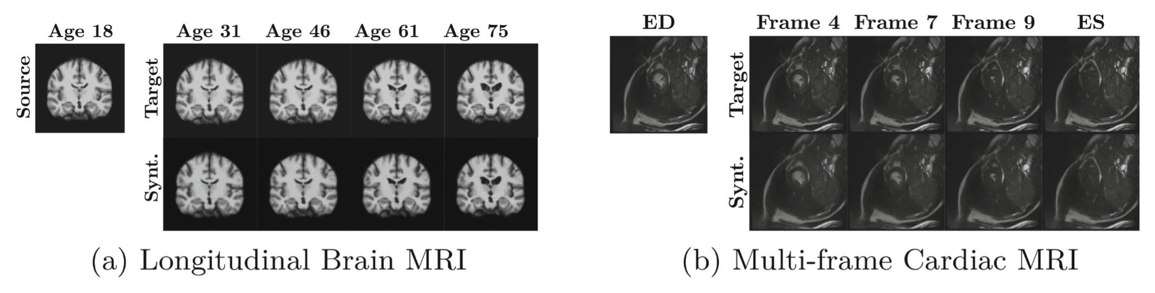
Appendix - SADM
Yoon, J. S., Zhang, C., Suk, H.-I., Guo, J., & Li, X. (2022). SADM: Sequence-Aware Diffusion Model for Longitudinal Medical Image Generation. Lecture Notes in Computer Science (Including Subseries Lecture Notes in Artificial Intelligence and Lecture Notes in Bioinformatics), 13939 LNCS, 388–400. https://doi.org/10.1007/978-3-031-34048-2_30

Slide 57
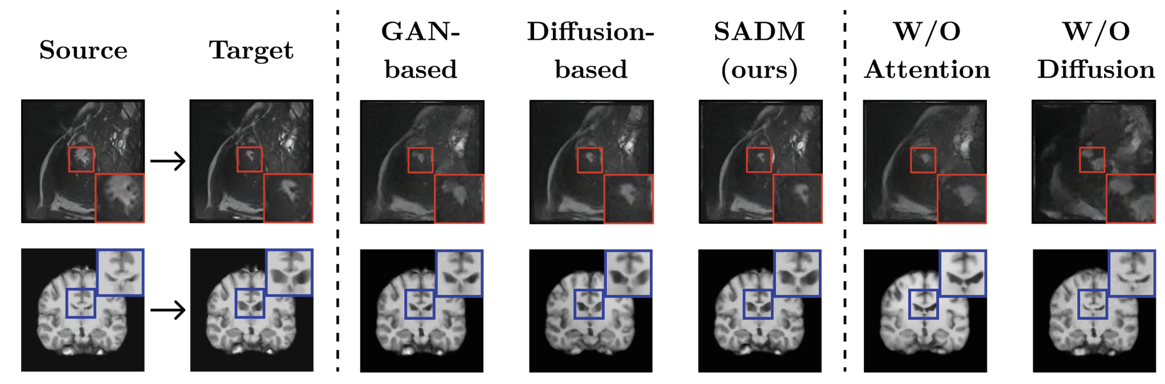
Appendix - SADM
Yoon, J. S., Zhang, C., Suk, H.-I., Guo, J., & Li, X. (2022). SADM: Sequence-Aware Diffusion Model for Longitudinal Medical Image Generation. Lecture Notes in Computer Science (Including Subseries Lecture Notes in Artificial Intelligence and Lecture Notes in Bioinformatics), 13939 LNCS, 388–400. https://doi.org/10.1007/978-3-031-34048-2_30

Slide 58
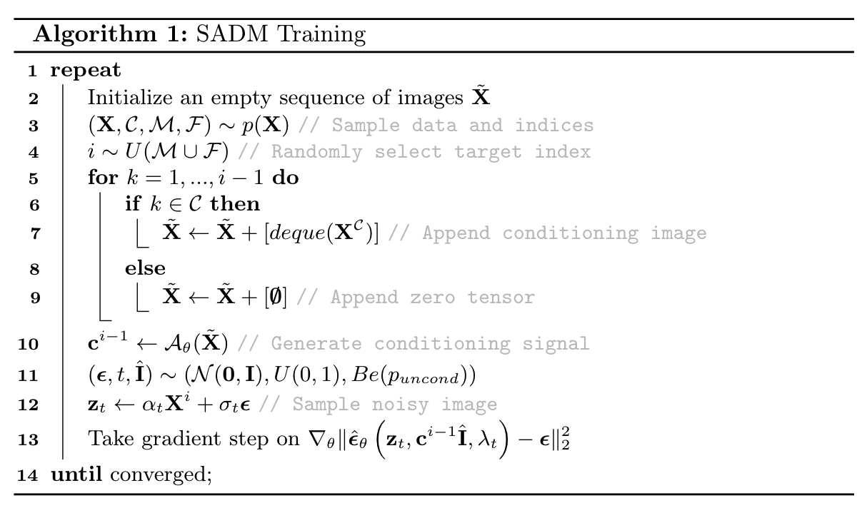
Appendix - SADM
Yoon, J. S., Zhang, C., Suk, H.-I., Guo, J., & Li, X. (2022). SADM: Sequence-Aware Diffusion Model for Longitudinal Medical Image Generation. Lecture Notes in Computer Science (Including Subseries Lecture Notes in Artificial Intelligence and Lecture Notes in Bioinformatics), 13939 LNCS, 388–400. https://doi.org/10.1007/978-3-031-34048-2_30

Slide 59
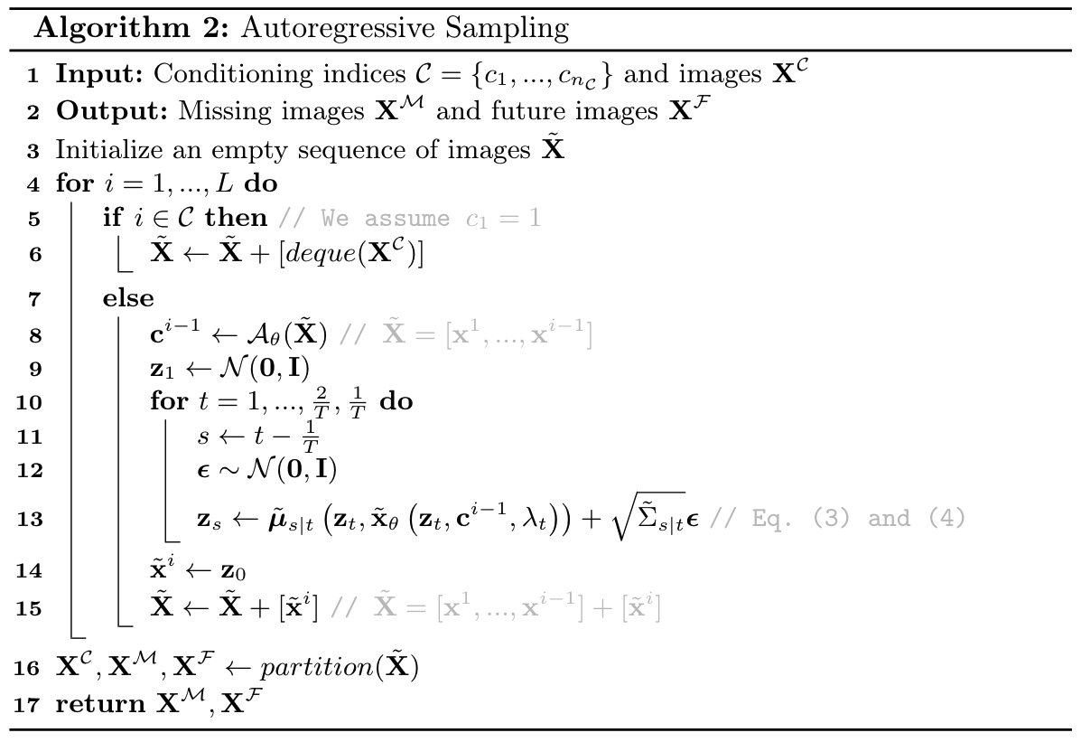
Appendix - SADM
Yoon, J. S., Zhang, C., Suk, H.-I., Guo, J., & Li, X. (2022). SADM: Sequence-Aware Diffusion Model for Longitudinal Medical Image Generation. Lecture Notes in Computer Science (Including Subseries Lecture Notes in Artificial Intelligence and Lecture Notes in Bioinformatics), 13939 LNCS, 388–400. https://doi.org/10.1007/978-3-031-34048-2_30

Slide 60
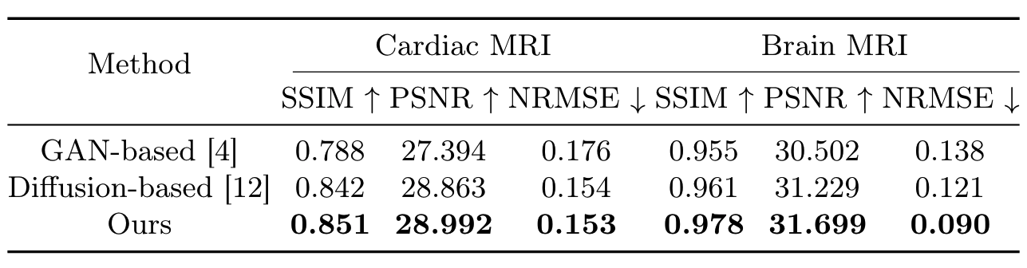
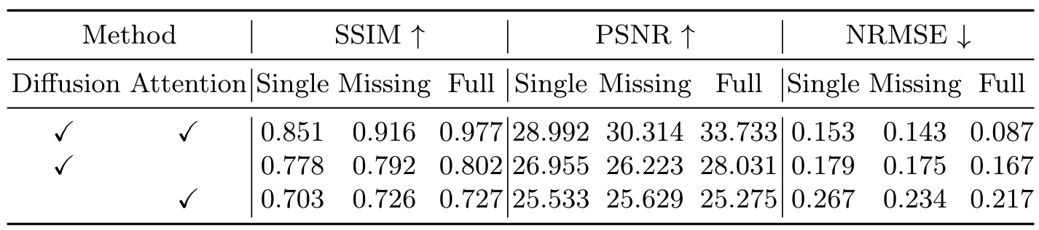
Appendix - SADM
Yoon, J. S., Zhang, C., Suk, H.-I., Guo, J., & Li, X. (2022). SADM: Sequence-Aware Diffusion Model for Longitudinal Medical Image Generation. Lecture Notes in Computer Science (Including Subseries Lecture Notes in Artificial Intelligence and Lecture Notes in Bioinformatics), 13939 LNCS, 388–400. https://doi.org/10.1007/978-3-031-34048-2_30

Slide 61
Appendix - Latent Motion Matrix
,
,
Krebs, J., Delingette, H., Ayache, N., & Mansi, T. (2021). Learning a Generative Motion Model from Image Sequences Based on a Latent Motion Matrix. IEEE Transactions on Medical Imaging, 40(5), 1405–1416. https://doi.org/10.1109/TMI.2021.3056531
Notes:
Motion Matrix:
sample motion matrix z from q
Sigma = covariance matrix Diag(K_{l})
K_{l} choosable -> chose Cauchy Kernel
resistant to outliers
long range dependencies

Slide 62
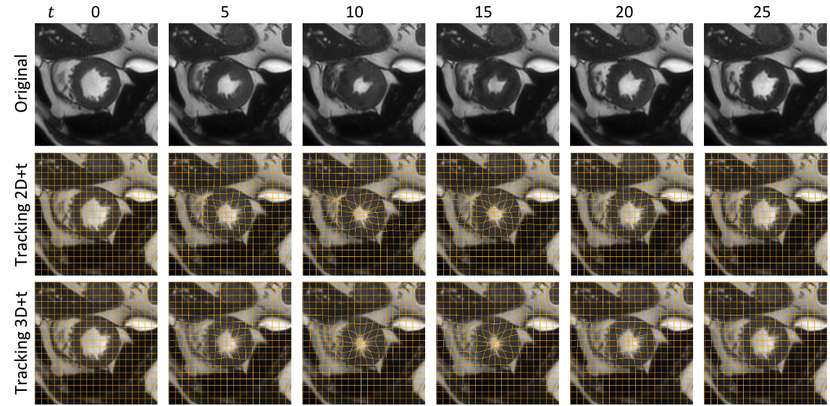
Latent Motion Matrix CVAE
Application: Motion Tracking & Reconstruction
Krebs, J., Delingette, H., Ayache, N., & Mansi, T. (2021). Learning a Generative Motion Model from Image Sequences Based on a Latent Motion Matrix. IEEE Transactions on Medical Imaging, 40(5), 1405–1416. https://doi.org/10.1109/TMI.2021.3056531
Notes:
Generated Motion Matrices -> reconstructed images
Real data sequence over 25 timesteps
2D+t sequence (only on that slice)
3D+t sequence (full volume)
deformation field in yellow
Can spot differences between real & synthetic but created realistic motion

Slide 63
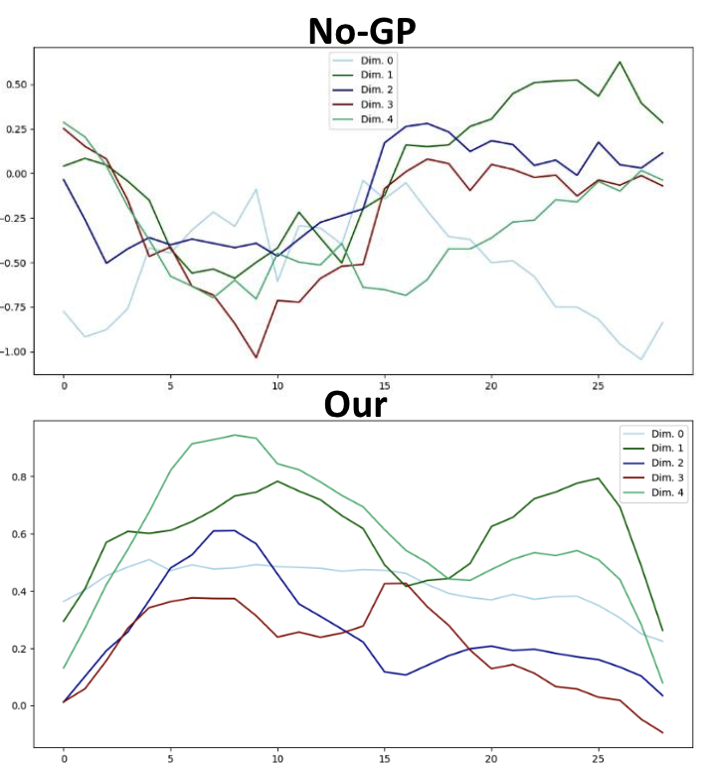
Appendix - Latent Motion Matrix
first five dimensions of the latent space
Krebs, J., Delingette, H., Ayache, N., & Mansi, T. (2021). Learning a Generative Motion Model from Image Sequences Based on a Latent Motion Matrix. IEEE Transactions on Medical Imaging, 40(5), 1405–1416. https://doi.org/10.1109/TMI.2021.3056531
Notes:
smoother with Gaussian Process Prior

Slide 64
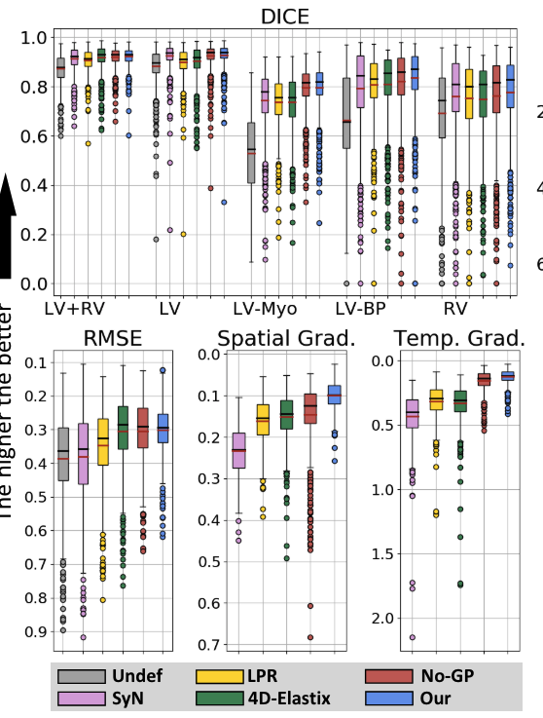
Appendix - Latent Motion Matrix
Krebs, J., Delingette, H., Ayache, N., & Mansi, T. (2021). Learning a Generative Motion Model from Image Sequences Based on a Latent Motion Matrix. IEEE Transactions on Medical Imaging, 40(5), 1405–1416. https://doi.org/10.1109/TMI.2021.3056531
Notes:
smoother with Gaussian Process Prior

Slide 65
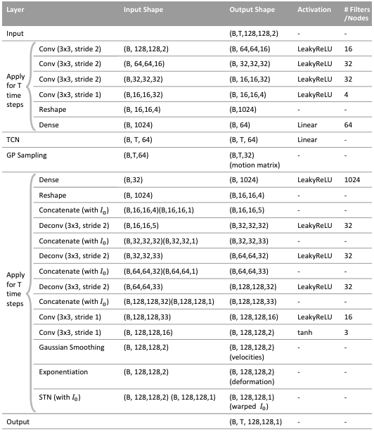
Appendix - Latent Motion Matrix
Implementation Details
Krebs, J., Delingette, H., Ayache, N., & Mansi, T. (2021). Learning a Generative Motion Model from Image Sequences Based on a Latent Motion Matrix. IEEE Transactions on Medical Imaging, 40(5), 1405–1416. https://doi.org/10.1109/TMI.2021.3056531
Notes:
smoother with Gaussian Process Prior

Slide 66
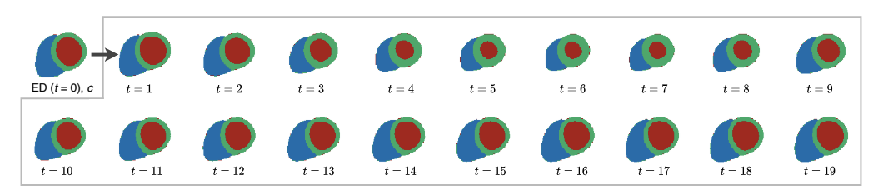
Appendix - CHeart
Qiao, M., Wang, S., Qiu, H., de Marvao, A., O’Regan, D. P., Rueckert, D., & Bai, W. (2024). CHeart: A Conditional Spatio-Temporal Generative Model for Cardiac Anatomy. IEEE Transactions on Medical Imaging, 43(3), 1259–1269. https://doi.org/10.1109/TMI.2023.3331982
Notes:
Blue = RV
Red = LV
Green = Myocardium

Slide 67
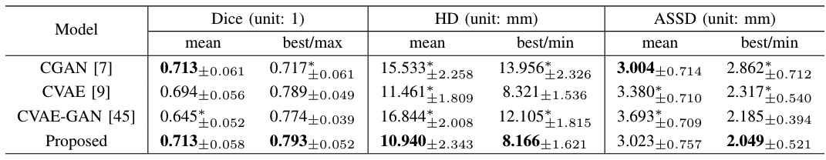
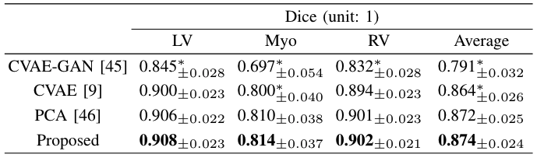
Appendix - CHeart
Qiao, M., Wang, S., Qiu, H., de Marvao, A., O’Regan, D. P., Rueckert, D., & Bai, W. (2024). CHeart: A Conditional Spatio-Temporal Generative Model for Cardiac Anatomy. IEEE Transactions on Medical Imaging, 43(3), 1259–1269. https://doi.org/10.1109/TMI.2023.3331982
Notes:
table1:
COMPARISON OF SEQUENCE GENERATION PERFORMANCE BETWEEN CGAN, CVAE, CVAE-GAN AND THE PROPOSED MODEL, IN TERMS OF MEAN AND BEST DICE METRIC AND CONTOUR DISTANCE METRICS FOR THE AVERAGE PERFORMANCE OVER LV, RV AND MYO. THE BEST VALUE ACROSS 20 SAMPLES FOR DICE METRIC (MAXIMUM), HD (MINIMUM) AND ASSD (MINIMUM) ARE REPORTED. ASTERISKS INDICATE STATISTICAL SIGNIFICANCE ( ∗: P ≤ 0.05) WHEN USING A PAIRED STUDENT’S t-TEST COMPARING THE PERFORMANCE OF THE PROPOSED METHOD TO OTHER METHODS.
table2:
THE SEQUENCE COMPLETION PERFORMANCE OF DIFFERENT MODELS IN TERMS OF DICE, HAUSDORFF DISTANCE (HD), AVERAGE SYMMETRIC SURFACE DISTANCE (ASSD). MEAN AND STANDARD DEVIATION ARE REPORTED. ASTERISKS INDICATE STATISTICAL SIGNIFICANCE ( ∗: P ≤ 0.05) WHEN USING A PAIRED STUDENT’S t-TEST COMPARING THE PERFORMANCE OF THE PROPOSED METHOD TO OTHER METHODS

Slide 68
Appendix - Datasets used
SADM:
Automated Cardiac Diagnosis Challenge Dataset (ACDC)
Latent Motion Matrix CVAE:
ACDC
dataset from MD-Paedigree project (non-public)
CHeart:
short-axis 3d MR dataset of 1383 subjects from Hammersmith Hospital, Imperial College London
Qiao, M., Wang, S., Qiu, H., de Marvao, A., O’Regan, D. P., Rueckert, D., & Bai, W. (2024). CHeart: A Conditional Spatio-Temporal Generative Model for Cardiac Anatomy. IEEE Transactions on Medical Imaging, 43(3), 1259–1269. https://doi.org/10.1109/TMI.2023.3331982

