Slide 1
Multimodal Generative Models
Deep Learning for Medical Applications

Slide 2
Motivation
Current models are designed to perform a single task
  Generate images, text, ...
Multi-modal models generate data from/to multiple modalities
  Using multiple medical imaging modalities to perform diagnosis
  Combine personalized concepts
  Controllable image generation tasks
Notes:
In recent years, the field of artificial intelligence has seen significant advancements, particularly in the development of generative models.
However, current models are designed to perform a single task. For example, a text-to-image model takes an input prompt and generates a corresponding image.
While these models are employed in various field with great results, we need different concepts, for example in the medical field. Imagin tools in medicine have been drastically improved over the last decade, leading to better resolutions and easier application.
Now the goal is to combine multiple imaging modalities to enhance the accuracy and robustness of diagnostic models.
Multi-modal generative models are designed to handle and generate data from multiple modalities, such as text, images, and audio, simultaneously.
Say what possible with these models and where there limitaitons are => why we need multimodal generative models

Slide 3
Background
Deep Learning for Medical Applications
Notes:
Now, I will give a short overview of generative model, specifically diffusion models

Slide 4
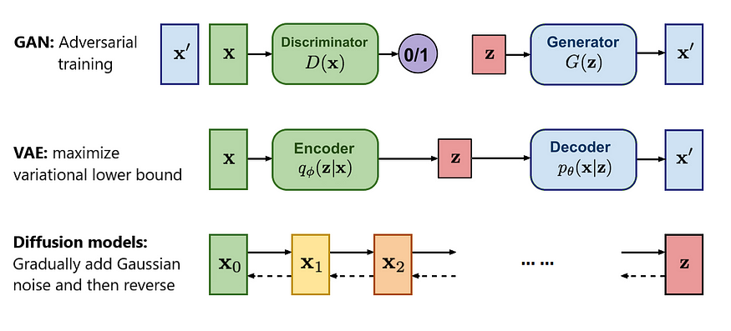
Generative Models
A probabilistic model aims to learn a complex data distribution, which allows the creation of new samples from the learned distribution.
https://towardsai.net/p/machine-learning/diffusion-models-vs-gans-vs-vaes-comparison-of-deep-generative-models
Notes:
A generative model is a probabilistic model, that aims to learn a complex data distribution. This allows the model to create new samples from the learned distribution.
Different types of generative models a generative adversarial networks (GAN), variational autoencoders (VAE), and diffusion models.
A generative model is a probabilistic model of the joint probability distribution 𝑃(𝑋,𝑌) on a given observable variable X and target variable Y;^{[1]} A generative model can be used to "generate" random instances (outcomes) of an observation x.^{[2]}

Slide 5
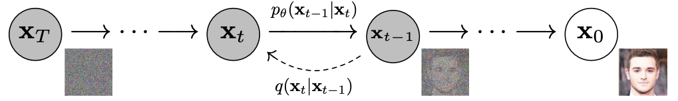
Diffusion Models
Class of generative models that learn to model the data distribution by iterative denoising of a noisy input signal.
Training consists of
  Forward process: iteratively add random noise to input image
  Reverse process: iteratively remove random noise from noisy image
Advantages
  Produce high-quality images
  Flexible generation process (manipulate latent space, condition on extra information)
Ho, Jonathan, Ajay Jain, and Pieter Abbeel. "Denoising diffusion probabilistic models." Advances in neural information processing systems 33 (2020): 6840-6851.
Notes:
Diffusion models are the current standard for generative models. They learn to model the data distribution by denoising a noisy input signal. They consist of a forward process, where noise is added, and learn a reverse process, that removes the noise.
The reason for their popularity is that is the possibility to create high-quality images, and that they offer the most flexible generation process that allows to manipulate the latent space or condition on additional information.
This controllability enables applications like image editing, style transfer, and multimodal generation.
High-fidelity samples. It’s due to the nature of gradually removing noise. Unlike VAEs and GANs, which generate samples at once, diffusion models create samples step by step. The model first creates a coarse image structure and then focuses on adding fine details on top.
High diversity samples. Likelihood maximization covers all modes of the training dataset.
The intermediate noisy images serve as latent codes and have the same size as the training images. This is one of the reasons why diffusion models can generate high-fidelity samples.

Slide 6
Concept Weaver: Enabling Multi-Concept Fusion in Text-to-Image Models
Deep Learning for Medical Applications
Notes:
The first paper that I’m going to present is concept Weaver: enabling multi-concept fusion in text-to-image models

Slide 7
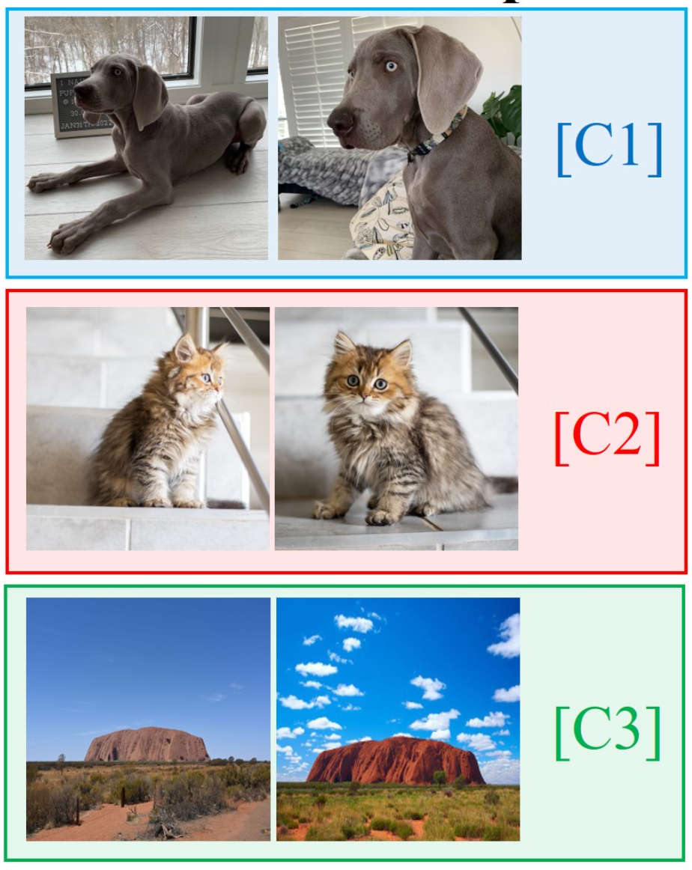
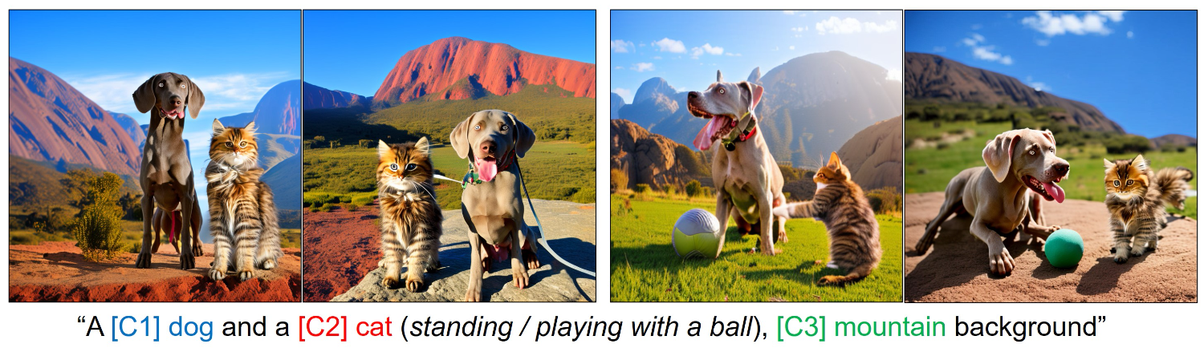
Concept Weaver – Problem Statement
Given: several user-specified concepts
Goal: fuse concepts into single image
G. Kwon, S. Jenni, D. Li, J.-Y. Lee, J. C. Ye, and F. C. Heilbron, “Concept Weaver: Enabling Multi-Concept Fusion in Text-to-Image Models.” arXiv:2404.03913 (2024).
Notes:
We are given several user-specific concept, each with a few images.
Goal is to fuse these concepts into a single image given an input prompt referencing the concepts.
Image should not only keep semantic meaning of input prompt but also distinct visual features of each concept.

Slide 8
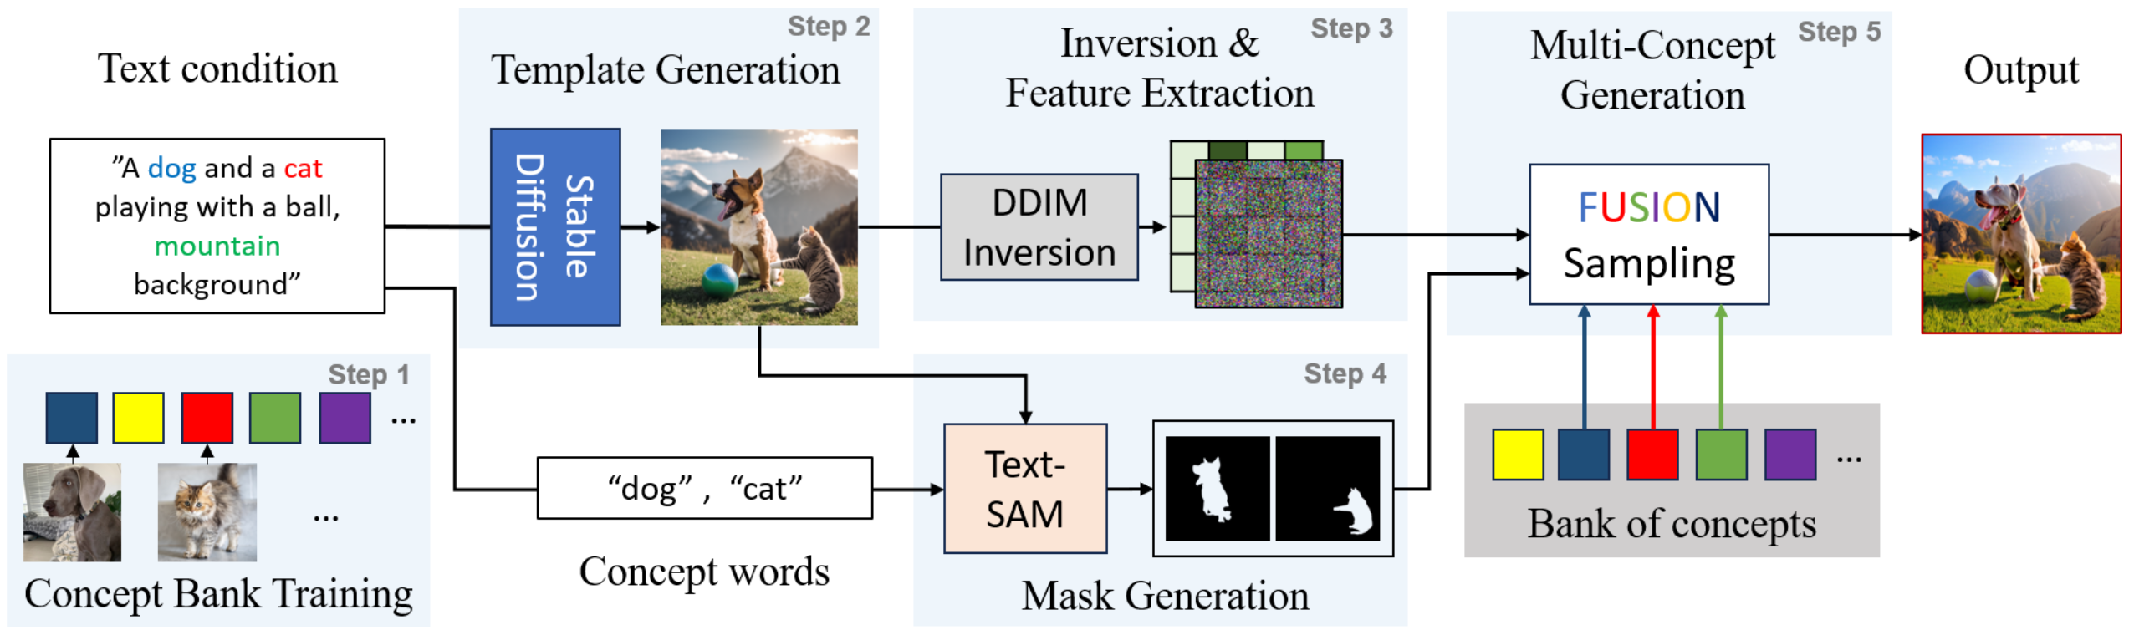
Concept Weaver – Method
G. Kwon, S. Jenni, D. Li, J.-Y. Lee, J. C. Ye, and F. C. Heilbron, “Concept Weaver: Enabling Multi-Concept Fusion in Text-to-Image Models.” arXiv:2404.03913 (2024).
Notes:
This is an overview of proposed concept weaver’s method to create multi-concept images in a single step.
Let’s look at each step individually:
(First, we fine-tune a text-to-timage model for each target concept in the bank (Step 1). Then we source a template image (Step 2). Given the template image, we apply the inversion process with simultaneous feature extraction to save its structural information (Step 3). In Step 4, we extract region masks from the template image with off-the-shelf models [10]. With extracted features and masks, we generate the multi-concept image in Step 5))

Slide 9
Concept Weaver – Method
G. Kwon, S. Jenni, D. Li, J.-Y. Lee, J. C. Ye, and F. C. Heilbron, “Concept Weaver: Enabling Multi-Concept Fusion in Text-to-Image Models.” arXiv:2404.03913 (2024).
Notes:
At first, a Custom Diffusion model is fine-tuned for each personalized concept, this is called Concept Bank Training. The fine-tuning only affects the Key and Value weights of the cross-attention layers. Additionally, the input prompt contains a modifier token so that the fine-tuning process modifies the specific concept and not the general visual representation of the concept. E.g. learning the visual traits of the given dog (color, race, …), and not changing the general view of dogs.

Slide 10
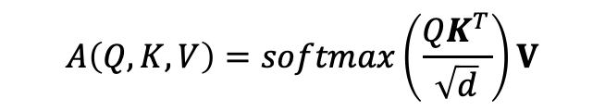
Concept Weaver – Method
$$A\left(Q,K,V\right)=softmax\left(\frac{QK^{T}}{\sqrt{d}}\right)V$$
Modifier tokens: [C*] concept
G. Kwon, S. Jenni, D. Li, J.-Y. Lee, J. C. Ye, and F. C. Heilbron, “Concept Weaver: Enabling Multi-Concept Fusion in Text-to-Image Models.” arXiv:2404.03913 (2024).
Notes:
At first, a Custom Diffusion model is fine-tuned for each personalized concept, this is called Concept Bank Training. The fine-tuning only affects the Key and Value weights of the cross-attention layers.
Additionally, the input prompt contains a modifier token. This allows the model to associate the unique token [V] with the specific visual instance of that subject, while still leveraging its prior knowledge about the general class (e.g. dogs).
Later during the generation process, the prompt with the token is used generate the given concept.
E.g. learning the visual traits of the given dog (color, race, …), and not changing the general view of dogs.
By only fine-tuning Wk and Wv for each target concept, the model can learn to associate that concept's visual representation with the corresponding text prompt, without altering the rest of the model parameters.

Slide 11
Concept Weaver – Method
G. Kwon, S. Jenni, D. Li, J.-Y. Lee, J. C. Ye, and F. C. Heilbron, “Concept Weaver: Enabling Multi-Concept Fusion in Text-to-Image Models.” arXiv:2404.03913 (2024).
Notes:
Then a basic template is generated by using a basic text-to-image model, in this case stable diffusion. TODO: reference stable diffusion

Slide 12
Concept Weaver – Method
G. Kwon, S. Jenni, D. Li, J.-Y. Lee, J. C. Ye, and F. C. Heilbron, “Concept Weaver: Enabling Multi-Concept Fusion in Text-to-Image Models.” arXiv:2404.03913 (2024).
Notes:
This template image is used to guide the generation process. Therefore we need to extract some information out of it.
Click

Slide 13
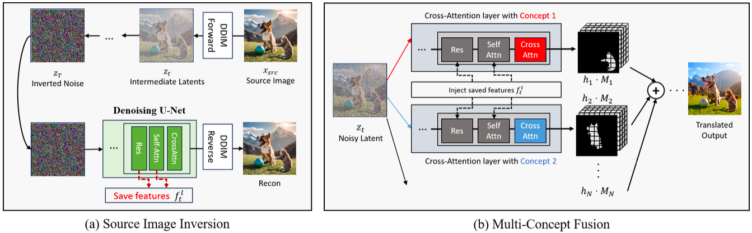
Concept Weaver – Method
G. Kwon, S. Jenni, D. Li, J.-Y. Lee, J. C. Ye, and F. C. Heilbron, “Concept Weaver: Enabling Multi-Concept Fusion in Text-to-Image Models.” arXiv:2404.03913 (2024).
Notes:
we use the forward diffusion process on template image and save a latent representation, which is as the starting point of the diffusion process later on.
click
Additionally, we also apply the backwards process on the fully inverted noise. this is done to extract features from specific U-net layers, which are then used in the last step to guide the image generation for each concept with the same structural informaiton.

Slide 14
Concept Weaver – Method
G. Kwon, S. Jenni, D. Li, J.-Y. Lee, J. C. Ye, and F. C. Heilbron, “Concept Weaver: Enabling Multi-Concept Fusion in Text-to-Image Models.” arXiv:2404.03913 (2024).
Notes:
we use the forward diffusion process on template image and save a latent representation, which is as the starting point of the diffusion process later on.
click
Additionally, we also apply the backwards process on the fully inverted noise. this is done to extract features from specific U-net layers, which are then used in the last step to guide the image generation for each concept with the same structural informaiton.

Slide 15
Concept Weaver – Method
G. Kwon, S. Jenni, D. Li, J.-Y. Lee, J. C. Ye, and F. C. Heilbron, “Concept Weaver: Enabling Multi-Concept Fusion in Text-to-Image Models.” arXiv:2404.03913 (2024).
Notes:
we use the forward diffusion process on template image and save a latent representation, which is as the starting point of the diffusion process later on.
click
Additionally, we also apply the backwards process on the fully inverted noise. this is done to extract features from specific U-net layers, which are then used in the last step to guide the image generation for each concept with the same structural informaiton.

Slide 16
Concept Weaver – Method
G. Kwon, S. Jenni, D. Li, J.-Y. Lee, J. C. Ye, and F. C. Heilbron, “Concept Weaver: Enabling Multi-Concept Fusion in Text-to-Image Models.” arXiv:2404.03913 (2024).
Notes:
we use the forward diffusion process on template image and save a latent representation, which is as the starting point of the diffusion process later on.
click
Additionally, we also apply the backwards process on the fully inverted noise. this is done to extract features from specific U-net layers, which are then used in the last step to guide the image generation for each concept with the same structural informaiton.

Slide 17
Concept Weaver – Method
G. Kwon, S. Jenni, D. Li, J.-Y. Lee, J. C. Ye, and F. C. Heilbron, “Concept Weaver: Enabling Multi-Concept Fusion in Text-to-Image Models.” arXiv:2404.03913 (2024).
Notes:
Use a of the shelf text segment anything model to create a mask for each concept from the template image..

Slide 18
Concept Weaver – Method
G. Kwon, S. Jenni, D. Li, J.-Y. Lee, J. C. Ye, and F. C. Heilbron, “Concept Weaver: Enabling Multi-Concept Fusion in Text-to-Image Models.” arXiv:2404.03913 (2024).
Notes:
Now the last step, where everything is combined

Slide 19
Concept Weaver – Method
G. Kwon, S. Jenni, D. Li, J.-Y. Lee, J. C. Ye, and F. C. Heilbron, “Concept Weaver: Enabling Multi-Concept Fusion in Text-to-Image Models.” arXiv:2404.03913 (2024).
Notes:
Use custom pre-trained diffusion model for each concept:
Starting point latent representation, inject extracted features
we than have a seperate image for each concept and use masked guidance to merge these into the final image.

Slide 20
Concept Weaver – Method
G. Kwon, S. Jenni, D. Li, J.-Y. Lee, J. C. Ye, and F. C. Heilbron, “Concept Weaver: Enabling Multi-Concept Fusion in Text-to-Image Models.” arXiv:2404.03913 (2024).
Notes:
Use custom pre-trained diffusion model for each concept:
Starting point latent representation, inject extracted features
we than have a seperate image for each concept and use masked guidance to merge these into the final image.

Slide 21
Concept Weaver – Method
G. Kwon, S. Jenni, D. Li, J.-Y. Lee, J. C. Ye, and F. C. Heilbron, “Concept Weaver: Enabling Multi-Concept Fusion in Text-to-Image Models.” arXiv:2404.03913 (2024).
Notes:
Use custom pre-trained diffusion model for each concept:
Starting point latent representation, inject extracted features
we than have a seperate image for each concept and use masked guidance to merge these into the final image.

Slide 22
Concept Weaver – Method
G. Kwon, S. Jenni, D. Li, J.-Y. Lee, J. C. Ye, and F. C. Heilbron, “Concept Weaver: Enabling Multi-Concept Fusion in Text-to-Image Models.” arXiv:2404.03913 (2024).
Notes:
Use custom pre-trained diffusion model for each concept:
Starting point latent representation, inject extracted features
we than have a seperate image for each concept and use masked guidance to merge these into the final image.

Slide 23
Concept Weaver – Method
G. Kwon, S. Jenni, D. Li, J.-Y. Lee, J. C. Ye, and F. C. Heilbron, “Concept Weaver: Enabling Multi-Concept Fusion in Text-to-Image Models.” arXiv:2404.03913 (2024).
Notes:
Use custom pre-trained diffusion model for each concept:
Starting point latent representation, inject extracted features
we than have a seperate image for each concept and use masked guidance to merge these into the final image.

Slide 24
Concept Weaver – Method
G. Kwon, S. Jenni, D. Li, J.-Y. Lee, J. C. Ye, and F. C. Heilbron, “Concept Weaver: Enabling Multi-Concept Fusion in Text-to-Image Models.” arXiv:2404.03913 (2024).
Notes:
Use custom pre-trained diffusion model for each concept:
Starting point latent representation, inject extracted features
we than have a seperate image for each concept and use masked guidance to merge these into the final image.

Slide 25
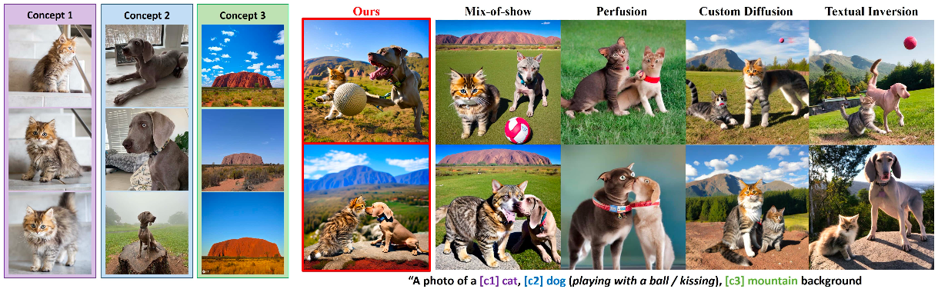
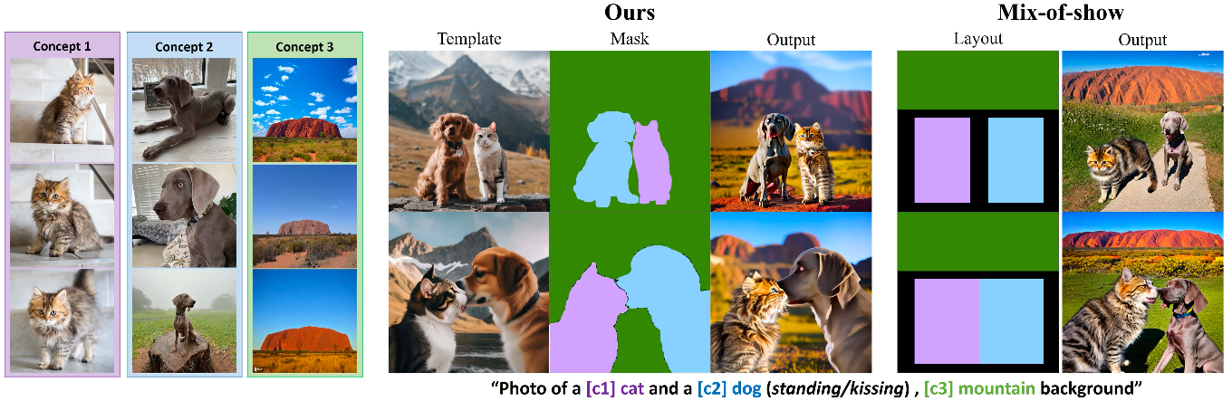
Concept Weaver – Results
G. Kwon, S. Jenni, D. Li, J.-Y. Lee, J. C. Ye, and F. C. Heilbron, “Concept Weaver: Enabling Multi-Concept Fusion in Text-to-Image Models.” arXiv:2404.03913 (2024).
Notes:
Visual results of concept weaver. Close interaction good possible, no mix of concepts.
You can see those detailed masks that allows to merge the different concepts easily.

Slide 26
Concept Weaver – Results
G. Kwon, S. Jenni, D. Li, J.-Y. Lee, J. C. Ye, and F. C. Heilbron, “Concept Weaver: Enabling Multi-Concept Fusion in Text-to-Image Models.” arXiv:2404.03913 (2024).
Notes:
Visual results of concept weaver. Close interaction good possible, no mix of concepts.
The reason for that is in the created masks, that are very detailed, compared to prior methods such as mix-of-show.

Slide 27
Concept Weaver – Results
G. Kwon, S. Jenni, D. Li, J.-Y. Lee, J. C. Ye, and F. C. Heilbron, “Concept Weaver: Enabling Multi-Concept Fusion in Text-to-Image Models.” arXiv:2404.03913 (2024).
Notes:
Visual results of concept weaver. Close interaction good possible, no mix of concepts.
The reason for that is in the created masks, that are very detailed, compared to prior methods such as mix-of-show.

Slide 28
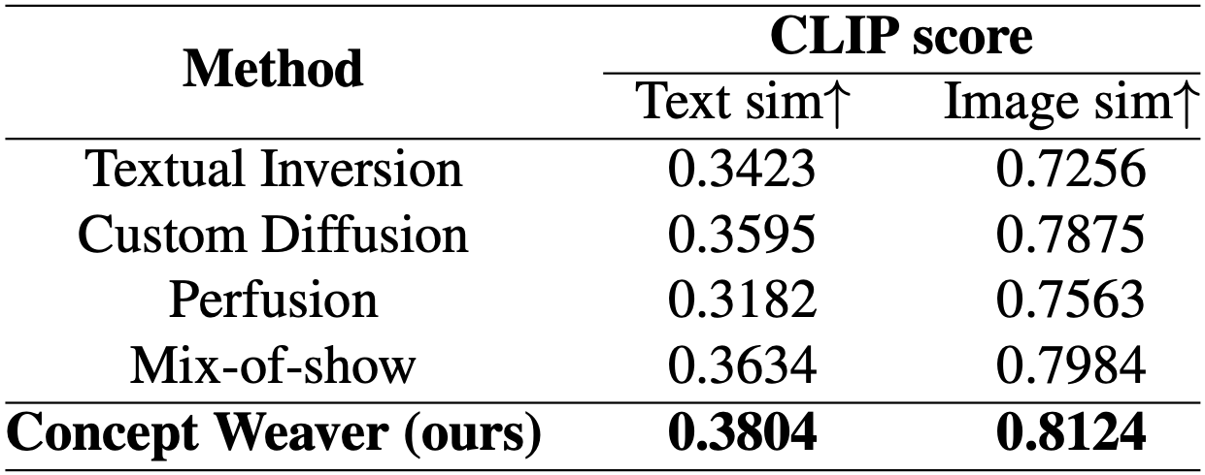
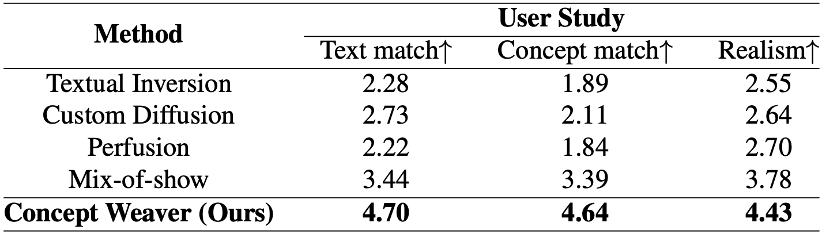
Concept Weaver – Results
G. Kwon, S. Jenni, D. Li, J.-Y. Lee, J. C. Ye, and F. C. Heilbron, “Concept Weaver: Enabling Multi-Concept Fusion in Text-to-Image Models.” arXiv:2404.03913 (2024).
Notes:
Using CLIP score to check for text and image similarity of created pictures. CLIP is a model from openai that is trained to learn representations of images and text in a joint embedding space. This allows to calculate the cosine similarity between the created image and input prompt, as well as the similarity between each concept in the generated image and the input image.
Additionally, a user study with 20 people was conducted, where participants reviewed generated images for their alignment to the text, each concept, and the realism of the image. Scores are form 1 to 5, where 5 is the best.
We can see that concept weaver scores’ are better than compared models in all results.

Slide 29
Instruct-Imagen: Image Generation with Multi-Modal Instruction
Deep Learning for Medical Applications
Notes:
The next paper is Instruct-Imagen: Image Generation with Multi-Modal Instruction

Slide 30
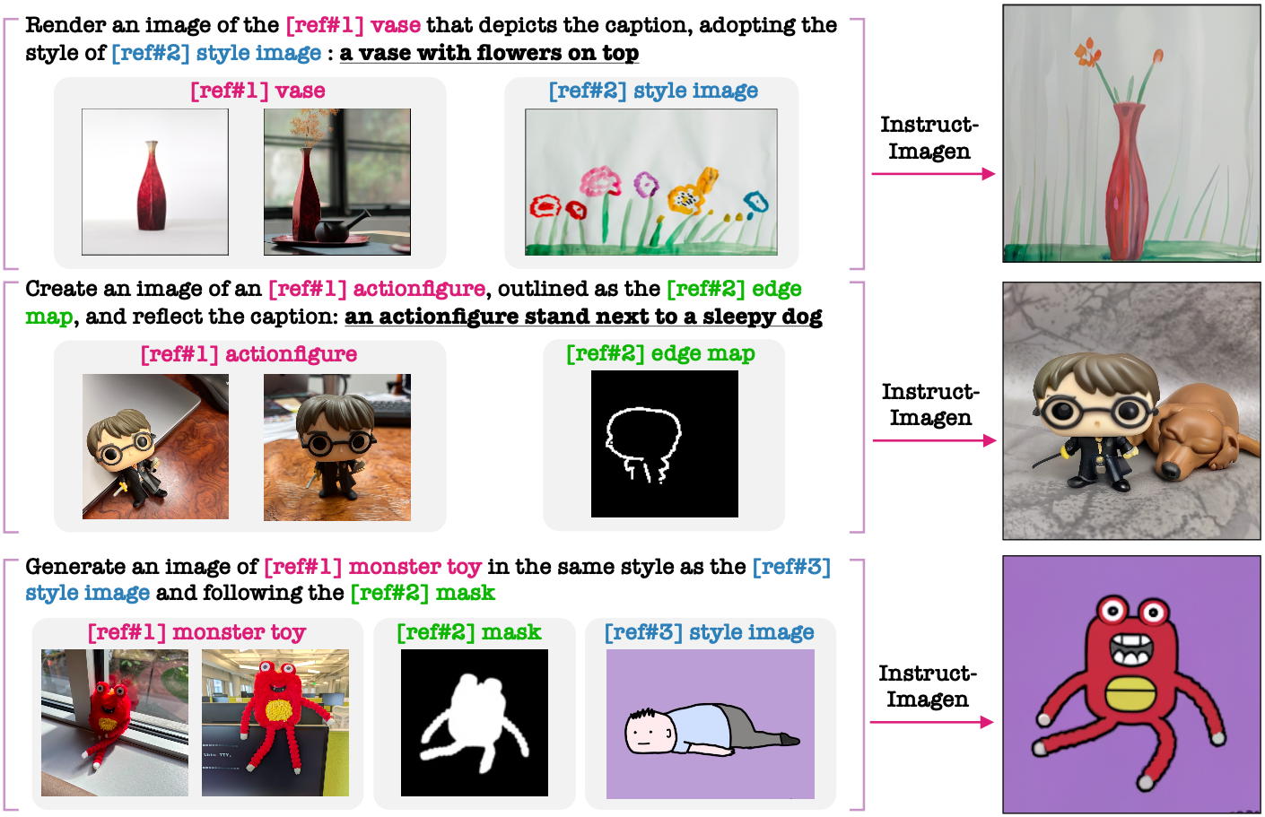
Instruct-Imagen – Problem Statement
Image generation inherently includes multi-modality.
Current models specialize on one modality
=> Need model that can accept multi-modal instruction
H. Hu, K. Chan, Y. Su, W. Chen, Y. Li, K. Sohn, Y. Zhao, X. Ben, B. Gong, W. Cohen, M. Chang, X. Jia, “Instruct-Imagen: Image Generation with Multi-modal Instruction.” arXiv:2401.01952 (2024)
Notes:
As I mentioned before, Image generation inherently include multi-modality, if we want to give detailed instruction on how the image should be generated/so that we can define the generated image in more details. Current models only specialize on one modality. The proposed Instruct Imagen model by Hu et al. introduces multi-modal instruction.

Slide 31
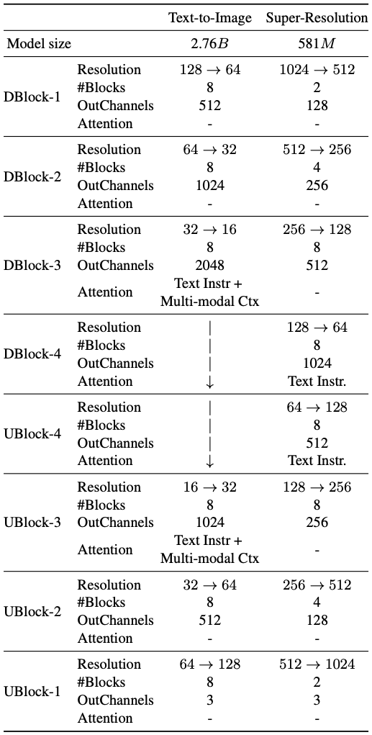
Instruct-Imagen – Network Architecture
Two-stage cascaded U-Net diffusion model
  Text-to-Image
  Super-Resolution
Modified from Imagen [1]
  Cross-attention layer that conditions on multi-modal context
  Text-to-Image down sampler used to extract features from multi-modal instructions
H. Hu, K. Chan, Y. Su, W. Chen, Y. Li, K. Sohn, Y. Zhao, X. Ben, B. Gong, W. Cohen, M. Chang, X. Jia, “Instruct-Imagen: Image Generation with Multi-modal Instruction.” arXiv:2401.01952 (2024)
[1] C. Saharia et al., “Photorealistic Text-to-Image Diffusion Models with Deep Language Understanding.” arXiv (2022)
Notes:
Instruct-Imagen model is a two-stage cascaded diffusion model. This mean that the first stage, generate an image in a low resolution, and the second stage upscales the images to a higher resolution.
The architecture is based on the Imagen model.
Specifically, the U-Net is modified by adding additional cross-attention layer that condition the generation process on multi-modal context and other smaller changes.
Additionally, the Text-to-Image dowm sampler is also used to extract features from multi-modal instructions.

Slide 32
Instruct-Imagen – Network Architecture
Two-stage cascaded U-Net diffusion model
  Text-to-Image
  Super-Resolution
Modified from Imagen [1]
  Cross-attention layer that conditions on multi-modal context
  Text-to-Image down sampler used to extract features from multi-modal instructions
H. Hu, K. Chan, Y. Su, W. Chen, Y. Li, K. Sohn, Y. Zhao, X. Ben, B. Gong, W. Cohen, M. Chang, X. Jia, “Instruct-Imagen: Image Generation with Multi-modal Instruction.” arXiv:2401.01952 (2024)
[1] C. Saharia et al., “Photorealistic Text-to-Image Diffusion Models with Deep Language Understanding.” arXiv (2022)
Notes:
Instruct-Imagen model is a two-stage cascaded diffusion model. This mean that the first stage, generate an image in a low resolution, and the second stage upscales the images to a higher resolution.
The architecture is based on the Imagen model.
Specifically, the U-Net is modified by adding additional cross-attention layer that condition the generation process on multi-modal context and other smaller changes.
Additionally, the Text-to-Image dowm sampler is also used to extract features from multi-modal instructions.

Slide 33
Instruct-Imagen – Network Architecture
Two-stage cascaded U-Net diffusion model
  Text-to-Image
  Super-Resolution
Modified from Imagen [1]
  Cross-attention layer that conditions on multi-modal context
  Text-to-Image down sampler used to extract features from multi-modal instructions
H. Hu, K. Chan, Y. Su, W. Chen, Y. Li, K. Sohn, Y. Zhao, X. Ben, B. Gong, W. Cohen, M. Chang, X. Jia, “Instruct-Imagen: Image Generation with Multi-modal Instruction.” arXiv:2401.01952 (2024)
[1] C. Saharia et al., “Photorealistic Text-to-Image Diffusion Models with Deep Language Understanding.” arXiv (2022)
Notes:
Instruct-Imagen model is a two-stage cascaded diffusion model. This mean that the first stage, generate an image in a low resolution, and the second stage upscales the images to a higher resolution.
The architecture is based on the Imagen model.
Specifically, the U-Net is modified by adding additional cross-attention layer that condition the generation process on multi-modal context and other smaller changes.
Additionally, the Text-to-Image dowm sampler is also used to extract features from multi-modal instructions.

Slide 34
Instruct-Imagen – Network Architecture
Two-stage cascaded U-Net diffusion model
  Text-to-Image
  Super-Resolution
Modified from Imagen [1]
  Cross-attention layer that conditions on multi-modal context
  Text-to-Image down sampler used to extract features from multi-modal instructions
H. Hu, K. Chan, Y. Su, W. Chen, Y. Li, K. Sohn, Y. Zhao, X. Ben, B. Gong, W. Cohen, M. Chang, X. Jia, “Instruct-Imagen: Image Generation with Multi-modal Instruction.” arXiv:2401.01952 (2024)
[1] C. Saharia et al., “Photorealistic Text-to-Image Diffusion Models with Deep Language Understanding.” arXiv (2022)
Notes:
Instruct-Imagen model is a two-stage cascaded diffusion model. This mean that the first stage, generate an image in a low resolution, and the second stage upscales the images to a higher resolution.
The architecture is based on the Imagen model.
Specifically, the U-Net is modified by adding additional cross-attention layer that condition the generation process on multi-modal context and other smaller changes.
Additionally, the Text-to-Image dowm sampler is also used to extract features from multi-modal instructions.

Slide 35
Instruct-Imagen – Network Architecture
Two-stage cascaded U-Net diffusion model
  Text-to-Image
  Super-Resolution
Modified from Imagen [1]
  Cross-attention layer that conditions on multi-modal context
  Text-to-Image down sampler used to extract features from multi-modal instructions
H. Hu, K. Chan, Y. Su, W. Chen, Y. Li, K. Sohn, Y. Zhao, X. Ben, B. Gong, W. Cohen, M. Chang, X. Jia, “Instruct-Imagen: Image Generation with Multi-modal Instruction.” arXiv:2401.01952 (2024)
[1] C. Saharia et al., “Photorealistic Text-to-Image Diffusion Models with Deep Language Understanding.” arXiv (2022)
Notes:
Instruct-Imagen model is a two-stage cascaded diffusion model. This mean that the first stage, generate an image in a low resolution, and the second stage upscales the images to a higher resolution.
The architecture is based on the Imagen model.
Specifically, the U-Net is modified by adding additional cross-attention layer that condition the generation process on multi-modal context and other smaller changes.
Additionally, the Text-to-Image dowm sampler is also used to extract features from multi-modal instructions.

Slide 36
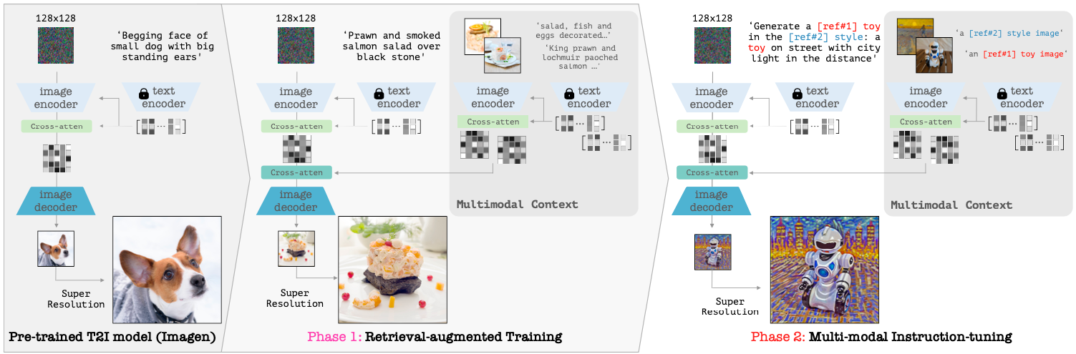
Instruct-Imagen – Method
H. Hu, K. Chan, Y. Su, W. Chen, Y. Li, K. Sohn, Y. Zhao, X. Ben, B. Gong, W. Cohen, M. Chang, X. Jia, “Instruct-Imagen: Image Generation with Multi-modal Instruction.” arXiv:2401.01952 (2024)
Notes:
This is the proposed training pipeline to introduce multi-modal capabilities

Slide 37
Instruct-Imagen – Method
H. Hu, K. Chan, Y. Su, W. Chen, Y. Li, K. Sohn, Y. Zhao, X. Ben, B. Gong, W. Cohen, M. Chang, X. Jia, “Instruct-Imagen: Image Generation with Multi-modal Instruction.” arXiv:2401.01952 (2024)
Notes:
The training process is started on a version of Imagen pretrained on internal data sources. This is now a basic text-to-image model.

Slide 38
Instruct-Imagen – Method
H. Hu, K. Chan, Y. Su, W. Chen, Y. Li, K. Sohn, Y. Zhao, X. Ben, B. Gong, W. Cohen, M. Chang, X. Jia, “Instruct-Imagen: Image Generation with Multi-modal Instruction.” arXiv:2401.01952 (2024)
Notes:
After that, the Retrieval-augmented training is started.
Here the pre-trained diffusion model is further trained on a newly created dataset.
The dataset consists of domain-specific clustered image-text pairs with five pairs per cluster. During training, one pair is selected as the input and target for the model and three other pairs as the multi-modal context. One pair is randomly selected to be redundant.

Slide 39
Instruct-Imagen – Method
H. Hu, K. Chan, Y. Su, W. Chen, Y. Li, K. Sohn, Y. Zhao, X. Ben, B. Gong, W. Cohen, M. Chang, X. Jia, “Instruct-Imagen: Image Generation with Multi-modal Instruction.” arXiv:2401.01952 (2024)
Notes:
As mentioned before, the image encoder is used to to encode the multi-modal input, which are cross-conditioned on their image description. This is than used as the multi-modal context that is used to guide the generation process.

Slide 40
Instruct-Imagen – Method
H. Hu, K. Chan, Y. Su, W. Chen, Y. Li, K. Sohn, Y. Zhao, X. Ben, B. Gong, W. Cohen, M. Chang, X. Jia, “Instruct-Imagen: Image Generation with Multi-modal Instruction.” arXiv:2401.01952 (2024)
Notes:
The second training phase fine-tunes the model on a diverse set of image generation tasks focused on multi-modal instructions. This includes tasks that combine text with other modalities such a syles, edges, or subject

Slide 41
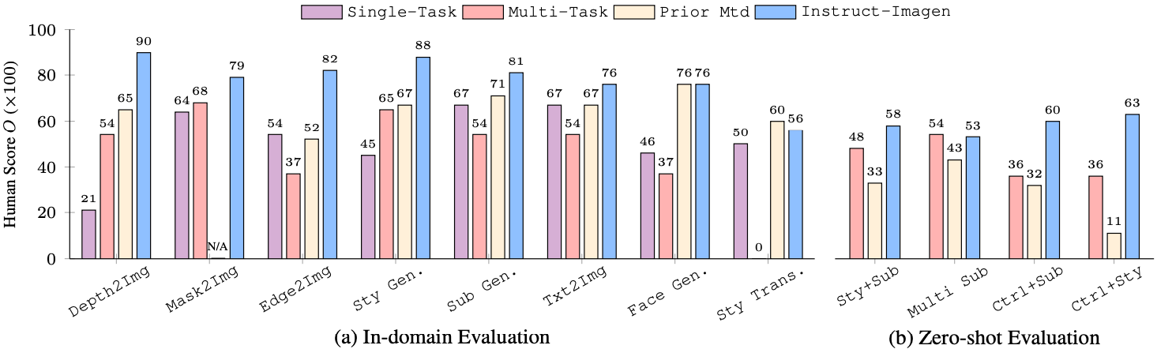
Instruct-Imagen - Results
H. Hu, K. Chan, Y. Su, W. Chen, Y. Li, K. Sohn, Y. Zhao, X. Ben, B. Gong, W. Cohen, M. Chang, X. Jia, “Instruct-Imagen: Image Generation with Multi-modal Instruction.” arXiv:2401.01952 (2024)
Notes:
Instruct-Imagen was tested on in-domain and zero-shot problems, where the latter involves of complex and unseen instructions for image generation. The evaluation was performed using a variety of datasets and was evaluted by humans for all different subtasks. The evaluation is based on the semantic consistency and perceptual quality The single-task and multi-task models are baseline models of Instruct-Imagen with the same model architecture, but they do not have access to multi-modal instruction during fine-tuning. Instead, they directly accept the raw multi-modal inputs relevant to the specific task. Additionally, a single-task model needs to be trained for each subtask. We can see that the proposes methods outperforms prior methods in nearly all evaluated tasks.

Slide 42
MedM2G: Unifying Medical Multi-Modal Generation via Cross-Guided Diffusion with Visual Invariant
Deep Learning for Medical Applications
Notes:
Now I will present the last paper: MedM2G: unifying Medical Multi-Modal Generation via Corss-Guided Diffusion with Visual Invariant.

Slide 43
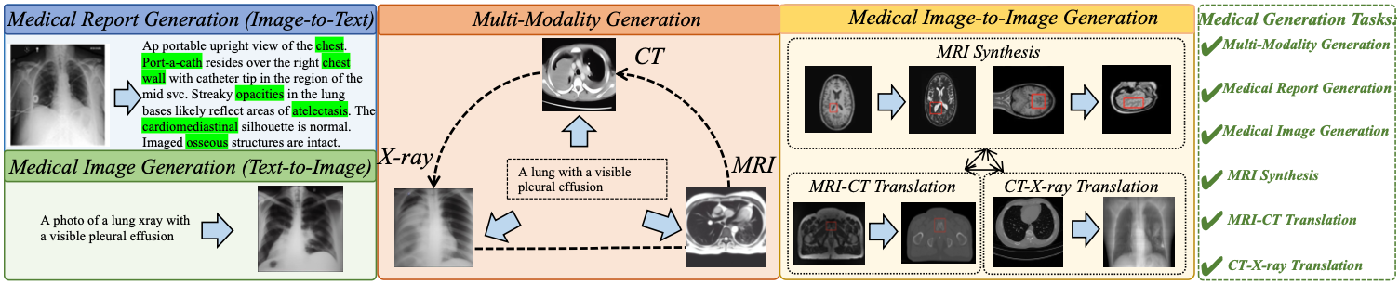
MedM2G – Problem Statement
Medical diagnosis is constrained, by having separate generation models for different modalities
=> Combine three medical modalities in one model
C. Zhan, Y. Lin, G. Wang, H. Wang, and J. Wu, “MedM2G: Unifying Medical Multi-Modal Generation via Cross-Guided Diffusion with Visual Invariant.” arXiv:2403.04290 (2024)
Notes:
Prior models treat every modality individually, resulting in inefficient analysis. The challenge for multi-modality is to align and integrate diverse medical generation task that keeps the distinct features for each modality. The lack of large and diverse medical datasets over multiple modalities hinders the development and training of effective multi-modal generation models.

Slide 44
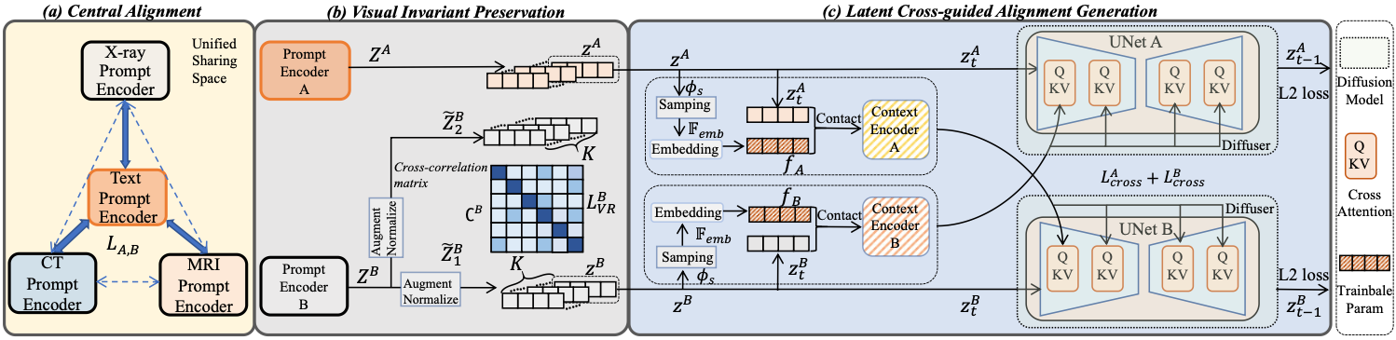
MedM2G – Method
C. Zhan, Y. Lin, G. Wang, H. Wang, and J. Wu, “MedM2G: Unifying Medical Multi-Modal Generation via Cross-Guided Diffusion with Visual Invariant.” arXiv:2403.04290 (2024)
Notes:
Now let’s take a look on how MedM2G tackles these problems.

Slide 45
MedM2G – Method
C. Zhan, Y. Lin, G. Wang, H. Wang, and J. Wu, “MedM2G: Unifying Medical Multi-Modal Generation via Cross-Guided Diffusion with Visual Invariant.” arXiv:2403.04290 (2024)
Notes:
In the beginning, each modality is encoded in its respective latent space. A crucial step is to align the different medical modalities into a shared latent space. They use the text-model for the alignment of the latent space, as it is included in most datasets.

Slide 46
MedM2G – Method
C. Zhan, Y. Lin, G. Wang, H. Wang, and J. Wu, “MedM2G: Unifying Medical Multi-Modal Generation via Cross-Guided Diffusion with Visual Invariant.” arXiv:2403.04290 (2024)
Notes:
Another important feature of MedM2G is the preservation of the medical visual invariant for each imaging modal to maintain the unique clinical properties and diagnostic values. This is achieved by minimizing the off-diagonal elements of the cross-correlation matrix of two augmented images from the dataset.
By minimizing the off-diagonal elements, the goal is to reduce redundancy and enforce the independence of the features in the latent space. This process ensures that the augmented images retain and encode the same underlying information despite being different due to augmentations.

Slide 47
MedM2G – Method
C. Zhan, Y. Lin, G. Wang, H. Wang, and J. Wu, “MedM2G: Unifying Medical Multi-Modal Generation via Cross-Guided Diffusion with Visual Invariant.” arXiv:2403.04290 (2024)
Notes:
The framework also introduces a latent cross-guided alignment generation approach to enable flexible interaction among medical modalities. Guided adaption extracts features from the latent representation of one modality and processes them for another modality. This includes sampling relevant features, embedding them and projecting them to unified shared latent space using a context encoder. Subsequently, cross-conditioning leverages the extracted features from the source modality to condition the target modality’s generation process. This allows the model to effectively integrate information from different modalities, enabling the generation of coherent and clinically relevant outputs.

Slide 48
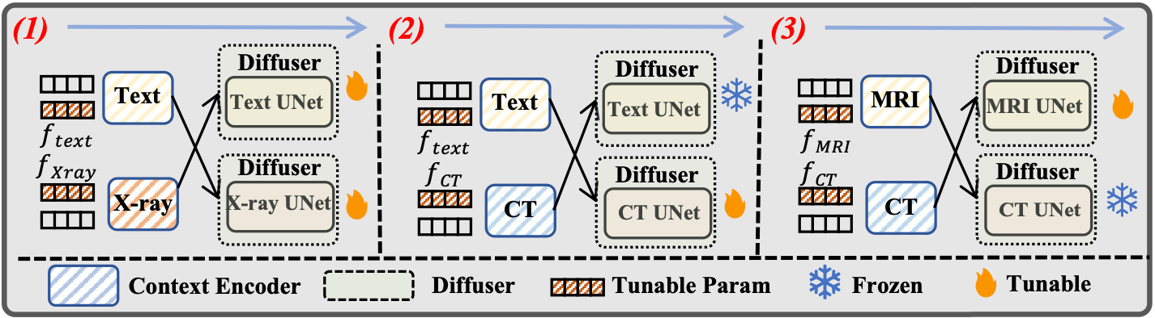
MedM2G – Method
C. Zhan, Y. Lin, G. Wang, H. Wang, and J. Wu, “MedM2G: Unifying Medical Multi-Modal Generation via Cross-Guided Diffusion with Visual Invariant.” arXiv:2403.04290 (2024)
Notes:
These components are combined in three rounds of multi-flow training. Each round focuses on a specific cross-guided alignment task: Text-X-ray, Text-CT, CT-MRI. To ensure efficient training and knowledge transfer, the modality-specific encoders are trained one at a time and then frozen

Slide 49
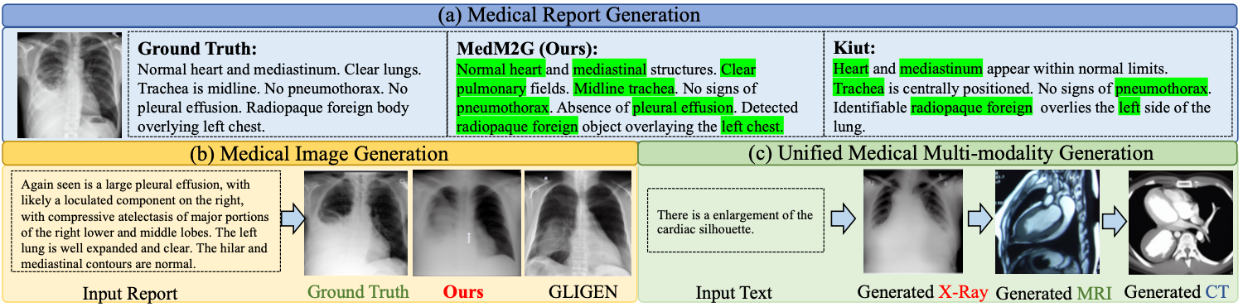
MedM2G – Results
C. Zhan, Y. Lin, G. Wang, H. Wang, and J. Wu, “MedM2G: Unifying Medical Multi-Modal Generation via Cross-Guided Diffusion with Visual Invariant.” arXiv:2403.04290 (2024)
Notes:
Here is a quick overview of qualitative examples, on what the medm2g framework is able to do.
It can create a medical report from a medical image. Create medical image from an input report, for single or multi-modalities.

Slide 50
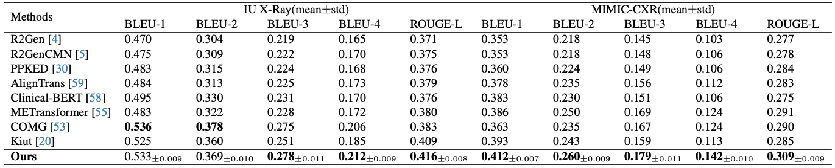
MedM2G – Results
Medical report generation
C. Zhan, Y. Lin, G. Wang, H. Wang, and J. Wu, “MedM2G: Unifying Medical Multi-Modal Generation via Cross-Guided Diffusion with Visual Invariant.” arXiv:2403.04290 (2024)
Notes:
Now I will present some selected results from the paper.
These are the results of medical report generation from an x-ray image on two datasets, IU X-Ray and MIMIC-CXR. Both are anylized with different similarity measurements of the generated report and the target report.

Slide 51
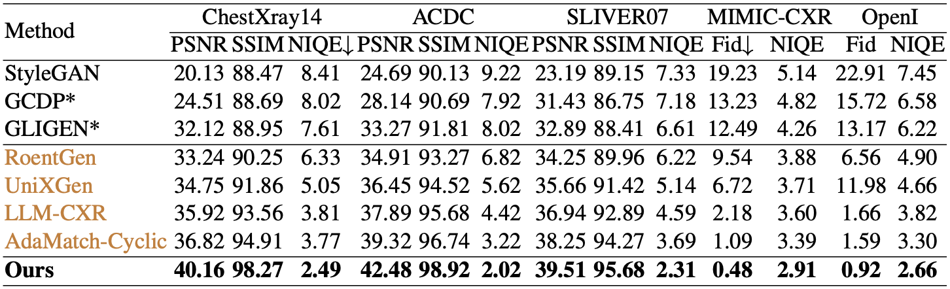
MedM2G – Results
Medical image generation
C. Zhan, Y. Lin, G. Wang, H. Wang, and J. Wu, “MedM2G: Unifying Medical Multi-Modal Generation via Cross-Guided Diffusion with Visual Invariant.” arXiv:2403.04290 (2024)
Notes:
These are the results for Medical image generation on on X-ray, MRI, and CT datasets.
We can again see, that the scores of Medm2g are better that prior methods.
X-ray, mri, ct, xray, ?

Slide 52
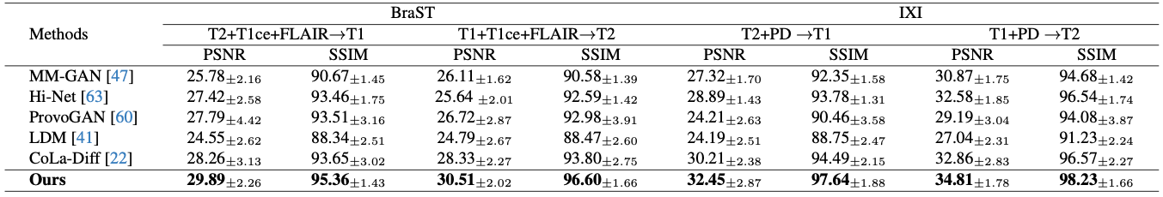
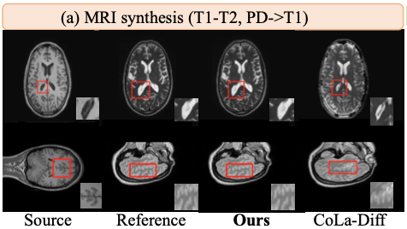
MedM2G – Results
MRI-Synthesis
C. Zhan, Y. Lin, G. Wang, H. Wang, and J. Wu, “MedM2G: Unifying Medical Multi-Modal Generation via Cross-Guided Diffusion with Visual Invariant.” arXiv:2403.04290 (2024)
Notes:
The following table shows the results of MRI Synthesis on the BraST and IXI dataset. TODO
Each MRI image is made up of different components. TODO: weglassen

Slide 53
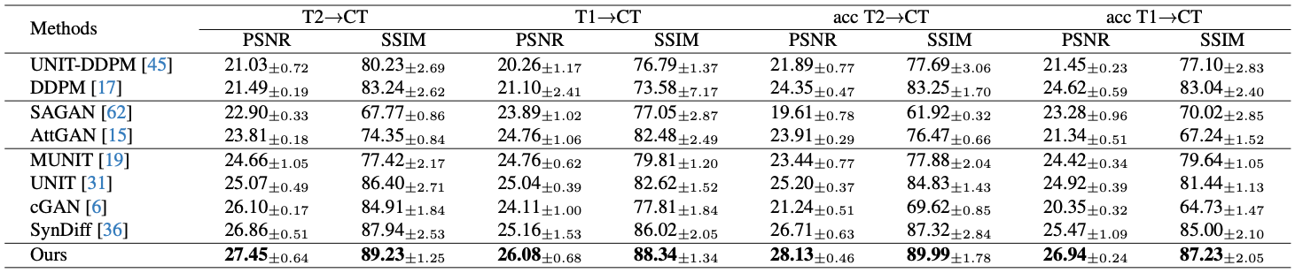
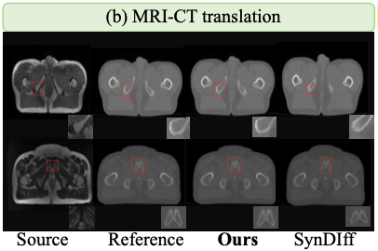
MedM2G – Results
MRI-CT Translation
C. Zhan, Y. Lin, G. Wang, H. Wang, and J. Wu, “MedM2G: Unifying Medical Multi-Modal Generation via Cross-Guided Diffusion with Visual Invariant.” arXiv:2403.04290 (2024)
Notes:
MRI-CT Translation
And the last results I'm going to present are text on the translation form MRI images to CT. Again the model shows impressive results.
In the image you can see the that the model keeps the medical information marked in the red rectangle, during the generation process.

Slide 54
Conclusion
Deep Learning for Medical Applications

Slide 55
Conclusion
Model | Objective | Evaluation | Strengths | Weaknesses
Concept Weaver | Personalized multi-concept fusion | User study, CLIP score for text and image similarity | Keeping distinct characteristics of each concept | Need own fine-tuned model for every concept, no code public
Instruct-Imagen | Multi-modal instructions for image generation | User study for different image generation tasks | Fast inference time, well documented implementation details | No code public
MedM2G | Medical multi-modal framework | Evaluated with multiple domain specific datasets. | Extensive evaluation with single-task models | Complex paper, missing appendix, no code public
Notes:
Concept Weaver
+: distinct characteristics of concept, no mix of concept during close interactions
-: Fine tuned model for every concept, the more concept fusing, the more complex,
Instruct Imagen
+: fast inference time, 17 sec., only training process adapted for multi-modality, just small encoding during inference
-: no code published
MedM2G:
+: extensive evalution with prior single-task models
-: complex paper, missing appendix which is reference, no published code
Usage of standard text-to-image model, if they get better, it also will lead to better results

Slide 56
Thank you for your attention!
Questions?

