Slide 1
Can a Neural Network Learn Physiology?
Deep Learning in Medical Applications
Presented by Donna Hooft
Supervisor: Francesca De Benetti

Slide 2
What is physiology?
Can a Neural Network Learn Physiology?

Slide 3
What is physiology?
Anatomy
What?
Where?
Notes:
Animationcs, into screen 1 by 1
Herein, I'd like to make the distinction between anatomy and physiology.
TotalSegmentator can segment anatomical structures, identifying over 104 structures on CT images with high robustness and accuracy.

Slide 4
What is physiology?
Anatomy
Physiology
What?
Where?
How?
Why?
Notes:
Animationcs, into screen 1 by 1
Herein, I'd like to make the distinction between anatomy and physiology.
TotalSegmentator can segment anatomical structures, identifying over 104 structures on CT images with high robustness and accuracy.

Slide 5
What is physiology?
Anatomy
Physiology
What?
Where?
Already shown in NN
  TotalSegmentator (Wasserthal et al., 2023)
How?
Why?
Notes:
Animationcs, into screen 1 by 1
Herein, I'd like to make the distinction between anatomy and physiology.
TotalSegmentator can segment anatomical structures, identifying over 104 structures on CT images with high robustness and accuracy.

Slide 6
What is physiology?
Anatomy
Physiology
What?
Where?
Already shown in NN
  TotalSegmentator (Wasserthal et al., 2023)
How?
Why?
Not a lot of evidence on learning in AI/NNs
Notes:
Animationcs, into screen 1 by 1
Herein, I'd like to make the distinction between anatomy and physiology.
TotalSegmentator can segment anatomical structures, identifying over 104 structures on CT images with high robustness and accuracy.

Slide 7
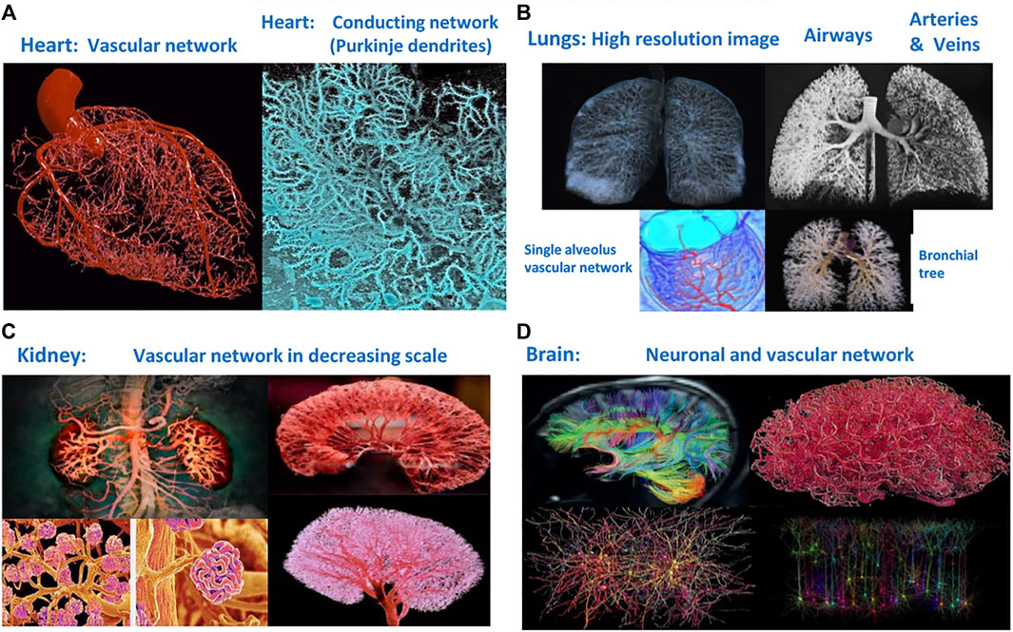
Physiological Systems within the Human Body
Ivanov, P. C. (2021). The new field of network physiology: Building the human physiolome. Frontiers in Network Physiology, 1. https://doi.org/10.3389/fnetp.2021.711778
Notes:
Complex systes → complex interactions
Anatomy and physiology cannot be separated
The human body is an organism comprised of many physiological systems. To resolve many medical issues and challenges, it is important to know how these systems work and how they interact on multiple scales.
But this has not been extensively done yet. So, why is this?

Slide 8
Human Physiology = Complex
Models → Complexity
Notes:
So from this you could already infer for a bit that human physiology can be quite complex, however, when trying to model this, is aiming to reduce the complexity

Slide 9
Network Physiology
A
E
F
B
G
C
Notes:
Even though human physiology, is complex, we could, try model it like many other systems, as a network with nodes and edges

Slide 10
A = Neuron
B = Astrocyte
C = Pericyte
Network Physiology: Neurovascular Coupling
A
E, G, F = Interactions
E
F
B
G
C
Notes:
Basics neurovasc coupling
Short explanation peri and astro
Let’s use this example to model a significantly simplified version neurovascular coupling , wherein a is a neuron, B is an astrocyte and C a pericyte ( an endothial cell of the vascular lining of the brain)

Slide 11

A = Neuron
B = Astrocyte
C = Pericyte
Neural Activity
A
E
F
B
G
C
E, G, F = Interactions
Notes:
Neural activity rises, so there is more glucose and oxygen consumed in the neuron

Slide 12
A = Neuron
B = Astrocyte
C = Pericyte
A
E
F
B
G
C
E, G, F = Interactions
Notes:
The neural cell wil signal to the astocyte like, hey im gonna need some more fuel here

Slide 13
A = Neuron
B = Astrocyte
C = Pericyte
A
E
F
B
G
C
E, G, F = Interactions
Notes:
Then the astrocyte singal sto the endothial cell wih cytokines, like, Hey you have to relax we need more blood inflow here

Slide 14
A = Neuron
B = Astrocyte
C = Pericyte
A
E
F
B
G
C
E, G, F = Interactions
Notes:
This makes the pericyte expand the arteerial

Slide 15

A = Neuron
B = Astrocyte
C = Pericyte
A
E
F
B
G
C
E, G, F = Interactions
Notes:
And this will lead to more blood flow toward the neurons

Slide 16
Dynamic States/ Entities
A, B, C
Network Physiology: Challenges
A
Learning Physiology ≠ (only) Causality
E
F
Dynamic Interactions
E, F, G
G
B
C
Notes:
This is, of course, a very simplified example, but what you could take from this is that if we want to model physiology, we have to keep in mind that the entities and the interactions between them are all dynamic.
And that's exactly what is important in studying physiology. It is not just about learning causal relationships; it's about grasping the dynamic interactions and the dynamic states of these entities, and also on multiple scales. So here you can already guess the issue of complexity that comes into play.

Slide 17
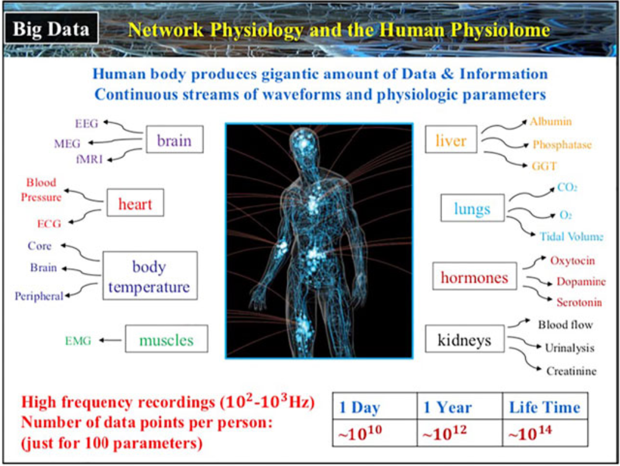
Human Body = Huge Data generator
Availability in Clinical Setting
What data to focus on?
Image from Ivanov, P. C. (2021). The new field of network physiology: Building the human physiolome. Frontiers in Network Physiology, 1. https://doi.org/10.3389/fnetp.2021.711778
Notes:
Smartwatches? → possible solutions

Slide 18


Major Challenges Physiology
Dynamic system states
Nonlinear and Dynamic interactions
Multi-scale Data

Slide 19


Current Solutions
Dynamic system states
Nonlinear and Dynamic interactions
Data
Adaptive Dynamical Networks
Time Delay Stability
Hierarchical Networks
Notes:
Skip data distinction→ only keep hierarchicial
Well, there are already a few issues being resolved with some methods I will also discuss more later on in depth. One of them is using adaptive dynamical networks; these are networks capable of having both dynamic edges and nodes, which are useful in dynamic system states and nonlinear and dynamic interactions.
Additionally, for the data problem, we could try to focus on some subparts of the data streams respectively. I also thought of smartwatches, for instance, which record continuously. However, for the further scope of this presentation, I will focus more on the intrinsic issues of modeling physiology and on why this is important.

Slide 20
Neural Networks In Physiology
Can a Neural Network Learn Physiology?

Slide 21
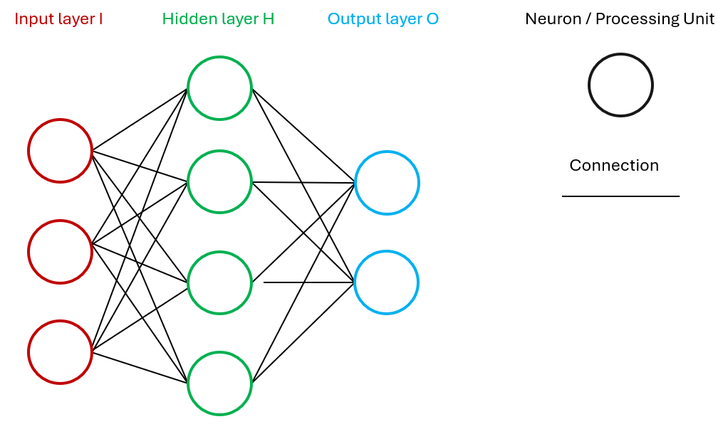
A Basic Neural Network
Notes:
Okay, so now we know what physiology is and its issues with trying to learn it in a neural network or trying to model it, it is first important to know what a neural network is.
Could I shortly ask, who ahs never heard of neural network
--- okay, and who has heard of it
And who can explain to me exactly what it is?
Assume: everytone heard of it → can skip, else quick slide on NNS
Else quick explanation
NN = computer algorthm insipred by human brain
has vrious layers with diff amount of neurons (processing elemetnd)
each neuron receives inputs, processes it and passes it on to the next layer

Slide 22
Neural Network Methods for Physiology
Hierarchical Networks
Adaptive Dynamic Networks
Embedding multiple networks
Multiscale physiological interactions
Enable analysis of different aspects of input data
Inherently adaptive (Berner, et al. 2023)
Dynamic states, nodes, and interactions
Model complex systems
Notes:
Hierarchical networks are multiple networks embedded in one, in a hierarchical structure
Adaptive dynamic networks are networks wherein both states and connections are dynamic and can coevolve.
Neural networks are inherently adapting as they self-adjust during learning phase, and in the following sections we will also talk about an example of such a network.
Berner et al. note that neural networks are inherently adaptive dynamical networks because they self-adjust during the learning phase through gradient descent and backpropagation
Furthermore, hierarchical networks have already been implemented in neural network
So NNs could already implement some physiological

Slide 23
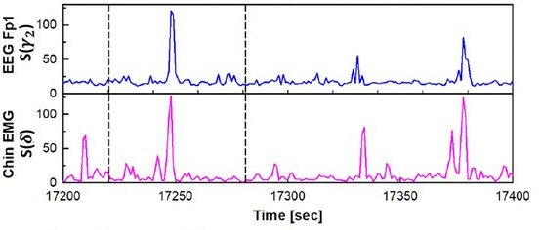
Non Neural Network Methods for Physiology
Time Delay Stability (TDS)
-
+
-
+
+
Quantifies synchronization
Using stable time delays
Modeling interactions between different network modalities
From Rizzo, Rossella & Zhang, Xiyun & Wang, Jilin & Lombardi, Fabrizio & Ivanov, Plamen. (2020). Network Physiology of Cortico–Muscular Interactions. Frontiers in Physiology. 11. 558070. 10.3389/fphys.2020.558070.
Notes:
Tds emthod not neural but for physapplication
Introduction tds
(Ims from blog post intuition TDS

Slide 24

Example Hierarchical NN→ Missing Links Metabolic Pathways
Metabolic pathway
  E. Coli
  Energy production and consumption
  Protein synthesis
Modeling Challenges:
Interactions on multiscale levels

Slide 25
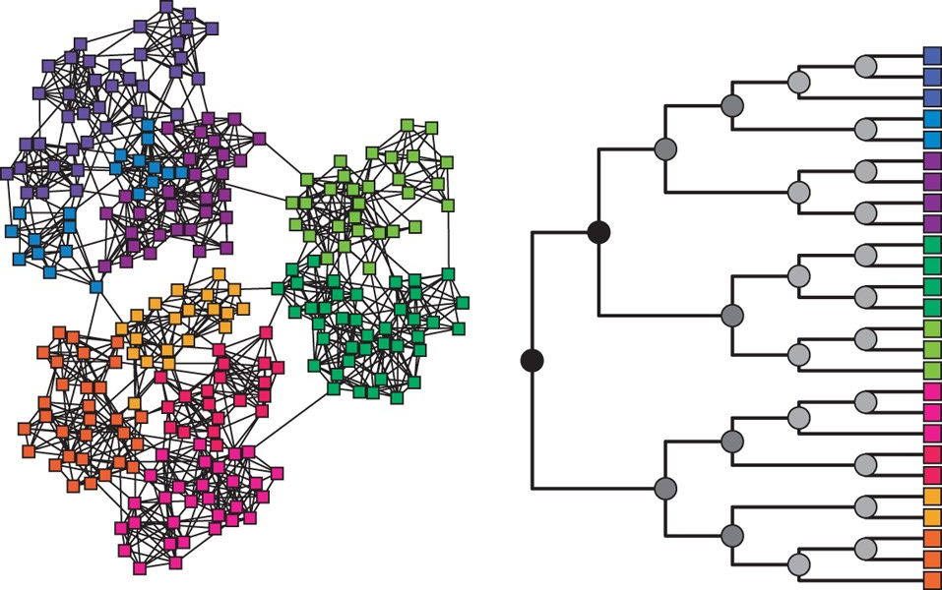
Example Hierarchical NN→ Missing Links Metabolic Pathways
A hierarchical network
Hierarchical random graph
Predictor missing links
Clauset, A., Moore, C. & Newman, M. Hierarchical structure and the prediction of missing links in networks. Nature 453, 98–101 (2008). https://doi.org/10.1038/nature06830
Notes:
An example of how hierachical neural entwork can be used is in etabolic pathways, in this image i want to show you a heirachical entwork, its random raph , and this is from a paper wherein it is desrcibed how these networks can aid in predictiing missing links in physiological networks, such as metabolic pathways

Slide 26
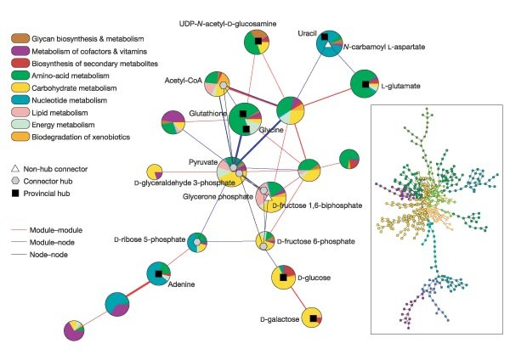
Example Hierarchical NN→ Missing Links Metabolic Pathways
Metabolic network of E. coli
Circle = Modules
Lines = Interaction
Hierarchical NNs used to predict missing link in metabolite Network
Guimerà, R., Nunes Amaral, L. Functional cartography of complex metabolic networks. Nature 433, 895–900 (2005). https://doi.org/10.1038/nature03288
Notes:
And in this publication by .. Et al they used these hiera chical neural entworks to form a network of the metabolic pathways in the bacteri a e. coli.
473 metabolites
574 links.
Colour = metabolite classicfication)
Thickness ~ Nr of links
And herein you can see how these moduels are conencted to eachother, and what type of metabolism is happenign here
Including the network andom graph
And in this apper they actually only maed this grpah, but with the apper shown ion the previosu slide, they used hierarchical neural entworks to predic tthe missing link in this metabolic functional network

Slide 27
Example Adaptive Dynamical Network → Sepsis
Sepsis = Life-threatening condition from the body's extreme response to infection.
From (Berner, Sawicki, Thiele, Löser, & Schöll, 2022).
Notes:
Add animation
One case in which ad dyn network were used wa in sepsis,
Well shortly about sepsis, its an extreme reponse to infections, so extreme, life threatening
Aproach can be adapted for other conditions with complex cell interactions.
So this is an example wherein physiology is actually learned and modeled accordingly with the use of an adaptive dynamical network
And this is pretty challenning to model as a lot of differnt cell sinteraction with eachother and also on the tissue scale

Slide 28
Example Adaptive Dynamical Network → Sepsis
Sepsis = Life-threatening condition from the body's extreme response to infection.
  Infection triggers immune response releasing chemicals into the bloodstream.
  Causes widespread inflammation, blood clotting, and leaky blood vessels.
  Resulting in: poor blood flow, organ dysfunction, and tissue damage.
Modeling challenges:
Intercellular and Interlayer interactions
From (Berner, Sawicki, Thiele, Löser, & Schöll, 2022).
Notes:
Add animation
One case in which ad dyn network were used wa in sepsis,
Well shortly about sepsis, its an extreme reponse to infections, so extreme, life threatening
Aproach can be adapted for other conditions with complex cell interactions.
So this is an example wherein physiology is actually learned and modeled accordingly with the use of an adaptive dynamical network
And this is pretty challenning to model as a lot of differnt cell sinteraction with eachother and also on the tissue scale

Slide 29
Example Adaptive Dynamical Network → Sepsis
Sepsis = Life-threatening condition from the body's extreme response to infection.
  Infection triggers immune response releasing chemicals into the bloodstream.
  Causes widespread inflammation, blood clotting, and leaky blood vessels.
  Resulting in: poor blood flow, organ dysfunction, and tissue damage.
Modeling challenges:
Intercellular and Interlayer interactions
From (Berner, Sawicki, Thiele, Löser, & Schöll, 2022).
Notes:
Add animation
One case in which ad dyn network were used wa in sepsis,
Well shortly about sepsis, its an extreme reponse to infections, so extreme, life threatening
Aproach can be adapted for other conditions with complex cell interactions.
So this is an example wherein physiology is actually learned and modeled accordingly with the use of an adaptive dynamical network
And this is pretty challenning to model as a lot of differnt cell sinteraction with eachother and also on the tissue scale

Slide 30
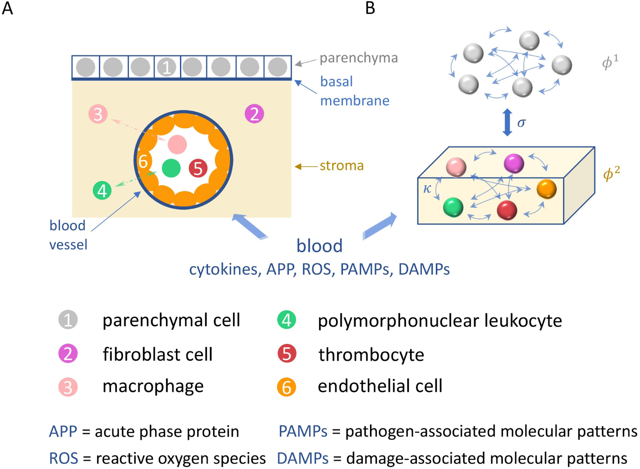
Example Adaptive Dynamical Network → Sepsis
2-layer network
Coupled Oscillators
Adaptive coupling
→ Dynamic changes
Healthy = Synchronized
Pathological = Desynchronized
From Berner, R., Sawicki, J., Thiele, M., Löser, T., & Schöll, E. (2022). Critical parameters in dynamic network modeling of sepsis. Frontiers in Network Physiology, 2, 904480. https://doi.org/10.3389/fnetp.2022.904480
Notes:
And one propored solution for this was using adn , in this case … within 1 various cell types and properties incorporated
Even thought th focus is on the computational approach it still successfully models cellular interactions and dysregulation in sepsis.
Also
Aproach can be adapted for other conditions with complex cell interactions.
So this is an example wherein physiology is actually learned and modelled accordingly with the use of an adaptive dynamical network

Slide 31
Example TDS → Cortico-Muscular Connectivity
Connection/Synchronization between the brain's motor cortex and muscles.
  Can vary across consciousness stages
  And across pathologies
Modeling Challenges:
Interactions between 2 different network modalities
From Rizzo, Garcia-Retortillo, Rizzo, & Ivanov, 2022
Notes:
And you can apply this method to verify the connectivity between cortical and muscular systems in various sleep stages,
and then again compare this between healthy controls and patinets, in this study by rizzo et al they did this with aprkisnosn patients, who are often known to have issues with sleeping,
And in these images, you really see the connectivity in the leg-muscle network really varies between healthy people and ps patients!

Slide 32
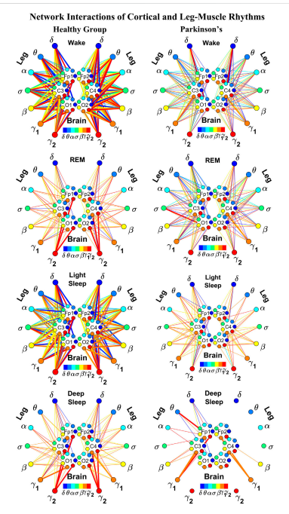
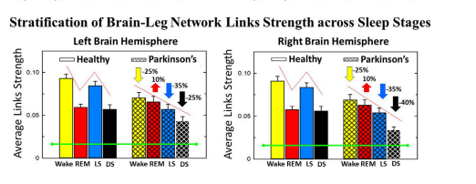
Example TDS → Cortico-Muscular Connectivity
Rizzo, R., Wang, J. W. J. L., DePold Hohler, A., Holsapple, J. W., Vaou, O. E., & Ivanov, P. C. (2023). Dynamic networks of cortico-muscular interactions in sleep and neurodegenerative disorders. Frontiers in Network Physiology, 3. https://doi.org/10.3389/fnetp.2023.1168677
Notes:
Emphasize there are methods not neural butable to model nonlinear complex interactions (fact that ints parks are mroe sparese, is what we expect with connectivity)
Explain CM connectvitity , fromtds -→ conenctvity → results
And you can apply this method to verify the connectivity between cortical and muscular systems in various sleep stages, and then again compare this between healthy controls and patinets, in this study by rizzo et al they did this with aprkisnosn patients, who are often known to have issues with sleeping,
EVEN though not Neural__> still a good methdo to stdy physiology accros networsk
And in these images, you really see the connectivity in the leg-muscle network really varies between healthy people and ps patients!

Slide 33
So, can Neural Networks learn physiology?
In theory → Yes!
Notes:
And by now, you are probably wondering why I'm talking about these methods and these dynamical networks. Well,
We talked about how neural networks can be applied to hierarchical neural networks and adaptive dynamical neural networks, and even a method like TDS could probably be implemented in a neural network to get a quicker overview of connectivity.
Well, neural networks already provide these solutions to some major challenges in learning physiology, so in theory, we would say yes, this is possible.
But then we should probably shift our focus from "Is this possible?" to "Do we have to learn this in order to be of use in physiological issues?"

Slide 34
Learning Physiology vs. Practical Utility
Can a Neural Network Learn Physiology?
Notes:
And this brings us to the next and final part of our presentation, do we have to be able to learn the physiology in order to be useful in physiological issues and challenges?

Slide 35
Tackling physiology, without learning physiology?
NN applications:
  Drug Matching & Treatment Prediction
  (Mambetsariev et al., 2023).
  Cancer Diagnosis (Munir et al., 2019).
  Seizure Detection in EEG (Acharya et al., 2018).
Learning Physiology?
Learning Patterns in Data?
Useful in physiology?
Notes:
Neural networks sued
All-in all Neural networks are already used in complex medical systems for disease detection, classification, and drug testing
but in these cases, is the nn really learning physiology?

Slide 36

Tackling physiology, without learning physiology?
NN applications:
  Drug Matching & Treatment Prediction
  (Mambetsariev et al., 2023).
  Cancer Diagnosis (Munir et al., 2019).
  Seizure Detection in EEG (Acharya et al., 2018).
Learning Physiology?
Learning Patterns in Data?
Useful in physiology?
Notes:
No,
How about learning patterns in the data,
Is that what the NN is doing?

Slide 37

Tackling physiology, without learning physiology?
NN applications:
  Drug Matching & Treatment Prediction
  (Mambetsariev et al., 2023).
  Cancer Diagnosis (Munir et al., 2019).
  Seizure Detection in EEG (Acharya et al., 2018).
Learning Physiology?
Learning Patterns in Data?
Useful in physiology?
Notes:
Okay but then, is this useful in learning physiology? Or is it neccessary?

Slide 38
Tackling physiology, without learning physiology?
NN applications:
  Drug Matching & Treatment Prediction
  (Mambetsariev et al., 2023).
  Cancer Diagnosis (Munir et al., 2019).
  Seizure Detection in EEG (Acharya et al., 2018).
Learning Physiology?
Learning Patterns in Data?
Useful in physiology?
Notes:
Well yes, but with a question mark, because this raises another questions

Slide 39
What has to be learned?
Notes:
So considering this, what has be learned by a neural network in order to be of use in human physiology?

Slide 40
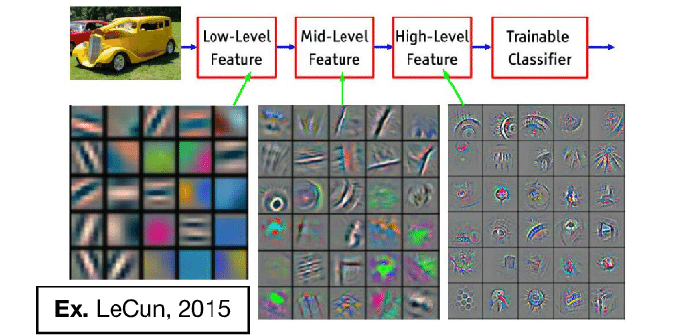
What has to be learned? → Meaningful Features
Notes:
In image classificaiton for instance, you notice when visualizing features, that in deeper layers of the neural network, the features learned already start to resemble some objects.
Low level are more like gradients and edges, mid level features are shapes and lines, and then finally things became more integrated objects in the higher level features.
This kind of shows that the classifier in the nn kind of learns featuers similar to human in identifiying and classifyin objects.
So in the case → the features have semantic meaning

Slide 41
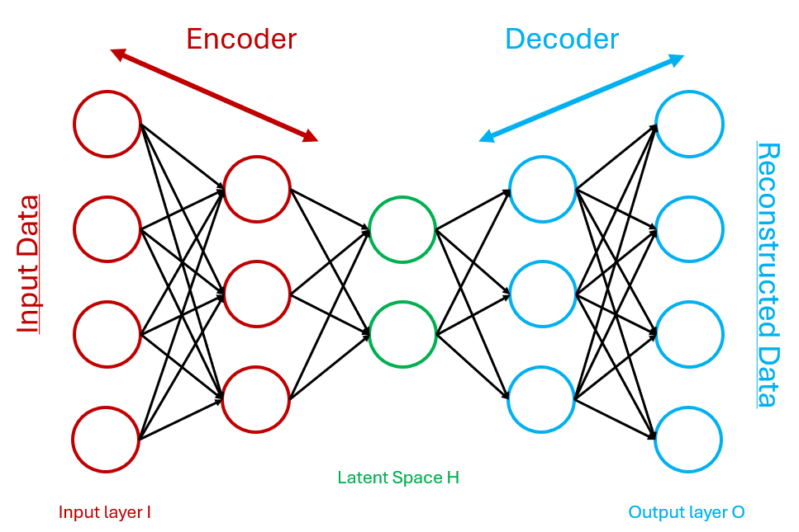
What has to be learned → CVAEs latent space
Data Compression Encoder
Reconstruction Decoder
CVAE → Generation outputs
Notes:
Additionally, conditional variation autoencoder have a latent space wherein some lower level features correpsond to aspects of the output
Here you see an image of a normal autoencoder, it downsampled input, to a latent space in the encoder, and then reconstructs the input in the decoder

Slide 42
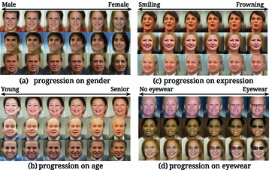
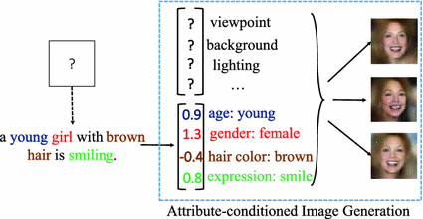
What has to be learned? → CVAEs latent space
Images from Yan, Yang, Sohn, & Lee (2016)
Notes:
And ONE VERy interesting, IS THAT IN THE LATENT SPACE, SOME FEATURES HAVE SEMENTIC MEANI
For instance in the one of Yan, Yang, Sohn, & Lee (2016)
Wherein the values in the latent space, have semantic meaning for the CVAE s output,
Such as age, gender, hair color and expression

Slide 43
Neural Network Performace vs. Interpretability
NNs detect abstract patterns
Uninterpretable for humans
Notes:
The reason why I'm using this exampleof certain uses of neural networks is that, in these cases, the features have a certain semantic meaning. And in these cases, they are very useful for image generation.
However, when neural networks are applied to physiological challenges, they might learn patterns in the data which are too abstract for humans to interpret.
But then again, if the performance of these networks is pretty good, should we have to worry about them being interpretable?

Slide 44
Neural Network Performace vs. Interpretability
NNs detect abstract patterns
Uninterpretable for humans
If performance → Why worry?
Notes:
The reason why I'm using these examples of certain uses of neural networks is that, in these cases, the features have a certain semantic meaning. And in these cases, they are very useful for image classification and generation.
However, when neural networks are applied to physiological challenges, they might learn patterns in the data which are too abstract for humans to interpret.
But then again, if the performance of these networks is pretty good, should we have to worry about them being interpretable?

Slide 45




NN Performance vs. Interpretability in Medical Applications
Accountability and avoiding biases.
Raises ethical and transparency issues.
Interpretability and understanding are key to building trust and reliability in AI systems in the context of healthcare
Notes:
Well, there is one small caveat there because these neural networks are used in medical care.
So the features or the patterns that they learn have to be at least interpretable for humans, doctors, or physicians in order to avoid biases and accountability issues. It should rather help them in making informed decisions on these outputs than making them all by itself.
In other words, if we do not know how a neural network decides on certain medical issues, we will not be able to apply them in medical settings due to the ethical and transparency issues.

Slide 46
Applications in physiology?
Learning Physiology?
Learning Patterns in Data?
Notes:
They can definitely be useful in helping wiht physiological questions
Do they need to learn physiology in the data
No not neccessarily

Slide 47
Applications in physiology?
Learning Physiology?
Learning Patterns in Data?
Learns Intepretable Patterns in Data?
Notes:
But they should learn intepretable patterns

Slide 48
Applications in physiology?
Learning Physiology?
Learning Patterns in Data?
Learns Intepretable Patterns in Data?
Useful in Physiology?
Notes:
Then They can definitely be useful in helping with physiological questions

Slide 49
Conclusion
Can a Neural Network Learn Physiology?
Notes:
And this brings us to the next and final part of our presentation, do we have to be able to learn the physiology in order to be useful in physiological issues and challenges?

Slide 50
Can a Neural Network Learn Physiology?
Notes:
So to get back to our original questions
Can a neural network learn physiology, the answer in theory is yes
(but in order to be useful in physiological applications?
r it does not need to learn physiology, but it should learn interpretable features or patterns
Thank you for listening

Slide 51
Can a Neural Network Learn Physiology?
In theory → Yes!
Notes:
So to get back to our original questions
Can a neural network learn physiology, the answer in theory is yes
(but in order to be useful in physiological applications?
r it does not need to learn physiology, but it should learn interpretable features or patterns
Thank you for listening

Slide 52
Can a Neural Network Learn Physiology?
In theory → Yes!
Must a NN learn Physiology?
Notes:
So to get back to our original questions
Can a neural network learn physiology, the answer in theory is yes
(but in order to be useful in physiological applications?
r it does not need to learn physiology, but it should learn interpretable features or patterns
Thank you for listening

Slide 53
Can a Neural Network Learn Physiology?
In theory → Yes!
Must a NN learn Physiology?
No, but it should learn interpretable patterns or features to be applicable in medicine.
Notes:
So to get back to our original questions
Can a neural network learn physiology, the answer in theory is yes
(but in order to be useful in physiological applications?
r it does not need to learn physiology, but it should learn interpretable features or patterns
Thank you for listening

Slide 54
Questions?
Notes:
So these were the questions I asked myself during the process of developing this blog post and presentation
Do you have any questions for me?

Slide 55
References
Ivanov, P. C. (2021). The new field of network physiology: Building the human physiolome. Frontiers in Network Physiology, 1. https://doi.org/10.3389/fnetp.2021.711778
Wasserthal, J., Breit, H.-C., Meyer, M. T., Pradella, M., Hinck, D., Sauter, A. W., Heye, T., Boll, D. T., Cyriac, J., Yang, S., Bach, M., & Segeroth, M. (2023). Totalsegmentator: Robust segmentation of 104 anatomic structures in ct images. Radiology: Artificial Intelligence, 5(5), e230024. https://doi.org/10.1148/ryai.230024
Ivanov, Plamen & Wang, Jilin & Zhang, Xiyun & Chen, Bolun. (2021). The New Frontier of Network Physiology: Emerging Physiologic States in Health and Disease from Integrated Organ Network Interactions. 10.1007/978-3-030-62497-2_12.
Berner, R., Sawicki, J., Thiele, M., Löser, T., & Schöll, E. (2022). Critical parameters in dynamic network modeling of sepsis. Frontiers in Network Physiology, 2, 904480. https://doi.org/10.3389/fnetp.2022.904480
Munir, K., Elahi, H., Ayub, A., Frezza, F., & Rizzi, A. (2019). Cancer diagnosis using deep learning: A bibliographic review. Cancers, 11(9), 1235. https://doi.org/10.3390/cancers11091235
Mambetsariev, I., Fricke, J., Gruber, S. B., Tan, T., Babikian, R., Kim, P., Vishnubhotla, P., Chen, J., Kulkarni, P., & Salgia, R. (2023). Clinical network systems biology: Traversing the cancer multiverse. Journal of Clinical Medicine, 12(13), 4535. https://doi.org/10.3390/jcm12134535
Acharya, U. R., Oh, S. L., Hagiwara, Y., Tan, J. H., & Adeli, H. (2018). Deep convolutional neural network for the automated detection and diagnosis of seizure using EEG signals. Computers in Biology and Medicine, 100, 270-278. https://doi.org/10.1016/j.compbiomed.2017.09.017
Yan, X., Yang, J., Sohn, K., & Lee, H. (2016). Attribute2image: Conditional image generation from visual attributes. In B. Leibe, J. Matas, N. Sebe, & M. Welling (Red.), Computer Vision – ECCV 2016 (Vol. 9908, pp. 776-791). Springer International Publishing. https://doi.org/10.1007/978-3-319-46493-0_47
Rizzo, R., Wang, J. W. J. L., DePold Hohler, A., Holsapple, J. W., Vaou, O. E., & Ivanov, P. C. (2023). Dynamic networks of cortico-muscular interactions in sleep and neurodegenerative disorders. Frontiers in Network Physiology, 3. https://doi.org/10.3389/fnetp.2023.1168677

Slide 56
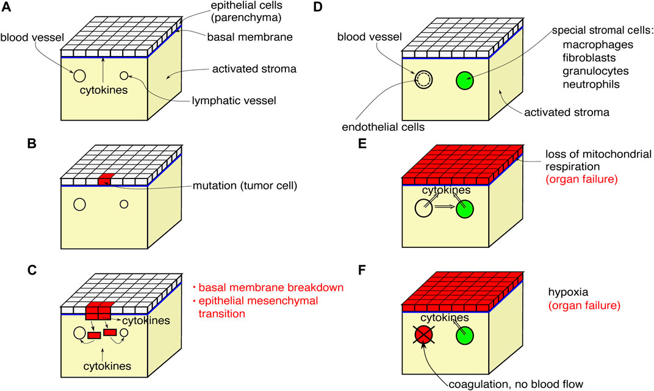
Add title!

Slide 57
Add title!

Slide 58
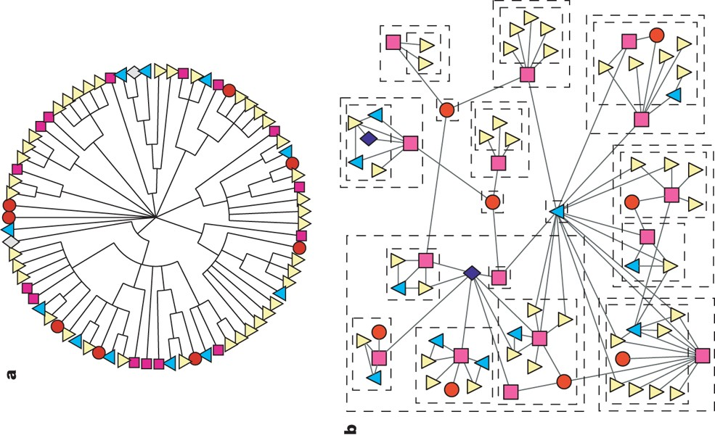
Missing links network for grassland species iteractions

Slide 59
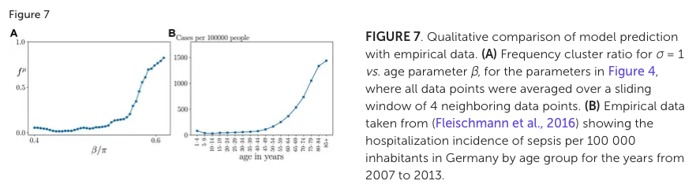
Fig. 5A: Ratio of observed pathological states vs. initial conditions depending on age parameter B
- Probability of pathological sepsis state rises sharply for \( \beta > 0.5\pi \).
- Empirical data comparison: Number of sepsis cases per 100,000 inhabitants in Germany (Fig. 5B) → Similar between modeled and empirical data.
- Provides initial evidence for the potential of the proposed functional modeling approach.

