Slide 1
3D Reconstruction in Context of Medical Applications
Deep Learning for Medical Applications

Slide 2
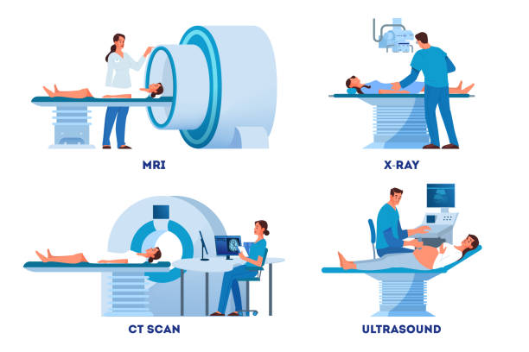
Motivation
Reduce radiation
Less expensive
More accessible
Surgery planning
Diseases diagnosis

Slide 3
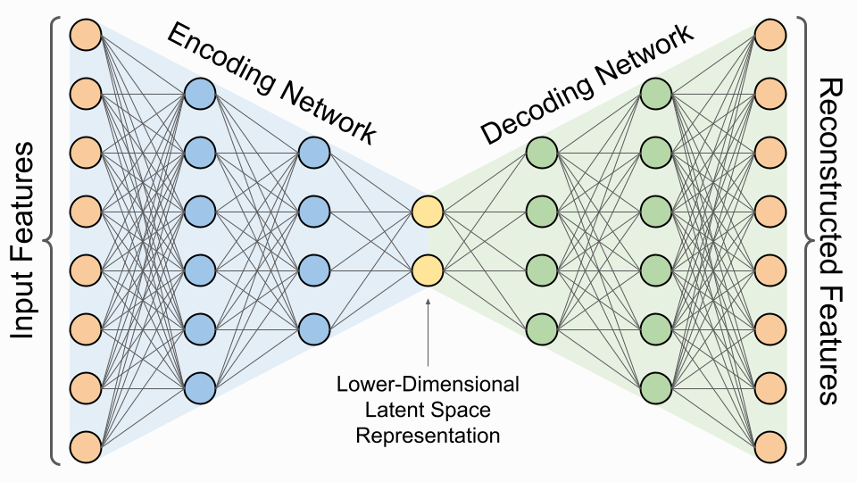
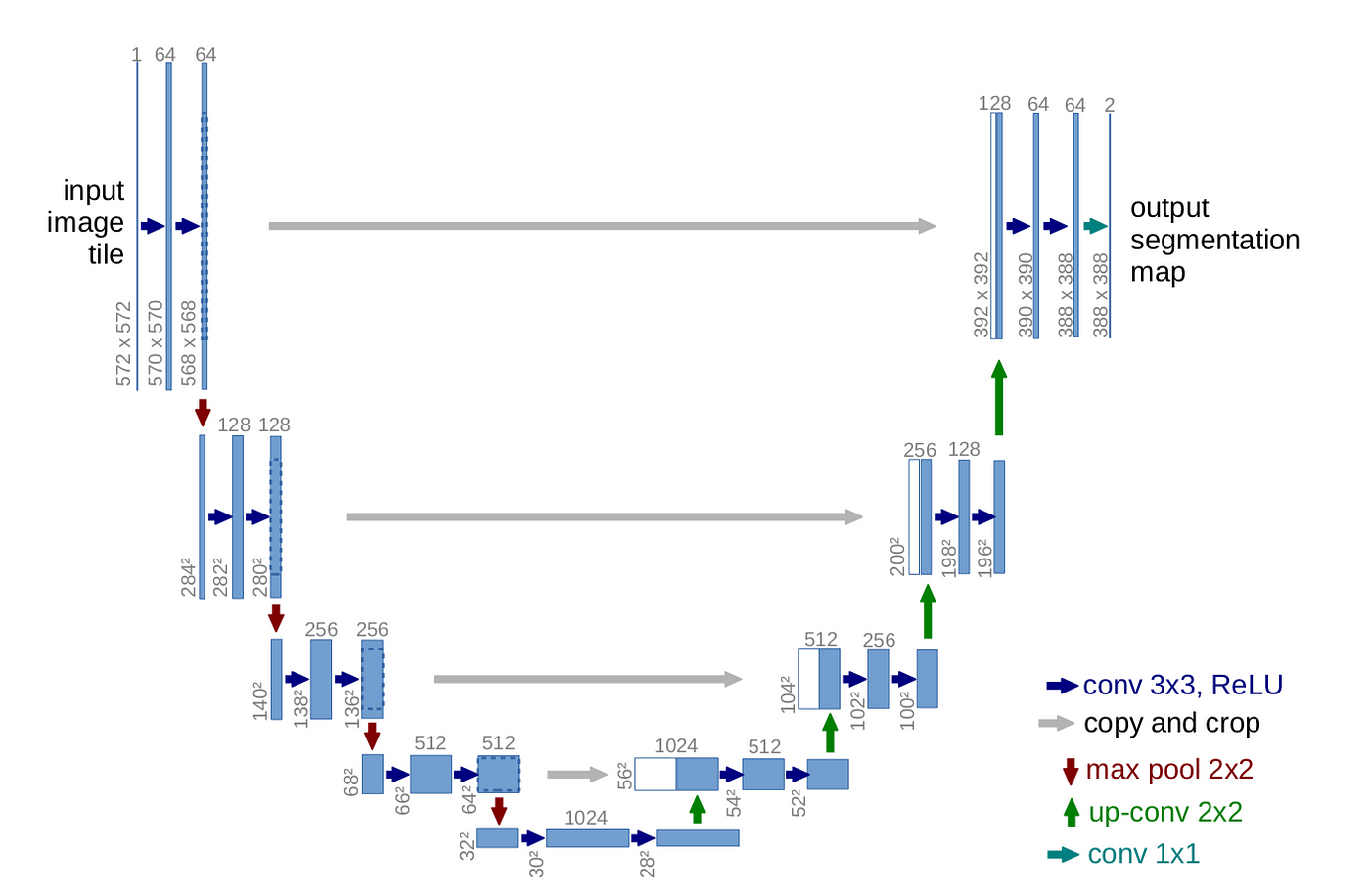
Background Knowledge
Metrics
Dice score
IoU
ASSD
Hausdorff Distance

Slide 4
Benchmarking Encoder-Decoder Architectures for
Biplanar X-ray to 3D Shape Reconstruction
Deep Learning for Medical Applications

Slide 5
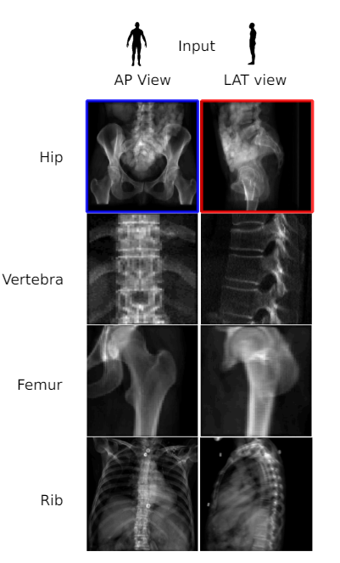
Idea

Slide 6
Models
Anatomies
AttentionUNet
SwinUNETR
2DConcat
MultiscaleConcat
Unet
UNETR
TL-Embedding
1DConcat
Femur
Pelvic
Vertebra
Rib

Slide 7
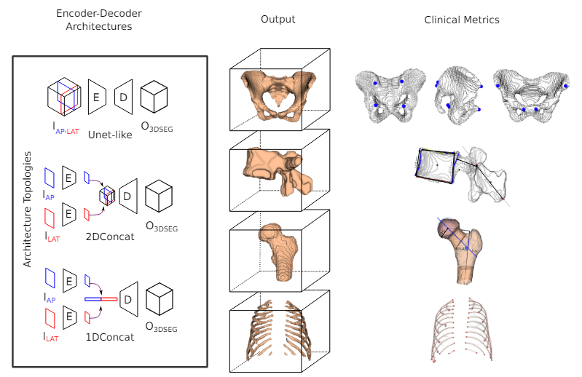
Architecture Details

Slide 8
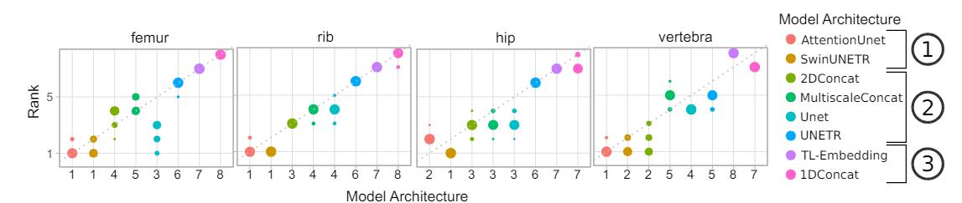
Results

Slide 9
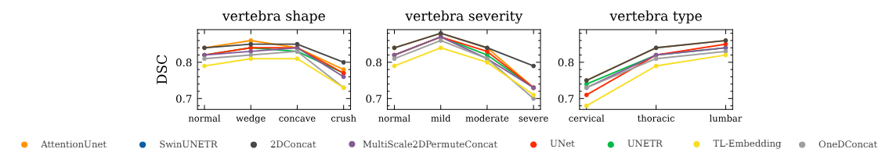
Performance in Clinically Relevant Subgroups

Slide 10
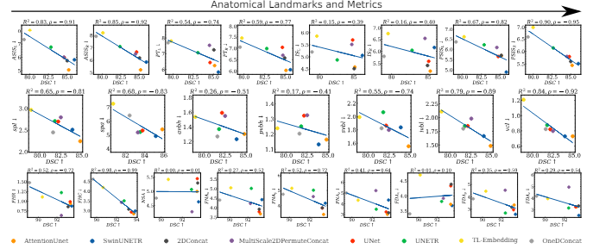
Dice Score vs Clinical Metrics

Slide 11
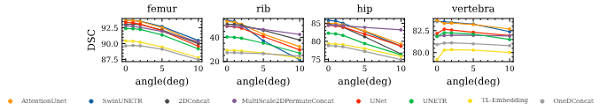
Misalignment Results

Slide 12
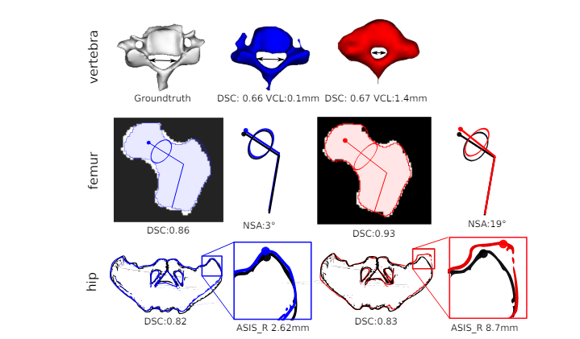
Clinical Metric and DSC Diverge

Slide 13
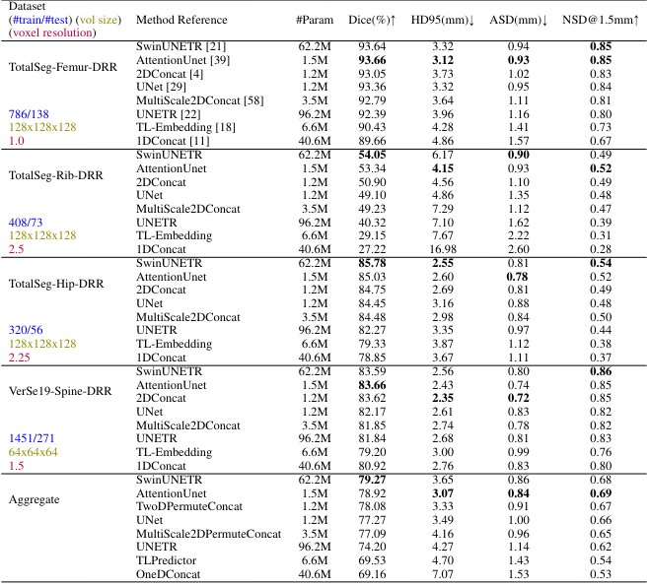
Evaluation Metrics

Slide 14
3D Reconstruction of Proximal Femoral Fracture
from Biplanar Radiographs with Fractural Representative Learning
Deep Learning for Medical Applications

Slide 15
Model
3D reconstruction network (3DReconNet)
  Encoder module
  Decoder module
  Fusion module
Auxiliary class
Fractural augmentation

Slide 16
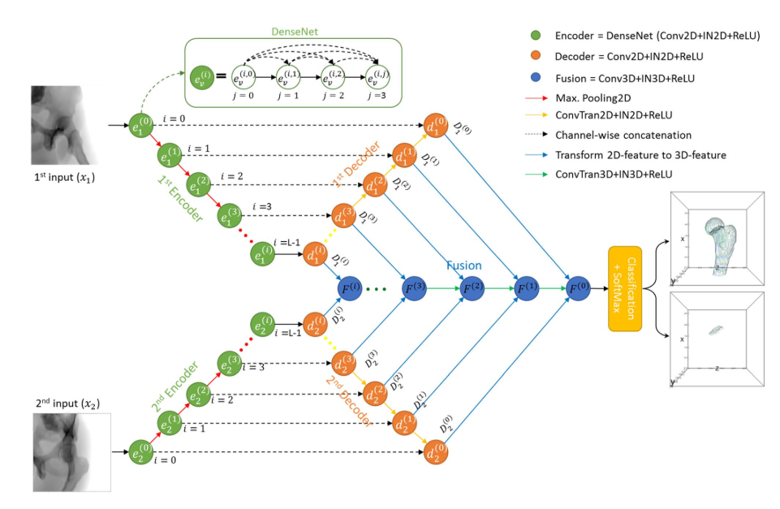
3D reconstruction network (3DReconNet)

Slide 17
Experiment Setting
3DReconNet: 3D reconstruction network
3DReconNet-AC: 3DReconNet simultaneously trained with the auxiliary class (AC)
FracReconNet: 3DReconNet-AC network trained with fractural augmented data.

Slide 18
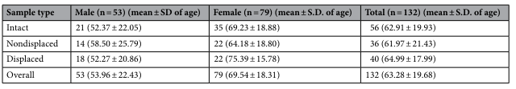
Experiment Setting Dataset

Slide 19
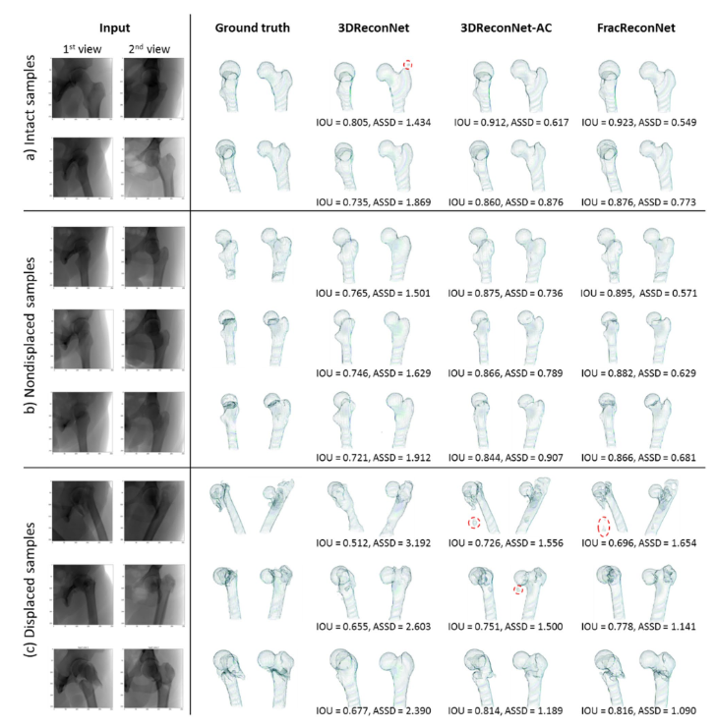
Intact samples
Input GroundTruth 3DReconNet 3DReconNet-AC FracReconNet

Slide 20
Nondisplaced Fracture Samples
Input GroundTruth 3DReconNet 3DReconNet-AC FracReconNet

Slide 21
Displaced Fracture Samples
Input GroundTruth 3DReconNet 3DReconNet-AC FracReconNet

Slide 22
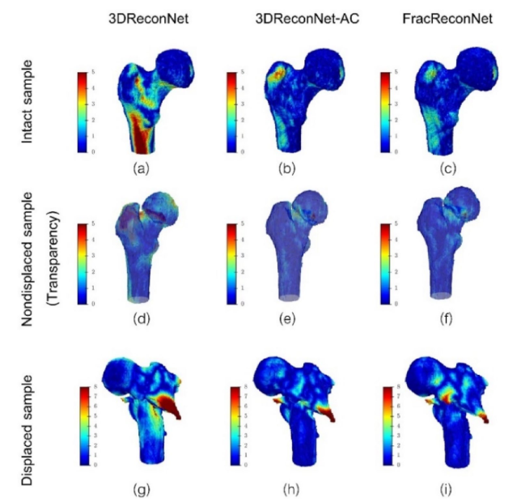
Surface Distance Error

Slide 23
A Deep-Learning Approach For Direct Whole-Heart Mesh Reconstruction
Deep Learning for Medical Applications

Slide 24
Anatomies
LV - Left Ventricle
LA - Left Atrium
RA - Right Atrium
RV - Right Ventricle
Epicardium
Aorta
Pulmonary Arteries

Slide 25
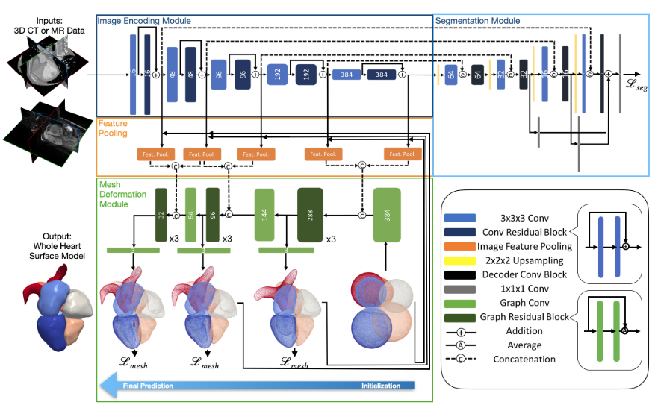
Model

Slide 26
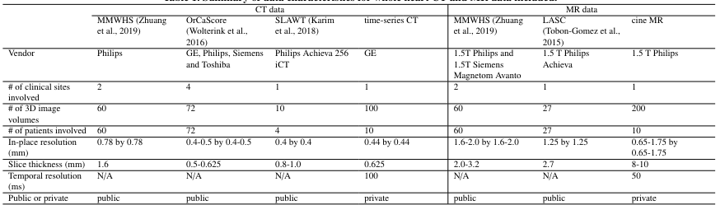
Data Characteristics

Slide 27
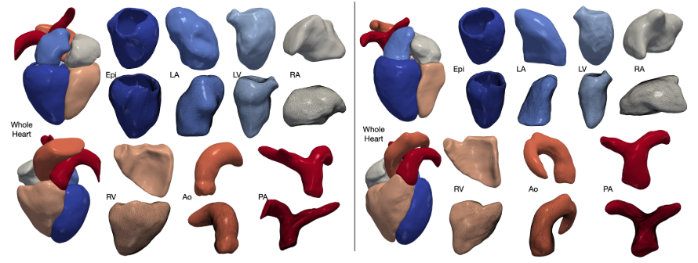
Experiments and Results

Slide 28
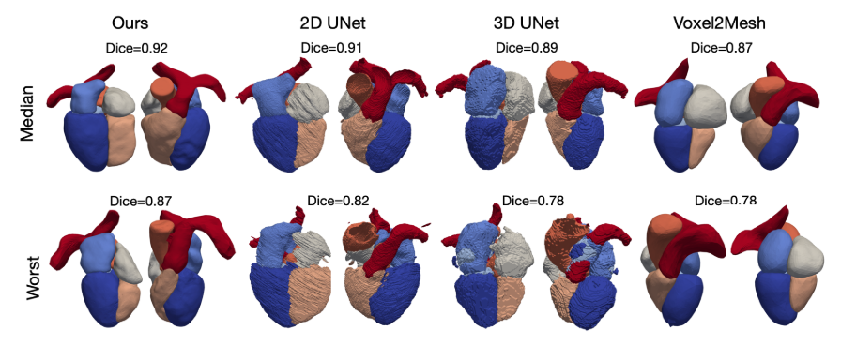
Median and Worst Reconstruction Results on MMWHS CT test dataset

Slide 29
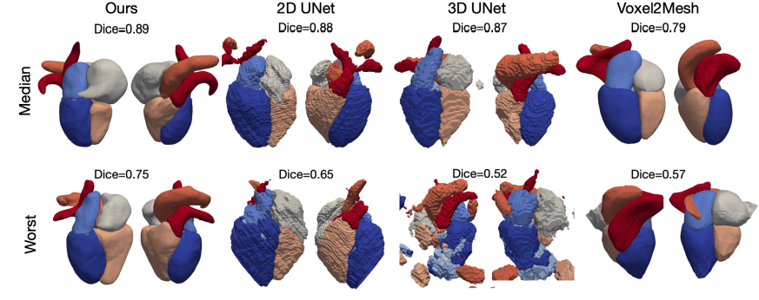
Median and Worst Reconstruction Results on MMWHS MR test dataset

Slide 30
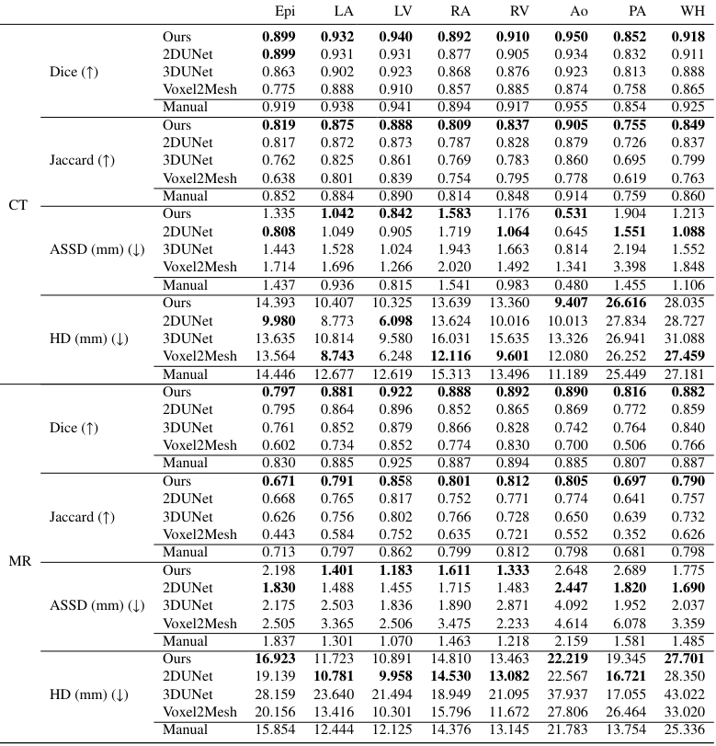
Results

Slide 31
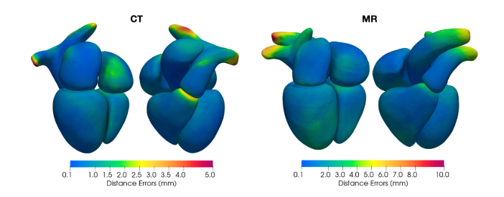
Distribution of the Average Surface Distance Errors

Slide 32
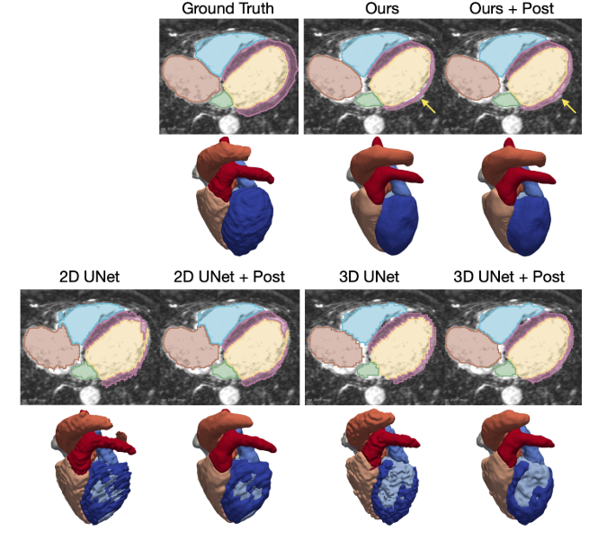
Reconstruction Results Before and After Post-Processing

Slide 33
Discussion
Dice Score and Clinical Metrics
Bad Performance in Clinically Relevant Subgroups
Real Data Misalignment Issue
Bad Performance on MR Data
Lack of Discussion and Explanation of Model Architecture
Lack of Public Datasets
Only Laboratory Results
…

Slide 34
Conclusion
Discuss different models for Biplanar X-rays to 3D bone reconstruction
clinical metrics comparison to DSC, misalignment results, disaggregated reporting
3D Reconstruction of Proximal Femoral Fracture
good performance on nondisplaced samples, discussion of performance on displaced samples
Whole-Heart Mesh Reconstruction
different models comparison, real low-resolution MR data reconstruction,
good performance on the construction of Whole-Heart 4D models from Motion Image Data, impact of Post-Processing on reconstruction performance

Slide 35
Thank you for your attention!
Questions?

