Slide 1

Seminar Maschinelle Intelligenz
Lesson 6
28.05.2024
Klaus Diepold, Marisa Ripoll

Slide 2
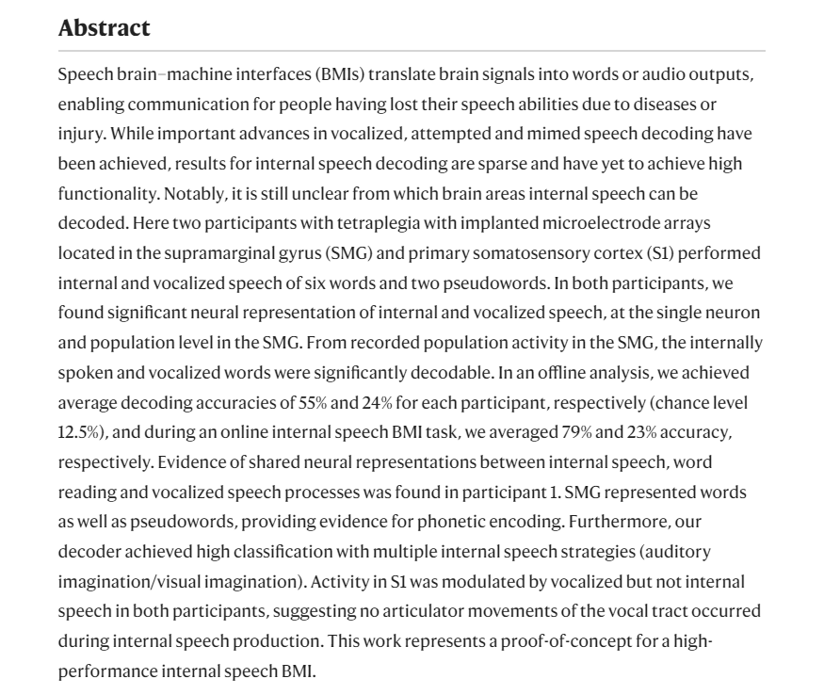
Representation of internal speech by single neurons in human supramarginal gyrus
Selected Reading for Week 7
Wandelt, Sarah K., et al. "Representation of internal speech by single neurons in human supramarginal gyrus." Nature Human Behaviour (2024): 1-14.

Slide 3
Speed dating Activity: Discussion in Groups of 3
You can choose any topic related to the paper.
Every 10-15 minutes I will ask you to change groups.
If you don’t have any ideas for starting topics here are some:
What are the main findings from the paper?
Other than LDA, what other AI methodologies could they implement?
What other research questions could be answered from the data they used?
What is the impact of this work?
What new things did you learn from it?
Written cue: visual imagination vs sound imagination. What are you more prone to while you read?
What factors could have contributed to the lower performance in the decoding of signals from participant 2?
What do the results from S1 vs results from the SMG suggest?

Slide 4

Group Project
The second part of the seminar will consist of a group project.
3 members per Group. (Exceptions → 4)
Every group receives a different topic.
You can choose your own groups and sign them up to moodle.
    Deadline: Thursday 30th 23:59
Every session from now on will include student individual presentations with weekly updates.
Grades will depend on:
    Attendance
    Final Report
    Final Group Presentation
    2 Individual Presentation (explained in a couple of slides)

Slide 5
Topics:
You are welcome to think up your own topic and send me an email for approval.
(1) Neural Decoding of Visual Stimuli
Neural Decoding of Language:
    (2) State of the Art in Speech Decoding
    (3) State of the Art in Text Decoding
(4) Neural Decoding of the Motor Cortex
The Decoding of Endogenous Stimuli:
    (5) Inner speech
    (6) Inner imagery
(7) Trends and applications in Industry
(8) Neural decoding for Neurodegenerative diseases
(9) Optimal AI architectures for the Decoding of Brain Signals
(10) Neuroimaging Techniques and Data Acquisition
(11) Information processing: Similarities and Differences between the Brain and AI
(12) Explainable AI for Neural Decoding
(13) Ethical Considerations in Neural Decoding (x2)

Slide 6
Research Expectations and Final Report
Every Group Project Report must include:
An Abstract,
An Introduction,
A Literature Review on their topic
A table/list and description of current challenges and
Add a small section on future work for their topic.
A conclusion or discussion
(Depending on the topic – sections may vary – namely for topics 11 and 12)

Slide 7
Agenda and Individual Presentations
Weeks Left | Day | Plan
1 | Week 8: 4 June | Project planning, brief update and group discussion.
2 | Week 9: 11 June | Literature Review Pecha Kucha Presentations – 7 PKs
3 | Week 10: 18 June | Literature Review Pecha Kucha Presentations – 7 PKs
4 | Week 11: 25 June | Literature Review Pecha Kucha Presentations – 7 PKs
5 | Week 12: 2 July | Challenges Pecha Kucha Presentations – 7 PKs
6 | Week 13: 9 July | Future Trends Pecha Kucha Presentations – 7 PKs
7 | Week 14: 16 July | Discussion Pecha Kucha Presentations – 7 PKs
 | 19 July | Deadline to give in Project Reports
8 | Week 15: 23 July | Final Presentations
9 | Week 16: 30 July | Final Presentations
10 | Week 17: 6 August | -
One member per group every week.

Slide 8
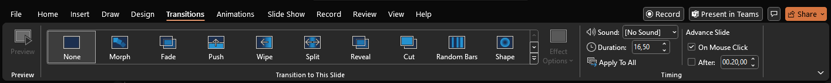
How to prepare for your Pecha Kucha?
A Pecha Kucha is an Individual presentation where the presenter shows 20 slides for 20 seconds each.
The idea is: “talk less, show more”
Add plenty of figures and images to your slides – reduce the text when unnecessary.
Make sure you practice the presentation at least once before you give it in class.
Every presentation must be uploaded to moodle a day in advance: Monday at 15:00
Presentations should include the powerpoint feature of advancing slide automatically after 20 seconds (see image below)

Slide 9
Next Steps:
For Thursday:
Complete the Group Choice Assignment
On Friday:
Every group will receive a random topic
For Next Session:
Begin preparing research review.
Bring list of bullet points per group:
  What are the main points you will be addressing in your topic?
  How will you divide and organise research tasks?
  What will you present in each of the 3 literature review presentations? Will the weekly presentations be progress based? Or topic based?

Slide 10
Previous Year Reports
Trend Reports – Seminar on Machine Intelligence WS 21/22 (AI for 6G telecommunication)
Trend Reports – Seminar on Machine Intelligence SS 21 (Data Science for the Environment)

