Slide 1
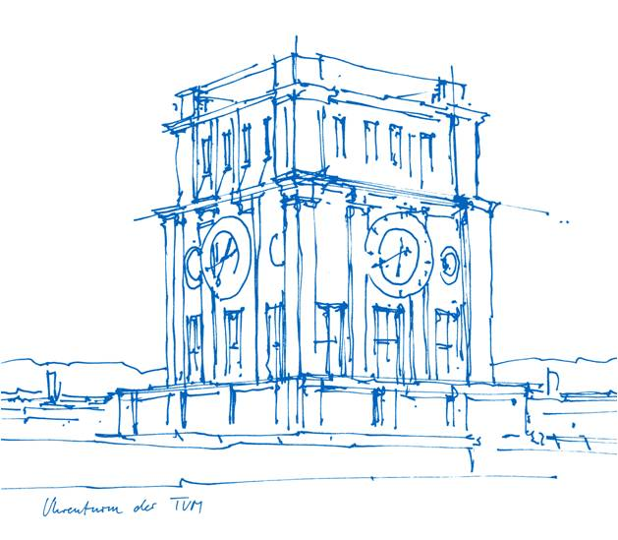
Seminar Maschinelle Intelligenz
Lesson 2
23.04.2024
Klaus Diepold, Marisa Ripoll

Slide 2
Agenda
Neuroscience Fundamentals
Machine Learning Models – Recap
Paper Number 1

Slide 3
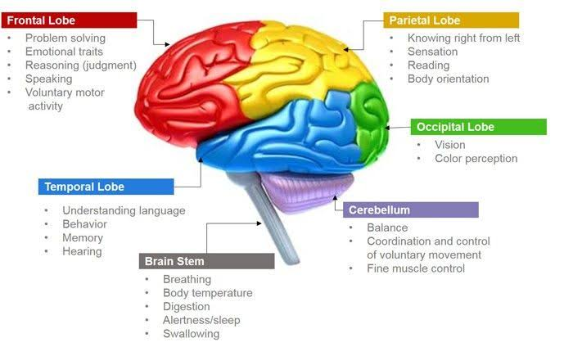
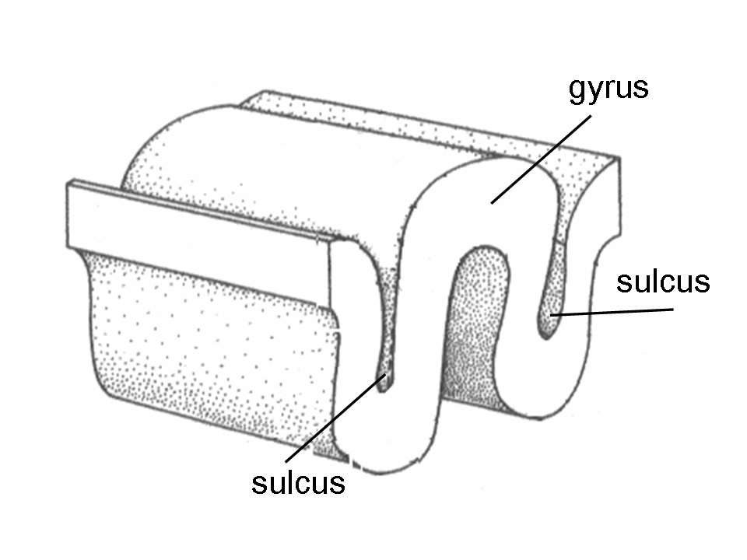
Neuroscience Basics
The scientific study of the nervous system: the brain, the spinal cord and the peripheral nervous system.
The Cerebral Cortex: Center for Higher Cognitive Functions
Frontal Lobe: Short-term memory, action planning, movement control
Parietal Lobe: Somatic Sensation, Body Image
Occipital Lobe: Vision
Temporal Lobe: Hearing, Learning, Memory
Other Nomenclature:
eg: Central Sulcus, lateral sulcus, precentral gyrus, postcentral gyrus

Slide 4
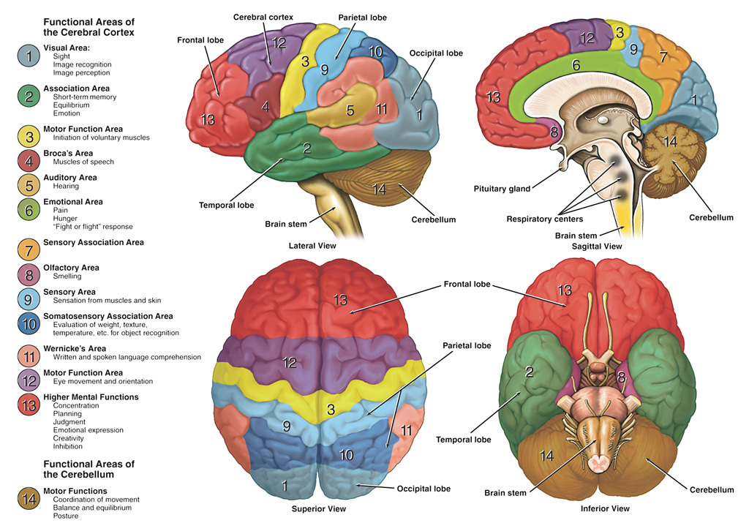
Functional Areas of the Cerebral Cortex
* https://dana.org/resources/neuroanatomy-the-basics/

Slide 5
Neuroimaging Techniques
Invasive vs. Non-invasive
Structural vs Functional
Spatial Resolution: Where is the signal coming from?
Temporal Resolution: How often do you get a signal?
Most common techniques in Neural Decoding Literature:
fMRI (functional Magnetic Resonance Imaging)
  MRI: senses magnetic properties of H atoms which dissipate energy differently depending on the surrounding tissue
  fMRI is an extension of MRI. It visualizes changes in blood oxygen levels caused by brain activity from stimuli/ cognitive processes.
  High spatial resolution, Low temporal resolution
EEG (Electro-encephalography):
  EEG measures electrical potentials resulting from brain activity.
  Low spatial resolution, High temporal resolution
ECoG (ElectroCorticography):
  ECoG is an invasive form of EEG. The measuring device is composed of electrodes placed in direct contact with the brain.
  High spatial and temporal resolution.
MEG (Magneto-encephalography):
  MEG records the Magnetic activity of the brain.
  High temporal resolution, Low spatial resolution (Spatial resolution is better in MEG than in EEG since magnetic fields are not distorted by the tissue conductivity of the scalp)

Slide 6
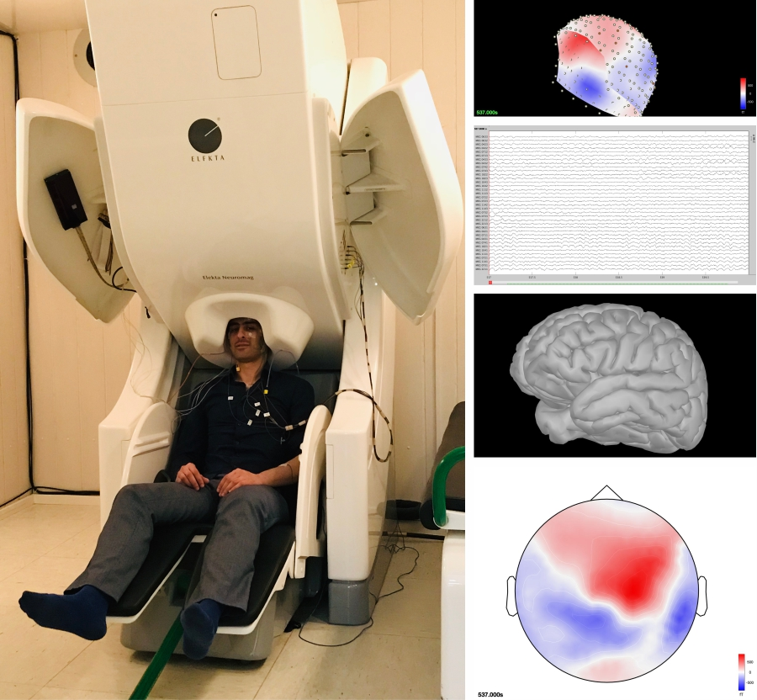
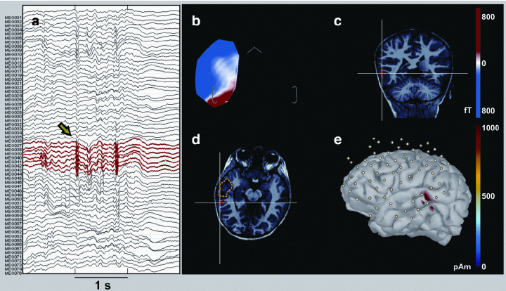
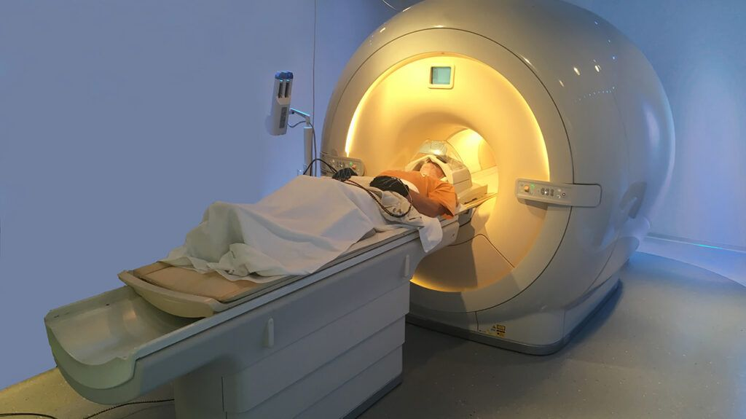
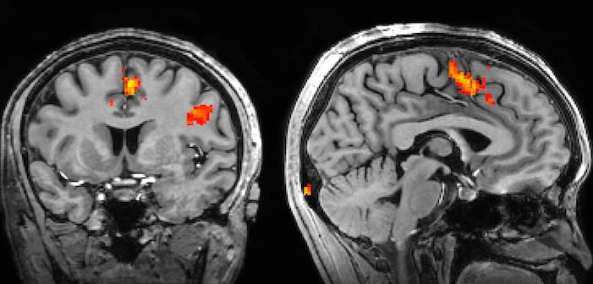
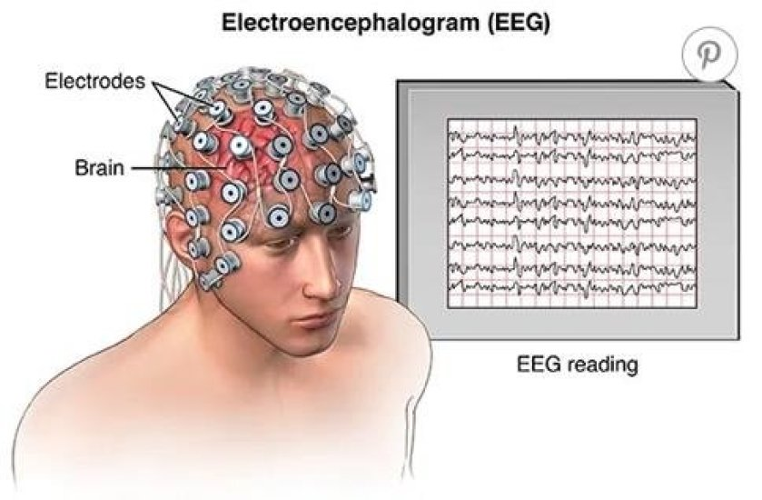
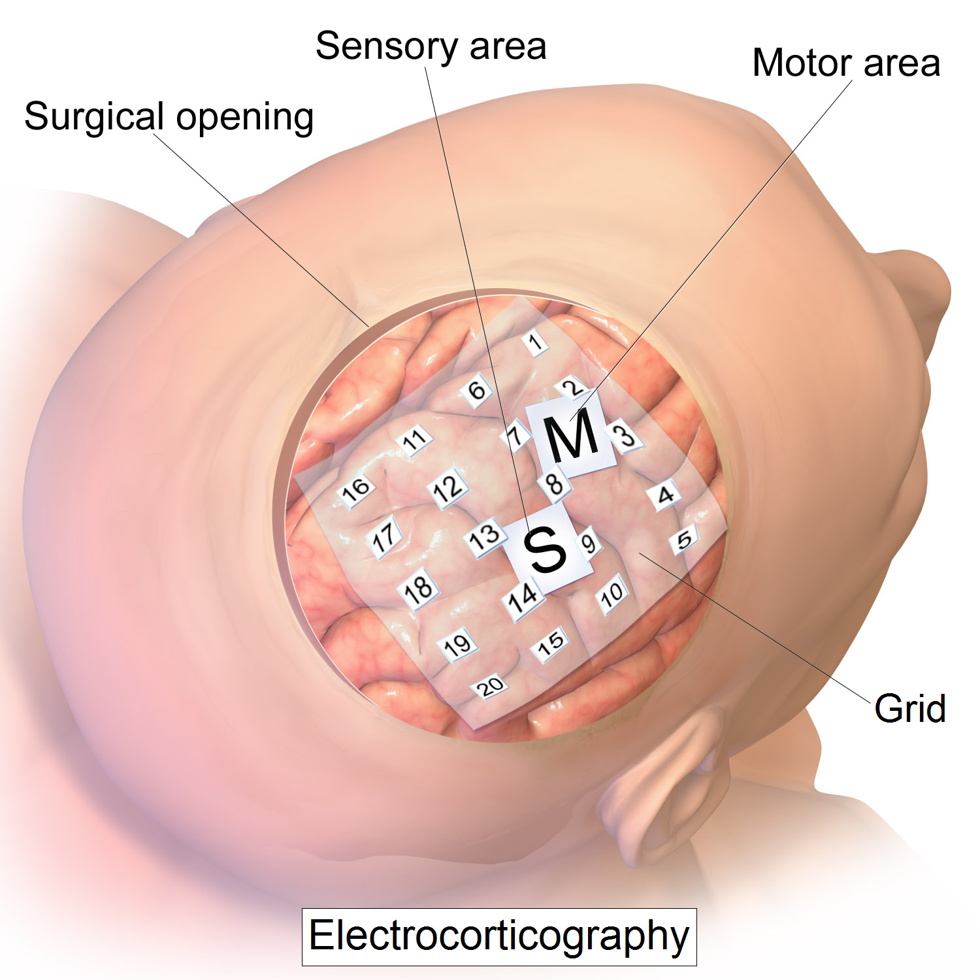
Neuroimaging Techniques
MEG
ECoG
fMRI

Slide 7
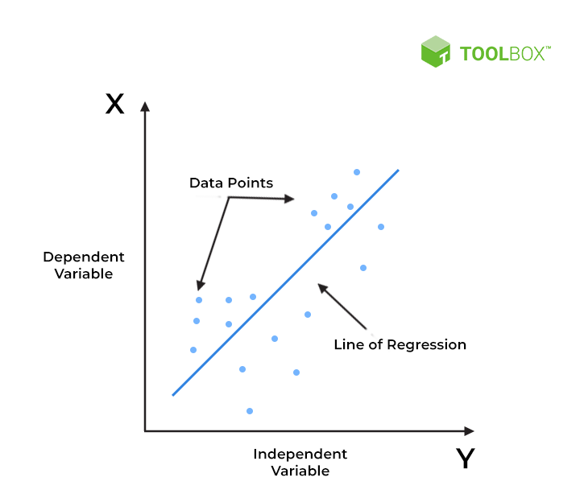
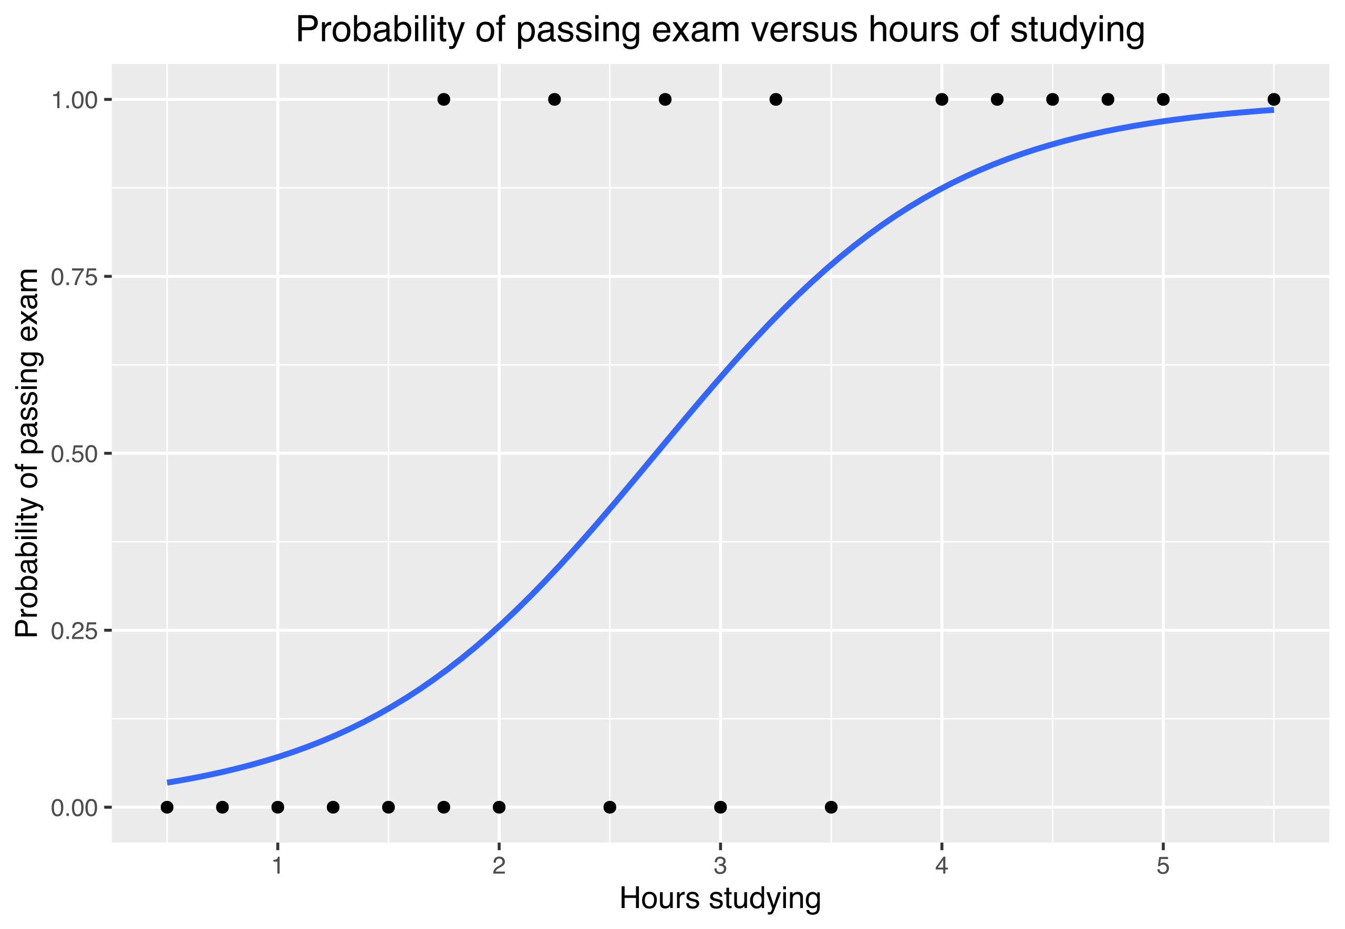
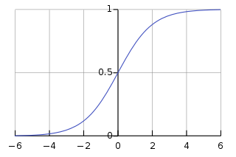
Machine Learning Recap - Regression
Linear Regression: Fitting a linear function to continuous data (with a linear correlation).
Logistic Regression: Fitting a logistic curve to binary data.
Ridge Regression (L2 Regularization): Introduces bias to avoid overfitting. It adds a penalty based on the square of the coefficients to the cost function.
Lasso Regression (L1 Regularization): Introduces penalty of “absolute value of magnitude”. Lasso tends to disregard the less important features. → feature selective.
** Regularized Regression can refer to Ridge, Lasso or other types of regularization based regressions
Reminder: Lines are fitted to the data by minimizing the cost function. The process involves setting the derivatives of the current line to zero to find fct maxima or minima.

Slide 8
Machine Learning Recap - Regression
You will find other regressions mentioned in literature. No need to understand everything
Sparse Multinomial Regression: complex – used for high dimensional sparse data
Hierarchical Logistic Regression: solely used for the analysis of data with group structure and a binary response variable.

Slide 9
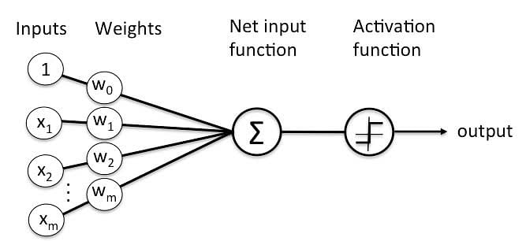
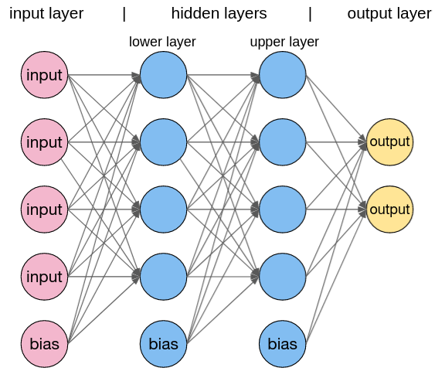
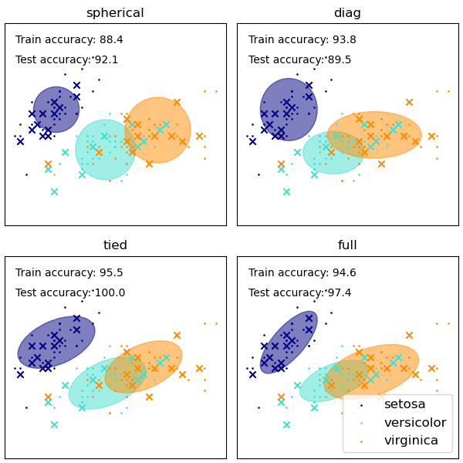
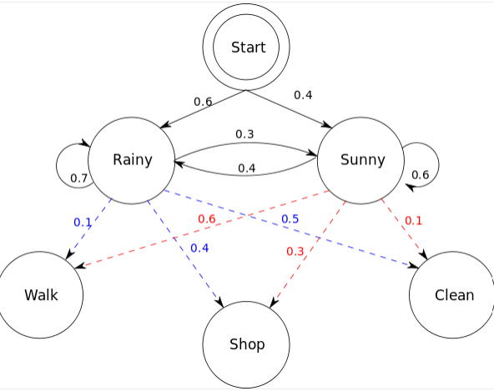
Machine Learning Recap - Models
Perceptron: Single layer Neural Network.
Multi-layered Perceptron (MLP): Input layer, hidden layer(s), output layer
K-NN models: Classification model based on distances between data points.
Gaussian Mixture Model: Probabilistic model that identifies clusters of data and fits a gaussian distribution to each cluster. Assuming the data is generated from a mixture of a finite number of Gaussians.
Hidden Markov Model: Probabilistic Graphical model used to predict sequences of hidden variables given a set of observed variables.

Slide 10
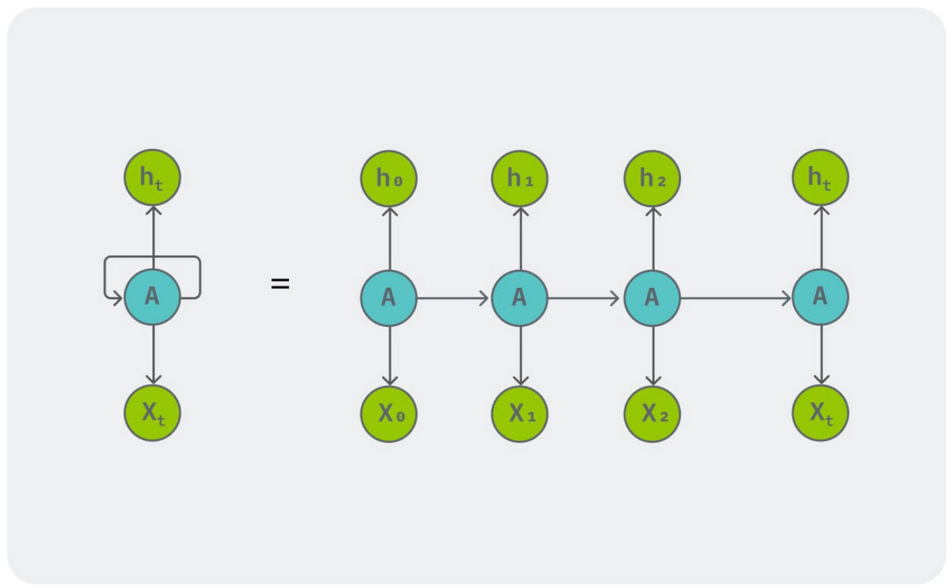
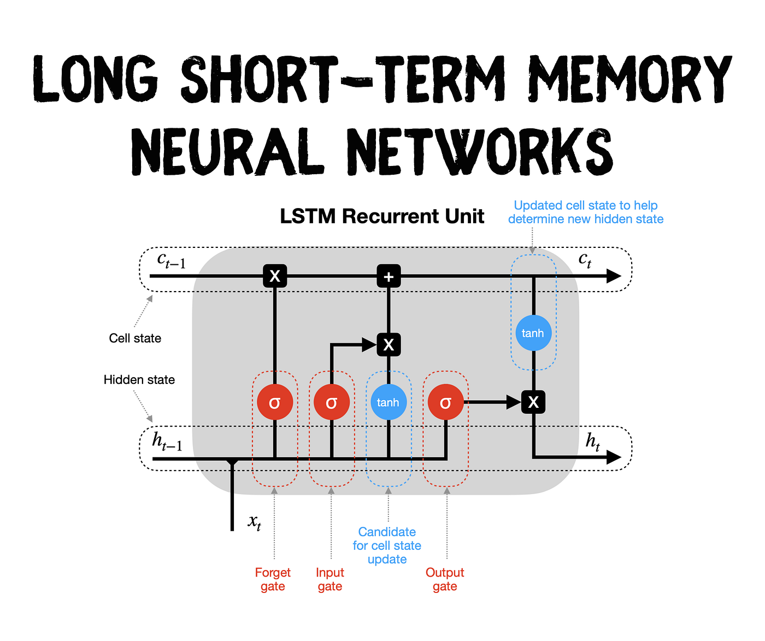
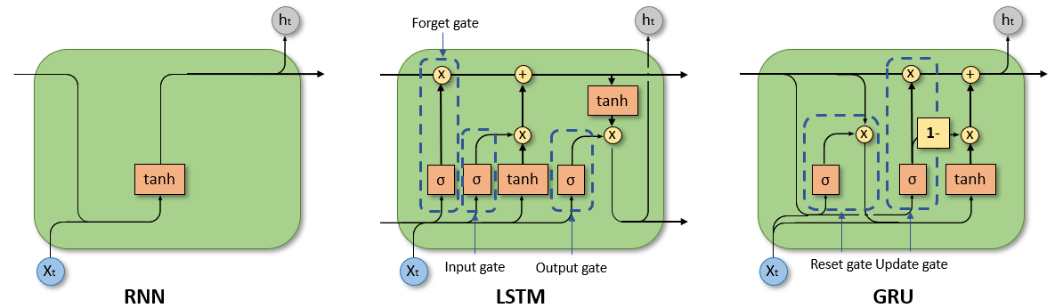
Machine Learning Recap - Models
Recurrent Neural Network (RNN): A network that allows the output of some of its neurons to affect the future inputs of neurons in the same layer or previous layers.
Long Short Term Memory (LSTM): Deals with the RNN vanishing gradient problem. It fixes this issue by introducing a memory unit called the “cell state” with a forget layer, input layer and output layer.
Gated Recurrent Units (GRU): Model like an LSTM but without an “output gate”. Similar effect with less parameters.

Slide 11

Homework for next session - First selected Reading
Artificial Intelligence based multimodal language decoding from brain activity: A review
Zhao, Y., Chen, Y., Cheng, K., & Huang, W. (2023). Artificial intelligence based multimodal language decoding from brain activity: A review.
Brain Research Bulletin, 110713.

