Slide 1
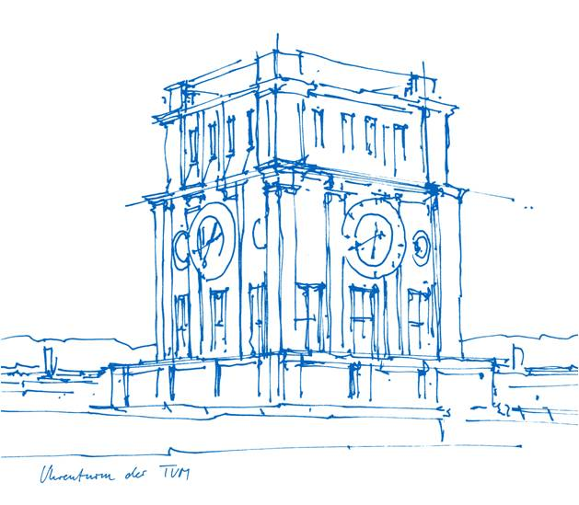
Master Thesis Topics
The Technical University of Munich
TUM School of Management
The Chair of Research and Science Management

Slide 2
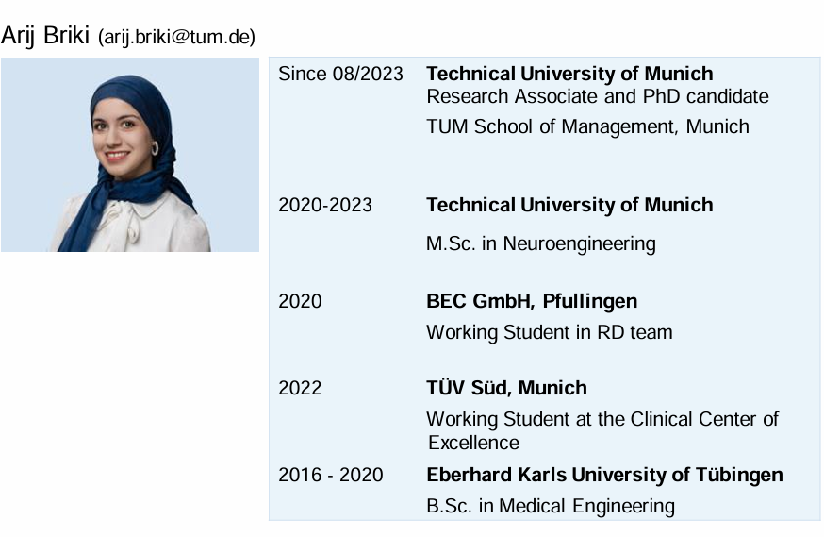
Developing Virtual Reality Scenarios for Assessing Responses to Destructive Leadership
This study aims to create and implement virtual reality (VR) scenarios featuring avatars that simulate previously validated workplace scenarios. These scenarios are designed to interact with participants in leadership positions, assessing their reactions and stress responses in realistic, controlled settings. The VR-based assessment tool will provide insights into individuals' behavioral and emotional responses contributing to a better understanding of the emergence of destructive leadership behaviors.
Keywords: VR, destructive leadership, situational judgement.
Potential start date: May 2025.
Requirements: C#, experience with Unity and 3D modelling, interest in interactive design, interest in leadership assessment.
Contact: Arij.briki@tum.de

Slide 3
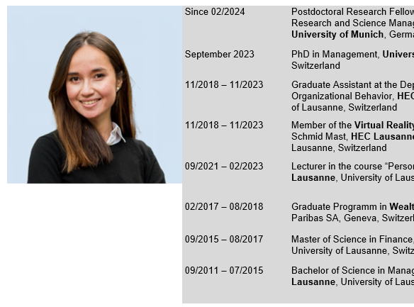
Embodiment and Leadership Skill Training in Immersive Virtual Reality
This topic aims to explore the Proteus Effect in Immersive virtual reality and investigate how embodying different identities impacts individuals verbal and nonverbal behavior linked to leadership skills. Concretely, this topic aims to investigate whether the embodiment of a (a) specific female or male leadership role model can influence participant’s public speaking skills, or (b) the embodiment of individuals of another gender influences participant verbal or nonverbal behavior.
Keywords: VR, gender, leadership, public speaking, pitching
Potential start date: May 2025.
Requirements: experience with Unity and 3D modelling, interest in interactive design, interest in leadership research.
Contact: anely.bekbergenova@tum.de

