Slide 1
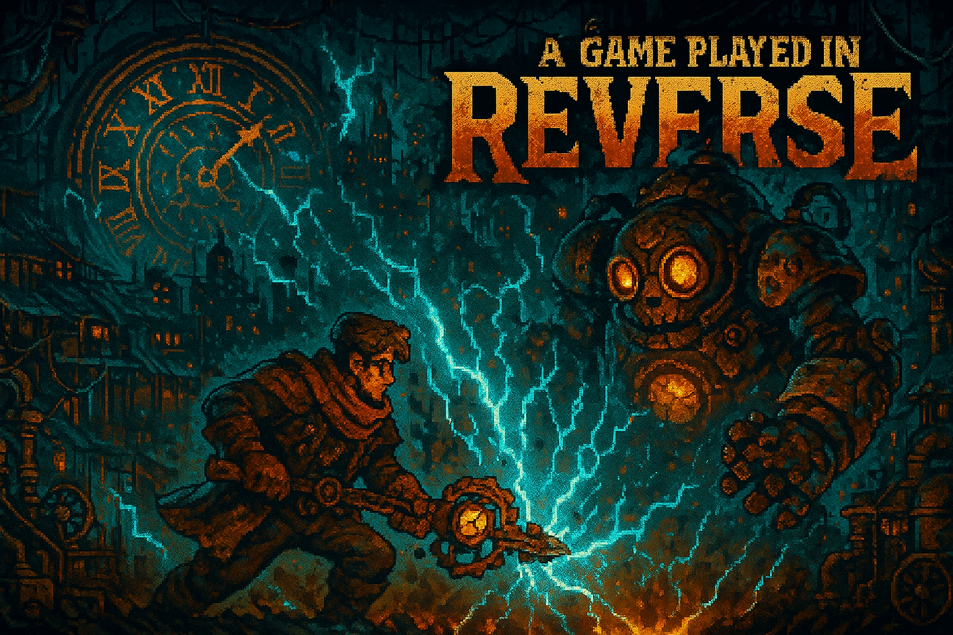
Alpha-Release
A Game by Ayoub Mabkhout and Samuel Saruba
Team:
Last Minute

Slide 2
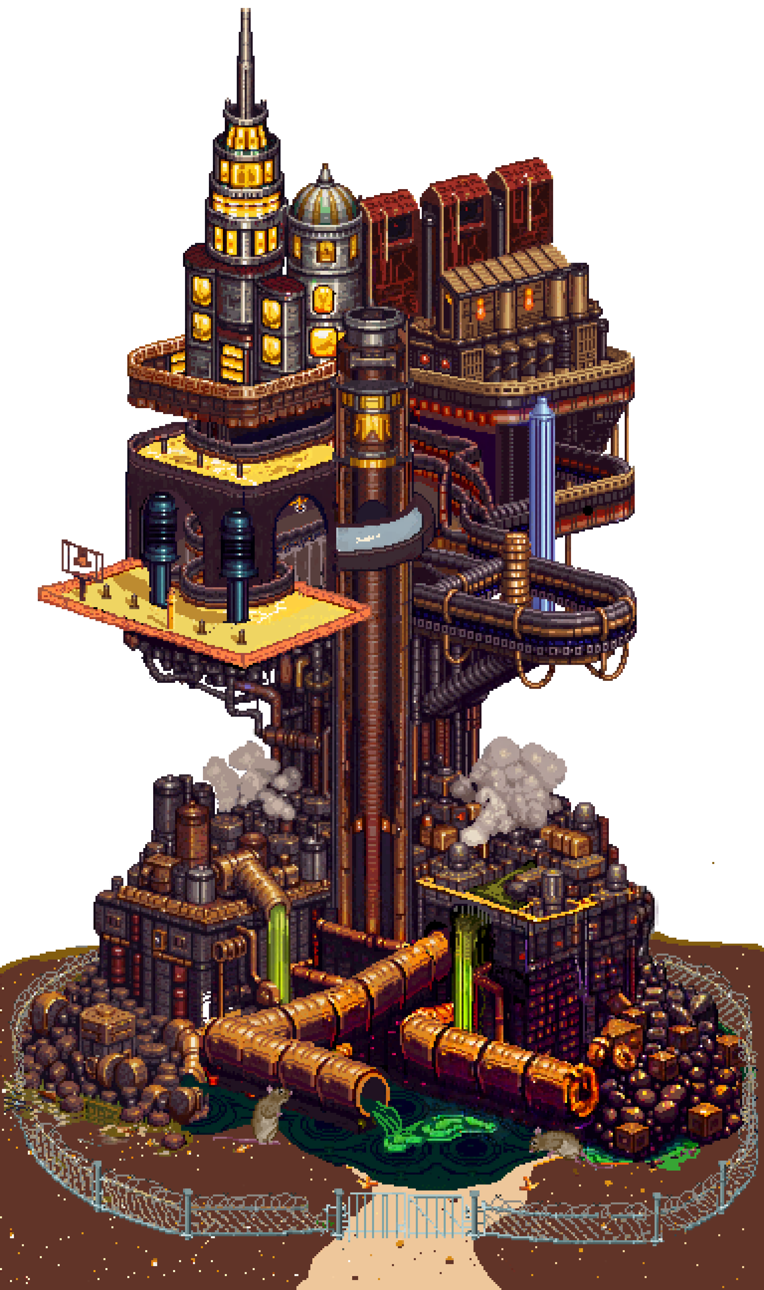
Core Loop:
Enter encounter
Solve combat puzzle
Move through nodes (combat → loot room → combat…)
“Unloot” gear between encounters (reverse progression)

Slide 3
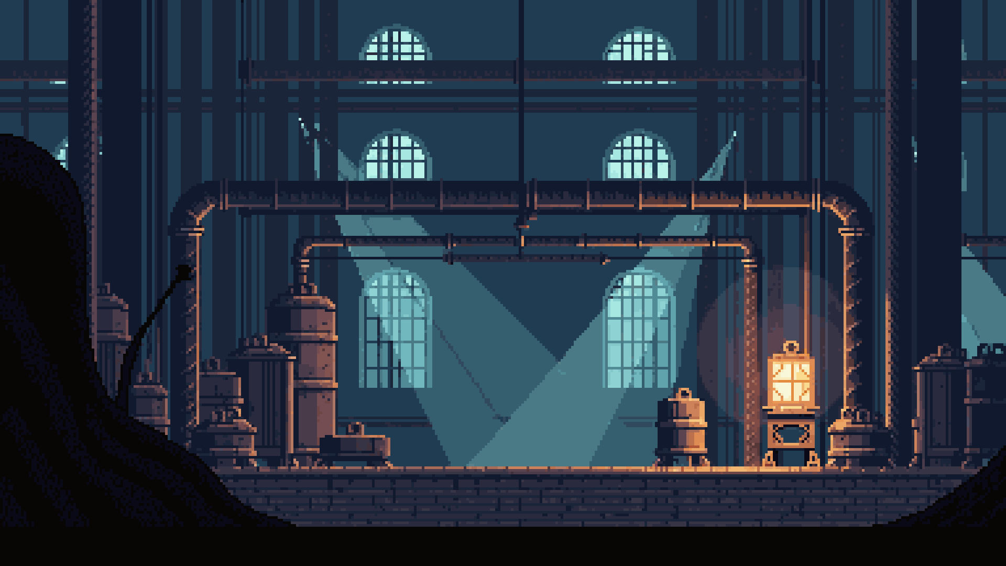
What’s in the alpha?
Full playable run structure
3 fully playable encounters
2 work-in-progress encounters
Node-based progression + loot rooms
Detailed Tutorial + clearer UI (timeline preview, tooltips)
Story framing via intro, item & enemy descriptions
5 music tracks integrated (menu, encounters, overworld)

Slide 4
What’s missing/next?
Resolution Engine (solver + UI)
Sound effects & ambient audio
Balancing and tuning encounters
Finishing WIP encounters
Adding story closure at the end

