Slide 1
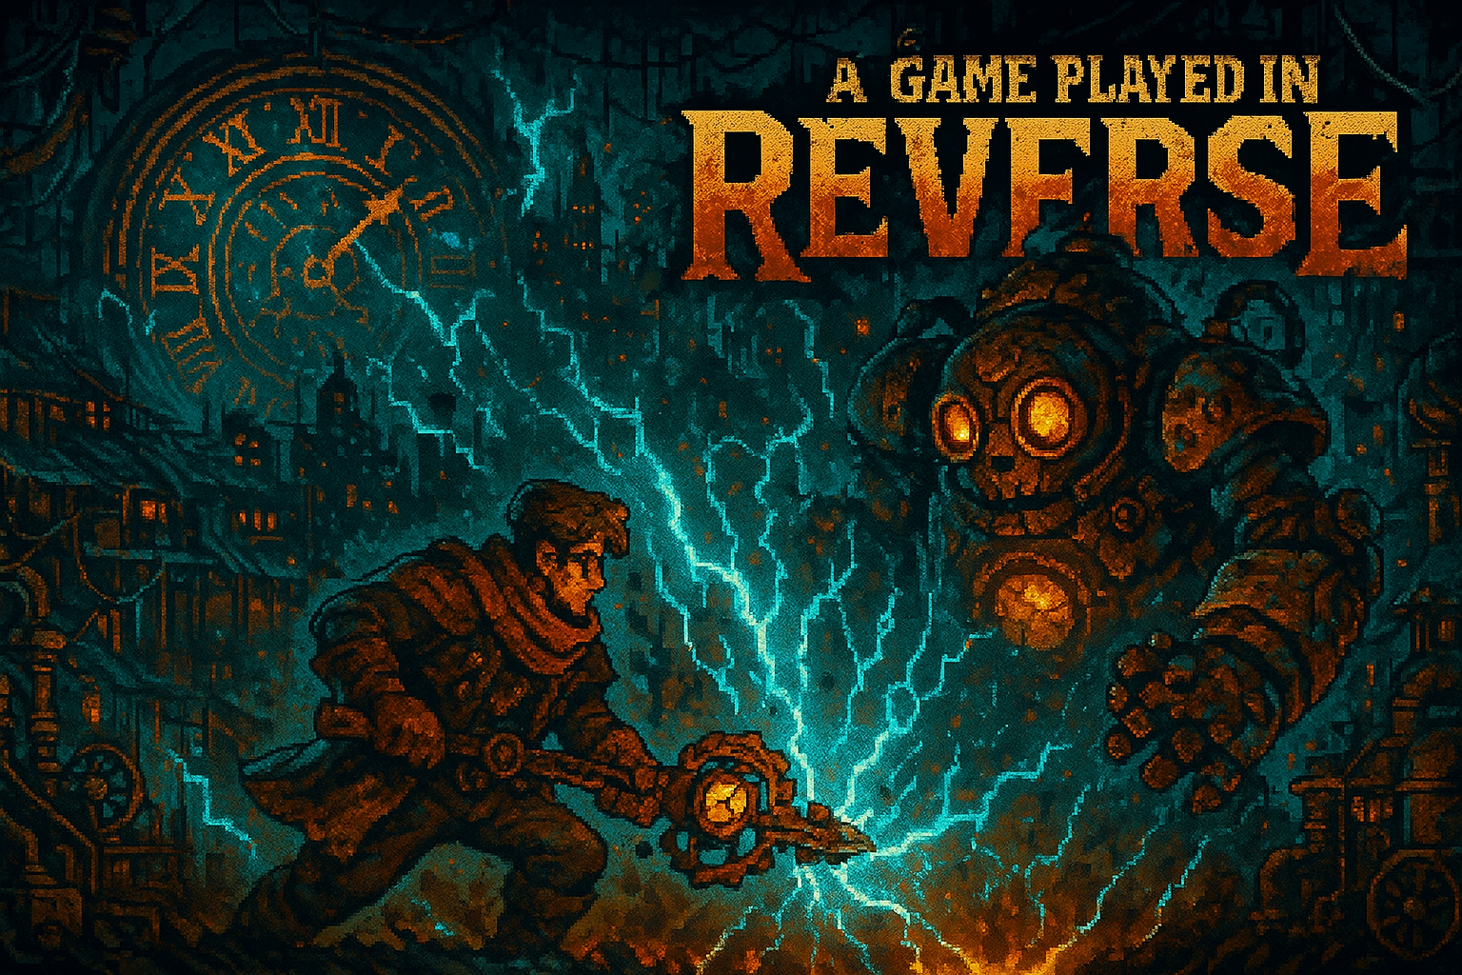
Milestone 3
A Game by Ayoub Mabkhout and Samuel Saruba
Team:
Last Minute

Slide 2
System Architecture
Subscribes to TurnManager
Core
Persistent data (Player, Enemy, Gear)
Combat
Runtime logic (TurnManager, CombatState)
UI
Presentation (event-driven listeners)
Key Decision: ScriptableObjects
All actions, gear, enemies = data assets
No code changes to add content
Designer-friendly iteration
EncounterManager: bridges Core → Combat, spawns Player/Enemy from data

Slide 3
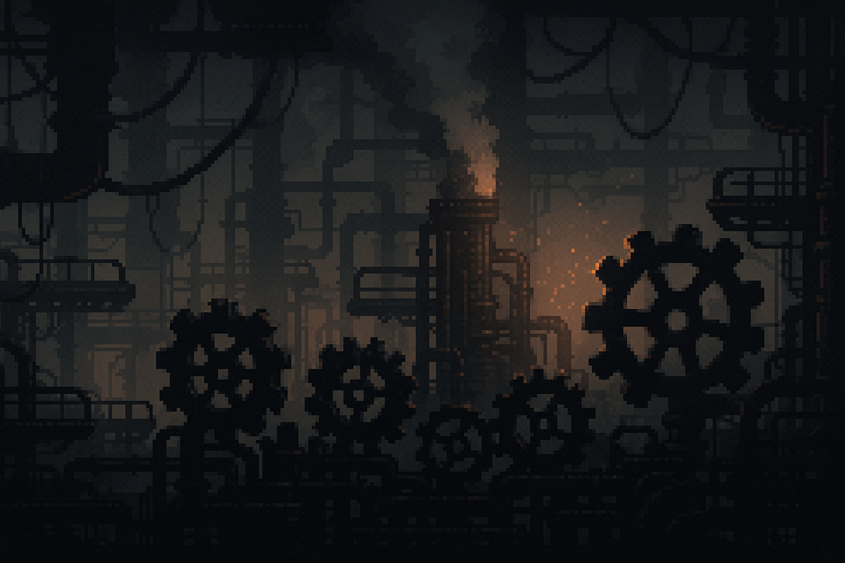
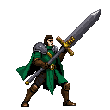
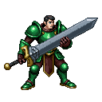

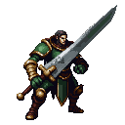
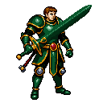
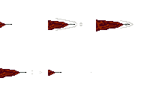

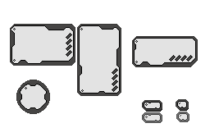
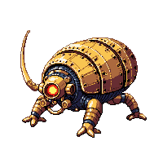



Art & Visuals
Free pixel art packs from itch.io (placeholders)
PixelLab AI sprite generation (mixed results)
Learning Aseprite for custom modifications

Slide 4

Encounter 1
Solution 1: Minimize Turns
  Cleave → Sting → Cleave
Solution 2: Minimize Player HP
  Cleave → Sting → Mend → Self-Repair → Cleave → Sting → Mend → Self-Repair → Cleave
Encounter 2
Attack, Defense Stat –
  Formula: Damage * (STRENGTH/10) / (DEFENSE/10)
Solution: Cleave → Fortify → Cleave → Fortify → Cleave → Fortify → Cleave → Fortify → Cleave → Fortify → Amplify

Slide 5

Current State & Next Steps
✓ Core architecture complete, combat logic solid
✓ 2 playable encounters, HP persists between fights
✓ ScriptableObjects: easy content creation
✗ Resolution Engine (solution path counter)
✗ Between-encounter flow (map, unlooting, gear downgrade)
✗ Game juice (animations, sound, background motion)
✗ Visual polish (cohesive art style)

