Slide 1
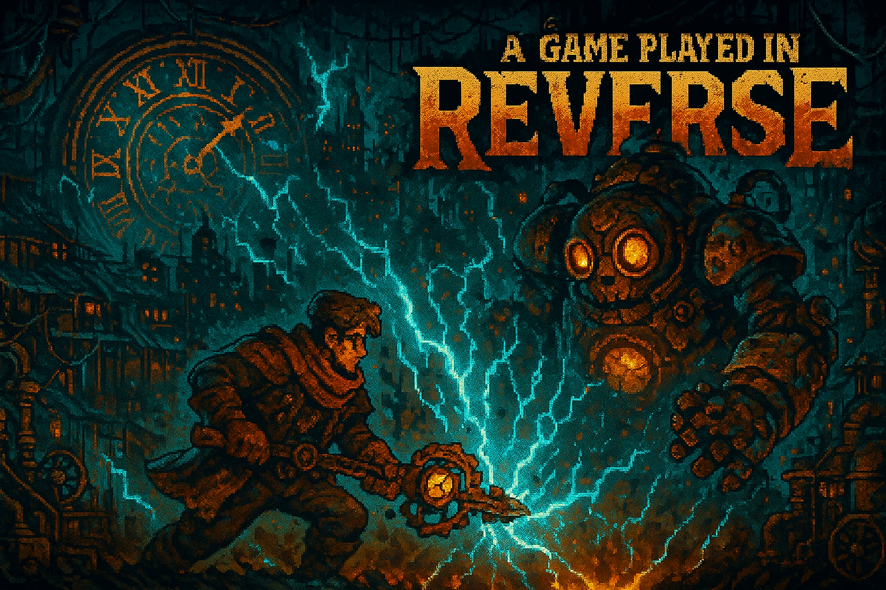
Milestone 5:
Playtesting
A Game by Ayoub Mabkhout and Samuel Saruba
Team:
Last Minute

Slide 2

Why We Playtested:
We only tested with ourselves so far
Systems are highly non-standard
Risk of tunnel vision
Goal: first-contact understanding, balancing

Slide 3
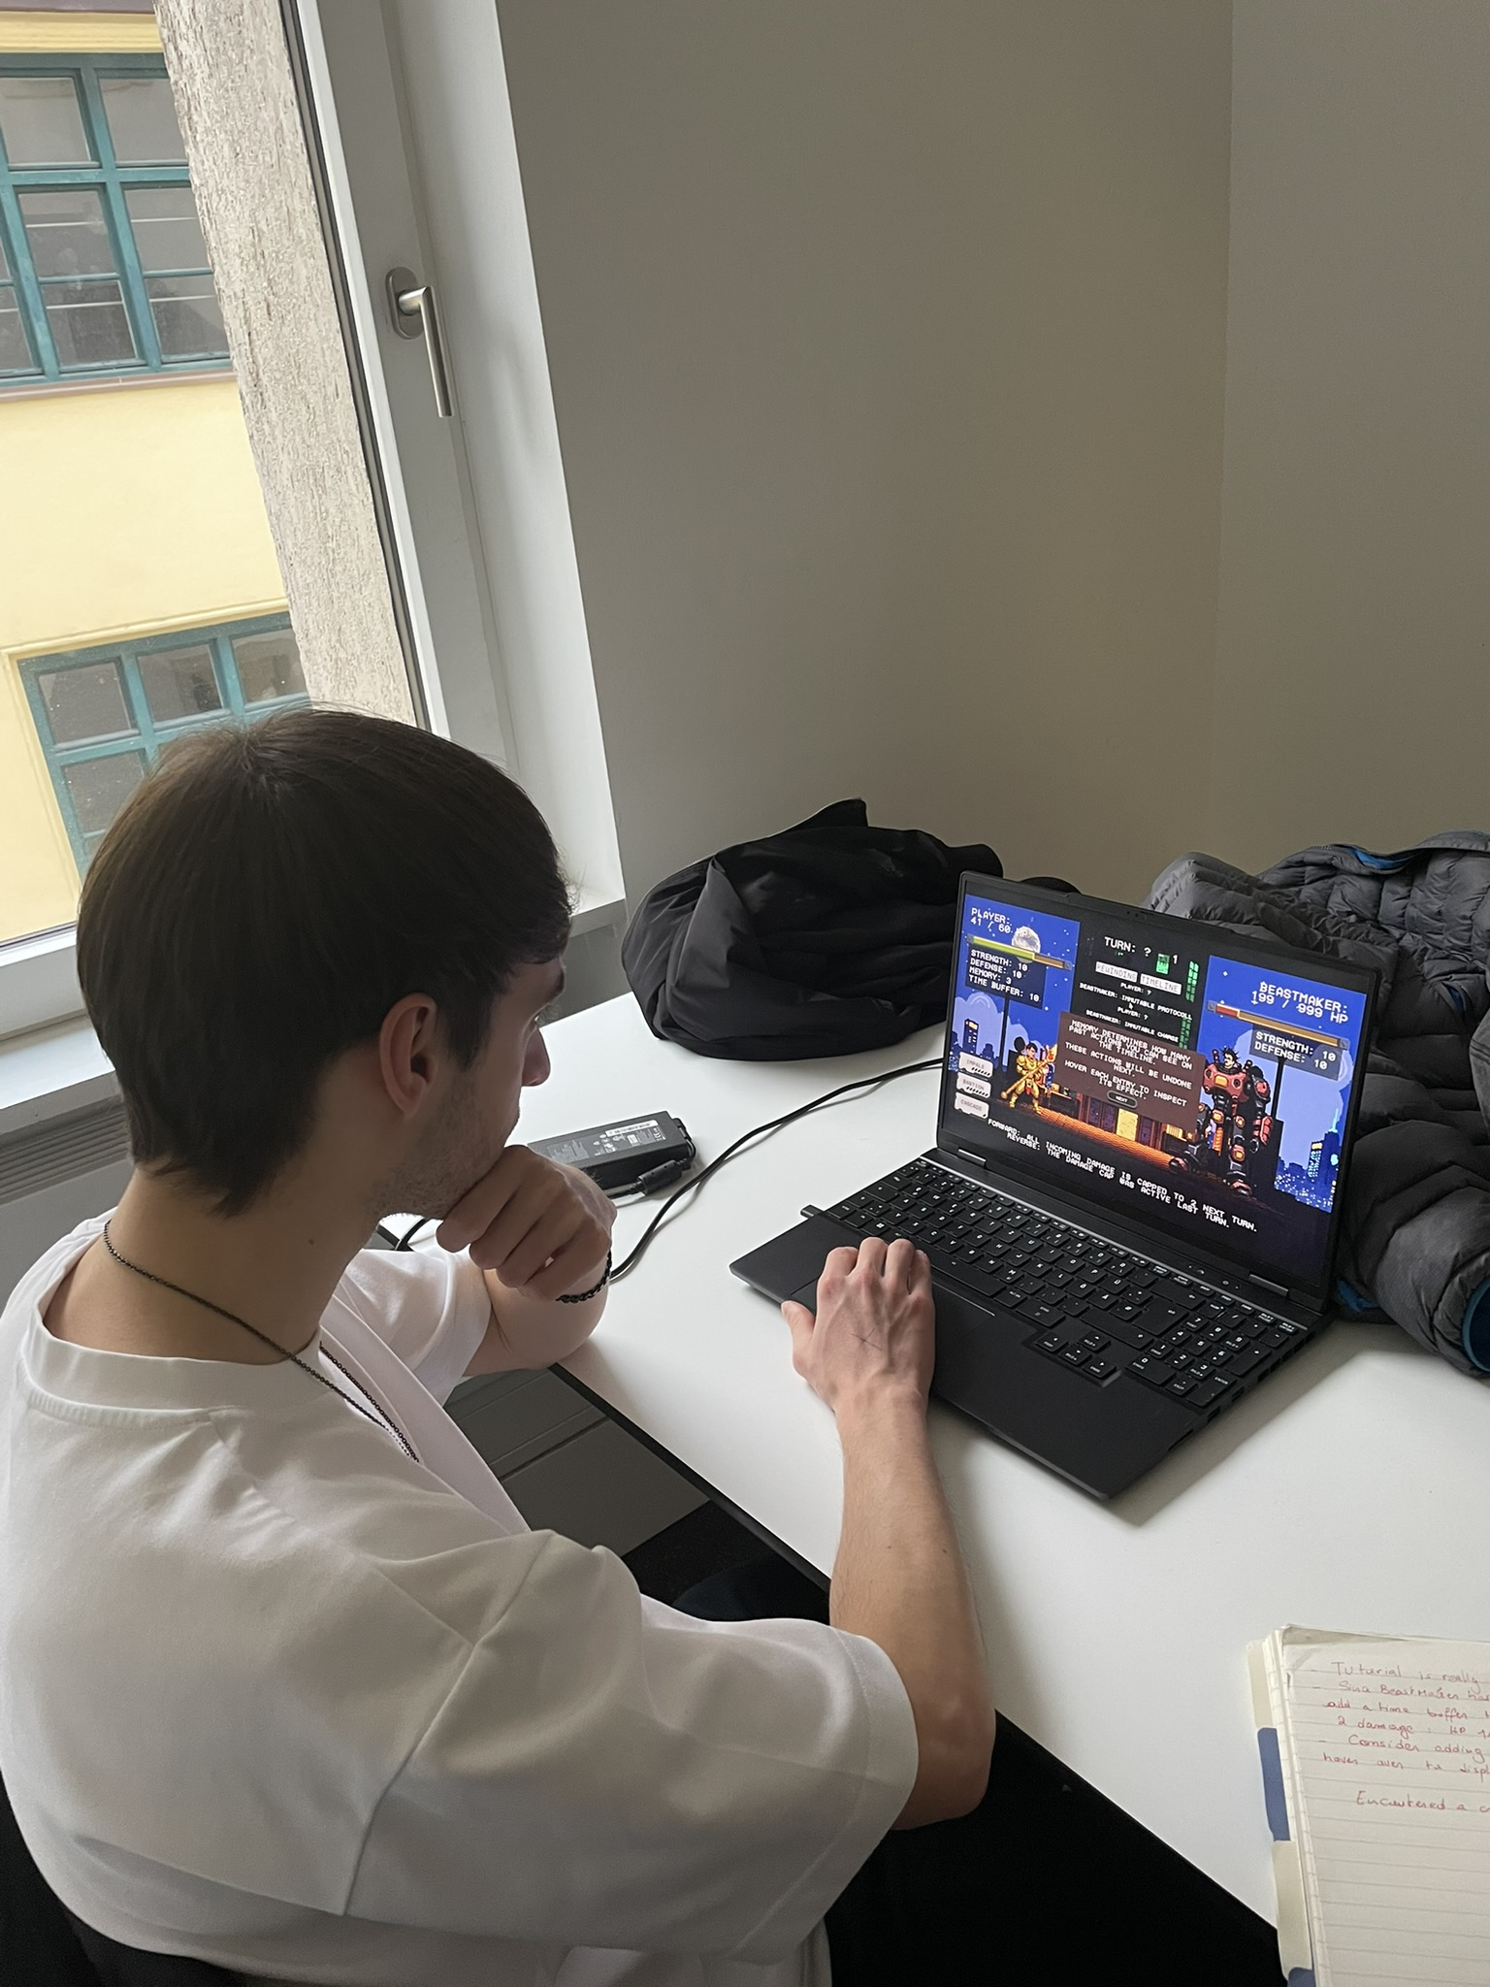
Playtest Setup:
Alpha: content-complete run (Ending + Unrest added)
Minimal to no explanation
Think-aloud encouraged
Short interview after
Experienced roguelike player
Regular gamer (low RPG literacy)
Casual gamer
Non-gamer
Online + in-person sessions
Playtesters:

Slide 4
Questions asked:
Did anything happen that felt unfair, arbitrary, or unearned?
How much did you actually plan your actions versus just clicking something? What was more fun?
Did the idea of playing in reverse make sense to you? When (if ever) did it click?
Did the system feel coherent, logical and well thought out – even if you might not have understood everything?
What information did you wish the game had told you but didn‘t?

Slide 5
What Worked:
Main Problems:
Core idea felt novel
System felt logically consistent
Planning is fun (when readable)
Visuals + music praised
Reverse progression stood out
Tutorial takes 20–30 min
Too much information upfront
UI wording confusion
Players overwhelmed quickly

Slide 6
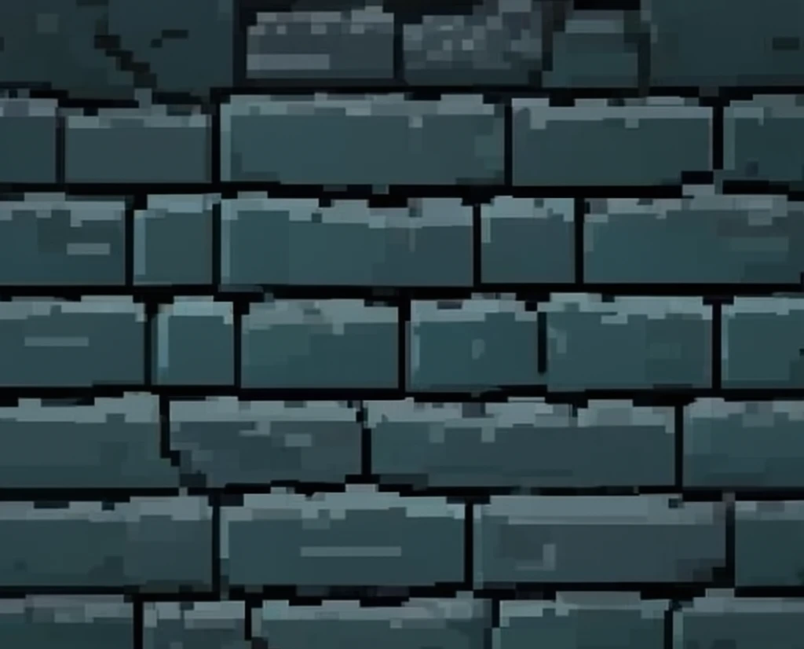
Biggest Complexity Wall:
Simple actions vs retroactive actions
Shield / buffs / Rot break intuition
Requires rewriting past
Mental simulation too expensive

Slide 7
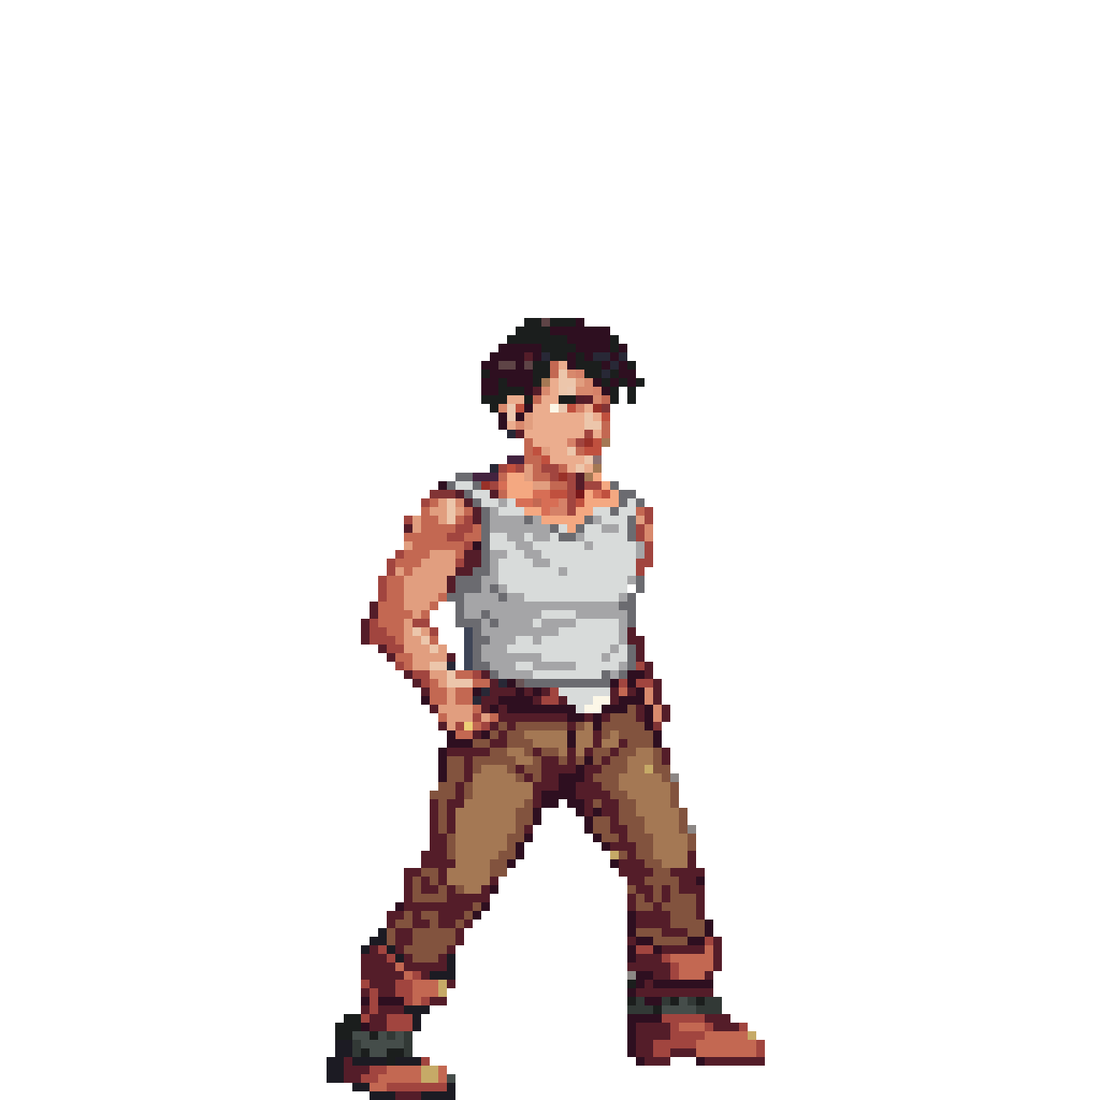
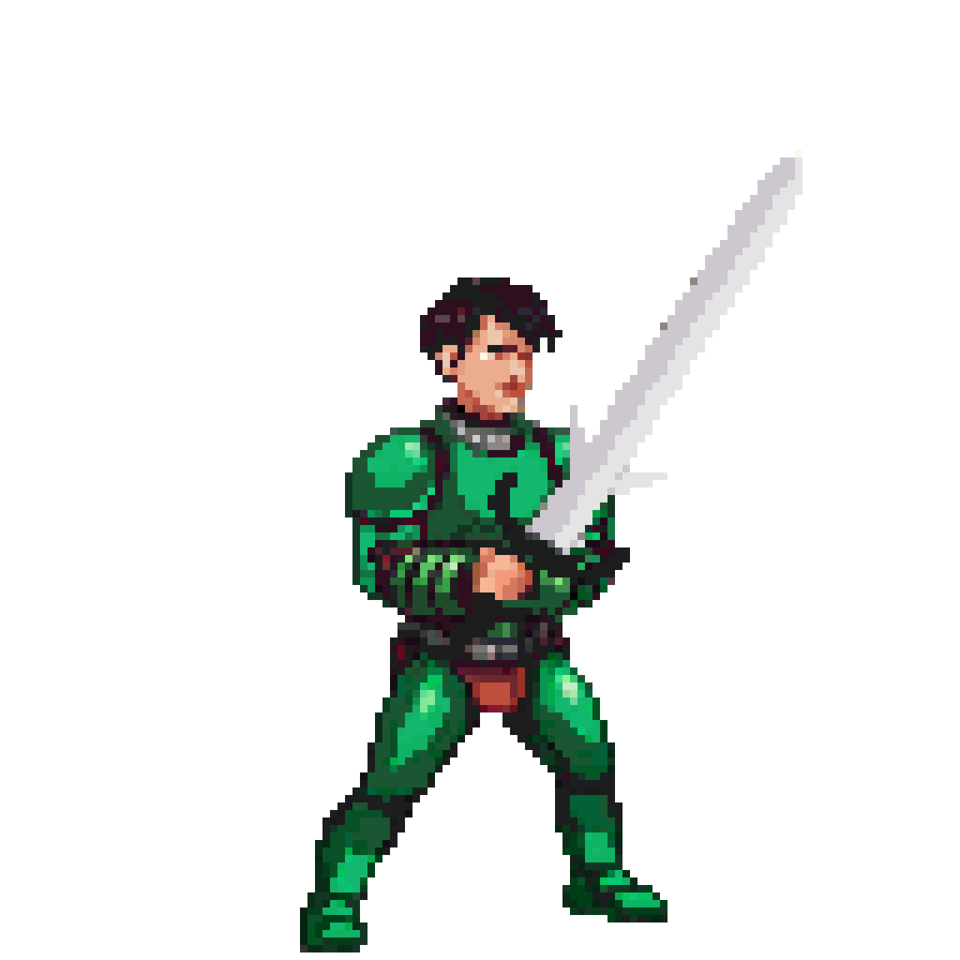
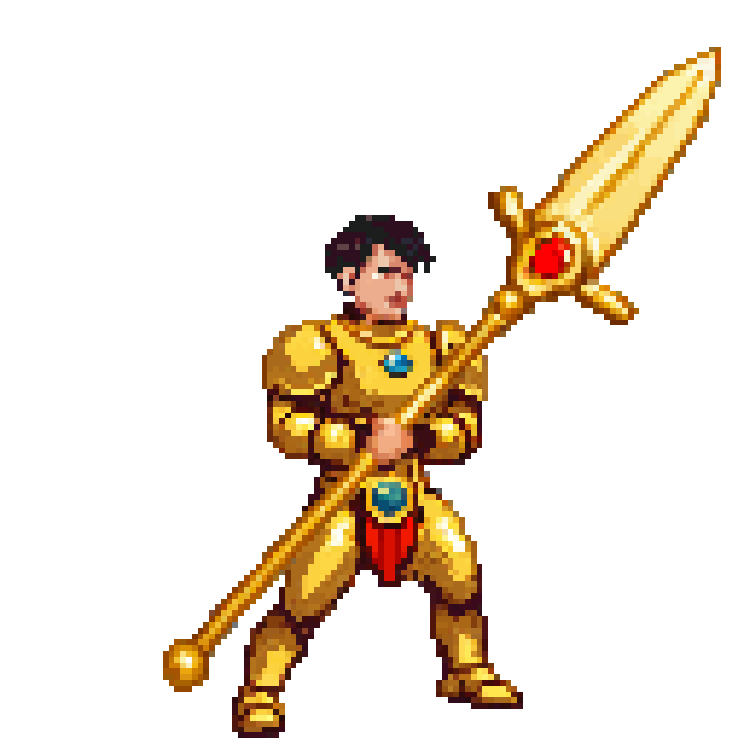
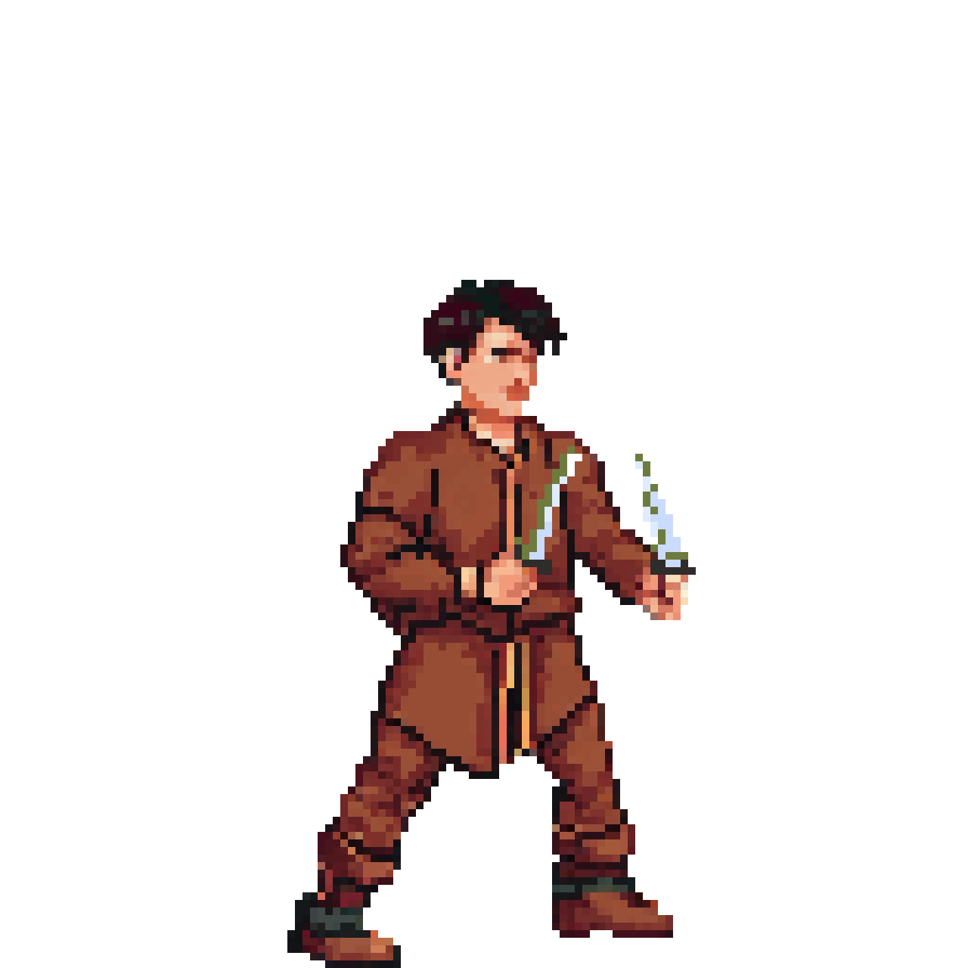
Player Differences:
Experienced player: deep engagement, minimal help
Regular gamer: overwhelmed but intrigued
Casual gamer: lost when mechanics stack
Non-gamer: unplayable
Genre literacy is critical

Slide 8
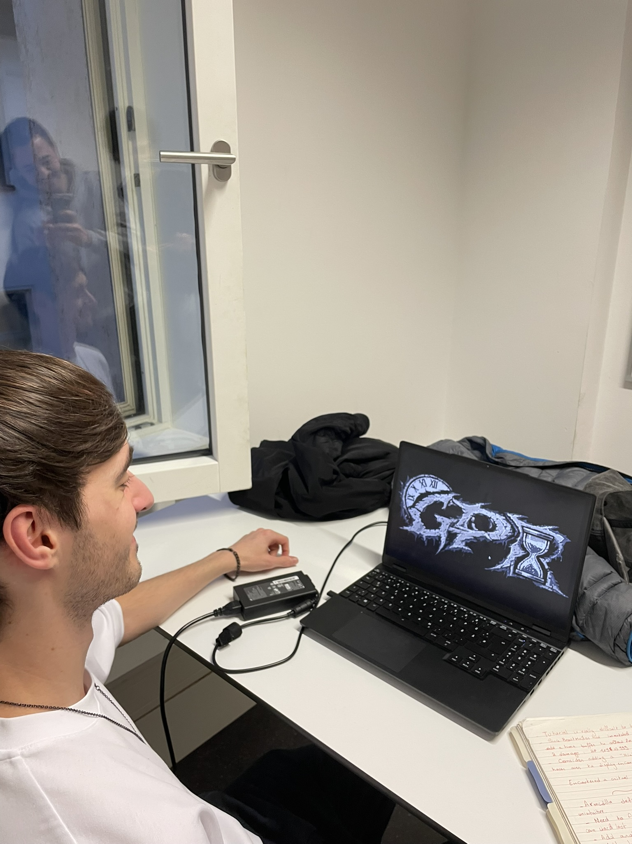
Key Takeaways:
Conceptually strong but cognitively fragile
Tutorial overload is the main barrier
GPR is niche but real

Slide 9
Immediate Changes Made:
Clearer tutorial text
Timeline & Action descriptions rewritten
Hint system added
Unrest simplified
Time Buffer removed
Planned Improvements:
Easier pre-tutorial fight
Animated timeline
Reset fight button
Forward-time visualization
Less front-loading

