Slide 1

Chrono Regime????
You are trying to be the powerful dictator of a modern, fictional country and squash all opposition.
Your scientists have built the world’s first time machine but it can’t erase memory. When you rewind time, everyone remembers what happened in the future.
The world becomes a political battlefield as rival factions race to build their own machine.
You must manipulate information, alliances, and warfare to stay ahead in a collapsing timeline.

Slide 2
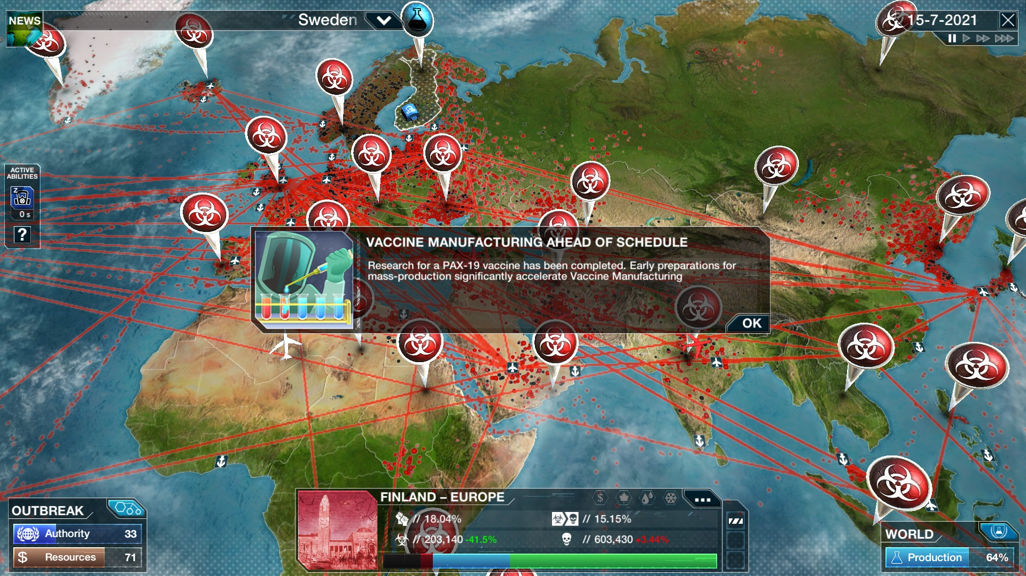
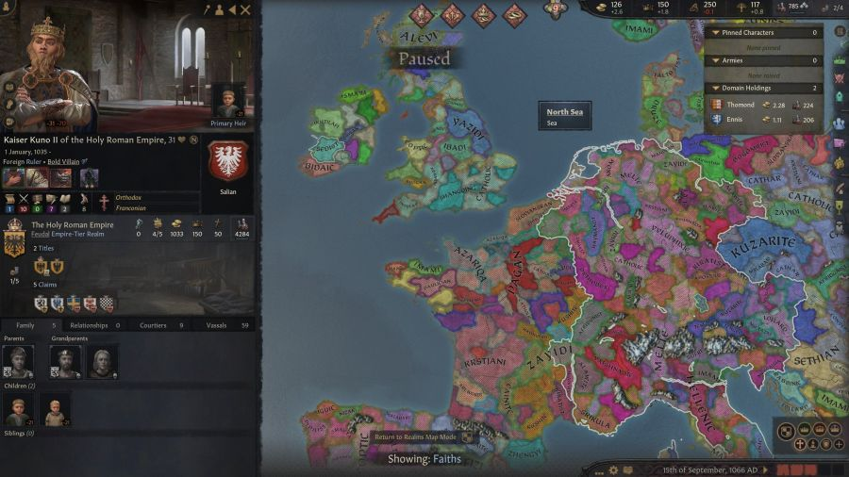
Goal:
Maintain dominance long enough to be the only one capable of controlling time
Do not let them to invent the time machine! Think of Crusader Kings II meets Plague Inc.

Slide 3
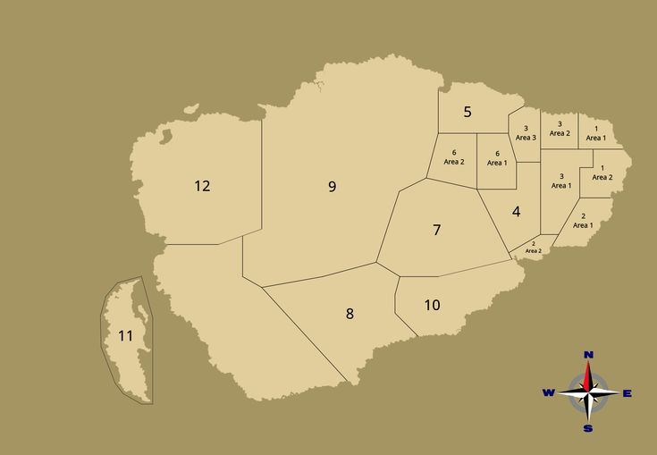
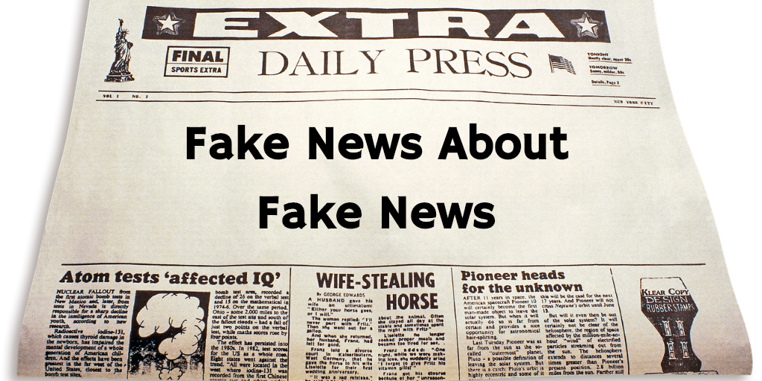
Money, Popularity, Military Strength, Sympathy Level of Faction per Faction & You as Dictator
Population
Public Support
Education Level
Geography/Lore
Economy
Start Round

Slide 4
Gameplay: Possible per-round decisions are LLM-Driven Minigames
Propaganda: Be shown an article, rewrite real headlines to manipulate public opinion. The effectiveness depends on your reach (public support) and on the quality of the spin as judged by an LLM.
Diplomacy: Natural-language negotiation with AI faction leaders to form alliances or orchestrate betrayal and potentially bribe them.
Invasion: Invade a province/region occupied by an opposing faction. LLM judges the likelihood of success based on factors like army size, geographical features, and tactics.
Rewind Time: Rewind time to undo an invasion or a decision, but beware, everyone retains memory of the future and this will affect your public support.
Immersion: LLM-generated context
E.g., LLM generates news and news articles.
The enemy factions are LLM based agents and act independently of you

Slide 5

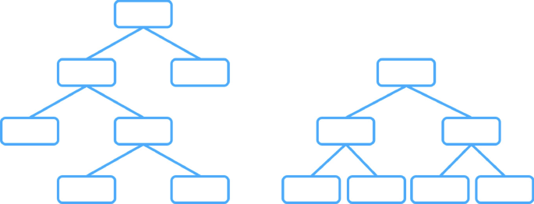

Round:
Decision A
Decision B
Each action has upsides and downsides affecting (hidden) stats that change the altitude and distribution of the population
Decision C
You and each Faction (controlled by AI Agent) make one decision in the decision tree or take one common action
Common Actions:
Attack Region
Initiate Talk with Faction
Invest in Military

