Slide 1


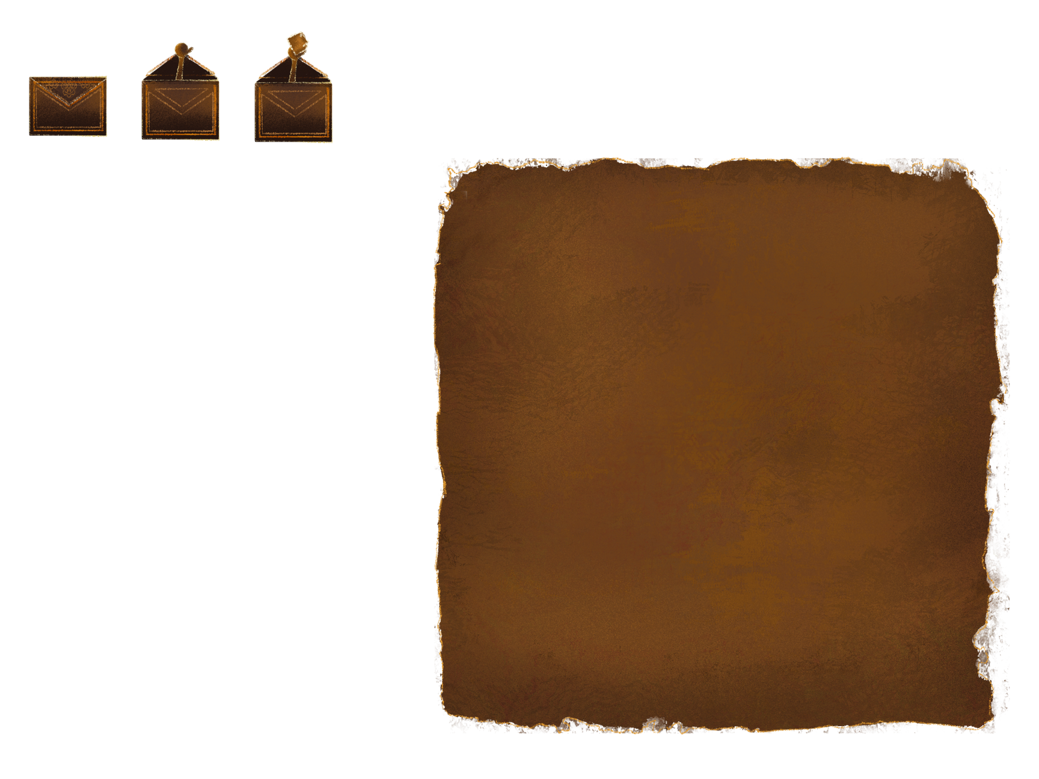

Team 7
21.01.2026

Slide 2
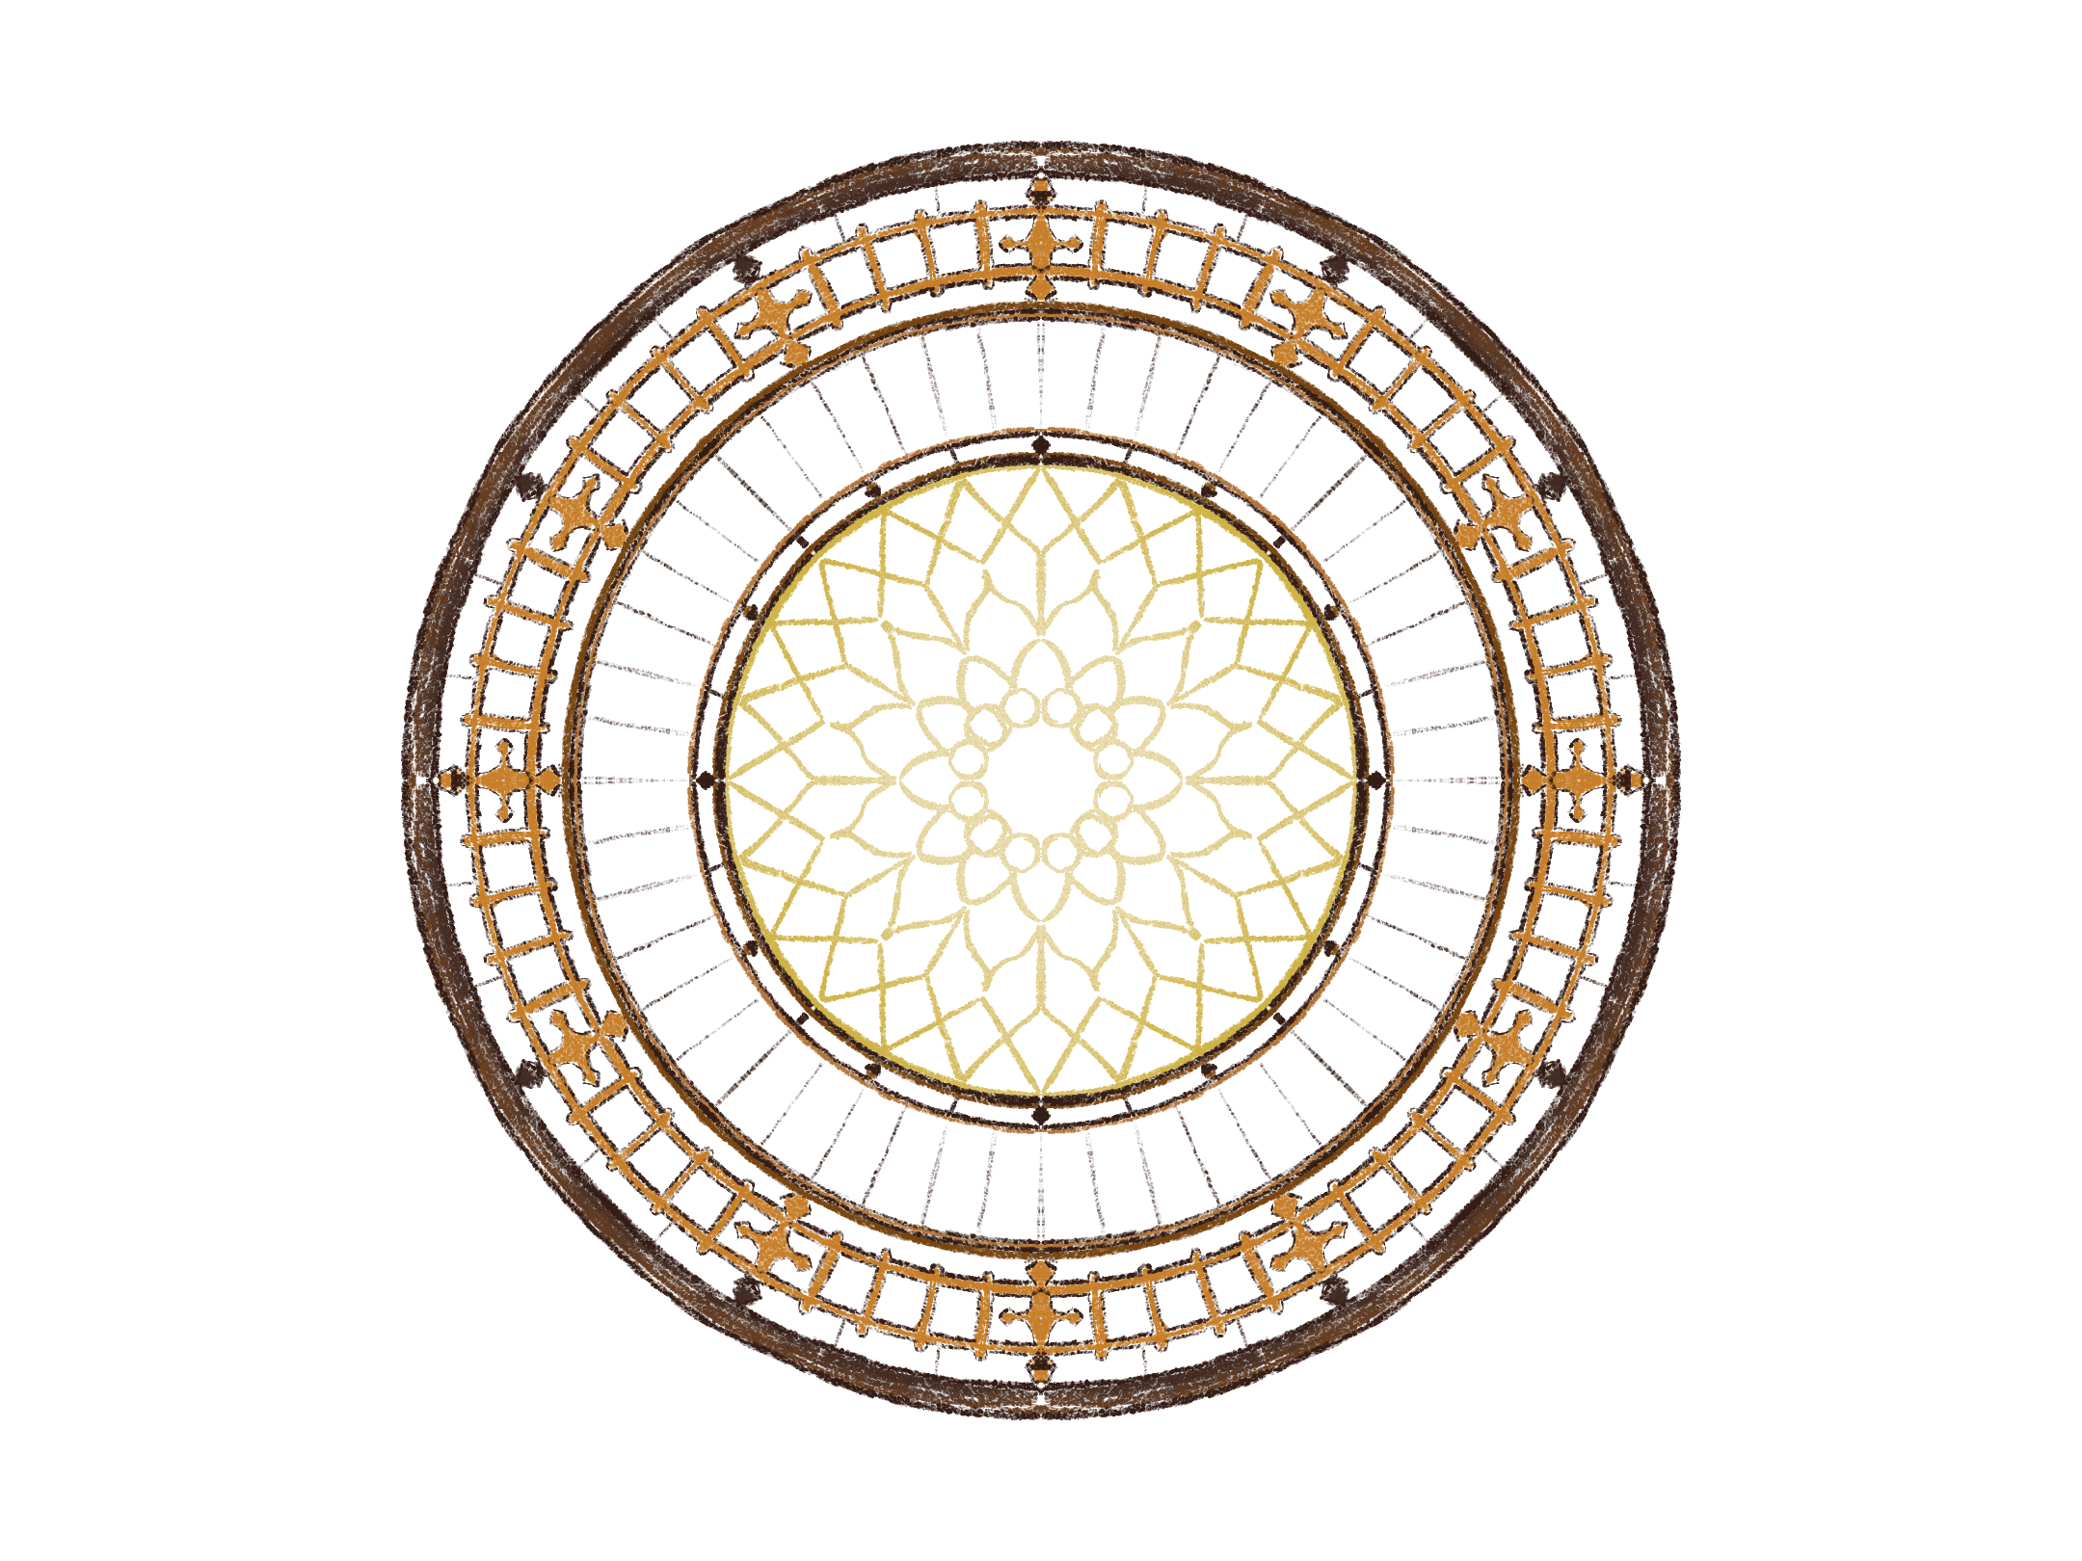
playtesting - demographics
  8+ respondents
  Played the game for 30-40 minutes, followed by 5-minutes Google Form questionnaire
  Mostly friends (87.5%), family (12.5%)
  The majority of adults aged 25-34 (62.5%) and the remaining 18-24(37.5%)

Slide 3
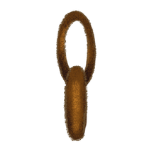
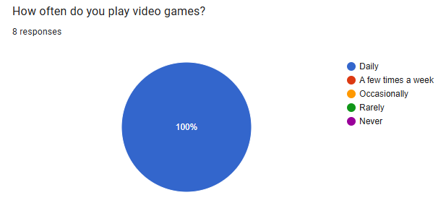
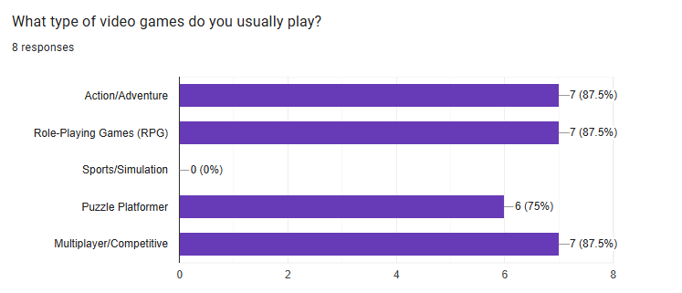
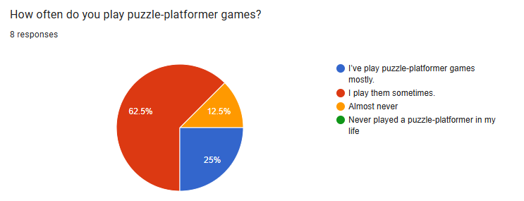
playtesting - demographics

Slide 4
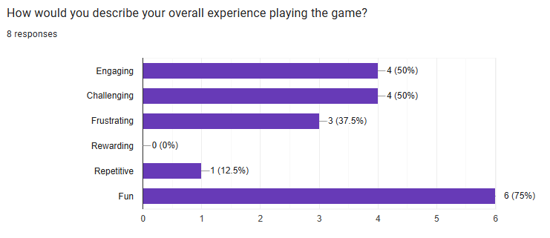
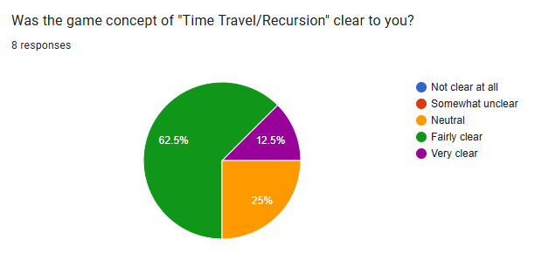
playtesting - General Feedback

Slide 5
playtesting - Open questions
  What could make the "Time Travel/Recursion" concept clearer to you?
    Tutorial or visual showcase could clarify the concept.
    Make objects (e.g., the clock) interactive and add time-manipulating platforms.
    More Narrative clarity and emotional cues

Slide 6
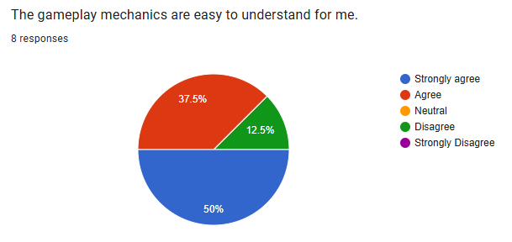
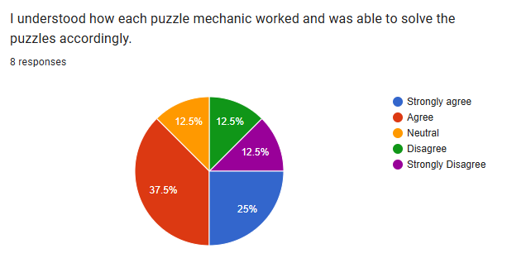
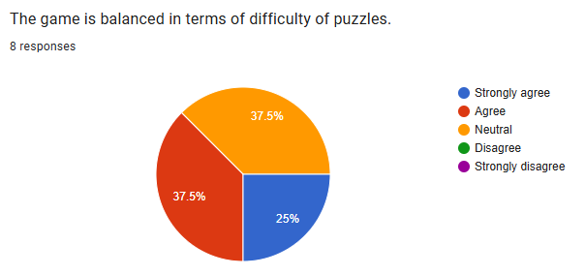
playtesting - Game Mechanics

Slide 7
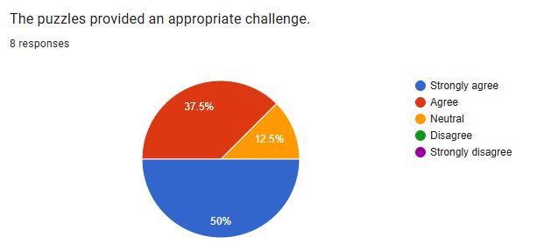
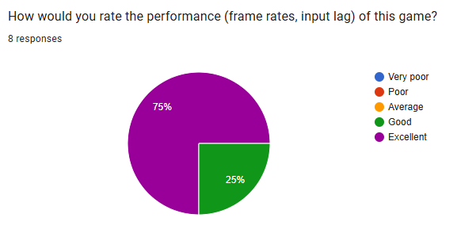
playtesting - experience and performance

Slide 8
playtesting - Open questions
  What Players Loved:
    The self-cloning "solo co-op" and time-travel concepts.
    Polished Puzzles, specifically the "satisfying" bell puzzles.
    Strong vibe and atmosphere, appealing art style, lively environments, and a likable protagonist ("Boi").
    The "Tarzan-like" chain adventure mechanics.

Slide 9
playtesting - Open questions
  What Players Disliked:
    Inconvenient key bindings (Clone/Interact vs. WASD)
    Glitchy chain mechanics and inconsistent interaction hints.
    Issues related to camera work

Slide 10
playtesting - Open questions
  Future update requests:
    Add more time-manipulation (slow/fast) and the ability to create multiple clones.
    Implement a puzzle hint system and clearer visual indicators for interactable objects.
    Technical Fixes: Polish the "buggy" chain mechanic and improve camera behavior.
    Allow "W" for jumping and relax the strict timing on the elevator puzzle.
    Add better lighting to help distinguish colors for the music puzzles.

Slide 11
playtesting - Open questions
  Encountered bugs:
    Players could leave the intended area or get stuck
    Clone issues: camera not following, inconsistent behavior after interactions.
    Camera problems on elevators/chains; sometimes requires jumping to regain view
    Cables are inconsistent, and boxes are falling endlessly

Slide 12
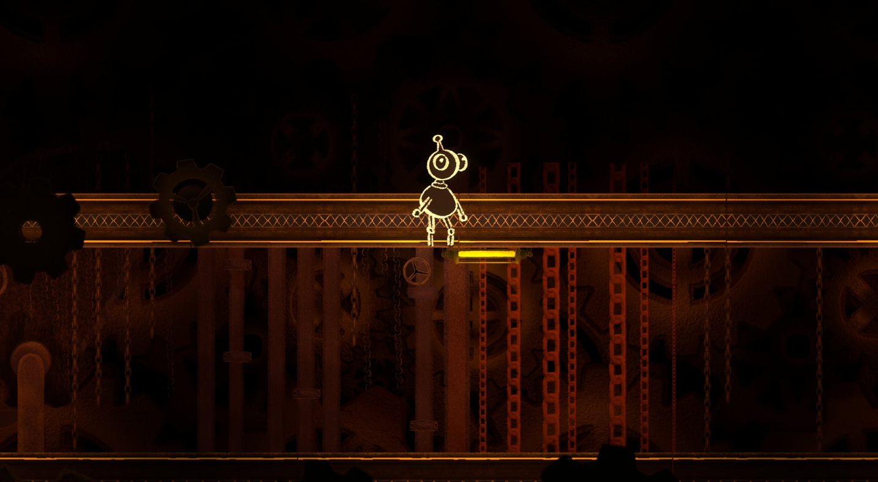
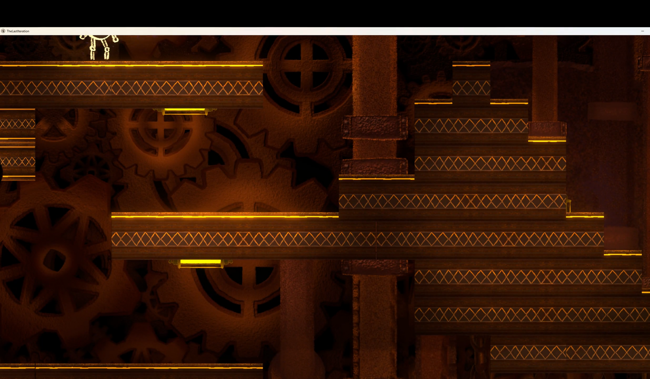
out of the map bug

Slide 13
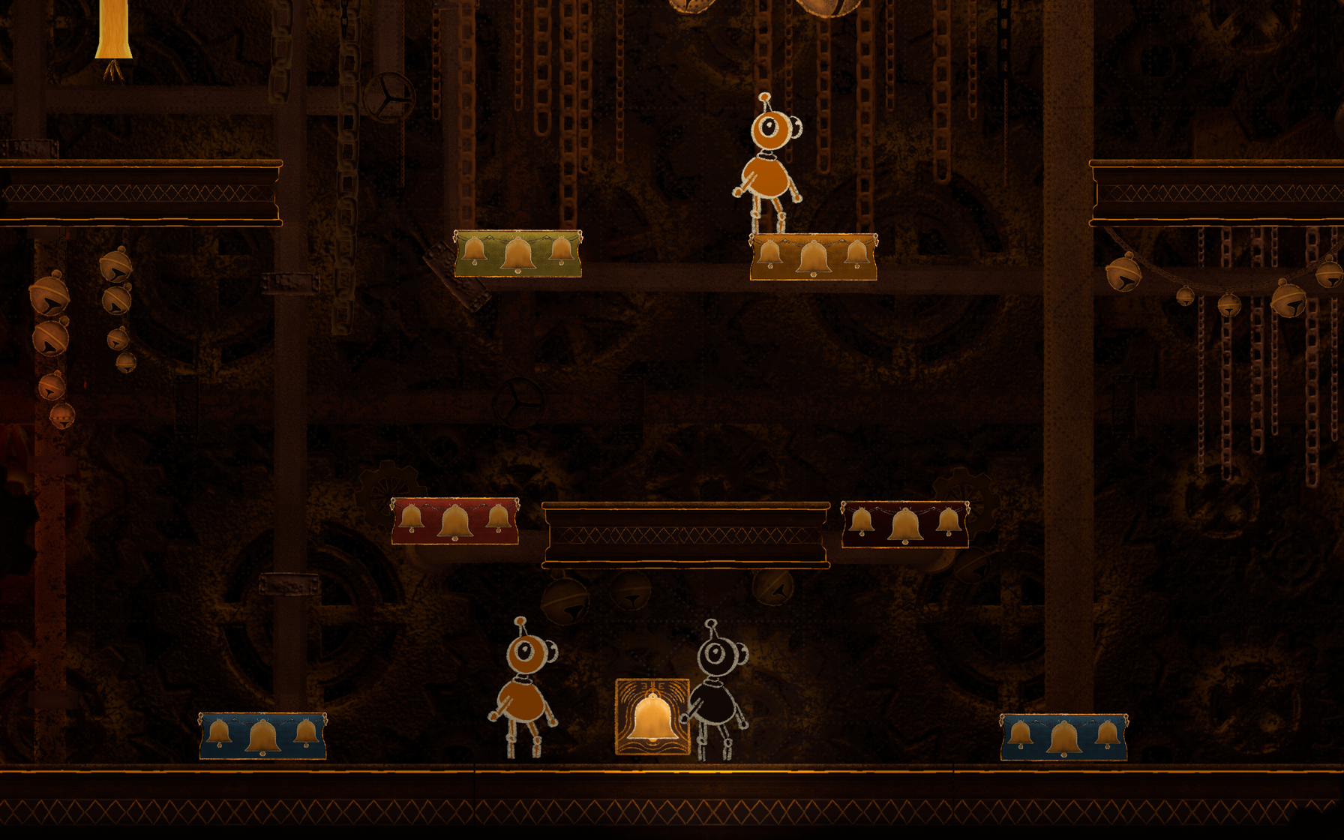
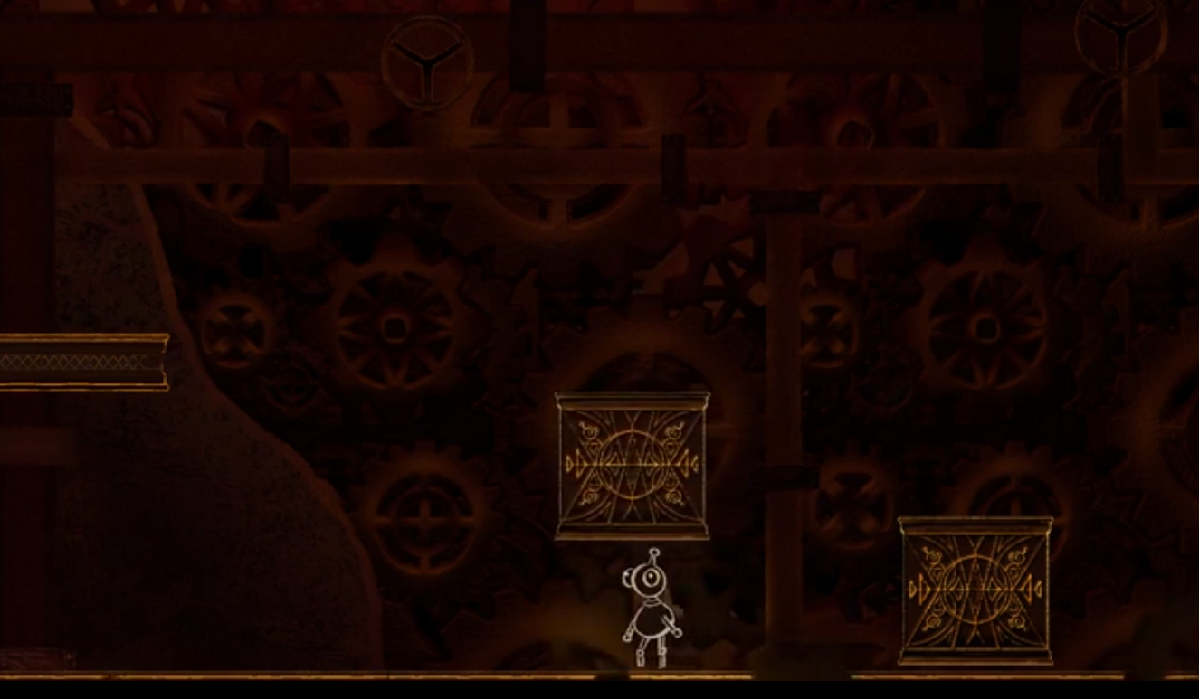
other visual bugs

Slide 14
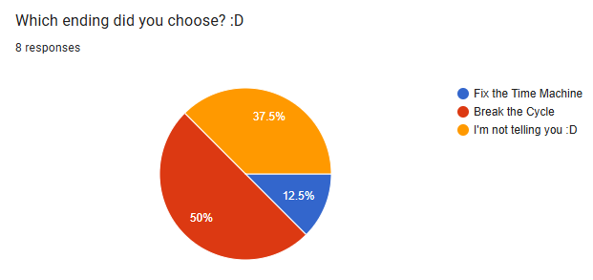
playtesting - Open questions

Slide 15
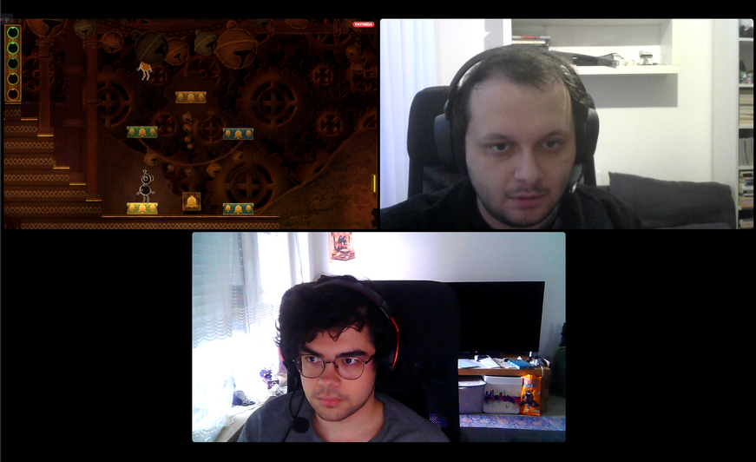
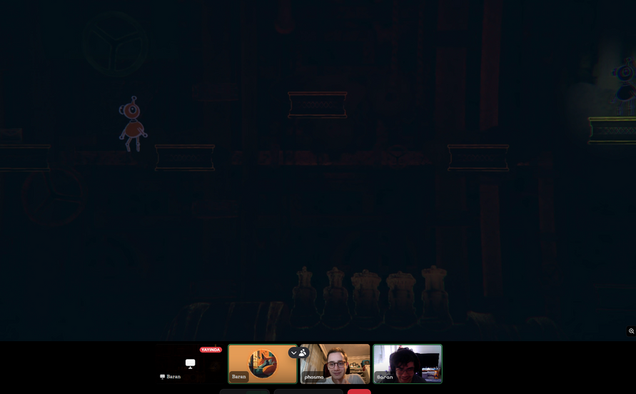
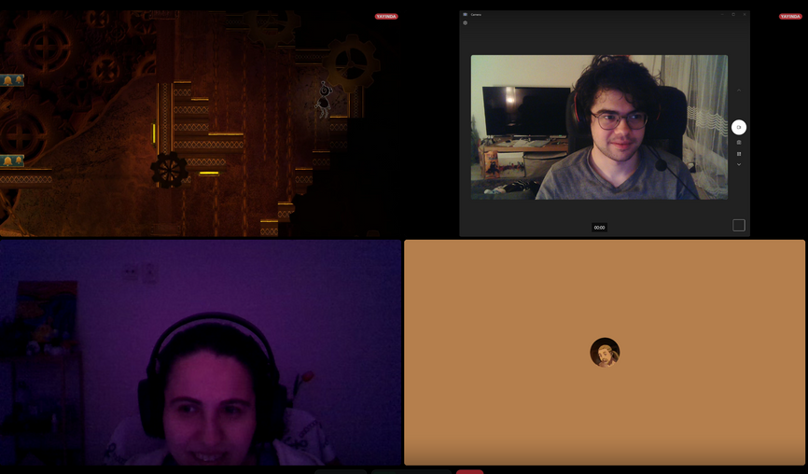
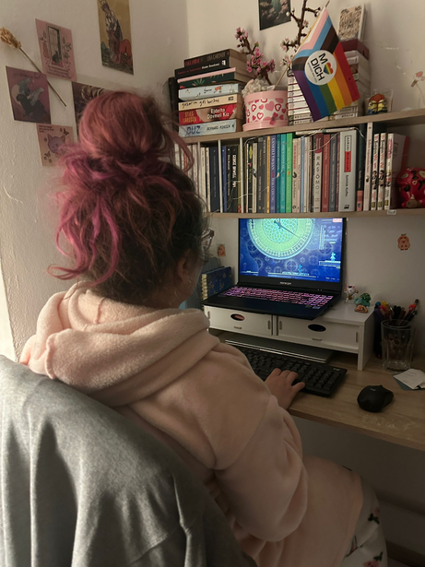
SOME OF THE playtesting photos

Slide 16
what needs to be fixed
  Tutorial needed
    Most of our testers got confused and did not know how the puzzles worked, resulting in frustration
  Breaking out of the map bugs
    Some of our mechanics allowed the player to get out of the map and break the game completely
  Controls
    Change the controls of some mechanics, since they were unintuitive and hard to grasp
  Improve camera behavior → already done
  More visual cues for interactable items
  Address narrative issues → partly done
  Restrict cloning in mid-air and restrict chains

Slide 17
Nice-to-have improvements
  Greater Puzzle Variety
    Introduce new mechanics, specifically the ability to manipulate time (slowing down or accelerating) and the option to create multiple clones
  Hint System
    Implement a dedicated system to assist players who get stuck on puzzles
  Checkpoints
    After completing a single puzzle we place a hidden checkpoint, so player can revert back to checkpoint as they progress, if needed.

Slide 18

Lessons learnt
  Players solved music puzzles mostly using visual cues, not audio.
  Some puzzles assumed to be easy, were more challenging than expected.
  Developers can lose perspective due to familiarity with the game.
  Action-based tutorials are more effective than static text instructions.

Slide 19
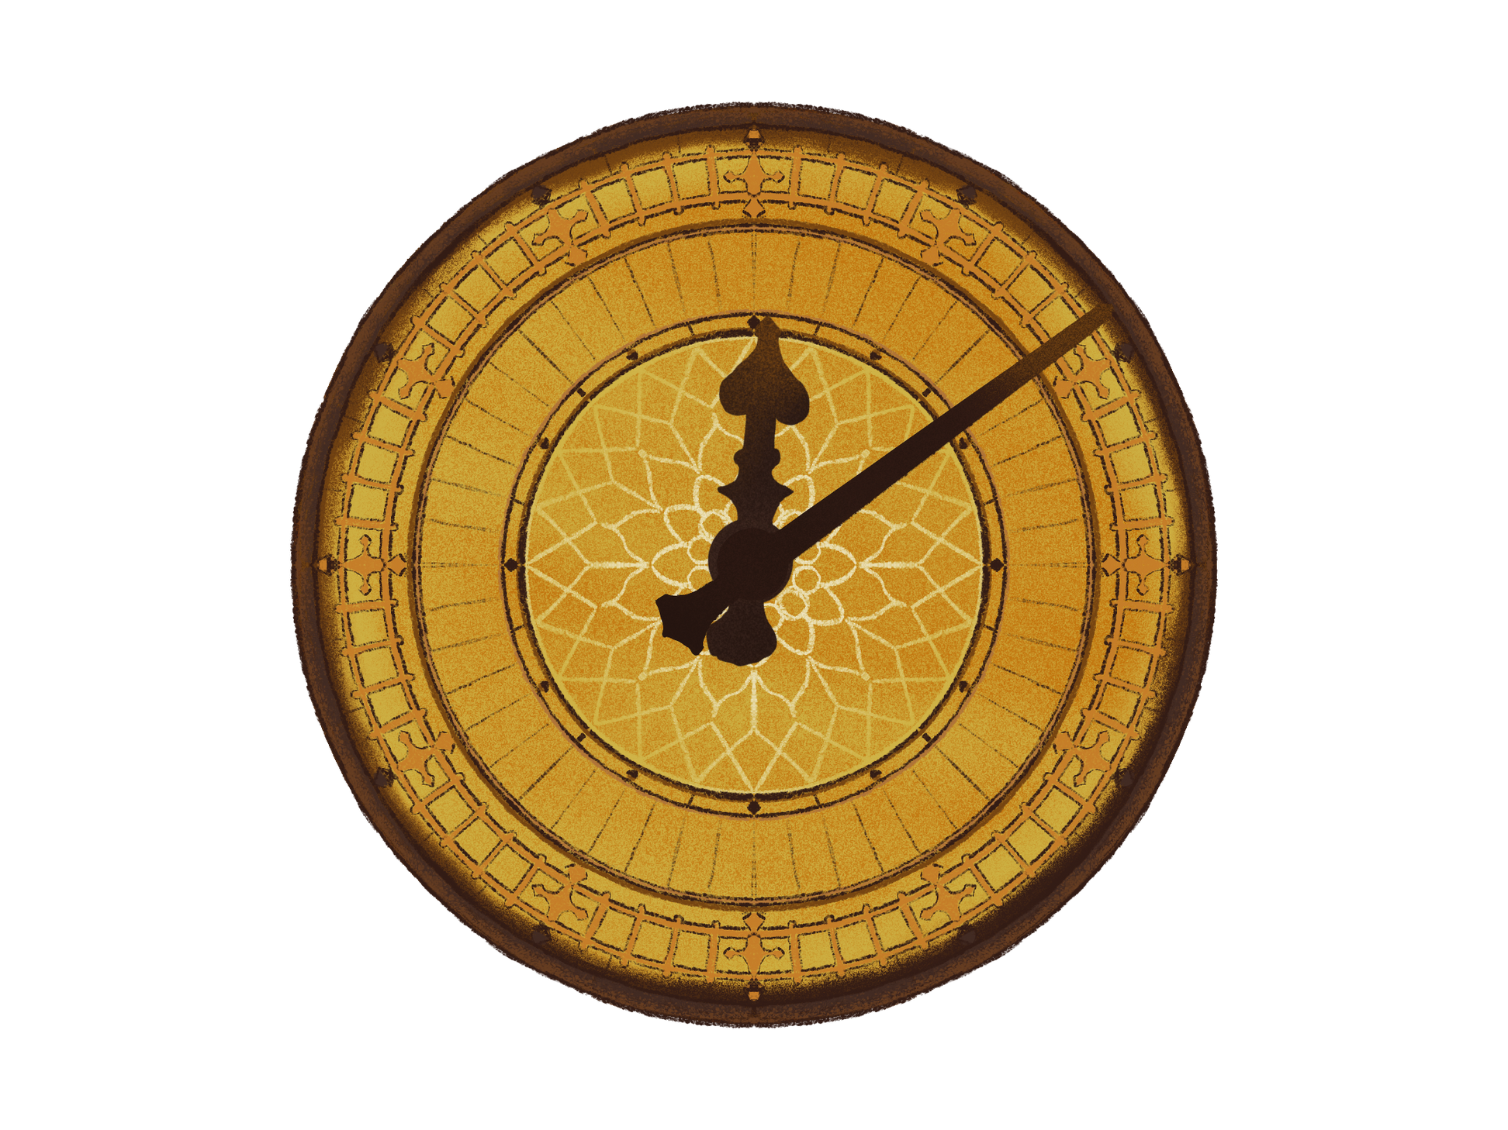
questions?

