Slide 1
Milestone 5:
Playtesting
Alexandra Colf
Christian Barbu
Luka Demetrashvili

Slide 2
Pre-Testing and polishing
Internal playtesting for obvious bugs
  fire & fire extinguisher
    no damage
    weird or no responses at all
  smaller colliders for hazard objects
  visual masking for grandma and hazards
  story (diary)
  music

Slide 3
Playtesting
Playtester group: friends and family
  face-2-face without talking
  video call
  only filling in google forms, but describing thoughts in the available text boxes
use of google forms
  usual demographic information (age, game expertise)
  gameplay questions

Slide 4
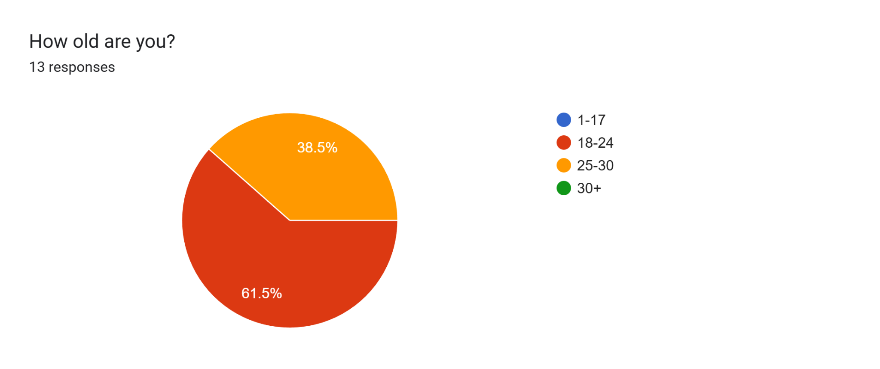
Results

Slide 5
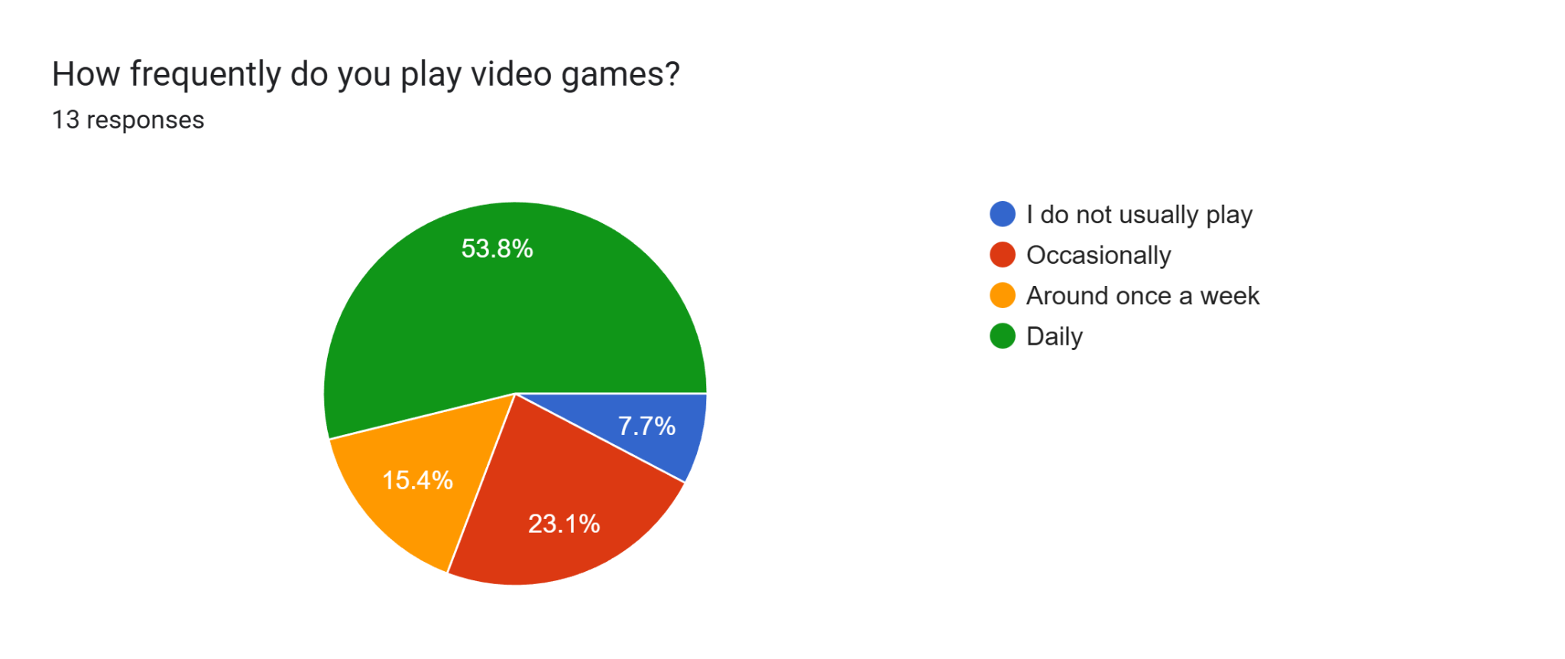
Results

Slide 6
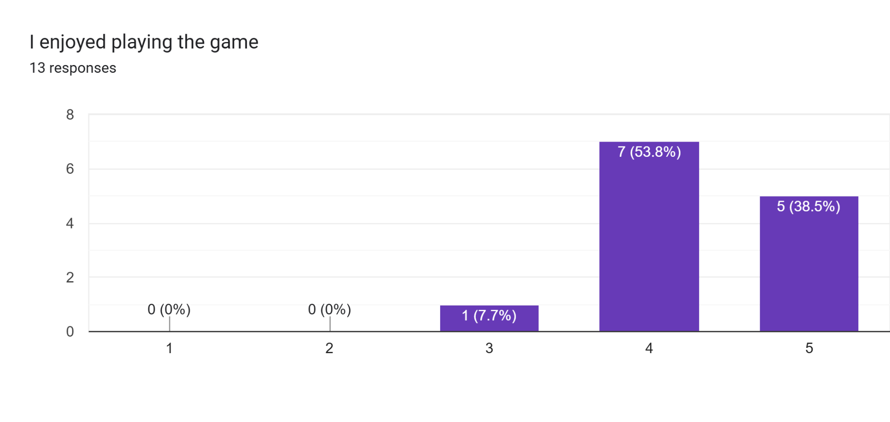
Results
Strongly Disagree
Strongly Agree

Slide 7
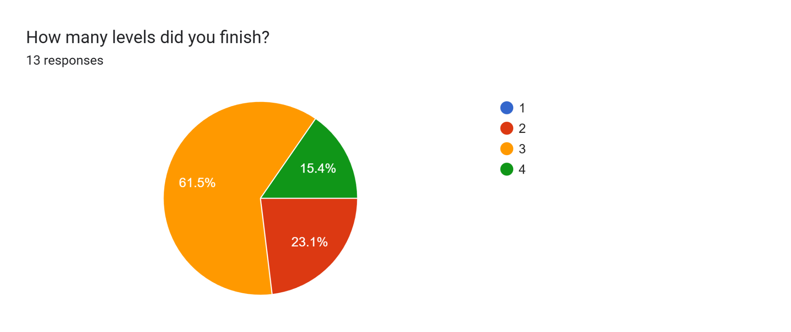
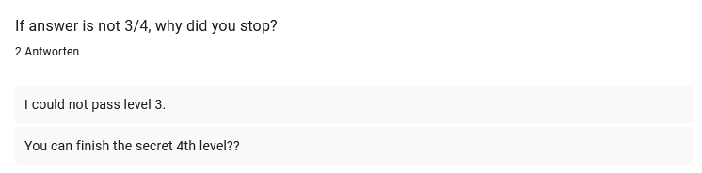
Results

Slide 8
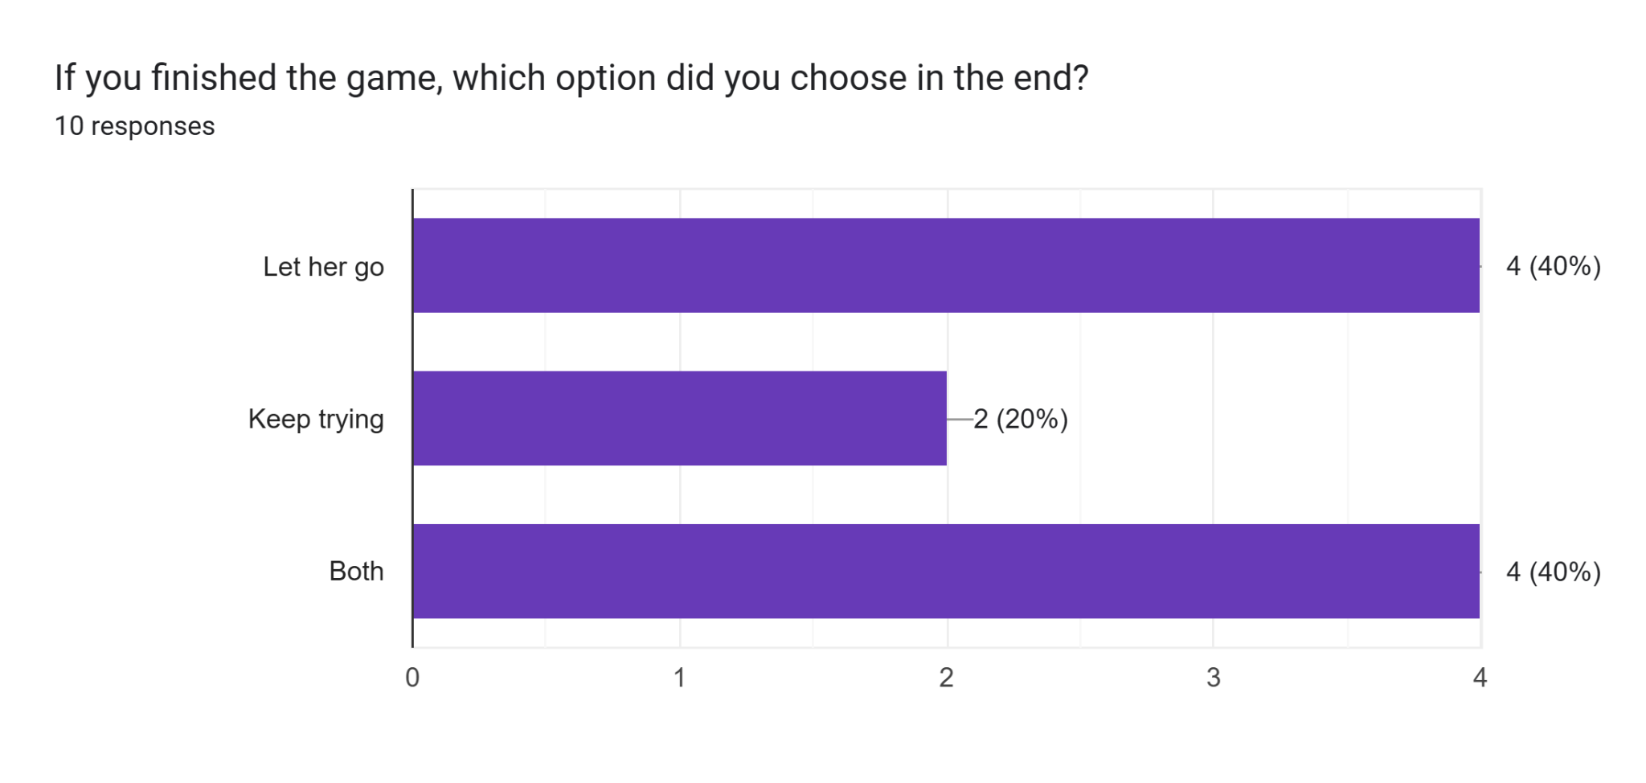
Results

Slide 9
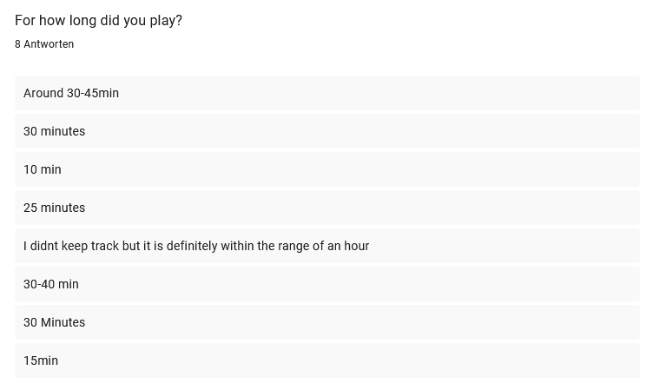
Results

Slide 10
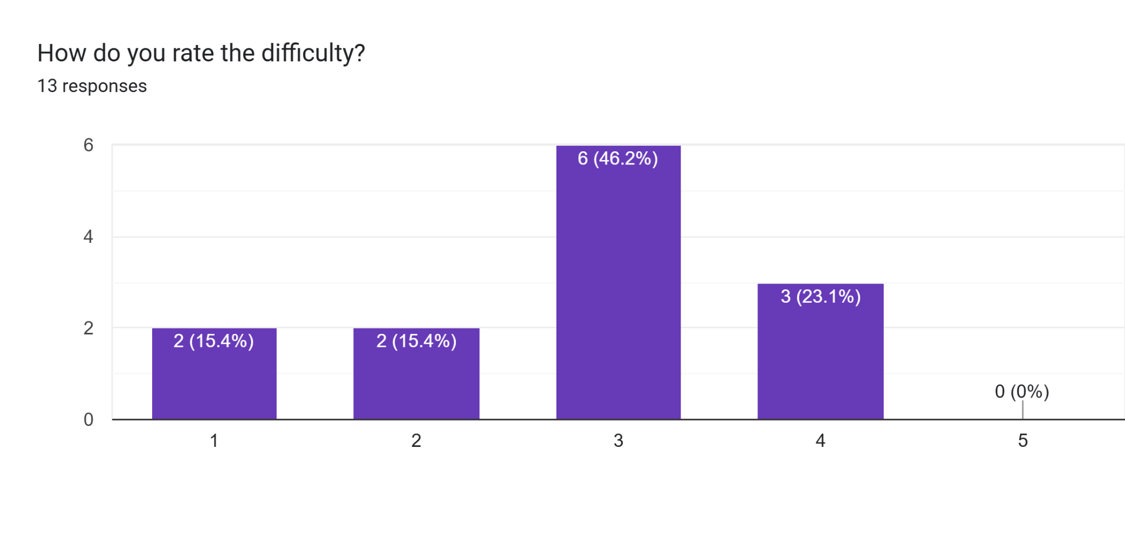
Results
Way too difficult
Very easy

Slide 11
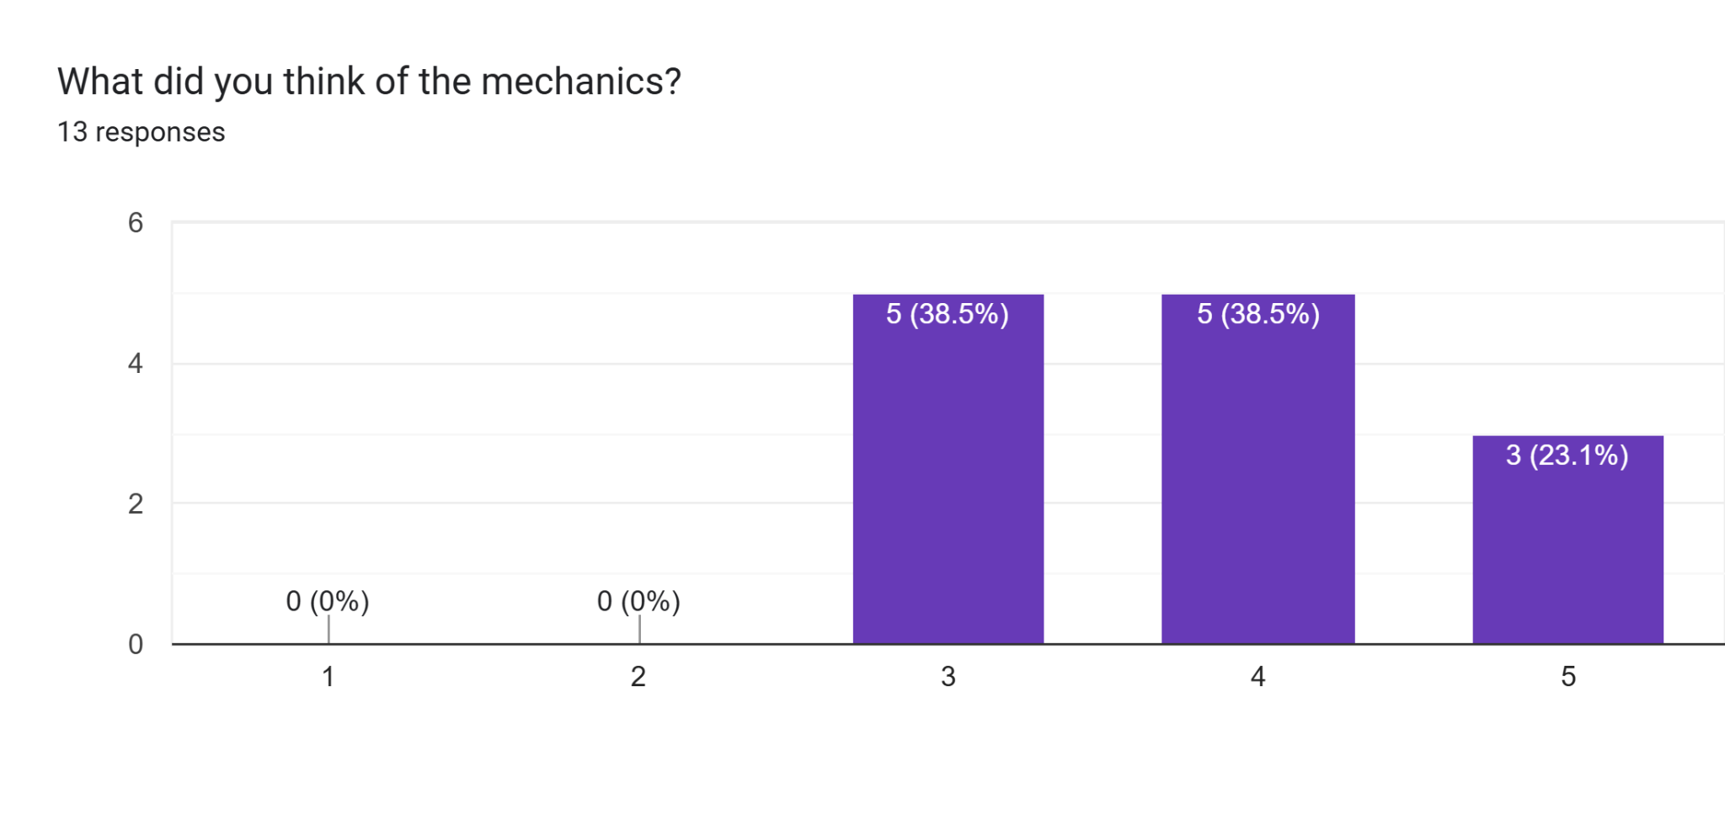
Results
Very hard to understand
Very intuitive

Slide 12
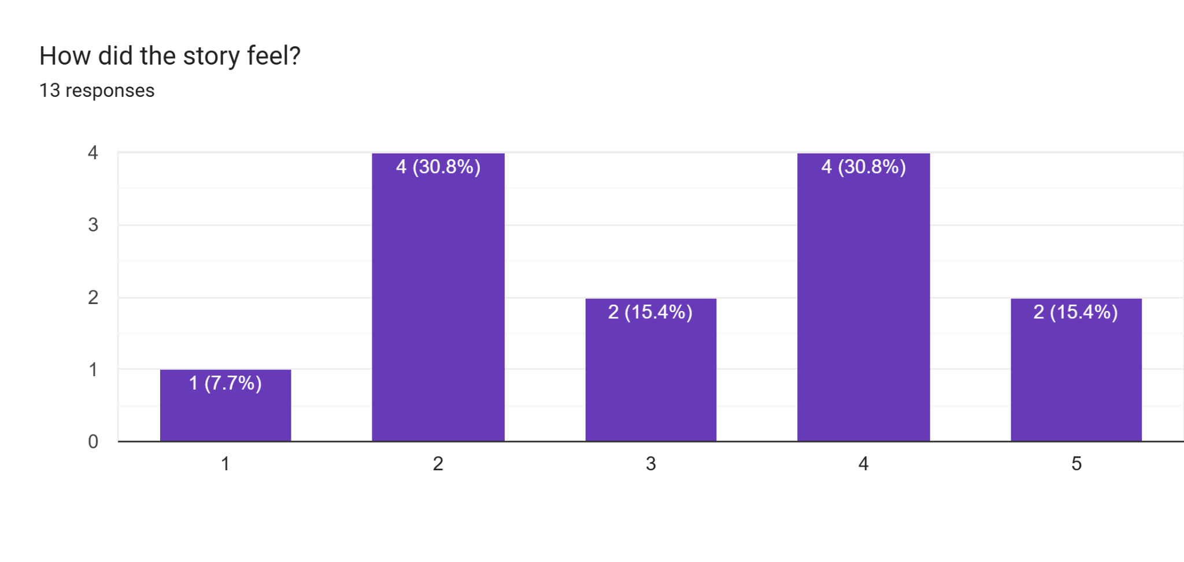
Results
Very Boring
Very Interesting

Slide 13
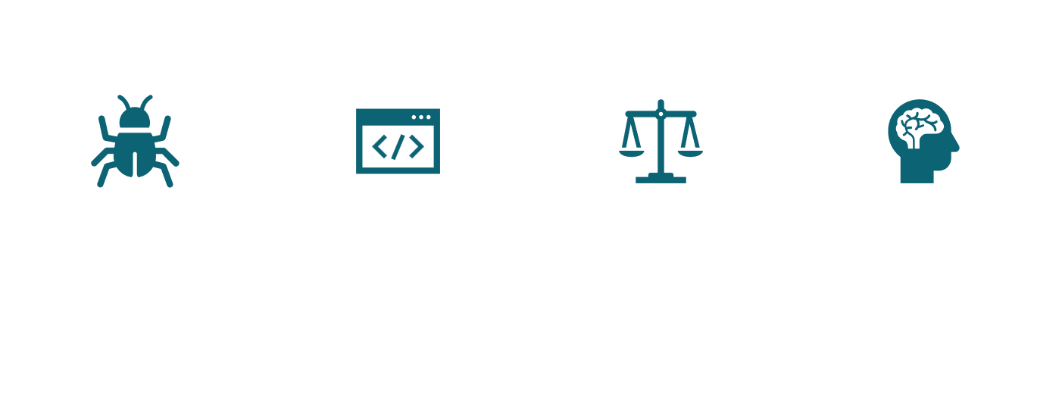
Next steps

Slide 14
Thank you for listening!

