Slide 1
Milestone 4:
Alpha Release
Alexandra Colf
Christian Barbu
Luka Demetrashvili

Slide 2
Current Progress Timeline
Layer 1: Functional Minimum
Layer 2: Low Target
Layer 3: Desirable Target
Layer 4: High Target
✅Basic AI movement for the grandma character
✅Grandma movement animations
✅Basic scene design
✅One death condition for grandma
✅Three possible death conditions for Grandma
✅Player solutions for each death scenario
✅One fully playable level
✅Level timer
✅Two fully designed and playable levels
✅Grandma’s sanity bar is affected by witnessing player actions
✅Display for grandma’s stats
✅Visual display of grandma’s line of sight
✅AI behaviour tuning
✅Main game menu
✅Level selection screen
✅Event-based audio and music transitions
✅Three completed levels with progressive difficulty
🔃Bug fixing and performance optimization
🔃Final polish on visuals, UI
✅Story integration between levels
✅Dialogue or environmental storytelling elements

Slide 3
Current Progress Timeline
Layer 5: Extras
❌Add grandpa AI
✅Add cat AI
❌Neighbor characters delivering packages
❌Additional levels beyond the initial plan
✅New game mechanics
✅A present-day interactive level where the player pieces together the events that left to their current situation and can interact with the grandma

Slide 4
Levels
Three levels which have increased difficulty
  Intro:
    showing grandma’s dead body
    explanation on how to use the time machine
    location where all the notes collected can be viewed
  Level 1: Banana, Puddle
  Level 2: Level 1 + Fire, TV
  Level 3: Level 2 + Cat AI

Slide 5
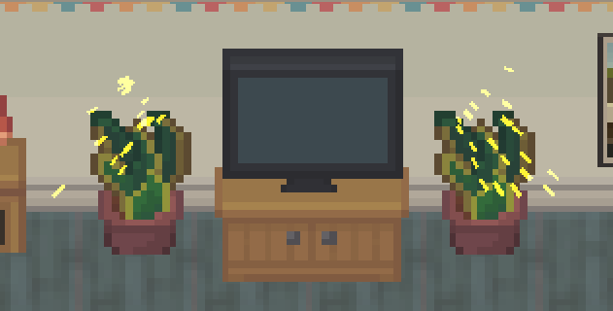
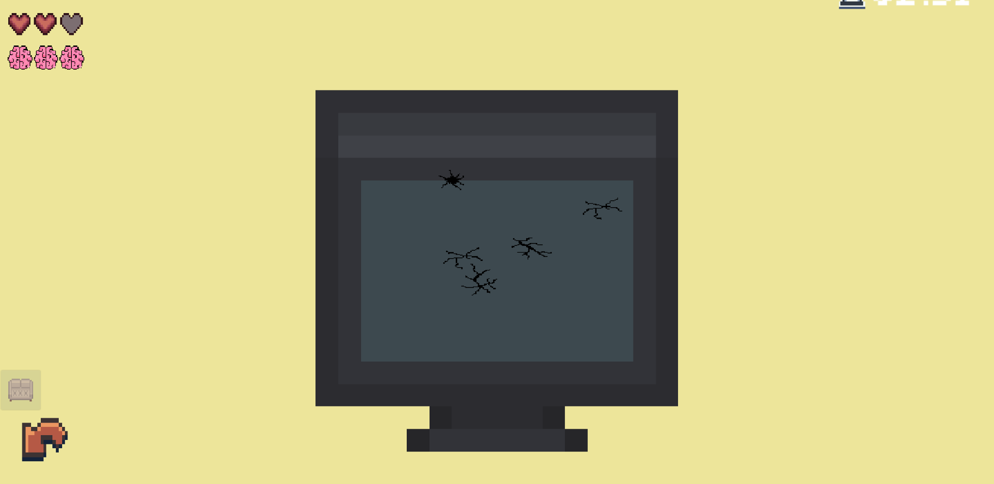
New Mechanics:
TV
TV breaks after 10 seconds being used
grandma takes damage, if she sees the broken TV
player needs to repair the TV, by clicking on the cracks in the minigame

Slide 6
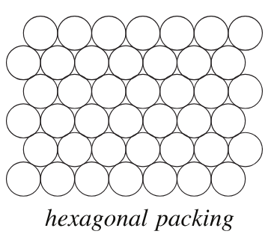
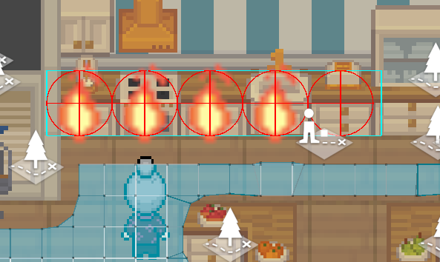
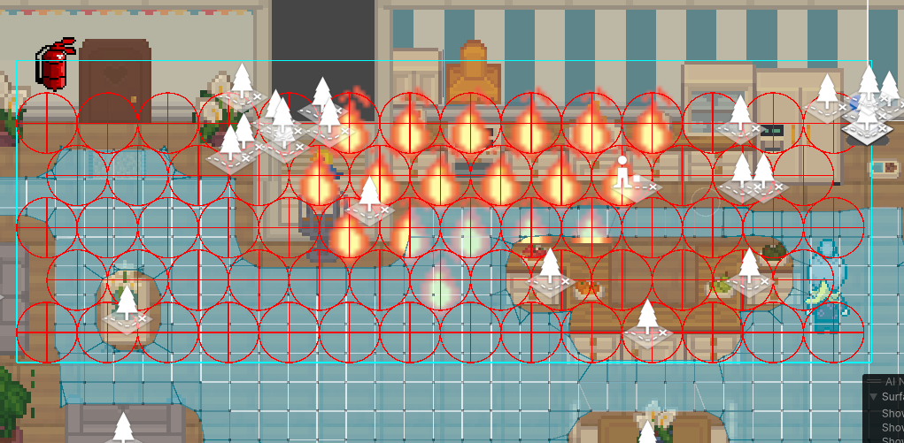
Old Mechanics (Update): Fire Spread
fire can now also spread
using hexagonal circle packing to fill in whole areas of the TilemapRenderer
https://mathworld.wolfram.com/CirclePacking.html

Slide 7
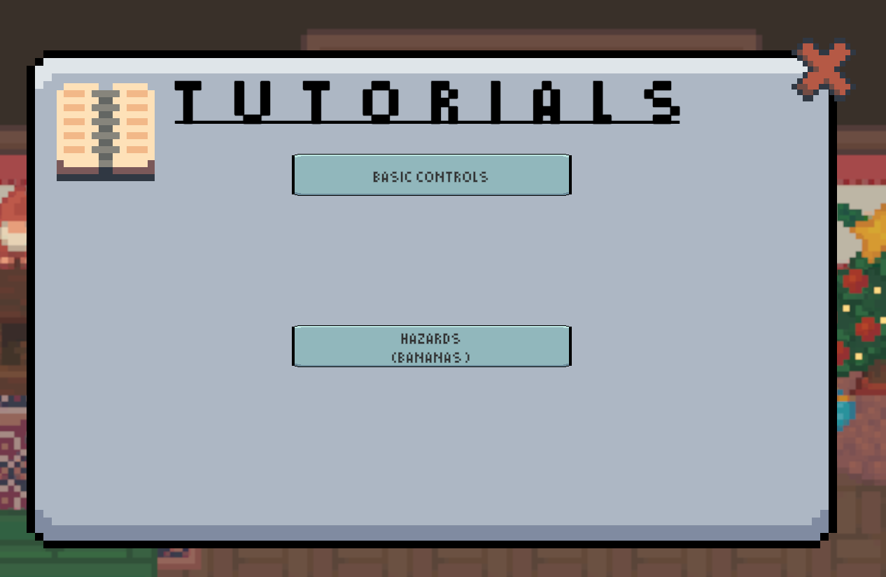
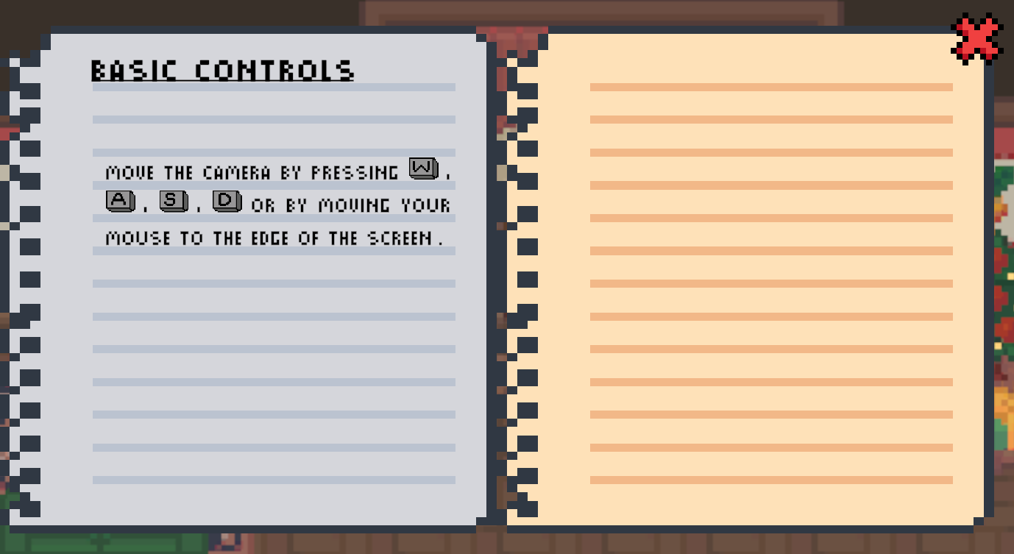
Tutorials
in-game tutorials,
  which can are shown during playtime
  but which can be accessed through the main menu, as the game advances (avoiding cognitive overload)

Slide 8
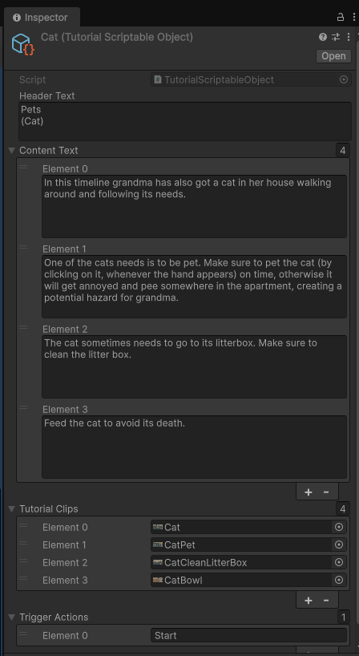
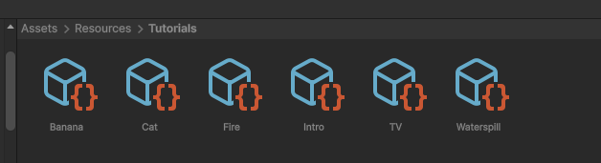
Tutorials
making use of ScriptableObjects for creating tutorials

Slide 9
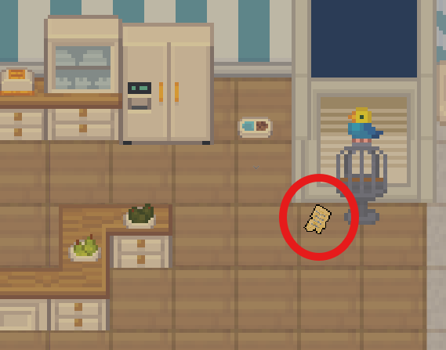
Story
story is unveiled through short notes, left by grandma
notes are then gathered as the game progresses

Slide 10
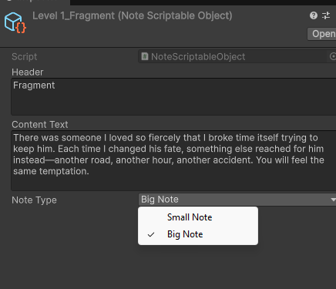
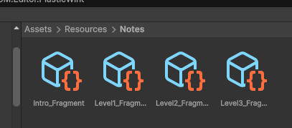
Story
again making use of ScriptableObjects for creating the notes

Slide 11





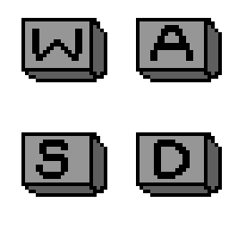
Pixel Art & Animation
Selfmade (as not part of the used pack):
  Litter Box Sprites / Animation
  Note / Note Highlighting Animation
  W, A, S, D keys

Slide 12
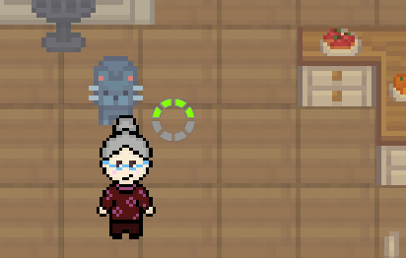
Action Progress
usage of an ready-to-use shader for the progress
source:
How to Make an AWESOME Segmented Circular Health Bar in Unity

Slide 13
AI
same approach for the cat AI as grandma (UtilityAI)
however: its own actions and needs
  sleep
  hunger
  pleasure (need for getting pet)

Slide 14
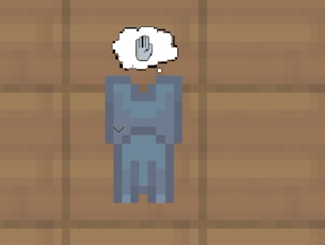
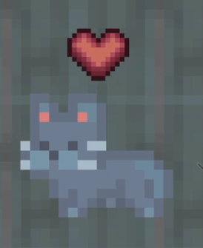
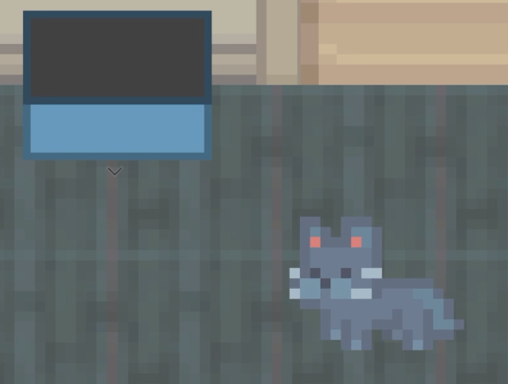
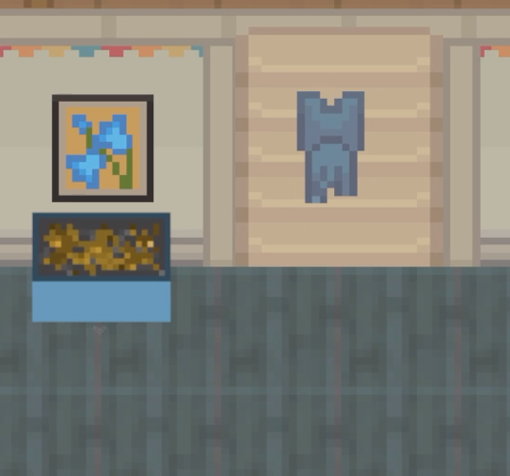
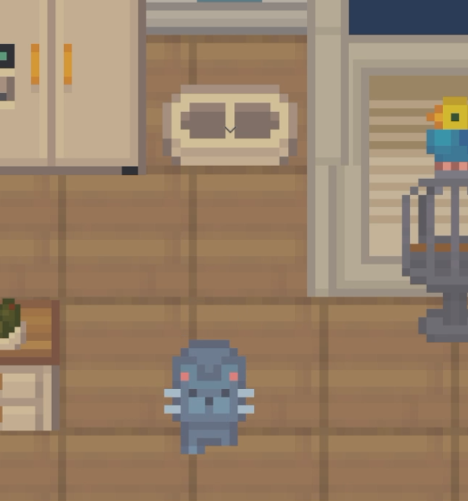
New Mechanics with Cat
Tasks for the player
  Pet the cat
  Clean litter box
  Fill the bowl to eat
Potential dangers:
  Peeing in the apartment
  Making the apartment dirty
  Cat dying

Slide 15
Thank you for listening!
→ Live Demo

